Slide 1

Speech Emotion Recognition System
Name-Ritu Raj
Roll no.-CS-23411458
Sec- 4CSE_12
RR
by RITU RAJ

Slide 2

Introduction to Speech Emotion Recognition
What is Speech Emotion Recognition?
Technology that identifies human emotions from voice signals.
Importance
Enhances human-computer interaction and emotional intelligence in AI.

Slide 3

Project Objectives
Purpose
Develop an accurate model to classify emotions from speech.
Expected Outcomes
Reliable emotion detection system
Insightful performance analysis

Slide 4
Methodology
Technologies Used
Dataset & Steps
Python programming
ML models and sklearn
Librosa for audio processing
RAVDESS emotional speech dataset
Feature extraction of audio signals
Model training and prediction

Slide 5
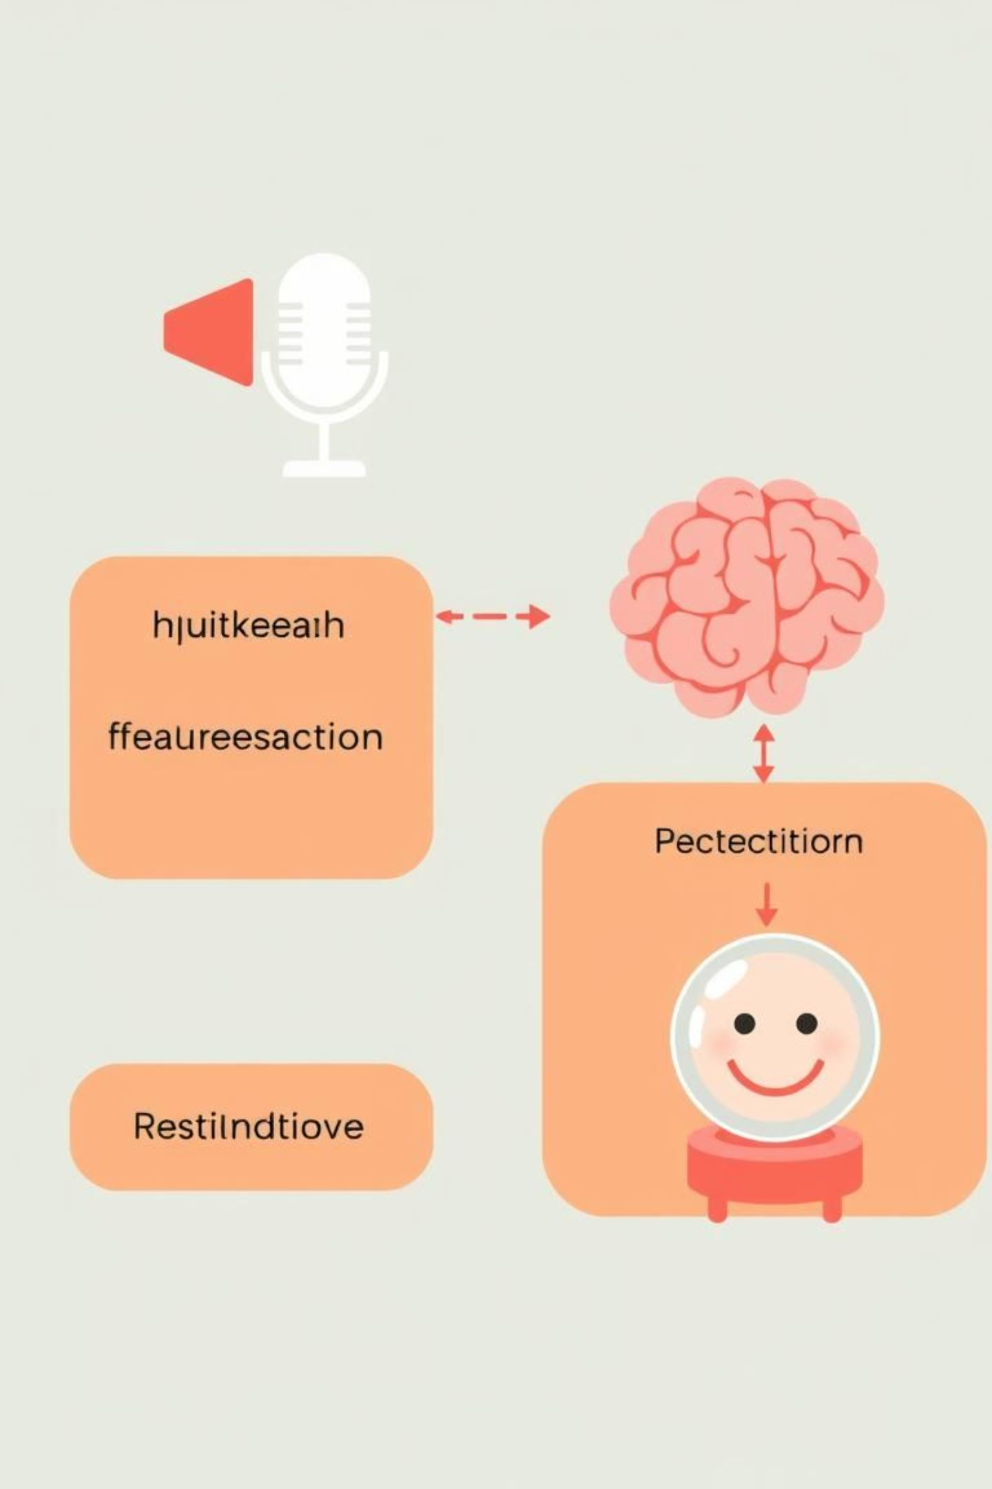
System Implementation
Input Speech Signal
Feature Extraction
Model Training
Emotion Prediction

Slide 6
Results and Performance
Accuracy
Performance Visual
Model achieved over 85% accuracy in emotion classification.
Graphs indicate steady learning and effective feature capture.

Slide 7

Conclusion and Future Scope
Achievements
Future Improvements
Successful emotion recognition from speech
Validated model with real dataset
Include multi-language support
Enhance real-time processing speed

Slide 8

Acknowledgment
Special Thanks
Heartfelt gratitude to my friends of IILM University.

