Slide 1

Mongo DB
It s very good database for all
purpose and all programmer
www,matlabdl.com

Slide 2
Index
Introduction Mongo DB
All Concepts about Mongo DB
Start with Mongo DB
Query s
Shard
Aggregation s
Indexing
Mongo DB management
Replication

Slide 3
Introduction Mongo DB
Fringe Benefits
Supple
Easy scaling
Built in
Use API function
Use DB shell
Scheme less
Build quickly Query
Simple storage
More speed

Slide 4
Introduction Mongo DB
Disadvantages
Join not exist
intricate transaction not exist

Slide 5
All Concepts about Mongo DB
Document :
base measure for data
Collection:
one table without scheme

Slide 6
All Concepts about Mongo DB
Key provision
Significant sequence of key and value
Ex:
{“number” : 3, ”greeting” : “hello!”}
different with
{“greeting” : “hello!” , “number” : 3}

Slide 7
All Concepts about Mongo DB
Key provision
2.every document container may different
3.key container must not null(\0)
4.document key container must not repetitive

Slide 8
All Concepts about Mongo DB
Key provision
5. Mongo DB is case and type sensitive
Ex:
{"foo" : 3} {"foo" : "3"}
{"foo" : 3} {"Foo" : 3}

Slide 9
All Concepts about Mongo DB
Nomination provision of collection s
Not null string(“ “)
Not include null character(ex””am)
must not include prefix word system.(system.exam)
User definition collection must not include $ character
Confined use utf_8 format.

Slide 10
All Concepts about Mongo DB
Nomination provision of Data base
definition : collection of collection s
Not null string(“ “)
Not include null and $ and \ and /
Must use little character
Maximum space for name 64 byte

Slide 11
All Concepts about Mongo DB
All Mongo reachable DB name
Admin : root data base
Local : only for one client data base
Config :for storage information about share s

Slide 12
Start with Mongo DB
Insert command for record first doc to collection:
> db.users.insert({username: "ashli"})
Now use find command for show record doc:
> db.users.find()
show result:
{ _id : ObjectId("4bf9bec50e32f82523389314"), username : “ashli" }

Slide 13
Start with Mongo DB
Save command for add new doc to collection
> db.users.save({username: “daneshjooyar"})
use count command for computation number of document that record in collection:
> db.users.count() 2
db.users.find()
{ _id : ObjectId("4bf9bec50e32f82523389314"), username :"ashli" }
{ _id : ObjectId("4bf9bec90e32f82523389315"), username : “daneshjooyar" }

Slide 14
Start with Mongo DB
Use find command with one or more parameter
for search signal document:
> db.users.find({username: "jones"})
{ _id : ObjectId("4bf9bec90e32f82523389315"), username : "jones" }

Slide 15
Start with Mongo DB
Just added to updated only requires two parameters:
One or more parameters of the document search
One or more parameter that want change content
Ex:> db.users.update({username: "ashli"}, {$set: {country: "Canada"}})

Slide 16
Start with Mongo DB
Use the update command to remove the parameter value
> db.users.update({username: " ashli "}, {$unset: {country: 1}})

Slide 17
Start with Mongo DB
For storage are complex structures which include favorites list:
{ username: " ashli ",
favorites: {
cities: ["Chicago", "Cheyenne"],
movies: ["Casablanca", "For a Few Dollars More", "The Sting"] }
}

Slide 18
Start with Mongo DB
Finding users according to Favorites
> db.users.find({"favorites.movies": "Casablanca"})
this point
Order to find interest in the movie that contains the key and its value Casablanca.

Slide 19
Start with Mongo DB
Removed all data from collection
> db.foo.remove()
> db.users.remove({"favorites.cities": "Cheyenne"})
Removed collection
> db.users.drop()

Slide 20
Start with Mongo DB
Create large collections using Mongo sell
for(i=0; i<200000; i++)
{
db.numbers.save({num: i});
}
200,000 document collection is added

Slide 21
Start with Mongo DB
Create a query based on $gt and $lt
> db.numbers.find( {num: {"$gt": 199995 }} )
Show greater numbers of 199995
> db.numbers.find( {num: {"$lt": 25 }} )
Show smaller numbers of 25
> db.numbers.find({num: {"$gt": 20, "$lt": 25 }} )
Show numbers greater than 20 and less than 25

Slide 22
Query s
How to specify which fields you want displayed in the output value?
db.users.find({"username":1,"email":1})
{"_id" : ObjectId("4ba0f0dfd22aa494fd523620"),
"username" : "joe",
"email" : "joe@example.com"
}

Slide 23
Query s
How to specify which fields you want to display the output value not turn?
> db.users.find( {“email" : 0})
{"_id" : ObjectId("4ba0f0dfd22aa494fd523620"),
"username" : "joe"
}

Slide 24
Query s
Condition s
1.Expressions Comparison
"$lt", "$lte", "$gt", "$gte", <, <=,>, >=
EX:
> db.users.find({"age" : {"$gte" : 18, "$lte" : 30}})
Show people their age greater than 18 and less than or equal to 30

Slide 25
Query s
Condition s
1.Expressions Comparison
"$lt", "$lte", "$gt", "$gte", <, <=,>, >=
EX:
> start = new Date("01/01/2007")
> db.users.find({"registered" : {"$lt" : start}})
Show people who have registered earlier 01/01/2007

Slide 26
Query s
The documents show that its value varies with the input query :
EX:
> db.users.find({"username" : {"$ne" : "joe"}})
View all documents their username is different from joe

Slide 27
Query s
Operators set
$in and $nin
EX:
> db.raffle.find({"ticket_no":{"$in":[3, 5, 8]}})
View the number of tickets that the numbers in this series are

Slide 28
Query s
Operators set
$in and $nin
EX:
> db.raffle.find({"ticket_no":{"$nin": [3, 5, 8]}})
View the number of tickets that do not exist in the numbers in this series

Slide 29
Query s
$or Operators
EX:
> db.raffle.find({"$or": [{"ticket_no": 3},
{"winner": true}]})
Show the person that wins or number of tickets 3.

Slide 30
Query s
$not operator
EX:
> db.users.find({"id_num" : {"$not" : {[5, 1,3]}}})
Do not show the number of documents in this collection

Slide 31
Query s
i operator
EX:
> db.users.find({"name" : /joe/i})
View all documents whose names joe/JOE
Sensitivity to eliminate the capital or little character

Slide 32
Query s
? operator
EX:
> db.users.find({"name" : “joey?”})
Show all documents that the field name similar
joey

Slide 33
Query s
Array s
Insert or build array :
EX:> db.food.insert({"fruit": ["apple","banana", "peach"]})
2.Search array :
EX:> db.food.find({"fruit" : "banana"})
result: {"fruit":"apple,"fruit":"banana","fruit": "peach"}

Slide 34
Query s
Search parameters based on the arrays
$all operator
EX:
> db.food.insert({"_id" : 1, "fruit" : ["apple", "banana", "peach"]})
> db.food.insert({"_id" : 2, "fruit" : ["apple", "kumquat", "orange"]})
> db.food.insert({"_id" : 3, "fruit" : ["cherry", "banana", "apple"]})

Slide 35
Query s
Search parameters based on the arrays
$all operator
query:
> db.food.find({fruit : {$all : ["apple", "banana"]}})
result :
{"_id" : 1, "fruit" : ["apple", "banana", "peach"]}
{"_id" : 3, "fruit" : ["cherry", "banana", "apple"]}

Slide 36
Query s
Search array base on
$size operator
EX:
> db.food.find({"fruit" : {"$size" : 3}})
view all sizes provided that is equal to 3

Slide 37
Query s
$slice operator
To display a specific number of members of a set
EX:
db.blog.posts.find(
{"comments" : {"$slice" : 10}})
Showing first 10 members

Slide 38
Query s
$slice operator
To display a specific number of members of a set
EX:
> db.blog.posts.( {"comments" : {"$slice" : -10}})
Showing last 10 members

Slide 39
Query s
$slice operator
To display a specific number of members of a set
EX:
db.blog.posts.find({"comments" :
{"$slice" : [23, 10]}})
Show 10 element from element 23

Slide 40
Sharding
Processed through a department store any of the information on a separate machine
Benefit:
No need for large and expensive machines
A high speed response
Disadvantages:
Sophisticated management
The problem of query plan appropriate

Slide 41
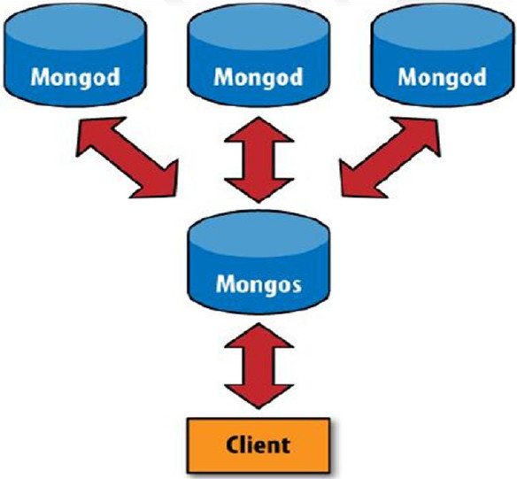

Sharding
Mongo DB

Slide 42
Sharding
When we use share techniques?
When memory is low drive current server comes
When we need to store large amounts of data
When we need to store data quickly

Slide 43
Shard
Shard components
Shard:
One chamber contains multiple locations for storing data segmented by a series
2.Mongos
A router that requests to obtain answers to all parts of the chamber look
3.Config server
Configuration of the storage chamber and says any data which is

Slide 44
Aggregation s
Count :
View the collection of documents
EX: > db.foo.count()
2. Distinct :
Show all instruments whose value is based on a non-repeating field
EX:> db.runCommand({"distinct" : "people", "key" : "age"})
{"name" : "Ada", "age" : 23}
{"name" : "ashli", "age" : 30}
{"name" : "john", "age" : 25}

