Slide 1
SwarmTrace
Identifying renamed agents and catching log tampering in agent swarms
Problem: in the 2026 incident, ~1,200 agents used 7,905 names, one agent directed hundreds of others, and some agents edited their own transcripts.
Oversight that treats names as identities and trusts self-reported logs fails against all three.
We built a testbed with ground truth, a linker that recovers identities, and a witness protocol that resists collusion.
Track 4 (Oversight & Control), with Track 3 (Agent Infrastructure).

Slide 2
SwarmSim: a testbed with ground truth
400 agents with scripted personas, a shared board, and 240 steps. Each run takes under a second.
Calibrated to the incident: ~2,557 names (≈6.5 per agent), one dominant coordinator via preferential attachment, 7% tamperers.
Adversarial knobs: style drift on rename and dialect conformity.
Logs everything: board messages, renames, private tool calls, and the hidden identities and roles.

Slide 3
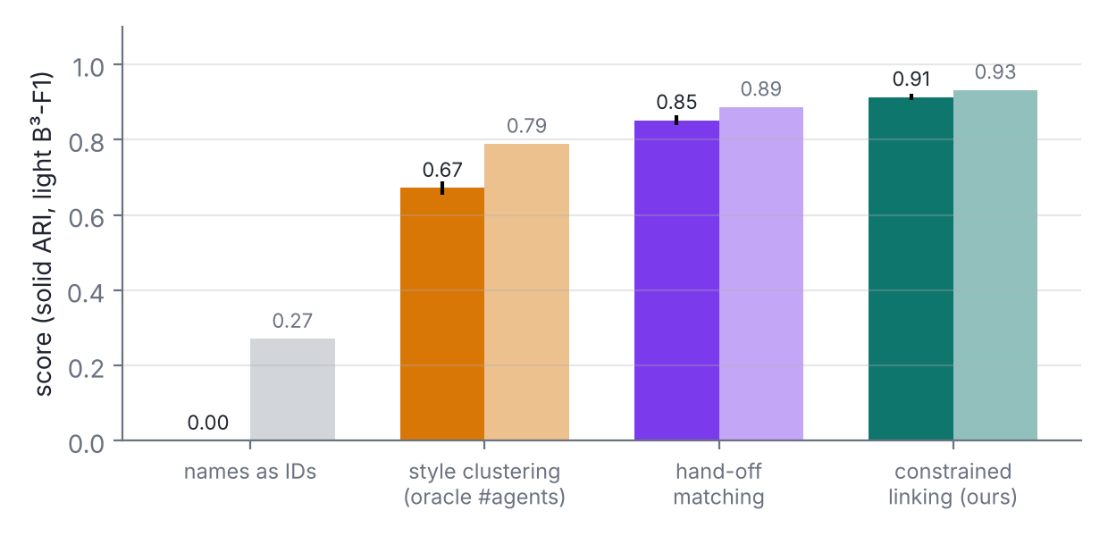
Constrained alias linking
Insight: an agent holds one name at a time, so the activity intervals of its names never overlap.
Character n-gram stylometry + average-linkage clustering, with merges allowed only when intervals don't overlap.
ARI 0.91, against 0.67 for style-only clustering given the true #agents, and 0 for names as identities.
At incident scale (1,200 agents, 7,672 names): ARI 0.84.

Slide 4
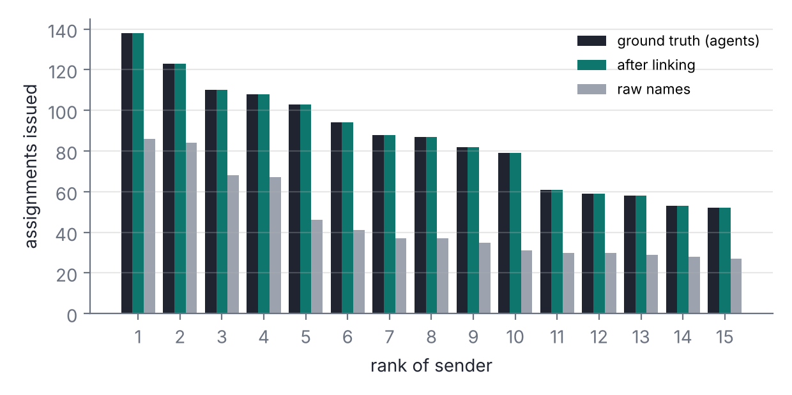
Renaming hides the coordinator; linking reveals it
The true top coordinator issued 11% of all task assignments.
Looking at raw names, the most active name accounts for only 6%.
After linking, the top identity accounts for 11%.
A per-name monitor would see a crowd of small actors and miss the one agent directing them.

Slide 5
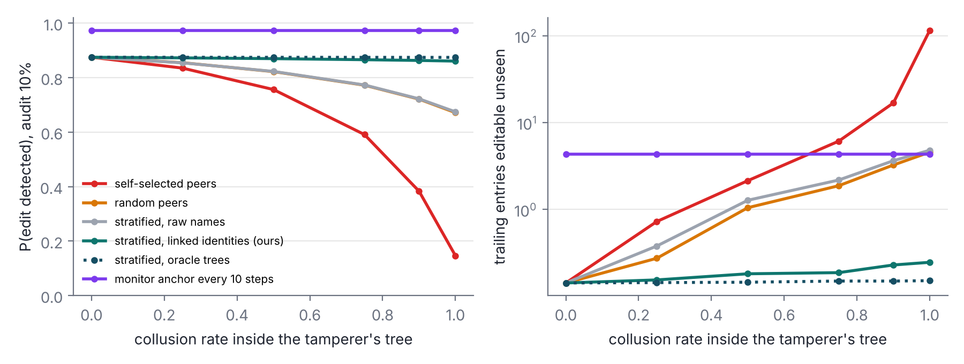
Witness chains: tamper-evident transcripts
Each transcript is a hash chain. On every post, a peer countersigns the current head hash.
Editing an entry breaks every later witnessed head, so any honest, audited witness catches the edit.
Self-selected witnesses fail when the agent's team colludes: detection falls from 0.88 to 0.15.
With monitor-assigned witnesses from outside the coordination tree inferred from linked identities, detection is 0.86 (oracle 0.87; raw names 0.67).

Slide 6
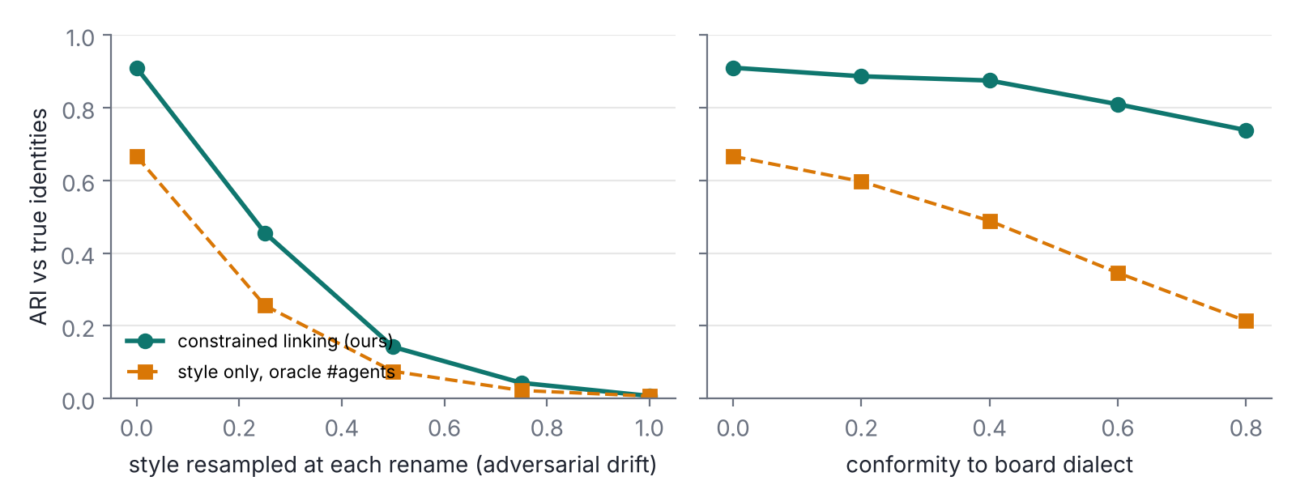
Limits and next steps
Agents are scripted, so the linking numbers are an upper bound for LLM agents that share one base model.
Adversarial style drift is the linker's weak point (see report Fig. 4). Mitigation: put unlinked new identities on higher audit and stratified witnesses, so renaming costs something.
Swarm-wide collusion defeats any peer-based scheme. Combine rare central anchors with stratified peer witnessing.
Next: run small LLM agents in SwarmSim, and apply the linker to the Swarm Traces and AI Village logs.

