Slide 1


Project Final Defense
On
“Sign Language Detection System”
Presented By :
Bishal Maharjan (6-2-456-213-2019)
Roshan Ghimire (6-2-456-230-2019)
BCA VIII (76)
Under the Supervision of
Mr. Suswas Karki
October, 2024

Slide 2
Outlines
Introduction
Problem Statement
Objective
Scope and Limitation
Methodology
Description of Algorithm
Implementation
Conclusion and Future Recommendations

Slide 3
Introduction
A Sign Language Detection System is designed to recognize and interpret sign language gestures using Convolutional Neural Networks (CNNs). The system captures hand movements through a camera, analyzing them to translate American Sign Language (ASL) signs into text and then audio.

Slide 4
Problem Statement
Speech-impaired individuals used hand signs for communication, creating challenges for hearing individuals to understand.
Environments like airports often encountered difficulties during verification tasks due to communication gaps.
Not everyone could learn sign language, highlighting the need for a solution.

Slide 5
Objective
• To develop a desktop application that predicts hand gestures in real time, displays the corresponding words, allows selection from word suggestions, and converts the selected word into speech, enabling seamless and effective communication

Slide 6
Scope
Gesture Recognition
Translation
Real-Time Processing
User Interface
Limitation
Limited Language Support
Limited Gesture Dataset
Environmental Adaptation

Slide 7
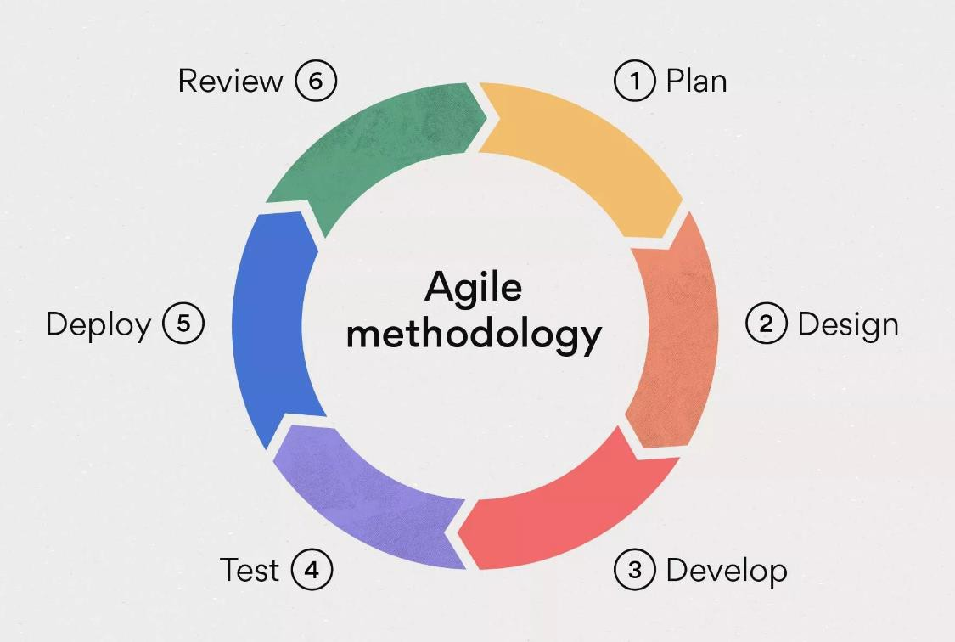
Methodology

Slide 8
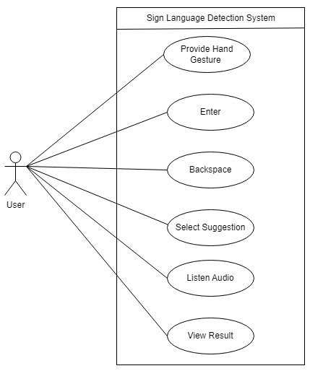
Use Case Diagram
fig: Use Case Diagram of Sign Language Detection System

Slide 9
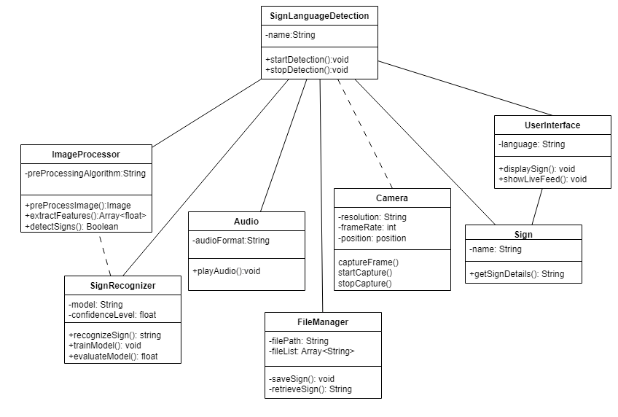
Class Diagram
Figure: Class Diagram of Sign Language Detection System

Slide 10
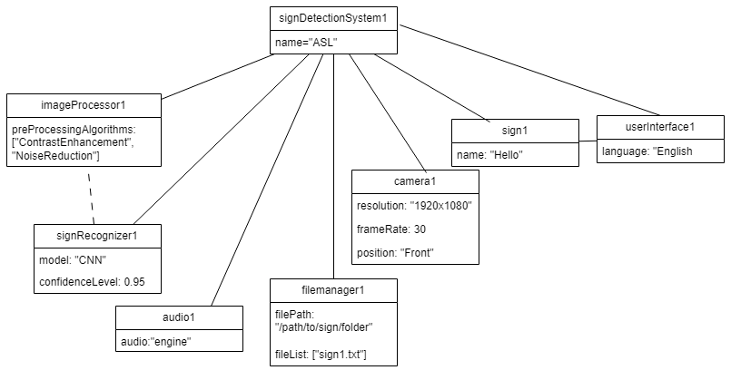
Object Diagram
Figure: Object Diagram of Sign Language Detection System

Slide 11
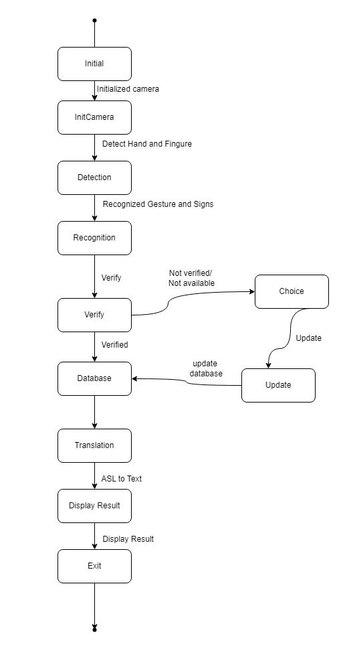
State Diagram
Figure: State Diagram of Sign Language Detection System

Slide 12
Description of Algorithm
Convolutional Neural Network (CNN) is a class of deep, feed-forward artificial neural networks, most commonly applied to analyze visual imagery. CNNs use a variation of multilayer perceptron designed to require minimal preprocessing.

Slide 13
Description of Algorithm
Key Components of CNNs:
Input Data
Preprocessing
Feature Extraction
Model Training
Gesture Recognition
Output Generation

Slide 14
Implementation
Tool Used:
Programming Language: Python
Libraries: OpenCV (image processing)TensorFlow/Keras (machine learning and CNN)
Development Environment: VisualStudio (IDE)

Slide 15
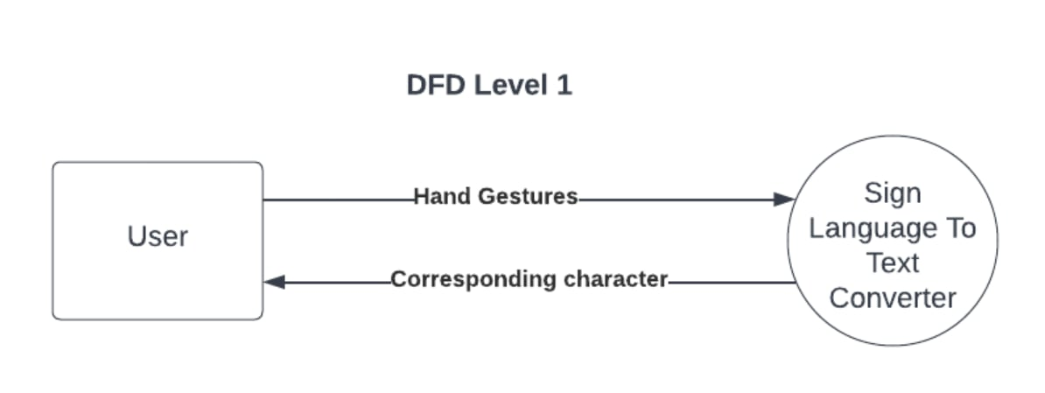
Implementation Details of Modules
Fig: DFD level 1 of Sign Language Detection System

Slide 16
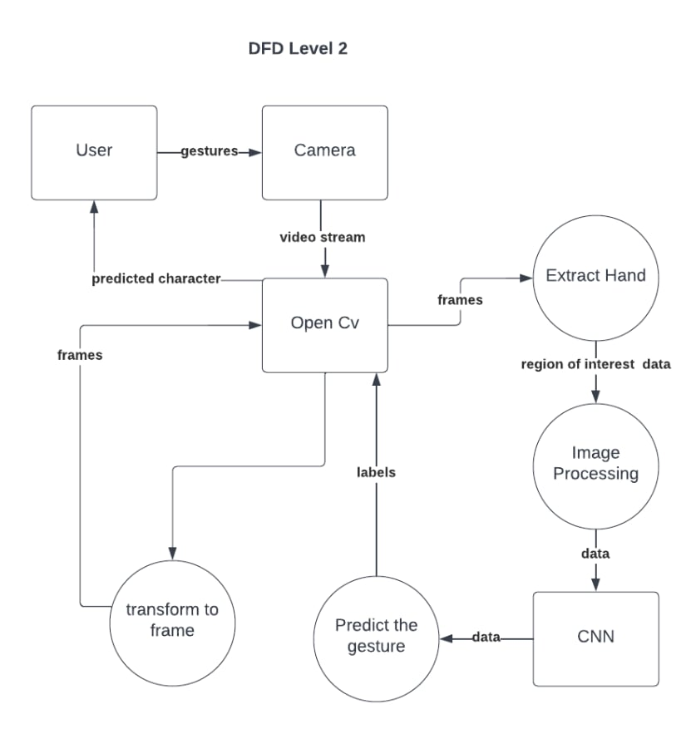
Fig: DFD level 2 of Sign Language Detection System

Slide 17
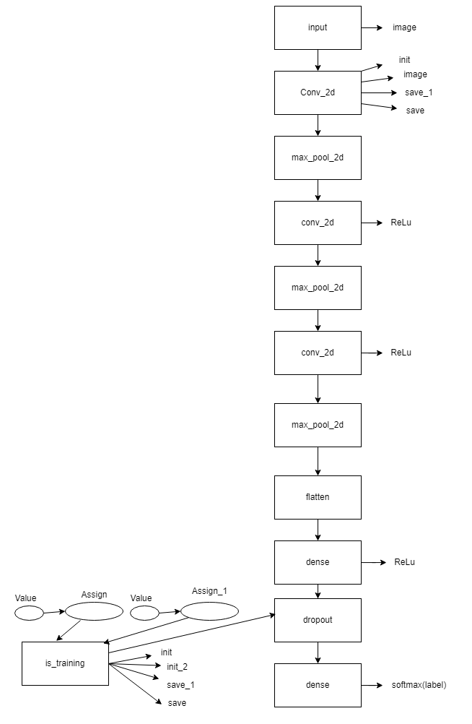
Implementation Details of Algorithm
Fig: Flow diagram of Algorithm

Slide 18
Implementation of Algorithm
First Convolutional Block: A Conv2D layer with 32 filters (3x3), using ReLU, takes 400x400 RGB images, followed by MaxPooling to downsample.
Second Convolutional Block: Adds a Conv2D layer with 64 filters and MaxPooling to capture more complex features.
Third Convolutional Block: Another Conv2D layer with 128 filters and MaxPooling for deeper feature learning.
Flattening Layer: Flattens the output from the convolutional layers into a 1D vector for the dense layer.
Dense Layer: : A fully connected layer with 512 neurons using ReLU to combine learned features
Dropout Layer: A Dropout layer (50%) to reduce overfitting.
OutputLayer: A Dense layer with softmax activation for classifying 26 classes (A-Z). Model

Slide 19
Conclusion and Future Recommendations
Conclusion
Developed Sign Language Detection System addressing communication challenges for speech-impaired individuals.
Utilized a Convolutional Neural Network (CNN) for real-time recognition of ASL gestures.
Converted recognized gestures into text and speech with high accuracy.

Slide 20
Future Recommendations
Android application
Adding new Gestures
Multi Language Support
Pre Image Recognition

Slide 21
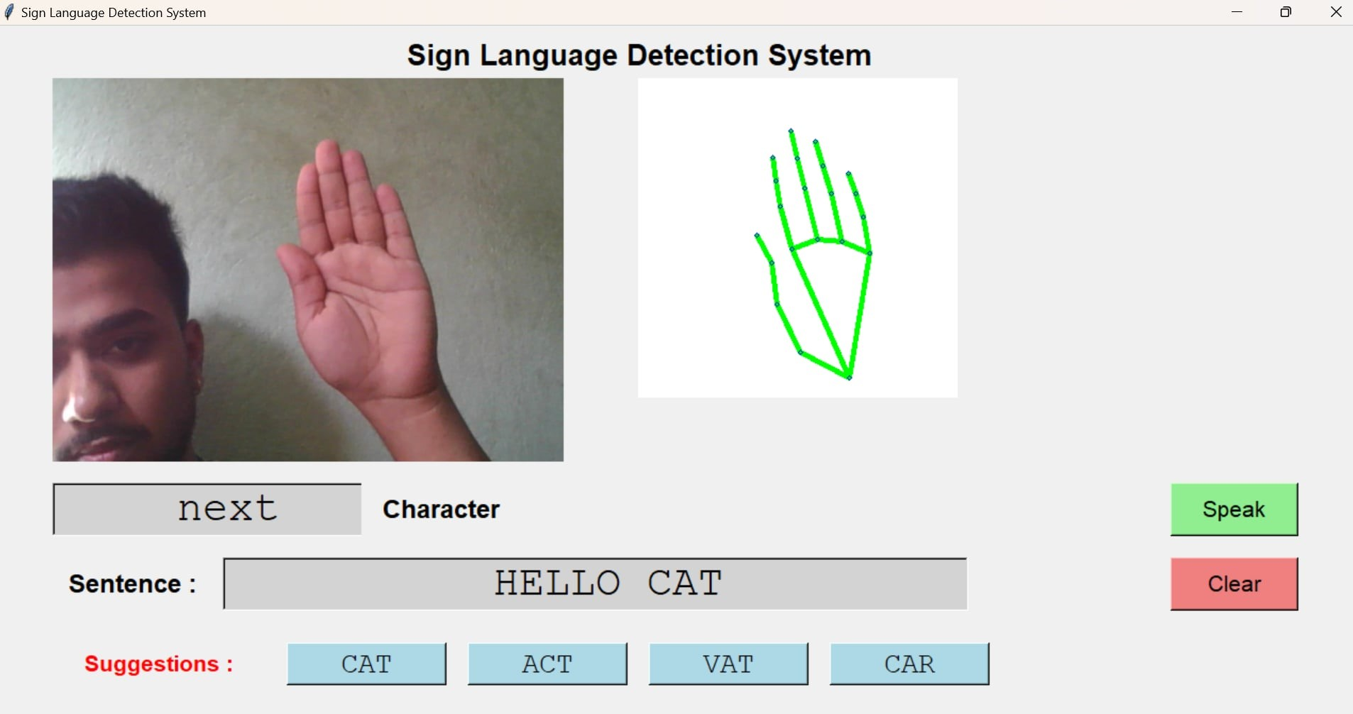
Appendix
Fig: Output

Slide 22
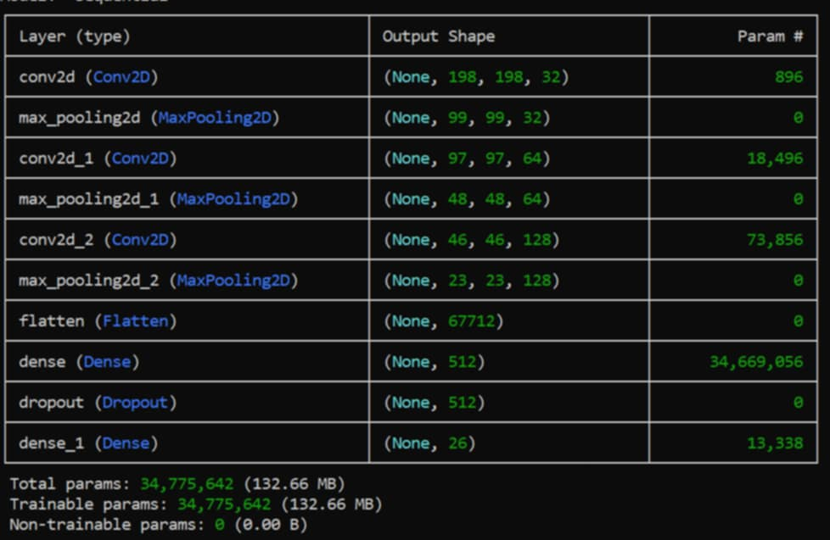
Appendix

Slide 23
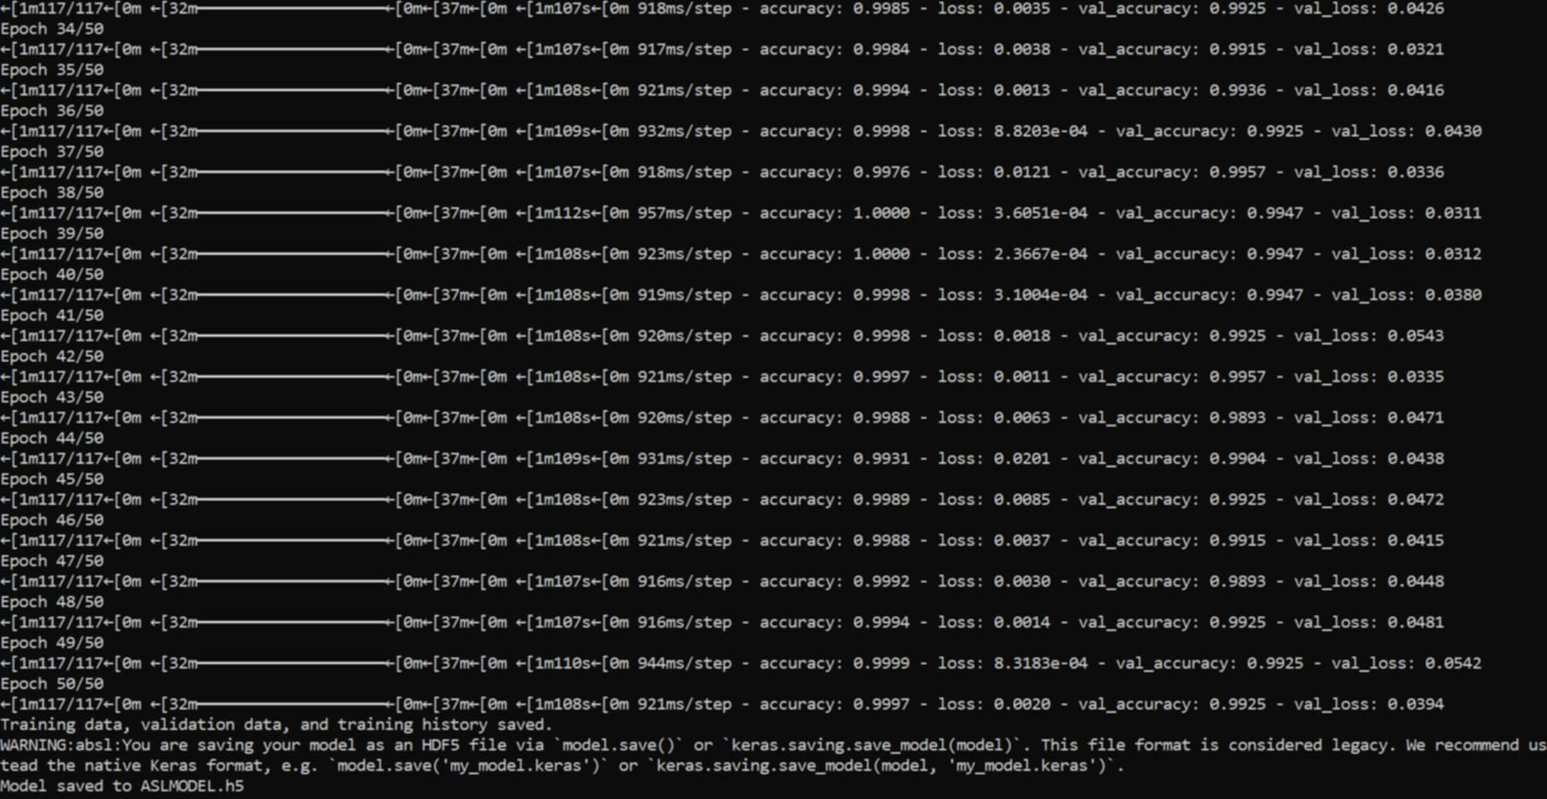
Appendix

Slide 24
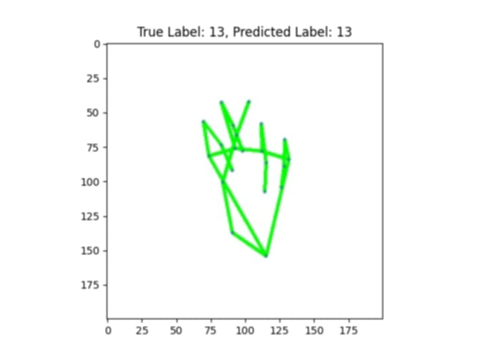
Appendix

Slide 25
THANK YOU

