Slide 1
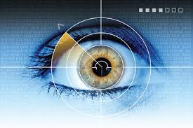
Iris Scanning
Presented By:-
Ku.Roshani Gorde
From M.Sc-II

Slide 2
Iris Scanning
Presented By :- Ku.Roshan Gorde
From M.Sc-II

Slide 3

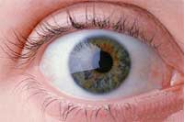

Slide 4
Introduction
Iris recognition is an automated method of biometric identification.
Iris recognition is a method of identifying people based on unique pattern within a ring shaped region surrounding pupil of the eyes.
Identification process is carried by gathering ones or more detailed images of the eye.

Slide 5
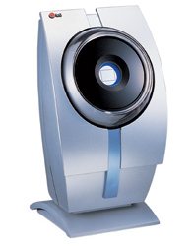
Iris Scanning Device

Slide 6
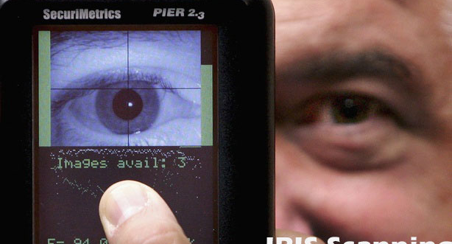
Iris scanning

Slide 7
working
The iris scanning is biometric machine to locate the iris of the person’s eye.
Once the unique pattern of your eye has to be recognize so that you can be positively identified.
There are two distinct stages involved in iris scanning.

Slide 8
Enrollment
A closer breathtaking aspect of this program
is that each new person enrolled is first compared biometrically with all the persons already enrolled to detect any duplicate identity.
The enrollment is completely automatic and usually takes no more than a couple of minutes.

Slide 9

Iris Code

Slide 10
Verification
Once you are stored into system, it's a simple
Matter check your identity.
The system process the image and extract
your iris code before comparing it against
the hundreds,thousands,or millions store in its
database.
If your code matches one of the stored ones,
you are positively identified, if not tough luck !

Slide 11
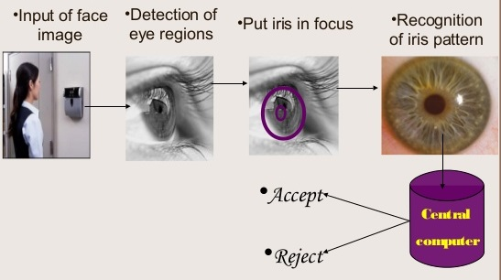
Steps for Iris scanning

Slide 12
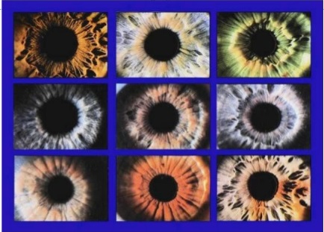
Different Iris Pattern

Slide 13
Advantages
No Harm to internal organ of the eye
Even irises pattern of identical twins differ
Accuracy
Stable

Slide 14
Disadvantages
Obscured by eyelashes, lenses, reflection
The person should be present at the spot
Flash of camera should not become so bright
Expensive

Slide 15
Application
Computer Login
Credit card authentication
Tracing missing or unwanted persons
Driving licenses

Slide 16
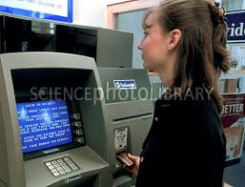
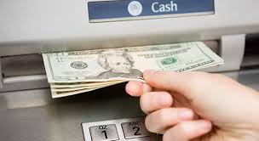
ATM using Iris Scanning

Slide 17
Conclusion
In this era of Information technology security plays a vital role. The versatility of iris technology lends itself to virtually any application where identity or authentication is required to enhance security, ensure service. Due to its high accuracy and less precision eliminate fraud and maximize convenience.

Slide 18
References
http://www.bioprivacy.org/privacy_fears.htm
http://www.brighthub.com/computing/smb-security/articles/63325.aspx
http://en.wikipedia.org/wiki/Biometrics
http://www.accu-time.com/Body%20As%20Credential

Slide 19
Any Query…

Slide 20
Thank You…

