Slide 1

CRYPTOGRAPHY
Presented By:-
Ku.Roshani Gorde

Slide 2
Overview
What is cryptography
Histroy of cryptography
Basic terms
Encryption and Decryption
Classification of cryptography
Techniques on cryptography
Attacks on cryptography
Goals
Applications
Conclusion

Slide 3

What is Cryptography
Cryptography is the science and art of transforming messages to make them secure and immune to attack.
It is the collection of algorithn and associated procedures for hiding and unhiding information

Slide 4
History of cryptography
The term cryptography came from the two greek word “kryptos”,and ”graphein”.
Cryptography, the use of codes and ciphers to protect secrets, began thousands of years ago. The development of cryptography has been paralleled by the development of cryptanalysis — the "breaking" of codes and ciphers.

Slide 5
Basic terms
plaintext - original message
ciphertext - coded message
cipher - algorithm for transforming plaintext to ciphertext
key - info used in cipher known only to sender/receiver
encipher (encrypt) - converting plaintext to ciphertext
decipher (decrypt) - recovering ciphertext from plaintext
cryptanalysis (codebreaking) - study of principles/ methods of deciphering ciphertext without knowing key

Slide 6
Encryption and Decryption
Encryption
scrambling a message or data using a specialized
cryptographic algorithm.
Decryption
the process of converting ciphertext back
to the original plaintext.

Slide 7
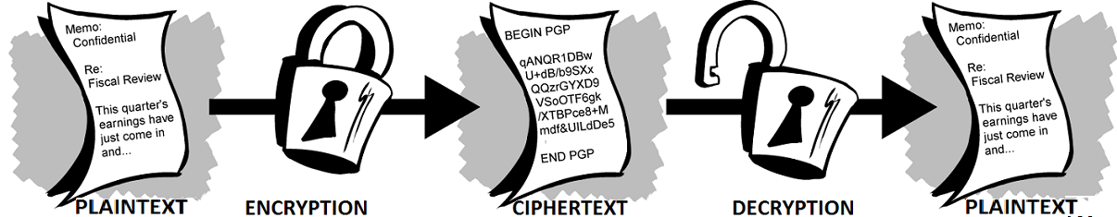
Encryption and decryption

Slide 8
Classification of Cryptography
Cryptography mainly classified into two catagories –
Symmetric cryptography
Asymmetric cryptography

Slide 9
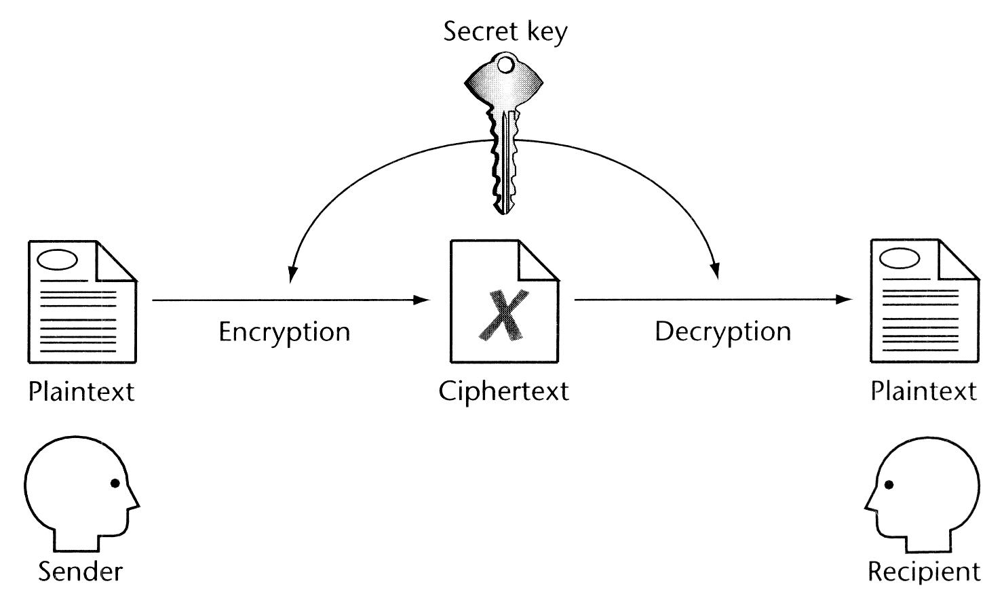
Symmetric cryptography
It is also known as secret key. Sender & receiver uses same key & an encryption/decryption algorithm to encrypt/decrypt data. i.e. the key is shared.

Slide 10
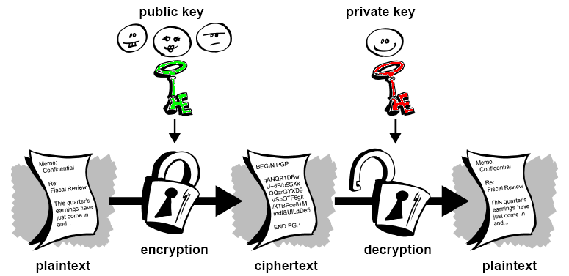
Asymmetric cryptography
Also known as public key cryptography. Sender & receiver uses different keys for encryption & decryption namely PUBLIC & PRIVATE respectively.

Slide 11
algorithm
It will be often useful to have a notation for relating plaintext, cipher text & Keys.
Let’s assume that ,the plaintext has n characters , drawn from an alphabet X.
We represent the plaintext msg. as a vector of n symbols— X={x1,x2,x3,……xn}
Before transmitting, the sender Encrypts the msg.
This is done by a rule that maps X into a sequence of new characters called as Cipher text.
Y={y1,y2,y3,…..,yn}

Slide 12
Cont….
The mapping from X to Y is based on an encryption rule ,which we may write as
Y= Ek(X)
The subscript k (Key) denotes a particular rule, employed in a ciphersystem to determine the cipher text.
The cipher text msg. is transmitted to the receiver.
In order to read the original msg.the receiver must use another rule ,called a decryption rule.

Slide 13
Cont….
This decryption rule can be looked as an inverse mapping defined by encryption rule.
X= Dk(Y)
Y = Ek (X)
X = Dk (Y)
X = Dk(Ek(X))

Slide 14
Techniques in cryptography
1.Transposition Technique
2.Substitution Technique
3.Stream Technique
4.Block Technique

Slide 15
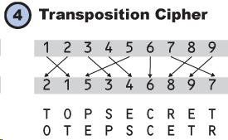
Transposition cipher
In this techniques, a transposition cipher changes one character from the plaintext to another i.e. the order of the characters is changed.

Slide 16
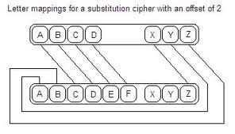
Substitution cipher
Substitution cipher is a method of encryption by which units of plaintext are substituted with ciphertext according to a regular system.

Slide 17
Stream cipher
A Stream Cipher is a symmetric or secret-key encryption algorithm that encrypts a single bit at a time. With a Stream Cipher, the same plaintext bit or byte will encrypt to a different bit or byte every time
e.g. :-
Plain text: Pay 100
Binary of plain text: 010111101 (hypothetical)
Key: 100101011 ----- Perform XOR
____________________
Cipher text 110010110 ----- ZTU9^%D
To decrypt make the XOR operation of the cipher text with the key .

Slide 18
Block cipher
Block cipher technique involves encryption of one block of text at a time .Decryption also takes one block of encrypted text at a time. Length of the block is usually 64 or 128 bits.
e.g. :-
Plain text: four and five
Four and five
Key Key Key
wvfa ast wvfa ---ciphertext

Slide 19

Attacks on cryptography
Ciphertext-only-attack
Known plaintext-attack
Chosen plaintext-attack
Chosen ciphertext-attack

Slide 20
goals
Authentication
Confidentiality
Integrity
Non-repudiation

Slide 21
Applications
Defense services
Secure data manipulation
E –commerce
Business transactions
Internet payment systems
User identification systems
Access control
Data security

Slide 22
Conclusion
By usingcryptographtechnique,
confidentiality,authentication,integrity,accesscontrol and avaibility of data is maintained.
It hides the messages and keep your privacy safe.

Slide 23


Slide 24
Any Query..?

