Slide 1
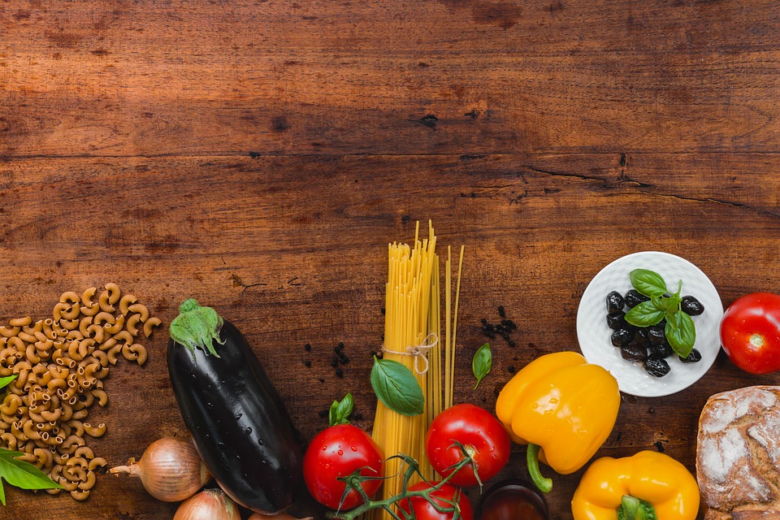

RECIPE HUNT
Team : DA - Crusaders

Slide 2
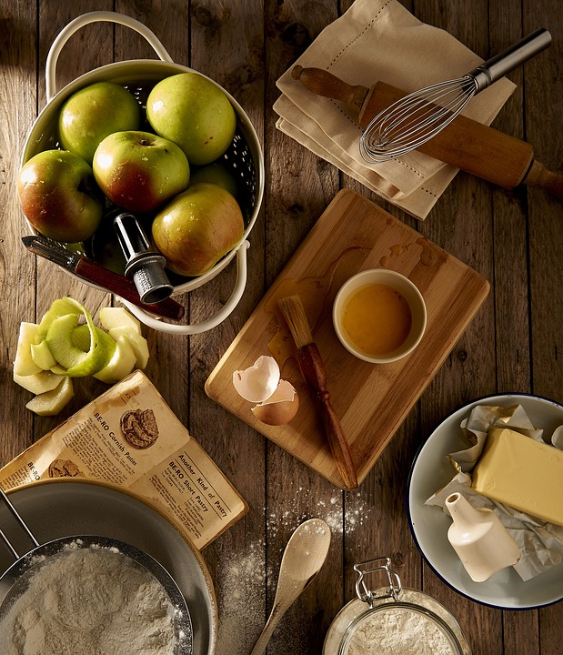
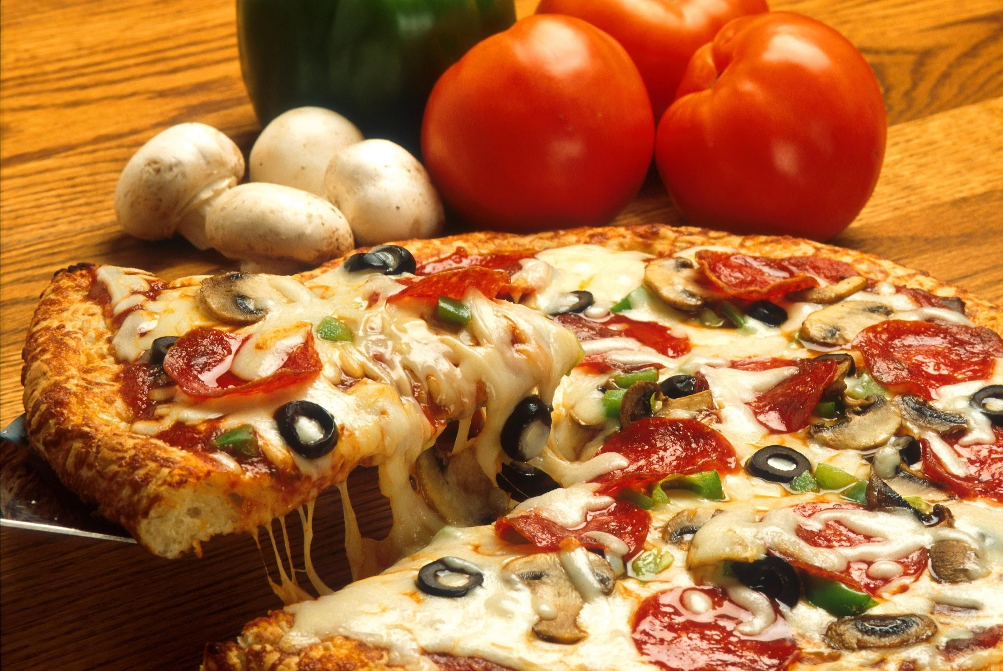
INTRODUCTION
It happens many a times that we are left with certain ingredients in our fridge and are clueless about what to do with it. Generally most of the times we throw away these materials thus causing wastage of food. But now no need to worry as we have come up with a solution.
Recipe Hunt provides us the opportunity to use those leftover ingredients to turn them into something really delicious. Just enter the ingredients you are left with and get started.

Slide 3
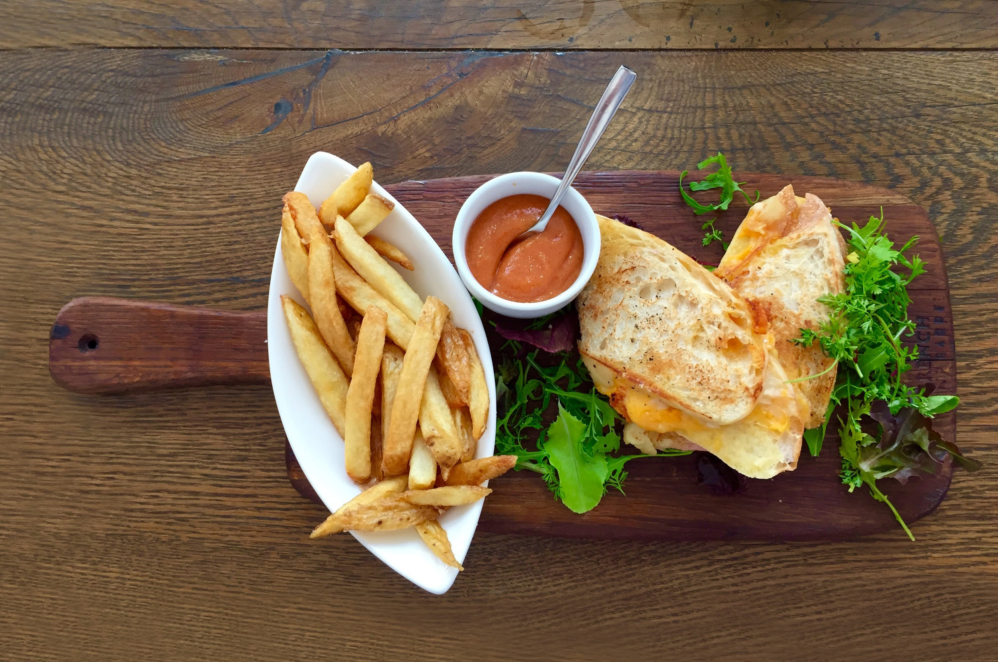

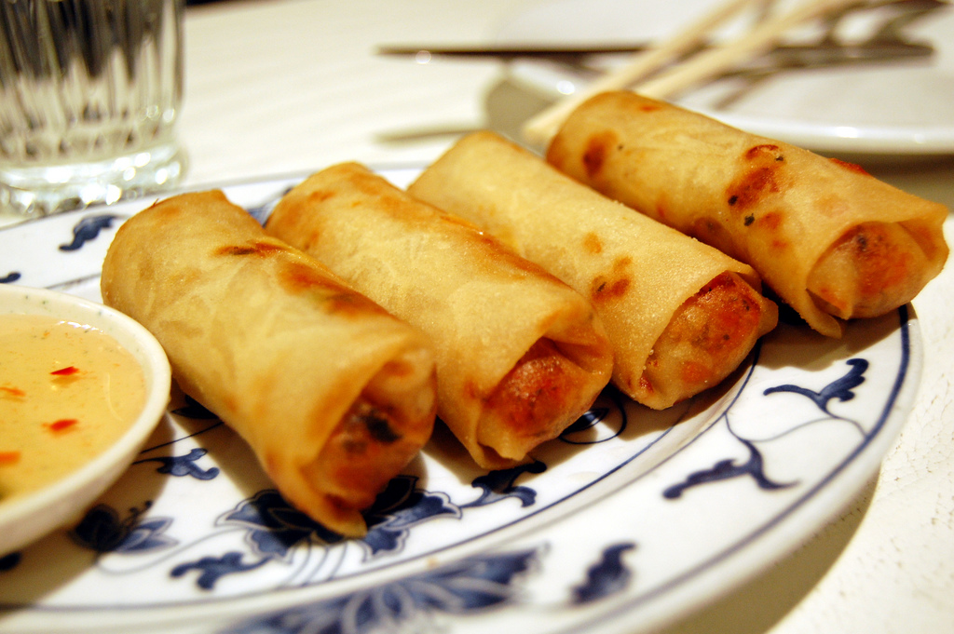
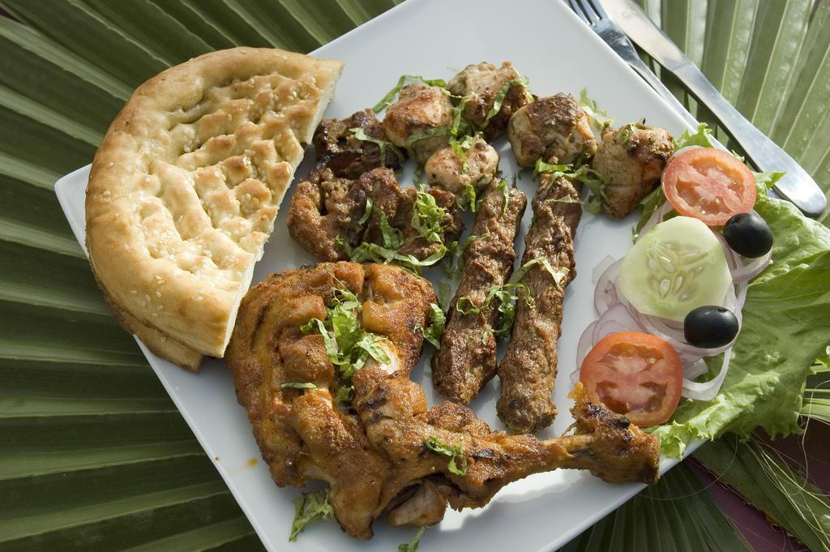
SOLUTION TO THE PROBLEM
In Recipe Hunt we get you some of the best recipes that are easy to prepare and delicious to savour. When a person is left with certain ingredients and they have no idea what to do with them our site helps them by providing a solution.
All one needs to do is visit our website and choose the items that they are left with. Then we would find the various recipes that can be made out of those ingredients and provide the audience with instructions to prepare them.
If anyone has a new recipe he/she can also put up their recipes on our website so that others can also get a chance to enjoy it.

Slide 4
BUSINESS MODEL
We plan on promoting various renowned restaurant chains who can put up their recipes up here and also sponsor us.
We even give an option for different restaurants to put up their menus so that people can take a quick glimpse at them and get an idea of what the restaurant serves.
For each restaurant tie up we plan to take 2.5 % of their profit into account ( for promoting their restaurant chain).
We also can have tie ups with renowned chefs where they can put up their recipes and tutorials.
Also new chefs who have just stepped into this industry can join us and get an introduction to the workspace.

Slide 5

How do we plan to attract customers?
We plan to give offers to restaurants who will be tying up with us.(such as free membership for one year)
Secondly , we would also give opportunities to new chefs to promote themselves.
We also plan on giving special vouchers of our sponsor restaurants, and prizes such as best recipe of the month etc.

Slide 6
In the end we would like to say that Recipe Hunt provides you the platform to learn and hunt new recipes. It also ensures that you don’t throw away the leftovers but give them a new makeover.
Because anyone can cook!
Thank You!

Slide 7
TEAM MEMBERS
ADARSH MISRA
NISHI DOSHI
ROHAN DHANWANI
ROSHANI R

