Slide 1


Communication

Slide 2






Generally communication defines process of exchanging
Information
ideas
Thoughts
Feelings
Emotions
through
the speech.

Slide 3


How communication happens ?
Let's understand through diagram.
Encoding
Sender
Channel
Message
Barrier
Noise
Feedback
Channel
Decoding
Receiver

Slide 4

People communicate with each other in various ways that depends up on the message and its context in which being sent.
There are two types of communication based on communication channels.
Verbal
Non-verbal

Slide 5


Verbal Communication
It is type of communication where message can be transmitted verbally.
It can be word of mouth and piece of writing.
It should be KISS (keep it short and simple).
It is defined into two parts
Oral Communication
Written Communication

Slide 6
Oral Communication
It includes face to face conversations, speech, telephonic conversation, voice over internet.
Influenced by pitch, volume, speed and clarity of speaking.
Advantages
Brings quick feedback
In a face to face conversation, reading facial
expression and body language one can guess
whether he/she is trust worthy or not.
Disadvantages
Brings quick feedback
In a face to face conversation, reading facial
expression and body language one can guess
whether he/she is trust worthy or not.

Slide 7

Written Communication
written signs and symbols are used to communicate
It can be transmitted through email, letter, report, memo etc.
This is famous within corporates communication.
Advantages
Message can be edited and revised.
It facilitates record and backup
It enables receiver to fully understand it and send
appropriate feedback.
Advantages
does not bring quick feedback
It takes more time to compose/write and organize
words than word of mouth.

Slide 8
Non-verbal communication
Sending and receiving wordless messages. Such as gesture, body language, posture, tone of voice, facial expression, are called non verbal communication.
3 things that we should take care
Appearance : Clothing, hairstyle, neatness and cosmetics
Body Language : Facial expression, postures.
Sounds : Voice tone, volume, speech rate.

Slide 9

Intrapersonal communication
Those type of communication which occurs in your own mind. It is based on your feelings, thought, and beliefs
Examples
when you make any kind of decision such as what to wear, what to eat.

Slide 10
Interpersonal communication
Those type of communication which involves more in informal conversation between two peoples.
Examples
When you are talking to your friends. A teacher and student discussing an assignment.

Slide 11
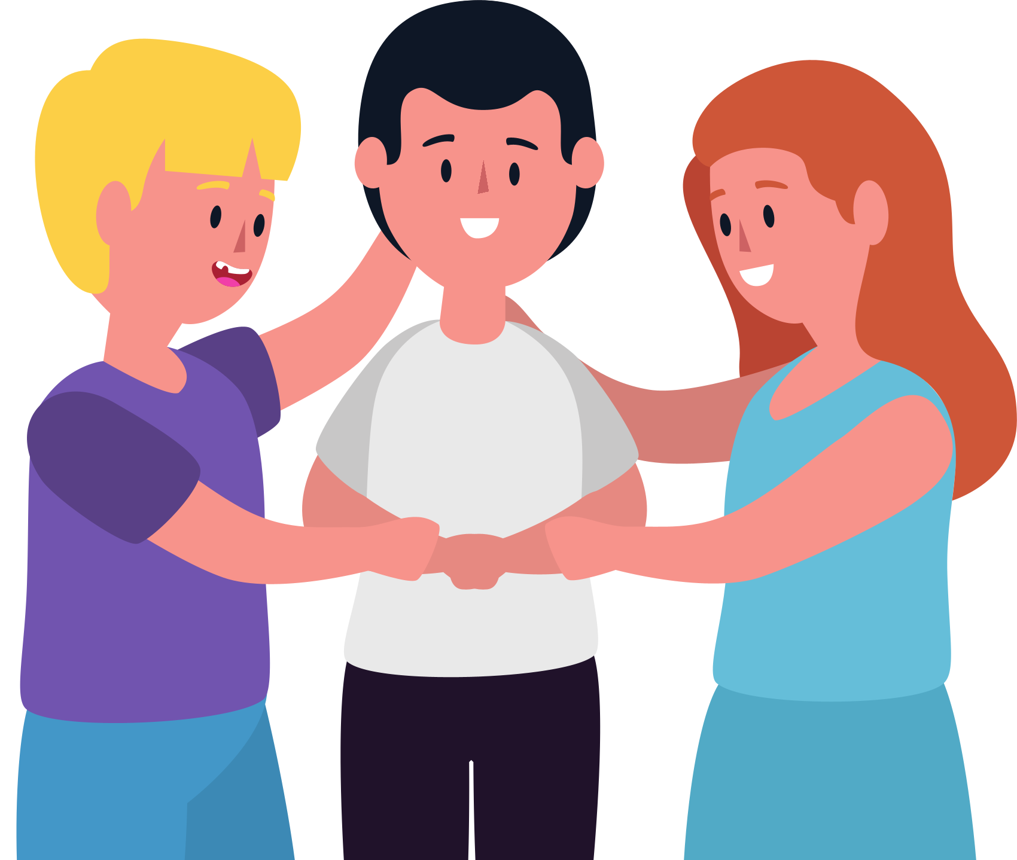
Small group communication
Those type of communication which is within formal or informal teams. It is group interaction that results in decision, problem solving, and discussion within organization.
Examples
Small team working for project.

Slide 12


One to group communication
Those type of communication which is involves a speaker who seeks to inform , persuade or motivate participants.
Examples
Motivational class, a teacher teaching student

Slide 13


Mass communication
Those type of communication which is done through radio, television, film and printed media designed to reach largest number of audiences.

Slide 14
Barriers to communication
Message
medium or channel
Barriers
medium or channel
feedback

Slide 15


Barriers to communication
Physical barrier
Perceptual barrier
Emotional barrier
Cultural barrier
Language barrier
Gender barrier
Interpersonal barrier

Slide 16
Few steps to overcome barriers
Talking to receiver naturally.
Crystal clear message
Delivering messages skillfully
Focusing on the receiver
Ensuring appropriate feedback
Becoming aware of state of minds and emotions.

Slide 17
Tools of effective communication
Be brief
Manners
Channelize your ego
Be positive
Good listener
Spice up our words
Clarity and good pronounciation

Slide 18
There are so many communication theories such as
ACT
AST
AST
Actor-Network Theory
Adaptive Structuration Theory
Agenda Setting Theory
CDT
SET
SLT
Cognitive Dissonance Theory
Social Exchange Theory
Social Learning Theory
There are so many theories like these which defines values of communication
in our daily lives.

Slide 19






This is one of the method which you can use to gauge your emotions before engaging in any discussion. i.e. Fist-to-Five method
Fist
1 Finger
2 Fingers
I'm not very at ease, and I don't want to proceed.
I’m not at ease,
and I need support before proceeding.
I feel a little uneasy,
but I want to try
and proceed.
3 Fingers
4 Fingers
5 Fingers
I’m unsure how I feel.
I’m at ease enough
to proceed.
I’m very at ease
to proceed.

Slide 20
Importance of communication in agile
Agile Manifesto:
Individuals and interactions over processes and tools
Working software over comprehensive documentation
Customer collaboration over contract negotiation
Responding to change over following a plan
Basically, Agile is based on fluent, effective communication throughout the team to be able to build a working software that meets the needs and expectations of the client. Agile methodologies encourage a transition from a traditional and formal communication to a casual and direct form that allows the client and development team to work more closely together and be on the same page.
This frequent communication in agile results in better performance of the development team and therefore, a better final product.
Let’s see how important communication is in every phase of an Agile Project:

Slide 21
Before project starts
When we are in the process of selling a new project to a client, everything is about how well we communicate with them to understand what their needs are, what they are trying to achieve, and how big the effort is going to be to make this dream come true.
Quality communication will allow us to understand where the client is now, where they want to be at the end of the project, and by when do they want to get there. This means we have to make sure we identify all the features, the high-level requirements, and also what are the most important/urgent of these for the client.
If we do it right we will have helped the client to define a picture of what the product will look like, and most importantly, we will see that picture too! But if we don’t, we are going to have an unclear scope, an unclear amount of effort needed, and it’s very likely the client will be disappointed because the expectations were not set properly

Slide 22
When the Project starts…
It is extremely important that every team member has a clear understanding of the scope of the project and any commitments are included in the statement of work (SOW). This means there has to be a good handoff from the sales team to the project team, to make sure everybody is on the same page regarding scope, timeline, and contacts from the client side as well as their roles; and of course, it is always useful to have some tips about who can be an ally and who is more reluctant to the entire project idea.
We also need to help the client define the user stories for the project and not only to write them but prioritize them! Communication is vital here to understand and be very specific about what each user story is about, and what the right acceptance criteria are going to be. Defining user stories may seem like an easy task, but remember, clients are not familiar with Agile in the majority of cases. The tricky part is that we have to deal with the fact that the stories are likely to change quickly or not be completely known at the beginning of the project.
In this phase, quality communication will allow us to set the appropriate pace to make sure we don’t build features out of the scope, we hit deadlines, we satisfy client’s expectations, and we find quick solutions to any roadblock. If we don’t have everyone on the same page we will surely have some conflicts when we release the first deliverables…

Slide 23
When the Project is ongoing…
Sprint Planning Meeting – This meeting takes place before a new sprint starts. The goal is to define what the deliverables of the sprint are going to be, refine the user stories to have clear acceptance criteria, have an idea of what the effort is for each of them, and also figure out the sub-tasks involved. The team is empowered to only select the user stories they are sure they can finish within the sprint.
Standup Meetings – to keep a daily status of the project and be able to work around any roadblock detected.
Demo Meeting – to show the client what the team has built. This meeting will have the entire team on the same page regarding what is already completed.
Retrospective Meetings – to improve project performance by sharing lessons learned
In addition to these formal meetings, there needs to be open communication between all the stakeholders in order to clarify a requirement or show some possible approaches when having more than one option.

Slide 24
If you reached this point I guess I got you into the idea that Communication is the key to the success of any project, but if it is an Agile Project, then you should already know that the entire methodology is built upon Communication… The better the communication is, the more satisfied the client and the entire team are going to be.

Slide 25
Hope you understood partially or fully about communication

Slide 26

Thank you for participating!
Have a great day ahead.

