Slide 1
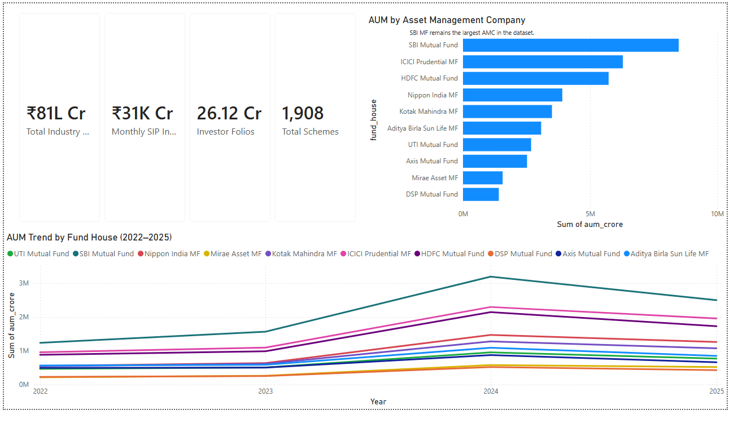
Bluestock Mutual Fund
Analytics Capstone
Final Day 7 Submission | Data Analyst Internship Capstone
Report • Dashboard • ETL • Analytics • Presentation
Bluestock MF Capstone | 1/12

Slide 2
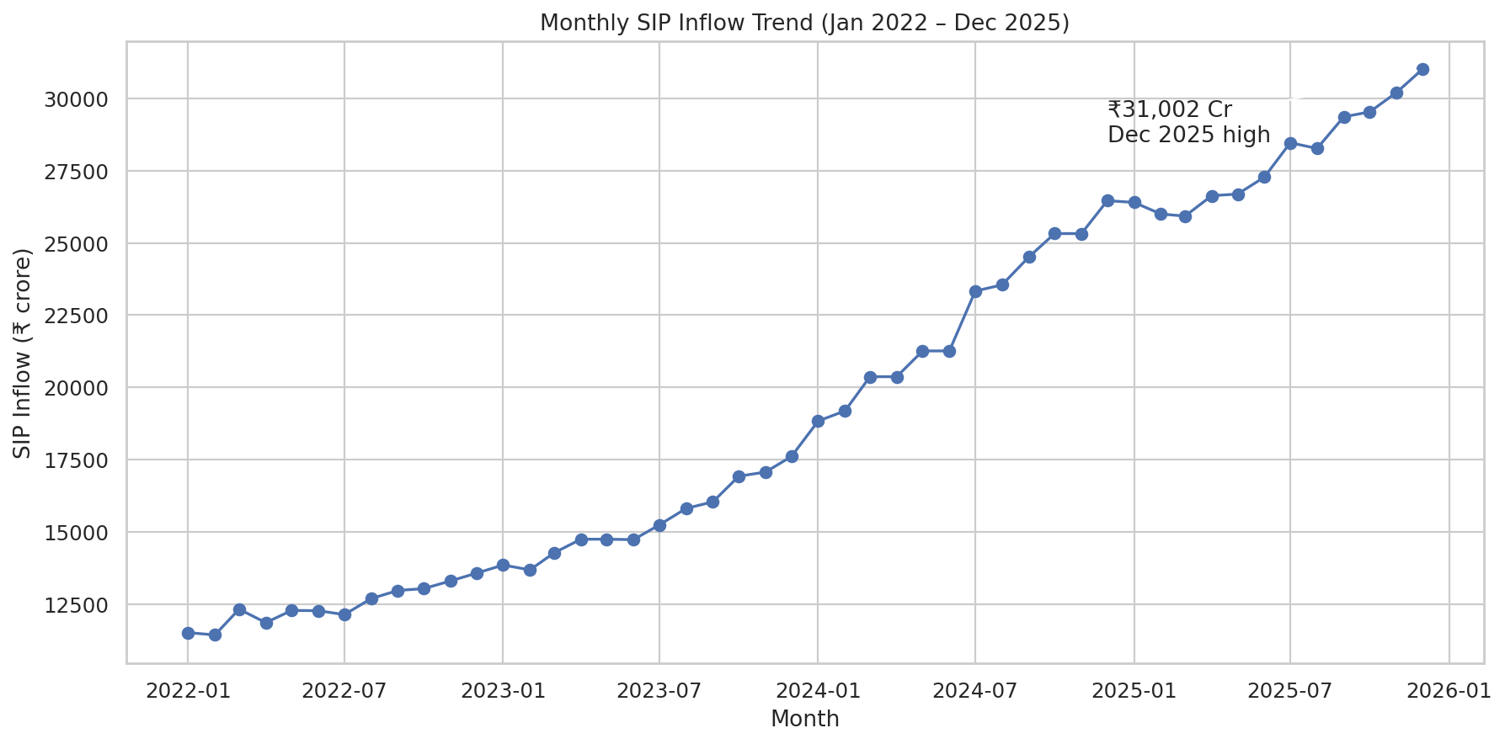
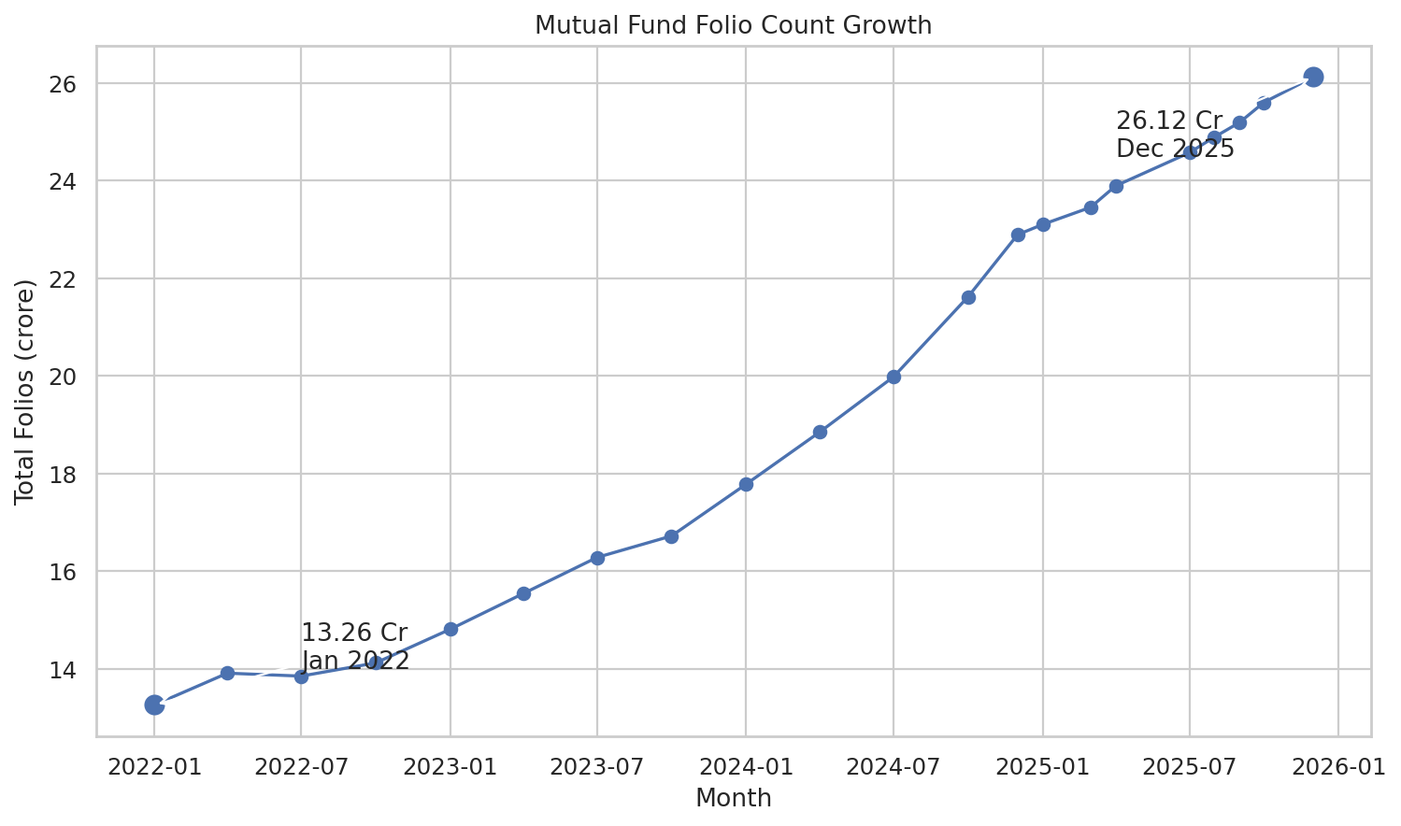
Problem & Objective
Convert fragmented mutual fund data into decision-ready analytics
Build one reliable workflow for ingestion, cleaning, analysis and dashboarding.
Compare funds using both returns and risk-adjusted performance.
Explain industry growth, SIP inflows and investor transaction behavior.
Deliver a professional report, 12-slide deck, clean code and README.
Bluestock MF Capstone | 2/12

Slide 3
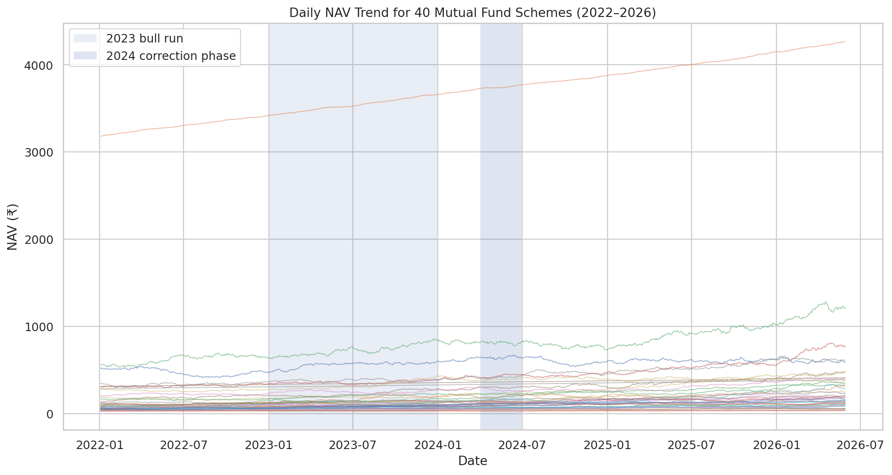
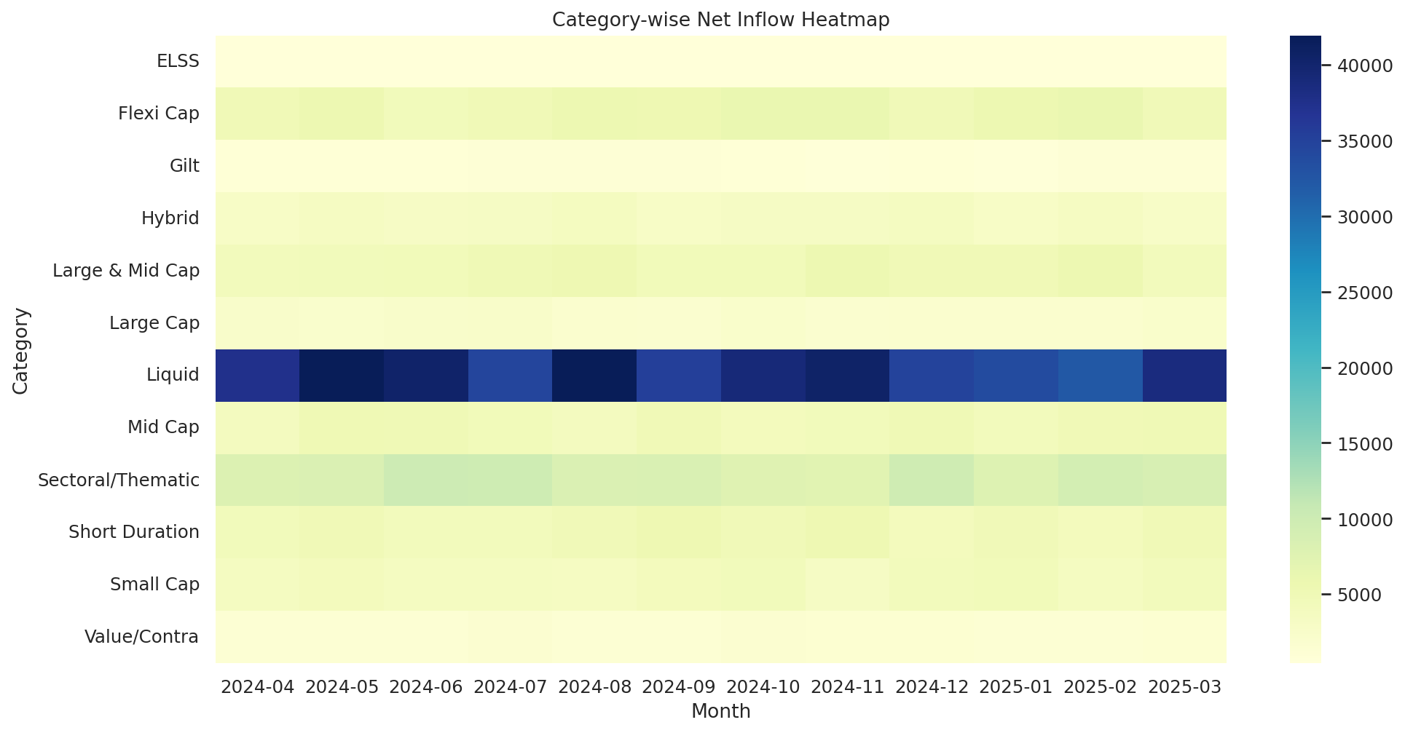
Data Sources
Ten core datasets plus selected live NAV histories
Fund master, NAV history, AUM by fund house and SIP inflow datasets.
Category inflows, folio counts, scheme performance and investor transactions.
Portfolio holdings and benchmark index data for risk and comparison analysis.
Live NAV CSVs fetched for selected schemes from mfapi.in.
Bluestock MF Capstone | 3/12

Slide 4
Architecture
Raw data to dashboard and final submission
1. Raw CSV + Live NAV
3. SQLite Warehouse
5. Power BI Dashboard
2. Pandas Cleaning
4. EDA + Metrics
6. Final Docs
run_pipeline.py executes data profiling and ETL loading.
Processed CSV files and SQLite DB support repeatable analysis.
Notebook outputs and dashboard screenshots form final storytelling assets.
Bluestock MF Capstone | 4/12

Slide 5
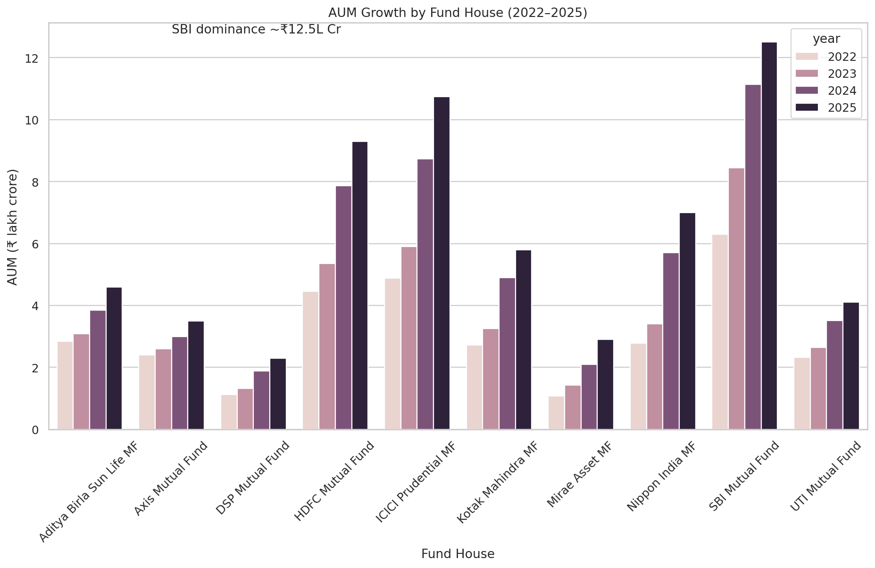
EDA Highlights 1
NAV, AUM and SIP trends
Bluestock MF Capstone | 5/12

Slide 6
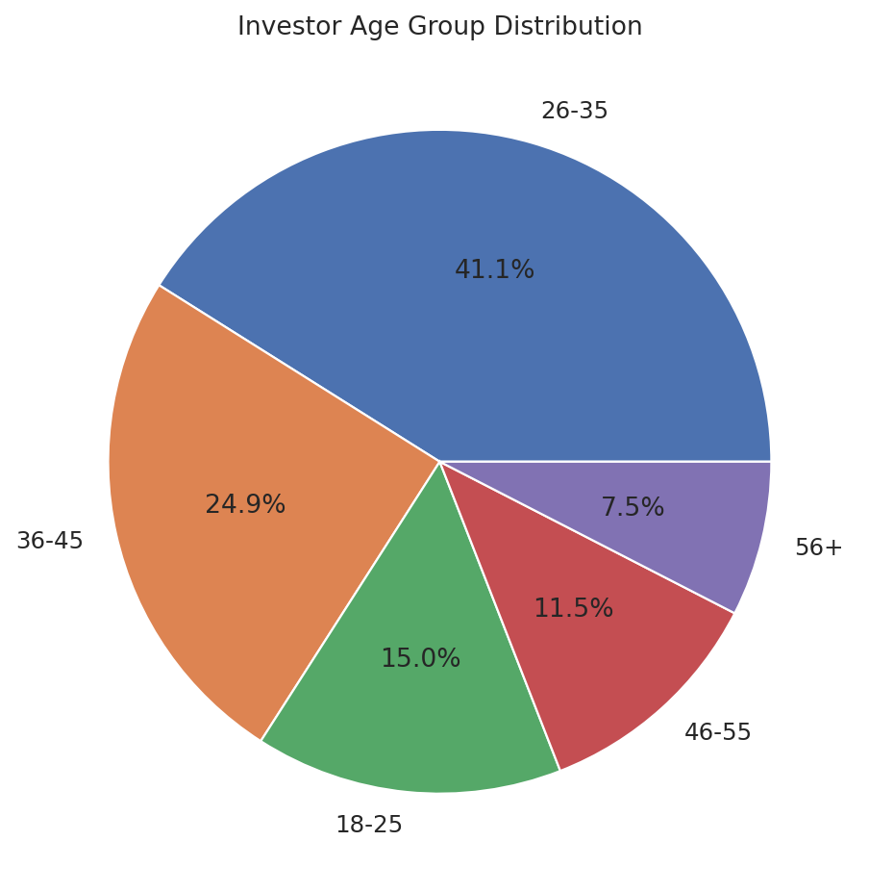
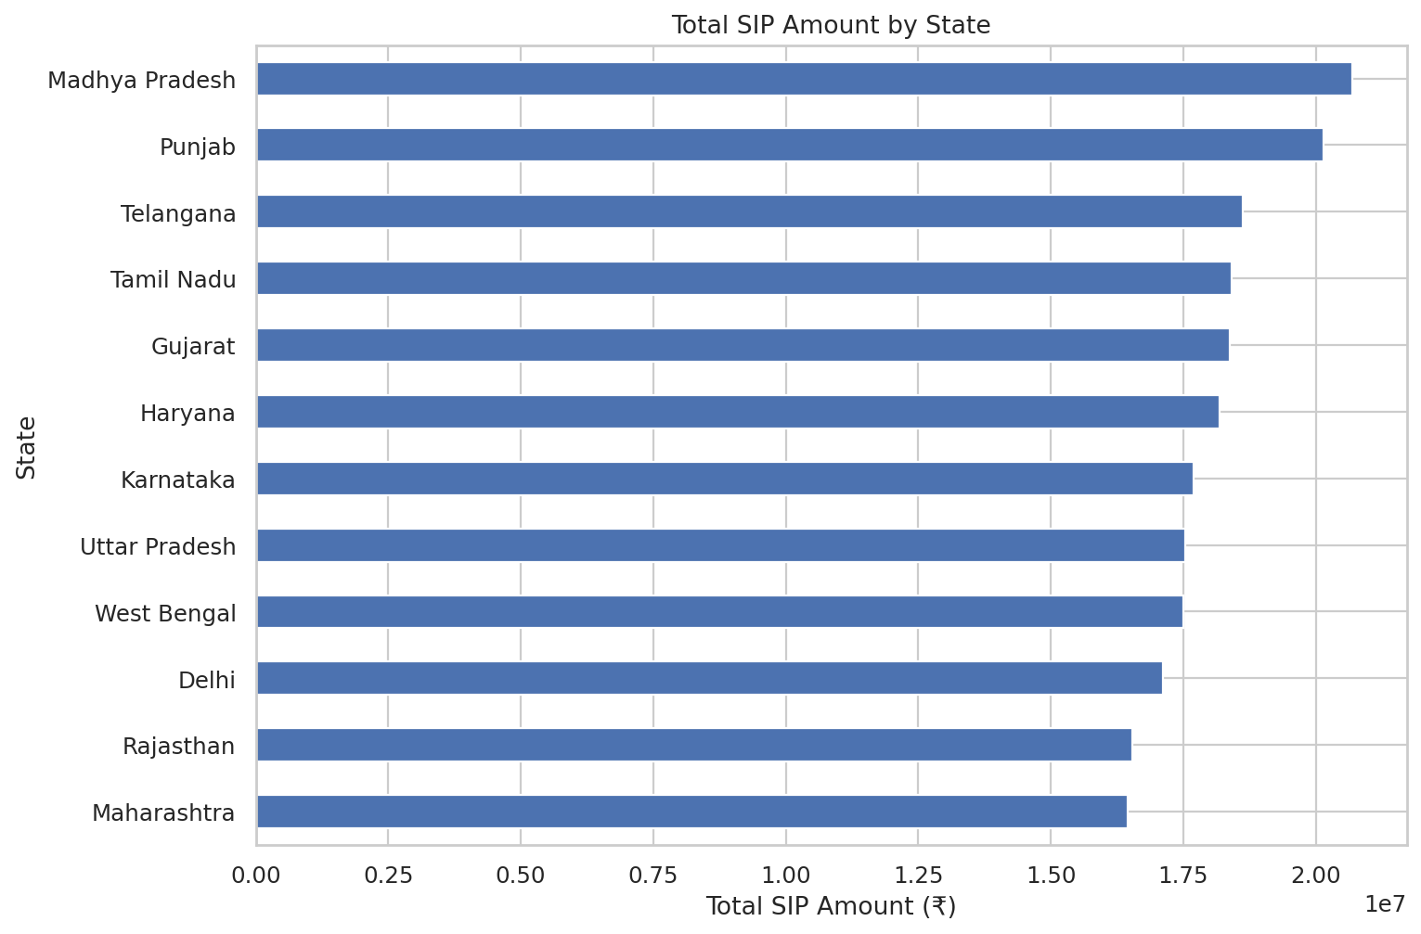
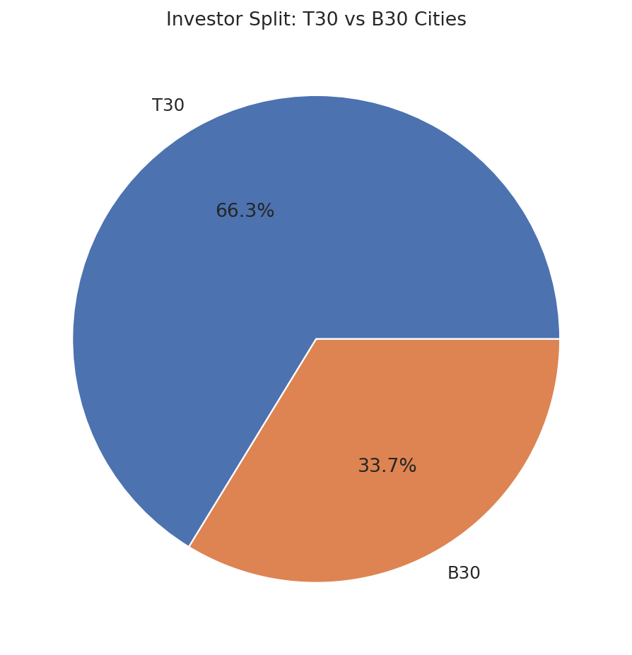
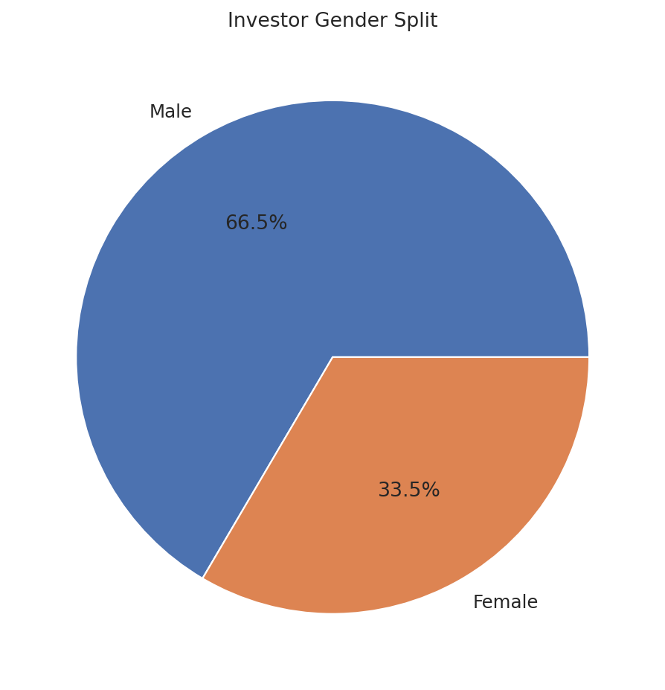
EDA Highlights 2
Investor and category behavior
Bluestock MF Capstone | 6/12

Slide 7
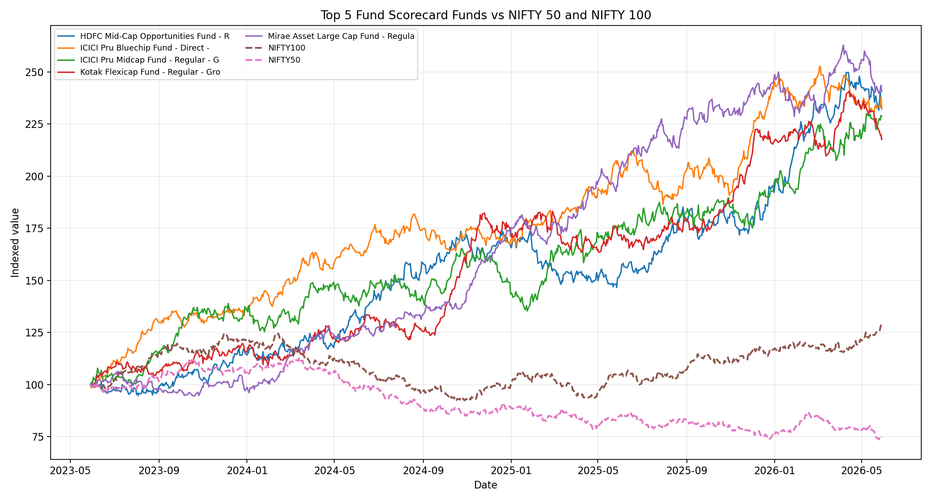
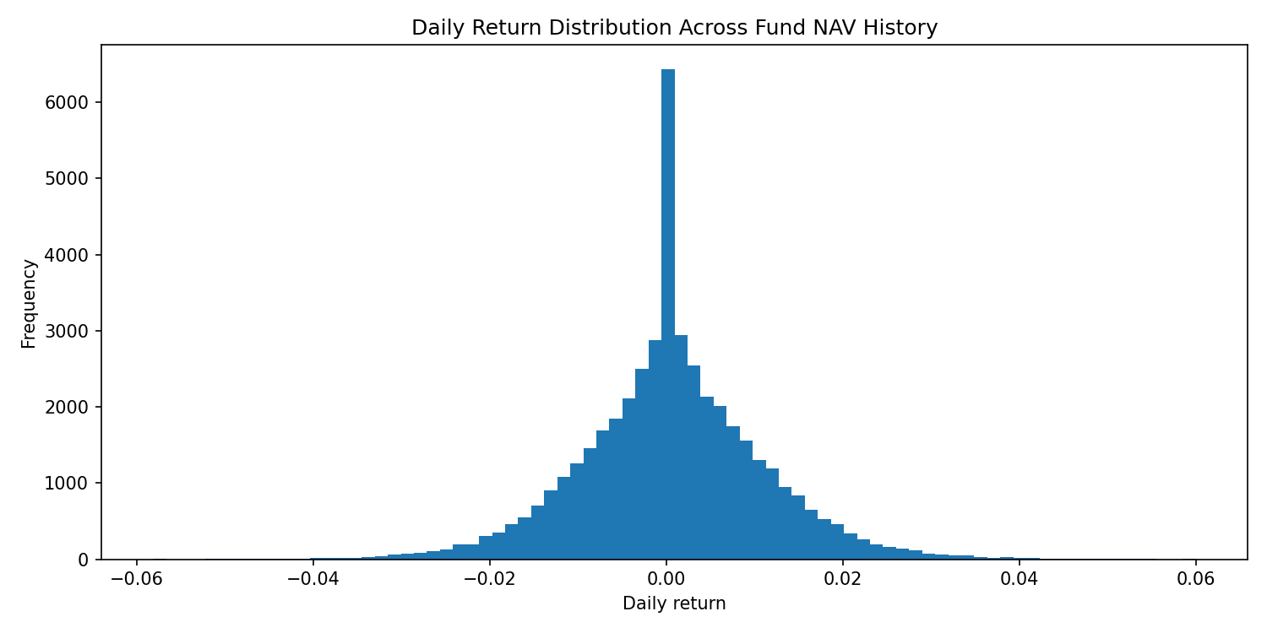
Performance Metrics 1
Return and benchmark comparison
Daily returns were computed from NAV history.
CAGR, alpha, beta and tracking error support performance comparison.
Benchmark analysis helps separate market-driven gains from fund skill.
Bluestock MF Capstone | 7/12

Slide 8
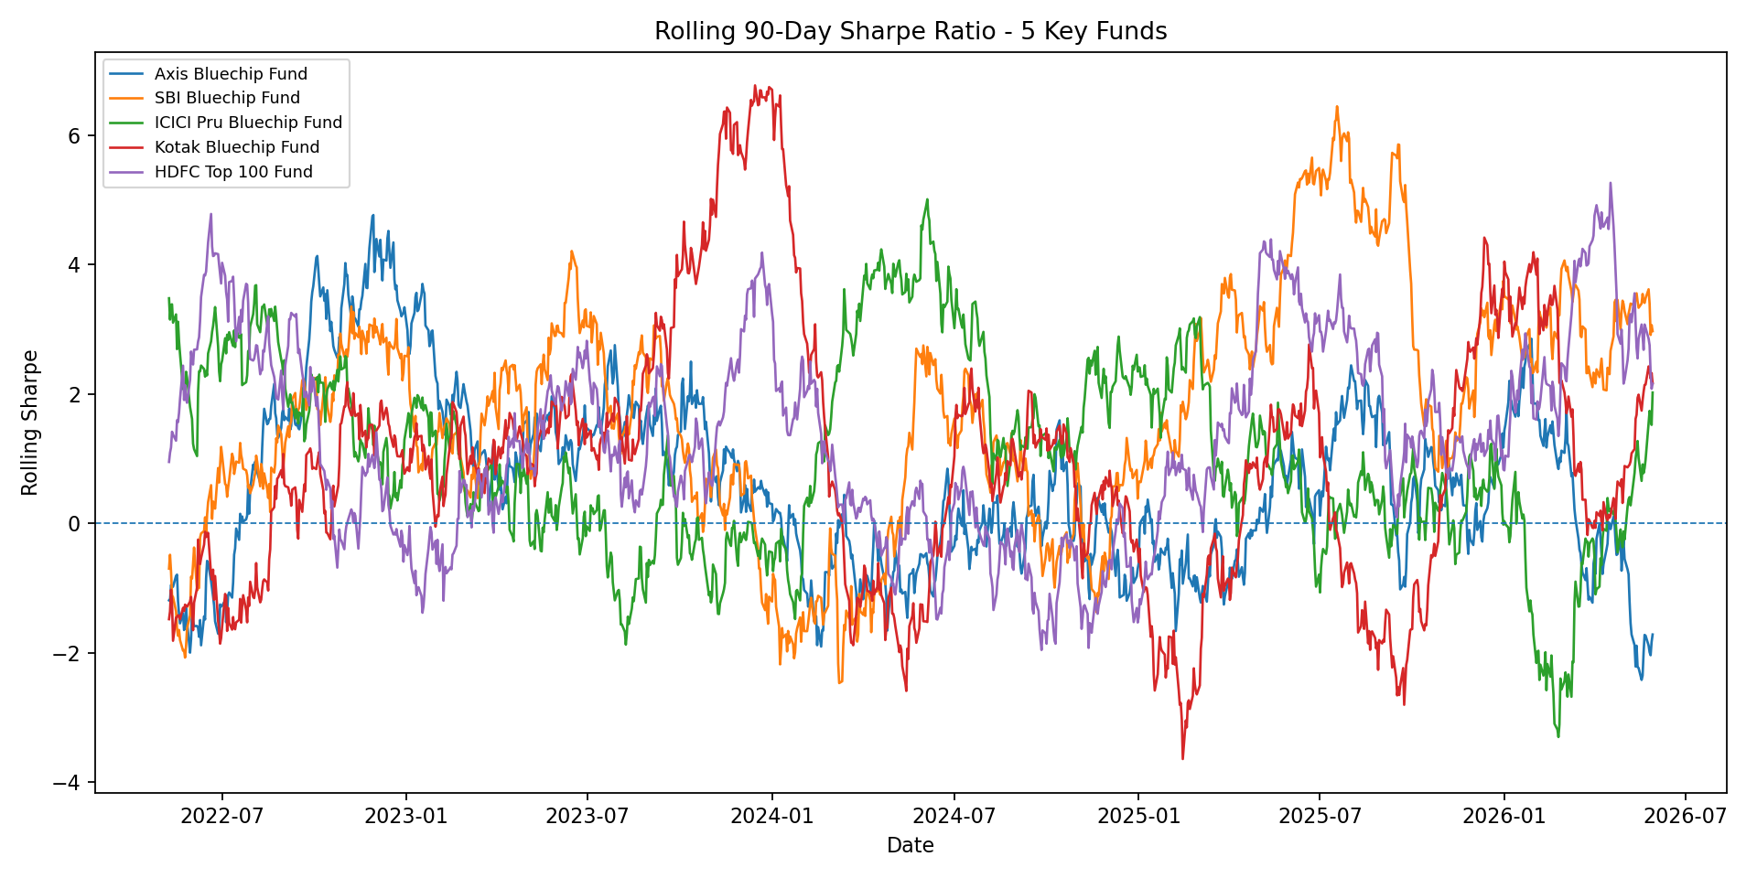
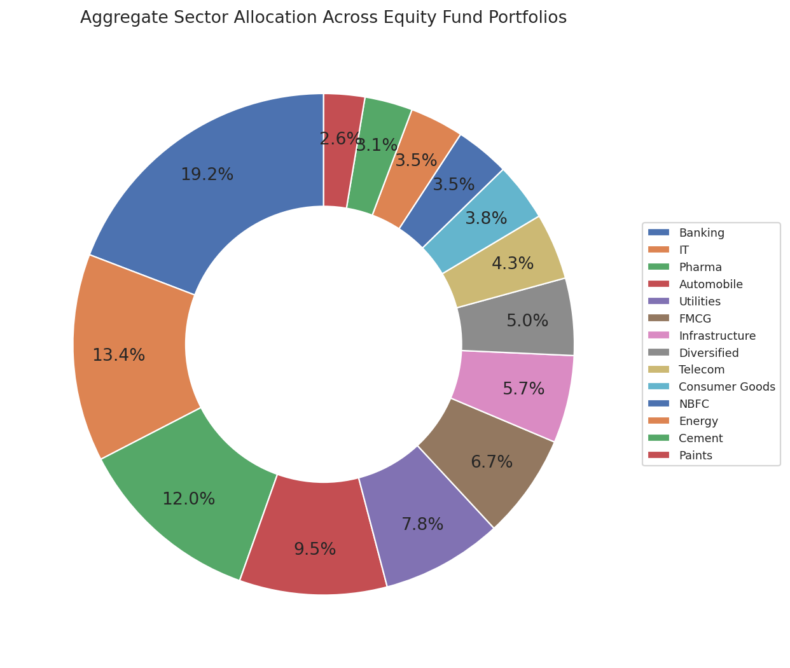
Performance Metrics 2
Risk, stability and recommendation layer
VaR and CVaR quantify downside risk from historical returns.
Rolling Sharpe shows whether risk-adjusted performance is stable over time.
Sector HHI measures concentration; recommender ranks funds by risk appetite.
Bluestock MF Capstone | 8/12

Slide 9
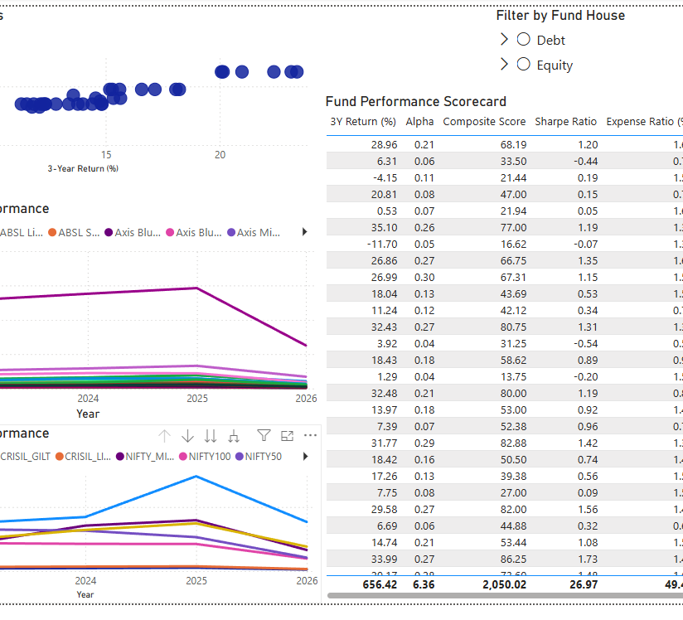
Dashboard Screenshots 1
Industry overview and fund performance pages
Bluestock MF Capstone | 9/12

Slide 10
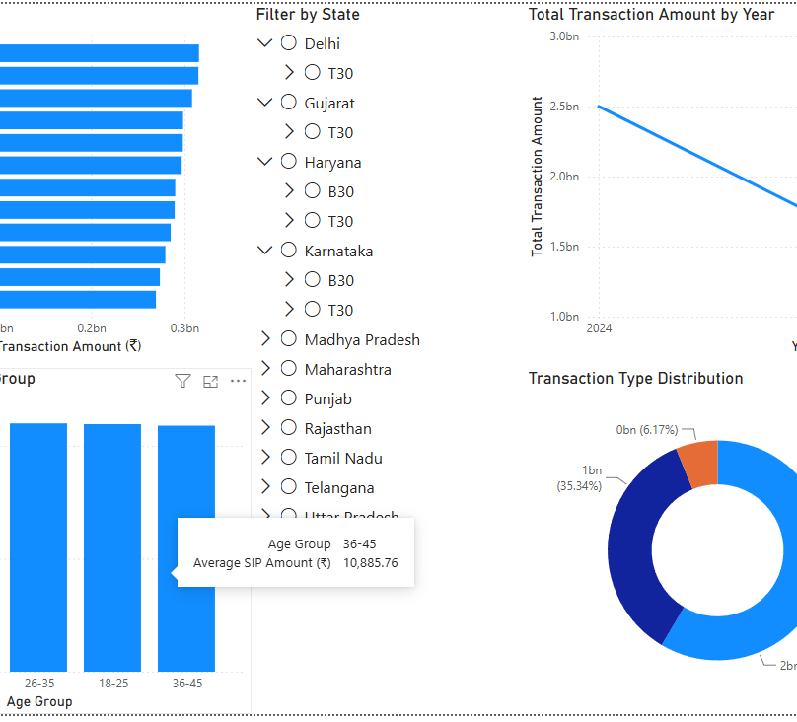
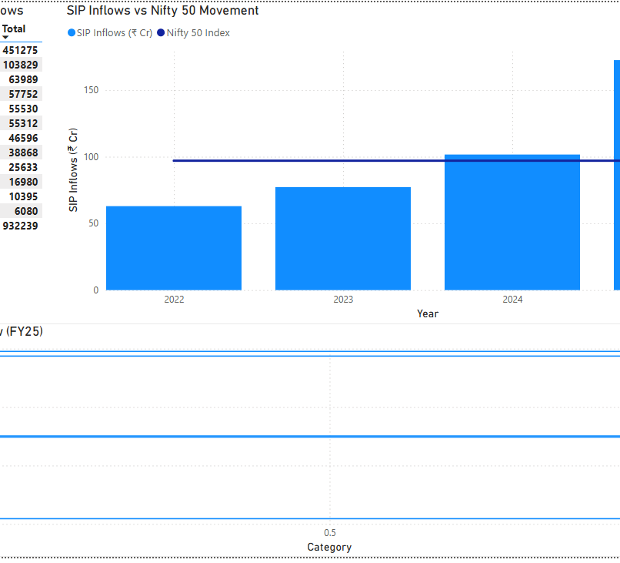
Dashboard Screenshots 2
Investor analytics and SIP trend pages
Bluestock MF Capstone | 10/12

Slide 11
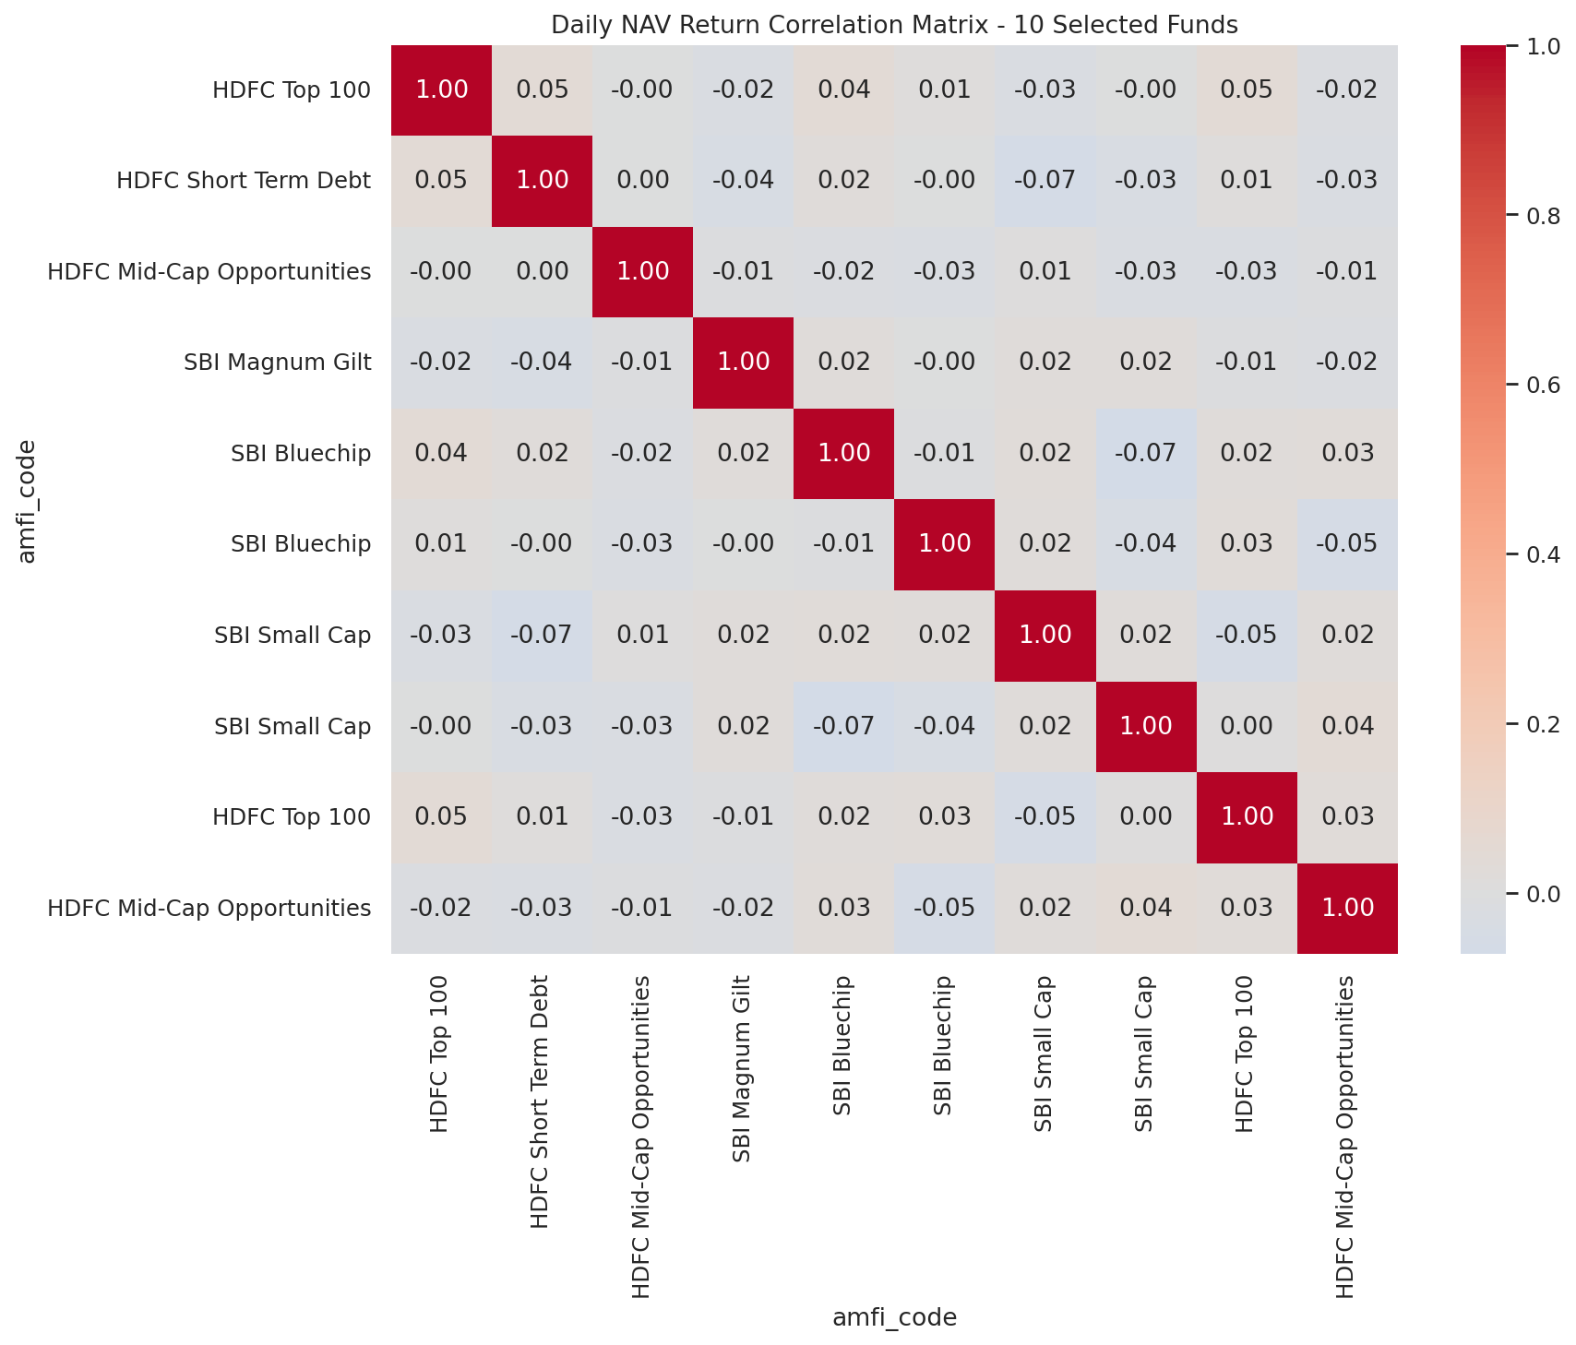
Key Findings
What the analysis shows
SBI Mutual Fund appears as the largest AMC in the dashboard dataset.
SIP inflows and folio growth indicate strong retail participation.
Fund ranking should combine return, Sharpe, drawdown and expenses, not return alone.
Investor behavior varies by geography, age group and transaction type.
Dashboarding makes the insights easier to present to non-technical stakeholders.
Bluestock MF Capstone | 11/12

Slide 12
Thank You
Bluestock Mutual Fund Analytics Capstone
Final package includes report, deck, dashboard screenshots, cleaned scripts, README, run_pipeline.py and self-review checklist.
Bluestock MF Capstone | 12/12

