Slide 1
Related Work
Data
TIMIT speech corpus is used for phoneme classification task
The corpus has 6300 spoken sentences; 10 sentences are spoken by 630 different speakers from 8 major dialect regions with both male and female speakers
Train set has 462 speakers and 4620 sentences
Test set has 168 speakers of 1680 sentences
Both train and test are proportionately split over dialect regions
We have ignored same sentences spoken by all the speakers (SA) sentences to avoid bias

Slide 2
Related Work
Feature extraction
We have split the audio signals of sentences into individual phoneme based on time frame given in data set. Now each phoneme is in its own audio signal. This is done to reduce the complexity of time dependency
All the phoneme audio are converted to MFCC with 13 cepstral coefficients, window length of 25ms and overlapping window step of 10ms with 512 fft. We used ‘python_speech_features’ to extract mfcc.
We also computed first order and second order derivatives of mfcc using librosa
Both train and test data are normalized to have zero mean and unit variance along each cepstral co-efficient, first and second order derivatives based on train data
Each frame has 39 features as input, 13 mfcc with 13 first and 13 second order derivatives

Slide 3
Related Work
Experimental set up – DNN
We used 11 frames, 5 on both sides of the center phoneme for the classification task
Some phonemes are shorter than 11 frames zeros were padded at both ends
If the phonemes are longer than 11 frames we discarded the frames at the end
Architecture of DNN
Input layer – 429 units
Hidden layers – 2, 3, 4
Number of units in hidden layer – 1024
Output layer – 61 units (one for each phoneme)
Batch size – 122 (2 from each phoneme)

Slide 4
Related Work
Experimental set up – LSTM
We used 11 frames, same as DNN
Here instead of flat vector with 429 features, a matrix with 39 features for each 11 frame (39 * 11)
Architecture of LSTM
Input layer – 39 units (13 mffc + 13 1st order and 13 2nd order)
Hidden units – 140
Time frames – 11
Batch size – 122
Time step - 2
Output layer – 61 units (one for each phoneme)
We used softmax cross entropy as error function for both
Tensorflow is used for building neural networks

Slide 5
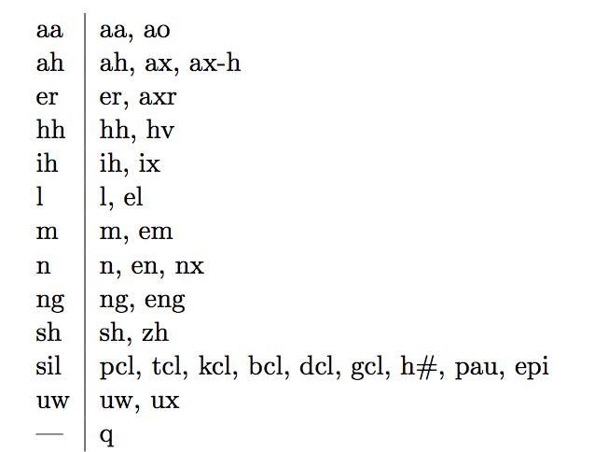
Related Work
Evaluation metrics
We used accuracy as evaluation metrics
Standard approach in the industry is to convert 61 phoneme classes into 39 phoneme classes by grouping similar sounding phonemes together

Slide 6
Related Work
Results
All the results are averaged over 5 repeats, each 100 epochs
Type of network | Accuracy over 39 classes | Accuracy over 61 classes
DNN – 2 hidden layers | 44.73 | 33.89
DNN – 3 hidden layers | 48.75 | 38.05
DNN – 4 hidden layers | 53.74 | 42.65
LSTM | 52.31 | 44.04

Slide 7
Related Work
Conclusion and Future work
Conclusion
DNN performed better with more number of hidden layers
DNN with more number of layers performed as good as RNN-LSTM
Classifying phonemes are harder without grouping
Future work
Use stacked DNN and implement RBM, by using current DNN for pretraining
Send phoneme to Viterbi decoder and see how effectively we can predict words with probability of phonemes along the time dimension. This would be challenging as state of the art system are only around 80% accurate with grouped phonemes.

Slide 8
Thank You!

