Slide 1
Image Description Generation
CSCI-B659 Vision for Intelligent Robotics (Fall 2016)
Roshan Kathawate

Slide 2
Overview
Overview
Introduction
Proposed Approach
Data
Standard RNN Architecture
LSTM Architecture
Experiments
Results
Conclusion and Future Work

Slide 3
Introduction
Introduction
How to generate natural language descriptions of images?
How to combine convolutional neural nets and recurrent nets to implement an image captioning system?
Performance comparison of simple RNN and LSTM-RNN

Slide 4
Proposed Approach
Proposed Approach
Micosoft COCO dataset
Used extracted features from the fc7 layer of the VGG-16 network pretrained on ImageNet.
Word Embedding for a language model where each word of the vocabulary will be associated with a vector, and these vectors will be learned jointly with the rest of the system.
Softmax loss function to compute loss and gradient at each timestep.
Implementation using Python and NumPy

Slide 5
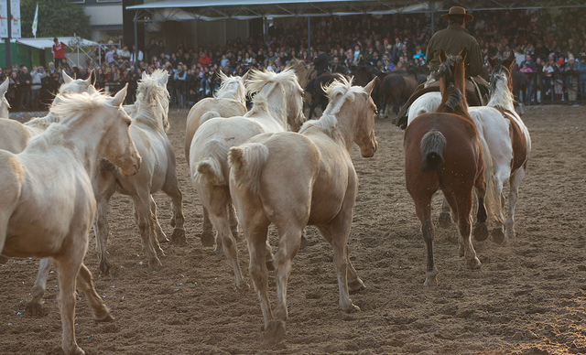
Data
Data
Microsoft COCO
  The dataset consists of 80,000 training images and 40,000 validation images, each annotated with 5 captions written by workers on Amazon Mechanical Turk.
<START> a herd of horses running across an <UNK> <END>

Slide 6
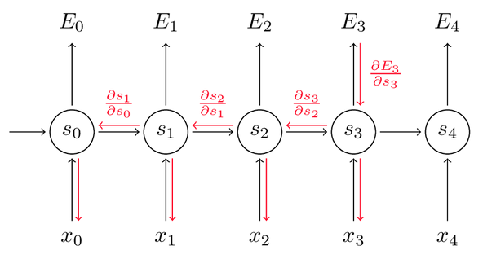



Standard RNN
Standard RNN
Forword Propogation:
  S_t = tanh(UX_t + WS_t-1 + b)
  Y_p = softmax(VS_t)
  C =
Back Propogation:

Slide 7
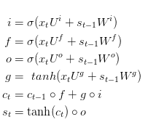
LSTM RNN
LSTM-RNN
Forword Propogation:

Slide 8

Evaluation Metric
Evaluation Metric
BLEU:
N-gram overlap between machine translation output and reference translation
_x000f_Compute precision for n-grams of size 1 to 4
_x000f_Add brevity penalty (for too short translations)
Typically computed over the entire corpus, not single sentence

Slide 9
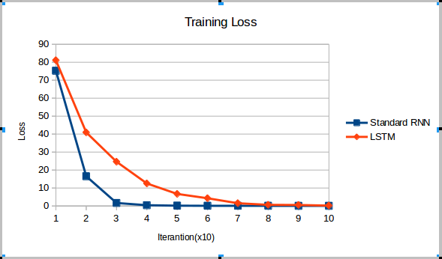
Results
Results

Slide 10
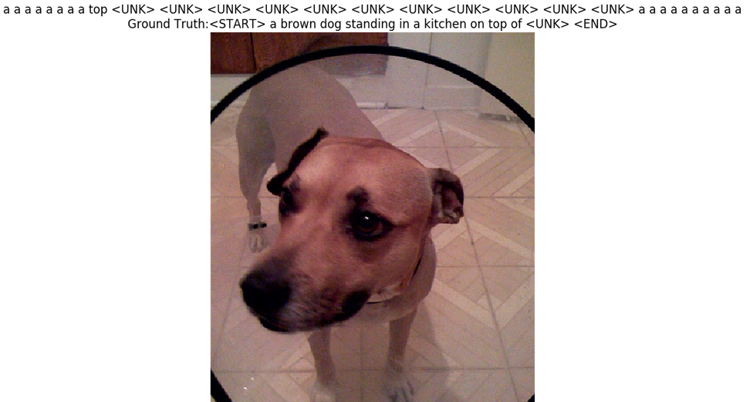
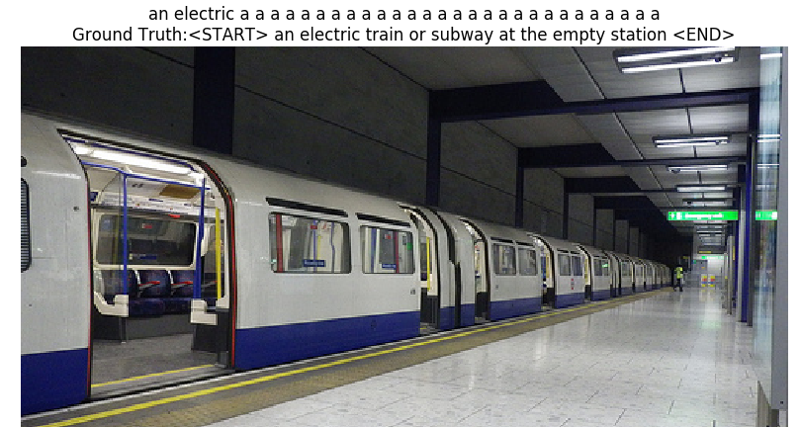
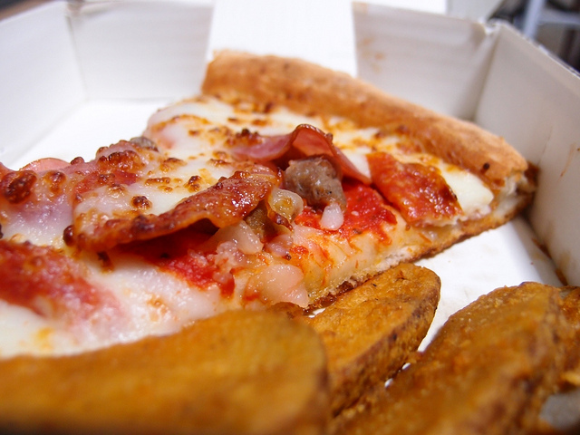
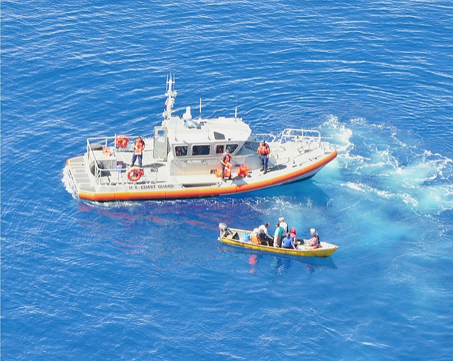
Results
Results

Slide 11
References
References:
http://cs.stanford.edu/people/karpathy/cvpr2015.pdf
http://deeplearning.cs.cmu.edu/pdfs/Hochreiter97_lstm.pdf
http://colah.github.io/posts/2015-08-Understanding-LSTMs/
http://cs231n.github.io/convolutional-networks/
http://neuralnetworksanddeeplearning.com/

Slide 12
Thank You!

