Slide 1
Datathon
Visualization of 2074 election data of Gandaki
Roshan Kc and Rajan devkota 15/08/2079

Slide 2
Flow
Dataset acquisition
Dataset merging
Outlier identification and correction
Data plotting
Data visualization

Slide 3
Data merging
Category:
Central
State
Removed grabage files like .DS_Store, .ipynb
get_files
Parent directory
List type containing all files
Different district of same category of data is merged

Slide 4
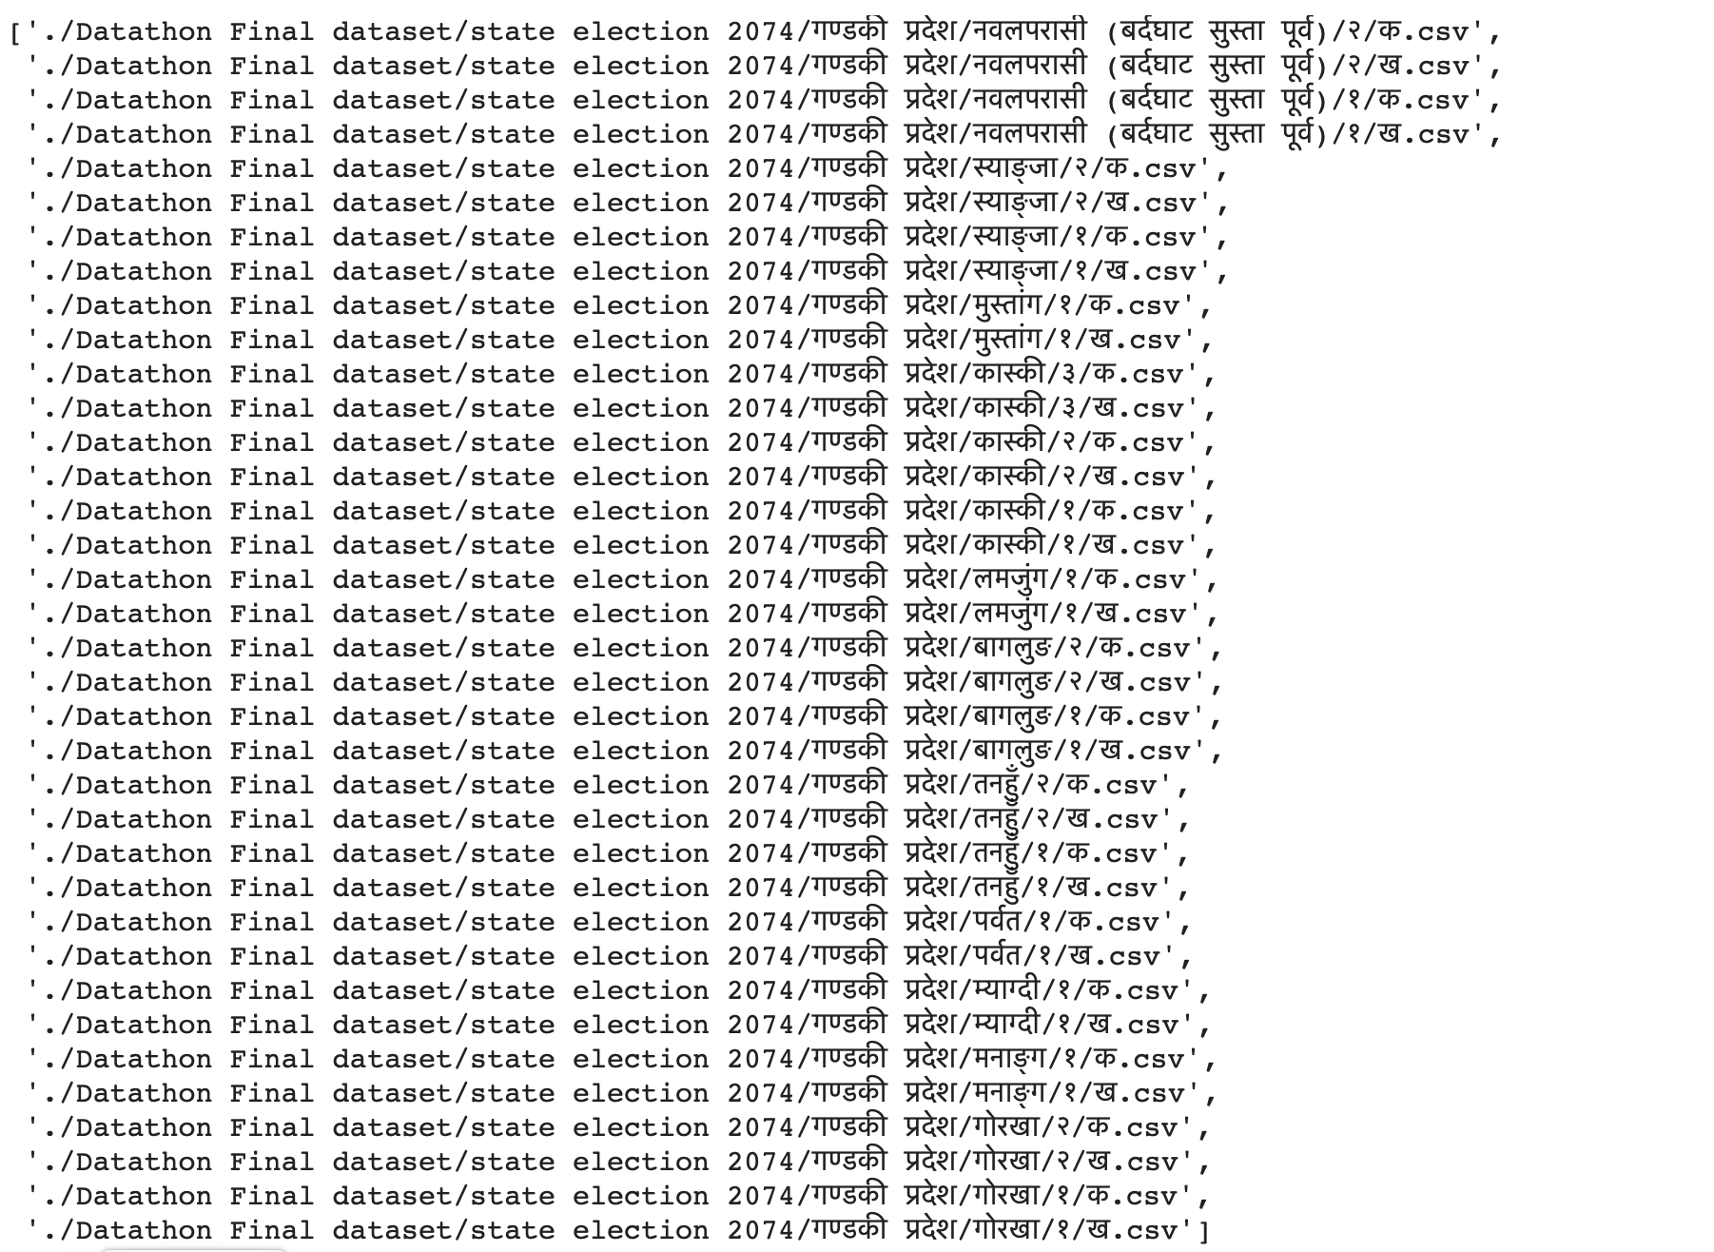

Slide 5
Outliers
Age out of range
Replaced with mean
One unknown district बहर
removed
Unknown party
Wrc दल, wrc sangathan
Removed
Unknown district

Slide 6
Data plotting
Count plot
Histogram
KDE plot

Slide 7
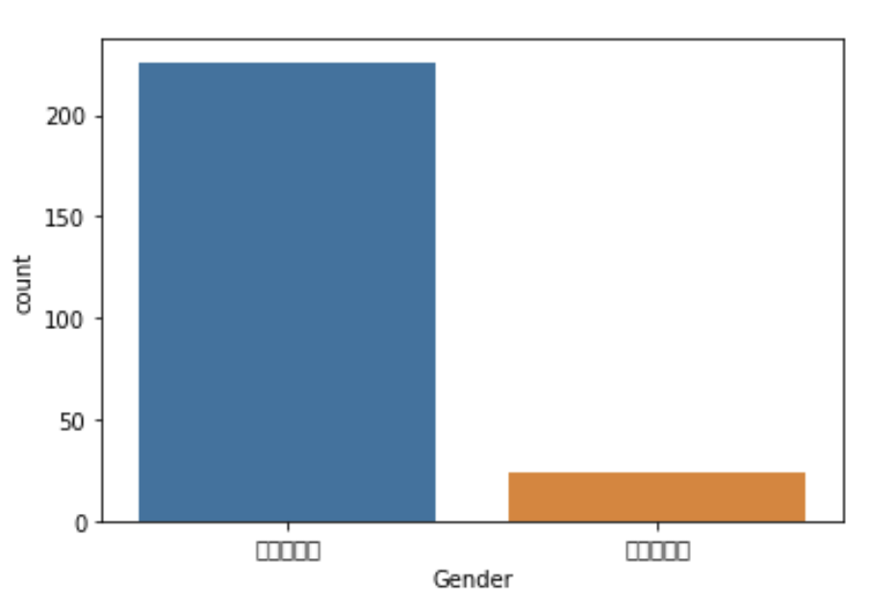
Data visualization
Count plot
Central
State

Slide 8
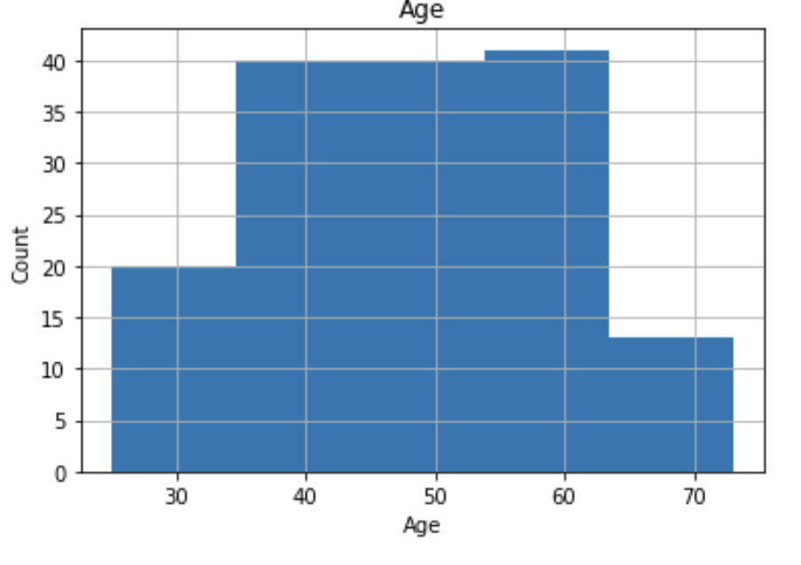
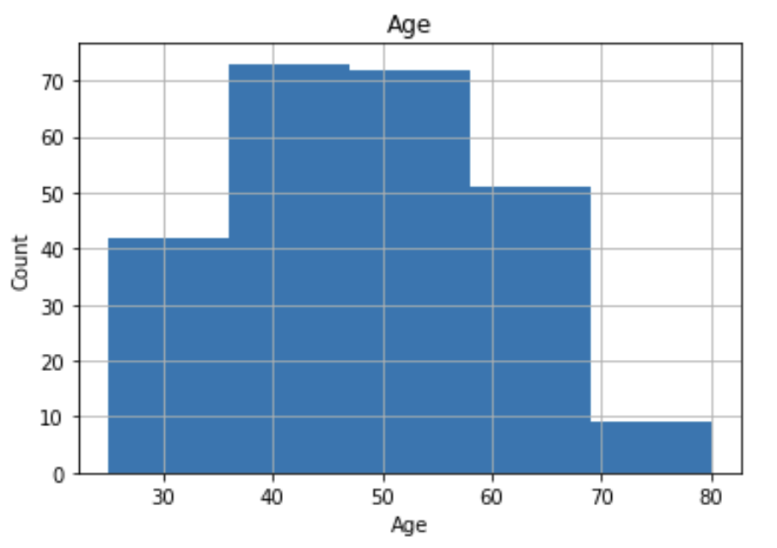
Data visualization
Histogram
Central
State

Slide 9
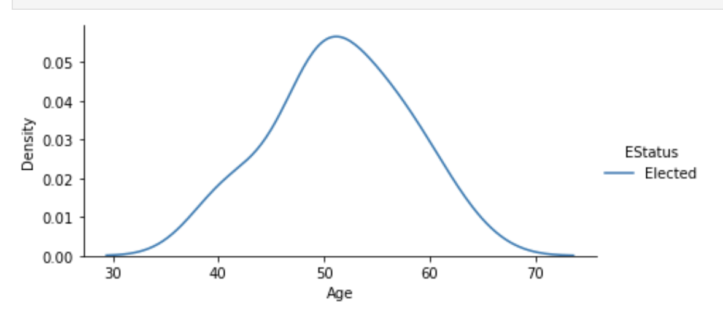
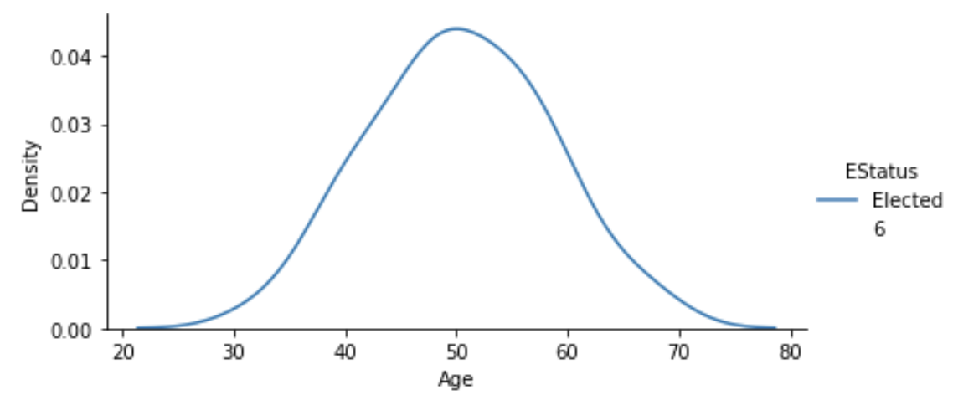
Data visualization
KDE
State
Central

