Slide 1

DEPARTMENT OF COMPUTER SCIENCE AND ENGINEERING
Professional Training - 1
SMART ATTENDANCE SYSTEM
PROJECT STUDENT GUIDE
Roshan KR, 42111086 Dr.B.Ankayarkanni,M.E.,P.H.D., Professor,CSE

Slide 2
AGENDA
Certificate
Introduction
Abstract
Objective
System Architecture / Ideation Map
Module Implementation
Results and Discussions
Conclusion
References

Slide 3

COURSE CERTIFICATE

Slide 4
INTRODUCTION
We are going to make an Artificial Intelligence-based face recognition system that can have a high impact on different organizations. The uniqueness or independence of an individual is his face. By considering this fact our system will be super faster and accurate in marking the attendance of individual students. We are going to use face detection and recognition in this project. Face detection is used to locate the position of face region and face recognition is used for marking the attendance. The database will store the faces of students. when the face of the student matches with one of the faces stored in the database then the attendance is recorded.
PROJECT PERSPECTIVE
We aim to improve and organize the process of tracking and managing the attendance of students and faculties in colleges.
Reduce manual process errors by providing an automated and reliable attendance system that uses face recognition technology.
Updating the time of attendance when a face is detected again

Slide 5
INTRODUCTION
ADVANTAGES
The system stores the faces that are detected and automatically marks attendance.
Convenient.
Manipulate and recognize the faces in real-time using live video data.
Multiple face detection.
Multipurpose software.
Can be used in different places, like classrooms, offices, etc.

Slide 6
ABSTRACT
Algorithm Used: Haar Cascade Frontal Face Algorithm is used for face detection.
Real-Time Detection: The system detects human faces in real-time.
Dataset Creation: It captures images of individuals' faces to create a dataset for model training.
Stored Dataset: The dataset is stored for future reference to identify individuals.
Live Video Feed: The system cross-checks faces from a live feed with the stored dataset.
Automated Logging: Identified individuals' names, along with time and date, are logged into an Excel file.
Fully Automated: The process eliminates manual attendance methods like sign-in sheets or roll calls.
Time and Error Efficiency: It streamlines attendance tracking, saving time and reducing errors.
Data Analysis with Pandas: Attendance data can be loaded and analyzed using Python’s Pandas library.
Attendance Analytics: Example commands like df.groupby('Name').count() allow analysis of attendance patterns.

Slide 7
OBJECTIVE
Here are some key objectives for a smart attendance system using face recognition:
Automated Attendance Tracking: To streamline the attendance process by automatically recording student or employee attendance through facial recognition, reducing manual effort and errors.
Real-time Monitoring: To provide real-time attendance updates, allowing instructors or managers to monitor attendance as it happens.
Enhanced Security: To improve security by ensuring that only authorized individuals are recognized and marked present, thereby preventing proxy attendance.
User-Friendly Interface: To develop an intuitive user interface that makes it easy for users to interact with the system, view attendance records, and generate reports.
Data Management and Analytics: To implement features for storing and analyzing attendance data, enabling insights into attendance patterns and trends over time.
Integration with Existing Systems: To ensure compatibility and integration with existing educational or organizational management systems for seamless data exchange.
Scalability: To design the system to be scalable, accommodating a growing number of users and evolving requirements.
Privacy and Compliance: To prioritize user privacy and ensure compliance with relevant data protection regulations while handling biometric data.
Multi-Factor Authentication: To enhance verification processes by combining facial recognition with other forms of authentication, if necessary, for increased accuracy.
Accessibility: To ensure the system is accessible to all users, including those with disabilities, and to support multiple languages if needed.

Slide 8
LITERATURE SURVEY
Paper & Authors | Algorithm/ Technique Used | Application | Features | Challenges | Outcomes
Face Recognition Based Attendance Marking System by K. Senthamil Selvi, P. Chitrakala | Principal Component Analysis (PCA) | Real-time face recognition | High accuracy; Camera captures images and sends them to an enhancement module; Attendance stored on the server | None mentioned | Saves time and improves attendance monitoring compared to traditional methods
Face Recognition Based Student Attendance System with OpenCV by CH. Vinod Kumar | Eigen Object Detector Algorithm, Haar Cascades | Classroom attendance | Uses HD camera; Detects and recognizes individuals in a fixed area | Requires proper setup with fixed camera; Limited by lighting conditions | Automates attendance marking accurately

Slide 9
LITERATURE SURVEY
Paper & Authors | Algorithm/ Technique Used | Application | Features | Challenges | Outcomes
Smart Attendance Monitoring System by Sudhir Bussa, Shruti Bharuka, Ananya Mani, Sakshi Kaushik | Holistic matching, Feature extraction, Hybrid techniques | Student attendance management | Works with a single grayscale image; Portable device for tracking attendance | Frame rate may be limited; Integrates with other data sources | Provides reliable and convenient attendance management
Smart Attendance System using OpenCV based on Facial Recognition by Sudhir Bussa, Ananya Mani | LBPH Algorithm, OpenCV | Automated attendance | Detects, encodes, and marks attendance in a spreadsheet and PDF; | Requires high-quality training images | Automates attendance without user involvement

Slide 10
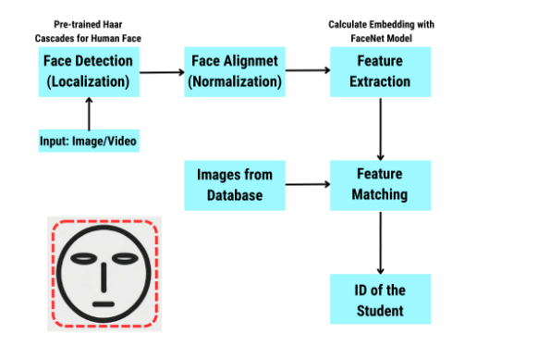
SYSTEM ARCHITECTURE / IDEATION MAP

Slide 11
MODULE IMPLEMENTATION
Face detection model:
Algorithm: use haar cascade frontal face algorithm for face detection
Functionality: 1) captures real time images using webcam
2) detects and extracts facial region to create an dataset for each student
Face recognition module:
Algorithm: utilized LBPH(local binary pattern histogram) or CNN-based models
Functionality: 1) compares the detected face with pre stored facial datasets
2) identifies the student by matching facial features
Attendance logging module:
Functionality: once the student is recognized, their name, date and time is logged
stores attendance in an excel or csv file for future reference
Database management module:
Functionality: maintains a dataset of all student image
stores information like name and roll no
integrates with sql database for scalability

Slide 12
RESULTS AND DISCUSSIONS
This system is capable of detecting the faces from the captured image from HD Video to investigate and discover the face. Face detection determines when a picture, a face is found and it's being done by scanning the various image scales and extracting the precise patterns to discover the face. The entire range of pictures saved within the folder can actuate the numeric attendance throughout the class. The images within the folder are going to be matched by the recognition part to faces already held on and trained on the database images. In future work, we need to improve face detection effectiveness with the help of the interaction among our system, the scholars, and the faculty. On the other hand, our system is improved by desegregation video-streaming service and lecture archiving system, to give additional profound applications in the field of distance education, course management system (CMS), and support for college development (FD).
We will improve this technique thus as we tend to run this system with additional than two students on a bench and permitting them to vary their positions.
● Can improve security by adding administrator login.
● Can use Neural Network for high accuracy.
● Can be used in a big factory or employee attendance.
● Can build on a fully web-based system.

Slide 13
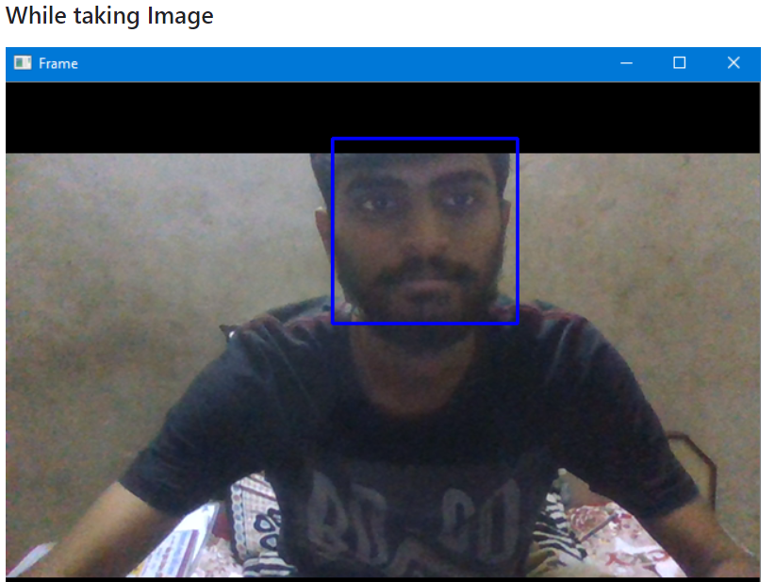
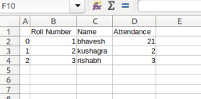
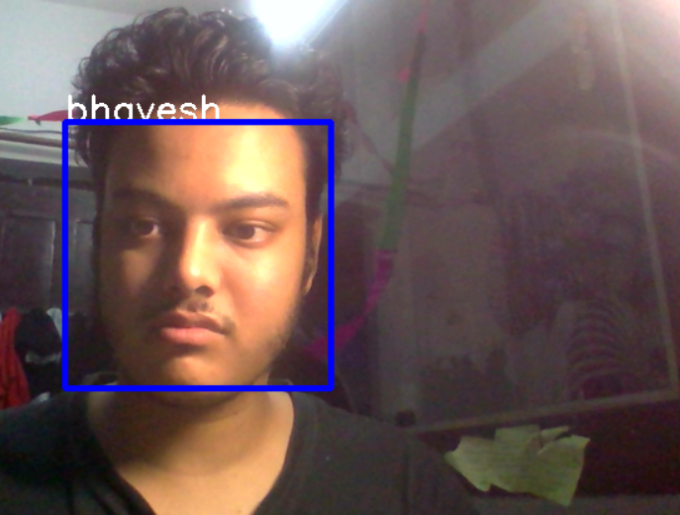
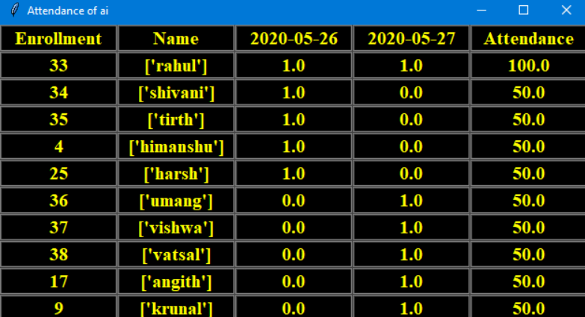
RESULTS AND DISCUSSIONS

Slide 14
CONCLUSION
Project Overview and Findings:
Development and Testing:
Complete system developed from initial requirements to testing.
Achieved project goals and objectives.
Analysis and Methodology:
Further analysis needed for intrinsic project evaluation.
Combining various methods may yield improved results.
Face Recognition Challenges:
Small class size impacted recognition accuracy.
Image size critical; pixel precision affects recognition success.
Attendance Mechanism:
System centers eyes and mouth for effective face recognition.
Login functionality to ensure security and data confidentiality.
Ethical Considerations:
Compliance with laws regarding data protection and privacy.
Consent required for using images for attendance purposes.

Slide 15
REFERENCES
Deshmukh, B.J., & Sudhir, M.K. (2014). Efficient attendance management: a face recognition approach. International Journal of Advanced Engineering and Technology, 7(3), 974.
Baskar, J., Karthik, S., & Jithin, S. (2020). Facial recognition for attendance and management. International Journal of Recent Technology and Engineering, 8(6), 1431-1435.
Husein, N.A., & Abbas, A.M. (2019). A novel approach to facial recognition in attendance systems. Journal of Computer Science and Technology, 34(4), 790-799.
Ramasamy, M., & Muthusamy, R. (2021). Smart attendance management system using face recognition and IoT. International Journal of Computer Applications, 175(18), 20-26.
Sahu, A.K., & Gupta, P. (2021). Implementation of smart attendance management system using face recognition. Journal of King Saud University - Computer and Information Sciences. DOI: 10.1016/j.jksuci.2021.03.009.
.

Slide 16
REFERENCES
Bhatti, K.L., & Jilani, M.F. (2018). Smart attendance system using facial recognition and deep learning. EAI Endorsed Transactions on Creative Technologies, 5(17), e4.
Rani, A., & Chaurasia, V. (2021). Real-time face recognition for attendance system. International Journal of Advanced Computer Science and Applications, 12(5), 139-143.
Jain, P., & Kumar, A. (2020). Face detection and recognition based attendance management system. International Journal of Recent Technology and Engineering, 9(3), 25-29.
Singh, V., & Kumar, M. (2020). Automatic attendance management using face recognition. International Journal of Engineering Research and Technology, 9(4), 57-61.
Verma, P., & Gupta, S. (2021). Face recognition-based attendance system for classrooms. International Journal of Computer Applications, 177(26), 17-22.

Slide 17
THANK YOU
We thank God, Our Department, Guide, Panel Members, Supportive Professors and all Technical and non Technical staff who helped us in our Project.

