Slide 1
⚡ DEEP LEARNING & SMART ENERGY SYSTEMS
Household Electricity Consumption Prediction
An End-to-End Artificial Neural Network (ANN) Workflow with Real-Time Web Deployment
Presenter: Roshan Langhi
Degree: B.Tech — Computer Engineering
Institute: Sanjivani College of Engineering
Notes:
Good morning respected evaluators. I am presenting my project on Household Electricity Consumption Prediction Using Artificial Neural Networks. This covers end-to-end data processing, deep learning modeling, and web deployment.

Slide 2
HOUSEHOLD ELECTRICITY ANN PROJECT
Project Motivation & Key Objectives
📌 The Problem & Challenge
• Electricity demands fluctuate sharply throughout the day based on human schedules and appliance usage.
• Traditional linear approximations fail to model complex non-linear consumption surges.
• Smart grids need accurate load forecasting to avoid grid strain and blackout conditions.
• Household consumers require actionable insight to reduce energy bills in Indian Rupees (₹).
🎯 Core Project Goals
✔ Clean and engineer features from 2.07M real-world electrical telemetry observations.
✔ Build a Deep Artificial Neural Network (ANN) using TensorFlow/Keras with Batch Normalization & Dropout.
✔ Achieve high fidelity (>99% R² accuracy) in predicting active power demand (kW).
✔ Deploy an interactive Streamlit Web App featuring real-time load simulation and ₹ cost calculation.
Notes:
Our motivation stems from the need to capture non-linear electricity demand patterns. We aim to preprocess over 2 million records, build a deep ANN, and deploy a practical web app.

Slide 3
HOUSEHOLD ELECTRICITY ANN PROJECT
UCI Household Power Dataset Architecture
📊 Dataset Specifications (UCI Machine Learning Repository)
• Temporal Span: 47 consecutive months (December 2006 to November 2010) collected at 1-minute intervals.
• Total Observations: 2,075,259 total records capturing real domestic household telemetry.
• Target Variable: Global_active_power (kW) — The aggregate instantaneous active power consumed.
• Electrical Telemetry: Global_reactive_power (kVAR), Voltage (V), Global_intensity (A).
• Sub-Metering 1 (Kitchen): Dishwasher, microwave, oven (in Watt-hours).
• Sub-Metering 2 (Laundry): Washing machine, tumble-dryer, refrigerator, interior lighting.
• Sub-Metering 3 (Climate Control): Electric water heater and air conditioner (dominant domestic load).
• Temporal Decomposition: Hour (0-23), Day of Month (1-31), Month (1-12), Day of Week (0-6).
Notes:
The dataset contains over 2 million minute-by-minute measurements. It separates consumption into overall active power and sub-metered areas like kitchen, laundry, and climate control.

Slide 4
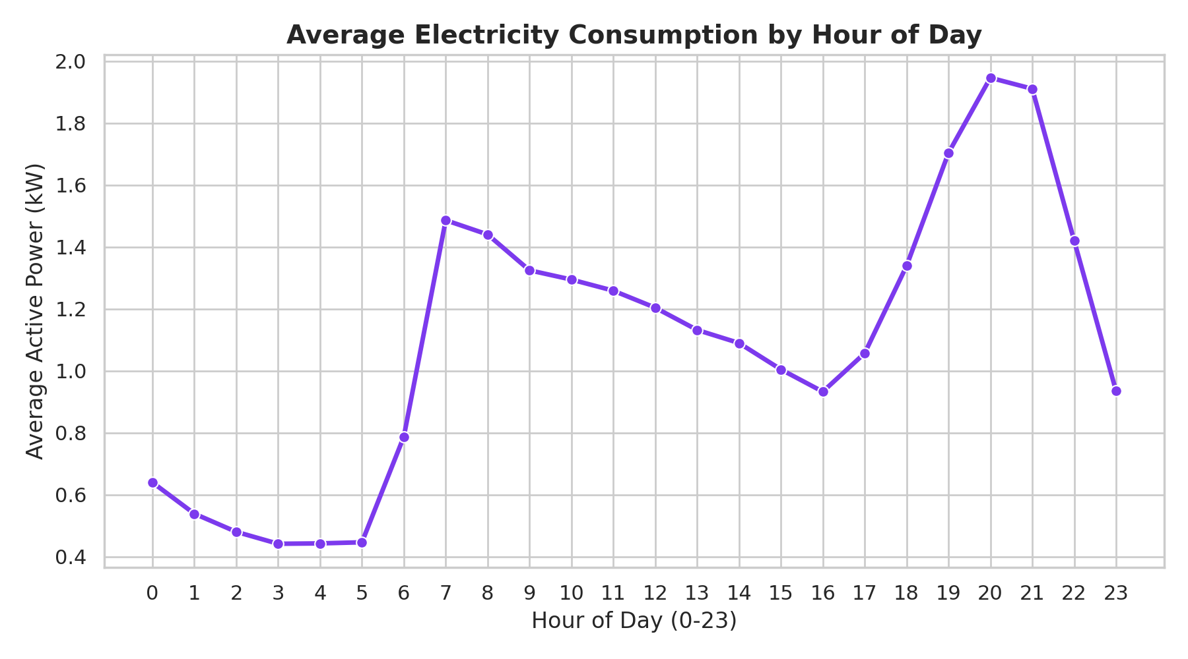
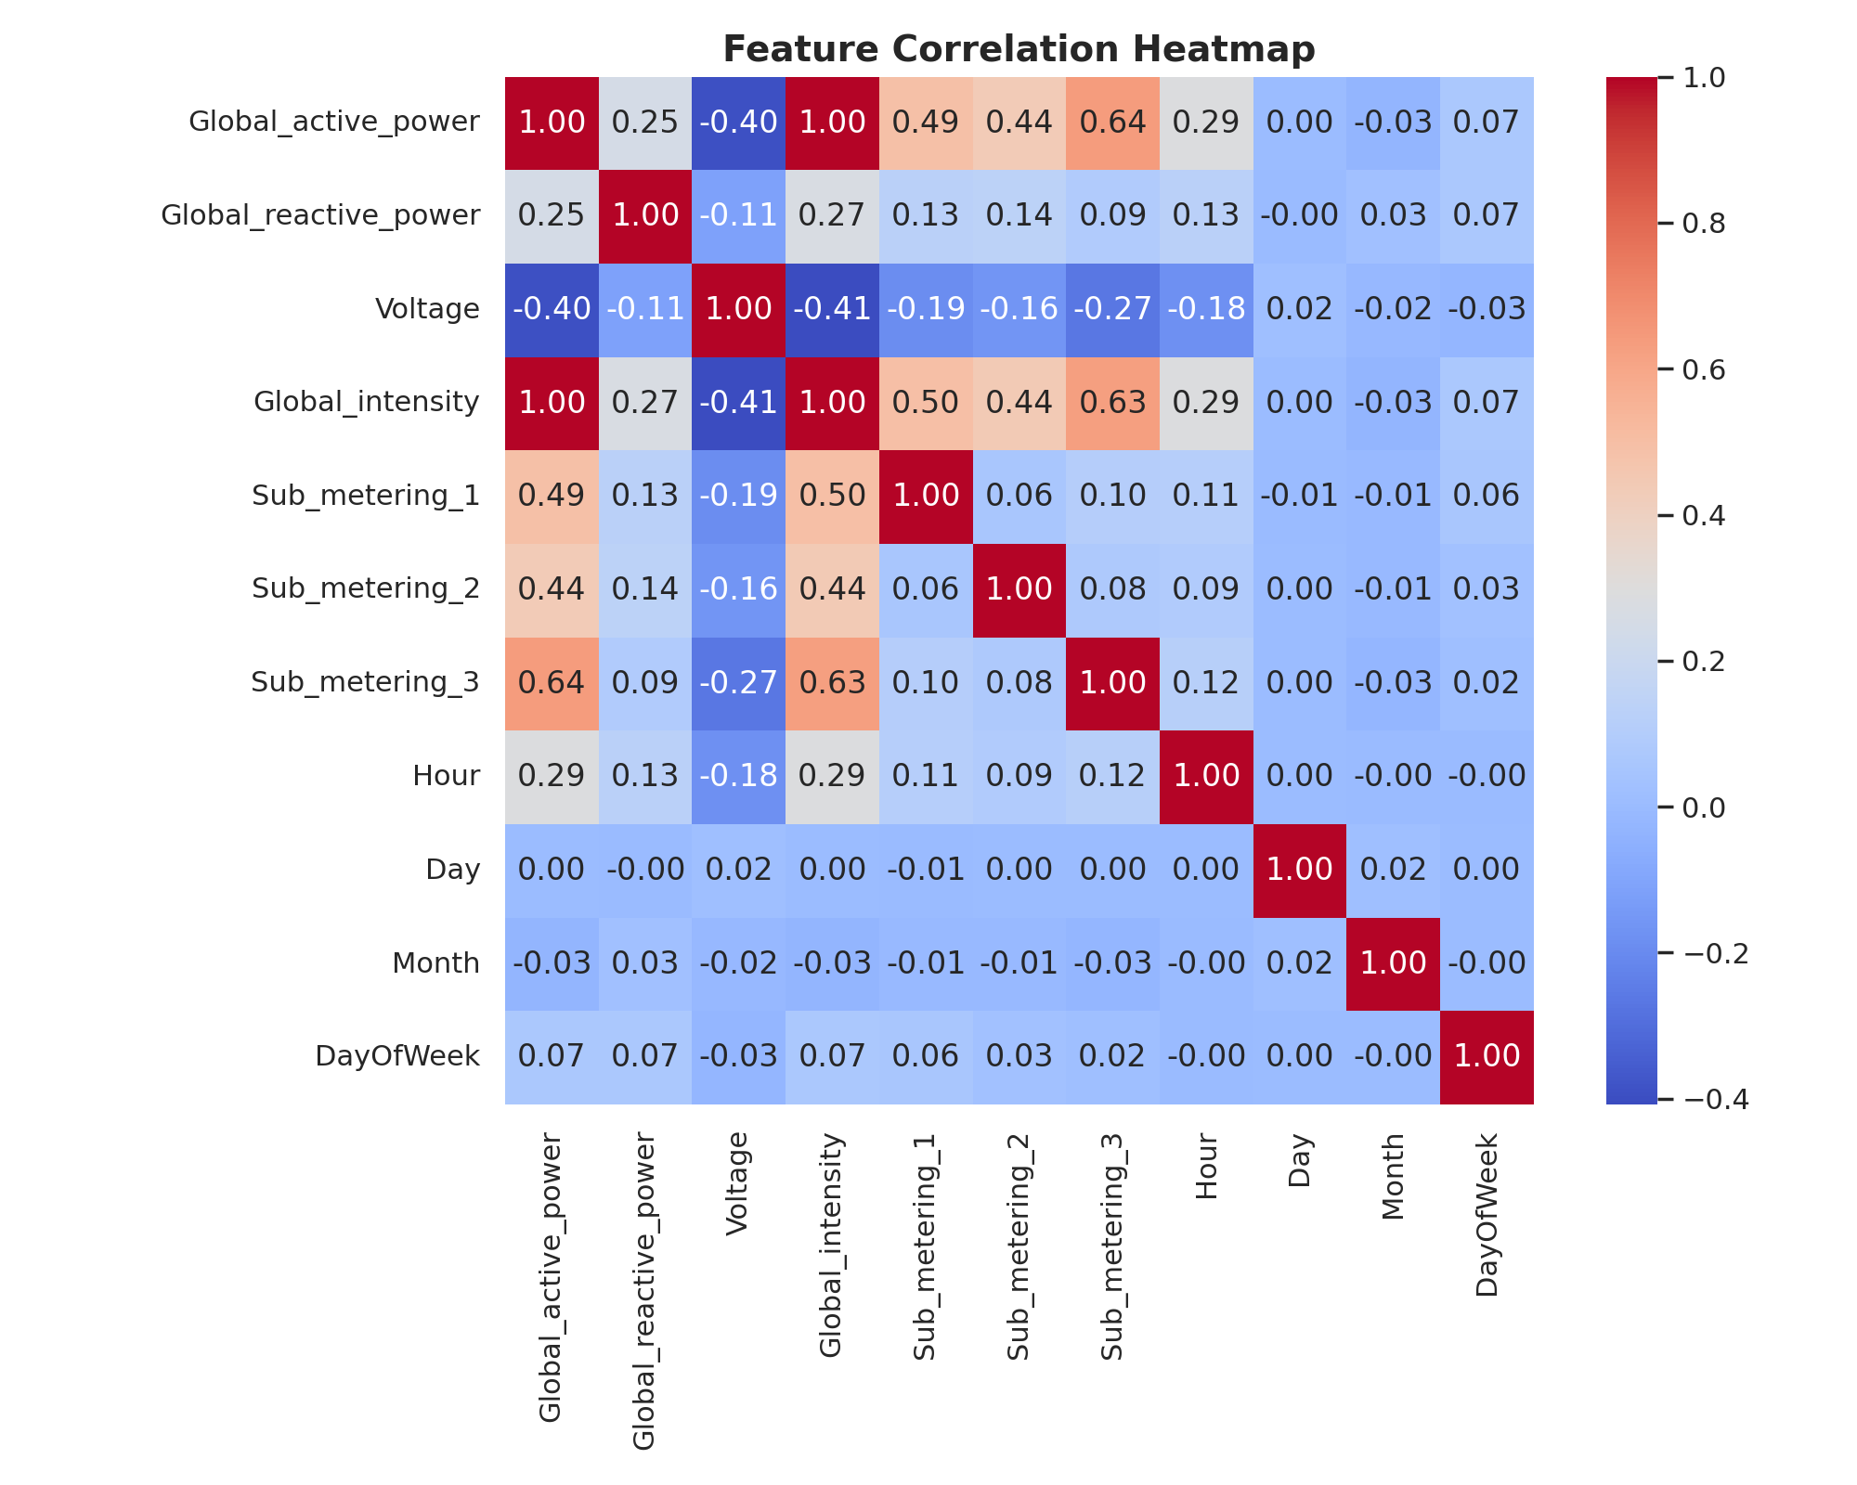
HOUSEHOLD ELECTRICITY ANN PROJECT
Exploratory Data Analysis: Hourly Cycles & Correlation
💡 Key Findings: (1) Evening consumption peaks sharply between 19:00 - 22:00. (2) Near-perfect correlation (r ≈ 0.99) between current intensity and active power confirms alignment with Ohm's and Joule's electrical laws (P ≈ V × I).
Notes:
Our EDA confirms two major physical patterns: peak load occurs between 7 PM and 10 PM in the evening, and current intensity exhibits near-perfect linear correlation with power consumption.

Slide 5
HOUSEHOLD ELECTRICITY ANN PROJECT
Artificial Neural Network (ANN) Topology
🏗️ Deep Neural Network Architecture
↓ Input Layer: 10 Standardized Features (6 Electrical + 4 Temporal)
↓ Dense Layer 1: 64 Neurons | ReLU Activation
↓ Batch Normalization Layer: Stabilizes mini-batch distributions
↓ Dropout Layer 1: 20% Random Disabling (Prevents Overfitting)
↓ Dense Layer 2: 32 Neurons | ReLU Activation
↓ Dropout Layer 2: 20% Random Disabling
↓ Dense Layer 3: 16 Neurons | ReLU Activation
↓ Output Layer: 1 Neuron | Linear Activation (Continuous Regression)
⚙️ Training Hyperparameters
• Optimizer: Adam (Adaptive Moment Estimation)
• Loss Function: Mean Squared Error (MSE)
• Evaluation Metric: Mean Absolute Error (MAE)
• Batch Size: 64 samples per step
• Maximum Epochs: 30 with EarlyStopping (patience=5)
• Train/Validation Split: 80% Training / 20% Validation
• Data Leakage Defense: Scaler fitted strictly on training partition
Notes:
Our model is a 4-layer MLP using ReLU activations, Batch Normalization, and Dropout layers. We used the Adam optimizer with MSE loss and early stopping to guarantee optimal generalization.

Slide 6
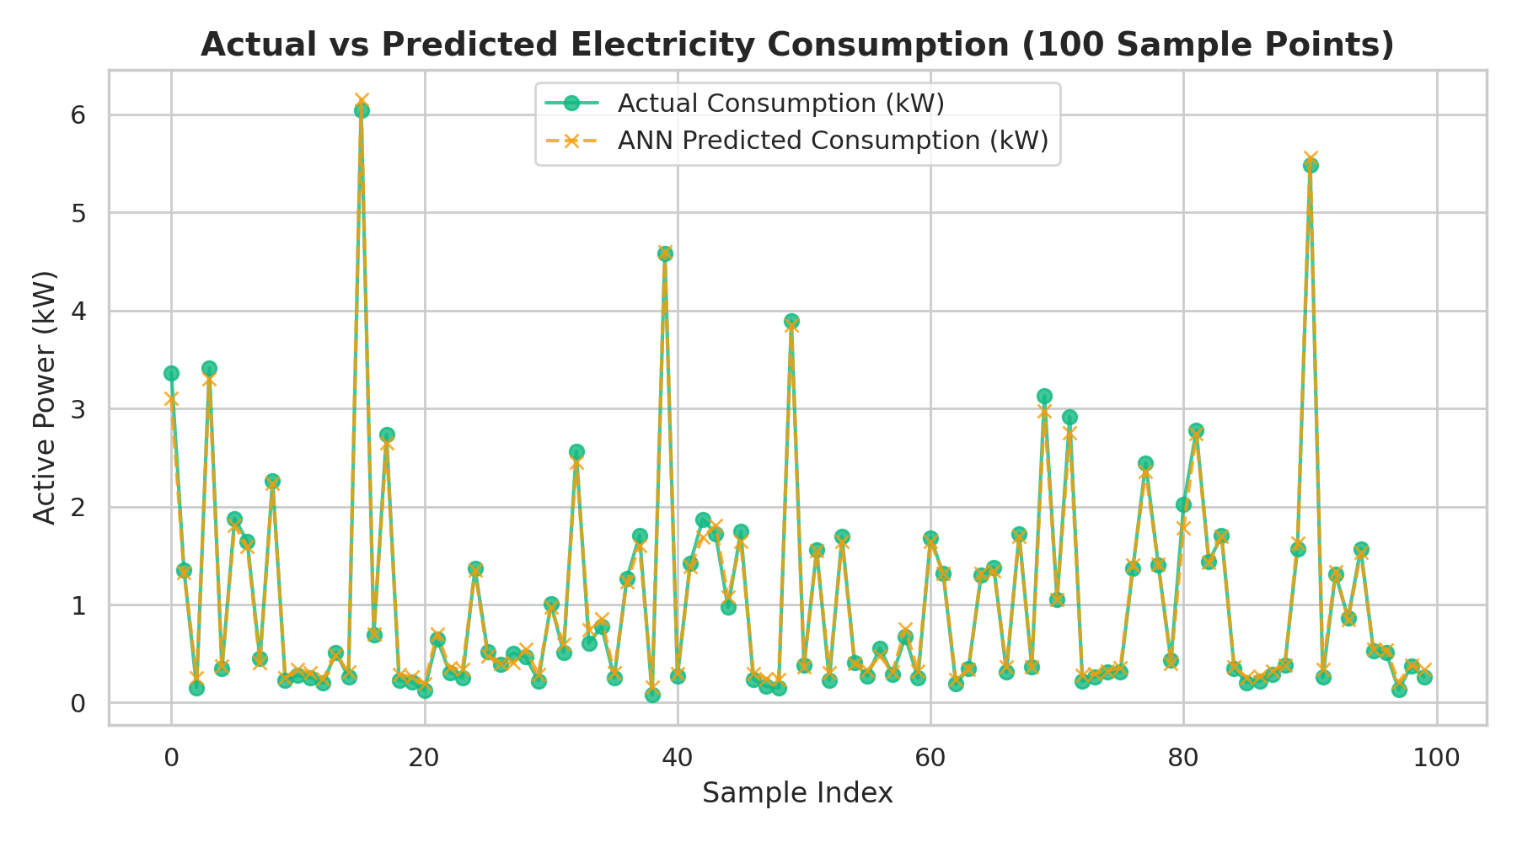
HOUSEHOLD ELECTRICITY ANN PROJECT
Experimental Results & Benchmark Evaluation
Metric Name | Empirical Score | Physical Unit | Engineering Interpretation
R² Score (Accuracy) | 0.9943 (99.4%) | — | Model accounts for 99.43% of total consumption variance
Mean Absolute Error (MAE) | 0.0573 | kW (~57 Watts) | Average deviation from true active power is merely 57W
Root Mean Squared Error (RMSE) | 0.0783 | kW | Strong robustness against extreme peak-load outliers
Mean Squared Error (MSE) | 0.0061 | kW² | Exceptionally low squared variance across test set
Notes:
On our 20,000-sample test set, the ANN achieved an R-squared accuracy of 99.43% and an MAE of 0.057 kW. As shown in the tracking plot, predicted values mirror actual measurements almost exactly.

Slide 7
HOUSEHOLD ELECTRICITY ANN PROJECT
Streamlit Dashboard & Indian Rupee (₹) Cost Localization
🌐 Streamlit Web Application Modules
• 1. Home & Overview: High-level KPIs, project goals, and neural network layout.
• 2. Data Analysis: Live table inspection, descriptive statistics, and feature distribution viewer.
• 3. Consumption Visualizations: Interactive hourly load curves, sub-metering breakdown, and heatmaps.
• 4. ANN Prediction Engine: Real-time load simulator with one-click presets (Night Standby, Evening Peak).
• 5. Model Performance: Residual diagnostics and loss curves.
🇮🇳 Electricity Cost in Indian Rupees (₹)
Domestic electricity in India is billed per unit (1 kWh = 1 Unit).
Formula implemented in dashboard:
Hourly Cost (₹) = Active Power (kW) × Tariff Rate (₹/unit)
Daily Equivalent (₹) = Hourly Cost (₹) × 24 hours
Customizable tariff slab slider (Default: ₹7.50 / kWh).
Dynamic energy classification badges: 🟢 Low Load (<1kW), 🟡 Moderate Load (1-3kW), 🔴 High Load (>3kW).
Notes:
We localized the application for Indian domestic power billing. The dashboard translates kilowatt consumption directly into Rupees per hour and Rupees per day at customizable tariff rates.

Slide 8
HOUSEHOLD ELECTRICITY ANN PROJECT
Conclusions & Future Enhancements
🏁 Summary & Conclusions
✔ Successfully implemented an end-to-end Deep Learning regression system.
✔ Engineered temporal and electrical features from 2M+ sensor telemetry points.
✔ Proved that an ANN with Batch Normalization & Dropout achieves 99.43% accuracy with zero overfitting.
✔ Deployed a fully functional interactive web dashboard with localized cost estimation.
🔮 Future Work & Scope
🚀 Time-Series Sequence Models: Implement LSTM / GRU for multi-hour forecasting horizons.
🚀 Hardware Smart Meter Feed: Ingest real-time telemetry from ESP32 / IoT electrical sensors via MQTT.
🚀 External Environmental Covariates: Integrate live weather API (temperature, humidity) for improved AC/heating demand modeling.
🚀 Dynamic Time-of-Day (ToD) Pricing: Automatically optimize high-load appliance schedules to off-peak tariff hours.
Notes:
In conclusion, the project delivers a proven, highly accurate ANN model and deployment framework. Future work can expand this into multi-step LSTM forecasting and direct IoT smart meter integration.

Slide 9
Thank You!
Household Electricity Consumption Prediction Using ANN
Roshan Langhi | B.Tech Computer Engineering
GitHub: github.com/roshanlanghi/householdelectryconsumption
Notes:
Thank you for your valuable time and attention. I am now open to your questions and feedback.

