Slide 1

Tumors that respond poorly to bevacizumab therapy show upregulation of angiogenesis genes in glioblastoma.
Roshan Lodha
Roshan Lodha, Graham Buchan, Gaelle Muller-Greven, Kunal Desai, Maha Qadan, Jill Barnholtz-Sloan, Paul A. Decker, Jann Sarkaria, and Candece L. Gladson

Slide 2
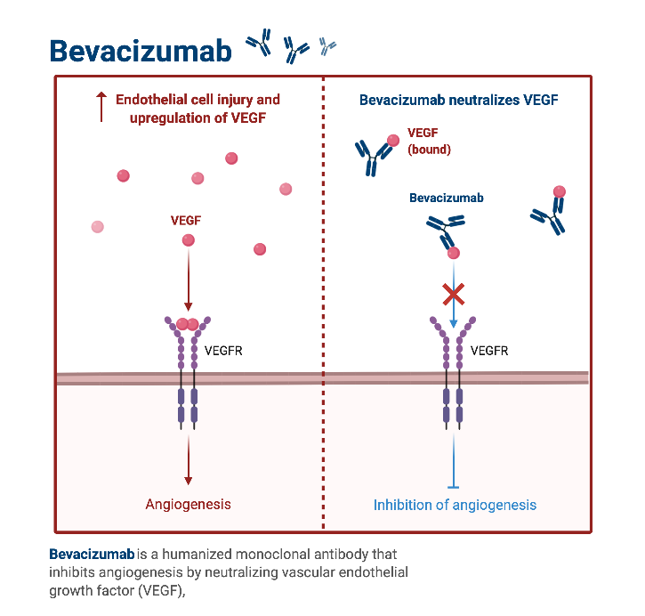
Background
Glioblastoma (GBM) is the most common primary brain tumor in adults and has an extremely poor prognosis.
Bevacizumab, the common treatment for recurrent-GBM, improves survival in only a fraction of patients, but improves quality of life.
Notes:
Glioblastoma (GBM) is the most common primary brain tumor in adults and has an extremely poor prognosis.
Even with surgical-resection and radio-chemotherapy the median survival is 15-months, and GBM has a recurrence rate of 90%.
Bevacizumab, the common treatment for recurrent-GBM, improves survival in only a fraction of patients, but improves quality of life. It works by binding vascular endothelial growth factor and preventing it from binding to its receptor, which prevents downstream angiogenesis, starving the tumor of nutrients and thus simultanouesly. Here we explored how response to poor responders to bevacizumab may delineate a distinct molecular phenotype of GBM.

Slide 3
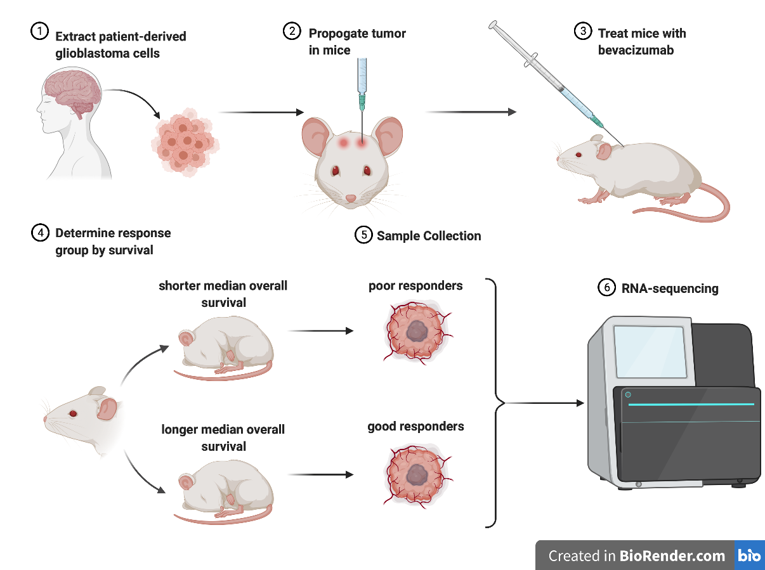
Biochemical Methods
Notes:
To find predictors of poor response to bevacizumab, we performed RNA-sequencing on multiple GBM patient-derived xenograft (PDX) tumors after orthotopic propagation in nude mice. The study was repeated, and once PDX-tumors were established, mice were treated with bevacizumab or vehicle until euthanasia. PDX-tumors were grouped based on their survival.

Slide 4
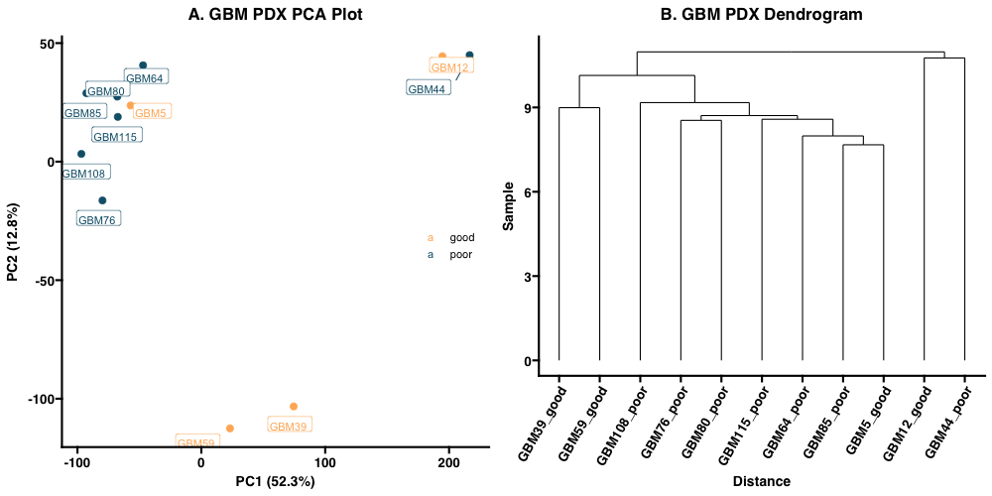
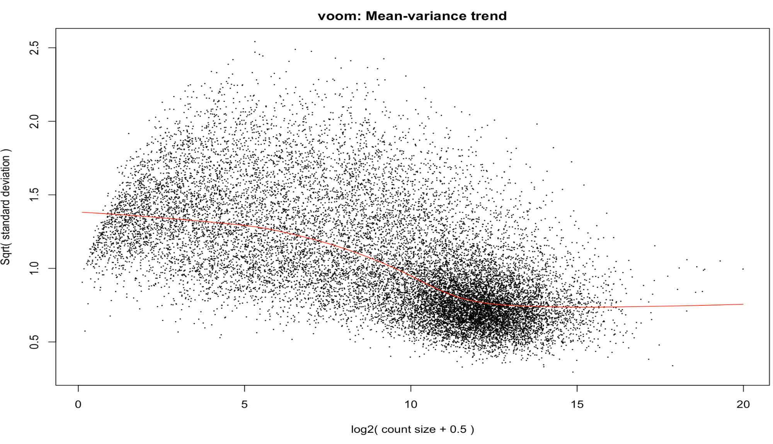
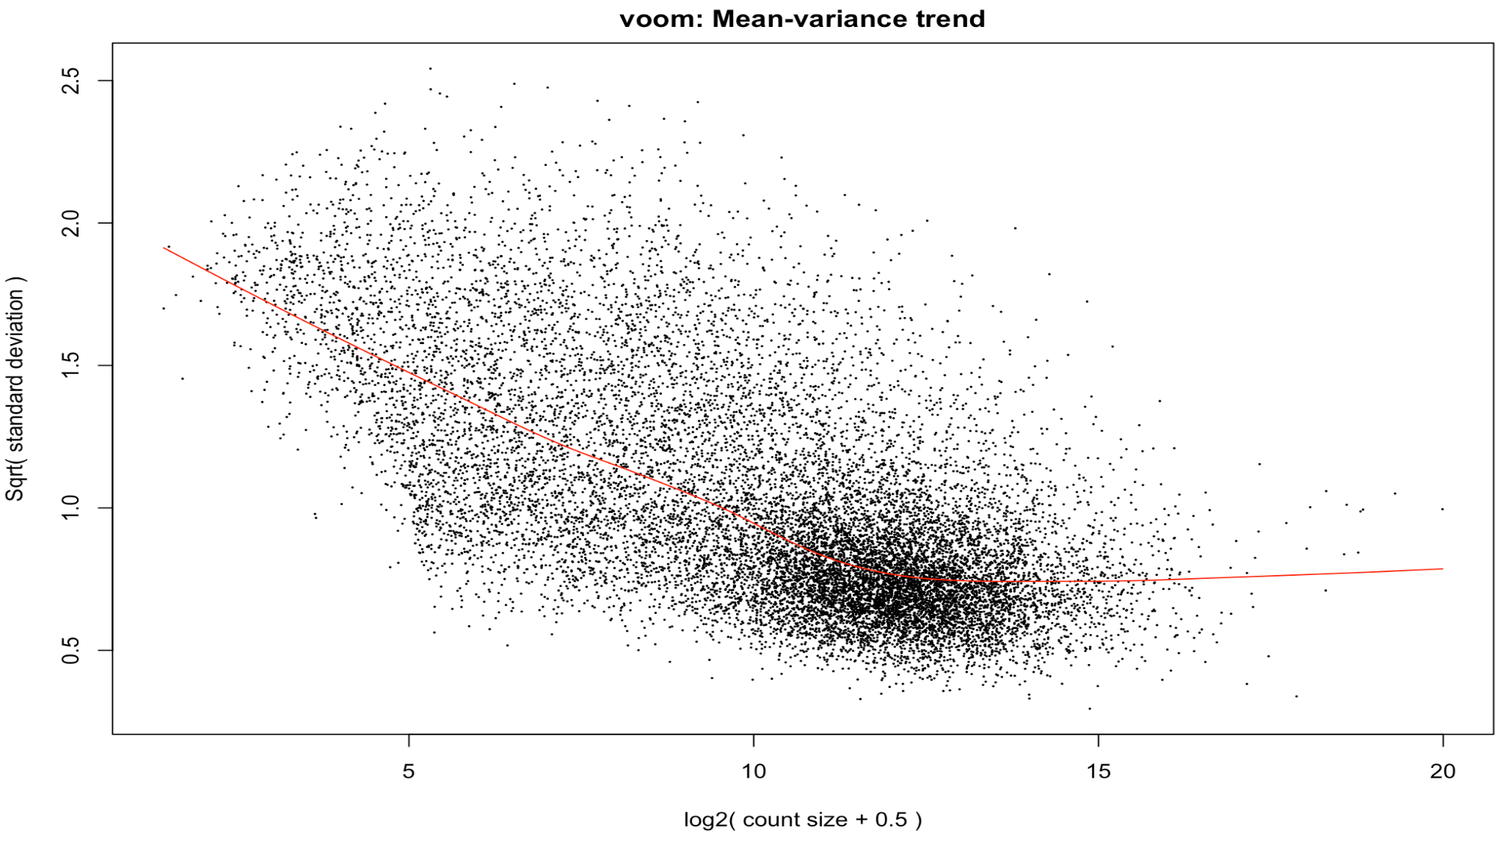
Computational Methods
In R, samples were clustered and outliers were removed using principal component analysis and hierarchical clustering.
Hyper-parameter optimization was carried out using mean-variance trends.
Differential gene expression and gene set enrichment analysis was done in R using DeSeq2 and GSEA.
Notes:
Following RNA-sequencing, the data were pulled into R. The data were cleaned using a combination of clustering (without normalization to preserve expression differences between sample) and hyperparameter optimization techniques. Finally, the DeSeq package was used for differential gene expression analysis while the GSEA package was used for gene set enrichment analysis. All p-values were corrected using the Bonferroni correction.

Slide 5
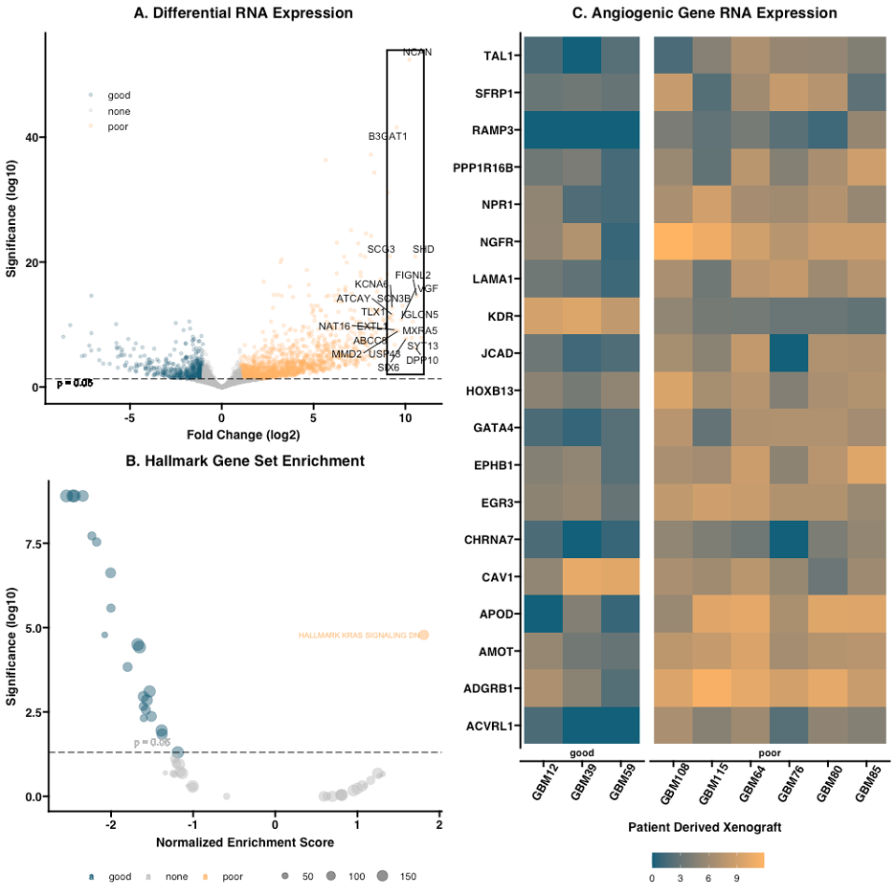
Differential gene expression in poor-responders to bevacizumab.
Volcano plot of differential gene expression. Log 2-fold change is plotted against negative log-scaled significance. Labeled points indicate the top 20 differentially expressed genes.
Hallmark gene set enrichment analysis of responders to bevacizumab. Normalized enrichment score is plotted against negative log-scaled significance. The KRAS signaling downregulation gene set is labeled.
Heatmap of log-scaled raw RNA-expression of differentially expressed genes regulating angiogenesis. Points in orange indicate higher overall expression while points in blue indicate lower overall expression.
Notes:
Our analysis demonstrated differential gene expression in poor responders to bevacizumab relative to good-responders along with upregulation of angiogenic genes. Within this gene set, multiple genes known to be regulated by the early growth response 1 (EGR1) transcription factor were identified; two were selected for further study based on their role in promoting cancer cell migration and proliferation, RAMP3 (accessory-receptor for adrenomedullin) and CHRNA7 (cholinergic-receptor-nicotinic-α7-subunit, or α7-nAChR).

Slide 6
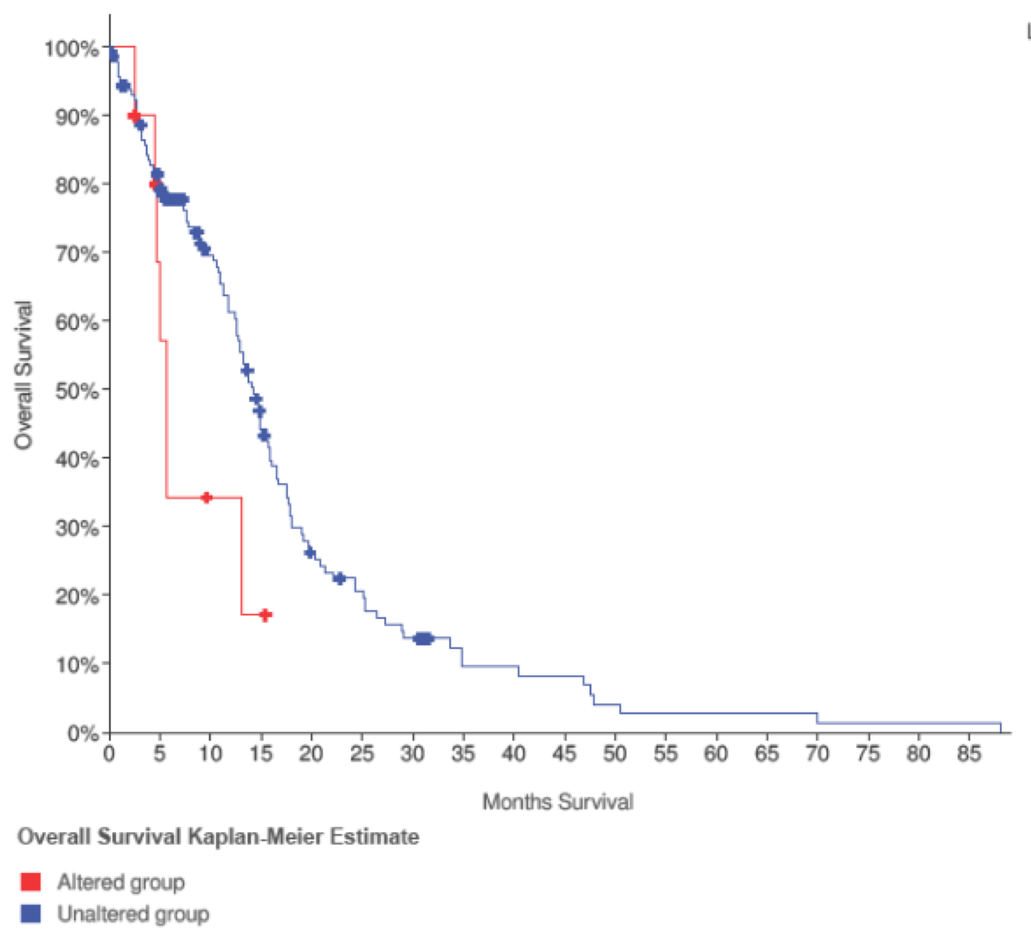
Survival curve of GBM patients with altered levels of EGR1 mRNA.
Log-rank survival analysis shows a significant difference in median overall survival (p = 0.045, n = 10).
Survival curve of GBM patients with altered levels of CHRNA7 mRNA showed a significant difference in median overall survival (p = 0.016, n = 12).
Notes:
The role of altered expression of CHRNA7 and EGR1 were explored in patient data. Log-rank survival analysis showed a significant difference in median overall survival in patients with altered EGR1 expression. Similarly, a survival curve of GBM patients with altered levels of CHRNA7 mRNA showed a significant difference in median overall survival.

Slide 7
Summary
Response to bevacizumab does delineate a distinct molecular phenotype of GBM tumors.
Poor responders to bevacizumab have significant upregulation of angiogenic genes.
Several upregulated angiogenic genes shared Early Growth Response 1 (EGR1) as a transcription factor.
EGR1 was upregulated in poor responders to anti-VEGF therapy.
Altered expression of CHRNA7 and/or its transcription factor EGR1 confers poor prognosis in GBM patients.

