Slide 1
Tumors that respond poorly to bevacizumab therapy show upregulation of angiogenesis genes in glioblastoma.
Roshan Lodha
Roshan Lodha, Graham Buchan, Gaelle Muller-Greven, Kunal Desai, Maha Qadan, Jill Barnholtz-Sloan, Paul A. Decker, Jann Sarkaria, and Candece L. Gladson

Slide 2
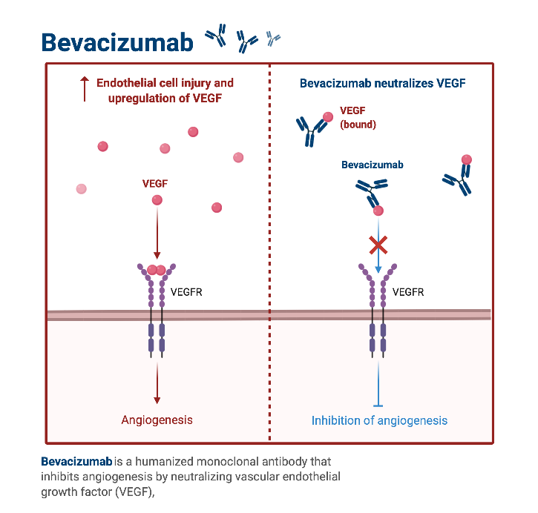
Background
Glioblastoma (GBM) is the most common primary brain tumor in adults and has an extremely poor prognosis.
Bevacizumab, the common treatment for recurrent-GBM, improves survival in only a fraction of patients, but improves quality of life.
Notes:
Even with surgical-resection and radio-chemotherapy the median survival is 15-months, and GBM has a recurrence rate of 90%.
We explored how response to bevacizumab may delineate a distinct molecular phenotype of GBM.

Slide 3
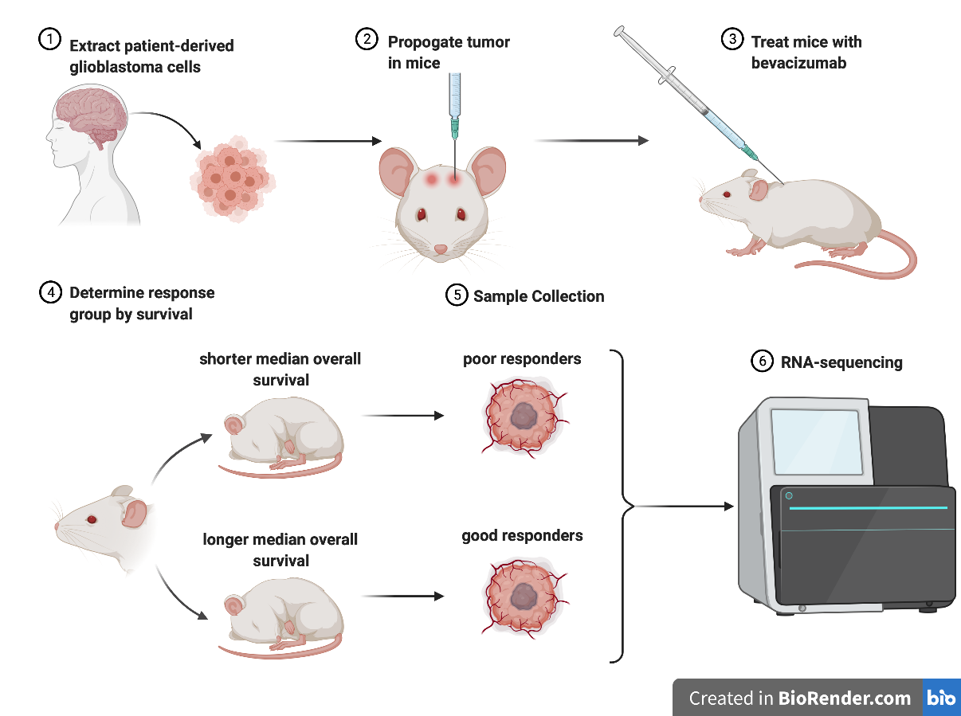
Biochemical Methods

Slide 4
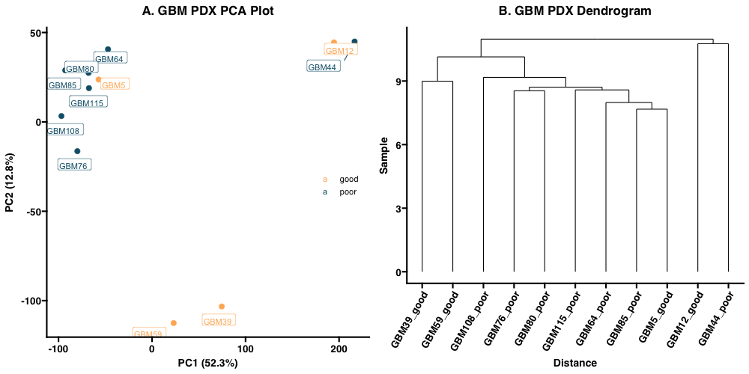
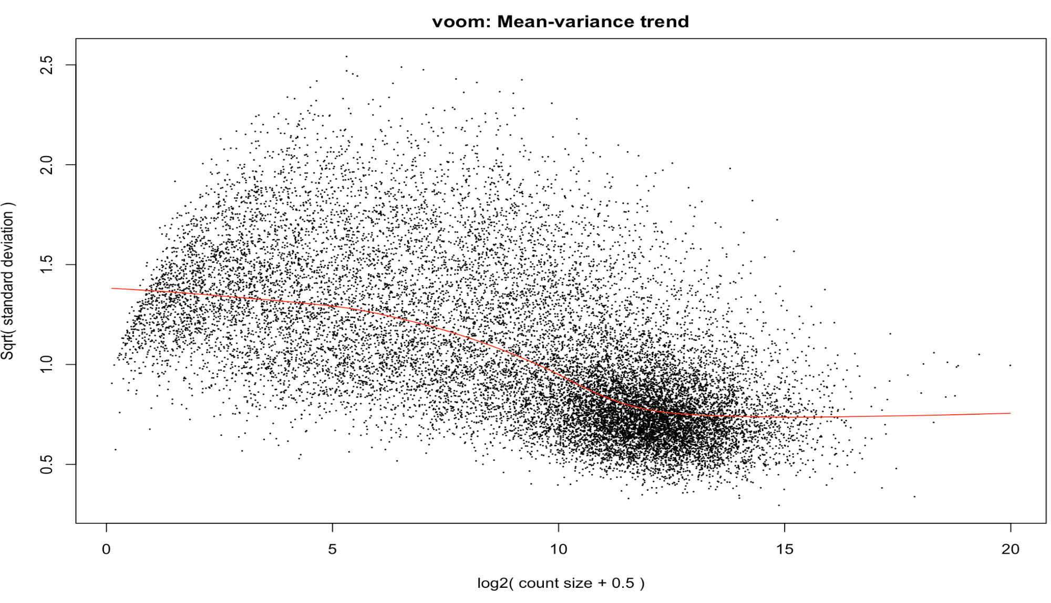
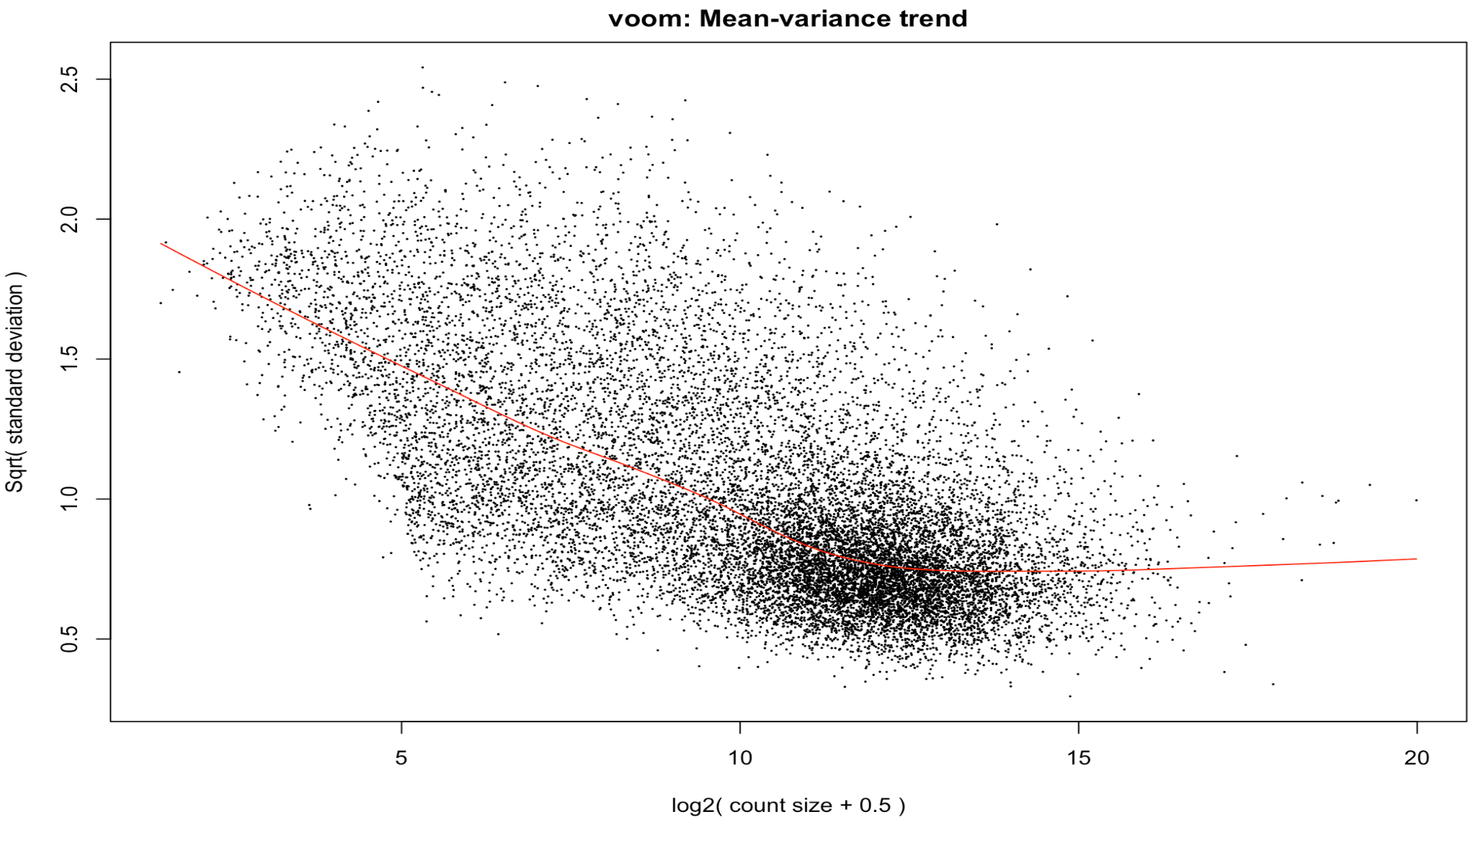
Computational Methods
In R, samples were clustered and outliers were removed using principal component analysis and hierarchical clustering.
Hyper-parameter optimization was carried out using mean-variance trends.
Differential gene expression and gene set enrichment analysis was done in R using DeSeq2 and GSEA.

Slide 5
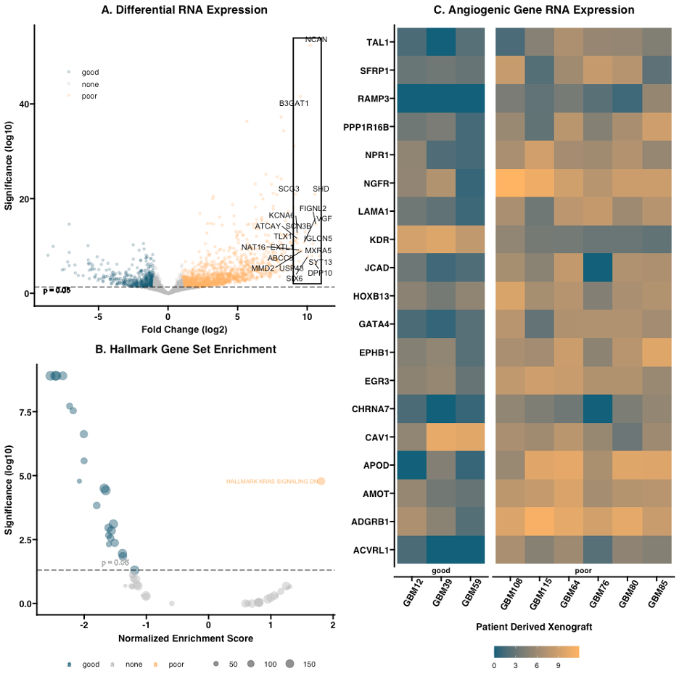
Differential gene expression in poor-responders to bevacizumab.
Volcano plot of differential gene expression. Log 2-fold change is plotted against negative log-scaled significance. Labeled points indicate the top 20 differentially expressed genes.
Hallmark gene set enrichment analysis of responders to bevacizumab. Normalized enrichment score is plotted against negative log-scaled significance. The KRAS signaling downregulation gene set is labeled.
Heatmap of log-scaled raw RNA-expression of differentially expressed genes regulating angiogenesis. Points in orange indicate higher overall expression while points in blue indicate lower overall expression.

Slide 6
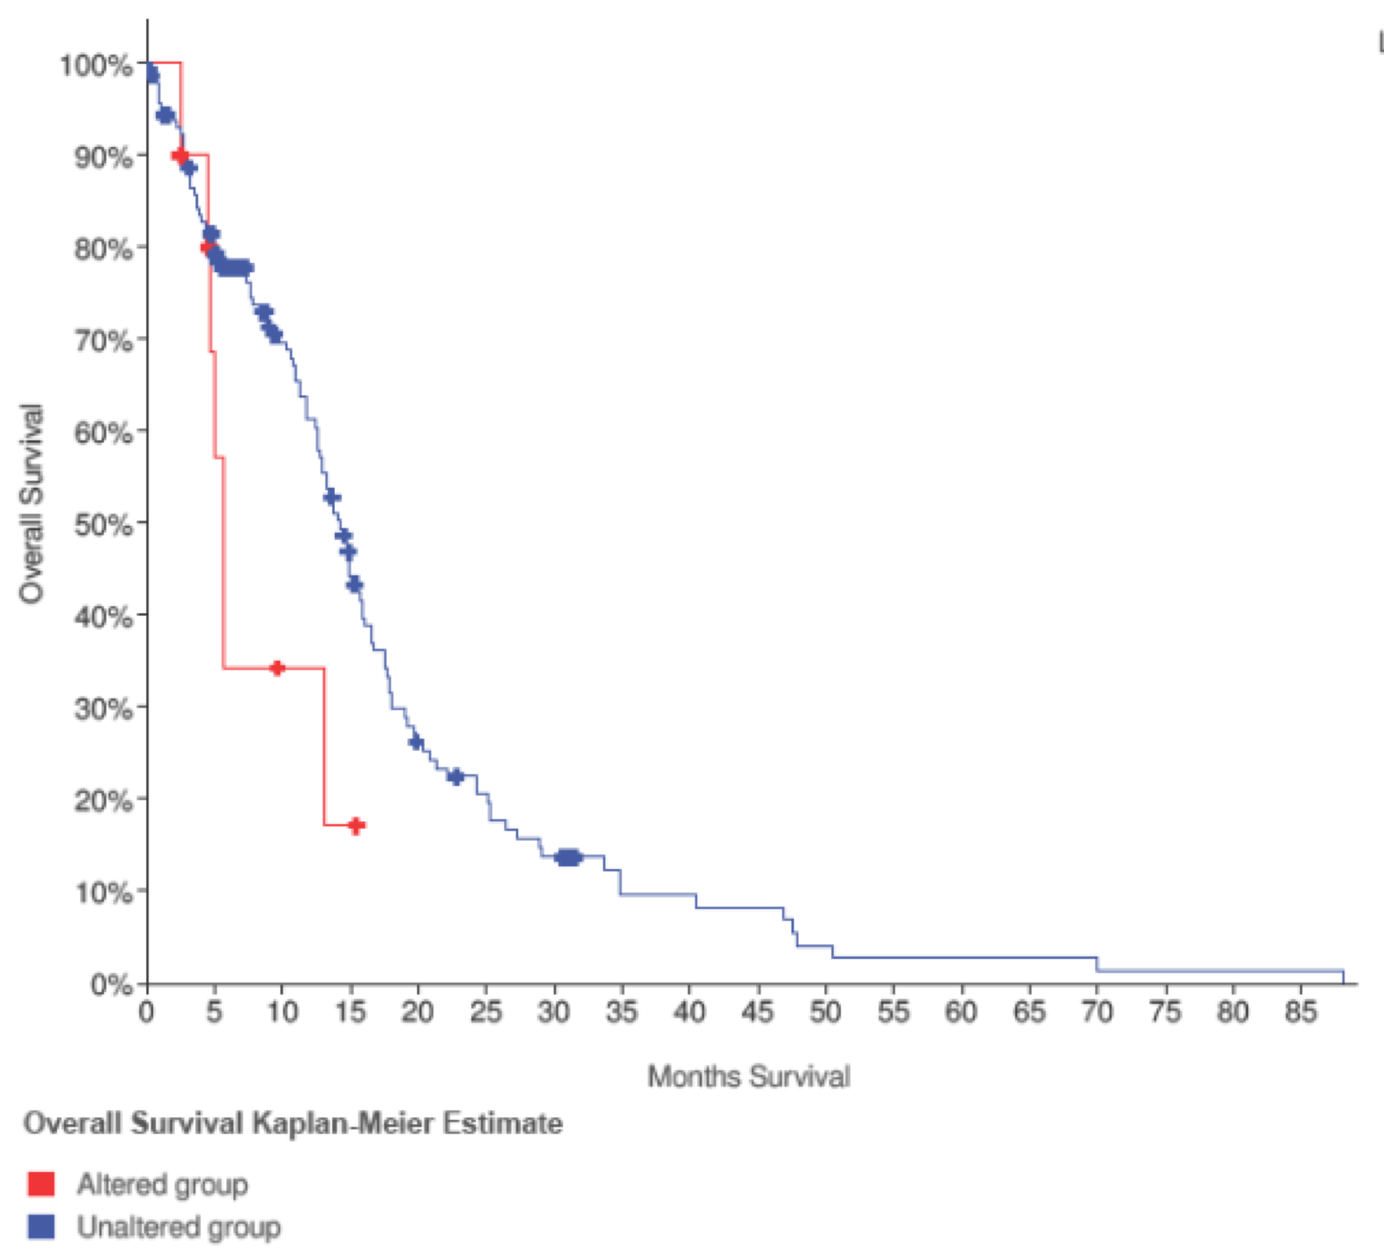
Survival curve of GBM patients with altered levels of EGR1 mRNA.
Log-rank survival analysis shows a significant difference in median overall survival (p = 0.045, n = 10).
Survival curve of GBM patients with altered levels of CHRNA7 mRNA showed a significant difference in median overall survival (p = 0.016, n = 12).

Slide 7
Summary
Response to bevacizumab does delineate a distinct molecular phenotype of GBM tumors.
Poor responders to bevacizumab have significant upregulation of angiogenic genes.
Several upregulated angiogenic genes shared Early Growth Response 1 (EGR1) as a transcription factor.
EGR1 was upregulated in poor responders to anti-VEGF therapy.
Altered expression of CHRNA7 and/or its transcription factor EGR1 confers poor prognosis in GBM patients.

