Slide 1


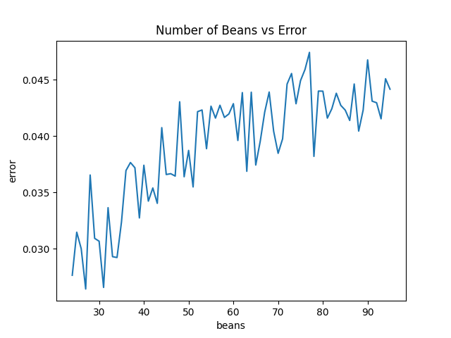
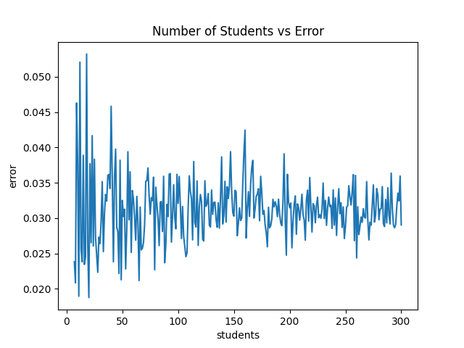
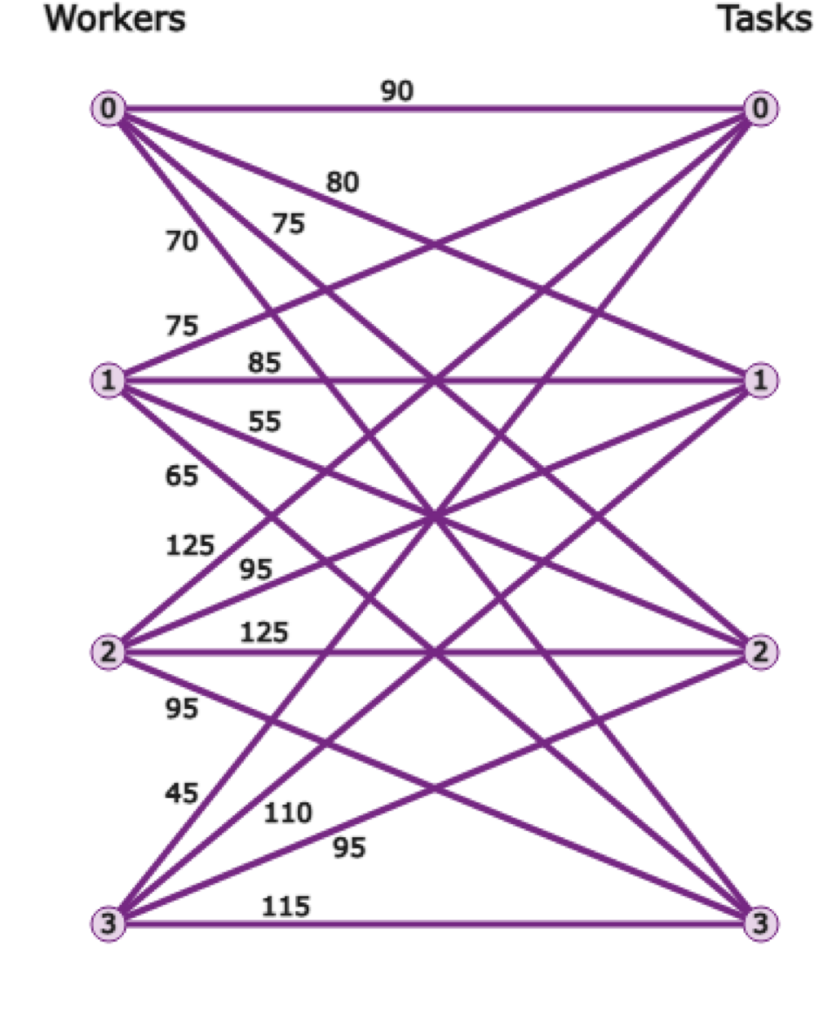
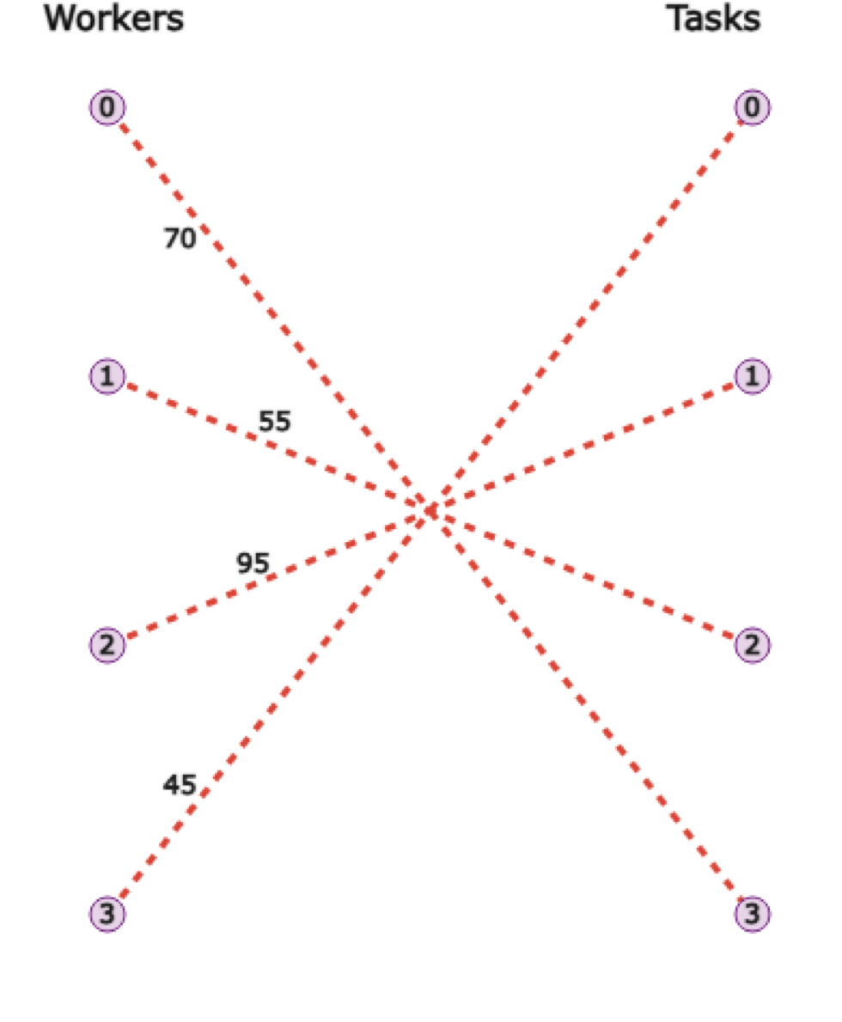
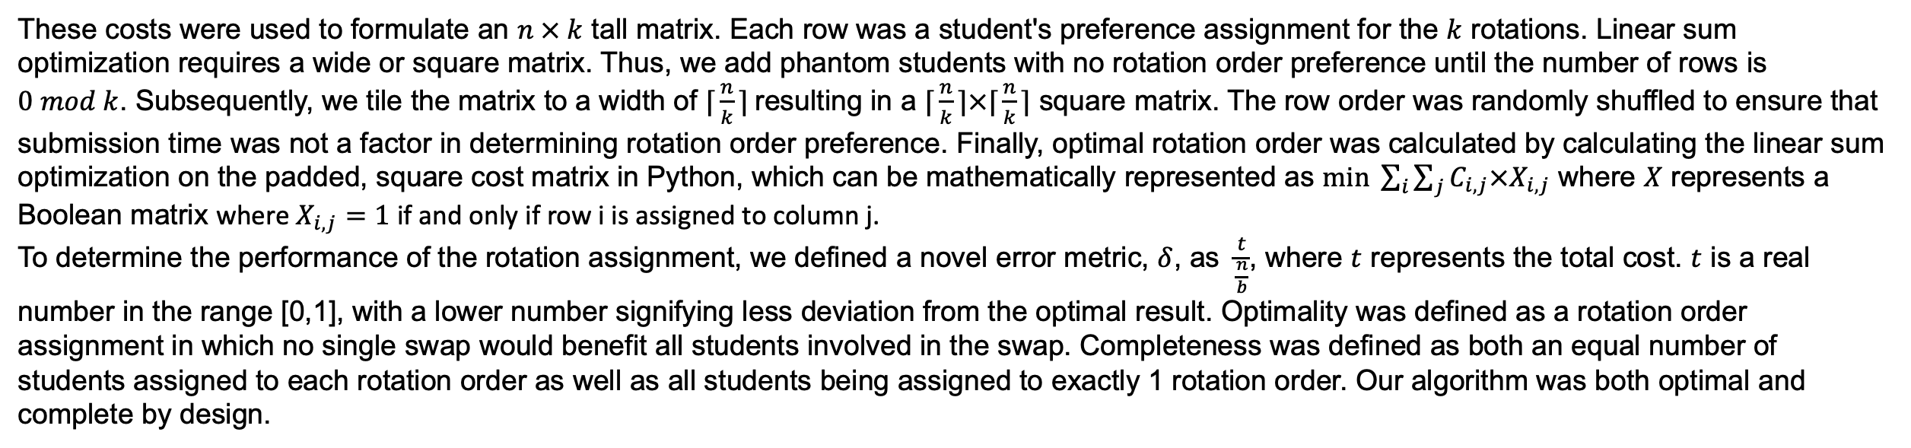
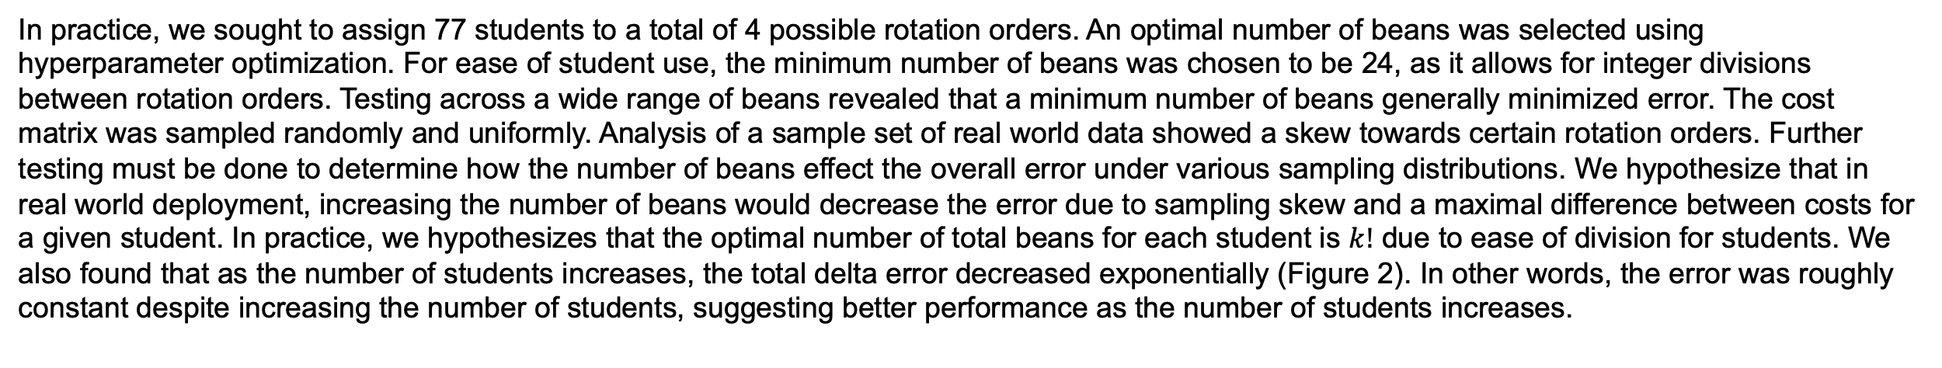
Non-random Rotation Matching Algorithm (NRMA)
A method for generalizable assignment of medical students to preferred clerkships.
Roshan Lodha, Alan Shen*, Nitesh Mohan*, Nikhil Pramod*, Victoria Rogness*, Neil Mehta, Craig Nielsen
Background & Objective
Methods (continued)
Discussion & Future Directions
Medical student are often assigned to 3rd year medical school clerkships pseudo-randomly. This can be taxing on both students who may not get the clerkship they desire and administrators tasked with assigning students to rotations. We sought to design a system that incorporates student preferences in assignment of medical students to clerkships while simultaneously automating the process to alleviate administrative burden. Previous attempts to incorporate student preference into had been limited to ranked-preference based approaches via the Hungarian method. Our goal was to build on these previous algorithms and improve and improve two key metrics generalizability and speed.
These costs were used to formulate an $n × k$ tall matrix. Each row was a student's preference assignment for the $k$ rotations. Linear sum optimization requires a wide or square matrix. Thus, we add phantom students with no rotation order preference until the number of rows is
$0 mod k$. Subsequently, we tile the matrix to a width of $\text{⌈}\frac{n}{k}\text{⌉}$resulting in a $\text{⌈}\frac{n}{k}\text{⌉}×\text{⌈}\frac{n}{k}\text{⌉}$ square matrix. The row order was randomly shuffled to ensure that submission time was not a factor in determining rotation order preference. Finally, optimal rotation order was calculated by calculating the linear sum optimization on the padded, square cost matrix in Python, which can be mathematically represented as $min \sum_{i}{\sum_{j}{C_{i,j}×X_{i,j}}}$ where $X$ represents a Boolean matrix where $X_{i,j}=1$ if and only if row i is assigned to column j.
To determine the performance of the rotation assignment, we defined a novel error metric, $δ$, as $\frac{t}{\frac{n}{b}}$, where $t$ represents the total cost. $t$ is a real number in the range [0,1], with a lower number signifying less deviation from the optimal result. Optimality was defined as a rotation order assignment in which no single swap would benefit all students involved in the swap. Completeness was defined as both an equal number of students assigned to each rotation order as well as all students being assigned to exactly 1 rotation order. Our algorithm was both optimal and complete by design.
Limitations
Real world behavior in rotation order selection is poorly modeled by a uniform distribution. Sampling of students preferences reveals high preferences for certain rotation orders. In practice, we found that rotation order 4 > rotation order 3 > rotation order 2 > rotation order 1. This selection lead to an increased number of students receiving a deeply unfavorable rotation order based on their choice of bean assignment.
Optimal Student Strategy
Due to a student-determined cost penalty and the unequal popularity of certain rotations, students could employ game theory to optimize their odds of recieving a certain rotation. For simplicity, consider a scenario with 75 students, where every student wanted rotation order 1 and no students wanted rotation order 4. In this case, only a maximum of 19 students could recieve the top choice rotation. Thus, students had the option of assigning all their beans to rotation order 1 to maximize their chance of getting this rotation. However, if more than 19 students employed this strategy, several would be randomly assigned to a different rotation. Due to the relative unpopularity of rotation order 4, it is likely that most of these students would be assigned to this rotation. Hence, it may benefit students to "take the L" and assign all their beans to their second choice rotation. Our algorithm allows for easy modification and eliminated of this aspect by having students rank their preferences followed by deterministic assigning a cost penalty to an unfavorable rotation order without the students consultation.
Unequal Rotation Sizes
While our usage mandated an equal number of students in each rotation, updating the algorithm for unequal distributions is as simple as modifying the tiling function to include more repetitions of options that can accommodate a higher number of students.
Future Directions
Applying a weight to the cost matrix can skew the results to avoid assigning students to their last-choice preference. For example, adding an exponential penalty would more significantly penalize rotation orders with fewer beans, skewing the optimal result away from those set of solutions. Our algorithm allows for easy modification of a cost matrix. Hyperparameter optimization should be used to determine the best cost penalty function for a given application. Similarly, distance penalties can be applied.
Problem Definition
Results
Medical student clerkship assignment can be framed as an assignment problem. Put simply, an assignment problem attempts to assign workers to jobs. This can be represented as a bipartite graph connecting worker nodes to task nodes with edge weights representing costs. Linear sum optimizers find the lowest cost such that each worker is assigned a job. NRMA builds a bipartite graph of students and rotations and assigns unfavourability of a given rotation for a given student as edges. Subsequently, NRMA uses a modified variant of the Jonker-Volgenant algorithm to trim the edges of this bipartite graph such that each “worker” node is connected to exactly one “job” node and that the sum of remaining edges is minimized. This can be graphically represented as below:
In practice, we sought to assign 77 students to a total of 4 possible rotation orders. An optimal number of beans was selected using hyperparameter optimization. For ease of student use, the minimum number of beans was chosen to be 24, as it allows for integer divisions between rotation orders. Testing across a wide range of beans revealed that a minimum number of beans generally minimized error. The cost matrix was sampled randomly and uniformly. Analysis of a sample set of real world data showed a skew towards certain rotation orders. Further testing must be done to determine how the number of beans effect the overall error under various sampling distributions. We hypothesize that in real world deployment, increasing the number of beans would decrease the error due to sampling skew and a maximal difference between costs for a given student. In practice, we hypothesizes that the optimal number of total beans for each student is $k!$ due to ease of division for students. We also found that as the number of students increases, the total delta error decreased exponentially (Figure 2). In other words, the error was roughly constant despite increasing the number of students, suggesting better performance as the number of students increases.
.
Methods
First, students decide the favorability of a given clerkship on a case-by-base basis. Each student was asked to divide n “beans” into k clerkship options as per their discretion. The cost of rotation was subsequently defined as n minus the number of beans assigned to that rotation. In practice, students were given 24 (4!) beans to maximize the number of possible assignments while minimizing the total bean count. An example for a single student’s assignment of beans and subsequent cost is shown below.
The assigned bean preferences for the first 6 students is reproduced below. Additional data, such as medical school track (College Program vs University Program) and current specialty of interest for residency, was collected to improve future clerkship options but was not used to determine assignment.
References
student | Please select your program. | Please select your preferred specialty for residency. | Beans assigned to LAB – TBC2 – TBC3 – TBC1? | Beans assigned to TBC2 – LAB – TBC1 – TBC3? | Beans assigned to TBC3 – TBC1 – LAB – TBC2? | Beans assigned to TBC1 – TBC3 – TBC2 – LAB?
1 | College Program | INTM | 0 | 0 | 12 | 12
2 | College Program | Plastic Surgery | 0 | 0 | 0 | 24
3 | University Program | Neurology (incl Child Neuro) | 0 | 0 | 0 | 24
4 | University Program | Ophthalmology | 0 | 0 | 24 | 0
5 | University Program | Urology | 0 | 0 | 24 | 0
6 | University Program | Anesthesiology | 0 | 3 | 6 | 15
1. Kuhn, H. W. The Hungarian method for the assignment problem. Naval Research Logistics Quarterly 2, 83–97 (1955).
2. Kuhn, H. W. Variants of the hungarian method for assignment problems. Naval Research Logistics Quarterly 3, 253–258 (1956).
3. Munkres, J. Algorithms for the Assignment and Transportation Problems. Journal of the Society for Industrial and Applied Mathematics 5, 32–38 (1957).
4. Crouse, D. F. On implementing 2D rectangular assignment algorithms. IEEE Transactions on Aerospace and Electronic Systems 52, 1679–1696 (2016).
5. MacLean, M. T., Lysikowski, J. R., Rege, R. V., Sendelbach, D. M. & Mihalic, A. P. Optimizing Medical Student Clerkship Schedules Using a Novel Application of the Hungarian Algorithm. Academic Medicine 96, 864–868 (2021).
12 beans
Clerkship 1
cost = 12
24 beans
8 beans
Clerkship 2
cost = 16
Student X
(n = 24, k = 4)
2 beans
Clerkship 3
cost = 22
2 beans
Clerkship 4
cost = 22
Fostering a passion for scientific inquiry, skills for critical thinking and a broad-based clinical expertise

