Slide 1
Exam Prep: 70-483 Programming in C#
Sidney Andrews, MCT
@sidney_andrews

Slide 2
Session Objectives
Understand where 70-483 fits into overall certification goals
Understand the objective domain for the 70-483 exam
Review a selection of topics covered by the exam

Slide 3
Microsoft Certifications

Slide 4
For You
For Your Career
Increased confidence in your abilities at work
Enhanced product knowledge
Learn about certification to educate your coworkers and bosses
Shows drive and initiative
Demonstrate mastery of a product
Sets you apart from your peers
Recognition inside and outside of Microsoft
Completely achievable at TechEd

Slide 5





MCSE and MCSD Certifications
Private Cloud
Server Infrastructure
Desktop Infrastructure
Business Intelligence
Data Platform
Web Applications
SharePoint Apps

Slide 6
Increased Rigor
Reflection of the real world
Learn more, validate more
Solutions are more complex, questions must reflect that
Best way to measure candidates know what they know
New item types
Fewer multiple choice
Case studies
Scenario based
See big picture and make decisions
Innovative item types

Slide 7
Exam Tips

Slide 8
Exam Basics
40-60 questions
1-4 hours to complete the exam
Can review questions
Cannot move between case studies
700 is passing
700 is not 70%

Slide 9
How to interpret questions
All questions have a consistent anatomy:
Business Problem
Goal Statement
One or Multiple Correct Answers
Multiple Distracters

Slide 10
Questions are not intended to trick you

Slide 11
Exam Scoring
Each exam has a “cut score”
No partial credit
No points deducted for wrong answers

Slide 12
Study Resources

Slide 13
Microsoft Learning Website
http://www.Microsoft.com/learning/en-us/exam-70-483.aspx
Skills Measured
Broken down by percentage
Preparation Options
Instructor-led training (MOC)
Exam prep video
Community Links

Slide 14
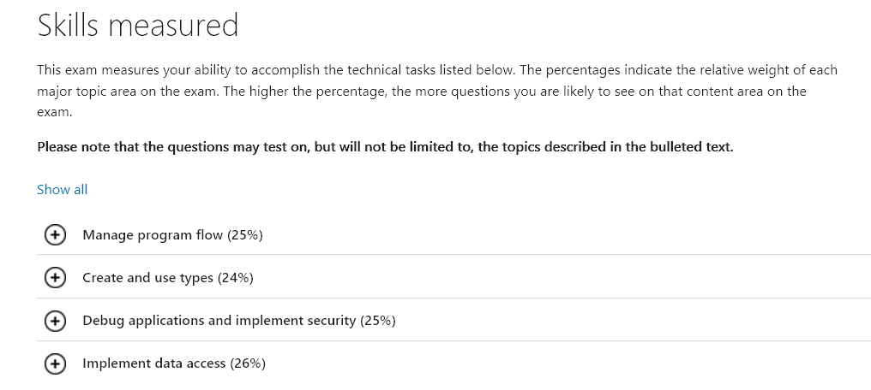
Microsoft Learning Website
http://www.Microsoft.com/learning/en-us/exam-70-483.aspx

Slide 15
Microsoft Virtual Academy
Programming in C# Jump Start
http://www.microsoftvirtualacademy.com/training-courses/developer-training-with-programming-in-c
C# Fundaments for Absolute Beginners
http://www.microsoftvirtualacademy.com/training-courses/c-fundamentals-for-absolute-beginners

Slide 16
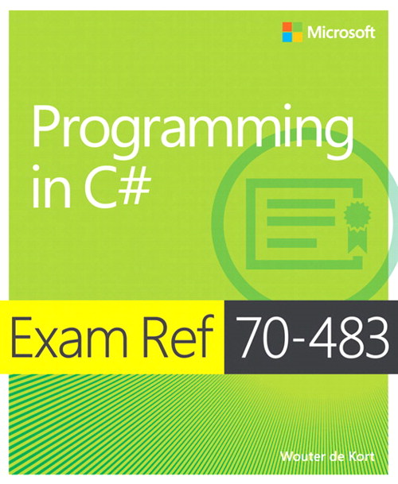
Microsoft Press
Training Guide: Programming in C#

Slide 17
Exam Topics

Slide 18
Exam Outline

Slide 19
Topics Outline
Manage Program Flow
Create and Use Types
Debug Applications and Implement Security
Implement Data Access

Slide 20
Manage Program Flow

Slide 21
Asynchronous Processing
Task Parallel Library
ParallelFor
PLINQ
Tasks
Async/Await keywords
Concurrent Collections
ConcurrentBag
ConcurrentDictionary
ConcurrentQueue
BlockingCollection

Slide 22
Multithreading
Cancellation Tokens
CancellationTokenSource, CancellationToken
Passing into Task
Cancelling a Task
Locks
Thread-safe methods

Slide 23
Program Flow
Control Statements
if/then
while
do/while
switch
for
foreach
break
continue
Goto
yield

Slide 24
Events and Callbacks
Delegates
Func<T, U>
Action<T>
Comparison<T>
Comparison<T, U>
Predicate<T>
EventHandler<T>
Lambda expressions
Anonymous methods
Subscribing/Unsubscribing from event

Slide 25
Example Question
You have an application that communicates with an external service.
The code to communicate with your service is implemented in a try block. You need a catch block that can re-throw the exception without loosing or changing the call stack so that you can log any unexpected exceptions.
Which catch block will fulfill your goal?
a.
catch(Exception e) { throw new Exception(e); }
b.
catch(Exception) { throw; }
c.
catch(Exception e) { throw e; }
d.
catch(Exception) { throw new Exception(); }

Slide 26
Create and Use Types

Slide 27
Types
Value Types
Structs
Enum
Reference Types
Generics

Slide 28
Class Members
Methods
Optional Parameters
Named Parameters
Parameter Attributes
Pass by Reference vs. Value
Static Extension Methods
Indexers
Static Variables
Overloaded/Overriden Members

Slide 29
Object Life Cycle
IDisposable
Finalization
Unmanaged Resources
Garbage Collection

Slide 30
Class Hierarchies
Interfaces
Member signatures
Base classes
Abstract base classes
Virtual members
Abstract members
Existing Interfaces
IComparable
IEnumerable
IDisposable
IUnknown

Slide 31
Example Question
You have an application that reads data from a database.
You need to combine 100+ lines of text.
Which of these is the most efficient way to combine the different strings?
a.
String append operator +=
b.
String concatenation
c.
StringBuilder class
d.
StringWriter class

Slide 32
Debug Applications and Implement Security

Slide 33
Encryption
Asymmetric
RSACryptoServiceProvider (RSA algorithm)
Public and Private Keys
Symmetric
CryptoStream
RijndaelManaged (Rijndael algorithm)
Hashing Data
MD5CryptoServiceProvider (MD5 Hash)
Hash + Salt Data

Slide 34
Diagnostics
System.Diagnostics.Trace
TraceListeners
Information, Warning, Error
Profiling
Performance Counters
System.Diagnostics.EventLog

Slide 35
Builds
Debugging
Compiler Directives
Build Types
Debug, Release
Versioning Assemblies
Signing Assemblies using Strong Names

Slide 36
Example Question
You have a web site that allows users to register new accounts with a username and password. Passwords are hashed and salted in your system.
At login, You need to use one of the encryption classes to hash and salt the user-provided password and verify that it matches the user’s stored password without exposing the original value of their password.
Which of these classes can be used to encrypt the password provided at login?
a.
SHA1CryptoServiceProvider
b.
RSACryptoServiceProvider
c.
TripleDESCryptoServiceProvider
d.
MD5CryptoServiceProvider

Slide 37
Implement Data Access

Slide 38
I/O Operations
Working with Files
File.ReadAllLines, File.ReadLine
File.WriteAllLines
Streams
CryptoStream
FileStream
MemoryStream
System.Net
WebRequest, WebResponse
HttpWebRequest, HttpWebResponse

Slide 39
Working with XML
LINQ to XML
XDocument.Load
XElement
XAttribute
Classic
XmlReader, XmlTextReader
XmlWriter
XmlNavigator

Slide 40
Serializing Data
Binary Serialization
Custom Serialization
XML Serializer
Data Contract Serializer
Data Contract JSON Serializer

Slide 41
LINQ
Operators
Projection
Join
Group
Take
Skip
Aggregate
Writing LINQ extension method
Query Syntax vs. Lambda Syntax
Deferred Query Execution

Slide 42
Collections
Generic Collections
Dictionary<T, U>
List<T>
Queue<T>
SortedList<T, U>
Stack<T>
ArrayList
Hashtable
Queue
Stack

Slide 43
Example Question
You have a service application that receives JSON data from client devices.
You need to deserialize the JSON strings to a pre-defined type.
Which of these classes can be used to deserialize your JSON strings?
a.
XmlObjectSerializer
b.
DataContractSerializer
c.
DataContractJsonSerializer
d.
SoapFormatter

Slide 44
Example Question
You have an application that queries a list:
int[] values = { 1, 3, 5, 7, 9 }; int threshold = 6;
var highValues = from v in values where v >= threshold select v;
threshold = 3;
var results = highValues.ToList();
What is the contents of the result list?
a.
{ 3, 5, 7, 9 }
b.
{ 7, 9 }
c.
{ 1, 3, 5, 7, 9 }
d.
{ 5, 7, 9 }

Slide 45

Resources
Learning
Sessions on Demand
Microsoft Certification & Training Resources
http://channel9.msdn.com/Events/TechEd
www.microsoft.com/learning
TechNet
msdn
Resources for IT Professionals
Resources for Developers
http://microsoft.com/technet
http://microsoft.com/msdn

Slide 46



Complete an evaluation and enter to win!

Slide 47


Evaluate this session
Scan this QR code to evaluate this session.

Slide 48


© 2014 Microsoft Corporation. All rights reserved. Microsoft, Windows, and other product names are or may be registered trademarks and/or trademarks in the U.S. and/or other countries.
The information herein is for informational purposes only and represents the current view of Microsoft Corporation as of the date of this presentation. Because Microsoft must respond to changing market conditions, it should not be interpreted to be a commitment on the part of Microsoft, and Microsoft cannot guarantee the accuracy of any information provided after the date of this presentation. MICROSOFT MAKES NO WARRANTIES, EXPRESS, IMPLIED OR STATUTORY, AS TO THE INFORMATION IN THIS PRESENTATION.

