Slide 1
Team: Friday

Slide 2
Problem
Problem
Help me with my Mood- With Social-media Health Analysis and Display Engine (SHADE).
Problem Statement
With the advances in technology about sentiment analysis and predictive analytics, it has opened many avenues for researchers and enterprises to understand human mental state better. The proposed challenge is to know the emotion/mood of a person, to help in eliminating any negative state of mind that might have adverse effect on his/her daily life.

Slide 3
Team Members
Name | Role
Roshan Maind | Leader, Coder, UI Designer, UX Designer, Project Manager
Vinayak Baghel | UX/UI reviewer, Tester, Trainee

Slide 4
APIs/Platforms used
IBM Watson Tone Analyzer
Twitter API
Kivy UI Library
Web Crawling
Heirarchical Data Format (HDF5) data storage database
Python Object Serialization for small/temporary data storage
Detailed explanation given in Ideation document

Slide 5
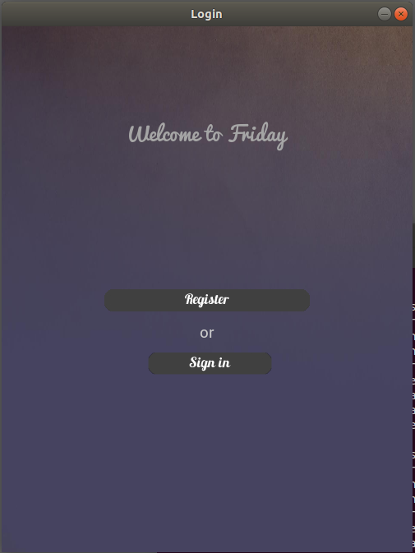
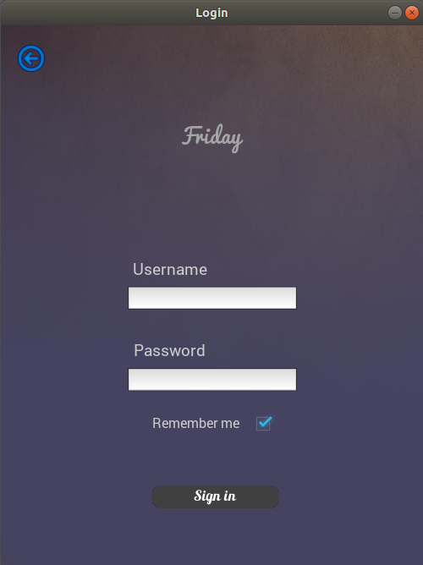
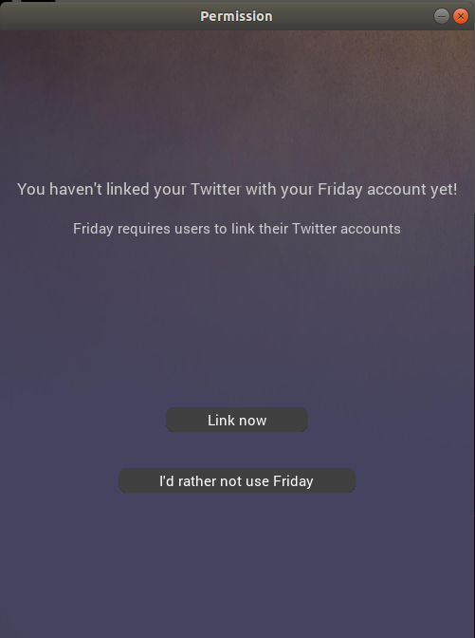
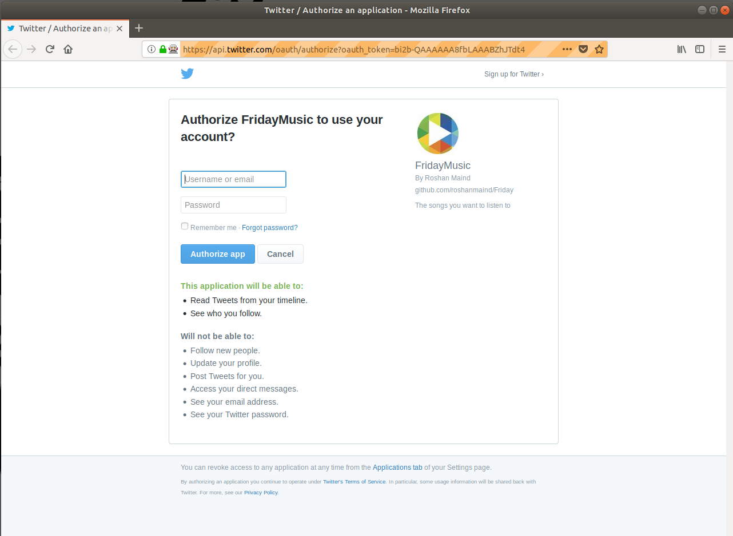
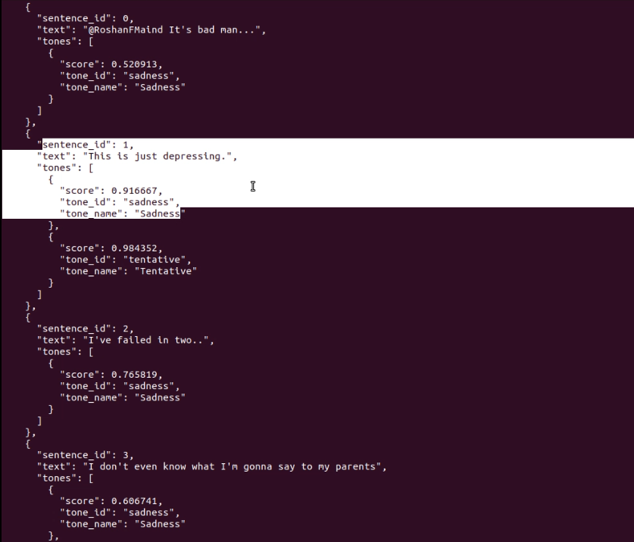
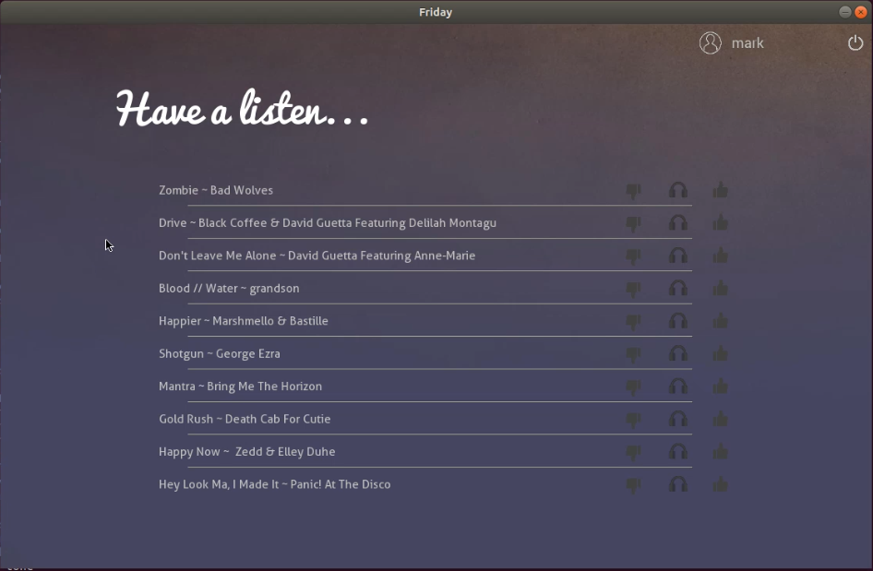

Process flow of application
Every launch of a new instance of Friday goes through a 5 step process
Login
Check twitter account OAuth connectivity and get tweets
Perform sentiment analysis on received tweets
Curate a playlist of 10 songs based on user’s music related posts, past interactions with the app, and user’s overall sentiment of last 24 hours
Main playlist screen where songs are displayed which can be liked, disliked and listened to from there.

Slide 6
IBM Cloud Services Integration
Friday uses one of the IBM cloud’s services named “Watson Tone Analyzer”.
The app automatically logs into its cloud account and uses the cloud service using its own API key.
We provide Friday’s API keys for Watson’s cloud services in a binary file named “watson.keys”. The file is not available on the main GitHub repository due to some major security issues. If you wish to obtain this binary file, you will have to write us on the email address of the official repository’s owner, @roshanmaind
Once you have obtained this file, place it in the root folder of the app where the “Friday.py” script is located. That’s it! Run the “Friday.py” script to use the app.

Slide 7
Twitter API integration
Friday uses the official Twitter API to access user data.
The app uses its own API keys and the users access tokens retreived from OAuth login (done at the first use of the app).
The API keys for the Twitter API are also given in a binary file named “twitter.keys”. The file is not available on the main GitHub repository due to some major security issues. If you wish to obtain this binary file, you will have to write us on the email address of the official repository’s owner, @roshanmaind
Once you have obtained this file, place it in the root folder of the app where the “Friday.py” script is located. That’s it! Run the “Friday.py” script to use the app.

Slide 8
UI and UX
Friday’s UI was custom made from the scratch. We have made our best efforts on making a UI that is both neat and simple to understand. To do this we have used the extensive Python library called Kivy.
Kivy also allowed us to make a software that is so platform independent that the core app can even be made to run on an Android or iOS device.
Screenshots can be found in ./data/screens/
UX is one of the most crucial aspects of any application. We made sure that we make the application simple to use, even for non technical users.
Keeping that in mind, a minimalist UX was made for Friday. Resulting into an app that isn’t a hassle to use and doesn’t waste much of the users time.

Slide 9
