Slide 1

ENHANCING THE SECURITY OF MOBILE BANKING TRANSACTIONS
Project ID
SEC2021CSPJ30
Aligned with SDG Number
9 – Industry Innovation And Infrastructure
(SAP090C01)
Domain
Security
Under the guidance of
Ms. C. Saranya,
Assistant Professor,
Department of CSE
Project carried out by
Roshan N P , 412517104105
Saket Sharma , 412517104107

Slide 2
Problem Statement
Online Banking offers users the convenience of managing one's finances anytime, anywhere. However, any online transaction can be vulnerable to security threats. Existing system uses two way authentication factor(OTP) that are easily breached by fraudsters resulting in users having their account details compromised without having the provision of hacker’s identification. Hence in this project we propose the idea of mobile sim serial based verification system to secure mobile transactions on multi-touch mobile devices. This idea provides the additional level of security apart from having the password. The sim serial number is registered with the user’s account and in case an intruder tries to initiate a transaction from some other sim, there arises a mismatch of the login credentials triggering the front camera to take the picture of the intruder and sending the picture and location of the intruder to the bank database. The bank then alerts the registered user by mailing them the intruder’s details. Since the mobile sim serial number is unique to the sim and is not provided manually rather extracted, there is no possibility of intruder initiating the transaction from other device, thus overcoming the concerns related to OTP. Also the revelation of the intruder’s details is an added advantage which makes it stand out from the existing system.

Slide 3
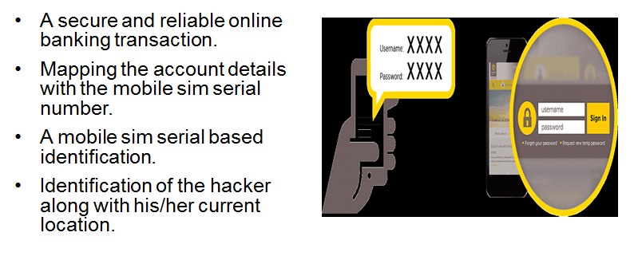
OBJECTIVE

Slide 4
EXISTING SYSTEM
TWO FACTOR AUTHENTICATION : -
Two-factor authentication (2FA), sometimes referred to as two-step verification or dual factor authentication, is a security process in which the user provides two different authentication factors to verify themselves to better protect both the user's credentials and the resources the user can access. Two-factor authentication provides a higher level of assurance than authentication methods that depend on single-factor authentication (SFA).

Slide 5
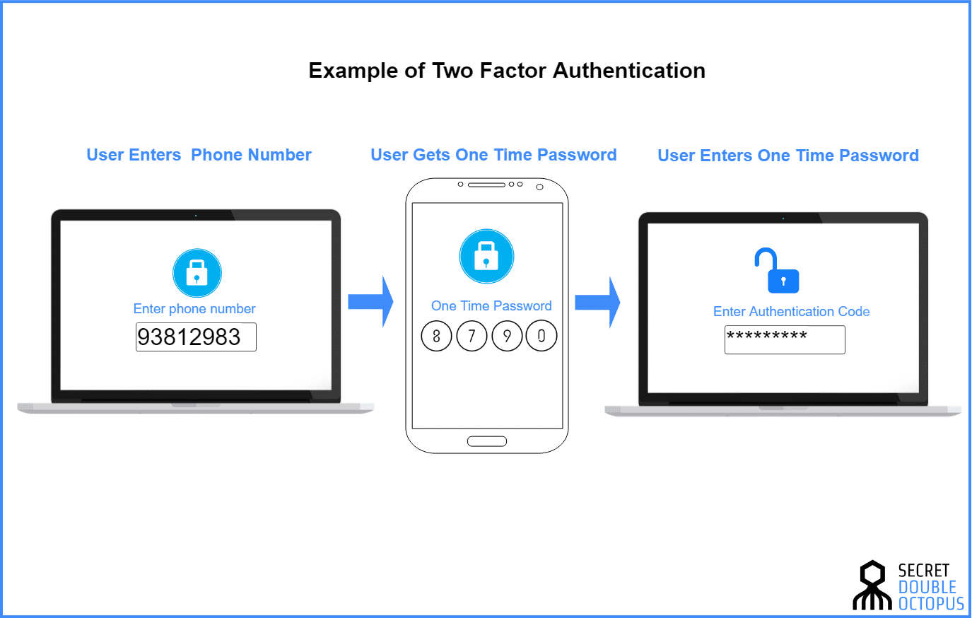

Slide 6
Drawbacks of Existing System
* Users may still be susceptible to phishing attacks. An attacker can send a text message that links to a spoofed website that looks identical to the actual website. The attacker can then get the authentication code, user name and password.
* Mobile phone reception is not always available - large areas, particularly outside of towns, lack coverage.
* Modern smartphones are used both for receiving email and SMS. So if the phone is lost or stolen and is not protected by a password or biometric, all accounts for which the email is the key can be hacked as the phone can receive the second factor.
* Mobile carriers may charge the user for messaging fees

Slide 7
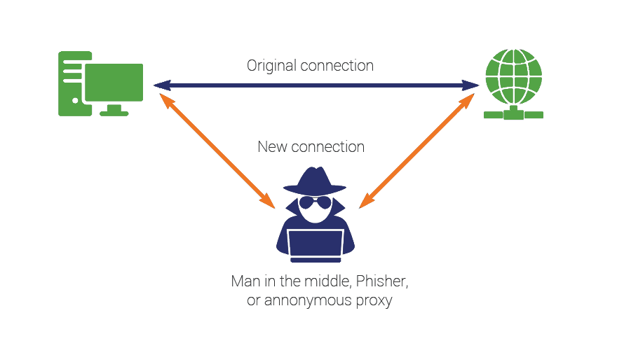
Drawbacks of Existing System
MITM ATTACK :
A man in the middle (MITM) attack is a general term for when a perpetrator positions himself in a conversation between a user and an application—either to eavesdrop or to impersonate one of the parties, making it appear as if a normal exchange of information is underway.

Slide 8

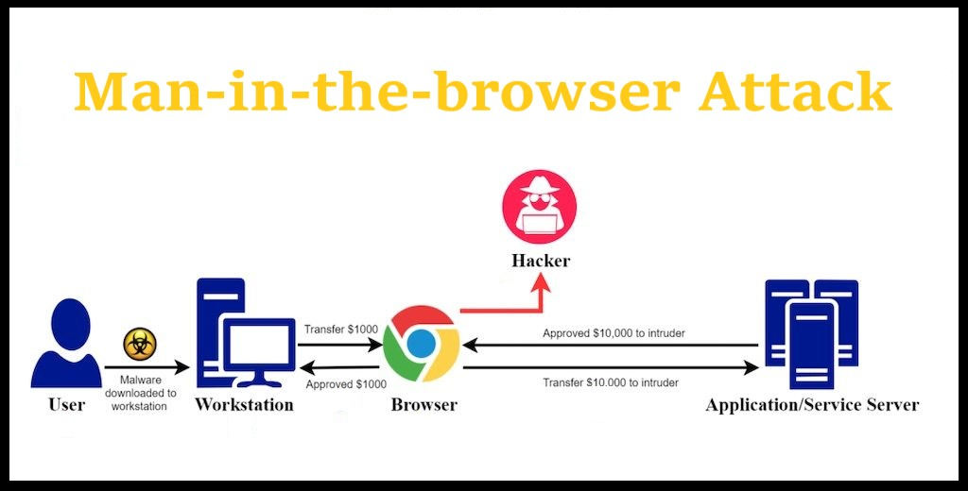
MITB ATTACK :
Man-in-the-browser is a form of man-in-the-middle attack where an attacker is able to insert himself into the communications channel between two trusting parties by compromising a Web browser used by one of the parties, for the purpose of eavesdropping, data theft and/or session tampering.

Slide 9
SIM SWAP FRAUD :
SIM swapping occurs when someone contacts your wireless carrier and is able to convince the call center employee that they are, in fact, you, using your personal data.
They do this by using data that's often exposed in hacks, data breaches, or information you publicly share on social networks to trick the call center employ into switching the SIM card linked to your phone number, and replace it with a SIM card in their possession.

Slide 10
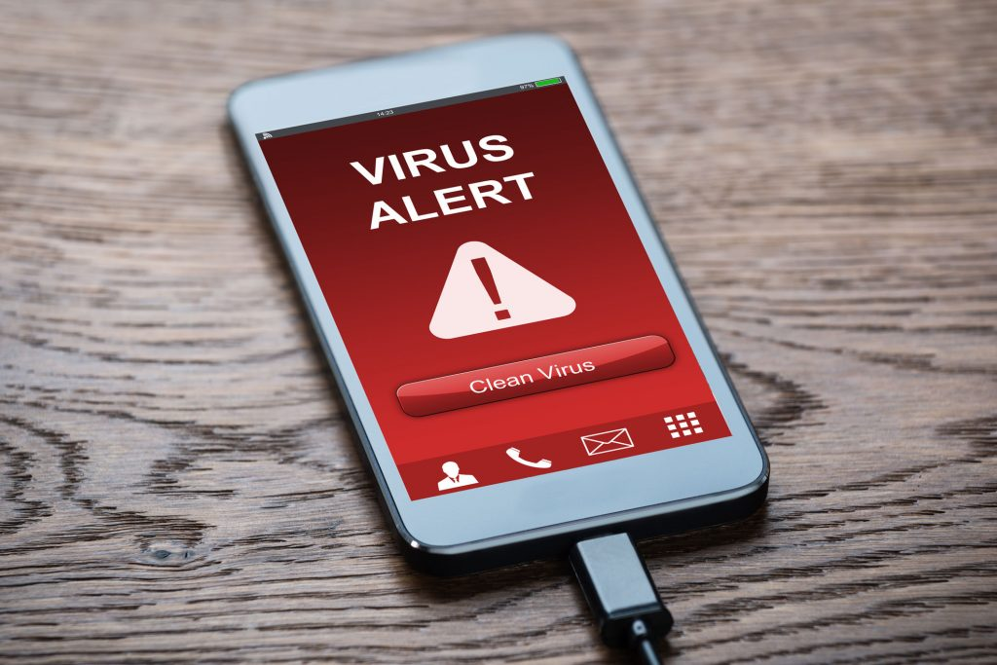
Mobile Malware :
Mobile malware, is a malicious software that specifically targets the operating systems on mobile phones. There are many types of mobile malware variants and different methods of distribution and infection. For organizations that depend on mobile phones to do business or who allow employees and visitors to use their own devices as part of a BYOD policy, the threat is very real and needs to be addressed.

Slide 11
PROPOSED SYSTEM
The aim of the project is to develop a mobile banking application that uses SIM serial ID(ICCID) for authentication process to enhance the security and also to provide the additional feature of tracing the location and mobile number of the of the intruder in case of a mismatch.

Slide 12
PROPOSED SYSTEM
* Our aim is to effectively build a secure application that uses SIM ID for verification.
The key features of the system Include :
Authenticate the user based on the SIM serial ID along with Face Recognition.
Taking the photograph of the intruder along with their Location in case of mismatch.

Slide 13


An User Creating an Account :
ARCHITECTURE DIAGRAM
Entering
Other
details
(ph,
acc no)
Extracting
Sim
Serial
ID
from Mobile
Capturing
Face
of
the user
Account
Created
Creating
Account

Slide 14



LOGIN FAILURE
ID match
Successfull
Transaction
Pass
Check
Sim ID
Check
Face
LOGIN
Unauthorized person
Fail
Capture
Face
from
Front
camera
ID
mismatch
mail
Capture
Location
Authorized person

Slide 15
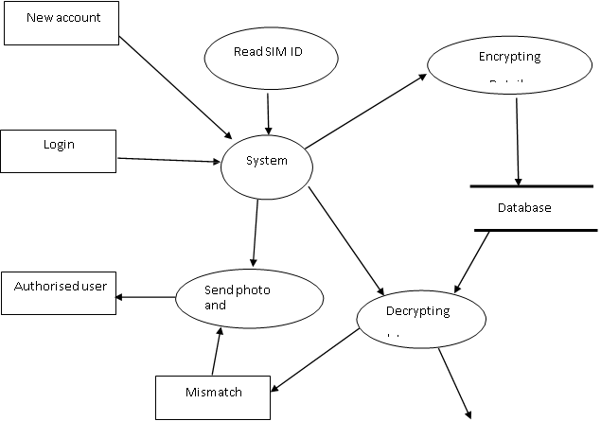
DATA FLOW DIAGRAM
Initiate Transaction
Match

Slide 16
Workflow
The user creates an account by entering the required credentials which is mapped with the mobile sim ID.
The transaction is smoothly carried out if the sim ID and Face matches with the account details(username and password).
In case of mismatch, the front camera is triggered to take the picture of the intruder without his/her knowledge.
The picture along with the location of the intruder is sent to the bank’s database and the user is alerted through the registered mail.

Slide 17
LITERATURE SURVEY
S.NO | AUTHOR | TITLE | YEAR | INFERENCE
1. | Rishav Kumar | How OTPs can be sniffed | IEEE, 2017 | The user can access your messages through Apps that have permission to access your messages.
2. | Sarah Lysecki | How secure are one-time passwords(OTPs) | IEEE, 2015 | OTP is insecure due to various malware threats such as Zitmo

Slide 18
S.NO | AUTHOR | TITLE | YEAR | INFERENCE
3. | Raymond J. Sobol | Portable instantaneous wireless event based photo identification and alerting security system | IEEE, 2009 | Location of the intruder is taken and is sent to the bank. Also an E-mail is sent to the account holder.
4 | John M. Burgan,Mohammad Besharat | Method and system for associating a user profile to a sim card | IEEE, 2006 | The system extract subscriber identity information from the SIM card when the SIM card is coupled to the wireless communication device

Slide 19
PROPOSED SYSTEM ADVANTAGES
* By using Sim serial ID for verification even if the intruder intercepts phone calls, messages(OTPs) the sim serial ID is unique and can’t be replicated. Our system detects him/her as an intruder as the Sim id doesn’t match and triggers the front camera to take photograph of the intruder
* Since no data is stored locally on the machine no malicious application(Malware) can read the data from our application
* The intruder cannot operate from another device because the SIM ID is different and once he/she does the front camera is triggered to take photograph and send it to bank database along with the intruder’s location

Slide 20
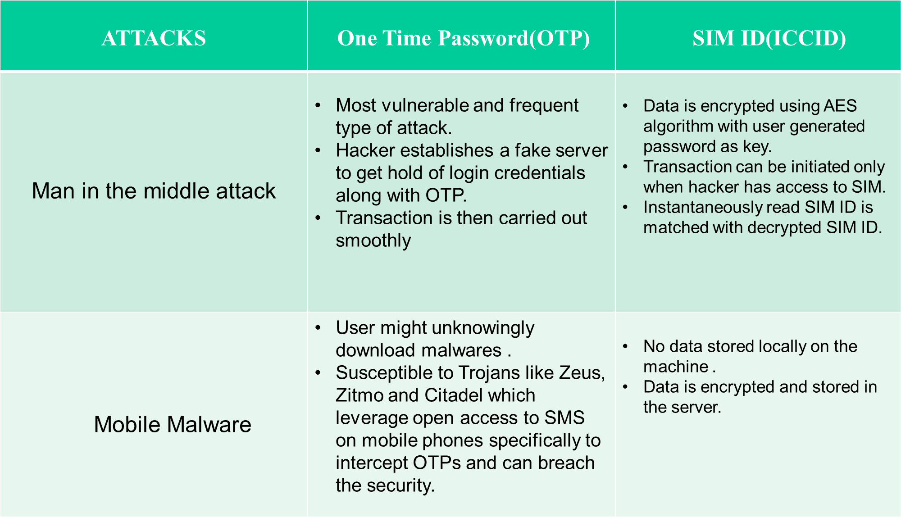

Slide 21
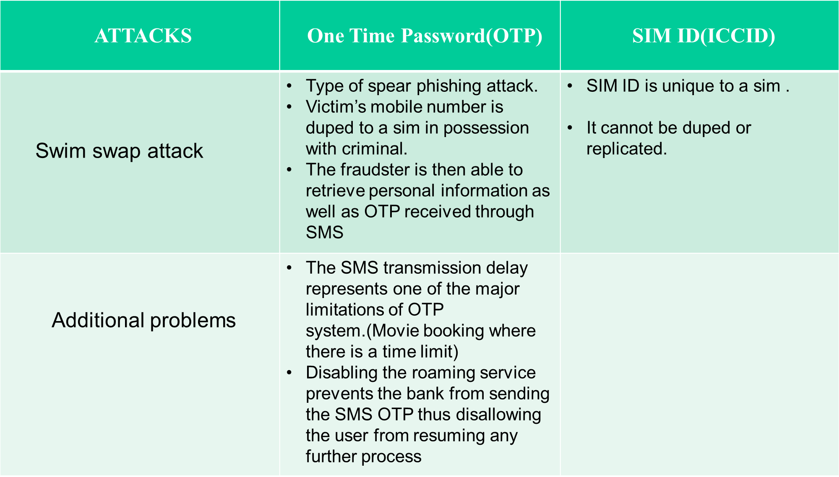

Slide 22
MODULE DIAGRAM
ID match
Successfull
Transaction
MODULE 1
Pass
Check
Sim ID
Check
Face
LOGIN
MODULE 4
Unauthorized person
Fail
Capture
Face
from
Front
camera
MODULE 2
(encryption/decryption)
ID
mismatch
Capture
Location
Authorized person
MODULE 3

Slide 23
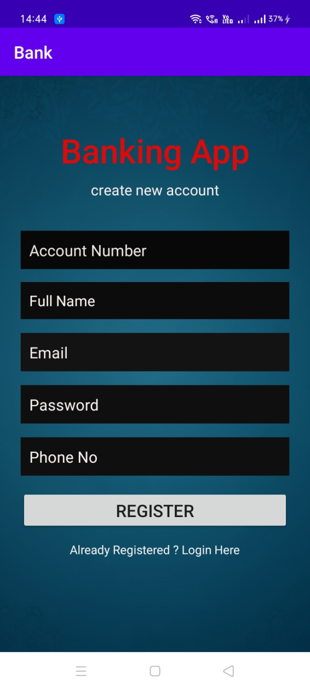
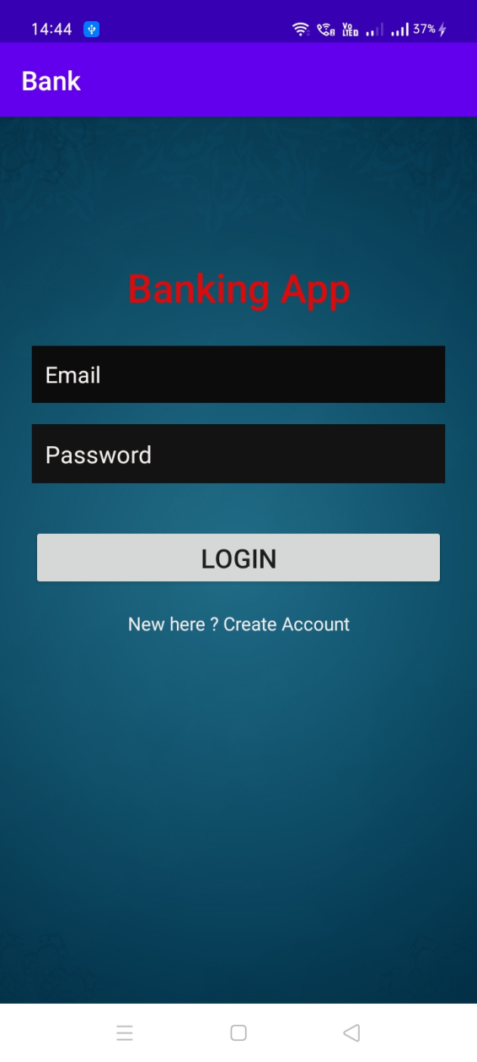
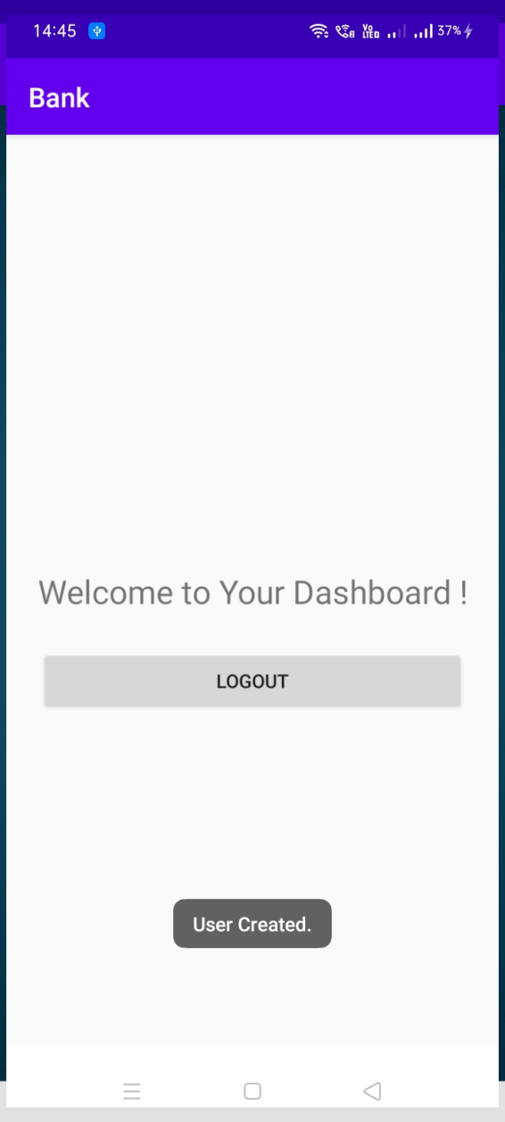
Experimentation Results (OUTPUT) : -
-

Slide 24
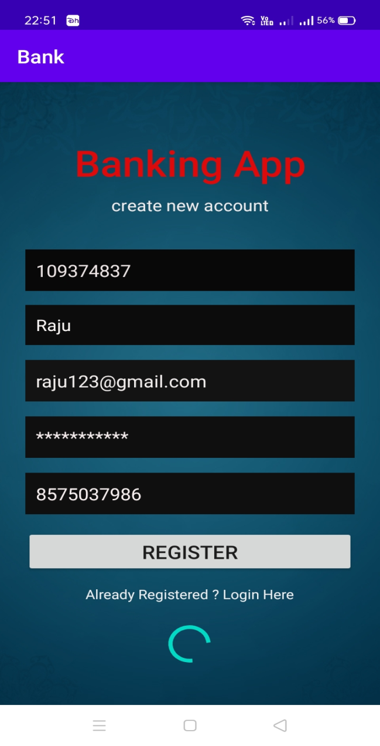
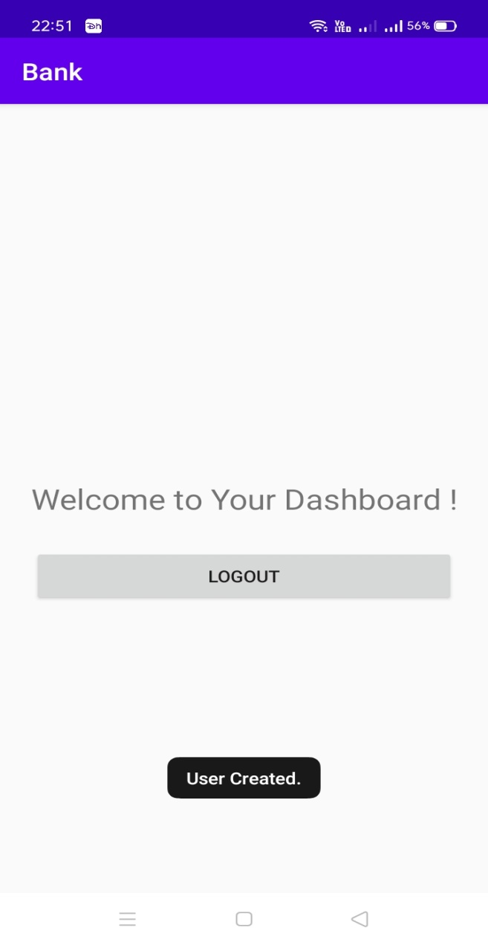
User Registration : -

Slide 25
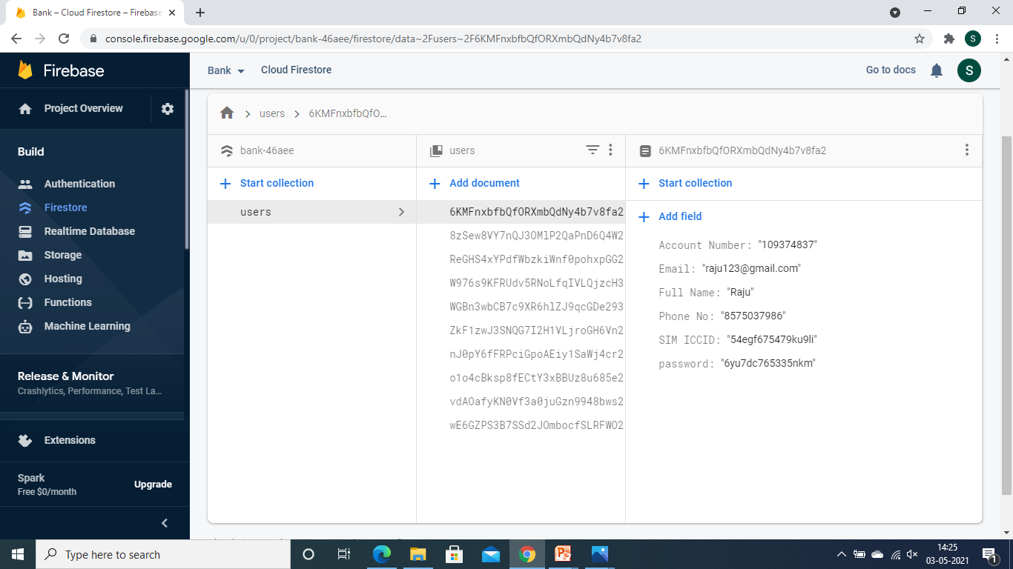
Database screenshot : -

Slide 26
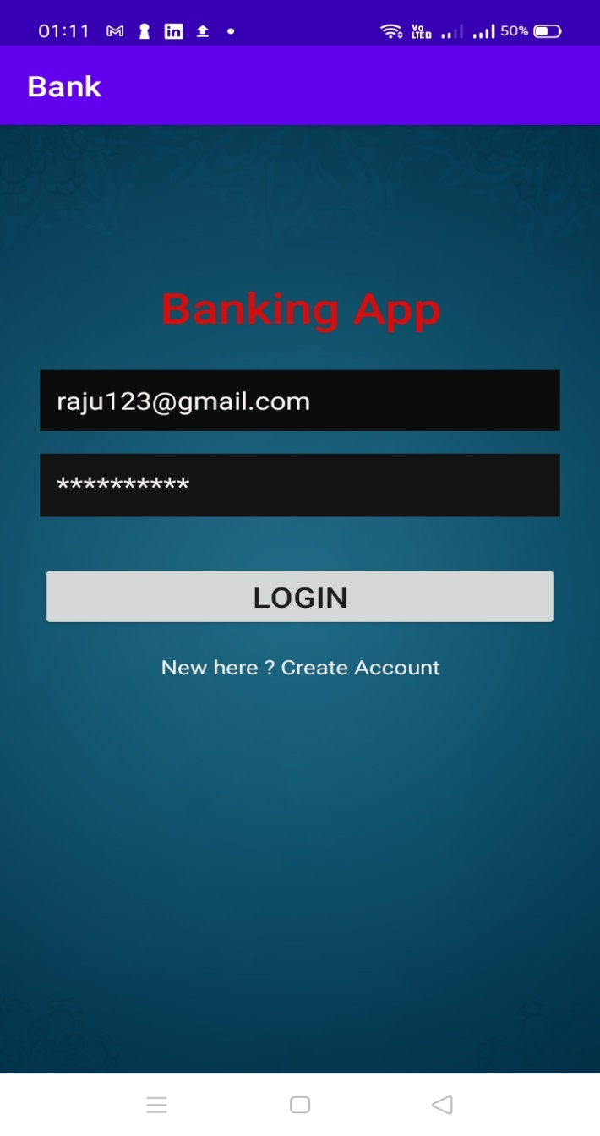
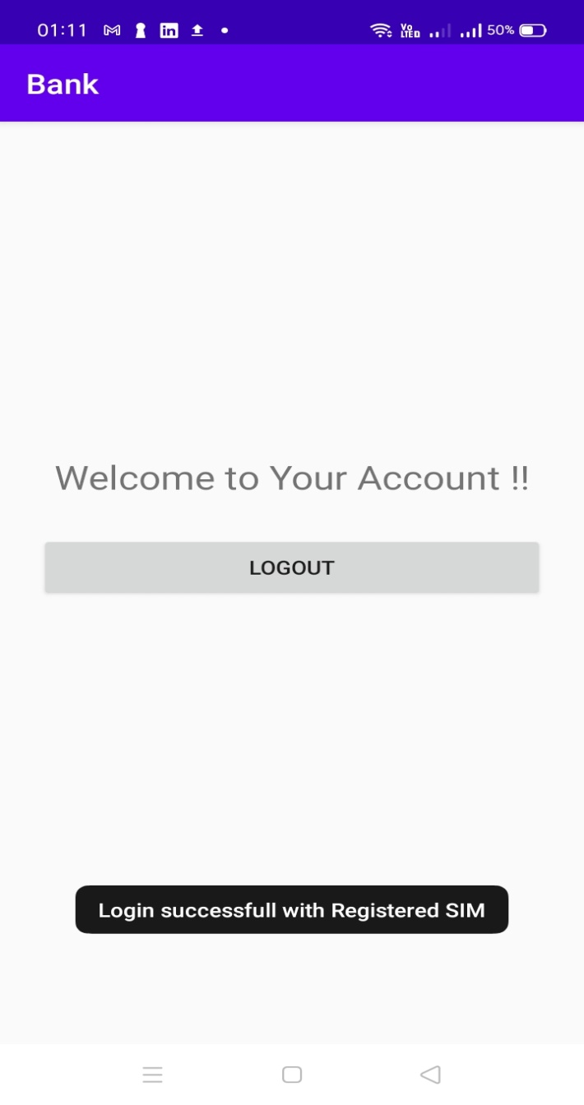
Successful Login : -

Slide 27
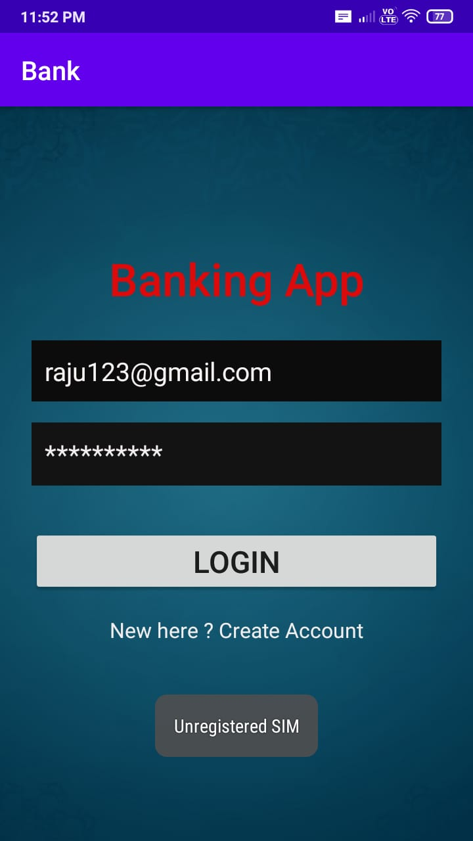
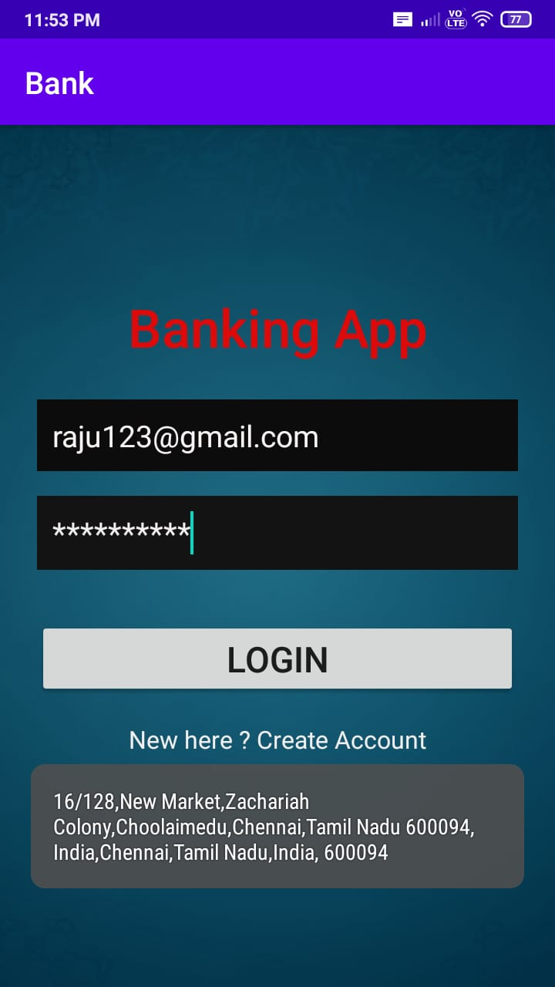
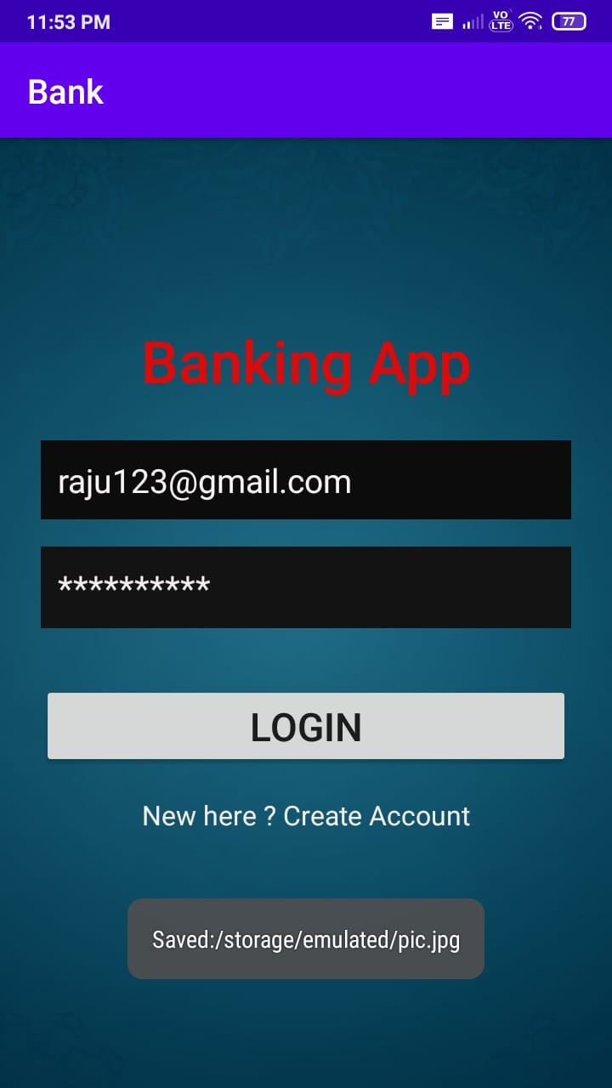
Login Failure: -

Slide 28
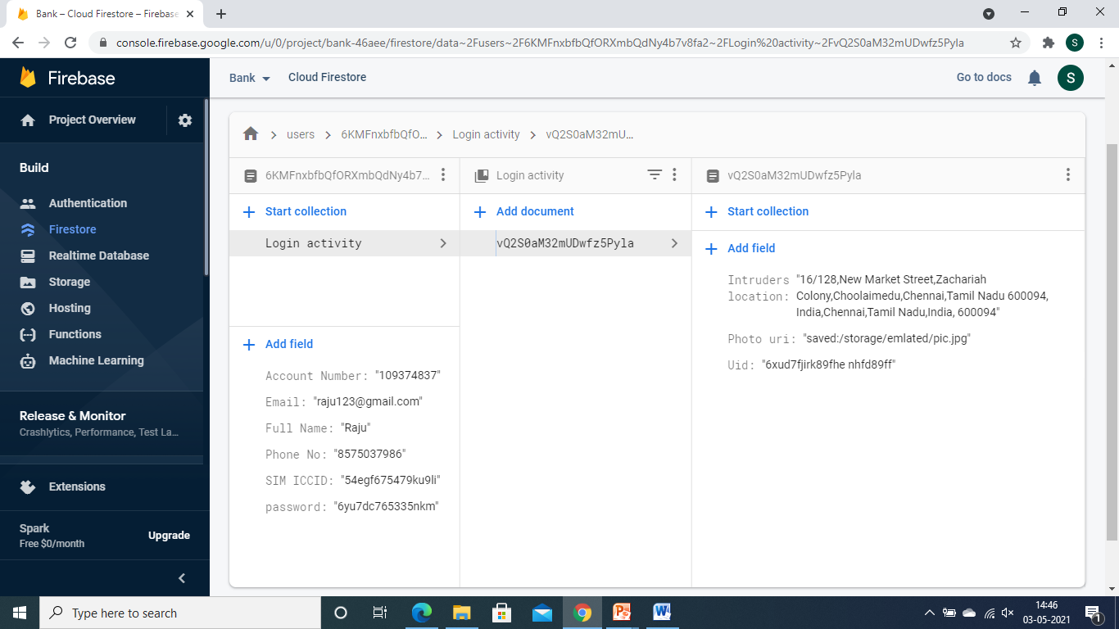
Database ( Login Failure ) : -

Slide 29
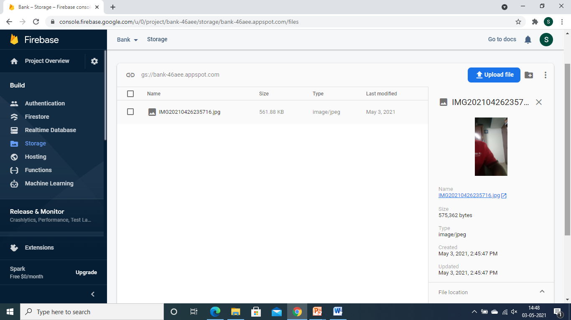
Database screenshot( Login Failure) : -

Slide 30
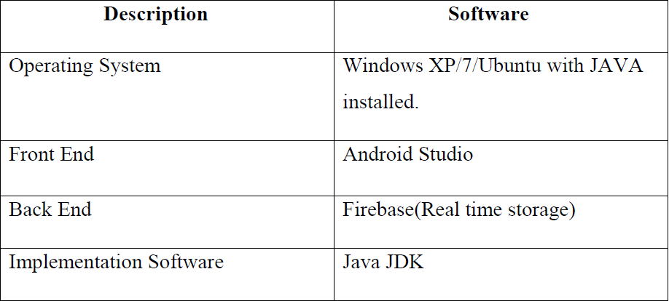
Software requirements

Slide 31
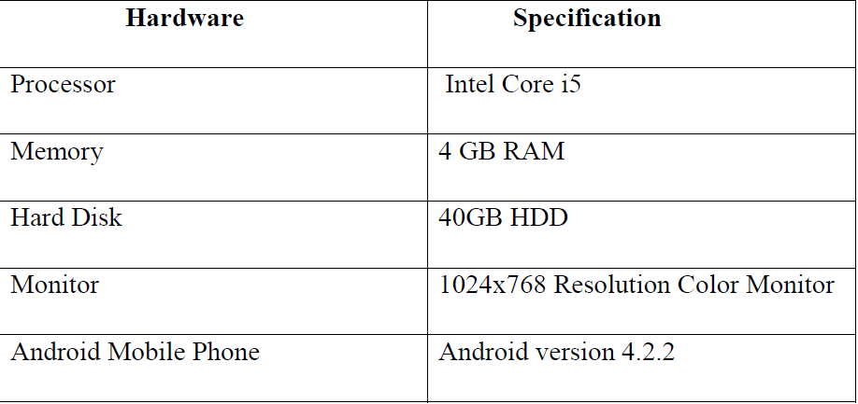
Hardware requirements

Slide 32
REFERENCES :-
1. Sarah Lysecki , “ How secure are one-time passwords(OTPs) ”.
2. Raymond J. Sobol, “Portable instantaneous wireless event based photo identification and alerting security system”.
3. Rishav Kumar, “ How OTPs can be sniffed “ .
4. John M. Burgan,MohammadBesharat, “Method and system for associating a user profile to a sim card ”.
5. Diffie, W., Hellman, M.: Cryptanalysis of the NTRU Signature Scheme (NSS). In: Boyd, C. (ed.) ASIACRYPT 2001. LNCS, vol. 2248, p. 1. Springer, Heidelberg (2001)
6. Chodowiec, P., Gaj, K.: Very Compact FPGA Implementation of the AES Algorithm. In: Walter, C.D., Koç, Ç.K., Paar, C. (eds.) CHES 2003. LNCS, vol. 2779, pp. 319–333. Springer, Heidelberg (2003)
7. G. Zhao, G. Xu and X. Hu, "Security Scheme for Online Banking Based on Secret Key Encryption," 2009
8. Marko Hölbl (2008).Authentication approaches for online-banking. CEPIS LSI Secretary.

Slide 33
|||| THANK YOU ||||

