Slide 1

Title of The Project
Sales Data Analysis
By Roshan Prajapati
Based on 2011–2016 dataset

Slide 2
Introduction
This project focuses on analyzing sales data using Python libraries like Pandas, Matplotlib, and Seaborn. It aims to uncover sales trends, high-performing products, and key business insights from raw sales data.
Before Cleaning Shape of the Dataset
The number of rows are 113036 and the number of columns are 18

Slide 3
Tools and Libraries Used
Python
Pandas
NumPy
Matplotlib
Seaborn
Jupyter Notebook

Slide 4
Data Loading and Overview
Sales data was loaded from a CSV file and converted into a DataFrame for analysis. Initial steps included checking for null values, data types, and exploring basic statistics.
• After cleaning data
• The Shape of Dataset: 48,340 rows, 19 columns
• Years: 2011 to 2016
• Data cleaned & enhanced
• Cleaned data, dropped duplicates, generated customer names with Faker

Slide 5
Key Metrics
• Total Revenue: ₹85,271,008
• Total Profit: ₹32,221,100
• Total Cost: ₹53,049,908
• Total Customers: 48,340
• Males: 24,622
• Females: 23,718

Slide 6
Top 5 Customers by Total Cost
Using groupby df.groupby('Customer_Name')['Cost'].sum()
• Radha Mody – ₹12,600
• Aahana Issac – ₹10,850
• Lucky Sem – ₹10,311
• Rachita Sharaf – ₹10,239
• Janaki Garde – ₹9,762

Slide 7
Top Country by Profit
• The United States generated the highest total profit.
• Total Profit: ₹5,208,215

Slide 8
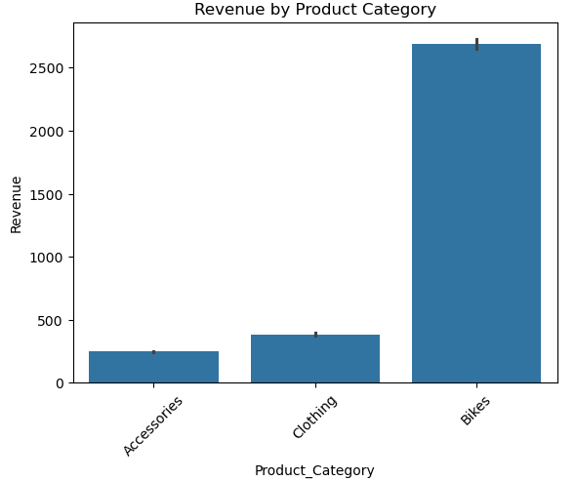
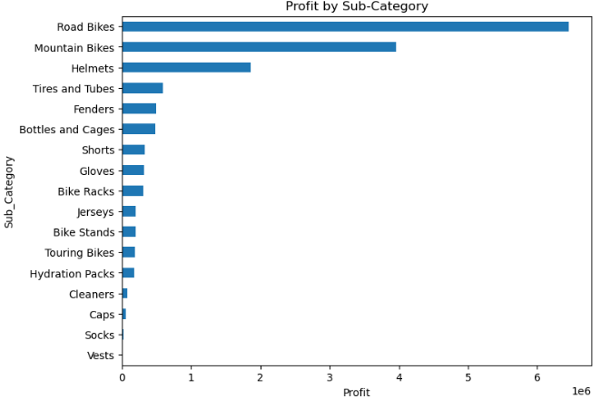
Product Performance
• Highest revenue from Bikes
• Highest profit from Road Bikes
• Sub-category trends visualized

Slide 9
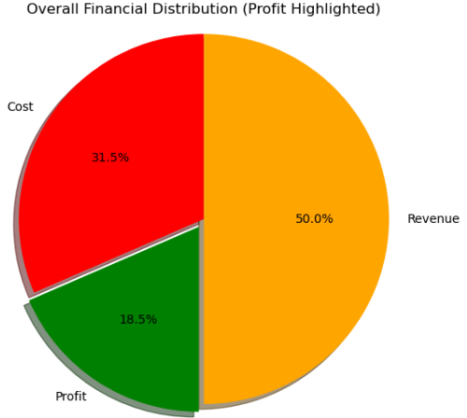
Financial Summary
• Pie chart shows: Revenue (50%), Cost (31.5%), Profit (18.5%)
• Profit highlighted using exploded chart

Slide 10
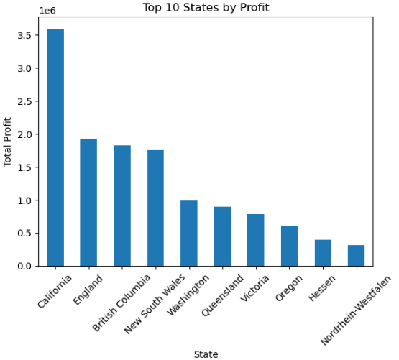
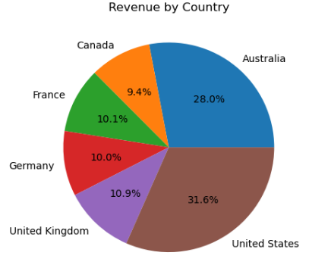
Geographical Insights
• Most profitable state: California
• Top country by profit: United States
• Country-wise revenue shown in pie chart

Slide 11
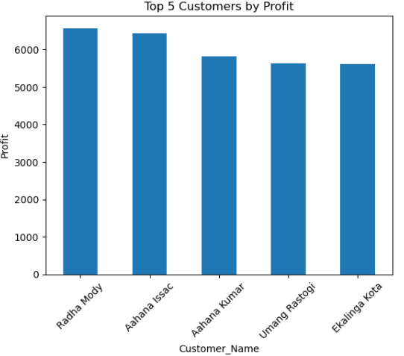
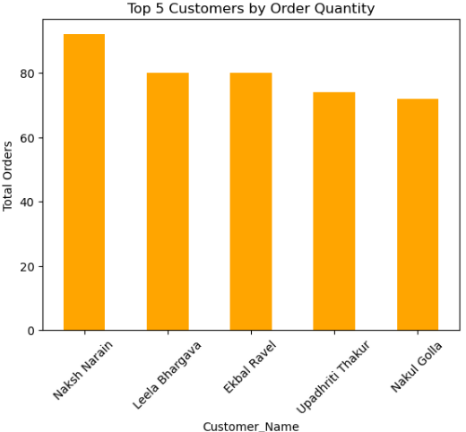
Top Customers
• Top by Profit: Radha Mody
• Top by Order Quantity: Naksh Narain
• Revenue vs Profit bar charts plotted

Slide 12
Multi-Dimensional Customer & Profit Analysis
• 📊 Histogram: Shows distribution of customer ages — helps identify dominant age groups like Youth and Adults.
• 👩‍💼 Bar Chart: Compares total revenue generated by Male and Female customers.
• 📈 Line Chart: Displays profit trends over time — highlights seasonal or yearly shifts in business performance.
• 📦 Box Plot: Highlights variations in profit across different product categories, revealing outliers and consistency.

Slide 13
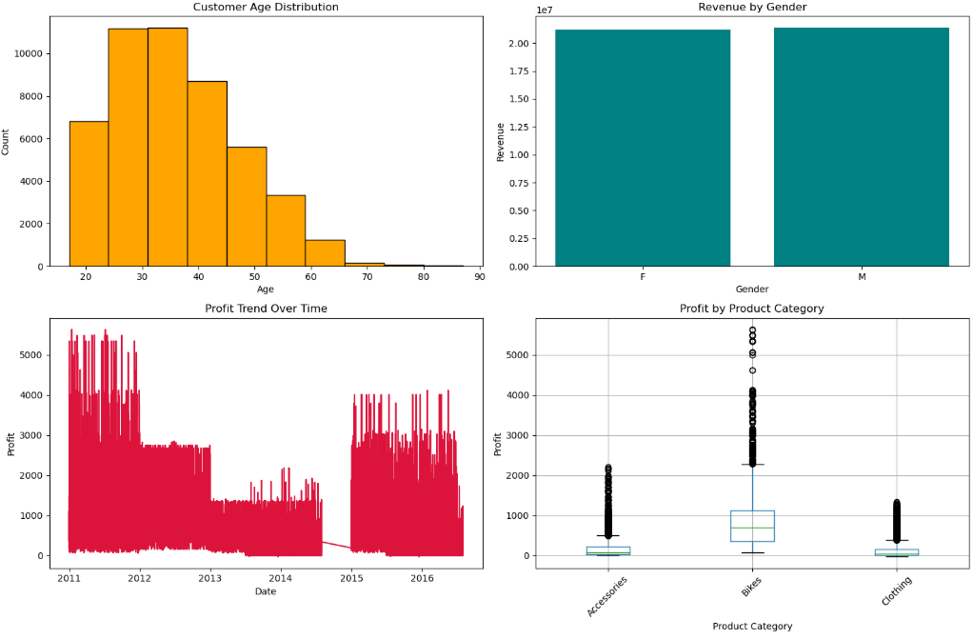
Multi-Dimensional Customer & Profit Analysis

Slide 14
Key Insights & Recommendations
• Focus on Accessories & Bikes
• Expand in US and California
• Leverage youth segment in marketing
• Invest in top-selling sub-categories
• 📈 Monitor profit trends across years to optimize seasonal strategies

Slide 15


