Slide 1
Problem Statement
Emotional-support chatbots are built for English, but many Indians share distress in Roman-script Hinglish (“yaar result aaya, bahut tension ho rahi hai, ghar pe kaise bataun”).
MultiAgentESC (EMNLP 2025), a strong LLM multi-agent ESC system, (i) retrieves past cases with an English-only encoder, (ii) picks replies without looking at the user's language mix, and (iii) was never tested on code-mixed users. Goal: make it work for Hinglish help-seekers without fine-tuning the LLM agents.
1) Group Name: CodeMixESC (individual project) 2) Team Name, Roll no: Roshan Raj — 12341830
3) Novelty
1 Code-Mix Profiler + Register Gate
HingBERT-LID + Code-Mixing Index measure how much Hindi the user mixes; the gate re-writes a reply whose mix is off (max. 1 extra call).
2 Cross-lingual retriever
Multilingual mpnet fine-tuned contrastively on 16,951 Hinglish–English pairs: Hinglish queries find the right English cases.
3 Register-aware selection
Agents see the user's register; debate, voting and refiner add a 4th criterion: language & cultural fit.
4 ESConv-HiEn benchmark
First Hinglish ESC test set with strategy labels: ESConv test set rewritten at Light and Heavy mixing, CMI-verified.
4) Contributions
Roshan Raj (sole member, 100%): designed the method; built ESConv-HiEn (LLM rewriting + CMI and meaning checks); built the 16,951 training pairs and fine-tuned the retriever; re-implemented MultiAgentESC with all four components and 4 baselines (zero-shot, few-shot CoT, MultiAgentESC, translate-pivot) + ablations; built the evaluation (BLEU, ROUGE-L, chrF, BERTScore, CMI gap, strategy JSD, LLM judge, conversation-level bootstrap) with 110 unit tests and CI.
Notes:
PROBLEM (30 s): Emotional support chatbots are mostly designed and tested in English. But in India many people describe their stress in Hinglish typed in Roman script, like 'yaar result aaya, bahut tension ho rahi hai'. My base paper is MultiAgentESC from EMNLP 2025. It is a multi-agent system: some LLM agents analyse the user's emotion, its cause and the user's intention, other agents choose a support strategy using similar past cases, and then agents debate and vote on the best reply. It has three gaps for Hinglish users: its retriever only understands English, nobody checks whether the reply matches the user's language mix, and it was never evaluated on code-mixed text. My goal was to fix these gaps without fine-tuning the large language models.
GROUP: This is an individual project, CodeMixESC, Roshan Raj, roll number 12341830.
NOVELTY (1 min), four parts:
1. Code-Mix Profiler and Register Gate: a word-level language identifier (HingBERT-LID) tags every word as Hindi or English, and the Code-Mixing Index tells how mixed the user's messages are. This register profile R is given to the agents. At the end the Register Gate checks the final reply: if its Hindi share is too far from the user's, it asks for one rewrite, and keeps it only if it is closer.
2. Cross-lingual retriever: I fine-tuned a multilingual sentence encoder with a contrastive loss on 16,951 Hinglish-English sentence pairs, so a Hinglish query finds the same English past cases as its English version.
3. Register-aware selection: the reply generator writes in the user's mix, and debate, voting and the refiner get a fourth criterion: language and cultural fit.
4. ESConv-HiEn: a new test set. I rewrote the 100 ESConv test conversations into Hinglish at two levels, Light and Heavy, kept the strategy labels and checked every utterance's mixing level automatically.
CONTRIBUTIONS: I did everything myself: design, dataset, retriever training, the multi-agent implementation with baselines and ablations, and the evaluation code with tests.

Slide 2
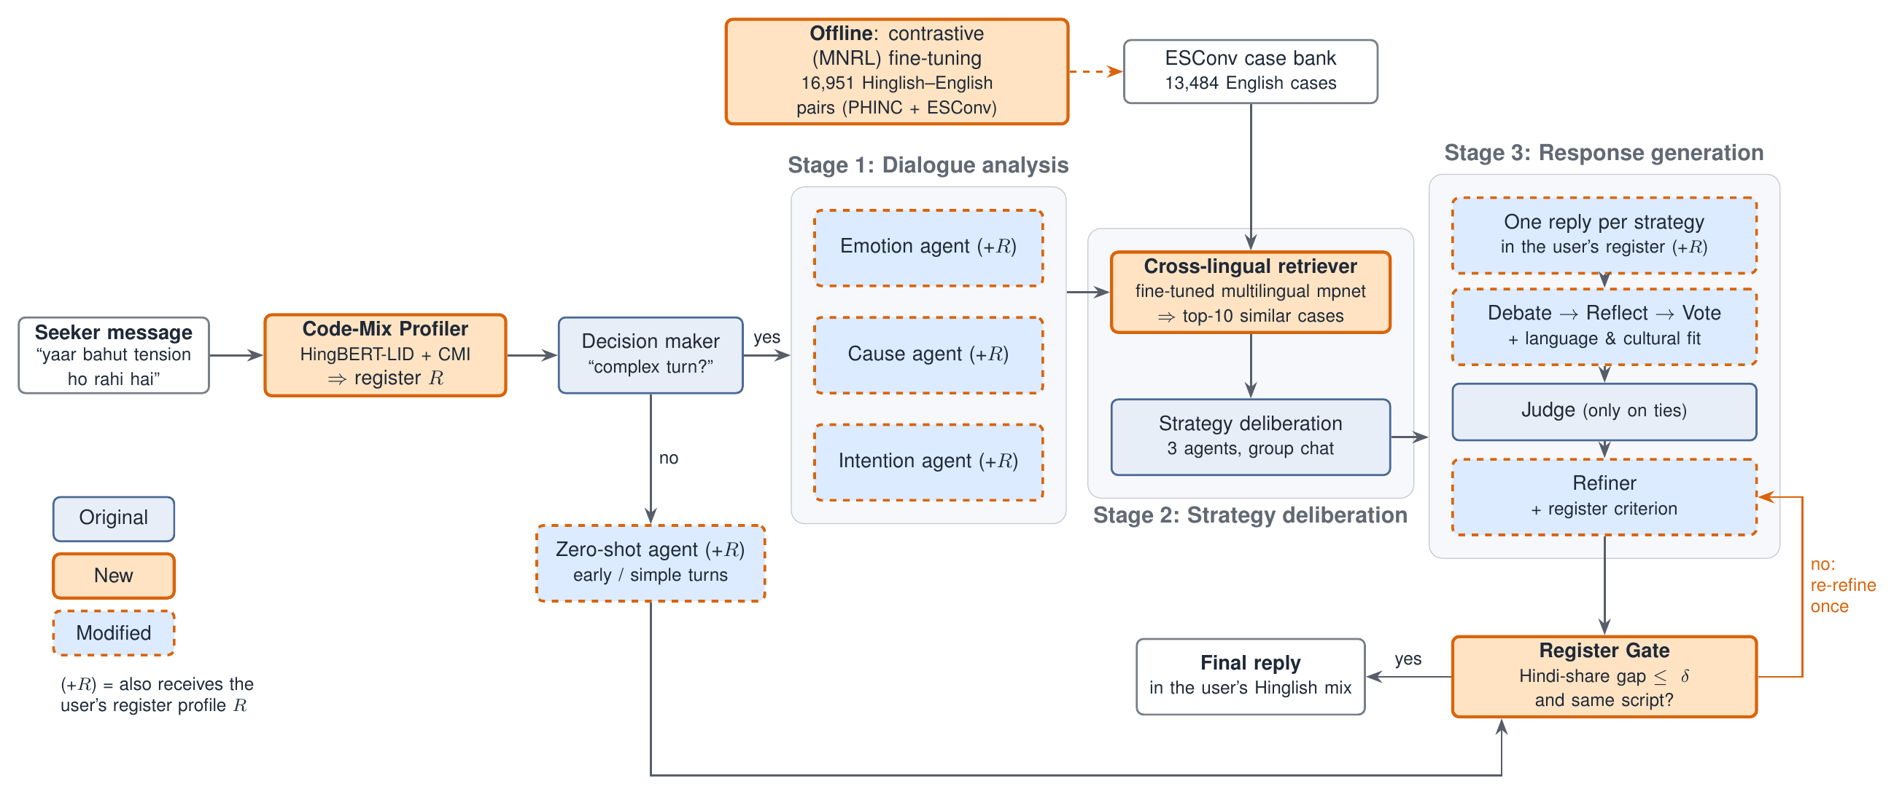
Architecture: CodeMixESC
Notes:
Walk the diagram left to right (1.5 min).
Orange boxes are new, dashed blue boxes are modified, plain blue boxes are unchanged from MultiAgentESC.
1. The seeker's message first goes to the Code-Mix Profiler, which computes the register profile R.
2. The decision maker checks if the conversation is complex. Early or simple turns go to one zero-shot agent, which also gets R.
3. Stage 1: the emotion, cause and intention agents analyse the dialogue; they also see R and a hint to read Hinglish expressions like 'tension' or 'log kya kahenge' by meaning.
4. Stage 2: the cross-lingual retriever finds the 10 most similar cases from 13,484 English ESConv cases. It was trained offline on Hinglish-English pairs. Three agents then choose strategies in a group chat.
5. Stage 3: one reply per strategy, written in the user's register; agents debate, reflect and vote with the extra language-fit criterion; a judge breaks ties; the refiner polishes the winner.
6. Finally the Register Gate compares the Hindi share of the reply with the user's. If the gap is above delta or the script differs, it re-refines once. Then the final reply goes to the user.

Slide 3
Results and Findings
A. Retrieval robustness (%)
C. Reply quality (first run: 31B agents, Light)
Retriever (test, 1,210 turns) | Overlap Light | Overlap Heavy | P@10 Light | P@10 Heavy
RoBERTa-L (base paper) | 56.9 | 27.0 | 35.8 | 33.8
LaBSE | 61.4 | 33.2 | 28.9 | 28.5
Multiling. mpnet | 69.9 | 31.3 | 31.6 | 28.4
mpnet fine-tuned (ours) | 73.2 | 53.3 | 32.0 | 31.5
System (Light, 97 turns) | R-L | chrF | BLEU-2 | CMI gap ↓ | Calls
MultiAgentESC (base) | 11.42 | 19.03 | 7.43 | 0.107 | 6.31
Translate-Pivot | 6.74 | 17.25 | 3.37 | 0.194 | 8.03
CodeMixESC w/o Gate | 12.33 | 19.28 | 7.95 | 0.125 | 6.35
CodeMixESC (ours) | 12.69 | 19.32 | 8.14 | 0.101 | 6.51
B. ESConv-HiEn (new dataset)
ESConv test set | Conv. | Utterances | Hindi words | Mean CMI | In target band | Sim. to English
English original | 100 | 3,140 | 1% | 0.01 | — | —
Light Hinglish (CMI 0.1-0.3) | 100 | 3,140 | 16% | 0.16 | 94.5% | 0.88
Heavy Hinglish (CMI 0.3-0.5) | 100 | 3,140 | 50% | 0.34 | 87.5% | 0.71
Key findings
• Heavy code-mixing breaks the English retriever: only 27% of its top-10 cases match the English query's; our fine-tuned retriever keeps 53% (+26.3 points, 95% CI [24.6, 28.2]) and the retrieved strategies stay stable (JSD 0.15 → 0.01); trade-off: problem-type precision −2 to −4 points.
• Replies: CodeMixESC beats MultiAgentESC on ROUGE-L (+1.27, p < 0.05) and Translate-Pivot on every metric (p < 0.01); the Register Gate cuts the CMI gap 0.125 → 0.101 (p < 0.01) for only +0.2 LLM calls per turn.
▶ Live demo: codemixesc.streamlit.app Code, data & results: github.com/roshanraj9136/CodeMixESC
Notes:
Table A (1 min): retrieval robustness on all 1,210 test turns. Overlap@10 means: for a Hinglish query, how many of its top-10 retrieved cases are the same as for the English original. With heavy mixing, the base paper's English encoder keeps only 27 percent; LaBSE and plain multilingual mpnet stay near 31 to 33 percent; my fine-tuned encoder keeps 53 percent, +26.3 points, statistically significant (conversation-level bootstrap). On light mixing it goes from 57 to 73. The strategies of the retrieved cases also stay the same across languages. The honest trade-off: precision of the problem type drops by 2 to 4 points.
Table B: the new dataset ESConv-HiEn. All 100 test conversations, 3,140 utterances, in two versions. Light has 16 percent Hindi words and 94.5 percent of the checked utterances in the target mixing band; Heavy is half Hindi with 87.5 percent in band. The similarity column shows the meaning is kept.
If table C is shown: response quality on the same turns for each system; the register columns show whether the reply matches the user's Hinglish mix.
Close: CodeMixESC keeps the multi-agent pipeline, adds at most one LLM call per turn, and makes retrieval and replies follow the user's language. Code and data: github.com/roshanraj9136/CodeMixESC.

