Slide 1
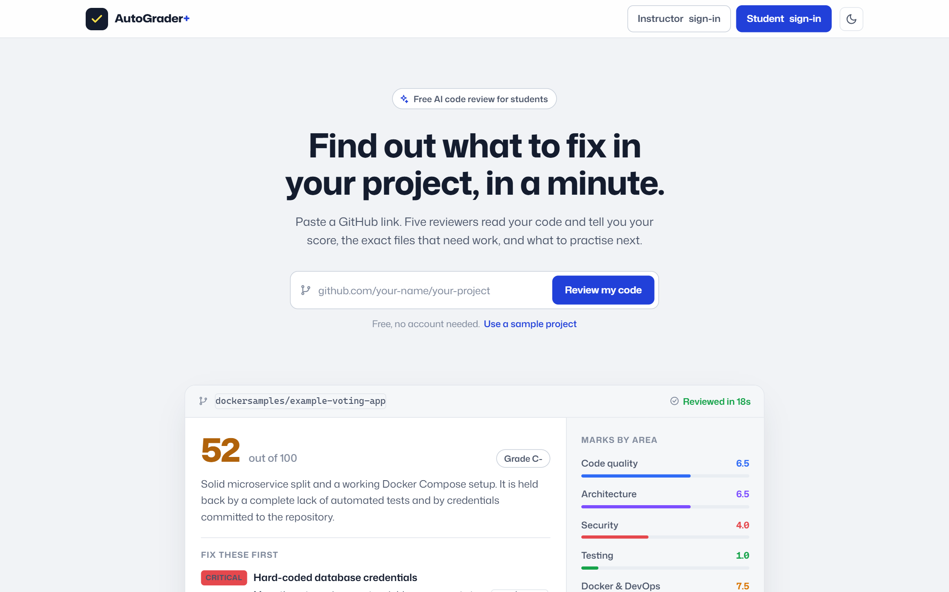
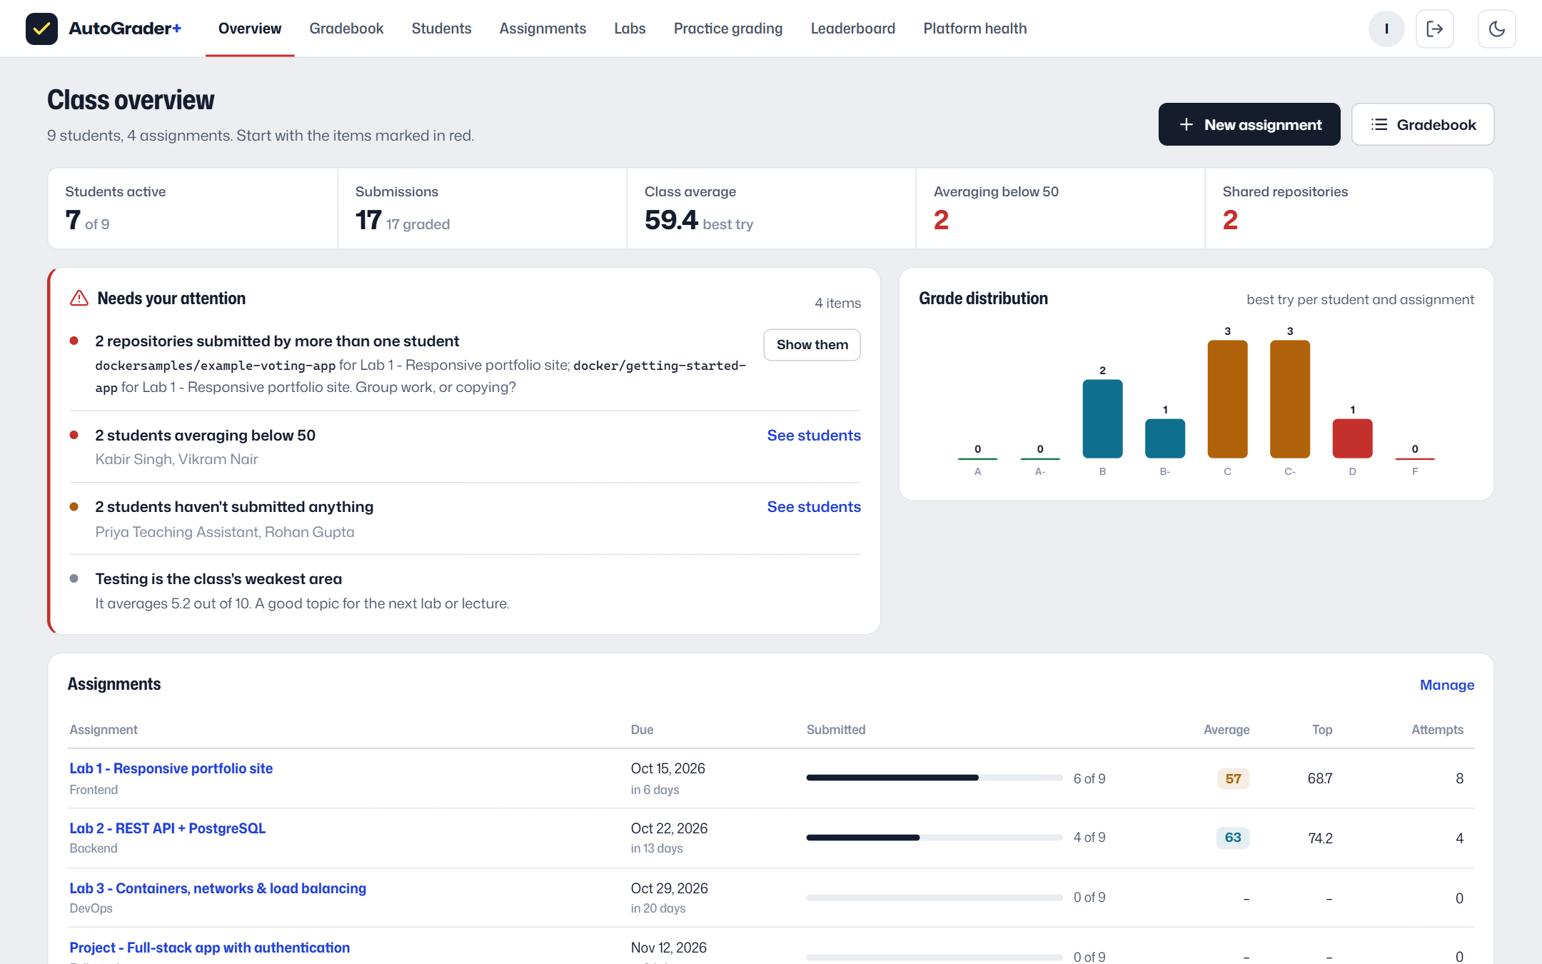
✓
AutoGrader+
Your repository, marked like a code review
Multi-agent grading + a full-stack learning platform
Live: autograder-plus.onrender.com
Code: github.com/roshanraj9136/auto-grader
CSL100 group project
Notes:
AutoGrader+ grades a student's whole full-stack project from its GitHub link and turns the result into feedback they can act on. Around the grader we built a learning platform with two different views: one for students and one for instructors. The site is live at the link on the slide, and everything I show today is running there.

Slide 2
Motivation
Why we built it
Grading full-stack projects by hand
What we wanted instead
• Slow. Every project has a frontend, an API, a database and a Dockerfile to read.
• Inconsistent. Two graders give the same project different marks.
• Late feedback. Students hear what was wrong after the deadline, when it no longer helps.
• No overview. Instructors can't easily see who is struggling or who copied.
• Feedback in about a minute, with the file and the fix.
• Reproducible scores: the total is computed in code from published weights.
• Students improve and resubmit; their best attempt counts.
• Instructors see the class: who needs help, the distribution, possible copying.
AutoGrader+ 2 / 19
Notes:
The problem: grading full-stack projects is slow and inconsistent, and feedback arrives too late to help. Our goals were feedback in about a minute, scores anyone can reproduce, a loop where students improve and resubmit, and a clear class picture for instructors.

Slide 3
Overview
What AutoGrader+ is
Grading engine
5 specialist reviewers run in parallel
1 judge calibrates and explains
score, priorities, learning path
Student view
assignments with visible rubrics
live progress, detailed feedback
dashboard, XP, labs
Instructor view
what needs attention, gradebook
assignment analytics, copy detection
grade adjustment, re-runs
Five reviewers, one area each
Code quality
readable, well-structured code
Architecture
layers, coupling, API and DB design
Security
OWASP Top 10, secrets
Testing
unit, integration, CI
Docker & DevOps
images, compose, delivery
Runs on free AI models (Groq: GPT-OSS 20B and 120B) or Claude, or with no API key on rule-based scorers through the same pipeline (heuristic mode).
AutoGrader+ 3 / 19
Notes:
Three parts. The grading engine: five reviewers, each responsible for one area, and a judge on top. The student view and the instructor view are built around what each group needs. Without an API key the same pipeline runs with deterministic rule-based scorers, which is how the public demo runs.

Slide 4
Architecture
System architecture
PostgreSQL
accounts, grades, reports
API replica 1
FastAPI: REST + SSE + grading
GitHub
shallow clone
Browser / phone
web app, PWA
Nginx load balancer
round-robin, least-conn, sticky
API replica 2
FastAPI: REST + SSE + grading
HTTPS
AI model API
5 reviewers + judge
API replica 3
FastAPI: REST + SSE + grading
Docker sandbox
optional build + run
• Stateless replicas: all shared state (users, sessions, submissions, reports) lives in PostgreSQL, so any replica serves any page.
• Durable event log: every progress event is also stored in PostgreSQL, so any replica can stream any job (no sticky routing needed).
• Deployed: one container on Render + Neon PostgreSQL; locally docker compose runs Nginx + 3 replicas + PostgreSQL.
AutoGrader+ 4 / 19
Notes:
The browser talks to an Nginx load balancer, which spreads requests over three identical FastAPI replicas. Each replica serves the web app and the API and runs grading jobs. Everything shared lives in PostgreSQL, so replicas are stateless and can be scaled. Even the live progress of a job is written to the database as it happens, so any replica can stream it. The public deployment is a single container on Render with a Neon database; the code is identical.

Slide 5
Grading pipeline
What happens to one submission
1
Admission
5
Docker
queue limit, single-flight de-duplication, submission recorded
20+ rule linter always; locked-down build and run optional
2
Resolve + clone
6
5 reviewers in parallel
git ls-remote and a shallow clone start in parallel
ranked evidence, 3.6k–7.2k tokens each, forced JSON schema output
3
Cache lookup
7
Judge
same commit, Dockerfile, rubric and models: report back in 1.2 s
reads ~1k tokens of reports, may move each area ±1.5 with a reason
4
Index
8
Report
one pass (~35 ms): languages, tests, CI, Dockerfiles, dependency graph, secret scan
score computed in code; HTML, Markdown, JSON saved to disk and PostgreSQL
The browser follows every stage live over Server-Sent Events; if the stream drops it falls back to polling.
AutoGrader+ 5 / 19
Notes:
Eight steps. Admission control limits concurrent jobs and attaches duplicate requests to the running job. Resolving the commit and cloning start together. If the same commit was graded before with the same rubric, the cached report comes back in about a second. Indexing reads the repository once. The Dockerfile is linted. Then the five reviewers run at the same time on evidence picked for them, the judge calibrates, and the report is written.

Slide 6
Grading pipeline
Stages overlap: the pipeline is a graph
code quality
architecture
resolve
index
cache
security
judge
report
clone
docker
testing
devops
T_total ≈ max(T_resolve, T_clone) + max(T_index + max(T_reviewer 1–4), T_docker + T_devops) + T_judge
Only the DevOps reviewer waits for Docker; the other four start right after indexing, so a slow build overlaps with model calls. Each report records its measured critical path and the speed-up over running the same stages in sequence.
AutoGrader+ 6 / 19
Notes:
This is why it is fast. The pipeline is a dependency graph, not a list. The total time is the longest path through the graph, not the sum of all stages. The model phase costs the slowest reviewer, not five reviewers in a row, and the Docker build overlaps with four of them.

Slide 7
Agents
Multi-agent design
Agent | Area | Evidence it sees (picked from the shared index)
Code Quality | readability, size, duplication | largest files, a diverse sample, duplication and comment metrics
Architecture | layers, coupling, API/DB design | entrypoints, routes/services/models, dependency graph and cycles, compose
Security | OWASP Top 10 | secret-scanner and risky-pattern hits (redacted), auth files, .gitignore
Testing | unit, integration, e2e, CI | test files, test-to-source ratio, CI workflows, test scripts
DevOps & Docker | containers and delivery | Dockerfile, 20+ lint rules, build/run result, compose, CI
Judge | final verdict | only the five compact structured reports, never raw code
• Structured output: every call uses forced tool use with a JSON schema; scores are clamped and validated in code.
• Bounded judge: can move each area by at most ±1.5 and must give a rationale; it calibrates, it does not re-grade.
• Graceful degradation: a reviewer that errors or misses its deadline falls back to its rule-based scorer, and the report says so.
AutoGrader+ 7 / 19
Notes:
Each reviewer sees only the evidence relevant to its area, chosen from one shared index of the repository. They must answer in a fixed JSON schema, so nothing is parsed from free text. The judge sees only their reports, which keeps it fast and cheap, and it is limited to small, explained adjustments.

Slide 8
Scoring
Scoring is computed in code
final score = 10 × Σ (weight_area × score_area)
• Each area is scored 0–10 by its reviewer, then calibrated by the judge (±1.5 at most).
• Weights are set per assignment and shown to students before they submit (default: code 25%, architecture 25%, testing 20%, security 15%, DevOps 15%).
• Best attempt counts: students can resubmit as often as they want.
• Instructor adjustment: a score can be set by hand with a written reason; the original is kept and can be restored, and the student sees the reason.
Grade | A | A- | B | B- | C | C- | D | F
Score from | 85 | 78 | 70 | 62 | 55 | 48 | 40 | 0
Why in code?
The same area scores always give the same total.
Every grade can be audited and explained.
Models judge quality; arithmetic stays deterministic.
AutoGrader+ 8 / 19
Notes:
The model never produces the final number. Each area gets a score from zero to ten, the judge can nudge it slightly, and the total is a weighted sum computed in code with the assignment's published weights. That makes grades reproducible. Instructors can still override a grade, but they must write a reason, the original is kept, and the student sees it.

Slide 9
Performance
Latency engineering
Technique | Effect
Fan-out of 5 reviewers | model phase costs the slowest reviewer, not the sum
Docker overlapped with reviewers | build leaves the critical path
Speculative clone ‖ ls-remote | a cache miss pays nothing for resolution
Content-addressed result cache | unchanged code re-graded in 1.2 s
Single-flight de-duplication | identical in-flight requests share one job
One-pass indexer | 35 ms for an 8-service repository
Ranked evidence + char budgets | 3.6k–7.2k input tokens per reviewer
Shared prompt prefix | byte-identical across reviewers for prompt caching
Capped output | ≤7 findings, short summaries (decoding dominates latency)
Non-blocking I/O | git, docker, indexing in worker threads; SSE keeps flowing
AutoGrader+ 9 / 19
Notes:
These are the techniques behind the speed, each with its effect. The biggest wins are running the reviewers in parallel, keeping Docker off the critical path, and caching results by commit so an unchanged project is re-graded in about a second.

Slide 10
Performance
Measured results
27.5 s
5 reviewers + judge, end to end
75.5 s
same stages in sequence
2.74×
speed-up from the graph
1.2 s
re-grade with a cache hit
Benchmark: scripts/latency_benchmark.py on dockersamples/example-voting-app, real clone, index, lint and judge logic; model latency simulated (0.8 s to first token, 20k in / 70 out tokens per second).
Stage | Typical | Hard limit
Resolve + clone | 0.8–2.5 s | 120 s
Index | < 0.1 s | 5,000 files, 40 MB
Each reviewer | 10–25 s | 120 s, then rule-based fallback
Docker build + run | 20–300 s | 600 s + 8 s run
Judge | 8–15 s | 150 s, then rule-based
Observed, not guessed
GET /api/metrics returns rolling p50 / p95 / max per stage.
The Platform health page shows them live.
Critical path: clone → index → security → judge → report.
AutoGrader+ 10 / 19
Notes:
On the benchmark repository the full grading takes 27.5 seconds instead of 75.5 if the stages ran one after another, a 2.74 times speed-up. A re-grade of unchanged code is answered from the cache in 1.2 seconds. Every stage has a hard limit, so the worst case is bounded, and the server reports its real p50 and p95 per stage.

Slide 11
Engineering
Reliability and scaling
• Timeouts everywhere: git, Docker, every model call and the judge.
• Retries with backoff for 429 and 5xx; a global semaphore queues model calls instead of causing retry storms.
• Admission control: a concurrency limit with a visible queue position.
• Heartbeats every 20 s: a replica that stops is detected; its unfinished gradings are failed and its files cleaned.
• Reports survive restarts: atomic writes plus a copy in PostgreSQL (free hosts wipe the disk).
• Replayable streams: events are stored in order; any replica serves them, and a dead replica's job ends with its saved outcome.
Scaling path
Today: stateless replicas + durable event log: add replicas to scale.
1. PostgreSQL work queue: workers claim jobs with FOR UPDATE SKIP LOCKED; jobs survive restarts.
2. Separate web and worker roles (Autolab-style queue + worker pool).
3. Isolated Docker build workers, a fresh environment per submission.
4. Reports in object storage; retry one reviewer, not the whole job.
5. Courses: one deployment, many classes.
AutoGrader+ 11 / 19
Notes:
Every external call has a deadline, failures degrade one area instead of the whole job, and replicas watch each other through heartbeats in the database so nothing hangs if one dies. Progress events are stored in the database, so adding replicas is enough to scale the web tier. The next step, following how Autolab scales, is a durable work queue in PostgreSQL using SKIP LOCKED, with separate worker processes that claim jobs.

Slide 12
Engineering
Security
Threat | Defence
Malicious repository input | only https://github.com/owner/repo; validated refs; no shell; git never prompts
Secrets in student code | 9 scanner rules; values redacted before any prompt or report
Untrusted Docker builds | no network, 512 MB, 1 CPU, 256 pids, all caps dropped; opt-in only
Stolen database | scrypt password hashes; session tokens stored only as SHA-256
Students reading others' data | every instructor route checks the role on the server; reports only for their owner
Password guessing | throttled per client IP (Cloudflare header, never forgeable X-Forwarded-For) and per account
Public demo misuse | only a demo student login is public; sign-up closed; demo logins read-only
Grade tampering | adjusted grade pinned in every view until restored; no student endpoint writes a score
Cross-site attacks | SameSite + Secure cookies, cross-site request blocking, strict CSP, HSTS, no framing
Spreadsheet injection | CSV gradebook neutralises formulas
AutoGrader+ 12 / 19
Notes:
Security covers both the grader, which runs untrusted student code, and the platform. Repository input is restricted, secrets are redacted before anything reaches a model, and the Docker sandbox is locked down. On the platform side, roles are checked on the server for every instructor action, so a student cannot change any grade, sign-in is throttled against password guessing, and the public demo has only a student login. We verified these with an automated script of 44 checks.

Slide 13
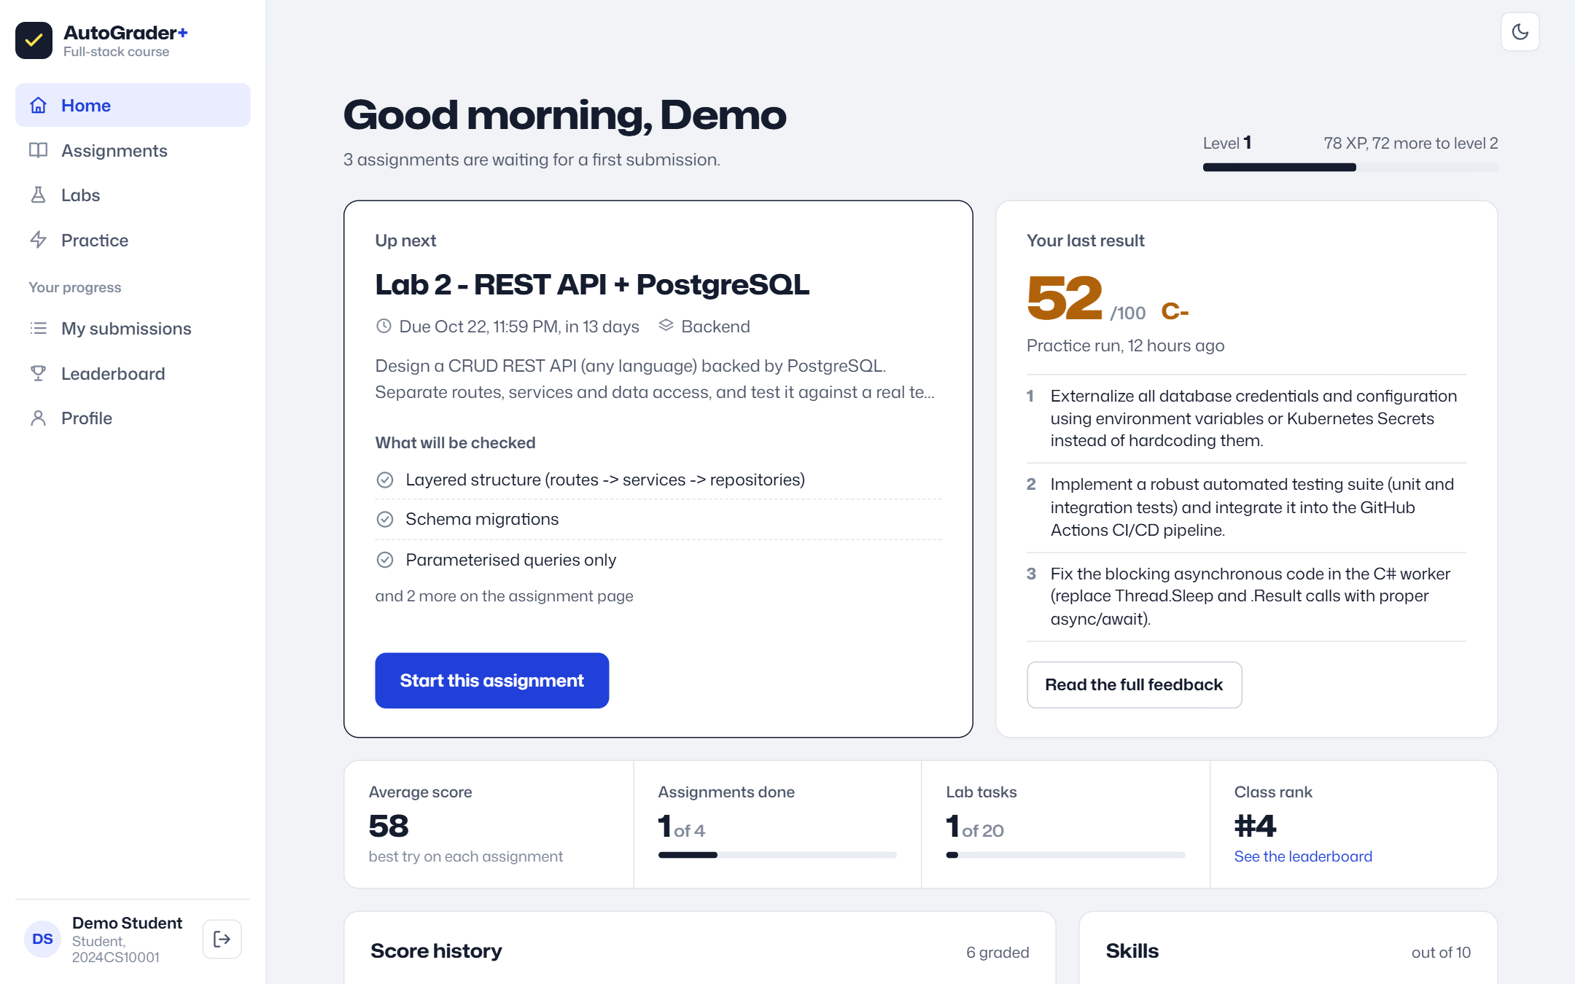
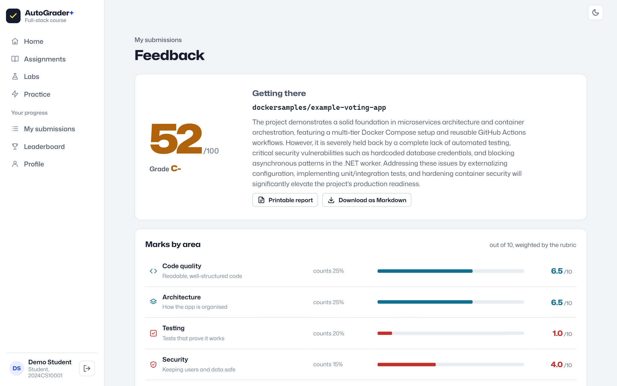
Students
Student view: what to do next
• Dashboard: the next assignment, the last result with the first three things to fix, progress, skills, deadlines.
• Feedback: the score, marks by area with weights, numbered priorities with file names, topics to learn, every finding with its fix.
AutoGrader+ 13 / 19
Notes:
The student view answers one question: what should I do next. The dashboard opens with the next assignment and the last result with the three most important fixes. The feedback page shows the score, marks by area with the rubric weights, the priorities with file names, and what to learn next.

Slide 14
Instructors
Instructor view: what needs attention
• Needs your attention: shared repositories, failed gradings, students below 50, students who haven't started, low completion near a deadline, the weakest area.
• Class numbers: active students, submissions, class average.
• Assignments: completion, average and top score per assignment.
• Latest submissions: filter by shared repo, failed, in progress.
AutoGrader+ 14 / 19
Notes:
The instructor view is built for a desk and dense information. The overview starts with a short list of things that need attention, so the instructor knows where to look first, followed by the class numbers and the assignment table.

Slide 15
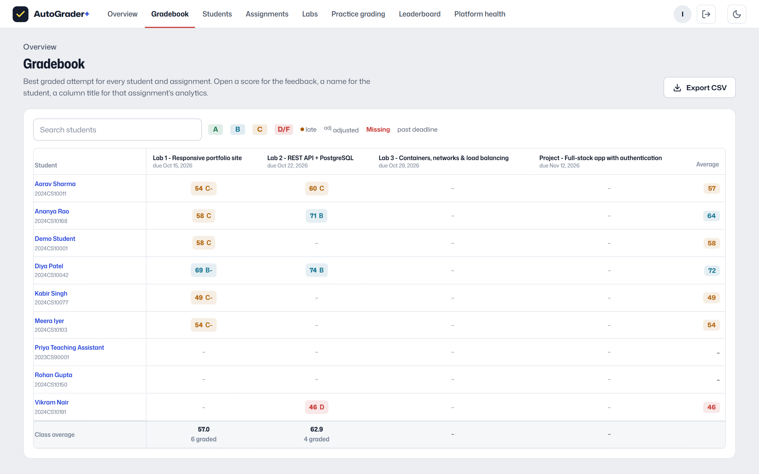
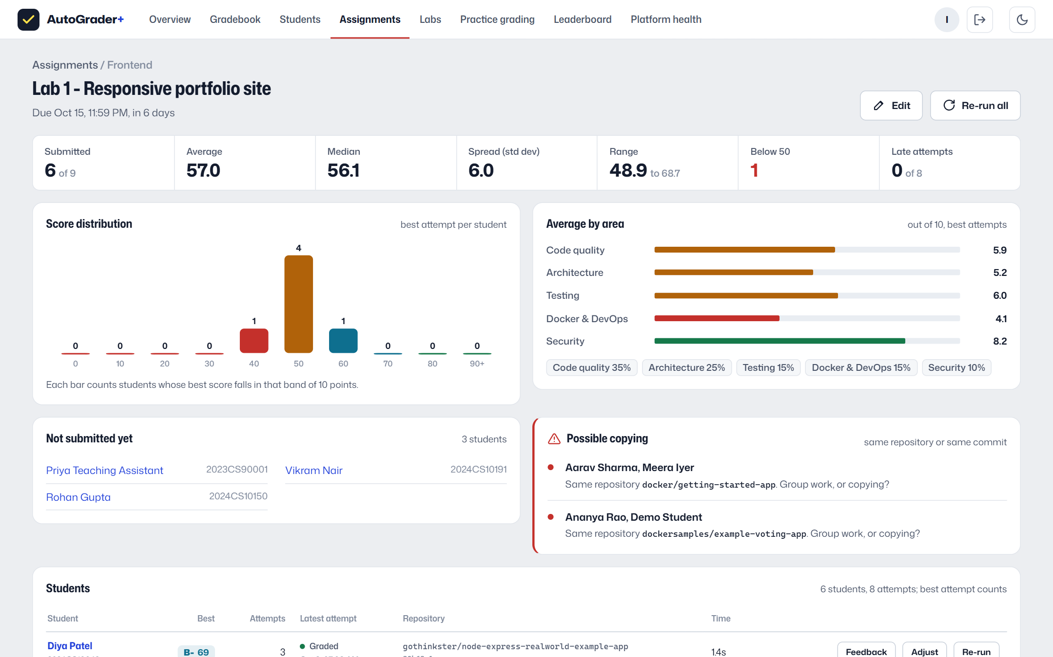
Instructors
Gradebook and assignment analytics
• Gradebook: every student × assignment, late and adjusted marks, missing work after the deadline, class averages, CSV export.
• Analytics: mean, median, spread, range, distribution, area averages, submissions per day, who hasn't submitted, possible copying.
• Actions: adjust a grade with a reason, re-run one submission, or re-run the whole assignment after changing its rubric.
AutoGrader+ 15 / 19
Notes:
Inspired by Gradescope and CodeGrade. The gradebook shows every student against every assignment. Each assignment has an analytics page with the statistics and the distribution, which students have not submitted, and possible copying, detected when two students submit the same repository or the same commit. From there the instructor can adjust a grade with a reason or re-run grading.

Slide 16
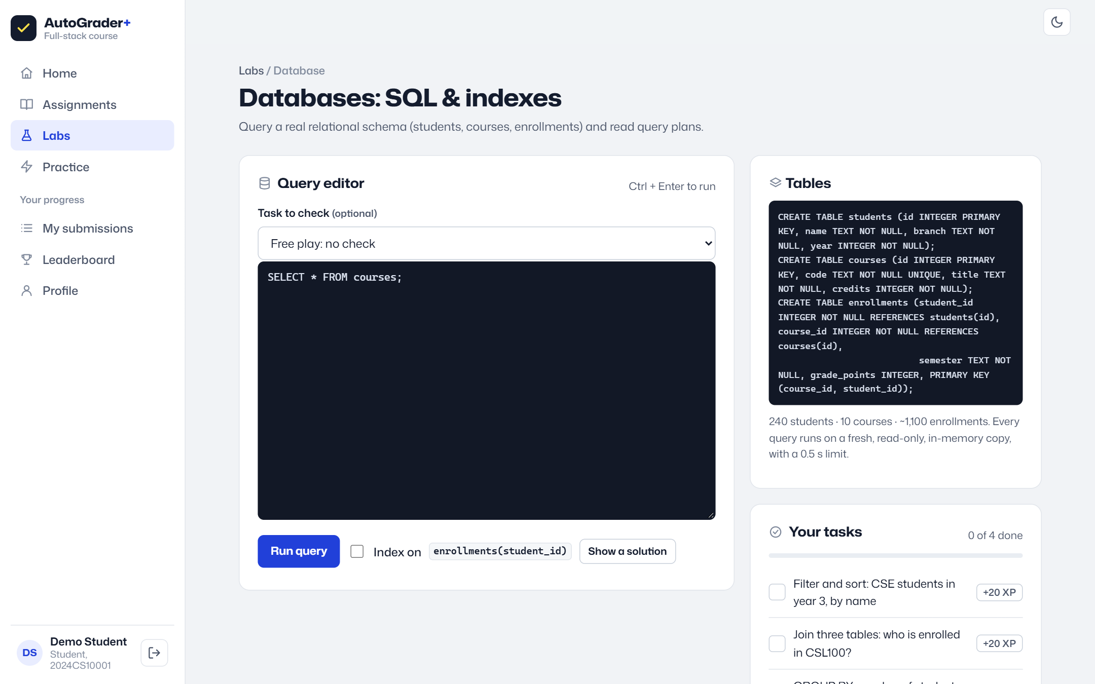
Students
Hands-on labs
• Frontend: HTML, CSS and JS editor with a sandboxed live preview and DOM checks.
• Testing: write test cases for a marking function; the server replays them against four seeded bugs.
• Databases: SQL on a real schema; the server checks answers; see an index change the query plan.
• Load balancers: real requests through Nginx to the replicas: round-robin, least-connections, sticky.
• Networks: round-trip time, jitter, proxy headers, Server-Timing breakdown.
• Docker: fix a Dockerfile with the same 20+ rule linter the grader uses.
• XP only for server-verified tasks, so the leaderboard can't be inflated from the browser.
AutoGrader+ 16 / 19
Notes:
The labs let students practise each layer. They are not simulations: the SQL lab runs real queries checked by the server, and the load-balancer lab sends real requests to the replicas. The labs page also opens with 'Start here': the next tasks, chosen from the student's weakest graded area, so practice follows their own review. The testing lab is mutation testing - a suite only counts when it fails on the broken versions of the function.

Slide 17
Engineering
Data model, stack and deployment
Table | Stores
users | students and instructors, scrypt hash, role
sessions | SHA-256 of session tokens, expiry
assignments | brief, track, rubric weights, checklist, deadline
submissions | each attempt: repo, status, score, area scores, priorities
grade_overrides | instructor adjustments: original, new, reason, who
job_events | progress events, so any replica can stream any job
report_artifacts | full HTML / Markdown / JSON reports
lab_progress | completed lab tasks
Tech stack
Python 3.12, FastAPI, asyncio, Pydantic v2
Free Groq models or Claude (forced tool use), or heuristics
PostgreSQL (psycopg 3) or SQLite
HTML/CSS/JS modules, SVG charts, SSE, PWA
Deployment
Docker: multi-stage, non-root, healthcheck
Render (free web service, auto-deploy from main)
Neon PostgreSQL (free, Singapore)
Local: docker compose = Nginx + 3 replicas + Postgres
AutoGrader+ 17 / 19
Notes:
Seven tables hold everything. The same SQL runs on SQLite for local use and PostgreSQL in production, without an ORM. The app ships as one Docker image that follows the same rules our DevOps reviewer checks.

Slide 18
Wrap-up
Limitations and next steps
Limitations today
Next steps
• A grading runs inside the server that accepted it; a restart fails it (the student resubmits).
• Docker builds run student RUN steps, so the sandbox is opt-in and meant for a dedicated VM.
• Copy detection compares repositories and commits, not code similarity.
• The free host sleeps after 15 minutes; the first visit takes about a minute.
• PostgreSQL work queue (SKIP LOCKED) and worker roles: jobs survive restarts.
• Token-level similarity (JPlag-style) across submissions.
• Per-student containers so each student's backend runs on the platform.
• Regrade requests from students, deadline extensions per student.
AutoGrader+ 18 / 19
Notes:
Being honest about limits: a grading lives in the server that accepted it, the Docker sandbox is opt-in for safety, copy detection is by repository and commit, and the free host sleeps. The next steps address each of these.

Slide 19
Thank you
Live demo
1
Open autograder-plus.onrender.com (allow a minute if it was asleep)
Links
Live: autograder-plus.onrender.com
Code: github.com/roshanraj9136/auto-grader
Design: docs/ARCHITECTURE.md
Report: docs/AutoGrader-Report.pdf
Demo logins are on the sign-in page
2
Sign in → Student view: dashboard, feedback, labs
3
Submit a repository and watch the reviewers run
4
Sign in with the instructor account
5
Overview → Gradebook → an assignment's analytics
6
Platform health: live latency per stage
Questions?
AutoGrader+ 19 / 19
Notes:
Demo plan: open the live site, look at the student side, submit a repository and watch the reviewers run in parallel, then the instructor side: overview, gradebook and an assignment's analytics, and finally the Platform health page with the live latency numbers. Thank you; happy to take questions.

