Slide 1
CVPR 2025 · DFD-FCG · EXPLAINABILITY STUDY
Why does the deepfake detector say YES or NO?
Exact spatial vs temporal attribution for a frozen-CLIP video deepfake detector
REAL SAMPLE 000.MP4
FAKE SAMPLE 000_003.MP4
ATTRIBUTION METHOD
REAL · P=0.421
FAKE · P=0.932
Exact, not estimated
correct ✓ 88% of clips agree
driver: TEMPORAL 70.9%
correct ✓ 100% of clips agree
driver: SPATIAL 50.4% · eyes
reproduces every head logit
to 9e-08
• Both FaceForensics++ samples shipped with the repository are classified correctly.
• Each decision is split — exactly — into a spatial vs temporal share, then into facial regions (patches around eyes / nose / lips / skin), patches and encoder layers.
• Stress-tested on the authors' own 7 perturbations × 3 severities: 12/21 false positives, 2/21 false negatives.
Released FFG ViT-L/14 checkpoint · 303.4 M parameters, only 0.25 M trained (0.08%)

Slide 2
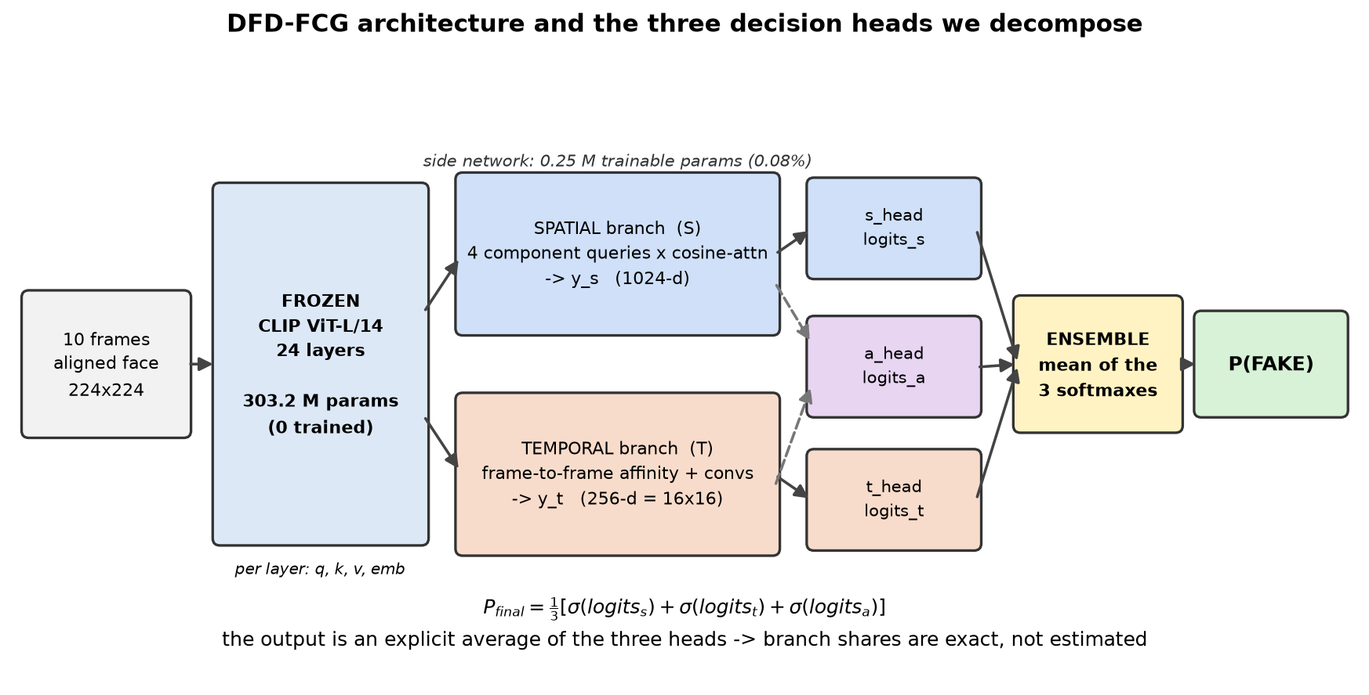
BACKGROUND
What the authors built
A small side network reads a frozen CLIP encoder
• CLIP ViT-L/14 is FROZEN — none of the 303 M backbone parameters are trained.
• A side network (0.25 M params) taps the q / k / v / embedding tensors of all 24 layers.
• SPATIAL branch (S): four learned queries — lips, skin, eyes, nose — attend over image patches. This is Facial Component Guidance.
• TEMPORAL branch (T): frame-to-frame affinity per patch, then convolutions; the output is a 16×16 map.
• Three heads vote: s_head, t_head and fusion a_head.
TRAINABLE
INPUT
0.08%
10 frames
0.25 M of 303.4 M
3 s clip, aligned face
Why this architecture is unusually explainable:
• the score is an explicit mean of three heads;
• y_s and y_t are sums over 24 layers, 4 components and 256 patches.

Slide 3
METHOD
How we measure each contribution
No gradients, no surrogate model, no approximation
The decision is a 2-class softmax, so the entire verdict is one number:
d = logit(FAKE) − logit(REAL), P(FAKE) = σ(d)
Each head is a LayerNorm followed by a Linear layer, and its input is a SUM of parts (24 layers; 4 components; 256 patches).
Because the LayerNorm mean is itself additive over those parts, d splits exactly:
d = Σₖ contribution(part k) + constant
Each contribution is a true share of the real logit — together they reproduce the model's own output with no residual.
RECONSTRUCTION ERROR
ADDITIVITY
9e-08
exact
instrumented vs untouched
verified 1e-16 in float64
Branch split = Shapley values over {S, T}:
• v(∅)=0.5, v({S})=s_head P, v({T})=t_head P, v({S,T})=final P
• φ_S + φ_T = P_final − 0.5 holds exactly
• the spatial head provably never reads the temporal branch, so a branch ablation is exact for this checkpoint
What this yields for every 3-second clip:
• spatial vs temporal percentage share - contribution of lips / skin / eyes / nose
• a 16×16 temporal evidence map - per-layer contribution across 24 CLIP layers

Slide 4
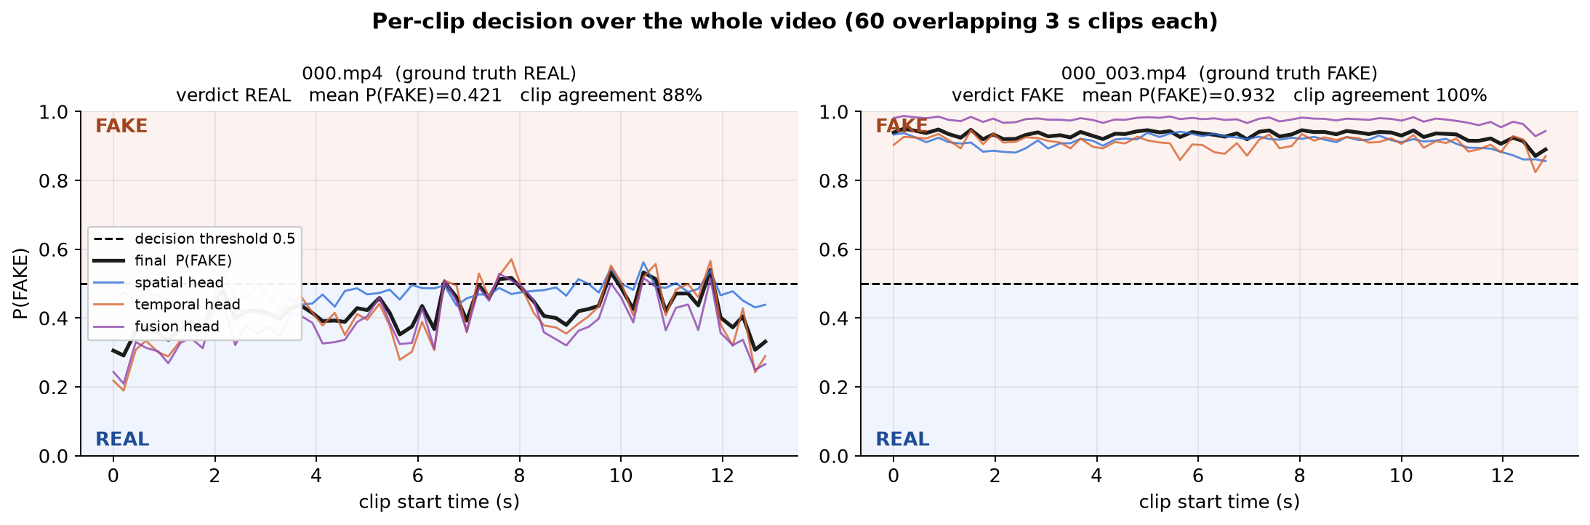
RESULT 1
The verdicts
60 overlapping 3-second clips per video
video | truth | verdict | mean P(FAKE) | range | clips correct
000.mp4 | REAL | REAL ✓ | 0.421 | 0.29 – 0.54 | 88% (53/60)
000_003.mp4 | FAKE | FAKE ✓ | 0.932 | 0.87 – 0.95 | 100% (60/60)
• The fake is detected confidently with zero disagreement across all 60 clips.
• The real video stays below threshold but much closer to it (0.42), and 7 of 60 clips drift over — the model is more certain about fakes than about reals.

Slide 5
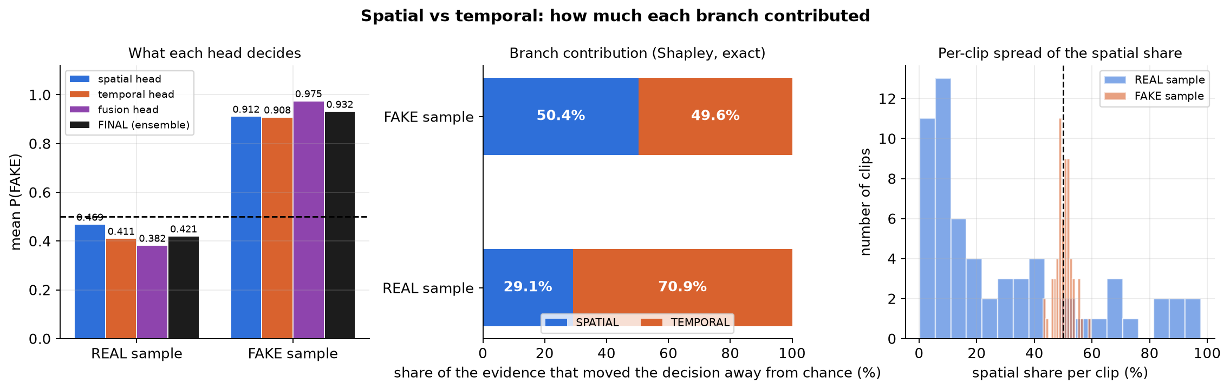
RESULT 2
Spatial vs temporal: the headline answer
Share of the evidence that moved each decision away from chance
video | verdict | SPATIAL | TEMPORAL | dominant branch | clips where S wins
000.mp4 | REAL | 29.1% | 70.9% | TEMPORAL | 13/60
000_003.mp4 | FAKE | 50.4% | 49.6% | balanced (S slightly ahead) | 33/60
• Saying FAKE is a JOINT decision: spatial 50.4% vs temporal 49.6%, with the branches agreeing on 100% of clips.
• Saying REAL is mostly TEMPORAL (70.9%): the evidence for authenticity is consistent motion, not clean-looking frames.

Slide 6
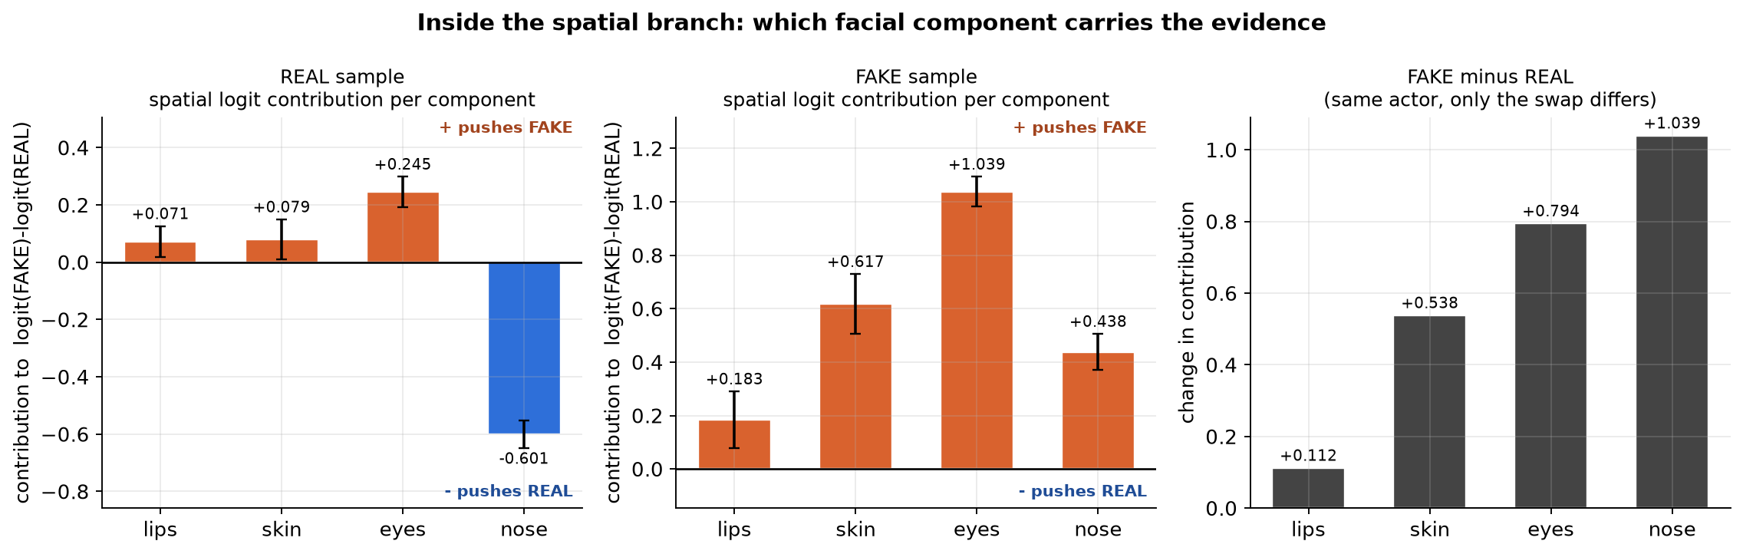
RESULT 3A
Why it said YES — view 1: the model's own components
Decomposing the spatial branch over its four guided queries (feature space)
component query | FAKE contrib. | share | REAL contrib. | share | change (F−R)
eyes | +1.039 | 45.6% | +0.245 | 24.5% | +0.794
skin | +0.617 | 27.1% | +0.079 | 8.0% | +0.538
nose | +0.438 | 19.2% | -0.601 | 60.3% | +1.039
lips | +0.183 | 8.0% | +0.071 | 7.2% | +0.112
• MAIN CAUSE of the FAKE verdict: the EYES query — 45.6% of the spatial evidence, then skin 27.1%.
• Caveat: a query is a learned embedding that attends over ALL 256 patches, so this is a FEATURE-space split, not a face-region split. Next slide does it by region.

Slide 7
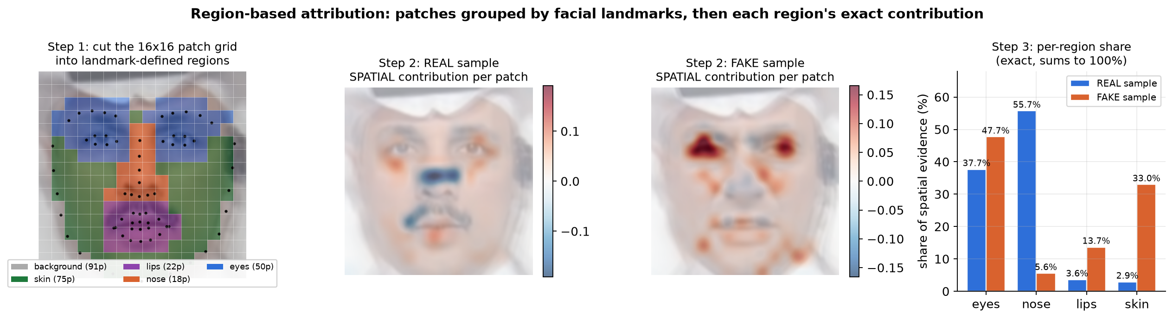
RESULT 3B
Why it said YES — view 2: patches grouped by face region
Cut the 16×16 patch grid into landmark-defined regions, then attribute each region
face region | patches | FAKE share | FAKE signed | REAL share | REAL signed
eyes | 46 | 47.7% | +1.1507 | 37.7% | +0.4331
nose | 18 | 5.6% | -0.1347 | 55.7% | -0.6402
lips | 27 | 13.7% | +0.3299 | 3.6% | +0.0416
skin | 70 | 33.0% | +0.7955 | 2.9% | +0.0337
• Same conclusion, now spatially localised: the EYE patches carry 47.7% of the FAKE evidence, skin 33.0%.
• In the REAL video the NOSE patches dominate (55.7%) and vote REAL (-0.6402). Exact: contributions sum to the head logit (error 4e-16).

Slide 8
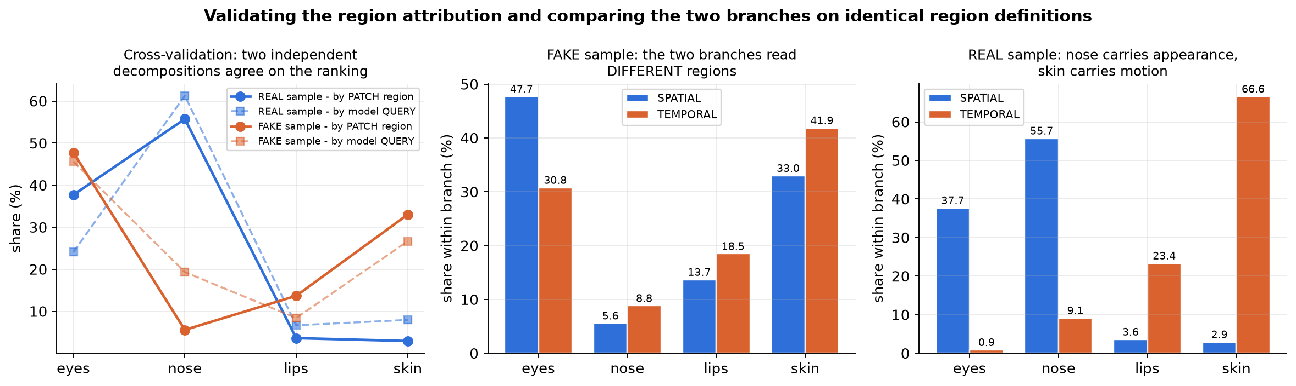
RESULT 3C
Do the two views agree? And where does each branch look?
Validating the region attribution, and comparing both branches on identical regions
query (named) | evidence from its OWN region | strongest region | verdict
eyes | 88.6% | eyes | localised ✓
skin | 79.5% | skin | localised ✓
lips | 86.0% | lips | localised ✓
nose | 9.1% | skin | DRIFTED ✗
Two findings:
• Both decompositions agree EYES dominate the fake — independent methods, same conclusion.
• 3 of 4 FCG queries sit on their own anatomy; the NOSE query drifts onto SKIN once the face is swapped (86% → 9%).
• The branches read DIFFERENT regions: for the fake, spatial favours eyes (47.7%) while temporal favours skin (41.9%) — they are not duplicating each other.

Slide 9
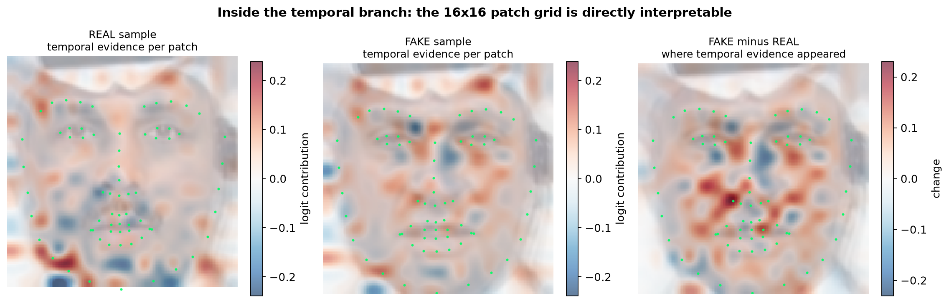
RESULT 4
Where in the face the temporal evidence lies
The temporal branch output is a 16×16 grid, so it maps straight back onto the face
Reading the maps:
• red = this patch pushed towards FAKE, blue = towards REAL;
• green dots are the averaged 68 facial landmarks;
• the right panel is FAKE minus REAL — exactly where the swap created new evidence.
zone (area-normalised) | REAL | FAKE | change
eyes | 0.0150 | 0.0399 | +0.0250
nose | 0.0342 | 0.0539 | +0.0197
mouth | 0.0244 | 0.0237 | -0.0007
jaw / contour | 0.0488 | 0.0306 | -0.0182
Biggest gains after the swap: eyes, nose, mouth — the same inner-face region the swap replaced.

Slide 10
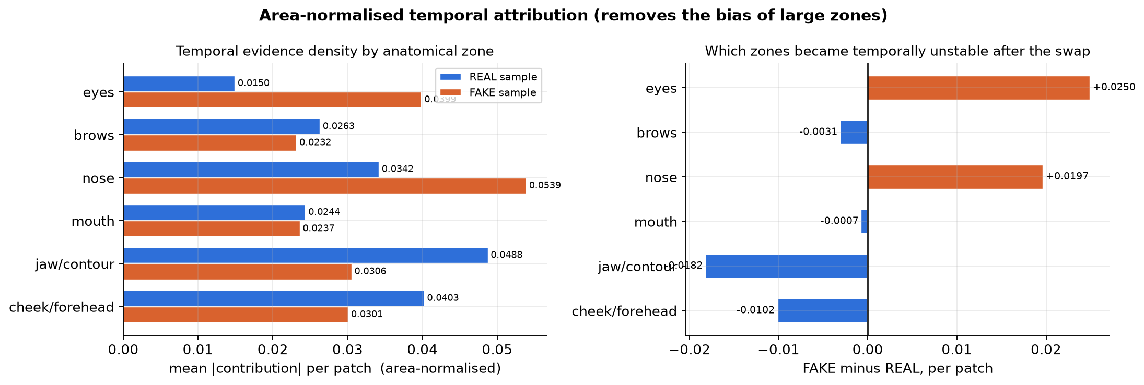
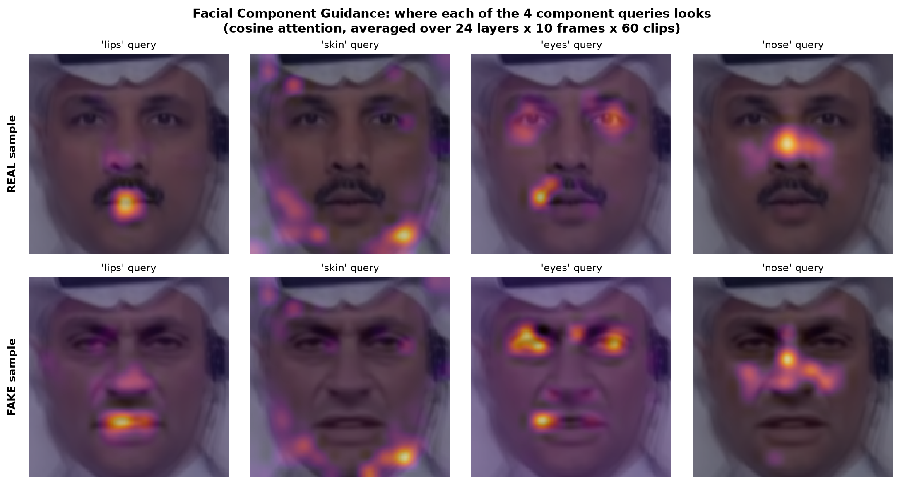
RESULT 5
Zone attribution and component attention
Area-normalising removes the advantage of physically large regions
Sanity check on FCG:
• each of the four queries lands on its own region,
• so the component percentages are anatomically meaningful,
• not four anonymous channels.

Slide 11
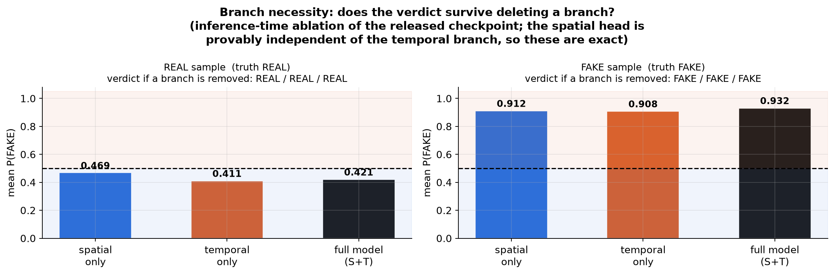
RESULT 6
Is one branch enough?
Inference-time ablation of the released checkpoint
FAKE SAMPLE
both sufficient
S alone 0.912 · T alone 0.908
REAL SAMPLE
both sufficient
S alone 0.469 · T alone 0.411
• On clean video either branch alone already reaches the correct verdict — the two are redundant here, not complementary.
• Fusion still adds confidence: the fake rises 0.91 → 0.93.
• That redundancy is exactly what breaks under degradation (next slide).
Per-clip branch agreement:
• fake: 100% - real: 87%

Slide 12
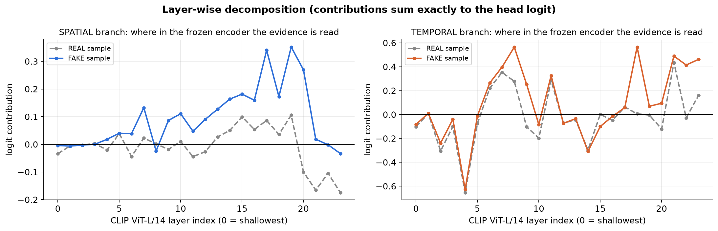
RESULT 7
Where in the frozen encoder the evidence comes from
Per-layer contributions across the 24 CLIP ViT-L/14 layers
• Spatial evidence concentrates in DEEP layers (top for the fake: 19, 17, 20) — semantic, identity-level features.
• Temporal evidence also draws on SHALLOW layers (top: 4, 18, 8) — low-level texture and motion cues.
• This is why a frozen backbone suffices: the two branches read genuinely different depths of the same encoder, which is the paper's core design claim.

Slide 13
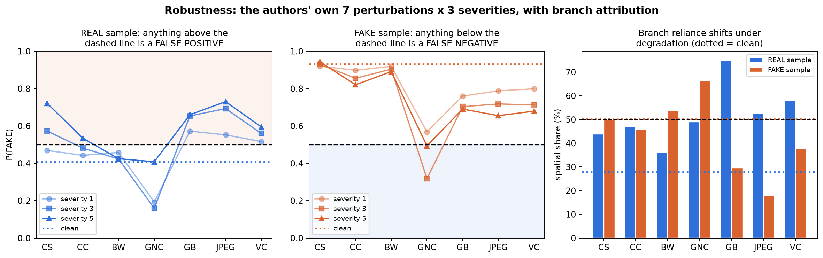
RESULT 8
Stress test on the authors' own protocol
7 perturbation types × 3 severity levels, same sample pair
FALSE POSITIVES
FALSE NEGATIVES
BLUR / COMPRESSION
BLOCK NOISE
12 / 21
2 / 21
always wrong
fully robust
REAL called FAKE
FAKE called REAL
GB, JPEG, VC at every level
BW correct at all levels
• The failure is strongly ASYMMETRIC: degradation pushes scores UP, so the model mistakes low quality for manipulation.
• Blur, JPEG-style resampling and H.264 compression flip the real video at every severity; Gaussian noise does the opposite and hides the fake.

Slide 14
RESULT 8 · TABLE
Robustness detail
Per-condition verdicts
condition | param | REAL P | verdict | FAKE P | verdict | error
clean | — | 0.408 | REAL | 0.931 | FAKE | —
CS L1 | 0.4 | 0.469 | REAL | 0.920 | FAKE | —
CS L3 | 0.2 | 0.573 | FAKE | 0.930 | FAKE | false positive
CS L5 | 0.0 | 0.721 | FAKE | 0.944 | FAKE | false positive
CC L1 | 0.85 | 0.443 | REAL | 0.898 | FAKE | —
CC L3 | 0.6 | 0.482 | REAL | 0.856 | FAKE | —
CC L5 | 0.35 | 0.535 | FAKE | 0.821 | FAKE | false positive
BW L1 | 16 | 0.458 | REAL | 0.920 | FAKE | —
BW L3 | 48 | 0.424 | REAL | 0.904 | FAKE | —
BW L5 | 80 | 0.425 | REAL | 0.891 | FAKE | —
GNC L1 | 0.001 | 0.193 | REAL | 0.568 | FAKE | —
GNC L3 | 0.005 | 0.160 | REAL | 0.319 | REAL | false negative
GNC L5 | 0.05 | 0.409 | REAL | 0.494 | REAL | false negative
GB L1 | 7 | 0.572 | FAKE | 0.760 | FAKE | false positive
GB L3 | 13 | 0.654 | FAKE | 0.703 | FAKE | false positive
GB L5 | 21 | 0.660 | FAKE | 0.691 | FAKE | false positive
JPEG L1 | 2 | 0.553 | FAKE | 0.788 | FAKE | false positive
JPEG L3 | 4 | 0.693 | FAKE | 0.718 | FAKE | false positive
JPEG L5 | 6 | 0.730 | FAKE | 0.655 | FAKE | false positive
VC L1 | 30 | 0.516 | FAKE | 0.799 | FAKE | false positive
VC L3 | 35 | 0.560 | FAKE | 0.713 | FAKE | false positive
VC L5 | 40 | 0.595 | FAKE | 0.679 | FAKE | false positive
CS colour saturation · CC colour contrast · BW block-wise noise · GNC Gaussian noise · GB Gaussian blur · JPEG down/up-sampling · VC H.264 compression

Slide 15
CONCLUSION
Answers to the question we set out to ask
WHEN IT SAYS FAKE (P = 0.932)
WHEN IT SAYS REAL (P = 0.421)
spatial 50.4% / temporal 49.6%
temporal 70.9% / spatial 29.1%
MAIN CAUSE: the EYES. By face region 47.7% of the spatial evidence; by the model's own query 45.6%. Two independent methods agree.
Second is skin (33.0%), which is also where the temporal branch looks (41.9%).
All 60 clips agree; either branch alone suffices.
MAIN CAUSE: temporal consistency — motion is coherent across frames.
Within the spatial branch the NOSE patches dominate (55.7%) and vote REAL (-0.640).
Lower margin: 7 of 60 clips cross the threshold.
What this tells us about the model
• Fake detection is driven by the EYES (47.7% of spatial evidence); authenticity is confirmed by MOTION CONSISTENCY (70.9%) — the two verdicts are not mirror images.
• The two branches look at different regions (spatial → eyes, temporal → skin), so they are genuinely reading different evidence even though either alone suffices on clean video.
• Facial Component Guidance mostly works: 3 of 4 queries sit on their own anatomy, but the nose query drifts onto skin once the face is swapped.
• The real weakness is QUALITY, not forgery type: 12/21 degraded conditions raised a false alarm, because blur and compression push scores towards FAKE.
• Practical consequence: a quality-aware threshold or compression augmentation would help more than an extra branch.

Slide 16
APPENDIX
Method validity and limitations
Why these numbers can be trusted
• The instrumented model reproduces the untouched model's logits to 9e-08 — we are explaining the real checkpoint.
• Contributions form an exact additive split, verified to 1e-16 in float64; they sum to the model's own logit with no residual.
• The region decomposition reproduces the spatial head logit to 4e-16.
• TWO INDEPENDENT decompositions (by model query, and by landmark-defined patch region) agree that the eyes dominate the fake verdict.
• Shapley efficiency holds exactly: φ_S + φ_T = P_final − 0.5.
• All 569 checkpoint tensors load with 0 missing and 0 unexpected keys.
• Labels verified from FaceForensics++ naming and visually: the difference between the pair is confined to the inner face, 22.7× the background difference.
Limitations stated honestly
• Two videos only. These are the samples shipped with the repository; FaceForensics++, Celeb-DF and DFDC are EULA-gated and cannot be downloaded without a signed agreement, so no cross-dataset generalisation is claimed.
• Region boundaries come from nearest-landmark assignment on a 16×16 grid, so a patch straddling two regions is assigned to one. The per-patch contributions are exact; the grouping into regions is the approximate step.
• Single-branch numbers are inference-time ablations of this checkpoint, not models re-trained with op_mode=[S] or [T], which would converge to different weights.
• The robustness sweep uses 8 clips per condition; the main analysis 60, the region analysis 30.

Slide 17
APPENDIX
Reproducing this analysis
Pipeline
1. landmarks + bboxes python -m src.preprocess.fetch_landmark_bbox ...
2. aligned face cropping python -m src.preprocess.crop_main_face ...
3. exactness self-test python xai/smoke.py
4. main analysis, 60 clips/video python xai/run_analysis.py --max-clips 60
5. figures + derived metrics python xai/make_figures.py
6. REGION analysis (by patches) python xai/run_region_analysis.py --max-clips 30
7. region figures python xai/make_region_figures.py
8. robustness sweep python xai/run_robustness.py --levels 1 3 5
9. audits python xai/audit/audit_math2.py , audit_pipeline.py
10. deck python xai/build_deck.py
Environment: Windows, RTX 3050 Ti 4 GB (peak 2.5 GB at batch size 2), torch 2.6 + CUDA 12.4.
Outputs: xai/out/{report,derived,regions,robustness}.json + arrays.npz, regions.npz.
Checkpoint: released FFG ViT-L/14 weights from the authors' Google Drive link.
Han, Huang, Hua, Chen — Towards More General Video-based Deepfake Detection through Facial Component Guided Adaptation for Foundation Model, CVPR 2025 · arXiv:2404.05583

