Slide 1
H
Harbormaster
AI Systems Architecture Review
Intelligent file-arrival control for financial reconciliation — a three-tier mapping ladder, quarantine and four-eyes review, hash-chained audit
Ship readiness complete · 12 September 2026 · Roshan Rana, AI Systems Architect

Slide 2
OVERVIEW
Executive summary
What it is
What it proves
Why it is enterprise-ready
The control layer between a bank's FTP landing directory / JSON queue and its reconciliation engine: six event-driven services (Go + Python) that decide which client a file belongs to, which value date it describes, and how its columns map onto one canonical schema.
It declines when it cannot decide, quarantines for a human, and records why.
A three-tier mapping ladder — alias dictionary, then fuzzy match, then a model — whose model dependence falls over time as confirmed mappings are cached and promoted into configuration.
97.7% field-mapping accuracy and 80.8% resolved without a model, measured against a 214-column hand-labelled corpus by a bench harness that reproduces the same numbers on every run.
Hash-chained, tamper-evident audit (an edited or deleted record is detected and the chain fails closed); quarantine with four-eyes review; masking of account numbers by default.
20 architecture decisions, 50 task packs, twelve named adversarial fixtures, 347 tests passing offline in this run, CI running the same gate.
Ask of the audience: agree the pilot scope (host-validated Docker run of make up / make test-e2e / HM_LIVE=1 make test-live, load test against the NFR-2 latency target) and whether Tier 2 embeddings (fastembed) ship enabled or degraded.
Harbormaster · AI Systems Architecture Review · 2

Slide 3
CONTEXT
The problem and the users
The bank's problem
The engine's constraint
Client, custodian and exchange reports land all day into one FTP directory as CSV, Excel, XML, FIXML and free-text email, plus a parallel JSON queue. Every venue names its columns differently, filenames are unreliable, and a file produced late at the client carries yesterday's business under today's date.
The downstream reconciliation engine is deliberately simple: it matches records for an expected file on each side. It has no opinion about which client, which value date, or which of four price columns is the trade price. It has to be told — correctly, or not at all.
Actor | Needs | Frequency
Reconciliation engine (downstream) | One canonical Parquet schema per file, with client, value date and side already resolved | Continuous, all day
Four-eyes reviewer | A specific reason for every quarantine, and the ability to correct, release or reject | On quarantine (0% of well-formed fixtures)
Client onboarding / ops team | Per-client YAML config; a promoted mapping resolves at Tier 1 forever after | As new clients or venues arrive
Compliance / auditor | A tamper-evident decision log that reconstructs any dispatch after the fact | On review, or on demand
Harbormaster · AI Systems Architecture Review · 3

Slide 4
APPROACH
Solution at a glance
1
Arrival
2
Classify
3
Map & score
4
Berth assignment
Portwatch detects a fully-written file or JSON payload, streams a SHA-256, and gates exact duplicates and same-content redeliveries by hash, not filename.
Inspector sniffs the format by content, attributes the client, and resolves the value date from three independent sources ranked by how much each actually knows.
The mapping ladder resolves every column — alias, then fuzzy, then a model for the residue — and a composed confidence routes to dispatch, quarantine or reject.
Berthmaster pairs both sides for the same client / domain / value date, handles the late window and supersession, and issues the assignment the recon engine consumes.
Six services, one log
Deterministic by default
Portwatch, Inspector, Berthmaster and Control plane over Kafka-compatible topics (Redpanda), a review queue with four-eyes decisions, and an operations console at /api/ops. Everything is replayable from offset zero.
The model tier is bound to a deterministic stand-in unless HM_ADJUDICATOR=claude and ANTHROPIC_API_KEY are set. make check and make bench run fully offline: no broker, no database, no network, no key.
Harbormaster · AI Systems Architecture Review · 4

Slide 5
ARCHITECTURE · C4 LEVEL 1
System context
FTP landing dir
Harbormaster
Redpanda (Kafka-compatible)
client / custodian files
8 durable topics; the event log is the audit trail
Ingestion
Portwatch (Go): write-completion, hashing, dedupe, JSON ingress
Upstream queue
Postgres 16
JSON payloads
read models, slot state, decision log, template cache
Inspector (Python)
format sniff · attribution · value date · mapping ladder T1/T2/T3 · confidence
Ops reviewer
Object store
browser, four-eyes
landed files + canonical Parquet; fs adapter default, S3 unwired
Berthmaster + Control plane (Go)
Recon engine
slot lifecycle · review queue · ops console /api/ops
Anthropic Claude (opt-in)
downstream, stubbed
Tier 3 adjudicator; deterministic fake bound by default
Docker (Redpanda, Postgres, all six services) is host-validated: not run in this build environment (ADR-018). The gate and the bench harness never touch a network.
Harbormaster · AI Systems Architecture Review · 5

Slide 6
ARCHITECTURE · C4 LEVEL 2
Component architecture
Portwatch (Go)
Inspector (Python)
Berthmaster (Go)
Control plane (Go)
scanner.go
parsers/*
slot state machine
web/
write-completion detection
delimited · excel · xml · fixml · email
expectation, late window
html/template + HTMX board
dedupe.go
attribution.py
supersession
/api/ops
content hashing gate
client scoring
void + replace, ordered
operator posture
ingress/queue.go
valuedate.py
missing-file alerts
review queue
JSON ingress path
3-source resolution
unmet expectations
four-eyes decisions
mapping/*
tier1 · tier2 · tier3 · resolver
confidence.py
dispatch/quarantine/reject
Message contracts are defined once in proto/ and generated for both languages with buf; protojson on the wire keeps topics human-readable for triage.
Harbormaster · AI Systems Architecture Review · 6

Slide 7
ARCHITECTURE · CRITICAL FLOW
The arrival-to-berth-assignment pipeline
1. Detect
2. Sniff & parse
3. Attribute
4. Resolve date
write-completion + SHA-256; exact duplicate and redelivery suppressed by content hash
format decided by content, not extension; six parsers behind one interface
client scored from filename patterns + embedded account IDs, not a priority list
filename, content and arrival time ranked; disagreement always flagged, never silent
5. Map columns
6. Score
7. Route
8. Assign berth
alias → fuzzy → model, one-way escalation, cached by template fingerprint
weighted composite confidence; material fields count 3× incidental ones
dispatch above threshold; quarantine to four-eyes; reject below the floor
both sides paired per client/domain/value-date; supersession replaces in order
Every stage records why it decided what it did. Audit is a property of the architecture: each decision appends to a hash-chained log, and read models are projections rebuildable from offset zero.
Harbormaster · AI Systems Architecture Review · 7

Slide 8
DESIGN · CORE MECHANISM
The mapping ladder: falling model dependence
Three escalating tiers, one-way
Structure over vocabulary
T1 alias dictionary (µs) 160/214 74.8%
T1 structural price rule 4/214 1.9%
T2 fuzzy match (ms) 8/214 3.7%
client override (promoted) 1/214 0.5%
T3 model, given the residue 5/214 2.3%
unresolved, declined 36/214 16.8%
settlement/mark/prior-settlement repeat per instrument-day; trade price varies per row — resolved by that shape, not the header text
Provenance on every field
each dispatched mapping carries a tier and non-empty evidence string; a mapping with no provenance is a defect
Each tier sees only what the previous one declined; a column T1 resolved is never re-litigated by a model
Results are cached by template fingerprint — the second file with a known layout costs nothing
A reviewer can promote a confirmed T3 decision into the client's T1 dictionary; it resolves at T1 forever after
Decline over guess
Measured, not hoped
a wrong mapping breaks reconciliation silently; unresolved becomes a review item instead
Second file with a known layout costs zero adjudications — asserted in test_correctness_targets_across_the_corpus, not claimed in prose.
Harbormaster · AI Systems Architecture Review · 8

Slide 9
ARCHITECTURE · DATA
Data architecture
8 Kafka-compatible topics
Postgres 16
Canonical output: Parquet, not CSV
hm.arrivals.raw (Portwatch→Inspector)
hm.arrivals.classified (30d)
hm.arrivals.quarantined (30d)
hm.review.decisions (30d)
hm.berth.assigned (90d)
hm.berth.superseded (90d)
hm.alerts.missing (30d)
hm.audit.decisions (compacted, infinite)
Partitioned by client:domain:value_date — ordering within a slot is structural, not a runtime hope.
Read models (arrival board, slot state), expectation state, hash-chained decision log, template mapping cache, review decisions. JSONB for variable-shape payloads.
Typed and columnar; a null settlement price survives distinctly from a zero one, which the downstream engine must not confuse (ADR-006).
Object store
Masking
Landed raw files + canonical Parquet output, behind an interface. Filesystem adapter is the default; an S3 adapter is implemented and unit-tested but unwired in the demo (ADR-015).
Account numbers masked to last-4 in logs and UI by default; account and client names stay visible. Applied in a serialisation hook, not per call site (ADR-011).
Contracts are defined once in proto/ and generated for Go and Python by buf; a cross-language round-trip test is part of the offline gate.
Harbormaster · AI Systems Architecture Review · 9

Slide 10
ARCHITECTURE · INTEGRATION
The model tier: opt-in, behind an interface
Off by default
Opt-in, explicit
HM_ADJUDICATOR defaults to fake — a deterministic stand-in bound behind the same MappingAdjudicator interface Claude implements. A misconfigured deployment runs without a model rather than failing to start.
HM_ADJUDICATOR=claude ANTHROPIC_API_KEY=sk-... make up enables the real tier; HM_LIVE=1 make test-live is the opt-in test against the live API. Every prior phase runs against the deterministic fake.
Bounded cost
What is and is not measured
Escalation is one-way; results are cached by template fingerprint. The second file with a given layout is resolved from cache and costs nothing — watch HM_ADJUDICATOR=claude logs for call and token counts.
Offline: which columns fall through to T3, and whether the stand-in and cache behave correctly (41 columns reached T3 here; 18 adjudication calls). Live-model mapping accuracy itself is pending — it needs the real key and is marked so in metrics/headline.json.
Harbormaster · AI Systems Architecture Review · 10

Slide 11
DESIGN DECISIONS
Design choices and why
Decision | Alternatives considered | Why this one
Three-tier mapping, not LLM-first (ADR-004) | A model call per column | 1,000 files/day × 10–40 columns makes per-column LLM calls slow, non-deterministic and unbounded in cost
Polyglot split: Go at the edges, Python in the middle (ADR-002) | Single-language stack | Portwatch/Berthmaster are I/O and state machines; Inspector is data shape and inference — each gets the right tool
Protobuf as the single source of truth (ADR-003) | Hand-written structs per language | Two languages on one topic will drift; proto-as-source turns that into a build failure, not a production incident
Poll the landing directory, not inotify (ADR-016) | fsnotify / inotify watcher | Landing dirs are NFS/SMB mounts; inotify silently misses remote-host writes exactly where it matters most
Server-rendered HTMX, not a React SPA (ADR-012) | React/TS/Vite front end | No Node, no bundler, no second dependency tree, for a live board plus a review form
fastembed (ONNX) over sentence-transformers (ADR-007) | sentence-transformers + PyTorch | ~90 MB CPU-only image instead of ~2 GB; degrades to fuzzy-only if unavailable, and says so
Topics provisioned by infrastructure, not the app (ADR-020) | Broker auto-create topics | A typo in a topic constant now fails loudly instead of silently stranding messages in a new topic
Harbormaster · AI Systems Architecture Review · 11

Slide 12
PRODUCT
Major features
The mapping ladder
Value-date resolution
Quarantine & four-eyes review
Alias dictionary → fuzzy/embedding match → model adjudication for the residue, with provenance on every field and promotion into client config
Three independent sources ranked by what they know, resolved against per-client business calendars; disagreements always flagged
Composite confidence routes to dispatch, quarantine or reject; no quarantined arrival ships without a recorded human decision
Hash-chained audit
Slot lifecycle & supersession
Operations console
Every classification and dispatch decision appends to a tamper-evident chain; a verifier walks it and reports the first break
Expectation state machine per client/domain/value-date, a T±2 late window, and ordered void-then-replace on correction
Embedded Go templates + HTMX over Postgres read models, projected from the topics; /api/ops for whoever is on call
Harbormaster · AI Systems Architecture Review · 12

Slide 13
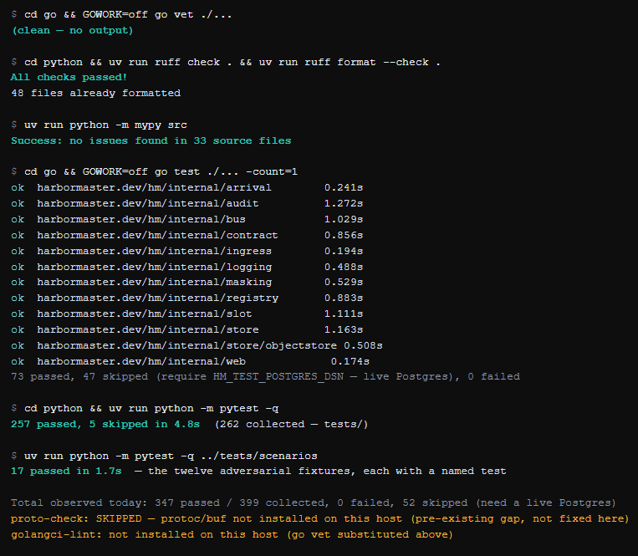
SCREENSHOTS · TERMINAL (THIS RUN)
The offline gate, green
go vet, ruff, mypy --strict, go test, and both pytest suites run in this task: 347 passed, 0 failed, 52 skipped (need a live Postgres). proto-check needs protoc/buf, absent on this host (pre-existing, not fixed here).
Harbormaster · AI Systems Architecture Review · 13

Slide 14
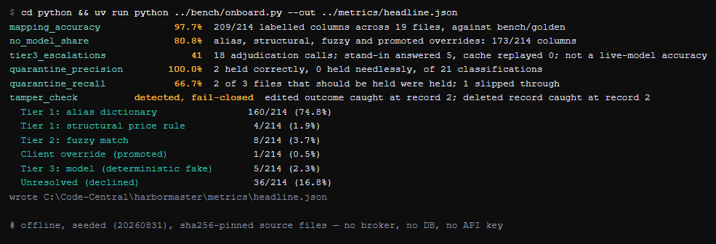
SCREENSHOTS · TERMINAL (THIS RUN)
The bench reproduces every published number
python bench/onboard.py, run in this task, wrote metrics/headline.json byte-for-byte identical to the committed file — the README's 97.7% / 80.8% / 100.0% / 66.7% figures are reproducible, not asserted.
Harbormaster · AI Systems Architecture Review · 14

Slide 15
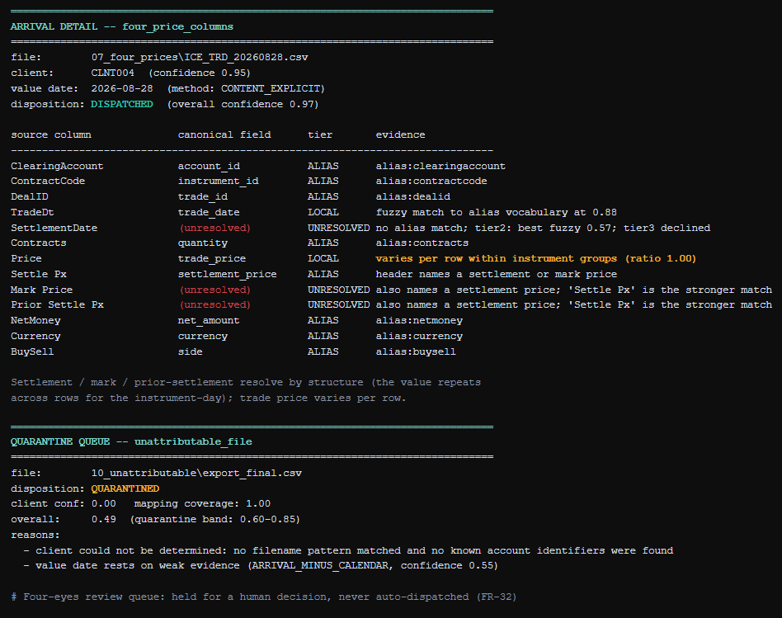
SCREENSHOTS · TERMINAL (THIS RUN)
The mapping ladder deciding, and quarantine holding
A small script run against the real Inspector for this task: four price columns disambiguated by structure, and the one deliberately unattributable fixture held in the four-eyes queue with its exact reasons.
Harbormaster · AI Systems Architecture Review · 15

Slide 16
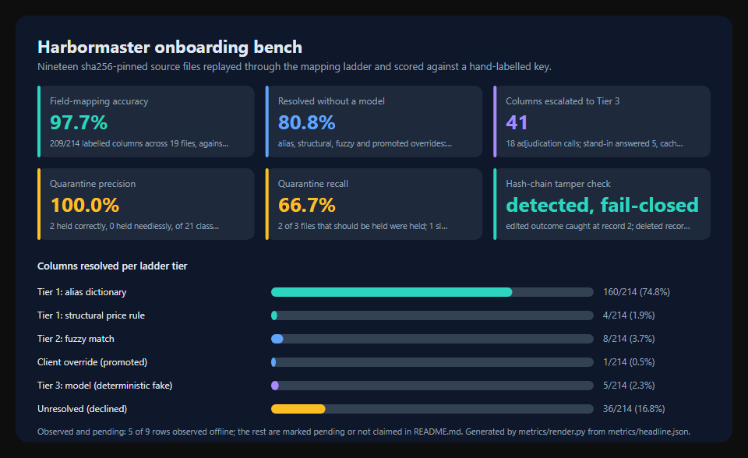
SCREENSHOTS · GENERATED REPORT
The generated metrics card
metrics/render.py renders this card from metrics/headline.json into docs/assets/metrics.svg and the README results block, so the deck, the README and the bench output cannot drift apart.
Harbormaster · AI Systems Architecture Review · 16

Slide 17
ENTERPRISE READINESS · CONTROLS
Security and compliance controls
Boundary | Threat | Control in the code | Evidence
B1 landing directory | malformed/oversized files, format confusion | content-based sniffing, not extension; streaming hash; per-format parsers behind one interface | arrival + parser tests
B2 model tier (Claude) | key leakage; unbounded cost; wrong mapping accepted | key from env only; one-way escalation; cache by template; structured-output validated against canonical schema | T3/resolver tests, ADR-004
B3 operations console | no authentication in the prototype | explicitly out of scope by requirements §7; designed to sit behind the institution's SSO | ship report §5, item 7
B4 audit log | tampering, deletion, silent edit | SHA-256 hash chain per arrival; a verifier walks every chain and reports the first break; fails closed | internal/audit tests, bench tamper check
B5 logs and UI | account numbers or client identifiers leaking | numbers masked to last-4 by default in a serialisation hook; names stay visible for operability (ADR-011) | masking + parity tests, Go & Python
Residual risks, written down rather than hidden: no console authentication (by design, pre-SSO), no leader election on the overdue sweep, throughput designed for but not load-tested.
Harbormaster · AI Systems Architecture Review · 17

Slide 18
ENTERPRISE READINESS · PROCESS
How it was built: a gated, evidence-producing lifecycle
G brief
M0 skeleton
M1 ingest
M2 parsers
M3 intel.
M4 slots
M5 audit
M6 UI
M7 corpus
M8 model
M9 ship
50
20
12
347
task packs, each with scope, acceptance criteria and a validation command
architecture decisions, each with context, consequences and cost
named adversarial fixtures, each with its own scenario test
tests passing offline in this run: 0 failed, 52 skipped pending a live Postgres
Split by what the build host can run
One command validates the rest
Every task is marked validated-here or validate-on-host (ADR-018). Docker (Compose, Redpanda, the six-service stack) is absent from the build environment, so end-to-end and live-model gates are authored to spec and run on a host with Docker.
gofmt · go vet · golangci-lint · ruff · mypy --strict · buf lint + codegen staleness · a cross-language contract test · every unit, property and scenario test. CI runs the same make check target verbatim.
Harbormaster · AI Systems Architecture Review · 18

Slide 19
ENTERPRISE READINESS · MEASUREMENT
Quality metrics from the bench and the gate
KPI | Value | Target
Field-mapping accuracy | 97.7% (209/214 columns, 19 files) | n/a, headline
Resolved without a model | 80.8% (173/214) | n/a, headline
Columns escalated to Tier 3 | 41 (18 adjudication calls) | ≤2% once warm (NFR-8)
Quarantine precision / recall | 100.0% / 66.7% | n/a; recall is an honest miss
Hash-chain tamper check | detected, fail-closed | must fail closed
Tests today (this run) | 347 passed / 399 collected, 0 failed | offline, no network
make check (minus proto-check) | green in this run | green offline
Quarantine recall (66.7%) is shown as measured, not smoothed: one of three files that should have been held slipped through in this corpus — see Quirks. Tier-3 escalation count is against a deterministic stand-in, not a live model.
Harbormaster · AI Systems Architecture Review · 19

Slide 20
HONESTY
Quirks and known limitations (stated, not hidden)
Quarantine recall is 66.7%, not 100%
Tier 2 embeddings are optional and untested against a real model here
1 of 3 files that should have been held was not, in the fixed reference corpus. Precision is 100% (nothing held needlessly) but recall is the honest miss; mitigation is a lower quarantine threshold or an added evidence source, not yet done.
fastembed is not installed in this environment, so the suite exercises the fuzzy-only degraded path; the degradation is recorded in the evidence string, never silent.
Live model accuracy is not measured offline
Docker-dependent gates are host-validated, not run here
The Tier 3 numbers above are against the deterministic stand-in. HM_LIVE=1 make test-live against the real Claude API is written but not run in this environment.
make up, make test-e2e, make demo and make verify-audit need Redpanda/Postgres/the six-service stack; ADR-018 marks every such task validate-on-host rather than claiming it done.
No authentication on the operations console
The overdue sweep is not leader-elected
Out of scope by requirements §7; intended to sit behind the institution's existing SSO for a pilot.
Running more than one Berthmaster instance would run the sweep more than once per interval. Slot state itself is safe across instances.
Throughput and p95 latency (NFR-2) are designed for, not measured
golangci-lint and protoc/buf are not installed on this host
The 1,000 arrivals/day envelope has no load test behind it in this environment.
go vet substituted for lint; proto-check could not run. Pre-existing gaps in this environment, not fixed as part of this task.
Harbormaster · AI Systems Architecture Review · 20

Slide 21
ENTERPRISE READINESS · OPERATIONS
Cost, performance and operability
µs / ms / s+$
0 keys
~4.8s
0 → next time
the three tiers' cost, in order — most columns resolve for free
needed for make check or make bench; the model tier is opt-in only
python/tests (257 passed) in this run; go test ./... a few seconds more
template-fingerprint cache: the second file with a known layout costs no model call
Operability
Observability and audit
• Runbook: first checkout, running the stack, seeing it work, verifying the audit trail, configuration reference, what to do when something is wrong
• make up targets healthy in under a minute (host-validated)
• make demo narrates the twelve adversarial fixtures through the live board
• Rollback: read models are projections, rebuilt by replaying topics from offset zero
• Structured JSON logs with correlation IDs (slog / structlog); no metrics stack by design (ADR-014)
• Hash-chained audit.decisions topic, compacted and retained indefinitely
• make verify-audit walks every chain and names the first break
• Client YAML is schema-validated strictly at load: an unknown key fails loudly, never at 3 a.m.
Harbormaster · AI Systems Architecture Review · 21

Slide 22
NEXT STEPS
Roadmap to production validation
Now
Near term
Before pilot
Scale
Host validation
Close the recall gap
Operational hardening
Beyond the prototype
go mod tidy; make up && make test-e2e on a machine with Docker
HM_LIVE=1 make test-live against the real Claude API
Confirm the 60s p95 / 180s p99 latency targets (NFR-2)
Investigate the missed quarantine case; consider a lower threshold or an added evidence source
Install fastembed and re-measure Tier 2 with real embeddings, not fuzzy-only
Leader-elect the Berthmaster overdue sweep for multi-instance runs
SSO in front of the operations console
Load test the 1,000 arrivals/day envelope and the burst target
Wire the already-implemented S3 object-store adapter
Extend the client dictionary from pilot-onboarding promotions
Revisit Redpanda vs. managed Kafka for production topology
Every item above is additive: the contracts, the ladder, the confidence scoring and the audit chain do not change.
Harbormaster · AI Systems Architecture Review · 22

Slide 23
APPENDIX
Appendix A — Decision log (abridged, 20 total)
ID | Decision | Consequence
ADR-001 | Event-driven log backbone (Kafka-compatible) over batch or sync calls | Replay is an offset operation; the log is the audit trail
ADR-002 | Polyglot split: Go at the edges, Python in the middle | Each language fits its workload; a hard requirement for shared contracts
ADR-003 | Protobuf single source of truth, buf-generated, protojson on the wire | Contract drift becomes a build failure, not a production incident
ADR-004 | Three-tier field mapping, not LLM-first | Model dependence decreases over time; NFR-8 (≤2% once warm) achievable
ADR-006 | Parquet for canonical output, not CSV | Nulls and types survive; a missing price is never confused with zero
ADR-011 | Masking: numbers masked to last-4, names visible | Boards and screenshots stay safe without hiding who a client is
ADR-016 | Poll the landing directory, not inotify | Correct on the NFS/SMB mounts this actually runs on
ADR-018 | Split validation between build and host environments | No task marked done on unexecuted code; the gap is visible, not implied
ADR-020 | Topics provisioned by infrastructure, not the application | A topic typo fails loudly instead of silently stranding messages
Harbormaster · AI Systems Architecture Review · 23

Slide 24
APPENDIX
Appendix B — Build statistics and defects found
Measure | Count
Go source | 4,991 lines across 12 packages and 3 binaries
Python source | 6,295 lines
Go tests | 73 passed, 47 skipped without a live Postgres, in this run
Python tests | 257 passed / 262 collected (tests/), 17/17 (scenarios), in this run
Documentation | 2,877 lines across requirements, HLD, LLD, ADRs, runbook, ship report
Task packs / ADRs | 50 task packs; 20 architecture decisions
Defects found and fixed during construction (from the ship report)
• Audit hashes recomputed differently on read: Postgres stores microseconds, Go carries nanoseconds — every chain would have failed verification
• inputs/outcome stored as JSONB normalised key order, so hashed bytes did not match stored bytes — changed to TEXT
• A description column full of commas beat the real pipe delimiter in the delimiter scorer
• bv or "" in the recon stub made a genuine zero indistinguishable from null (Decimal("0") is falsy)
• Masking revealed short account numbers in full: "last four" of a four-character value is all of it
Harbormaster · AI Systems Architecture Review · 24

Slide 25
APPENDIX
Appendix C — Repository map and how to run
go/ portwatch, berthmaster, controlplane, auditcheck,
internal/{arrival,audit,bus,contract,ingress,
logging,masking,registry,slot,store,web}
python/ inspector (parsers, mapping, valuedate,
attribution, confidence), corpus, reconstub
proto/ harbormaster.proto — single source of truth
config/ clients/*.yaml, calendars/*.yaml
bench/ onboard.py, golden/ — the fixed labelled corpus
metrics/ headline.json, card.json, render.py (drift-checked)
tests/scenarios/ the twelve adversarial fixtures, one test each
docs/design/ requirements, HLD, LLD, execution plan, 20 ADRs
docs/tasks/ 50 task packs
docs/pitch/ this deck
Run it
cd go && go mod tidy
cd .. && make check
make bench && make card
make test-scenarios
# with Docker (host-validated)
make up
make demo
make verify-audit
# the live model tier
export HM_ADJUDICATOR=claude
export ANTHROPIC_API_KEY=sk-...
HM_LIVE=1 make test-live
Harbormaster · AI Systems Architecture Review · 25

Slide 26
Questions
Harbormaster · roshanrana/harbormaster · design docs, decision log and runbook in the repository

