Slide 1
L
LedgerLens
AI Systems Architecture Review
Reconciles cheaply first, reasons expensively last, and explains every decision
AI-assisted financial reconciliation · Release 0.2.0 · 12 September 2026 · Roshan Rana, AI Systems Architect

Slide 2
OVERVIEW
Executive summary
What it is
What it proves
Why it is enterprise-ready
A reconciliation engine for messy bank, ledger and processor files: exact, rule and fuzzy tiers resolve the obvious pairs; a masked, cost-capped LLM adjudicates only the ambiguous middle band.
A LangGraph review gate pauses the run at a real interrupt() until a named reviewer resolves every open task, resumable from any process.
105 tests, 6 / 6 golden checks, a review gate resumed 1 / 1 times cross-instance, 0 raw counterparty or reference strings leaked to the model or the MCP server (asserted against real sample data).
Atomic runs with rollback; a Go match-worker validated by replaying real Python-exported events.
Frozen interface contracts per design doc (docs/05), a single offline gate (`make check`: unit + golden + card-drift), and a numbered decision log for every consequential trade-off.
Masking is one module used by both the LLM request and the human reviewer's tools — one perimeter, two consumers.
Ask of the audience: agree the pilot scope — which live LLM backend to validate first (Ollama, vLLM, Bedrock or Anthropic), the Postgres migration path, and whether the Kafka streaming profile is wanted for this client.
LedgerLens · AI Systems Architecture Review · 2

Slide 3
CONTEXT
The problem and the users
The reconciliation problem
The constraints
Bank statements, ledger exports and processor files never share a schema, a sign convention or a posting date. The obvious matches are cheap to automate; the cost is the residue — pairs that look alike but are not, and pairs that are the same transaction wearing two descriptions. Sending every pair to an LLM is neither affordable nor auditable.
A decision that reaches an auditor must be explainable and reproducible. Raw counterparty and reference strings must not leave the perimeter unmasked. A low-confidence decision must stay open until a named human resolves it — the run cannot silently mark itself complete.
Actor | Needs | Frequency
Reconciliation analyst | Reviews exceptions, resolves review tasks with a decision and notes, completes the run | Per run
Controller / compliance | Match rate, review-required rate, an audit trail from decision back to source rows | On review
Implementation engineer | Onboards a new client source via a mapping profile, not a code change | Per client
Automation / AI assistant | The same review gate over MCP (7 tools) or the JSON API, never raw source rows | Ad hoc
LedgerLens · AI Systems Architecture Review · 3

Slide 4
APPROACH
Solution at a glance
1
Ingest
2
Match ladder
3
Adjudicate & gate
4
Resolve & finalize
Config-driven source profiles map client columns to a canonical shape; raw rows and file hashes are kept for provenance.
Exact fingerprint, then deterministic rules, then fuzzy scoring; only the ambiguous middle band continues.
The middle band goes to a masked, cached LLM call; low-confidence results open a review task and the graph interrupts.
A reviewer resolves every task over the CLI, JSON API or MCP; `complete_review` resumes the graph from any process.
Surfaces
One perimeter, two consumers
Typer CLI · stdlib JSON API · MCP server (`ledgerlens-review`, 7 tools). All three call the same service functions over the same SQLite store; none re-implements the graph.
`ledgerlens/llm/masking.py` masks every candidate pair the same way for the model and for the MCP reviewer's tools: hashed tokens for reference and counterparty, digit-run redaction, a version tag.
LedgerLens · AI Systems Architecture Review · 4

Slide 5
ARCHITECTURE · C4 LEVEL 1
System context
Analyst
LedgerLens
LLM providers
CLI / API
fake (default) · Ollama · vLLM · Bedrock · Anthropic, one contract
Surfaces
Typer CLI · stdlib JSON API · MCP server
Reviewer
MCP clients
MCP client
Claude Desktop · Cursor · Claude Code · scripts
Core package `ledgerlens`
ingestion · normalization · matching ladder · LangGraph agents/graph · masking · reporting
Automation
Go match-worker
HTTP client
candidate generation over a Kafka-compatible topic (optional)
SQLite store (WAL)
Sidecar op
run-scoped tables, audit events, checkpoints
Event contracts
Go / Kafka
7 JSON-Schema event types + envelope
The fake adjudicator is the default and drives every test, the golden replay and CI; live providers are switched on by `--llm {ollama|vllm|bedrock|anthropic}` and a config file naming an environment variable, never a key.
LedgerLens · AI Systems Architecture Review · 5

Slide 6
ARCHITECTURE · C4 LEVEL 2
Component architecture
Surfaces
Orchestration
Data & domain
LLM & masking
cli.py
agents/graph.py
ingestion/*
llm/schemas.py
Typer commands
LangGraph StateGraph
profiles, csv loader
request/decision contract
api/server.py
agents/workflow.py
normalization/*
llm/fake.py
stdlib JSON API
WorkflowState, run modes
canonical transactions
deterministic default
api/resources.py
matching/engine.py
domain/models.py
llm/live.py
service functions
TieredMatcher
typed records
openai_compat · bedrock · anthropic
mcp/server.py
matching/text.py
persistence/*
llm/masking.py
7 MCP tools
fuzzy scoring
SQLiteStore, checkpointer
the one perimeter
Dependency direction is left to right. The matching engine is stdlib-only; LLM and masking are the only modules a candidate pair's raw fields ever reach on the way out.
LedgerLens · AI Systems Architecture Review · 6

Slide 7
ARCHITECTURE · CRITICAL FLOW
The reconciliation graph
1. Load & normalize
2. Candidates
3. Exact + rule
4. Fuzzy scoring
load_run_context, normalize_batch: canonical transactions with raw provenance
generate_candidates: bounded blocking by currency, amount and date window
apply_exact_matches, apply_rule_matches: fingerprints and known accounting patterns
score_fuzzy_candidates: high matches, low becomes an exception, middle continues
5. Adjudicate (masked)
6. Route & surface
7. Persist & report
8. Gate
adjudicate_ambiguous_pairs: masked pair to the cached LLM contract
route_review_tasks, surface_unmatched_transactions: low confidence opens a task
persist_decisions, generate_report: rows and the preliminary report commit
[open tasks] → await_review interrupt(); reviewer resolves → finalize_run
Thirteen nodes, one fixed order, no loops and no free-form tool calls. On the acme replay: 2 exact, 1 rule, 1 llm→needs_review, 1 human resolution; 4 of 12 transactions stay unmatched exceptions.
LedgerLens · AI Systems Architecture Review · 7

Slide 8
DESIGN · CORE MECHANISM
Deterministic first, masked LLM last: the perimeter
What crosses the perimeter (masked pair)
exact · rule · fuzzy
resolved without the model — 3 of 4 decisions on the acme replay
{ "id": "txn_23e4...", "date": "2026-05-04",
"amount": "-25.00", "currency": "USD",
"source_system": "bank",
"description": "bank service fee may",
"reference_token": "",
"counterparty_token": "aabfc736adc8",
"masking_version": "ledgerlens.masking.v1" }
llm: needs_review
masked pair, cached by pair, opens a review task
human: match / no_match
final decision; audited; the run cannot complete while it is open
What the module guarantees
id, date, amount, currency, source_system stay verbatim
reference and counterparty become stable hashed tokens (equal tokens still mean equal values)
description: digit runs of five or more redacted, capped at 80 chars
the fake reads computed features only, so masking moved none of the golden numbers
Why this matters
Only the ambiguous middle band ever reaches the model, and the model never sees the pair twice: `CachedLLMAdjudicator` keys on the pair and the model family, so fake and live decisions never collide.
LedgerLens · AI Systems Architecture Review · 8

Slide 9
ARCHITECTURE · DATA
Data architecture: SQLite of record, events at the edge
SQLite store (WAL)
Contracts, not just tables
Run-scoped tables: source_files, normalized_transactions, candidate_pairs, match_decisions, review_tasks, audit_events, llm_cache. One file also hosts the LangGraph SqliteSaver checkpointer, so rows and checkpoints commit together.
One envelope schema (event_id, idempotency_key, run_id) plus 7 payload schemas under `contracts/schemas/`. Every fixture and example validates in CI: 12 / 12 emitted `transaction.normalized` events pass their declared schema.
The Go match-worker consumes the same contract the Python side exports, so a cross-language boundary is tested against real events, not a hand-written stub.
7 event types
statement.ingested
transaction.normalized
match.candidate_created
match.decision_created
review.required / resolved
report.generated
Masking as the export boundary
Every payload that leaves the store for a model or an MCP client passes through `masking.py` first. Raw fields are read by matching and reporting only; nothing downstream sees them unmasked.
Classification: masked/tokenised fields only ever leave the store for a model or a review tool; raw customer data stays inside the SQLite boundary and the process that reads it.
LedgerLens · AI Systems Architecture Review · 9

Slide 10
ARCHITECTURE · INTEGRATION
LLM providers: one contract, five backends
--llm | Reaches | Environment
fake | nothing (deterministic) | default; drives tests, golden replay, CI
ollama | openai_compat → localhost:11434/v1 | no key; stdlib urllib
vllm | openai_compat → localhost:8000/v1 | VLLM_API_KEY
bedrock | boto3 converse, us-east-1 | AWS credential chain; [bedrock] extra
anthropic | Anthropic Messages API | ANTHROPIC_API_KEY; [anthropic] extra
One `LLMClient` protocol
`build_prompt` states the task, the three allowed decisions and the exact JSON shape; `parse_decision` tolerates fences and prose. A live client retries once with the parse error appended, then raises `LLMError`.
Config, never secrets
`configs/llm/<name>.json` holds the backend, model, base URL or region and the *name* of the key's env var — never a value. A missing variable or package raises `LLMError` naming what to set.
Cache-key separation
`model_family` (`<backend>:<model>`) enters the cache key, so a live decision and the fake's decision for the same pair never collide.
None of the three live backends has been run by the harness; their accuracy, latency and cost are pending — the results card says so rather than estimating.
LedgerLens · AI Systems Architecture Review · 10

Slide 11
DESIGN DECISIONS
Design choices and why
Decision | Alternatives considered | Why this one
LangGraph StateGraph + SqliteSaver (D-1) | Hand-rolled node loop (0.1's actual approach) | A checkpointer makes the pause resumable from any process, not just a status flag
Checkpoints hold ids and counters only (D-2) | Checkpoint the full WorkflowState | The store is the record; the checkpoint is the cursor — small, cheap, replayable
The gate finalises, it never re-adjudicates (D-3) | Re-run adjudication after review | Reviewer authority is final and auditable; the model is not consulted twice
Resume validated in the service, not the node (D-4) | Validate inside `await_review` | LangGraph persists the resume value before the node runs; a raising node would wedge the thread
One masking module for the model and MCP (D-5) | Separate redaction per consumer | One version tag, one perimeter; the fake is provably unaffected so golden numbers hold
`openai_compat` over stdlib `urllib` (D-6) | Vendor SDKs for Ollama and vLLM | Ollama and vLLM need nothing installed; Bedrock/Anthropic stay optional lazy imports
SQLite now, Postgres-shaped schema for later | Postgres from day one | Portable local demo; the run-scoped table design maps directly to a production database
LedgerLens · AI Systems Architecture Review · 11

Slide 12
PRODUCT
Major features
Config-driven source onboarding
The tiered matching ladder
Masked, cached LLM adjudication
A new client source is a mapping profile under `configs/clients/` plus one focused test — no matching-code change.
Exact fingerprint → deterministic rules (date lag, reference variants) → fuzzy scoring with an explicit middle band.
Only the ambiguous band reaches the model; decisions are cached per pair so a re-run never asks twice.
The LangGraph review gate
The MCP review server
Atomic runs with rollback
A real `interrupt()` at `await_review`; `complete_review` resumes the graph from any process once every task is resolved.
`ledgerlens-review`: 7 tools over stdio for Claude Desktop, Cursor or a script — masked pairs only.
A run that fails before the interrupt rolls back completely, checkpoints included.
Go match-worker + event contracts
Source diagnostics
The offline gate
7 JSON-Schema event types; the worker is validated by replaying real Python-exported events.
Missing references, missing external ids, duplicate references — surfaced before matching starts.
`make check`: 105 unit/e2e tests, the golden replay, and a results-card drift guard, no network, no key.
LedgerLens · AI Systems Architecture Review · 12

Slide 13
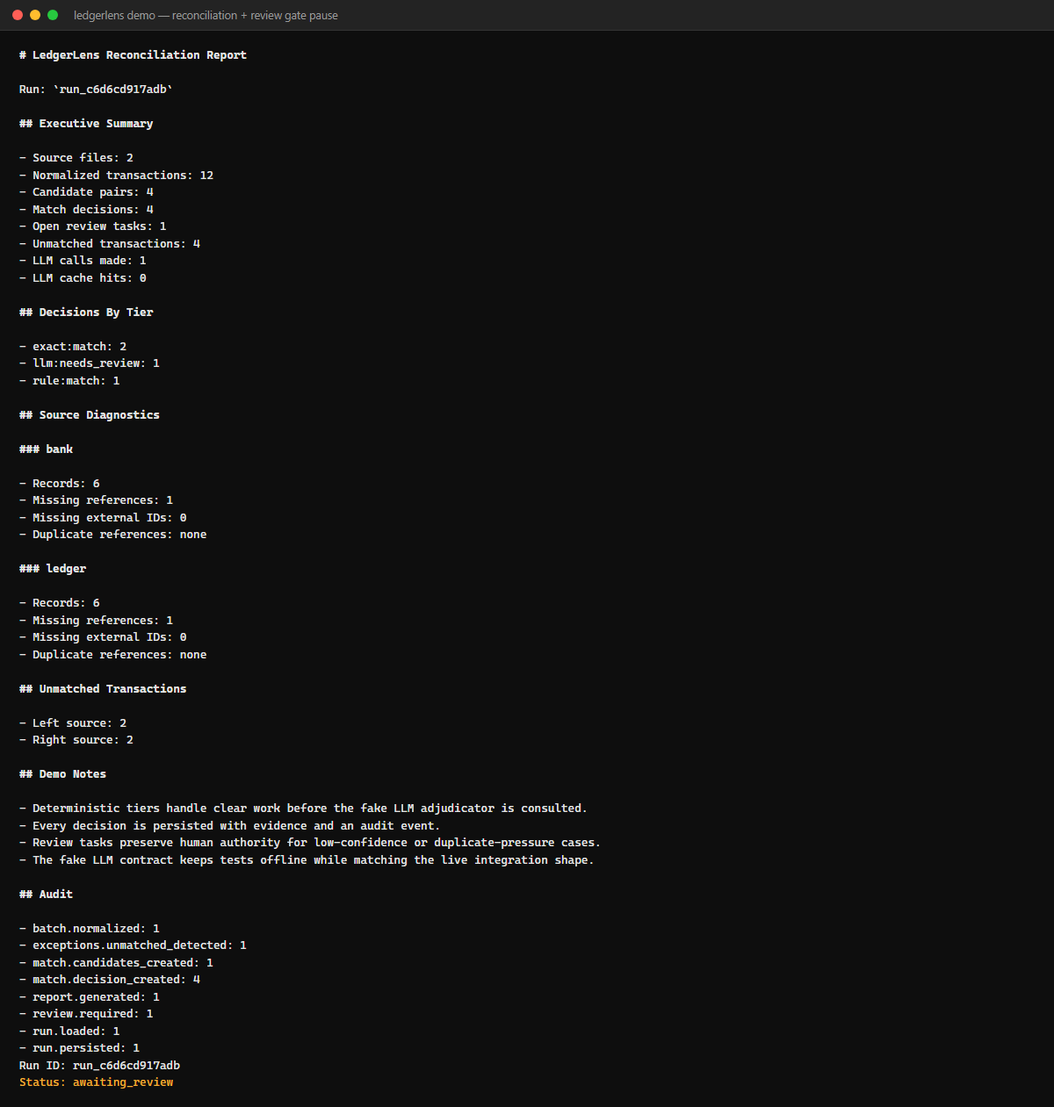
SCREENSHOTS · CLI DEMO
The reconciliation report — and the gate pause
What you are looking at
`ledgerlens.cli demo` ingests two acme sources, reconciles across every tier and prints the preliminary report: 2 exact, 1 rule, 1 llm review task, 4 unmatched. It ends `awaiting_review` — the run is paused, not finished.
The tier breakdown is the product
The report states what the model was asked (1 call, 0 cache hits) and what it was not asked — the other 3 decisions never reached it. This is the number that justifies the architecture to an operations lead.
LedgerLens · AI Systems Architecture Review · 13

Slide 14
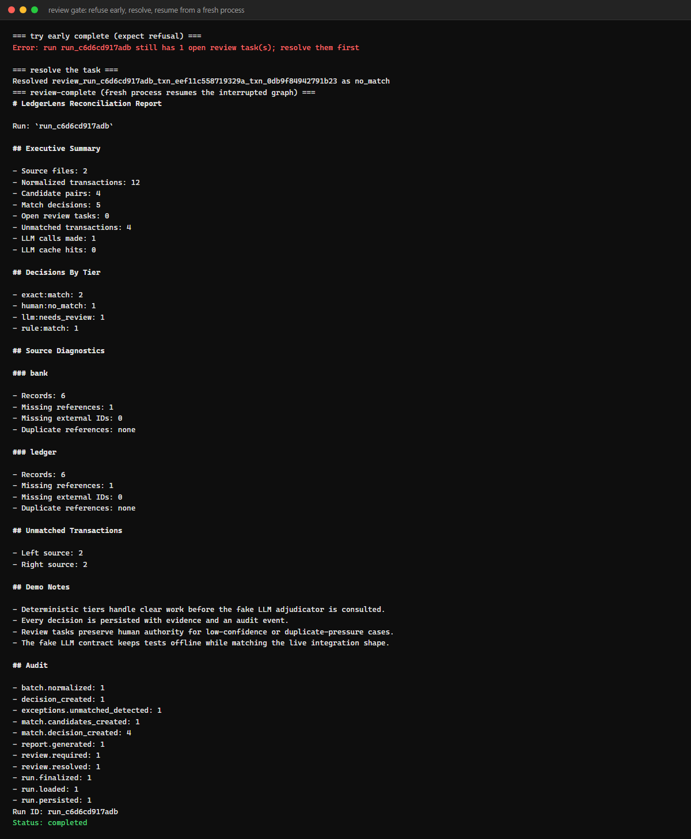
SCREENSHOTS · REVIEW GATE
The review gate: refuse, resolve, resume, finalize
Refused, then resolved
`review-complete` refuses while a task is open, with the exact reason. `review-resolve` records the analyst's decision and notes against the task.
Resumed from a fresh process
The second `review-complete` call opens a new workflow instance on the same database file and resumes the interrupted graph: `human:no_match` appears under Decisions By Tier, `run.finalized` under Audit, status `completed`.
LedgerLens · AI Systems Architecture Review · 14

Slide 15
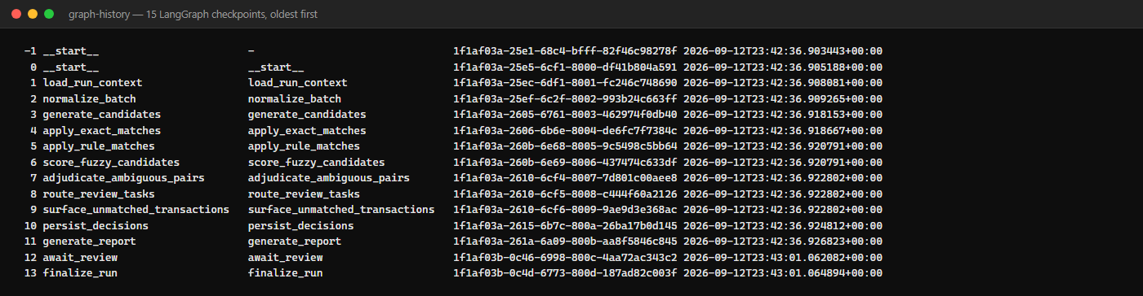
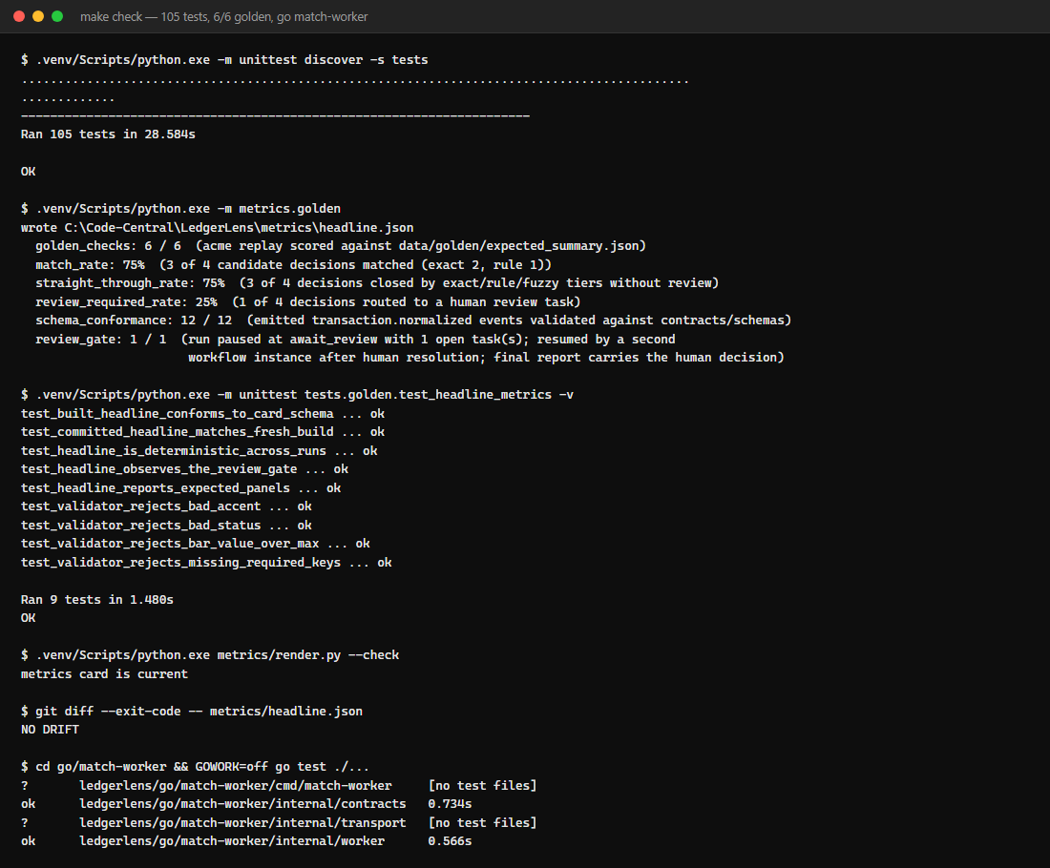
SCREENSHOTS · VERIFICATION
Checkpoints and the golden harness
graph-history: 15 checkpoints for the gated demo, oldest first — every step of the run is replayable from the checkpointer.
make check, unpacked: 105 tests, the golden replay's 6 KPIs, the headline self-check, the card-drift guard and the Go worker's own tests.
LedgerLens · AI Systems Architecture Review · 15

Slide 16
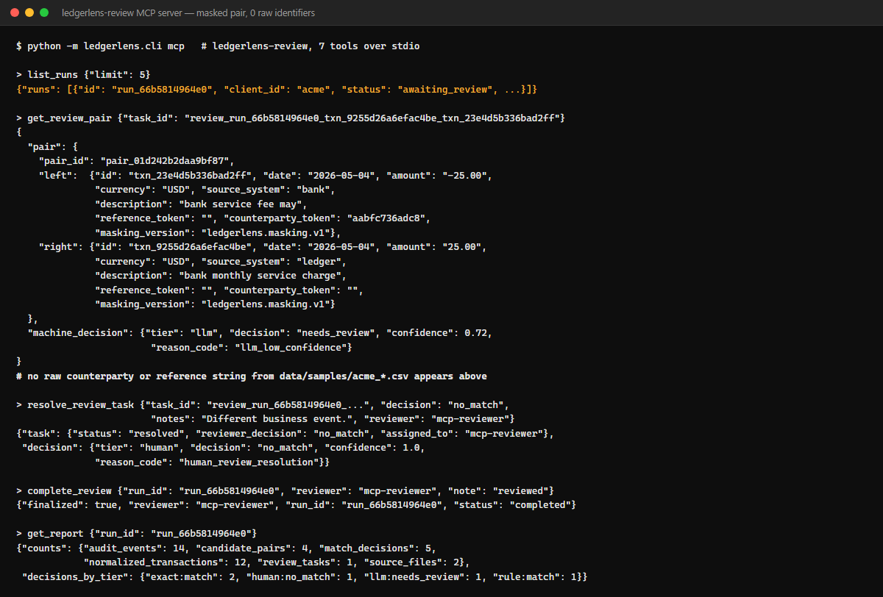
SCREENSHOTS · MCP
The MCP review server: masked, zero raw identifiers
What a reviewer's tool sees
`get_review_pair` returns the masked pair plus the machine's tier, decision, confidence and reason code — never the raw counterparty or reference. A test asserts 10 real strings from the sample CSVs against every tool result.
The same gate, another door
`resolve_review_task` and `complete_review` call the identical service functions the CLI and API use; the run cannot complete with an open task through any of the three surfaces.
LedgerLens · AI Systems Architecture Review · 16

Slide 17
ENTERPRISE READINESS · CONTROLS
Security and compliance controls
Boundary | Risk | Control in the code | Evidence
Masking perimeter | raw counterparty / reference reaching a model or reviewer tool | `llm/masking.py`: hashed tokens, digit-run redaction, version tag; one module for both consumers | `test_masking.py` (12); MCP no-leak test (10 sample strings)
MCP review server | a tool result leaking a raw sample value | every tool masks before returning; errors come back as `{"error": ...}`, never a raised exception | `test_no_tool_result_contains_raw_counterparty_or_reference`
LLM provider config | a key committed to source | `configs/llm/*.json` names an env var only; live backends are lazy imports behind extras | `test_shipped_configs_have_expected_shape_and_no_secrets`
Persistence / rollback | a half-written run after a late failure | `store.transaction()` covers ingestion through `generate_report`; checkpointer shares the connection and commits with it | `test_persistent_workflow_rolls_back_partial_run_on_late_failure`
Event contracts | a malformed or unschematised event reaching the Go worker | envelope + 7 payload JSON Schemas, validated in CI | 12 / 12 fixtures pass their declared schema
Residual risks, written down: no authentication in front of the API or MCP server (single-operator prototype); SQLite is not a multi-writer production database (a Postgres path is a design choice, not yet built); live LLM backends are untested against a real model.
LedgerLens · AI Systems Architecture Review · 17

Slide 18
ENTERPRISE READINESS · PROCESS
Frozen contracts, one gate, a decision log
01 HLD
02 LLD (multi-agent)
03 demo runbook
04 AI brief
05 review-gate design (frozen §3-6)
5
6
3
1
design docs (01-05); doc 05's §3-6 interfaces are frozen contracts for the build
numbered decisions (D-1 .. D-6) in the review-gate design, each with its consequence
task packs (LL-1, LL-2, LL-3) scoped to one module each, with an acceptance checklist
gate command: `make check` runs unit + golden + card-drift; CI runs the same command
STATE.md tracks the truth
One command validates everything
Phase 7, task log LL-0 .. LL-4, each row done/blocked/next; deviations are recorded rather than silently absorbed (0.1 promised LangGraph, 0.2 delivered it — decision D-1).
`python -m unittest discover -s tests`, `python -m metrics.golden`, `python -m unittest tests.golden.test_headline_metrics`, `python metrics/render.py --check` — the same four steps `make check` runs, and what CI runs on every push.
LedgerLens · AI Systems Architecture Review · 18

Slide 19
ENTERPRISE READINESS · MEASUREMENT
Quality metrics from the gate
KPI | Value | Source
Tests | 105 passed | unittest discover
Golden checks | 6 / 6 | vs expected_summary
Match rate | 75% | exact + rule + fuzzy
Straight-through | 75% | 3 of 4 decisions
Review required | 25% | 1 of 4 decisions
Schema conformance | 12 / 12 | vs contracts/schemas
Review gate resumed | 1 / 1 | cross-instance resume
MCP raw-value leaks | 0 / 10 | sample strings
Go worker packages | 2 / 2 ok | go test, GOWORK=off
Live LLM adjudication accuracy is not a KPI here: the harness runs the deterministic fake with no key, so live-model rows in the results card are marked pending, not estimated.
LedgerLens · AI Systems Architecture Review · 19

Slide 20
HONESTY
Quirks and known limitations (stated, not hidden)
Live LLM backends are unexercised
Only one client pair is golden-replayed
Ollama, vLLM, Bedrock and Anthropic ship behind the same contract and are unit-tested against fakes, but no live model has been run by the harness — accuracy, latency and cost are pending.
`bank_statement.csv` / `ledger_export.csv` have no mapping profile under `configs/clients`, so only the acme pair is scored by `make golden`.
No per-pair precision/recall
Matching is pairwise only
`expected_summary.json` carries aggregate thresholds only; there are no per-pair match labels to score against.
One-to-many and many-to-many matching are not implemented (tracked in STATE.md's backlog).
Go worker not in the offline gate
No HMAC on review resolutions yet
`go test` needs `GOWORK=off` locally because `go.work` pins Go 1.22 while the worker module requires >= 1.23; the worker is validated by `scripts/verify.py --docker`, not by `make check`.
A resolution is authenticated by the reviewer field only today; signing resolutions is next in STATE.md's backlog.
Masked description keeps its words
Streaming profile is opt-in
Only digit runs of five or more are redacted from the description; short free text like "bank service fee" still reads as English, by design (features, not raw ids, drive the decision).
Redpanda/Kafka validates the boundary, not production throughput; the default demo path is file mode.
LedgerLens · AI Systems Architecture Review · 20

Slide 21
ENTERPRISE READINESS · OPERATIONS
Cost, performance and operability
1 call
0 keys
15
14
LLM calls on the acme demo replay; the other 3 of 4 decisions never reach the model
needed for tests, the golden replay, CI or the demo; live backends read an env-var name only
LangGraph checkpoints for one gated run, each replayable via `graph-history`
audit events recorded for the completed demo run, from `run.loaded` to `run.finalized`
Operability
Observability and audit
• `make check` — the one offline gate; no network, no key
• `scripts/verify.py --docker required [--kafka-smoke]` — Go worker tests, container build, real-event replay, optional Redpanda round trip
• `docs/03-demo-runbook.md` — a scripted, minute-by-minute demo with expected output at each step
• Rollback: `store.transaction()` covers a run through the interrupt; a late failure leaves nothing partial behind
• `audit_events` table: one typed row per state change (`match.decision_created`, `review.resolved`, `run.finalized`, ...)
• `graph-history` replays every LangGraph checkpoint for a run, oldest first
• Cache stats (`calls`, `cache hits`) are printed in every report, so cost is visible per run
• The results card (`metrics/headline.json`) is regenerated by the gate and diff-checked against the committed copy
LedgerLens · AI Systems Architecture Review · 21

Slide 22
NEXT STEPS
Roadmap
Now
Next
Then
Later
Record a live run
Matching depth
Production shape
Scale the review workforce
Run one real Ollama adjudication and publish it as a recorded figure
Compare its decision against the fake's on the same masked pair
One-to-many and many-to-many matching
HMAC signing on review resolutions
A second client profile replayed by the golden harness
Postgres migration behind the existing SQLiteStore interface
Wire the Go worker and a Kafka smoke into CI, not only `scripts/verify.py`
Authentication in front of the API and MCP server
Multiple reviewers with role-scoped MCP sessions
A review-queue dashboard over the same service functions
SLA and aging metrics on open review tasks
Everything above is additive: the masking perimeter, the review gate and the event contracts do not change.
LedgerLens · AI Systems Architecture Review · 22

Slide 23
APPENDIX
Appendix A — Decision log (docs/05-langgraph-review-gate-design.md)
ID | Decision | Consequence
D-1 | LangGraph + langgraph-checkpoint-sqlite + mcp become core dependencies | The README's dependency-free claim narrows to the matching engine, which stays stdlib
D-2 | Checkpoints hold ids and counters only | The store is the record; the checkpoint is the cursor; checkpoints stay small
D-3 | The gate finalises the run; it does not re-adjudicate | Reviewer decisions stand; the model is never consulted a second time
D-4 | Resume payloads are validated in the service before Command(resume=...) | LangGraph persists the resume value before the node runs; a raising node would wedge the thread
D-5 | Masking is one module shared by the LLM request and the MCP server | One version tag, one perimeter; the fake's golden numbers are provably unaffected
D-6 | openai_compat uses stdlib urllib | Ollama and vLLM need no extra install; Bedrock/Anthropic stay optional lazy imports
LedgerLens · AI Systems Architecture Review · 23

Slide 24
APPENDIX
Appendix B — Build statistics and lessons
Item | Value | Source
Tests | 105 (unittest, offline) | unittest discover -s tests
Golden checks | 6 / 6 | metrics/golden.py vs data/golden/expected_summary.json
Design docs | 5 (01 HLD, 02 LLD, 03 runbook, 04 AI brief, 05 review-gate) | docs/
Task packs | 3 (LL-1 graph-gate, LL-2 live backends, LL-3 MCP server) | docs/tasks/
Numbered decisions | 6 (D-1 .. D-6) | docs/05-langgraph-review-gate-design.md
Event contract types | 7 + 1 envelope schema | contracts/schemas/
Go packages tested | 2 / 2 ok (contracts, worker) | go test ./... , GOWORK=off
Lessons
• A deviation belongs in STATE.md, not silently absorbed: 0.1 promised LangGraph and shipped a hand-rolled loop; 0.2 closed the gap and D-1 records why.
• `go.work` pinning a lower Go version than a module needs is easy to miss locally; the runbook's own Docker command already sets `GOWORK=off` for exactly this reason.
• Validate a resume payload before the graph touches it, not inside the node — LangGraph persists first (D-4), learned the hard way on a sibling project.
LedgerLens · AI Systems Architecture Review · 24

Slide 25
APPENDIX
Appendix C — Repository map and how to run
ledgerlens/ cli, api/, mcp/, agents/ (graph, workflow),
ingestion/, normalization/, matching/,
llm/ (schemas, fake, live, masking, cache),
persistence/, reporting/, domain/
go/match-worker/ contracts, worker, file/kafka transport
contracts/ event envelope + 7 schemas, fixtures
configs/clients/ per-client column-mapping profiles
configs/llm/ backend + model + env-var name, no secrets
data/samples/ acme_bank_statement.csv, acme_ledger_export.csv
data/golden/ expected_summary.json
metrics/ golden.py, headline.json, render.py
docs/ 01-05 design docs, tasks/, mcp.md, pitch/
tests/ 105 tests: unit, contract, e2e, golden
Run it
.venv/Scripts/python.exe -m ledgerlens.cli \
--db .ledgerlens/ledgerlens.db demo
# review the gate
review-list --run-id <run_id>
review-resolve <task_id> --decision no_match \
--notes "..." --reviewer analyst
review-complete <run_id> --reviewer analyst
# MCP server for a reviewer's tools
python -m ledgerlens.mcp.server
# the offline gate
python -m unittest discover -s tests
python -m metrics.golden
python metrics/render.py --check
LedgerLens · AI Systems Architecture Review · 25

Slide 26
Questions
LedgerLens · roshanrana/LedgerLens · release 0.2.0 · design docs and the review-gate design in the repository

