Slide 1
M
MarketSage
AI Systems Architecture Review
An MCP-native market intelligence workbench: typed finance tools, saved and auditable runs, sources that never hide what they are
Release/ship date · 12 September 2026 · Roshan Rana

Slide 2
OVERVIEW
Executive summary
What it is
What it proves
Why it is enterprise-ready
A Go MCP gateway exposes seven finance tools and a saved-run resource over stdio, backed by a Python FastAPI analytics core: market data, sentiment, evidence search and research briefs.
A Next.js analyst workbench gives the same capabilities to reviewers who never touch an MCP client; DuckDB persists every dataset, run and audit event.
Three data modes and warnings that cannot be suppressed: seeded is deterministic and credential-free, hybrid falls back with a payload warning, live fails clearly without OpenBB.
Every research-brief bullet carries a reference to the snapshot, evidence id or sentiment hash behind it — 12 / 12 grounded on the committed fixtures.
Built through 13 task packs (T-001…T-013) with frozen requirements, HLD, LLD and an execution plan; one gate (`npm run check`) covers four languages plus an offline evaluation with drift checks.
A separate dependency and vulnerability sweep (`npm run audit:deps`); CI runs the same gate on every push.
Ask of the audience: agree the pilot scope (filing evidence for the other three seeded tickers, embedding retrieval, a recorded FinBERT run, a live OpenBB provider) and the identity model that would sit in front of bearer auth.
MarketSage · AI Systems Architecture Review · 2

Slide 3
CONTEXT
The problem and the users
The analyst's problem
The constraints
A snapshot, a price trend, what the filings and the sentiment say, then a brief — a mature workflow, spread across a quote screen, a filings reader and a spreadsheet. A chat box bolted onto the same data gives a model no structure to call, no record of what it looked at, and no way to tell live data from illustrative seed data.
MarketSage does not execute trades, move money or provide investment advice. Every tool response must say which data mode produced it, cite the evidence behind each claim, and leave an audit row an operator can replay.
Actor | Needs | Where it is met
Analyst (primary) | Ticker in, brief out: snapshot, evidence, sentiment, caveats, in one workbench or one MCP call | Next.js workbench; `research_brief` tool
Compliance / reviewer | An audit row per call: request id, tool, status, duration, mode, warning count | DuckDB `audit_event`; `docs/security-and-ops.md`
Platform team | One local gate, no keys for the default path, optional bearer auth | `npm run check`; `MARKETSAGE_HTTP_TOKEN`
AI assistant / MCP host | Typed tools and a resource it can discover, not a chat window | 7 tools, 4 prompts, 1 resource template
MarketSage · AI Systems Architecture Review · 3

Slide 4
APPROACH
Solution at a glance
1
Ticker in
2
Market + evidence
3
Sentiment
4
Research brief
health_check and dataset_status confirm DuckDB, the market adapter and the Hugging Face manifest are ready, in seeded mode by default.
market_snapshot / price_history (seeded, hybrid or live) and evidence_search: BM25 over the committed FinanceBench filing corpus, ticker-scoped.
sentiment_score_text: a deterministic lexicon fallback by default, FinBERT opt-in behind an explicit environment flag.
research_brief assembles sections whose every bullet carries a reference; the run is saved to DuckDB and readable back as `marketsage://runs/{run_id}`.
Surfaces
Two data modes, one schema
A Go MCP gateway over stdio, and a Next.js workbench proxying server-side, both call the same FastAPI analytics core; neither one computes anything itself.
`seeded` is deterministic and credential-free (the default). `hybrid` tries OpenBB and falls back with a warning in the payload. `live` fails clearly when the optional dependency is missing.
MarketSage · AI Systems Architecture Review · 4

Slide 5
ARCHITECTURE · C4 LEVEL 1
System context
Analyst
MarketSage
OpenBB (optional)
browser
seeded / hybrid / live market data; absent, seeded mode runs and says so
Surfaces
Go MCP gateway (stdio) · Next.js workbench (server-side proxy)
AI assistant
Hugging Face
MCP host, stdio
FinanceBench + FiQA fixtures (build-time); FinBERT opt-in at runtime
Python analytics core
market/sentiment/evidence/briefs · OpenBB adapter · HF dataset boundary
Automation
GitHub Actions
MCP CLI client
`npm run check` on every push, ubuntu-latest
DuckDB
dataset manifest · research runs · audit events
MCP client (browser/host)
reads `marketsage://runs/{run_id}` back
Model downloads are off by default (MARKETSAGE_ENABLE_MODEL_DOWNLOADS enables FinBERT). Live OpenBB mode needs its optional dependency and provider configuration; the offline gate and CI never touch either.
MarketSage · AI Systems Architecture Review · 5

Slide 6
ARCHITECTURE · C4 LEVEL 2
Component architecture
Go gateway (stdio)
Python core
Persistence + API
Clients + contracts
main.go
openbb_adapter.py
storage.py / repo.py
mcp-cli
stdio transport, stderr logs
seeded/hybrid/live modes
DuckDB: manifest, runs, audit
TS MCP client, `demo:mcp`
server.go
datasets.py
routes.py
apps/web
7 tools, 1 resource template
HF manifest + status
HTTP surface, JSON envelope
Next.js workbench + proxy
prompts.go
sentiment.py
config.py
marketsage.schema.json
4 MCP prompts
lexicon default, FinBERT opt-in
modes, switches, from env
generated from Pydantic
coreclient/
retrieval.py
Go strict decode
HTTP client, token forward
BM25 over FinanceBench
unknown fields forbidden
briefs.py
sections + references
One schema, generated from the Pydantic models, describes every payload; the harness validates live responses against it and exports fixtures the Go client decodes with unknown fields forbidden.
MarketSage · AI Systems Architecture Review · 6

Slide 7
ARCHITECTURE · CRITICAL FLOW
The research-brief pipeline
1. Ticker in
2. Market
3. Evidence
4. Sentiment
health_check + dataset_status confirm readiness; mode defaults to seeded
market_snapshot / price_history: seeded, hybrid (fallback + warning) or live
BM25 over the committed FinanceBench corpus, ticker-scoped; warns when a ticker has none
lexicon fallback (marketsage-lexicon-v0) or FinBERT when enabled; warns on fallback
5. Assemble
6. Persist
7. Expose
8. Render
briefs.py builds sections; every bullet pairs with a `references` entry
DuckDB stores the run (input + output) and an audit_event row
`marketsage://runs/{run_id}` resource; a client reads the saved run back
Next.js workbench shows the same brief, evidence and caveats server-side
Failure is first-class, not an afterthought: nine named fault injections are scored 9 / 9 handled honestly — an explicit warning on degrade, a clean error and an audit row on failure, never invented data.
MarketSage · AI Systems Architecture Review · 7

Slide 8
DESIGN · GROUNDING
The core mechanism: every bullet carries a reference
One section of a real saved run (MSFT)
12 / 12
brief claims grounded, across 5 tickers
{
"title": "Sentiment",
"bullets": [
"Neutral sentiment (55% confidence,
marketsage-lexicon-v0)."
],
"references": [
"sentiment:29e7347946b40c0470c..."
]
}
8 / 8
responses conforming to the generated JSON Schema contract
9 / 9
fault injections handled with a warning or a clean error, never invented data
What the harness scores
every bullet's reference must resolve to a snapshot, evidence id or sentiment hash in the same payload
a ticker with no committed evidence says so instead of borrowing another company's
Why this matters to a reviewer
The reference list is the control, and the eval suite reports grounding as a headline KPI, not a claim about prose quality.
MarketSage · AI Systems Architecture Review · 8

Slide 9
ARCHITECTURE · DATA
Data architecture: fixtures, runs, audit
Committed fixtures (MIT)
Every write is addressable
FinanceBenchRetrieval: corpus/test 145 rows, queries/test 150, qrels/test 150. fiqa-sentiment-classification default/test 234 rows. sha256-pinned in data/fixtures/manifest.json; 32 companies mapped by ticker.
• `marketsage://runs/{run_id}` reads a saved run's exact input and output
• `audit_event`: request id, tool, status, duration, mode, warning count
• audit persistence is best-effort so a local DuckDB issue never masks API behaviour
• `/health` still reports DuckDB availability on its own
DuckDB, three tables
dataset manifest
research runs
audit_event
Coverage is explicit
Only 2 of 5 seeded tickers (MSFT, JPM) have filing excerpts in the corpus; the other 3 get a stated coverage warning instead of borrowed evidence.
Seeded market data (5 illustrative tickers) is not scored by the eval harness; only the retrieval and sentiment fixtures are.
MarketSage · AI Systems Architecture Review · 9

Slide 10
ARCHITECTURE · LIVE MODE
Data modes and warnings that cannot be suppressed
seeded (default)
hybrid
live
Deterministic local data from data/seed/. No credentials, no network. What every screenshot in this deck shows.
Tries OpenBB live data; on failure, falls back to seeded data with an explicit warning in the response payload — never a silent substitution.
Requires the optional OpenBB dependency and provider configuration; fails clearly, with a stated reason, when either is missing.
Model downloads: off by default
Protected local mode
Deterministic sentiment fallback runs with no download. `MARKETSAGE_ENABLE_MODEL_DOWNLOADS=true` enables FinBERT. The offline eval harness and CI never trigger a download; FinBERT accuracy is unmeasured here and marked pending.
`MARKETSAGE_HTTP_TOKEN` requires bearer auth on every analytics HTTP request. The Go gateway and the Next.js proxy both forward the same token server-side; `/health` reports only `http_auth_required`, never the token.
MarketSage · AI Systems Architecture Review · 10

Slide 11
DESIGN DECISIONS
Design choices and why
Decision | Alternatives considered | Why this one
Go gateway + Python core + TS clients (ADR-002) | Python-only MCP server; wrap OpenBB's own MCP server directly; TypeScript-only server | Go's stdio transport discipline plus Python's OpenBB/HF ecosystem fit; a Go spike in M0 proved the boundary before deeper build
DuckDB for local persistence (ADR-003) | SQLite; PostgreSQL | Strong local analytics/parquet fit, no database server for a reviewer to stand up; schemas kept portable enough for Postgres later
AGPL-3.0-only licensing (ADR-004) | MIT with OpenBB isolated behind an external service; delay the licensing decision | OpenBB states AGPLv3; this is the safe compatibility default while OpenBB is a direct dependency
Seeded data first, live second (ADR-005) | Live-first integration | A reviewer gets a working demo with no credentials or rate limits; live OpenBB mode layers on afterward
Lexical BM25 retrieval, no vector database | Embeddings with bge-small/MiniLM + a vector store | Deterministic in CI, ticker-scoped and explainable today; embedding retrieval is one function to add, and is listed pending
Deterministic sentiment fallback as the default | FinBERT as the default classifier | No model download needed for the demo or CI; the fallback's weak 8.1% commit rate is scored and shown, not hidden
MarketSage · AI Systems Architecture Review · 11

Slide 12
PRODUCT
Major features
Seven MCP tools, one resource
Four MCP prompts
Analyst workbench (Next.js)
health_check, dataset_status, market_snapshot, price_history, sentiment_score_text, evidence_search, research_brief; marketsage://runs/{run_id}
equity_research, portfolio_risk_scan, earnings_call_questions, source_quality_review; read from marketsage-mcp --describe
ticker + evidence-query inputs, mode selector, snapshot, price chart, evidence list, brief, dataset/caveat log
Offline evaluation harness
DuckDB audit trail
Dependency and vulnerability sweeps
BM25 recall, sentiment-fallback scoring, brief grounding, contract conformance, 9 fault injections, audit completeness, latency budget
request id, tool, status, duration, mode and warning count on every analytics call
npm audit, uv pip check, govulncheck and a secret-text scan, in `npm run audit:deps`
MarketSage · AI Systems Architecture Review · 12

Slide 13
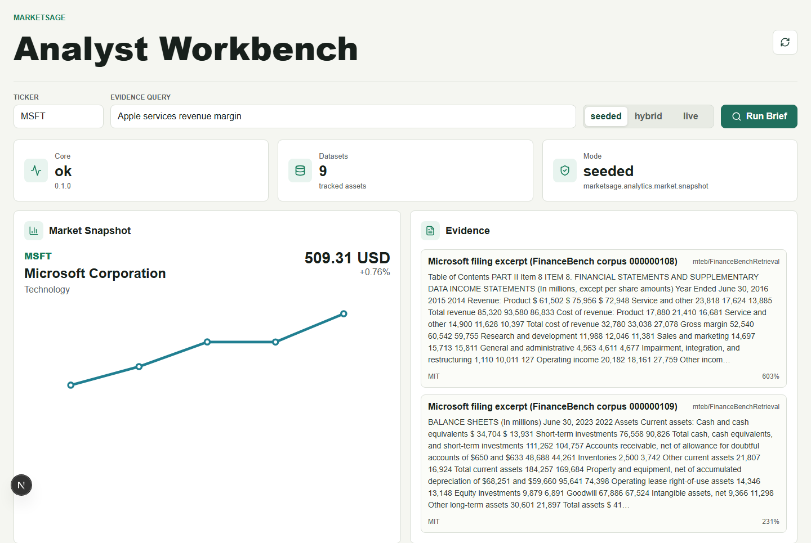
SCREENSHOTS · SEEDED MODE, NO KEYS
The analyst workbench: snapshot, trend and evidence
Seeded mode, no credentials. MSFT snapshot with a one-quarter close series and two FinanceBench filing excerpts scored by BM25, each captioned with its dataset and licence.
MarketSage · AI Systems Architecture Review · 13

Slide 14
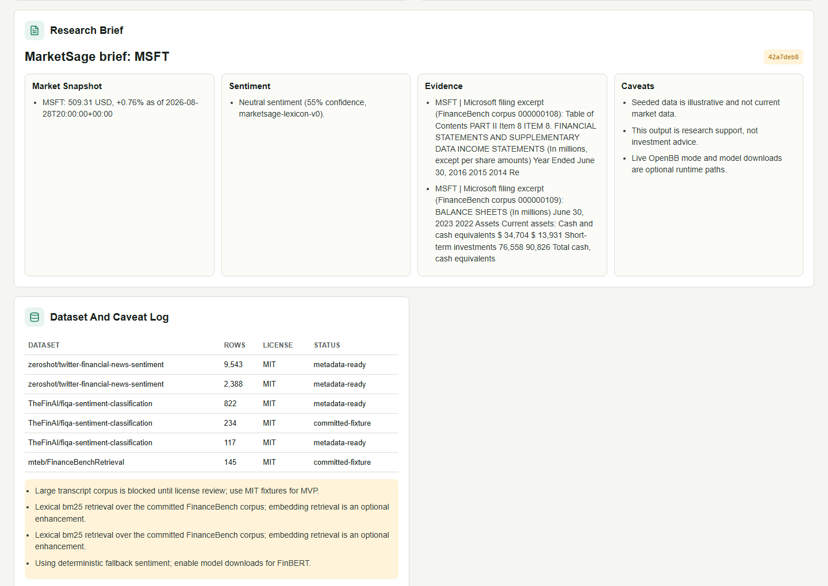
SCREENSHOTS · SEEDED MODE, SAVED RUN
The saved run: every section keeps its references
The same run, readable back through marketsage://runs/{run_id}: a run id badge, referenced sections, and the dataset/caveat log.
MarketSage · AI Systems Architecture Review · 14

Slide 15
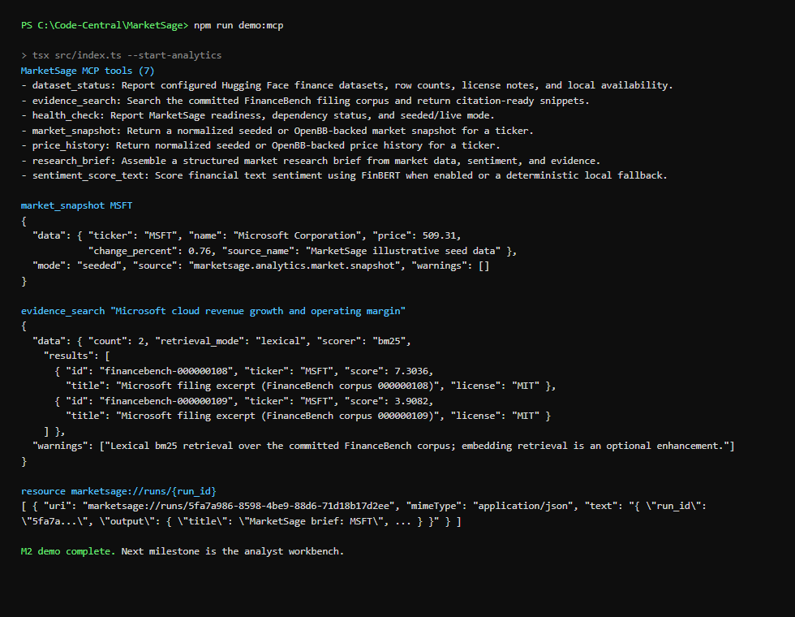
SCREENSHOTS · MCP CLI (NPM RUN DEMO:MCP)
Driving the gateway: tool discovery and a live call
The TypeScript MCP client discovers all seven tools, calls market_snapshot and evidence_search, and reads the saved run back as a resource — exactly what an LLM host would see.
MarketSage · AI Systems Architecture Review · 15

Slide 16
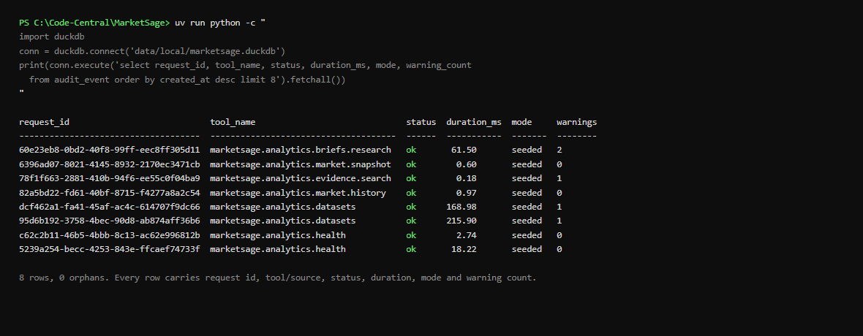
SCREENSHOTS · DUCKDB AUDIT_EVENT
Every call leaves a row
What you are looking at
The eight most recent audit_event rows from this session's own demo run and workbench call: request id, tool/source, status, duration, mode and warning count — 0 orphans.
MarketSage · AI Systems Architecture Review · 16

Slide 17
ENTERPRISE READINESS · CONTROLS
Security and compliance controls
Boundary | Threat | Control in the code | Evidence
B1 client input | malformed ticker, oversized text | Pydantic validators: ticker matches ^[A-Z][A-Z0-9.-]{0,9}$; sentiment text bounded 1-4000 chars | models.py TickerRequest/SentimentRequest
B2 analytics HTTP API | unauthenticated access | optional bearer auth (MARKETSAGE_HTTP_TOKEN); Go gateway and Next.js proxy forward it server-side; never returned by /health | security-and-ops.md
B3 MCP stdio transport | stdout corruption breaks JSON-RPC | slog.NewJSONHandler(os.Stderr, ...) only; StdioTransport from the MCP SDK | main.go; T-011 acceptance criteria
B4 analytics responses | unaudited or silent failures | DuckDB audit_event row per call; best-effort so a local DB issue never masks API behaviour; known failures write status=error rows | storage.py, repo.py
B5 dependencies and secrets | known CVEs, leaked keys | npm audit (0 high+), uv pip check, govulncheck, and a secret-text regex scan, run in npm run audit:deps | ship-report.md, 2026-09-07
B6 data and model licensing | unlicensed reuse | source-notes.md review; sp500-earnings-transcripts blocked pending license, sec-bert-base excluded (CC-BY-SA-4.0) | docs/research/source-notes.md
Residual risk, stated plainly: the local bearer token is a demo/prototype control, not production identity management, network policy or managed secrets (docs/security-and-ops.md).
MarketSage · AI Systems Architecture Review · 17

Slide 18
ENTERPRISE READINESS · PROCESS
How it was built: a gated lifecycle, one validation gate
Requirements
HLD
LLD
Execution plan
Decisions (5 ADRs)
13 task packs
Build (M0-M5)
Ship report
13
5
45
11
task packs, T-001 through T-013, each with acceptance criteria, milestone and risk tier
architecture decision records, each with context, options considered and consequences
Python tests passed (pytest), including nine named fault injections and the contract checks
Go tests passed, including strict decoding of the exported contract fixtures
Documents that stay frozen
One command validates everything
docs/design/01-requirements.md, 02-hld.md, 03-lld.md and 04-execution-plan.md are cited, not re-derived, once a task pack is in flight; docs/design/decisions.md records every ADR with its consequence.
docs, ruff, pytest, go fmt/test/vet, an MCP CLI smoke, the Next.js build, a workspace check, and an offline eval with drift checks on the results card and the generated contract. CI (.github/workflows/check.yml) runs the same command on ubuntu-latest on every push.
MarketSage · AI Systems Architecture Review · 18

Slide 19
ENTERPRISE READINESS · MEASUREMENT
Quality metrics from the eval harness
KPI | Value | Note
Evidence recall@5, ticker given | 94.7% | no hint: 44.0%, nDCG@10 0.38
Sentiment fallback commit rate | 8.1% | 19/234 FiQA; 89.5% right when it fires
Brief claims grounded | 12 / 12 | 5 tickers; 3 say so, not borrowed
Contract conformance | 8 / 8 | vs. the generated JSON Schema
Fault injections handled honestly | 9 / 9 | warning or clean error only
Audit completeness | 8 / 8 | 0 orphaned rows
Latency budget, 8 endpoints | 8 / 8 < 2s p95 | 5 runs; p95 63-252ms
Every figure is written by `npm run eval` to metrics/headline.json; `npm run check` fails if the README card or the generated contract drifts from it.
MarketSage · AI Systems Architecture Review · 19

Slide 20
HONESTY
Quirks and known limitations (stated, not hidden)
Evidence coverage is 2 of 5 tickers
Recall collapses without the ticker hint
Only MSFT and JPM have filing excerpts in the committed corpus; the other three seeded tickers get an explicit warning, never borrowed evidence.
94.7% recall@5 becomes 44.0% (MRR 0.33, nDCG@10 0.38) without it; the structured hint is doing the heavy lifting, and the card says so.
The sentiment fallback is weak by design
FinBERT accuracy is unmeasured here
marketsage-lexicon-v0 commits on 8.1% of FiQA test sentences (19/234); it exists so the demo runs with no download, not as a classifier.
Needs MARKETSAGE_ENABLE_MODEL_DOWNLOADS=true and a model download; the offline harness scores the lexicon fallback only.
Embedding retrieval is not implemented
Live OpenBB data is not scored
The bge-small / MiniLM path is pending; lexical BM25 is the only scorer in the eval today.
Seeded prices are illustrative; live mode needs the optional dependency and provider configuration, and is out of the offline gate by design.
`go fmt` flags every Go file on this Windows host
Bearer auth is a demo control
A CRLF checkout artifact, not a real formatting diff (gofmt -d shows only line-ending changes); CI on ubuntu-latest is green.
MARKETSAGE_HTTP_TOKEN is local prototype protection, not production identity, network policy or managed secrets.
MarketSage · AI Systems Architecture Review · 20

Slide 21
ENTERPRISE READINESS · OPERATIONS
Cost, performance and operability
0 keys
8 / 8
56
0
needed for seeded mode, the demo, or the offline eval harness
endpoints under the 2s p95 latency budget, in-process over 5 runs
tests passed at ship (45 pytest + 11 Go), plus the eval harness and CI
high-severity findings: npm audit, uv pip check, govulncheck all clean
Operability
Observability and audit
• demo-script.md: a five-minute walkthrough, check → demo:mcp → workbench → protected mode → eval → audit query
• SHOWCASE.md: a ten- and twenty-minute tour with commands and files
• Health endpoint reports duckdb/openbb/huggingface dependency status independently
• Protected mode is one environment variable away (MARKETSAGE_HTTP_TOKEN)
• DuckDB audit_event: request id, tool, status, duration, mode, warning count, per call
• Best-effort audit writes so a local DB issue never masks API behaviour
• Every payload carries its own warnings array; nothing is silently substituted
• The saved-run resource makes every brief reproducible after the fact
MarketSage · AI Systems Architecture Review · 21

Slide 22
NEXT STEPS
Roadmap to a pilot
Now
Next
Then
Later
Close the accuracy gap
Widen evidence coverage
Harden for a pilot
Scale
Record a FinBERT run with model downloads enabled; publish it as a recorded, not re-observed, figure
Add embedding retrieval behind the same scorer switch, scored on the same fixture
Filing excerpts for the three seeded tickers that currently get a coverage warning
Live OpenBB provider configuration and credentials for a real pilot ticker set
An identity layer in front of MARKETSAGE_HTTP_TOKEN
A tamper-evident audit sink, and a runbook for the on-call path
Full ticker universe instead of five seeded illustrative names
Batch briefs and a dashboard over audit and warning rates
The first two items are the project's own stated next steps (STATE.md); nothing below changes the contracts, the audit row, or the grounding check.
MarketSage · AI Systems Architecture Review · 22

Slide 23
APPENDIX
Appendix A — Decision log
ID | Decision | Consequence
ADR-001 | Use the full enterprise-dev-lifecycle track | Requirements, HLD, LLD, execution plan, task packs and a ship report before code merges
ADR-002 | Go MCP gateway, Python analytics core, TypeScript clients | Transport discipline in Go, OpenBB/HF fit in Python; a Go spike in M0 validated the boundary first
ADR-003 | DuckDB for local analytics and cache state | No database server for a reviewer; schemas kept portable enough for Postgres later
ADR-004 | Default to OpenBB-compatible (AGPL-3.0-only) licensing | Avoids muddled licensing for a public repository while OpenBB is a direct dependency
ADR-005 | Seeded data first, live data second | The full MCP/client workflow proven early; live OpenBB integration layered on without blocking the demo
MarketSage · AI Systems Architecture Review · 23

Slide 24
APPENDIX
Appendix B — Task packs and lessons
Task | Milestone | Status
T-001 Repository guardrails and validation skeleton | M0 | done
T-002 … T-004 Python core, Go gateway, TS client skeletons | M0-M1 | done
T-005 … T-009 OpenBB adapter, HF manifest, sentiment, evidence, briefs | M1-M2 | done
T-010 Next.js analyst workbench | M3 | done
T-011 Hardening, observability and security | M4 | done
T-012 Portfolio docs and public license | M5 | done
T-013 Offline evaluation harness, real evidence corpus, contracts, MCP prompts | M5 | done
Lessons recorded in STATE.md and the T-013 task pack
• Phases 0-3 planning artifacts were drafted in one pass at the user's request; the hard gate before application code stayed in force regardless.
• "Not done, on purpose": FinBERT and embedding numbers need downloads the offline gate forbids; they belong in a recorded run under a bench/ path, not asserted here.
• Six hand-written evidence rows that carried a FinanceBench label without coming from it were removed once the real corpus was committed.
MarketSage · AI Systems Architecture Review · 24

Slide 25
APPENDIX
Appendix C — Repository map and how to run
apps/web/ Next.js workbench + server-side API proxy
clients/mcp-cli/ TypeScript MCP client (`npm run demo:mcp`)
services/
mcp-gateway-go/ Go stdio MCP server: 7 tools, 4 prompts, 1 resource
analytics-python/ FastAPI core: market, sentiment, evidence, briefs,
OpenBB adapter, HF datasets, DuckDB storage, eval
packages/contracts/ marketsage.schema.json, generated from Pydantic
data/fixtures/ FinanceBench + FiQA, MIT, sha256-pinned manifest
metrics/ headline.json, eval-latest.json, render.py
docs/design/ requirements, HLD, LLD, execution plan, decisions
docs/tasks/ 13 task packs, T-001 … T-013
docs/graph/ codebase knowledge graph (graphify): 1199 nodes,
2180 edges, 90 communities
Run it
npm install
npm run check # the gate
npm run demo:mcp # MCP client, all 7 tools
npm run eval # the results-card harness
# the workbench, two terminals
npm run dev:analytics
npm run dev --workspace apps/web
# protected mode
$env:MARKETSAGE_HTTP_TOKEN="<key>"
npm run dev:analytics
MarketSage · AI Systems Architecture Review · 25

Slide 26
Questions
MarketSage · roshanrana/MarketSage · AGPL-3.0-only · design docs, ship report and demo script in the repository

