Slide 1
P
PROVENANCE
AI Systems Architecture Review
Verifiable, tenant-isolated LLM inference controls for regulated AI — reproducibility receipts, and a measured cross-tenant cache-leak fix
Release/ship date · 12 September 2026 · Roshan Rana, AI Systems Architect

Slide 2
OVERVIEW
Executive summary
What it is
What it proves
Why it is enterprise-ready
Two working controls for a bank's shared LLM inference platform: ATTEST proves a model's output is reproducible enough for a validator (SR 11-7); BARRIER closes a routing-layer channel that leaks one tenant's prompts to another.
Both ship against real vLLM, SGLang and llm-d — not a mock of them.
Batched inference at temperature 0 is not reproducible: 34 of 128 identical requests returned distinct logprob vectors. Determinism costs 18.0% of throughput isolated from caching (SGLang), 22.7% confounded with it (vLLM).
The routing-index leak is real (AUC 1.0000, p=9.999e-05) and the tenant-salt fix closes it (AUC 0.5000, at chance) — same schedule, same pre-registered rule, measured in public CI on every push for £0.
A gated lifecycle (phases 0–7), 12 ADRs and a 27-entry findings log — four of them guards that contained the defect they were written to catch, kept rather than hidden.
332 Python + Go tests; the statistics are implemented and unit-tested in-house so a reviewer can read the decision rule rather than trust a library call.
Ask of the audience: agree the pilot scope for the two open measurements — a client-observable timing oracle on real vLLM (FR-B-09) and a signed receipt against a live engine — and the GPU budget for the next session.
PROVENANCE · AI Systems Architecture Review · 2

Slide 3
CONTEXT
The problem and the users
The model-risk problem
The information-barrier problem
SR 11-7 and its analogues assume a model's output can be reproduced. On a default vLLM deployment the honest answer is that nobody can: batched inference is not deterministic even at temperature 0, because GPU kernels pick different reduction orders depending on what else is in the batch.
llm-d's cache-aware router makes a shared platform fast by routing matching prompt prefixes to the pod that already holds them. In a bank the prefixes are the sensitive part — by default, two tenants on one model share one routing namespace.
Actor | Needs | Frequency
Model validator / auditor | Demonstrable reproducibility for a specific output, model identity anchored outside the platform team's control | On review
Platform / SRE team | A mitigation that ships as a plugin, not a fork, and a diff that states exactly what changed | Deploy / operate
Compliance / InfoSec | Evidence the routing layer cannot leak across an information barrier, and an honest account of what was and was not measured | Ongoing
Tenants (Research vs M&A) | The same shared platform, and a guarantee neither can observe what the other is asking | Every request
PROVENANCE · AI Systems Architecture Review · 3

Slide 4
APPROACH
Solution at a glance
1
Measure
2
Quantify + attest
3
Probe
4
Close it
Drive a matrix of prompts, batch shapes and seeds through a real engine; record raw logprobs to an append-only, resumable ledger.
Bootstrap CI on the cost of determinism; decompose it across two engines; sign a receipt anchored to a Hugging Face commit SHA and weight digest.
Stand up a two-tenant llm-d cluster in kind; probe the prefix-cache router with a pre-registered AUC/bootstrap/permutation rule fixed before any attack code existed.
An out-of-tree EPP plugin binds the cache salt to authenticated identity; Envoy strips and re-injects it before ext_proc; both profiles run in CI on every push.
Surfaces
Two workstreams, one shared library (D-04)
attest CLI (verify exit codes 0/2/3/4/5/6) · barrier attack scripts · common/stats library · GitHub Actions. No service, no dashboard — every published number is a file under git.
ATTEST needs a rented GPU for about $2.00 total. BARRIER's kind cluster runs in public CI for £0. Neither blocks the other's ship; both share common/stats only.
PROVENANCE · AI Systems Architecture Review · 4

Slide 5
ARCHITECTURE · C4 LEVEL 1
System context
Reviewer
PROVENANCE
Hugging Face Hub
clone + run, no GPU
model identity: commit SHA + LFS weight digest
Surfaces
attest CLI · barrier attack scripts
vLLM / SGLang engine
Roshan (operator)
ATTEST + BARRIER
rented GPU, SM ≥ 8.0, released same day
GPU session + cluster
harness · receipt · analysis / attack · epp · deploy — common/stats shared by both
kind cluster
llm-d Router + simulator pods, two tenants
Model validator
bench/results/
verifies a receipt alone
immutable raw evidence; single writer per run-id
GitHub Actions
make check · BARRIER cluster workflow
Build/measure-time only: the GPU engine is rented by the hour and released the same day; the kind cluster stands up fresh in CI on every push. Nothing here is an always-on service.
PROVENANCE · AI Systems Architecture Review · 5

Slide 6
ARCHITECTURE · C4 LEVEL 2 · HLD §4, C1–C8
Component architecture
ATTEST — harness (C1)
ATTEST — receipt/analysis (C2,C3)
BARRIER (C4,C5,C6)
common + evidence (C7,C8)
matrix.py
schema / canonical
spike_s02 / demo_frb03
auc / permutation
prompts × batch × seed
in-toto + JCS
the oracle + FR-B-03 probe
rank AUC, permutation test
ledger.py
sign.py / cli.py
ground_truth.py
decision.py
cells.jsonl, resumable
ed25519, exit codes
prefix-index truth
the pre-registered verdict
engine / vllm / sglang
provenance.py
plugin.go / salt.go
calibration / noise
engine lifecycle
HF commit + LFS digest
tenant-salt EPP plugin
200-dataset CI check
run.py
cost / divergence
values-*.yaml
bench/results/
cell → JSONL + receipt
CIs, no engine access
default vs hardened
immutable, single-writer
Responsibilities do not overlap (HLD §4): C3 never touches an engine, C1 never computes a statistic, C4 never decides whether a result passes — that is C7's pre-registered test.
PROVENANCE · AI Systems Architecture Review · 6

Slide 7
ARCHITECTURE · CRITICAL FLOW · FR-B-03
The critical flow: measuring the cross-tenant leak
1. Plant
2. Probe +
3. Probe −
4. Read
tenant B submits a fresh nonce prefix nobody has sent before
tenant A submits the identical text — the positive class
tenant A submits a different fresh nonce — the negative class, same tenant, same key, same length
match ratio read from the EPP's own prefix_indexer_hit_ratio histogram, attributed to exactly one request
5. Guard
6. Score
7. Repeat
8. Verdict
refuse the trial if the counter moved by anything other than one — another client or a retry would corrupt it
common/stats/decision.py: AUC ≥ 0.75, CI excludes 0.5, p < 0.01 for the attack; CI contains 0.5 for the mitigation
both profiles, same schedule, 40 trials per profile — in GitHub Actions, on every push
attack_succeeds / at_chance / neither — the middle case is a real state, not a bug
The rule was fixed in LLD §7 before any attack code existed. It has already returned 'neither' once (S-02, ADR-011) and both extremes once (FR-B-03, ADR-012) — never adjusted to fit.
PROVENANCE · AI Systems Architecture Review · 7

Slide 8
DESIGN · THE PRE-REGISTERED DECISION RULE
A verdict fixed before the evidence
What the rule requires (common/stats/decision.py)
attack_succeeds
default profile, run #15: AUC 1.0000, p=9.999e-05
attack_succeeds:
auc >= 0.75
ci_lower_bound > 0.5
p < 0.01
at_chance:
ci contains 0.5
otherwise:
inconclusive # neither claim
at_chance
hardened profile, run #15: AUC 0.5000, same schedule
inconclusive
S-02 simulator, run #12: AUC 0.5581 [0.5026,0.6138]
Why it holds up
Why this mattered twice
one function scores both the attack and the mitigation — nothing to let them silently drift apart
implemented in common/stats/ rather than imported: a reviewer can read the whole rule in about forty lines
bootstrap calibration-tested over 200 null datasets: nominal 95% should cover truth ~95% of the time (91.0% observed)
S-02 returned 'ORACLE VIABLE' on a plain millisecond counter — twice — because a five-name ignore-list only excludes noise you already named. The fix was a property test, not a longer list. Two more guards (F-25, F-26) failed the same way before the ground-truth check became tested code.
PROVENANCE · AI Systems Architecture Review · 8

Slide 9
ARCHITECTURE · DATA · ADR-001
Data architecture: no database, by design
Raw evidence (C1, C4)
Figures, generated not drawn
bench/results/<workstream>-<UTC timestamp>-<git SHA>/ — JSONL run output + manifest.json (command, SHA, env, timestamps). Single writer per run-id; immutable once the manifest finalises. Analysis reads, never mutates.
docs/figures/*.svg regenerated by scripts/make_figures.py from bench/results/measurements.json. tests/test_published_numbers.py fails the build if README or the ship report drifts from it.
Three kinds of file, all under git
raw output
receipts
metrics/headline.json
Receipts (C2)
in-toto-style JSON + detached ed25519 signature, JCS-canonicalised so two serialisations produce identical bytes. Model identity anchors to the Hugging Face Hub commit SHA and LFS weight digest — a root the platform team does not control.
A database would put a published number behind something that can drift (ADR-001) — the opposite of what a repository whose entire subject is verifiable claims can afford.
PROVENANCE · AI Systems Architecture Review · 9

Slide 10
ARCHITECTURE · INTEGRATION
Two engines, one plugin, and where the boundary sits
Two engines, one seam (C1)
One plugin, no fork (ADR-002)
attest/harness/engine.py defines one client interface; vllm.py and sglang.py implement its lifecycle. SGLang entered as a control arm (ADR-009) to decompose vLLM's confounded cost number — methodology, not coverage.
llm-d-router exports Register() and a package-level Registry, so barrier/epp/cmd/epp blank-imports the tenant-salt plugin and runs upstream's runner unmodified. Upgrades are a go.mod bump plus a compile check.
Ordering is the whole trust boundary (F-27)
The only 'live' surface is CI
Envoy applies route-level header mutations in the router filter, which runs AFTER ext_proc — a naive strip-and-inject never reaches the EPP. The fix places envoy.filters.http.header_mutation before ext_proc, and overwrites rather than remove-then-add, because Envoy applies removes after adds.
The two-tenant kind topology (llm-d Router + simulator pods) stands up fresh in GitHub Actions on every push to barrier/**, both profiles, £0 — the BARRIER cluster workflow, active and running since 2026-09-07.
PROVENANCE · AI Systems Architecture Review · 10

Slide 11
DESIGN DECISIONS
Design choices and why
Decision | Alternatives considered | Why this one
Monorepo of CLIs, no services (ADR-001) | Results service + dashboard; one unified CLI | Files under git are the simplest traceability story; a database puts published numbers behind something that can drift
Out-of-tree Go module, no fork (ADR-002) | Fork llm-d-router; configuration-only mitigation | Register/Registry are exported — a droppable plugin is stronger than a fork reviewers discount
Own the AUC/bootstrap/permutation test (ADR-003) | scikit-learn roc_auc_score; statsmodels | A reviewer assessing a security claim should read the forty-line test, not trust a library call
Helm, two values files as the deliverable (ADR-004) | Kustomize overlays; raw YAML per config | The diff between values-default.yaml and values-hardened.yaml IS the argument
ed25519 + in-toto predicate, sigstore deferred (ADR-005) | Sigstore keyless via cosign | Keyless signing needs network + OIDC at verify time, breaking the no-accounts path (D-13)
Strip identity at the proxy, fail closed (ADR-006) | Add the header to llm-d's own InputControlHeaders; trust it as received | Upstream's set is a hardcoded package var; the proxy boundary needs no upstream change
SGLang as ATTEST's control arm (ADR-009) | Publish the confounded vLLM number with a caveat; drop the claim | SGLang runs deterministic with its cache on, supplying the missing 2×2 cell
PROVENANCE · AI Systems Architecture Review · 11

Slide 12
PRODUCT
Major features
Signed attestation receipts
Resumable measurement harness
Cost-of-determinism decomposition
in-toto statement, JCS-canonicalised, ed25519-signed; model identity anchored to a Hugging Face commit SHA and LFS weight digest, not a local hash
matrix.py × ledger.py: a run that dies at cell 340 of 600 resumes at 341; raw output committed before analysis reads it
a 2×2 across vLLM and SGLang isolates determinism's cost (18.0%) from the prefix cache's (a 7.9% penalty on this workload)
Tenant-salt EPP plugin
Two-tenant kind topology in CI
Pre-registered statistics library
out-of-tree, registered via llm-d's exported Registry; HMAC-derives a salt from authenticated identity, propagates it to vLLM's own cache too
both deployment profiles stood up fresh on every push to barrier/**; the FR-B-03 measurement runs against them for £0
AUC, bootstrap CI, permutation test, calibration-tested over 200 null datasets; the decision rule is frozen before any attack code
attest verify CLI
barrier-diff
STATE.md findings log
a full exit-code contract: 0 valid, 2 signature invalid, 3 digest mismatch, 4 malformed, 5 Hub unreachable, 6 identity divergent
the entire mitigation presented as a three-change YAML diff between values-default.yaml and values-hardened.yaml
27 findings (F-01…F-27) — the project's own record of what it got wrong and how each was caught
PROVENANCE · AI Systems Architecture Review · 12

Slide 13
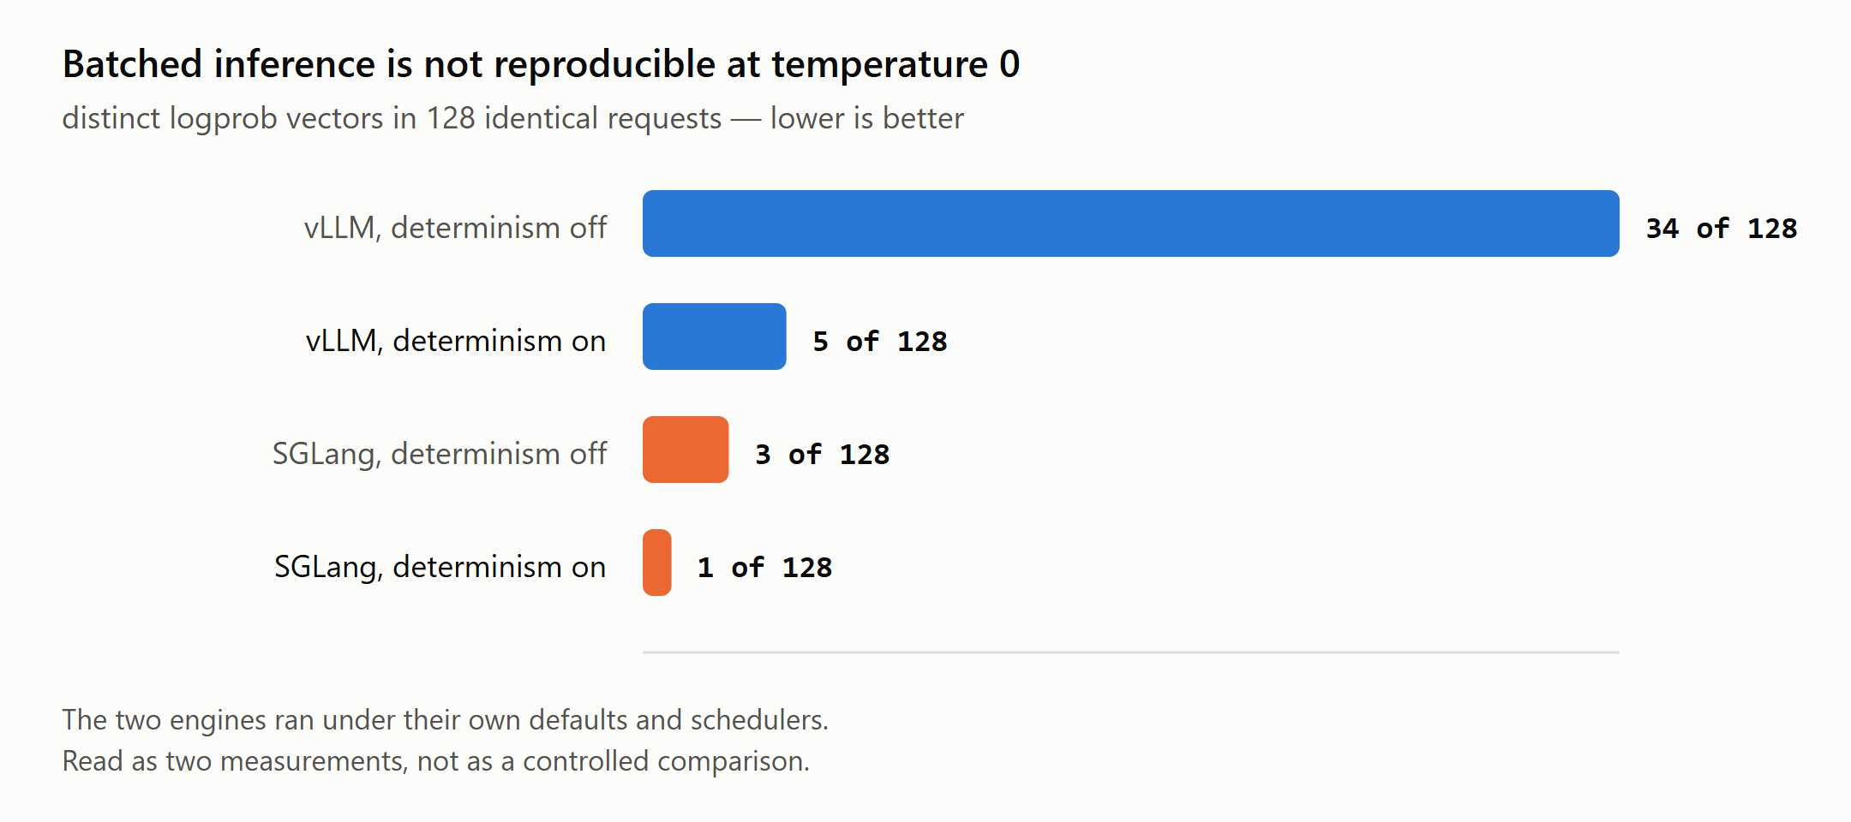
MEASURED · DOCS/RESULTS.MD §1
Batched inference is not reproducible
What this shows
128 identical requests, temperature 0, seed fixed. VLLM_BATCH_INVARIANT=1 cuts 34 distinct outputs to 5 — a large mitigation, not a guarantee. SGLang's deterministic mode reached 1 of 128.
What it does not establish
The two engines ran under their own defaults and schedulers — read as two measurements, not a controlled comparison (README).
PROVENANCE · AI Systems Architecture Review · 13

Slide 14
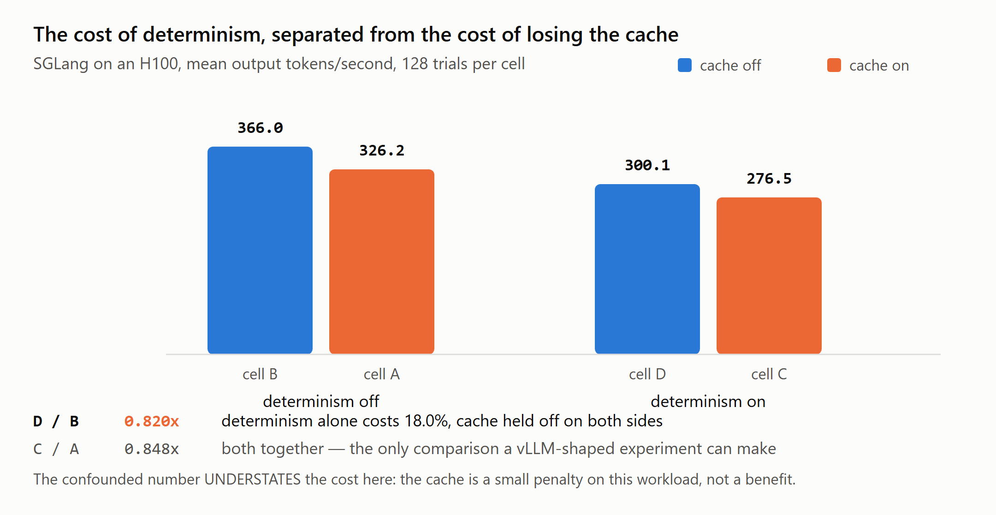
MEASURED · DOCS/RESULTS.MD §2 · ADR-009
The cost of determinism, decomposed
Why a second engine
vLLM cannot run batch-invariant with prefix caching on, so its 22.7% number is determinism plus the loss of the cache. SGLang runs deterministic with its cache on, supplying the missing 2×2 cell.
The counter-intuitive part
The confounded figure (0.848×) understates the isolated cost (0.820×) here — the two effects partly cancel on this short-prompt workload.
PROVENANCE · AI Systems Architecture Review · 14

Slide 15
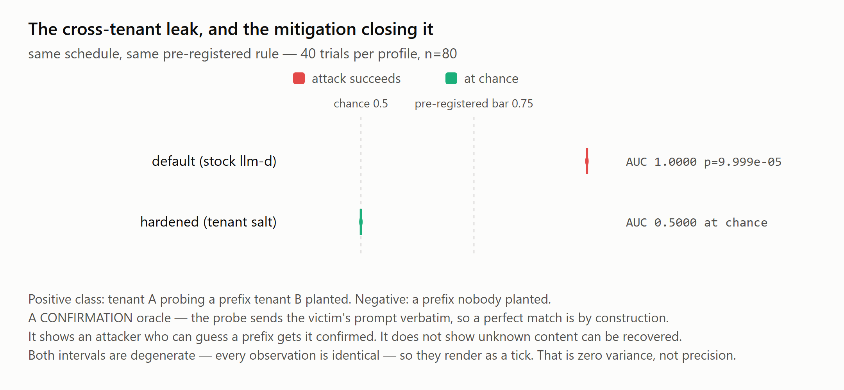
MEASURED · DOCS/RESULTS.MD §3 · ADR-012, CI RUN #15
The cross-tenant leak, and the mitigation closing it
Same schedule, same rule
40 trials per profile, n=80. default clears the pre-registered bar (AUC 1.0000, p=9.999e-05); hardened lands exactly at chance (AUC 0.5000) — the same instrument, the same threshold.
Scope, stated plainly
A confirmation oracle: the probe sends the victim's prompt verbatim, so 1.0 is by construction. It shows a guessed prefix confirmed, not unknown content recovered.
PROVENANCE · AI Systems Architecture Review · 15

Slide 16
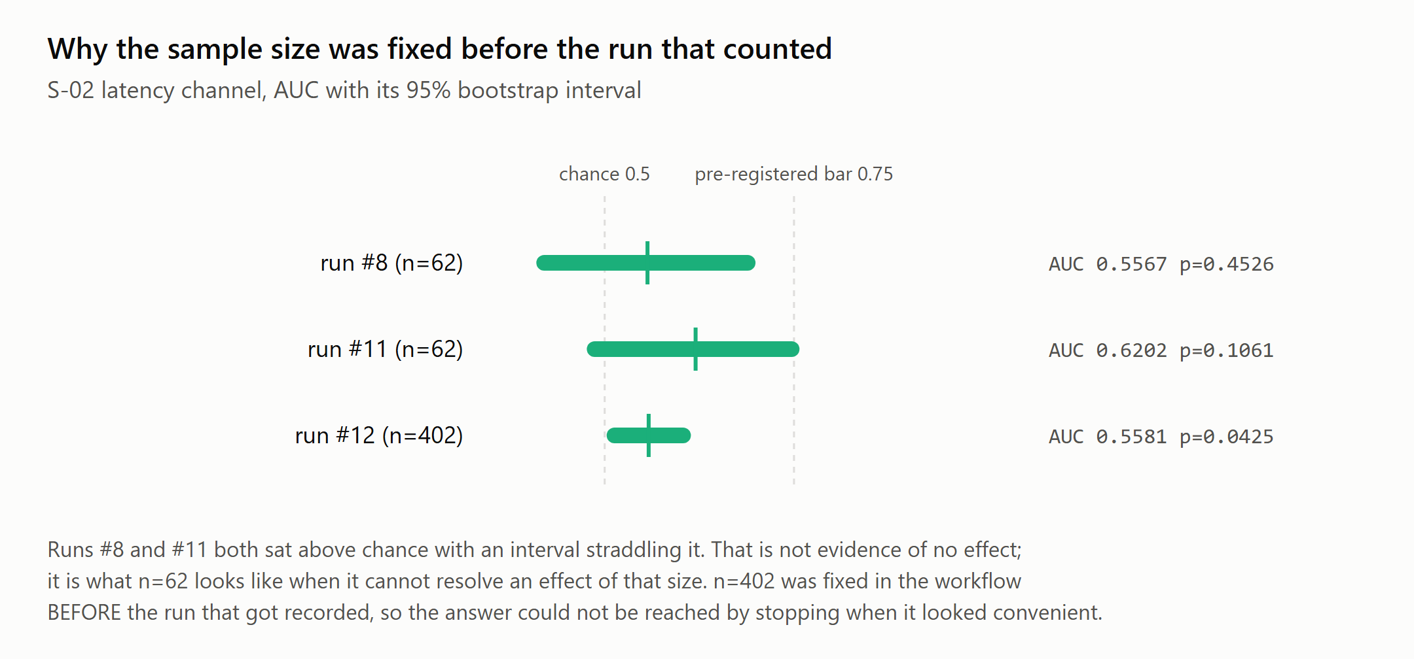
MEASURED · DOCS/RESULTS.MD §4 · ADR-011, CI RUN #12
What a pre-registered rule is actually for
Two wrong-shaped answers first
Two runs at n=62 put the AUC point estimate above chance with an interval straddling it — not evidence of no effect, just an underpowered sample.
n=402 fixed in advance
AUC 0.5581 [0.5026, 0.6138], p=0.0425 — clears none of the three thresholds. 'No oracle', stated precisely, not 'no effect'.
PROVENANCE · AI Systems Architecture Review · 16

Slide 17
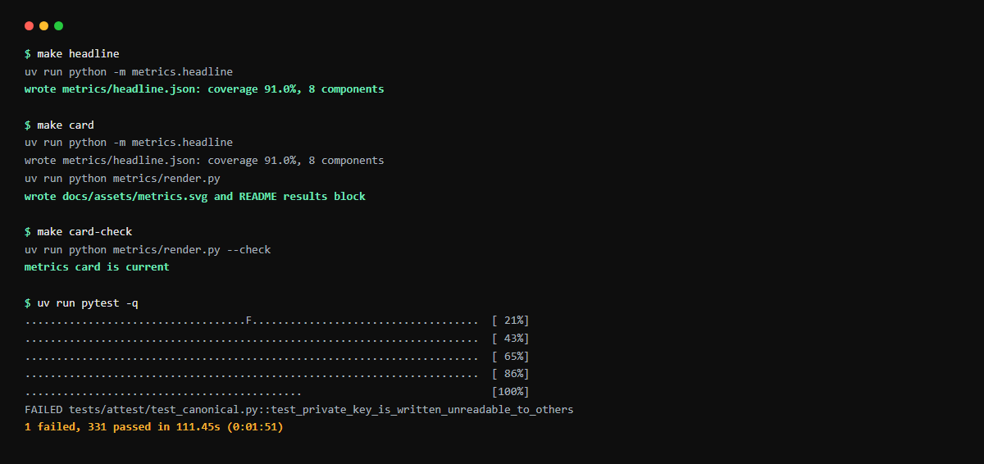
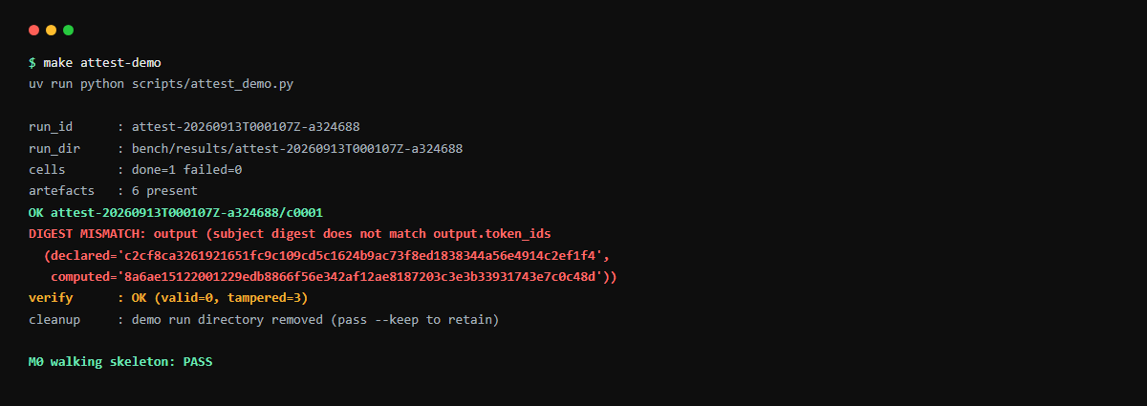
SCREENSHOTS · THIS REVIEW'S OWN RUNS
Confirming the numbers, and the receipt pipeline
Left: make headline / make card / make card-check, then the full pytest run (331 passed, 1 Windows-only failure, 111s). Right: make attest-demo — signs a receipt, then tampers with it three ways and requires the verifier to catch every one ('valid=0, tampered=3').
PROVENANCE · AI Systems Architecture Review · 17

Slide 18
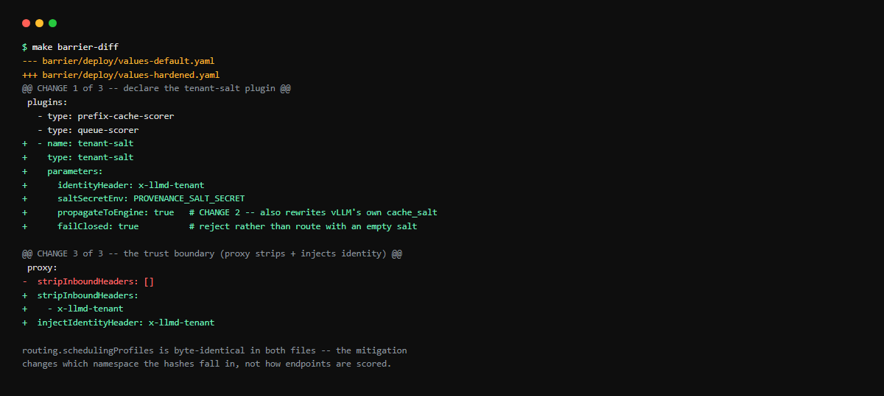
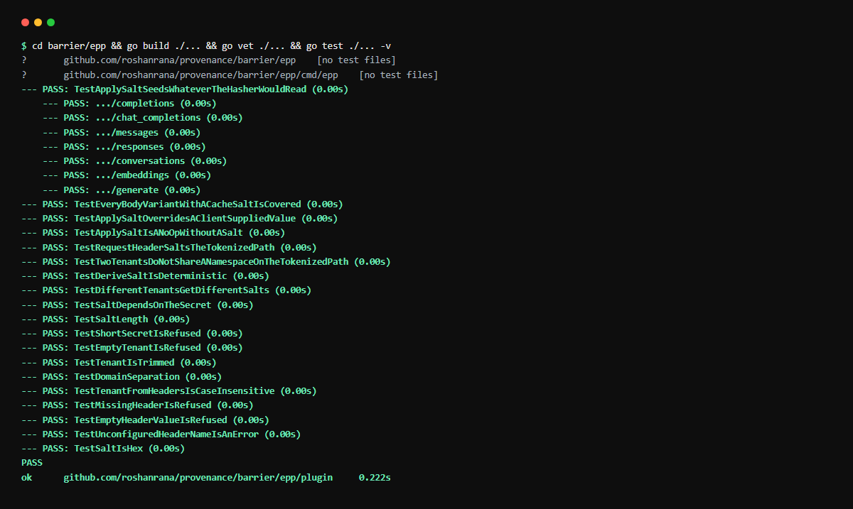
SCREENSHOTS · MAKE BARRIER-DIFF · BARRIER/EPP
The mitigation, and proof it compiles
Left: the entire mitigation as a three-change YAML diff — plugin declaration, salt propagated to vLLM's own cache, proxy strip-and-inject. Right: go build/vet/test against the real llm-d-router v0.10.0 graph — 19 test functions (26 with subtests), all passing.
PROVENANCE · AI Systems Architecture Review · 18

Slide 19
ENTERPRISE READINESS · CONTROLS
Security and compliance controls
Boundary | Threat | Control in the code | Evidence
Proxy (trust boundary) | attacker-supplied identity header | strip x-llmd-tenant, inject vouched identity via OVERWRITE_IF_EXISTS_OR_ADD, before ext_proc | run #13: 401 unauthenticated; F-27 fix
EPP prefix index (approximate) | omission / forgery / negligence of client-supplied cache_salt | salt is HMAC-derived from vouched identity; failClosed rejects absent/malformed identity | ADR-012 run #15: default AUC 1.0000, hardened 0.5000
Engine cache (precise path) | salt closes routing index but leaves vLLM's own KV cache shared | plugin rewrites the outbound cache_salt so the engine partitions identically (obligation 3) | Go test: all 7 body variants covered
Salt secret | a compromised secret derives every tenant's salt | min 32 bytes, mounted from a Secret, never logged, never in values files | threat-model.md §8
Receipt verifier | a claim the platform team could fabricate | model identity anchors to the HF Hub commit SHA + LFS digest, a root we do not control | attest verify --online, exit codes 5/6
Residual risks are written down, not hidden: no authentication on the demo cluster beyond the proxy; a compromised salt secret restores every forgery; the client-observable oracle on real vLLM (FR-B-09) is unmeasured.
PROVENANCE · AI Systems Architecture Review · 19

Slide 20
ENTERPRISE READINESS · PROCESS
How it was built: a gated lifecycle
P0 brief
P1 HLD
P2 LLD
P3 plan
P4 build
P5 measure
P6 amend
P7 shipped
12
27
50
$2.00
ADRs, each with options considered and consequences accepted — several overturning the original brief
findings logged in STATE.md (F-01…F-27); four are guards that contained the defect they were written to catch
tasks across 7 milestones in the execution plan; 6 detailed packs committed for the earliest waves
total rented GPU spend across six pods for every ATTEST number in this repository
Pre-registered, not post-hoc
One command validates everything
BARRIER's success criteria (AUC ≥ 0.75, CI excludes 0.5, p < 0.01) were committed before any attack code existed, and the git history shows that ordering.
ruff · ruff format · mypy strict · pytest (332 tests) · Go build/vet/test — make check. CI is meant to mirror it exactly; a step that passes locally and fails there is treated as the bug.
PROVENANCE · AI Systems Architecture Review · 20

Slide 21
ENTERPRISE READINESS · MEASUREMENT
Quality metrics from this review's own runs
KPI | Value | Source
Python tests | 331 passed, 1 failed (Windows-only) of 332 | pytest, this run
Go tests (barrier/epp) | 19 funcs / 26 with subtests, all pass | go test, this run
ADRs / findings logged | 12 / 27 (4 self-catching guards) | decisions.md
Cross-tenant leak (default) | AUC 1.0000, p=9.999e-05, n=80 | ADR-012, run #15
Mitigation (hardened) | AUC 0.5000, at chance, n=80 | ADR-012, run #15
Determinism cost, isolated | 18.0% (SGLang, D/B = 0.820×) | ADR-009, H100
Determinism cost, confounded | 22.7%, 95% CI [0.741, 0.808] (vLLM) | bench/results
The one Python failure asserts a 0600 file-mode; Windows filesystems do not enforce that bit the way POSIX does. Confirmed pre-existing and platform-specific during this review — not a defect in the path CI actually runs (ubuntu-latest).
PROVENANCE · AI Systems Architecture Review · 21

Slide 22
HONESTY
Quirks and known limitations (stated, not hidden)
A confirmation oracle, not an extraction one
No client-observable oracle — on the simulator
FR-B-03's probe sends the victim's prompt verbatim, so AUC 1.0 is by construction. It shows a guessed prefix gets confirmed; nothing about recovering unknown content (ADR-012).
S-02: latency AUC 0.5581 [0.5026, 0.6138], p=0.0425 — clears none of the three thresholds. Real vLLM does vary TTFT with cache state; that question is FR-B-09, open.
Two engines, not a controlled comparison
No signed receipt against a real engine
vLLM and SGLang ran under their own defaults and schedulers. The gap between 34 and 3 (determinism off) is larger than the determinism question alone explains.
attest-demo exercises the full pipeline, tamper detection included, against a stub. The GPU runs measured divergence and cost but emitted no receipts.
Four guards contained the bug they targeted
CI is disabled; only the cluster workflow runs
F-14, F-23, F-25, F-26: a comparison-arm guard that failed open, a millisecond counter mistaken for a discriminator (twice), a ground-truth gate that proved a plugin ran, not that it matched.
The CI workflow is manually disabled on GitHub; BARRIER cluster is the only active workflow, standing up both profiles on every push (confirmed via gh workflow list --all).
One pytest failure, Windows-only
Pre-existing lint/type debt in metrics/render.py
test_private_key_is_written_unreadable_to_others asserts a 0600 file mode Windows does not express the same way. 331 of 332 pass on this host.
ruff found 2 E501 lines and mypy found missing dict[...] type args during this review's confirmation run — present before this task, left unfixed as out of scope.
PROVENANCE · AI Systems Architecture Review · 22

Slide 23
ENTERPRISE READINESS · OPERATIONS
Cost, performance and operability
$2.00
£0
111s
8
total rented GPU spend (H100 + A40, six pods) for every ATTEST number in the repository
BARRIER's two-tenant kind cluster, both profiles, stood up fresh in GitHub Actions on every push
the 332-test Python suite on this host (0:01:51); Go build+vet+test completes in well under a second
components, no services (HLD §4) — every artifact is a file under git, traced to a command and a SHA
Operability
What is not yet instrumented
• STATE.md is the single source of truth for where the project stands — no repo-wide crawl needed to resume
• bench/results/ keeps the runs that were wrong alongside the ones that were right, each with the reason attached
• make check is the one gate agents, humans and CI all run
• make headline / make card regenerate the offline metrics card and fail the build on drift
• No alerting, no dashboard, no production deployment target — this is a measurement rig and a shipped mitigation, not a running service
• The GPU session is staged with a human decision point precisely because it is rented hardware, not standing infrastructure
• CI currently runs only the BARRIER cluster workflow (see Quirks)
PROVENANCE · AI Systems Architecture Review · 23

Slide 24
NEXT STEPS
Roadmap — none of it load-bearing
Next
Then
Then
Later
Real timing oracle
Continuous prefixes
Receipt on a live engine
Open statistical questions
FR-B-09 on real vLLM, where TTFT does vary with cache state
The simulator could not answer it (ADR-011) — this is the last open client-observable question
FR-B-03's separation is binary today (identical or disjoint)
A shared system prompt with differing tails makes the match ratio continuous and the interval non-degenerate
Sign a receipt against real vLLM/SGLang output, not the stub
Extend the tamper-detection test to that path
Confidence intervals on the SGLang 2×2; SGLang's Triton backend
Why vLLM's batch-invariant mode leaves 5 residual vectors of 128 where SGLang leaves 1
STATE.md lists all of this explicitly as 'none of it load-bearing' — both workstreams already have their headline result measured.
PROVENANCE · AI Systems Architecture Review · 24

Slide 25
APPENDIX
Appendix A — Decision log (abridged)
ID | Decision | Consequence
ADR-001 | Monorepo of CLIs, no services | No runtime to maintain; a dashboard, if ever built, is a mirror, never a source of truth
ADR-002 | Out-of-tree Go module, no fork | We track the runner API across releases; upgrades are a go.mod bump plus a compile check
ADR-003 | Own the AUC/bootstrap/permutation test | Both the attack and mitigation tests share one implementation — two would make the comparison meaningless
ADR-006 | Strip identity at the proxy, fail closed | The threat model states the proxy as the trust boundary; the guarantee is conditional on it
ADR-007 | Propagate the salt to the engine, not just the EPP | FR-B-05 gains a third obligation; the residual shrinks to 'whatever survives partitioning both'
ADR-009 | SGLang as ATTEST's control arm | D-06 amended: caching pinned off for vLLM because of an upstream integration gap, not determinism itself
ADR-011 | No client-observable oracle on the simulator; FR-B-03 rescopes | The attacker-observable oracle becomes FR-B-09's problem, on real vLLM
ADR-012 | FR-B-03 measured: the leak exists and the salt closes it | The two-profile diff is now backed by a measurement, not an argument
PROVENANCE · AI Systems Architecture Review · 25

Slide 26
APPENDIX
Appendix B — Build statistics and lessons
Item | Count | Where
ADRs | 12 | docs/design/decisions.md
Findings logged (F-01…F-27) | 27 | STATE.md
Findings that were guards containing their own defect | 4 (F-14, F-23/24, F-25, F-26) | STATE.md, SHIP-REPORT.md §2
Python tests | 332 (331 passing on this host, 1 Windows-only failure) | uv run pytest -q
Go tests (barrier/epp) | 19 functions / 26 with subtests, all passing | go test ./... -v
BARRIER cluster CI runs observed | active, both profiles, since 2026-09-07 | gh run list -R roshanrana/PROVENANCE
Lessons written into the record
• A limit that has not been re-tested is a guess (ADR-008 — the Go toolchain 'block' was asserted, not tested, and blocked nothing once actually tried).
• A gate whose failure message is silence cannot distinguish the thing it exists to catch (F-25).
• An ignore-list only excludes the noise you already named — S-02 needed a property test, not a longer list (F-23/F-24).
• Four instances of one shape is a pattern worth naming, not four coincidences.
PROVENANCE · AI Systems Architecture Review · 26

Slide 27
APPENDIX
Appendix C — Repository map and how to run
common/stats/ AUC, bootstrap CI, permutation, decision rule
attest/harness/ matrix, ledger, engine client, vLLM + SGLang
attest/receipt/ in-toto schema, JCS, ed25519, verify CLI
attest/analysis/ divergence tables, cost-of-determinism CIs
barrier/attack/ S-02 spike, FR-B-03 probe, ground truth
barrier/epp/ Go: tenant-salt plugin + custom EPP binary
barrier/deploy/ kind + Helm: values-default vs values-hardened
bench/results/ immutable raw output, every number's source
metrics/ headline.json, render.py (drift-checked)
docs/design/ requirements, HLD, LLD, decisions, spikes
docs/tasks/ early task packs (waves 1-2)
.github/workflows/ ci.yml (disabled), barrier.yml (active)
Run it
uv sync
make check # 332 Python
# + Go, ~2 min
make attest-demo # full pipeline,
# incl. tamper test
make barrier-diff # the mitigation,
# as a diff
# needs Docker + kind, no GPU
make barrier-up PROFILE=hardened
make barrier-spike
# needs a real GPU
make attest-stage1 \
ENGINE_URL=http://host:8000
PROVENANCE · AI Systems Architecture Review · 27

Slide 28
Questions
PROVENANCE · roshanrana/PROVENANCE · design docs, decision log and bench/results in the repository

