Slide 1
R
RegLens
AI Systems Architecture Review
Auditable regulatory RAG — cited answers, verified quotes, and a hash-chained trail a reviewer can replay, fully offline
Release/ship date · 12 September 2026 · Roshan Rana

Slide 2
OVERVIEW
Executive summary
What it is
What it proves
Why it is enterprise-ready
A regulatory question-answering system for compliance teams: hybrid retrieval, exact-citation routing, quote-verified grounded generation, and abstention when evidence is weak.
Every query is written to a hash-chained audit record with an evidence digest, so a reviewer can replay what the system read before it answered.
Verification is code, not a prompt: citations must resolve to retrieved chunks and quotes must appear in the cited text, checked after generation, every time.
275 deterministic tests and an offline eval harness — including four adversarial source-instruction cases — run with no API key, no vector database, no model download.
Fake embeddings, generation and reranking are real implementations bound by default; OpenAI, Qdrant and a cross-encoder reranker are optional layers that fail closed until explicitly configured.
CI runs the full offline gate (lint, mypy, 275 tests, eval) plus a container-config check on every push.
Ask of the audience: agree the pilot scope for live OpenAI + Qdrant (cost, latency, model choice), the OCR opt-in path, and the production auth/rate-limit posture.
RegLens · AI Systems Architecture Review · 2

Slide 3
CONTEXT
The problem and the users
The analyst's problem
The firm's constraints
A compliance officer gets a question from the trading floor: can we do this? The answer lives in a rulebook, notices and internal policy. A general-purpose chatbot will retrieve roughly the right passage, paraphrase it, cite something, and answer even when the evidence is thin — and leave no record of what it read.
A wrong citation is a liability and an unsupported answer is worse than no answer. Anything the tool says may be relied on and later examined, so citations must be structural, evidence must be verified in code, and every answer needs a replayable audit trail.
Actor | Needs | Frequency
Compliance analyst (primary) | A cited answer with retrieval diagnostics, or an honest refusal when evidence is weak | Several times a day
Legal / policy / model-risk reviewer | Source-level traceability: what evidence, what model, what prompt version, replayable months later | On review
Engineering / platform reviewer | Deterministic offline tests and eval, fail-closed optional providers, one command to verify | Deploy / operate
Automation and AI assistants | The same grounded answers over HTTP: /query, /chat (with SSE streaming), audit export | Ad hoc
RegLens · AI Systems Architecture Review · 3

Slide 4
APPROACH
Solution at a glance
1
Ingest
2
Retrieve & fuse
3
Generate
4
Verify & audit
Markdown, text, HTML, optional PDF, or an allowlisted FINRA URL, chunked so every chunk keeps its rule label and heading path.
BM25 keyword plus dense embeddings fused by Reciprocal Rank Fusion; an exact-citation route pins a named rule's chunks before fusion.
The model gets prompt-local [E1]…[En] evidence markers and must cite them; fake and OpenAI generation share one interface.
Citations must resolve, quotes must appear in evidence, weak evidence abstains, and every query writes a hash-chained audit row.
Surfaces
Two run modes, one contract
A dependency-free analyst UI served by FastAPI · JSON API (/retrieve, /query, /admin/ingest, /audit) · /chat with optional Server-Sent Events streaming for app and agent workflows.
Mock mode (default): fake embeddings, generation and reranker, fully offline, no key, no Qdrant. Local mode: the same code path with Qdrant and, optionally, OpenAI and a cross-encoder reranker behind explicit configuration.
RegLens · AI Systems Architecture Review · 4

Slide 5
ARCHITECTURE · C4 LEVEL 1
System context
Compliance analyst
RegLens
OpenAI (optional)
browser, analyst UI
text-embedding-3-small + gpt-5.4-nano; explicit provider name + key, fails closed otherwise
Surfaces
Analyst UI (/) · FastAPI JSON routes · /chat + SSE
Reviewer / auditor
Qdrant (optional)
audit export
Core pipeline
local vector store, collection regulatory_chunks, degrades to a structured error if unreachable
ingest → chunk → retrieve (BM25 + dense, RRF) → rerank → generate with [E1]… markers → verify citations/quotes → abstain or warn
sentence-transformers (optional)
Automation / agents
cross-encoder reranker, lazily loaded, local-files-only option
HTTP + SSE client
Persistence
SQLite: sources, chunks, query audits, evidence, chat sessions/turns
FINRA URLs (allowlisted)
finra.org / rules.finra.org, HTTPS only, snapshot stored locally
Mock mode (default) never calls any of the four boxes on the right. Local mode adds Qdrant; OpenAI and the cross-encoder are opt-in extras layered on top, each gated by an explicit setting.
RegLens · AI Systems Architecture Review · 5

Slide 6
ARCHITECTURE · C4 LEVEL 2
Component architecture
API (surfaces)
Ingestion
Retrieval
Generation & audit
routes_ui.py
loaders.py
keyword.py
prompts.py
analyst UI, dependency-free HTML
rule-aware BM25
[E1]… evidence markers
markdown/text/html/pdf
embeddings.py / qdrant_store.py
routes_query.py
fake or Qdrant-backed dense
llm.py / openai_llm.py
/retrieve, /query, /chat
chunking.py
fake or OpenAI Responses
fusion.py
routes_admin.py
deterministic, citation-preserving
Reciprocal Rank Fusion
citations.py / quote_verifier.py
ingest, ingest-url, documents
service.py
resolve + verify
normalizers.py
routing, pinning, trimming
routes_audit.py
persistence/repositories.py
citation-key extraction
rerank.py / cross_encoder_reranker.py
audit list/export/verify
fake or cross-encoder
hash-chained audit rows
Dependency direction is left to right. Every retrieval and generation provider is chosen by explicit settings, not by which package happens to be importable.
RegLens · AI Systems Architecture Review · 6

Slide 7
ARCHITECTURE · CRITICAL FLOW
The answer path
1. Route
2. Retrieve
3. Rerank
4. Trim
conceptual / citation reference / exact citation, from the question text
BM25 + dense fused by RRF; exact-citation matches pinned before fusion
fake lexical reranker, or an optional cross-encoder
evidence token budget enforced with trim diagnostics on every response
5. Generate
6. Verify
7. Abstain / warn
8. Persist
prompt-local [E1]…[En] markers; fake or OpenAI, one interface
every citation resolves to a retrieved chunk; every quote is found in it
weak evidence → refusal with no citations; source instructions → warning
hash-chained audit row + evidence digest + deterministic cost estimate
Refusal is a first-class outcome, not an error path: a refusal is the only answer allowed to carry no citations, and the eval measures it (refusal accuracy 100.0%, 0 false abstentions).
RegLens · AI Systems Architecture Review · 7

Slide 8
DESIGN · GROUNDING
Verify, don't trust: the citation and quote contract
What must be true for a non-refusal answer
✓ verified
quote found in the cited, retrieved chunk
every cited [E1]…[En] marker must resolve to a chunk that was actually retrieved (citations.py)
every quoted span must literally appear inside that chunk's text, case- and whitespace-normalised (quote_verifier.py)
a non-refusal answer with no citations is rejected; a refusal is the only answer allowed to have none
✗ rejected
fabricated evidence id, or a quote not in the chunk
⚠ warned
source text tried to inject an instruction; fact kept, instruction dropped
Enforced by tests, not by prompt wording
◇ abstained
evidence too weak; refusal allowed to carry no citations
test_verify_answer_citations_rejects_fabricated_evidence_id
test_verify_answer_citations_rejects_non_retrieved_chunk_citation
test_verify_answer_citations_rejects_quote_absent_from_evidence
test_non_refusal_answer_without_citations_is_rejected
Why this matters
Citation faithfulness is the eval's headline KPI: 21/21 answers, every quote verified (100.0%).
RegLens · AI Systems Architecture Review · 8

Slide 9
ARCHITECTURE · DATA
Data architecture: stores, retention, classification
SQLite (metadata + audit)
Classification and provenance
sources, sections, chunks, query audits, query evidence, chat sessions and turns. Query audit rows are append-only: re-saving an existing query_id is rejected, not updated.
Every chunk carries its source_id, checksum, corpus_id/version and heading path. Remote (FINRA URL) ingestion snapshots raw bytes locally under REGLENS_DOCUMENT_STORAGE_PATH before chunking, so provenance does not depend on the live page. reglens.db and reports/ are demo-local and gitignored; a production deployment swaps SQLite for a managed store without touching the audit-hash contract.
Retention rules
deleting a source cascades its sections/chunks and refreshes retrieval
deleting a chat session removes history but keeps its query audits
audits are immutable by design; chat history is not
Vector store
In-memory fake embeddings by default (mock mode); an optional Qdrant collection regulatory_chunks in local mode, degrading to a structured error if unreachable.
The bundled synthetic_rulebook.md fixture (11 sections/chunks) is what the eval and the screenshots in this deck run against; the schema is the same one a real rulebook would use.
RegLens · AI Systems Architecture Review · 9

Slide 10
ARCHITECTURE · INTEGRATION
Provider and live-mode design: fail closed by default
OpenAI (optional)
Qdrant (optional)
Cross-encoder (optional)
install .[openai], set an explicit provider name and OPENAI_API_KEY; text-embedding-3-small + gpt-5.4-nano, capped output tokens, bounded embedding cache keyed by provider/model/dims/hash.
install .[qdrant], REGLENS_RAG_MODE=local; a separate collection per embedding-dimension change; unreachable Qdrant degrades /ready, not startup.
install .[rerank]; ms-marco-MiniLM-L-6-v2, lazily loaded on first use; REGLENS_CROSS_ENCODER_LOCAL_FILES_ONLY avoids a network fetch.
The fail-closed test
FINRA URL ingestion
Mock mode rejects live-provider flags outright; setting OPENAI_API_KEY alone enables nothing. `test_openai_api_key_env_does_not_enable_live_providers_by_itself` and `test_provider_factories_do_not_import_openai_sdk_when_api_key_is_missing` make the boundary a test, not a convention.
POST /admin/ingest-url accepts only HTTPS finra.org / www.finra.org / rules.finra.org, validates the final redirect host, caps response bytes, snapshots raw bytes locally, then runs the normal ingest/chunk/audit path.
Every optional branch returns a structured dependency_unavailable error rather than crashing at startup when its package, key, quota or model is missing.
RegLens · AI Systems Architecture Review · 10

Slide 11
DESIGN DECISIONS
Design choices and why
Decision | Alternatives considered | Why this one
Verification in code after generation, not in the prompt | Trust the model to cite correctly; rely on prompt wording alone | A wrong citation in compliance is a liability the prompt cannot guarantee away; a code check can be tested and is enforced on every answer
Fake providers are real implementations, bound by default | Mocked test doubles that do not resemble production behaviour | 275 tests, the eval harness and the UI all run offline with no key; the same interface later carries a live provider
Hybrid BM25 + dense fused by RRF; Qdrant optional | Dense-only retrieval; a vector database required from day one | Works fully in-memory in mock mode; Qdrant is additive for local/production scale, not a hard dependency
Prompt-local [E1]…[En] evidence markers | Free-form citations inside the generated answer text | Markers exist only in the prompt, so every citation the model produces must resolve to something the system actually retrieved
Only a refusal may lack citations | Allow any answer to omit citations when the model is unsure | Makes 'no evidence' and 'unsupported claim' distinguishable in code, not just in tone
OCR deferred, scanned PDFs fail closed | Best-effort OCR bundled into default PDF ingestion | Uncertain OCR text must not silently enter a compliance answer without an explicit confidence and audit policy (docs/ocr-strategy.md)
SQLite for metadata and audit | PostgreSQL from the first line of code | Zero-infrastructure local development and CI; the audit hash-chain is a code invariant, not tied to a specific store
RegLens · AI Systems Architecture Review · 11

Slide 12
PRODUCT
Major features
Citation-preserving ingestion
Hybrid retrieval with exposed diagnostics
Markdown, text, HTML, optional PDF with page numbers, plus allowlisted FINRA URL ingestion that snapshots raw bytes
BM25 + dense fused by RRF, exact-citation pinning, optional reranking; every response carries dense/keyword/fusion scores
Grounded, verified generation
Weak-evidence abstention and safety warnings
Prompt-local evidence markers; citation and quote verification in code after every generation call
Refusal when evidence is thin; adversarial source-instruction text is filtered and warned on, never obeyed
Hash-chained audit trail
Durable chat with SSE streaming
Append-only query audits with evidence digests; JSON/Markdown export; /audit/verify walks the chain
/chat sessions persist in SQLite, link to immutable audits, and export as reviewer-friendly transcripts
RegLens · AI Systems Architecture Review · 12

Slide 13
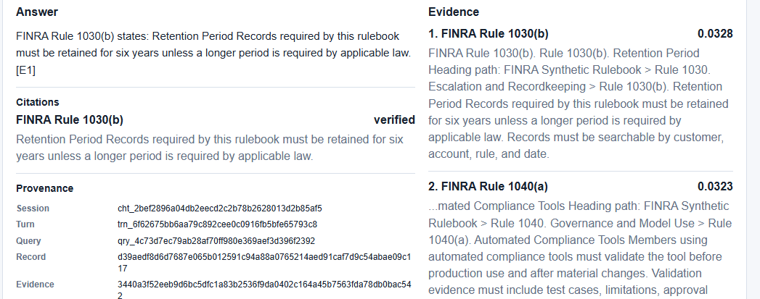
SCREENSHOTS · ANALYST UI, MOCK MODE
A cited answer, verified against retrieved evidence
"How long must records be retained?" against the bundled synthetic rulebook. FINRA Rule 1030(b) is cited, its quote is verified, and the provenance panel shows the audit hash chain and evidence digest.
RegLens · AI Systems Architecture Review · 13

Slide 14
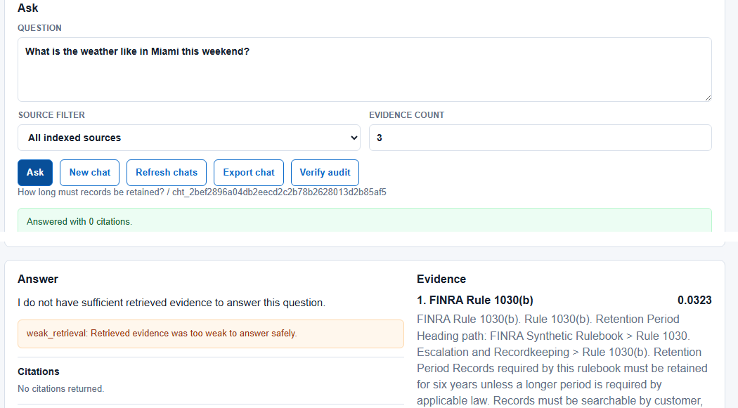
SCREENSHOTS · ANALYST UI, MOCK MODE
Weak evidence produces a refusal, not a guess
What you are looking at
"What is the weather like in Miami this weekend?" retrieves only weakly related evidence; the system abstains with a weak_retrieval warning and zero citations, and the chat history shows both turns side by side.
RegLens · AI Systems Architecture Review · 14

Slide 15
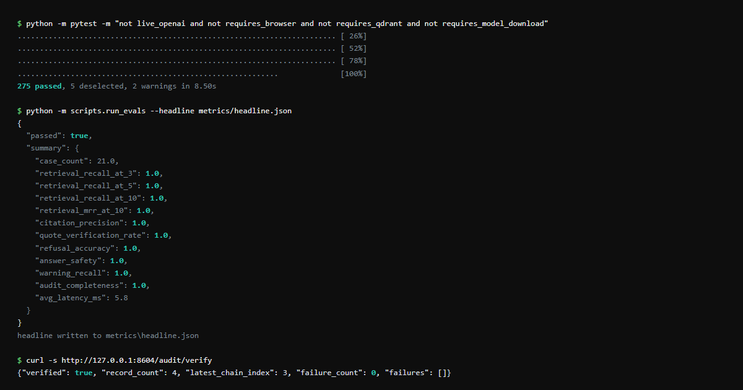
SCREENSHOTS · TERMINAL, THIS TASK RUN
The offline gate: tests, eval and the audit chain
Commands run for this deck: the default pytest marker set (275 passed, 5 deselected), the eval harness (writes metrics/headline.json), and /audit/verify against the running server.
RegLens · AI Systems Architecture Review · 15

Slide 16
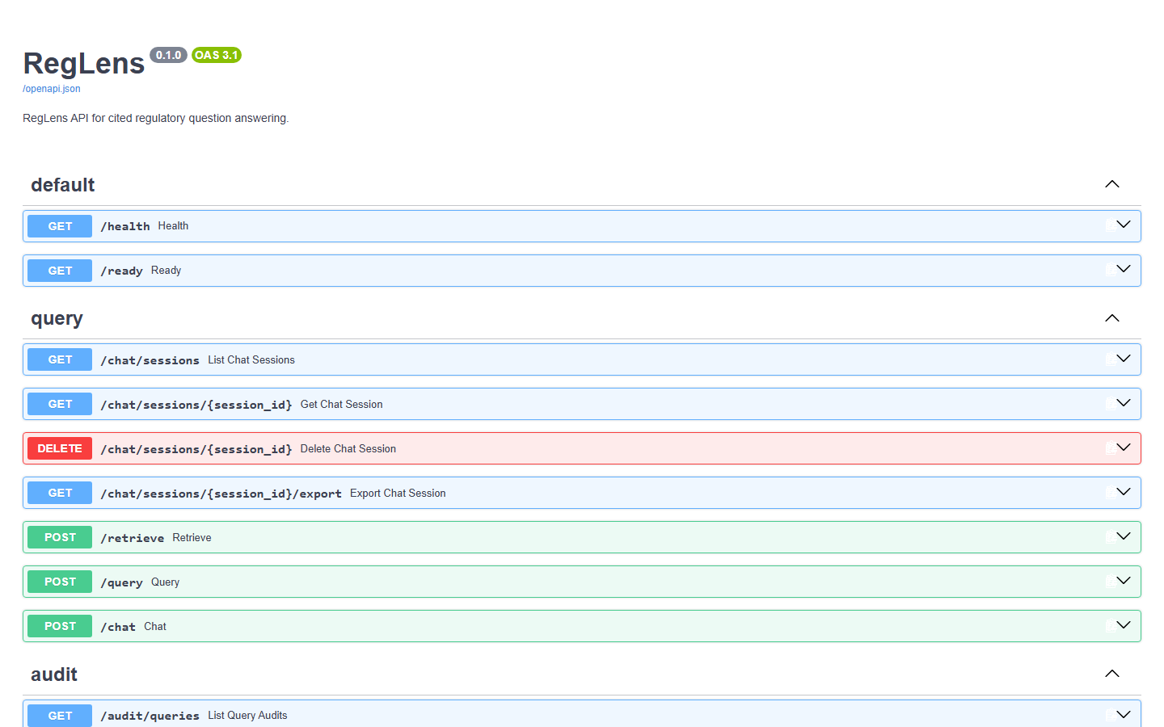
SCREENSHOTS · FASTAPI /DOCS, MOCK MODE
Every route is a typed, documented contract
Auto-generated OpenAPI 3.1 documentation for the running service on port 8604: health/readiness, chat sessions, retrieval, query and audit routes.
RegLens · AI Systems Architecture Review · 16

Slide 17
ENTERPRISE READINESS · CONTROLS
Security and compliance controls
Boundary | Threat | Control in the code | Evidence
B1 user question | prompt injection through the question text | question length bound; routing and retrieval do not execute instructions found in input | eval safety cases
B2 source documents | instructions embedded inside ingested regulatory text | instruction clauses are filtered and warned on without dropping the factual clause in the same sentence | 4 adversarial eval cases, warning_recall 100.0%
B3 API auth and rate limit | unauthenticated or unbounded access to operational routes | optional API-key auth (header or bearer) + per-minute rate limiting; health/ready/docs stay exempt | test_api_key_auth_protects_operational_routes_but_not_health
B4 remote ingestion | fetching or redirecting to an untrusted host | HTTPS-only, FINRA domain allowlist, byte-size cap, final-redirect host validated, snapshot stored locally | OPERATIONS.md ingest-url contract
B5 live providers | a stray key or flag silently enabling a live model | mock mode rejects live-provider flags outright; a key alone enables nothing | test_openai_api_key_env_does_not_enable_live_providers_by_itself
B6 audit integrity | edited or deleted evidence rows after the fact | append-only query audits, hash chain plus evidence digest, /audit/verify detects tampering | GET /audit/verify
Residual risks, stated: API-key auth and in-memory rate limiting are local controls, not an identity system; OCR for scanned PDFs is deferred and fails closed rather than guessing.
RegLens · AI Systems Architecture Review · 17

Slide 18
ENTERPRISE READINESS · PROCESS
How it was built: 13 waves behind one gate
W1 foundation
W2 retrieval loop
W3 audited answers
W4 quality gates
W5 local ingestion
W6 provider scaffold
W7 OpenAI live
W8 cross-encoder
W9 chat API
W10 chat sessions
W11 audit↔chat
W12 transcripts
W13 hardening
275
13
21
2
deterministic fake-mode tests, plus 5 deselected optional-profile tests
build waves, each shipped behind the same offline gate
eval fixture cases, including 4 adversarial source-instruction safety cases
CI jobs on every push: default-verify (lint, mypy, tests, eval, card-drift) and container-verify
One command validates everything
Deterministic-first, live optional
`make verify` = ruff lint + mypy strict + the default pytest marker set + the eval harness. CI runs the same profile via `python -m scripts.verify default`, plus a README results-card drift check.
Fake embeddings, generation and reranker are real implementations satisfying the same interface as live providers, so the whole gate — UI included — never needs a key, a vector DB, or a model download.
RegLens · AI Systems Architecture Review · 18

Slide 19
ENTERPRISE READINESS · MEASUREMENT
Quality metrics from the gate
KPI | Value | How measured
Tests | 275 passed, 5 deselected | pytest, this run
Abstention rate | 14.3% (3/21), 0 false abstentions | make eval
Citation faithfulness | 100.0% (21/21) | make eval
Recall@5 reranker ON vs OFF | 100.0% vs 94.4% (n=18) | headline.json
Cost / query (fake-run model) | $0.000202 | costing model
Avg eval latency | 5.8 ms (in-process, fake providers) | make eval
Live OpenAI cost / cross-encoder | pending | needs key/model
All five ratios read 1.0 on the 21-case offline fixture; the honest caveat is the corpus is 15 chunks and the embeddings are deterministic lexical hashes, not a production-scale semantic benchmark.
RegLens · AI Systems Architecture Review · 19

Slide 20
HONESTY
Quirks and known limitations (stated, not hidden)
100.0% recall/faithfulness is a small-fixture number
Live OpenAI cost is pending
21 queries over a 15-chunk synthetic corpus with deterministic lexical embeddings; not a production-scale or semantic benchmark.
The $0.000202/query figure is the repo's char/4-token costing model over fake-generated text, not a metered API call.
Cross-encoder reranker is unmeasured
OCR is a contract, not an implementation
ms-marco-MiniLM-L-6-v2 needs sentence-transformers and a model weight download; the offline gate never fetches it.
Scanned/image PDFs return corpus_load_error by design; docs/ocr-strategy.md is a deferred, explicit decision.
Local controls, not an identity system
reglens.db, tmp/ and reports/ are gitignored
API-key auth and in-memory rate limiting are single-process; no SSO, no tenant isolation, no multi-instance limiter.
The demo database and reports regenerate from `make eval`/ingestion; this deck's screenshots came from a fresh run.
The bundled rulebook is synthetic
Container check is static
FINRA rule numbers and text in the fixture are illustrative for testing, not the live FINRA rulebook.
`scripts.verify container` renders and validates Docker Compose config; this task did not build or run the image.
RegLens · AI Systems Architecture Review · 20

Slide 21
ENTERPRISE READINESS · OPERATIONS
Cost, performance and operability
$0.0002
5.8 ms
21
0 keys
mean fake-run cost per query, repo costing model, ~792 in / 34 out tokens
average eval latency, in-process fake providers, 21 cases
fixture queries over a 15-chunk synthetic corpus, 2 corpora, seed 0
needed for the full offline demo — mock mode, no OpenAI, no Qdrant
Operability
Observability and audit
• /health and /ready with per-provider status, mode and gated errors
• `make verify` is the one-command gate; CI runs the same profile
• Docker + Compose default to mock-safe (no key, no Qdrant needed)
• Rollback is an environment variable: REGLENS_RAG_MODE mock ↔ local
• `scripts.verify container` statically checks the Compose config
• Hash-chained query audit rows with an evidence digest per query
• GET /audit/verify walks the chain and reports failures, if any
• Request-ID propagation (X-Request-ID) through every response
• Structured dependency_unavailable errors, never a bare crash
• Deterministic cost estimate stored on every audit row
RegLens · AI Systems Architecture Review · 21

Slide 22
NEXT STEPS
Roadmap to a pilot
Weeks 1–2
Weeks 3–4
Weeks 5–6
Week 7+
Harden data
Secure and scale
Measure on live
Operate
OCR as an explicit opt-in extra, behind REGLENS_ENABLE_PDF_OCR
PostgreSQL for production metadata and audit storage
Richer corpus version diffing
SSO / RBAC in front of the API
Tenant isolation for multi-firm deployments
Durable async ingestion workers for larger corpora
A live OpenAI cost and quality run to replace the pending figures
Cross-encoder reranker evaluated on a non-synthetic corpus
Source-page citation highlighting in the UI
OpenTelemetry / Prometheus-style observability
A tamper-evident audit sink (external anchor for the hash chain)
Managed deployment path for client infrastructure
Everything above is additive: the verifier, the abstention rule and the audit-chain contract do not change.
RegLens · AI Systems Architecture Review · 22

Slide 23
APPENDIX
Appendix A — Decision log (abridged)
Area | Decision | Consequence
Grounding | Citations and quotes verified in code after generation, not asserted by the prompt | citations.py / quote_verifier.py; four rejection tests; citation faithfulness is a measured KPI
Refusal | Only a refusal may carry zero citations; any other answer without one is rejected | Weak evidence produces an honest abstention instead of a confident guess
Providers | Fake embeddings/LLM/reranker are real implementations bound by default | 275 tests + eval + UI run with no key, no Qdrant, no model download
Providers | Live providers fail closed: a key alone never enables them | test_openai_api_key_env_does_not_enable_live_providers_by_itself
Retrieval | Hybrid BM25 + dense via RRF; exact-citation queries are pinned before fusion | A question naming a rule number always sees that rule's chunks first
Ingestion | Remote ingestion is HTTPS-only and allowlisted to FINRA domains, with a local snapshot | Provenance for remote sources does not depend on the live page staying reachable
Audit | Query audit rows are append-only; re-saving an existing query_id is rejected | The audit trail cannot be silently edited by a retry or a bug
Scope | OCR is a documented, deferred decision; scanned PDFs fail closed | No uncertain OCR text can enter a compliance answer without an explicit policy
RegLens · AI Systems Architecture Review · 23

Slide 24
APPENDIX
Appendix B — Build statistics and lessons
Item | Value
Build waves (docs/CHANGELOG.md) | 13, Wave 1 (foundation) through Wave 13 (production hardening)
Tests, default marker set | 275 passed, 5 deselected (live_openai, requires_browser, requires_qdrant, requires_model_download)
Eval fixture | 21 cases (14 answerable, 3 out-of-scope, 4 adversarial source-instruction safety) over 2 corpora
CI jobs | default-verify (lint, mypy, tests, eval, README card drift) and container-verify, on every push/PR
Optional profiles | test-browser, test-qdrant, test-models, test-container, verify-openai, verify-full-local
Lines of code (app/ + tests/) | ≈ 19,600 across 123 files
Lessons the design carries forward
• Verification belongs in code that runs after generation, not in prompt instructions the model can drift away from.
• A fake provider must satisfy the real interface, or the tests it enables are not proving anything about production.
• An audit trail is only trustworthy if the store rejects edits at the boundary (append-only), not by convention.
• Optional heavy dependencies (Qdrant, OpenAI, cross-encoder) should fail closed with a structured error, never a crash.
RegLens · AI Systems Architecture Review · 24

Slide 25
APPENDIX
Appendix C — Repository map and how to run
app/ FastAPI app: main.py, core (config, security,
costing, errors), domain (ids, models)
app/api/ routes_ui, routes_query, routes_admin, routes_audit
app/ingestion/ loaders, chunking, normalizers
app/retrieval/ keyword (BM25), embeddings, qdrant_store, fusion,
rerank, cross_encoder_reranker, service
app/generation/ prompts, llm, openai_llm, citations, quote_verifier,
warnings, service
app/persistence/ db, repositories (SQLite: sources, audits, chat)
app/evals/ fixtures/, metrics.py, headline.py
tests/ 275 default tests (unit, integration, e2e)
scripts/ run_evals.py, verify.py
metrics/ headline.json, render.py (README card, drift-checked)
docs/ OVERVIEW, SHOWCASE, OPERATIONS, CHANGELOG,
ocr-strategy, project brief, this deck
Run it
python -m venv .venv
make install
make verify
python -m uvicorn app.main:app --reload
# ingest the bundled fixture
curl -X POST :8000/admin/ingest \
-d '{"path":"app/evals/fixtures/..."}'
# optional: local mode with Qdrant
export REGLENS_RAG_MODE=local
make qdrant-up
# optional: live OpenAI
export OPENAI_API_KEY=<key>
make verify-openai
RegLens · AI Systems Architecture Review · 25

Slide 26
Questions
RegLens · roshanrana/RegLens · main branch · README, OVERVIEW, SHOWCASE and OPERATIONS in the repository

