Slide 1
D
DRYDOCK
AI Systems Architecture Review
Agentic pipeline generation and validation harness — client feed specs in, tested ingestion pipelines out, nothing sails without a signature
Release/ship date · 12 September 2026 · Roshan Rana

Slide 2
OVERVIEW
Executive summary
What it is
What it proves
Why it is enterprise-ready
A bounded LangGraph state machine that plans through MCP tools, generates a pipeline + Airflow DAG + field mapping from a client's feed specification, tests the result in a sandbox against six deterministic checks, repairs on failure, and stops at a real human gate before anything is published.
The loop is provably bounded, auditable and resumable across processes: every step is a LangGraph checkpoint in SQLite, and the human-approval interrupt cannot be skipped by any flag, config or provider.
6/6 corpus scenarios replay as declared; 5/5 adversarial pipelines are rejected; the gate runs offline in one command.
Built through a gated, evidence-producing lifecycle: frozen LLD contracts, 12 task packs, code and security review, a documented three-layer sandbox hardened after an independent security review found real escapes.
Ask of the audience: agree the pilot scope (a recorded live-model run, the Docker sandbox as default, HMAC-signed approvals) and which provider (Ollama, vLLM, Bedrock, Anthropic) a first client's data perimeter should target.
DRYDOCK · AI Systems Architecture Review · 2

Slide 3
CONTEXT
The problem and the users
The onboarding problem
The trust constraint
Every client feed arrives with a specification that is nearly right and a sample file that is nearly what the specification describes. Someone reads both, writes a parser, runs it, finds the trailer row counted as data, fixes it, and asks a colleague to sign off in a chat message. The work is repetitive, the fixes are undocumented, and the sign-off leaves no evidence.
Language models can write the parser; the question is whether anything they write can be trusted into a scheduler. DRYDOCK's answer: the model's output is a proposal, a deterministic harness is the judge, and a human is the only thing that can publish.
Actor | Needs | Frequency
Forward-deployed engineer | A drafted, tested pipeline + DAG + mapping per client feed, with the repair history kept | Per client onboarded
Reviewer / approver | Iteration reports with evidence, an approve/reject gate that cannot be bypassed | On every run
Platform / ops | Deterministic gate offline; swappable model backend; no secrets in config | Deploy / operate
Automation / AI assistants | The same build/inspect/approve surface over CLI, dashboard and MCP | Ad hoc
DRYDOCK · AI Systems Architecture Review · 3

Slide 4
APPROACH
Solution at a glance
1
Plan
2
Generate
3
Evaluate & repair
4
Gate & publish
The Planner calls the drydock-sources MCP server: list_samples, peek_sample (<=5 lines) and profile_sample. Tool calls are recorded as evidence on the plan; the planner never receives the sample files.
Three files: a stdlib-only pipeline.py, an Airflow dag.py restricted to DAG/PythonOperator/>>, and a Harbormaster-compatible mapping.yaml.
The artifact runs in a sandbox against six deterministic checks (H1-H6); failures feed back into the next generation, up to a fixed iteration budget.
await_approval calls a real LangGraph interrupt(). A later approve/reject — from another process — resumes the checkpoint; publish writes deploy/<client>/ only after that.
Surfaces
Deterministic by default, live by explicit act
CLI (typer): build, runs, show, approve, reject, replay. Dashboard (FastAPI + vanilla HTML/JS): runs, diffs, checkpoint history. DRYDOCK MCP server: build/inspect/approve as 7 tools. All four read and write through one graph.service.
The fake provider drives the tests, the bench and CI: templates plus seeded fault injection, zero network calls. Ollama, vLLM, Bedrock and Anthropic are configuration files plus an environment variable, never a side effect of having a key present.
DRYDOCK · AI Systems Architecture Review · 4

Slide 5
ARCHITECTURE · C4 LEVEL 1
System context
Forward-deployed eng.
DRYDOCK
drydock-sources MCP server
CLI / dashboard
list_samples · peek_sample (<=5 lines) · profile_sample — the planner's only view of client data
Surfaces
CLI · dashboard (FastAPI) · DRYDOCK MCP server
Reviewer / approver
Model backend (swappable)
dashboard / CLI
LangGraph state machine
fake (offline, default) · Ollama · vLLM · Bedrock · Anthropic — one Provider protocol
load_spec -> plan -> generate -> evaluate -> await_approval [interrupt] -> publish, with repair and escalate branches
AI assistant
deploy/<client>/
MCP host
pipeline.py, dag.py, mapping.yaml, approval.json — written only by publish, after approval
SQLite (data/drydock.db)
runs + iterations + LangGraph checkpoints, keyed by thread_id = run_id
The corpus (corpus/<client>/spec.md, samples/, manifest.json) is the only client-owned input; everything the model sees is mediated by the sources server, never handed as whole files.
DRYDOCK · AI Systems Architecture Review · 5

Slide 6
ARCHITECTURE · C4 LEVEL 2
Component architecture
Contracts & corpus
Providers & MCP
Harness
Graph & surfaces
models.py
providers/
guard.py
graph/nodes.py
frozen Pydantic contracts
Protocol, FakeProvider, LLMProvider, backends
static AST allow/deny lists
8 nodes, 1 conditional edge
corpus.py
mcp/sources_server.py
runner.py
graph/service.py
load spec/samples/manifest, verify sha256
the planner's tools
runtime jail, stdlib only
start_run, decide
paths.py, errors.py
mcp/toolbox.py
sandbox.py
graph/store.py
env-driven paths, error taxonomy
sync facade over MCP session
process containment, docker mode
SQLite runs + iterations
mcp/server.py
checks.py
cli.py, dashboard/
DRYDOCK as 7 MCP tools
H1..H6
typer + FastAPI
Generated code never imports into the orchestrator: the harness copies pipeline.py and dag.py into a scratch directory and runs them in a fresh interpreter. models.py and the LLD are frozen contracts task packs code against without talking to each other.
DRYDOCK · AI Systems Architecture Review · 6

Slide 7
ARCHITECTURE · CRITICAL FLOW
The critical flow: plan, generate, evaluate, gate
1. load_spec
2. plan
3. generate
4. evaluate
parse spec.md's feed-contract block into a typed FeedSpec
3 MCP tool calls to drydock-sources; evidence recorded on IngestionPlan.tool_calls
render pipeline.py, dag.py, mapping.yaml from the plan + spec
sandbox run, 6 checks; on repair the previous artifact + findings go back in
5. fail, iter<N
6. fail, iter==N
7. pass -> await_approval
8. approve -> publish
loop back to generate with the harness findings as context
escalate: run ends, nothing published, all iteration reports on disk
a real LangGraph interrupt() — no path to publish skips it
resume from another process; deploy/<client>/ written with approval.json
Every node appends one line to runs/<run_id>/events.jsonl (node, iteration, ms, outcome). The bench replays all 5 flows (happy, self-heal, escalate, reject, cross-process resume) with a fixed seed.
DRYDOCK · AI Systems Architecture Review · 7

Slide 8
DESIGN · THE ONE IDEA
The core mechanism: agents propose, the harness decides, a human disposes
await_approval — the actual gate
Pass, iter 1
def await_approval(self, state):
# ...mark AWAITING_APPROVAL, log event
answer = interrupt(
approval_payload(state)
)
decision, approver, note = (
parse_decision(answer, state)
)
store.update(
run_id, approved_by=approver,
decision_note=note,
)
the deterministic harness found nothing wrong — straight to the gate
Fail, then pass
findings feed the next generation; repaired within the iteration budget
Fail x N, escalate
publish is reachable only through approve. No flag, config or provider skips it.
a spec that contradicts its sample cannot be fixed by better code — a person gets the contradiction, not a forced pass
The escalate scenario (meridian-legacy) is a wrong spec, not a broken generator: the pin is the client's asserted row count, so correct code fails three times and a person sees the contradiction. That is the behaviour a bank wants.
DRYDOCK · AI Systems Architecture Review · 8

Slide 9
ARCHITECTURE · DATA
Data architecture: corpus, run store, deploy
Corpus (committed, pinned)
deploy/<client>/ (publish only)
corpus/<client>/spec.md, samples/*, manifest.json: sha256, expected rows, baseline stats, and the scenario's injected_defect / expected_outcome. corpus/_adversarial/<name>/ holds bad artifacts plus the check each must fail.
pipeline.py, dag.py, mapping.yaml, approval.json (who, when, sha256 of each file — an audit trail, not a signature). 5 clients published at ship: acme-treasury, blue-harbour-fx, kestrel-payments, northwind-custody, orion-prime.
Canonical schema
trade_id
account_id
value_date
amount
currency
counterparty
description
Run store (SQLite)
data/drydock.db: runs + iterations tables plus LangGraph's checkpoint tables, keyed by thread_id = run_id. Artifacts on disk under runs/<run_id>/iter-N/.
The manifest is the oracle, not a reference implementation: the corpus author's parser builds it offline, the harness never calls it at run time, so a generator cannot pass by reproducing it.
DRYDOCK · AI Systems Architecture Review · 9

Slide 10
ARCHITECTURE · PROVIDERS
Swappable model backends, one contract
Provider | Backend | Runs where | Credential
fake (default) | templates + seeded fault injection | in process | none
ollama | openai_compat over httpx | your machine | OPENAI_API_KEY (any value)
vllm | openai_compat over httpx | your GPU host | OPENAI_API_KEY (server's key)
bedrock | boto3 converse API | your AWS account | AWS credential chain, AWS_REGION
anthropic | anthropic SDK | Anthropic's API | ANTHROPIC_API_KEY
Data perimeter (what leaves the process)
The provider changes who writes the code, nothing else
Feed contract (columns, formats, quirks); column profiles (row count, amount total, null rates); sample name/size/sha256; at most 5 peeked raw lines per sample; on repair only, the previous artifact plus harness findings. Never sent: whole sample files, anything under deploy/, the SQLite store, credentials.
It changes nothing about the harness, the sandbox, the six checks, the iteration budget or the approval gate. configs/providers/*.yaml name a backend, a model and the environment variable holding a credential — never the credential itself.
DRYDOCK · AI Systems Architecture Review · 10

Slide 11
DESIGN DECISIONS
Design choices and why
Decision | Alternatives considered | Why this one
LangGraph + SQLite checkpointer (ADR-002) | Hand-rolled state machine | Interrupts, checkpoint history and cross-process resume are requirements, not conveniences; a hand-rolled machine (as a sibling repo found) does not give all three
Python mcp 2.x, in-memory transport for tests (ADR-003) | Always-stdio MCP, a mocked tool layer | A real MCP session runs in the offline test suite with no spawned process; stdio only when the sources server runs standalone
Airflow validated via a stub package (ADR-004) | Install real Airflow; AST-only DAG check | Installing Airflow costs minutes and hundreds of MB and is irrelevant to the skill being shown; a stub records the declared structure
Raw backend adapters, not LangChain chat models (ADR-005) | LangChain chat model wrappers | Three adapters under 80 lines each behind one ChatBackend protocol make the local-vs-cloud story explicit and keep the base install small
Fault injection lives in the corpus manifest (ADR-006) | Fault injection in the generator itself | Each scenario declares injected_defect / expected_outcome; the unfixable scenario is a spec that contradicts its sample, keeping the demo honest
Three-layer sandbox (ADR-008) | Static AST guard alone | A security review showed the guard alone was not a boundary (an attribute hop reached os.system); defence in depth: guard, runtime jail, process containment
DRYDOCK · AI Systems Architecture Review · 11

Slide 12
PRODUCT
Major features
CLI (typer)
Review dashboard
DRYDOCK MCP server
build, runs, show, approve --approver, reject --note, replay --step N, serve, mcp, bench
FastAPI JSON API + dependency-free HTML trace viewer: iteration timeline, findings, code tabs with diff, checkpoint list, approve/reject form
7 tools over stdio; approve/reject enforce the gate before RunService is called; a run started from an MCP client shows up in the CLI and dashboard
Sources MCP server
Bench + results card
Three-layer sandbox
list_samples, peek_sample (<=5 lines, path traversal rejected), profile_sample — the planner's only view of client data
6 corpus scenarios + 5 adversarial artifacts replayed with seed 42; metrics/headline.json drives the README table and metrics.svg; CI fails on drift
static AST guard, runtime jail (jailed open, capability-stripped os), process containment (tree kill, rlimits, Windows Job Object, optional Docker)
DRYDOCK · AI Systems Architecture Review · 12

Slide 13
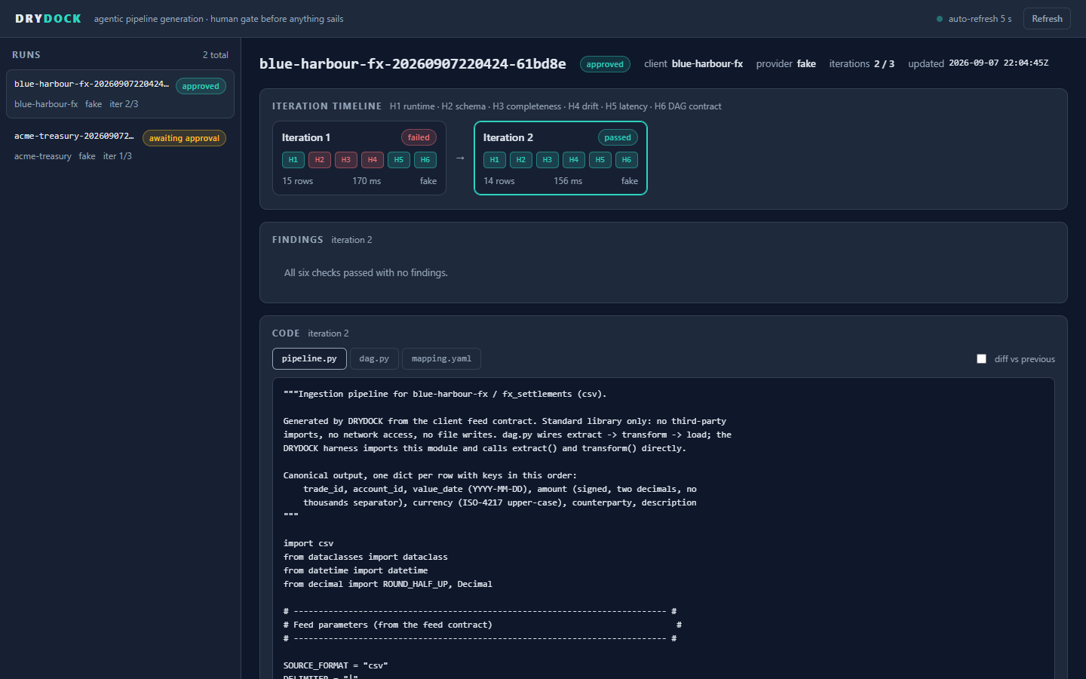
SCREENSHOTS · DASHBOARD (BLUE-HARBOUR-FX)
The review dashboard: a self-heal run end to end
blue-harbour-fx iteration 1 parsed the trailer row as data and failed H2, H3 and H4; iteration 2 passed all six checks and the run is approved with 2/3 iterations spent.
DRYDOCK · AI Systems Architecture Review · 13

Slide 14
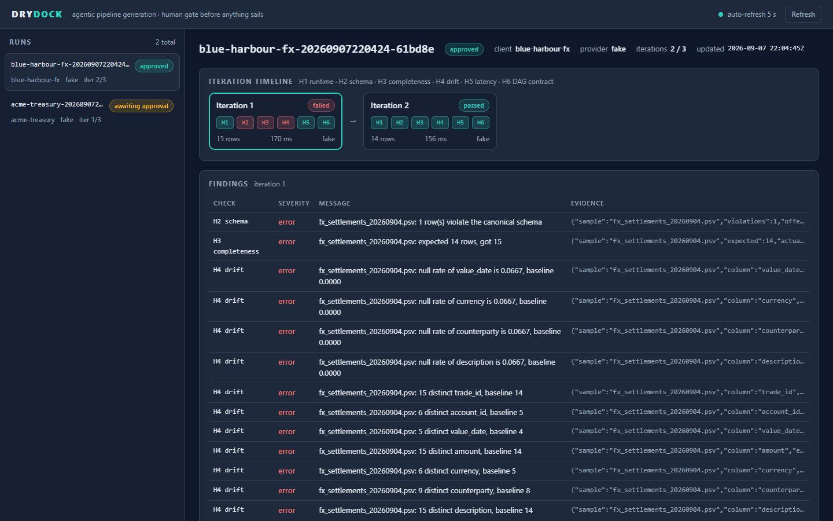
SCREENSHOTS · DASHBOARD (BLUE-HARBOUR-FX, ITERATION 1)
Findings are evidence, not a verdict
What you are looking at
H2 schema and H3 completeness fail because the trailer row (a record-count footer) was parsed as a data row; H4 drift then shows 11 cascading findings — null rates and distinct counts thrown off by that one bad row.
Why this matters
This is exactly what feeds the repair: the generator's second attempt receives these findings, not a vague "it failed". The pinned baseline (14 rows) comes from a manifest the generator never sees.
DRYDOCK · AI Systems Architecture Review · 14

Slide 15
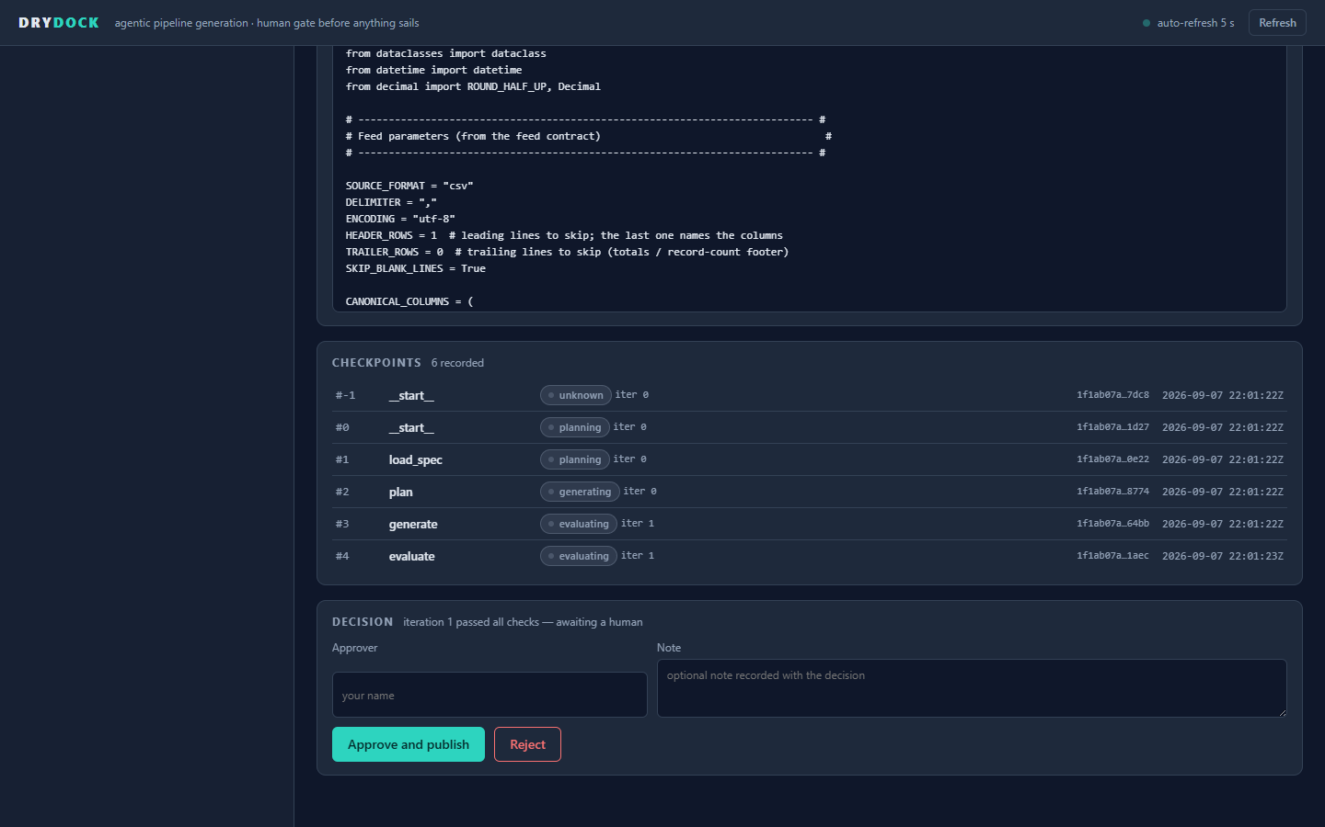
SCREENSHOTS · DASHBOARD (ACME-TREASURY, AWAITING APPROVAL)
The approval gate: checkpoints and the decision form
acme-treasury's 6 recorded checkpoints — start, load_spec, plan, generate, evaluate — each a LangGraph checkpoint, replayable step by step; the decision form refuses to submit without a named approver.
DRYDOCK · AI Systems Architecture Review · 15

Slide 16
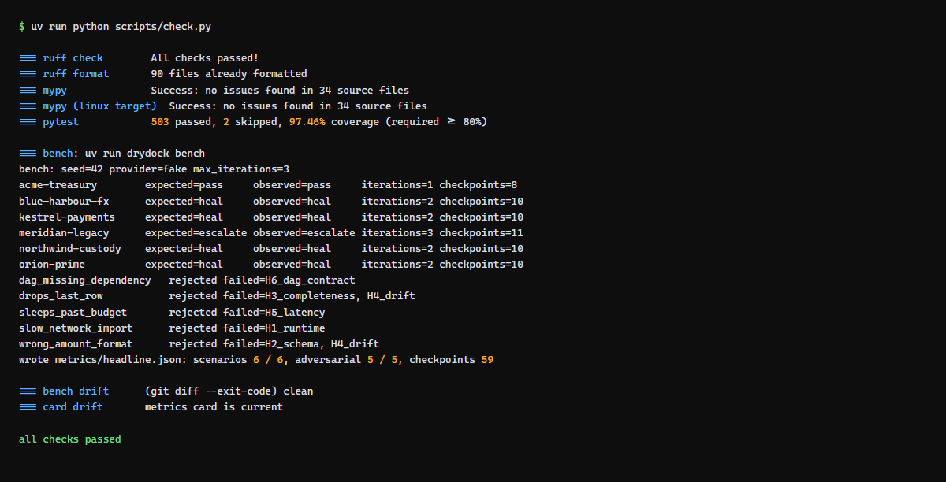
SCREENSHOTS · TERMINAL (SCRIPTS/CHECK.PY)
The gate, run: one command, offline
uv run python scripts/check.py, captured during this review: ruff, mypy strict (host and Linux target), pytest with coverage, the bench replay of all 6 scenarios and 5 adversarial pipelines, and both drift checks.
DRYDOCK · AI Systems Architecture Review · 16

Slide 17
ENTERPRISE READINESS · CONTROLS
Security and compliance controls
Layer | Threat | Control | Evidence
1. Static AST guard | Import of a dangerous module; an attribute hop to a real capability (os.path -> os.system) | Import allowlist; attribute/name denylists; forbidden-call list; runs before anything executes | test_guard_blocks_payload_before_execution
2. Runtime jail | Reads outside the scratch workdir leak host files into harness evidence, then into a repair prompt | open/io.open confined to reads inside the workdir; capability-stripped os; poisoned dangerous modules; import finder | test_*_outside_workdir_is_blocked
3. Process containment | A hung or forked child survives a timeout; unbounded memory | Process-group/session kill on timeout; POSIX rlimits; Windows Job Object (512 MiB); Docker: read-only mount, --cap-drop ALL, --network none | test_sleeping_child_tree_is_killed_on_timeout
What the security review found (2026-09-07)
Residual, stated plainly
3 critical, 4 high, 2 medium findings against drydock.harness.evaluate, all closed before ship (T-012). pip-audit over the locked dependency set: 0 known vulnerabilities.
approval.json hashes are an audit trail, not a signature (M1). The Windows Job Object memory cap is best-effort; the wall-clock timeout is the backstop. The guard is name-based; layers 2 and 3 exist because of that.
DRYDOCK · AI Systems Architecture Review · 17

Slide 18
ENTERPRISE READINESS · PROCESS
How it was built: a gated, evidence-producing lifecycle
M0 skeleton
M1 foundations
M2 the loop
M3 surfaces
M4 evidence
M5 ship
12
4
1
59
task packs (T-000..T-012), each scoped to disjoint files against a frozen LLD
parallel task waves, then an integration wave (T-011) reconciling 4 cross-component defects
independent security review; 3 critical + 4 high findings, all closed the same day (T-012)
LangGraph checkpoints replayed across the 6 bench scenarios, evidence for every KPI
Frozen contracts, disjoint scope
One command validates everything
models.py and the LLD are frozen; task agents touch only the files in their scope and stop at their pack's Handoff notes if they need more. Rule: files under 800 lines, functions under 50 where practical.
ruff, ruff format, mypy --strict (host and the Linux CI target), pytest with an 80% coverage floor, the offline bench, and two drift guards (headline.json, the rendered card). CI runs the identical script on every push.
DRYDOCK · AI Systems Architecture Review · 18

Slide 19
ENTERPRISE READINESS · MEASUREMENT
Quality metrics from the gate
KPI | Value | How
Tests / coverage | 505 / 97.46% | check.py, this review
Scenarios as declared | 6 / 6 | bench, seed 42
Healed | 4 / 4 | 4 heal scenarios
Adversarial rejected | 5 / 5 | hand-written artifacts
Mean iterations | 2.00 | per run, budget 3
Checkpoints | 59 | across 6 bench runs
Sandbox escape tests | 25 | test_sandbox_escapes.py
First-pass rate is 1/6 by design: 4 of 6 corpus scenarios inject a defect on purpose so the self-heal path is exercised, and one (meridian-legacy) is built to escalate. Live-provider, Docker-sandbox and real-Airflow rows on the results card are pending — no recorded run exists yet.
DRYDOCK · AI Systems Architecture Review · 19

Slide 20
HONESTY
Quirks and known limitations (stated, not hidden)
The bench measures the harness, not a model
Docker sandbox mode is untested by the bench
The fake provider is template-driven with scenario-declared defects; it says nothing about any real model's code quality. Live-provider accuracy is pending until a recorded run exists.
The bench always uses subprocess mode, so its numbers are byte-identical with or without a Docker daemon; the docker=... kind is covered by dedicated tests, not by the headline KPIs.
Airflow is a stub offline
approval.json is an audit trail, not a signature (M1)
Generated DAGs are validated against a package that records structure at import; whether they load in a real scheduler is checked only by the opt-in docker compose --profile airflow target, and that result is pending.
Its sha256 hashes record what was approved and by whom but are not tamper-evident; anyone who can write deploy/<client>/ can rewrite both the artifact and its recorded hash.
Windows memory cap is best-effort (H4)
The corpus is synthetic
The Job Object caps committed memory at 512 MiB; if the ctypes call fails, only the wall-clock timeout backstops a memory bomb, which then ends as a timeout rather than a MemoryError.
Six clients and five adversarial cases exercise every branch of the graph and every check; they are not a survey of real feed formats.
The canonical schema is fixed at 7 columns
No multi-tenant auth
trade_id, account_id, value_date, amount, currency, counterparty, description. Real clients would extend it; that is unbuilt.
The dashboard and the MCP server are local, single-operator tools; SSO or per-tenant isolation is not built.
DRYDOCK · AI Systems Architecture Review · 20

Slide 21
ENTERPRISE READINESS · OPERATIONS
Cost, performance and operability
0 tokens
2.00
30 s / 5 s
59
the fake provider drives the bench and CI; a live provider records tokens per call but none has been run yet
mean generate/evaluate iterations per run against a budget of 3
sandbox timeout per sample / H5 latency budget per sample, both configurable
LangGraph checkpoints across 6 bench runs — every step persisted and replayable
Operability
What a live run would add to this page
* runbook.md: start/stop, common failures
* replay <run_id> walks every checkpoint; --step N dumps state at that step
* events.jsonl: one line per node (node, iteration, ms, outcome) + one llm_usage line per real-model call
* Rollback is deleting deploy/<client>/; the run and its decision remain in SQLite and runs/
Prompt/completion tokens and latency per model call, written to events.jsonl by LLMProvider's on_usage callback. No aggregated cost figure exists in the repository today because no live run has been recorded; when one is, the sum over events.jsonl is the figure to report.
DRYDOCK · AI Systems Architecture Review · 21

Slide 22
NEXT STEPS
Roadmap
Now
Next
Next
Backlog
Recorded
A live-model run
Docker sandbox as a bench input
Hardening
6/6 scenarios, 5/5 adversarial, 505 tests, 97.46% coverage, all offline with the fake provider
Record one build with Ollama or vLLM and publish its accuracy/cost/latency as an observed figure, replacing the pending row
Run the bench under sandbox=docker so the results card reflects the OS-level isolation boundary, not just subprocess mode
HMAC-signed approvals (approval.json is presently an audit trail, not a signature); real-Airflow bench row; add DRYDOCK to the profile README
Per STATE.md's backlog: none of the next steps are load-bearing for the current, offline gate — they add recorded evidence, not new architecture.
DRYDOCK · AI Systems Architecture Review · 22

Slide 23
APPENDIX
Appendix A — Decision log (abridged)
ID | Decision | Consequence
ADR-000 | Design gates self-approved by the orchestrating agent, under the owner's autonomy instruction, for an interview-ready repo fast | Every gate artifact still exists and is reviewable after the fact
ADR-001 | Name: DRYDOCK — a vessel is tested and inspected before the harbour | Sets the metaphor: Harbormaster controls what enters the harbour, DRYDOCK decides what is seaworthy
ADR-002 | LangGraph with a SQLite checkpointer | Interrupts, checkpoint history and cross-process resume as first-class, zero-infra features
ADR-003 | Python mcp 2.x, in-memory transport for tests | Planner tool calls exercised over a real MCP session with no spawned process in CI
ADR-006 | Fault injection lives in the corpus manifest, not the generator | Keeps the self-heal and escalate demos honest and published, not hard-coded into the model
ADR-007 | Four Wave-1 integration reconciliations | Tool kwarg mismatch, escalate pin, a shifted adversarial slice, and a split adversarial case — all fixed at integration, not before
ADR-008 | Security findings drove a three-layer sandbox | Static guard alone was shown not to be a boundary; guard + runtime jail + process containment closed it
DRYDOCK · AI Systems Architecture Review · 23

Slide 24
APPENDIX
Appendix B — Build statistics and lessons
Item | Value
Task packs | 12 (T-000 .. T-012, including sandbox hardening)
Wave schedule | Wave 1 x4 parallel (corpus, harness, providers, sources MCP) -> Wave 2 x4 (graph, dashboard, MCP server, docs) -> Wave 3 x2 (bench, Airflow) -> Wave 4 (integration + ship)
Code review | approve, 0 critical, 0 high; 1 medium fixed (unbounded errors column), 1 low documented (unused SandboxTimeout)
Security review | 3 critical, 4 high, 2 medium before T-012; all closed same day; pip-audit clean
Tests / coverage at ship | 505 tests (98% per ship-report; 503 passed / 2 skipped / 97.46% observed in this review)
Generated code lines | 1689 across the final pipeline.py, dag.py, mapping.yaml of the 6 bench runs
Lessons written into the decision log
Integration-only defects surfaced where independently built components met (a tool kwarg mismatch, an escalate pin, a shifted adversarial slice) — reconciled in the integration wave, not before. The security review's own payloads are committed as regression tests, so a beaten guard cannot regress silently.
DRYDOCK · AI Systems Architecture Review · 24

Slide 25
APPENDIX
Appendix C — Repository map and how to run
drydock/ models.py, paths.py, errors.py, corpus.py
harness/ sandbox runner, six checks, stub airflow package
providers/ Provider protocol, FakeProvider, LLMProvider, backends
mcp/ sources server, toolbox, DRYDOCK's own MCP server
graph/ nodes, edges, checkpointer, run store, service API
dashboard/ FastAPI JSON API + dependency-free HTML viewer
cli.py, bench.py, events.py
corpus/ six synthetic clients and five adversarial pipelines
configs/providers/ fake, ollama, vllm, bedrock, anthropic
metrics/ render.py, card.json, headline.json (bench-written)
scripts/check.py the gate: ruff, mypy, pytest, bench, drift checks
docs/design/ requirements, HLD, LLD, execution plan, decision log
docs/tasks/ T-000 .. T-012 task packs
docs/ship-report.md, docs/security.md, docs/serving.md, docs/runbook.md
Run it
uv sync
uv run drydock build acme-treasury \
--provider fake
uv run drydock runs
uv run drydock approve <run_id> \
--approver <name>
# dashboard
uv run drydock serve --port 8601
# the whole gate, identical to CI
uv run python scripts/check.py
DRYDOCK · AI Systems Architecture Review · 25

Slide 26
Questions
DRYDOCK · roshanrana/drydock · 505 tests, 97.46% coverage, one offline gate · design docs and ship report in the repository

