Slide 1
F
Fathom
AI Systems Architecture Review
Advisor stock briefings grounded in SEC filings — quote, filings, verified-citation AI briefing, grounded Q&A
Perficient AI Prototype Challenge · Finance scenario · Release 0.2.0 · 12 September 2026 · Roshan Rana, AI Systems Architect

Slide 2
OVERVIEW
Executive summary
What it is
What it proves
Why it is enterprise-ready
A one-page briefing for a wealth-management advisor: current quote with context, the latest 10-K and 10-Qs with EDGAR links, an AI briefing in six sections, and follow-up Q&A.
Every AI claim carries a verbatim quote that the application re-checks against the filing before it is shown.
Grounded generation can be made auditable: claims are verified, advice language is blocked, and every model call leaves a hash-only audit record.
The same pipeline runs on 20 curated tickers (fixtures) or on any US-listed ticker from free, keyless sources.
Built through a gated, evidence-producing lifecycle: 25 task packs, 25 independent verifications, 14 security reviews, 43 hash-chained ledger entries, CI gate on every push.
Clear trust boundaries, a threat model, a runbook, an ORR and a change record.
Ask of the audience: agree the pilot scope (full EDGAR universe, SSO, tamper-evident audit, advisor eval set) and the data-source policy for live quotes.
Fathom · AI Systems Architecture Review · 2

Slide 3
CONTEXT
The problem and the users
The advisor's problem
The firm's constraints
A client calls about a name the advisor does not follow. Getting current takes 30–60 minutes across a quote screen and two or three SEC filings. A general-purpose chatbot is faster but cannot be quoted to a client: it paraphrases, it may recommend, and it leaves no record.
Wealth management is a supervised activity. Anything the tool says may be repeated to a client, so it must describe and never advise, cite sources an advisor can open, and keep a record of what the AI produced from which inputs.
Actor | Needs | Frequency
Advisor (primary) | One page per ticker: quote context, recent filings, cited briefing, follow-up questions; no advice language | Several times a day
Compliance / supervision | Audit trail: what was produced, from which filings, by which model; evidence the guards work | On review
Firm platform team | Runs on the firm's AI gateway; no keys in code; offline fallback; one command to validate | Deploy / operate
Automation and AI assistants | The same capabilities over HTTP and MCP with identical contracts | Ad hoc
Fathom · AI Systems Architecture Review · 3

Slide 4
APPROACH
Solution at a glance
1
Ticker in
2
Filings in
3
Briefing
4
Verify and guard
Quote card: last close, change, 52-week range, market cap, P/E, dividend yield — every figure stamped with its as-of date and source.
Latest 10-K and 10-Qs, parsed into SEC items (Business, Risk Factors, MD&A, Legal Proceedings, Cybersecurity, Controls) with EDGAR links.
The model receives capped section excerpts and must return JSON claims, each with a verbatim quote and section id.
The app checks each quote against the filing, blocks recommendation language, audits the call, and renders badges.
Surfaces
Two data modes, one schema
Streamlit advisor page · Typer CLI · FastAPI (JSON envelope) · MCP server (four tools). All four call the same package functions; none computes anything itself.
Fixtures: 20 large caps, 97 filings, committed. Live: any US-listed ticker from SEC EDGAR + Yahoo/Stooq, materialized per ticker into the same four tables. Switch with one environment variable.
Fathom · AI Systems Architecture Review · 4

Slide 5
ARCHITECTURE · C4 LEVEL 1
System context
Advisor
Fathom
Portkey AI gateway
browser
→ AWS Bedrock · Claude Sonnet 4.5 (client-operated; key at runtime)
Surfaces
Streamlit page · CLI · FastAPI · MCP
Operator
SEC EDGAR (official, free)
terminal
submissions · primary documents · XBRL company facts
Core package `fathom`
quotes · filings parser · BM25 retrieval · briefing / ask pipelines · citation verifier · advice guard · audit
Automation
Yahoo Finance / Stooq
HTTP client
daily bars (unofficial, keyless; fallback chain)
Data layer
AI assistant
fixtures (parquet) or live cache materialized per ticker
Audit log (JSONL)
MCP host
hashes, counts, model, latency — never bodies by default
Build-time only: Hugging Face datasets → fixtures via scripts/fetch_data.py. Live sources are called only when FATHOM_DATA_SOURCE=live; the gate and CI never touch the network.
Fathom · AI Systems Architecture Review · 5

Slide 6
ARCHITECTURE · C4 LEVEL 2
Component architecture
Surfaces (render only)
Pipelines
Data
Providers
app/main.py
briefing.py
data.py
providers.py
Streamlit page
context → draft → claims
loaders, ticker check
one protocol
cli.py
ask.py
quotes.py
Offline
Typer commands
guard → retrieve → answer
QuoteCard maths
extractive, default
api.py
contracts.py
filings.py
Portkey
FastAPI, JSON envelope
frozen pydantic models
SEC item parser
OpenAI-compatible
mcp_server.py
guard.py
retrieval.py
Anthropic
4 MCP tools
advice regexes · verifier
BM25 (title-boosted)
Messages API
audit.py
live/*
prompts.py
append-only JSONL
sec · prices · facts · build
frozen prompt text
Dependency direction is left to right only. Surfaces never import pandas or regex; providers never see settings beyond their own keys; the data layer knows nothing about models.
Fathom · AI Systems Architecture Review · 6

Slide 7
ARCHITECTURE · CRITICAL FLOW
The briefing pipeline
1. Context
2. Prompt
3. Provider
4. Draft → claims
latest 10-K + two newest 10-Qs; canonical sections capped (≈27k tokens)
frozen system prompt: excerpts are data; verbatim 6–40 word quotes; no advice
offline extractive | Portkey → Claude | Anthropic; one JSON contract
JSON parsed; one repair retry; text/quote length clamps; never raises
5. Verify
6. Guard
7. Audit
8. Render
quote normalised and matched inside the cited section → verified / unverified
14 recommendation patterns; flagged claims replaced by a fixed notice
sha256 of prompt and response, model, latency, counts, guard hits
six sections, badge text, source captions, disclaimer
Failure paths are first-class: invalid JSON → one repair → CONTRACT_INVALID; gateway down → PROVIDER_HTTP with a reason and no body; unverifiable quote → shown and flagged, never hidden.
Fathom · AI Systems Architecture Review · 7

Slide 8
DESIGN · GROUNDING
Verify, don't trust: the claim contract
What the model must return (one claim)
✅ verified
quote found in the cited section
{
"text": "Net sales increased 5% year over year",
"accession": "0000320193-26-000013",
"section_id": "10-Q:I.2",
"quote": "Total net sales increased 5% or $4.5 billion during the second quarter of 2026"
}
⚠️ unverified
shown, flagged, counted — never hidden
⛔ removed
recommendation-style language replaced by a fixed notice
What the application does with it
normalise whitespace, case and quote glyphs on both sides
require 6–60 words and a substring match inside the cited section's full text
set verified = true/false; scrub advice language; count; audit
Why this matters to compliance
The badge is the control, and the eval suite reports the verified share as a headline KPI. Offline mode is verified by construction (its quotes are the sentences themselves), so it proves the plumbing; live-mode quality is measured from the audit log, not asserted.
Fathom · AI Systems Architecture Review · 8

Slide 9
ARCHITECTURE · DATA
Data architecture: two sources, one schema
Fixture mode (default)
Downstream is unchanged
20 large caps · 97 filings (Apr 2025 – May 2026) · daily bars to 2026-09-11 · quote snapshot · company master. Rebuilt by scripts/fetch_data.py from four Hugging Face datasets; ≈12 MB committed with licences and hand-checkable anchors.
• SEC item parser (TOC-dropping, cross-reference fallback)
• BM25 index over items and chunks
• briefing and Q&A pipelines
• citation verifier and guard
• every surface
The live pipeline is a data producer, not a new code path: the smallest correct change, and the one already covered by 400+ contract tests.
Four tables, one schema
filings.parquet
bars.parquet
quotes.parquet
companies.parquet
Live mode (opt-in)
Any US-listed ticker. SEC EDGAR for filings and XBRL facts; Yahoo chart bars with Stooq fallback. Materialized per ticker into .cache/live/<T>/ with a manifest; 6-hour TTL; `fathom fetch --force` refreshes.
Design rule: `data_dir_for(ticker, settings)` is the only routing decision; the ticker is shape-validated before any path or URL is built.
Fathom · AI Systems Architecture Review · 9

Slide 10
ARCHITECTURE · LIVE MODE
Live data pipeline (free, no API keys)
SEC ticker map
LiveHttp
materialize(ticker)
company_tickers.json → CIK
User-Agent with operator contact (SEC fair-access policy)
per-host throttle ≥ 0.12 s (≤ 8 req/s vs SEC's 10)
on-disk cache keyed by URL hash; TTLs per call
25 MB streamed size cap
every failure → SOURCE_HTTP with a reason, never a body
typed accessors on every payload field → same four tables + manifest.json (fetched_at, accessions, section coverage, sources). Cold fetch measured at 2–3 s per ticker.
SEC submissions
recent 10-K/10-Q, 24 months, ≤5
SEC primary documents
iXBRL HTML → text (stdlib)
Valuation from XBRL facts
market cap = last close × shares outstanding; P/E = close / EPS TTM (four latest quarterly frames); P/B = market cap / equity; yield = DPS TTM / close. Labelled as derived; None when a fact is missing.
SEC XBRL facts
shares, EPS TTM, equity, DPS
Yahoo chart → Stooq CSV
2 years of daily bars
Tested offline with recorded fixtures and structural fuzzing; a network smoke test is opt-in (FATHOM_NETWORK_TESTS=1).
Fathom · AI Systems Architecture Review · 10

Slide 11
DESIGN DECISIONS
Design choices and why
Decision | Alternatives considered | Why this one
Verifiable claim contract (D-003) | Free-text summary; summary with section references | A briefing an advisor may repeat must be checkable; the badge becomes the control and the KPI
Lexical BM25 over SEC items, no vector DB (D-004) | Embeddings + FAISS/Chroma; rank_bm25 | Five documents per ticker already structured into items; explainable to compliance; deterministic in CI; one function to swap later
Offline provider is a real provider (D-005) | Branch in the pipeline between extractive and LLM | One code path from prompt to verified claims; demo, CI and bench never need a key
Plain httpx, no vendor SDKs | OpenAI / Anthropic / Portkey SDKs | The verifier and error taxonomy are the product; three small clients are easier to audit than three SDK surfaces
Live mode materializes the fixture schema (D-013) | DataSource protocol refactor; keyed vendor APIs | Parser, retrieval, briefing and guard stay untouched and contract-tested; no keys, SEC is official
Typed payload accessors + structural fuzz (D-014) | Enumerated exception guards | Four security rounds showed enumerated guards leak; typed accessors and node-mutation fuzz closed the class
Streamlit + Typer + FastAPI + MCP | React front end; n8n canvas | Core functionality over polish; every surface is a thin renderer over one package
Fathom · AI Systems Architecture Review · 11

Slide 12
PRODUCT
Major features
Quote card
Filings table
AI briefing
last close and change, 52-week range, market cap, P/E, dividend yield, one-year chart; each with an as-of stamp and source
latest 10-K and 10-Qs with fiscal period, accession and a link to the EDGAR index
six sections: business snapshot, latest results, risks, liquidity and capital, notable disclosures, talking points
Grounded Q&A
Advice guard
Audit log
advisor question → BM25 over items and chunks → cited answer; "not found" when the filings do not cover it
input and output patterns for buy/sell/hold, price targets, over/underweight, valuation calls; fixed notice on hit
one JSON line per call: hashes, model, latency, tokens, claim counts, guard hits; bodies only when opted in
Four surfaces
Live data mode
Eval bench in the gate
Streamlit page, CLI (brief/ask/quote/filings/fetch/probe/bench), HTTP API with a JSON envelope, MCP tools
any US-listed ticker from SEC EDGAR + Yahoo/Stooq; `fathom fetch`; cache and TTL; same contracts
parser coverage, retrieval hit-rate, guard escapes, verified share, injection test → metrics card
Fathom · AI Systems Architecture Review · 12

Slide 13
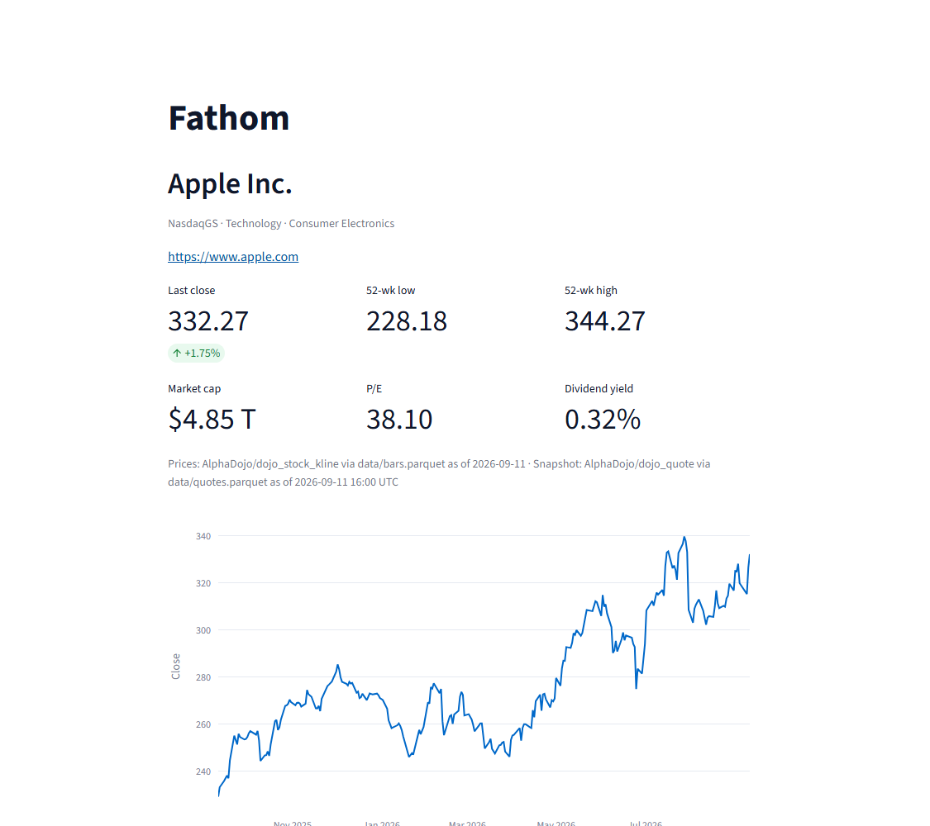
SCREENSHOTS · FIXTURE MODE (APPLE INC.)
The advisor page: quote card, chart and filings
Offline fixture mode. Six metrics with a single source caption; the one-year close series; the filings table links to the EDGAR index for each accession.
Fathom · AI Systems Architecture Review · 13

Slide 14
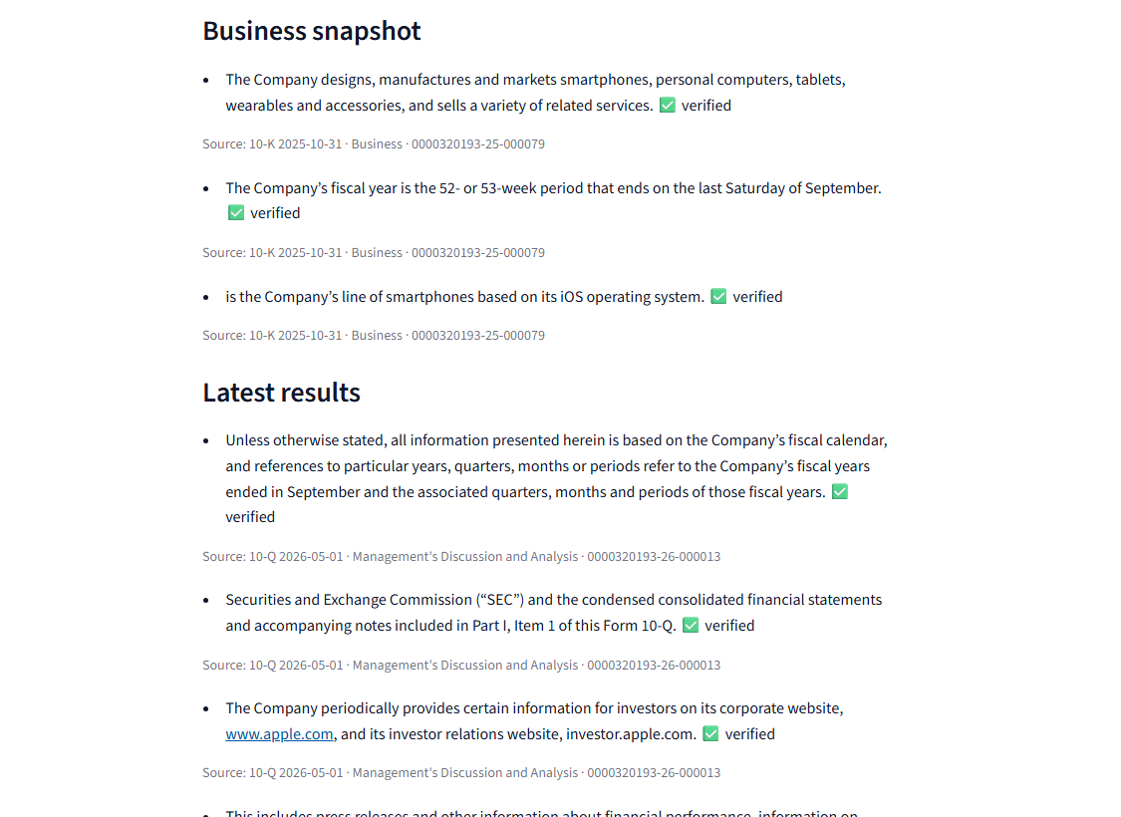
SCREENSHOTS · FIXTURE MODE (APPLE INC.)
The briefing: every claim cited, every badge earned
What you are looking at
Offline extractive provider: sentences lifted verbatim from the cited sections, so every badge is ✅ verified by construction. Each claim carries a caption with form, filing date, section title and accession.
In live LLM mode
Claude Sonnet 4.5 via Portkey writes the claim text and must copy a 6–40 word quote; paraphrased quotes surface as ⚠️ unverified. The status strip shows provider, model, claim counts and verified counts for the session.
Fathom · AI Systems Architecture Review · 14

Slide 15
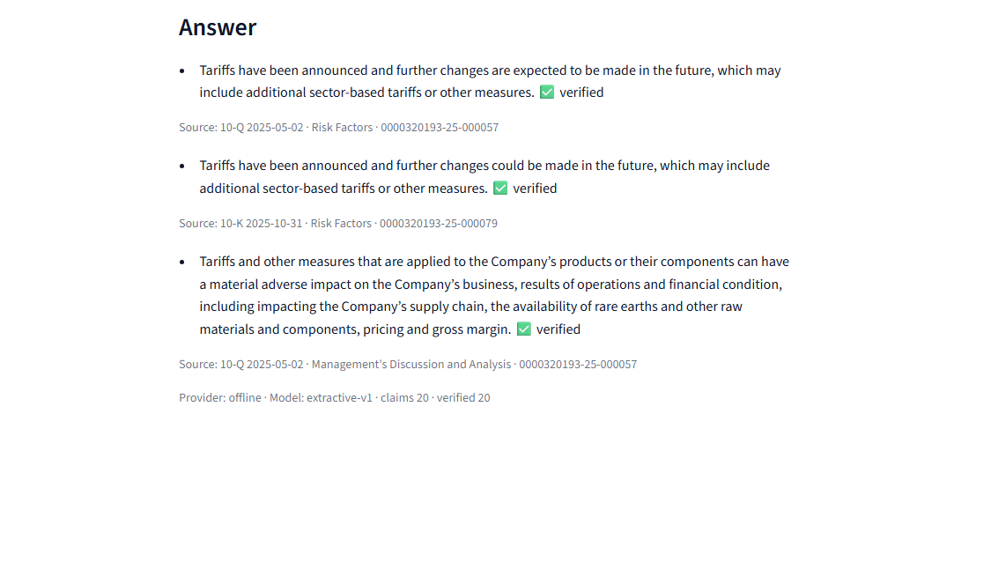
SCREENSHOTS · FIXTURE MODE (APPLE INC.)
Grounded Q&A and the advice guard
Cited answers
Guarded questions
"What are the main risk factors?" → the top-ranked chunks, answered with verified quotes from Risk Factors.
"Should I buy Apple stock?" never reaches the model: the input guard returns the fixed notice and the call is audited with provider = guard.
Fathom · AI Systems Architecture Review · 15

Slide 16
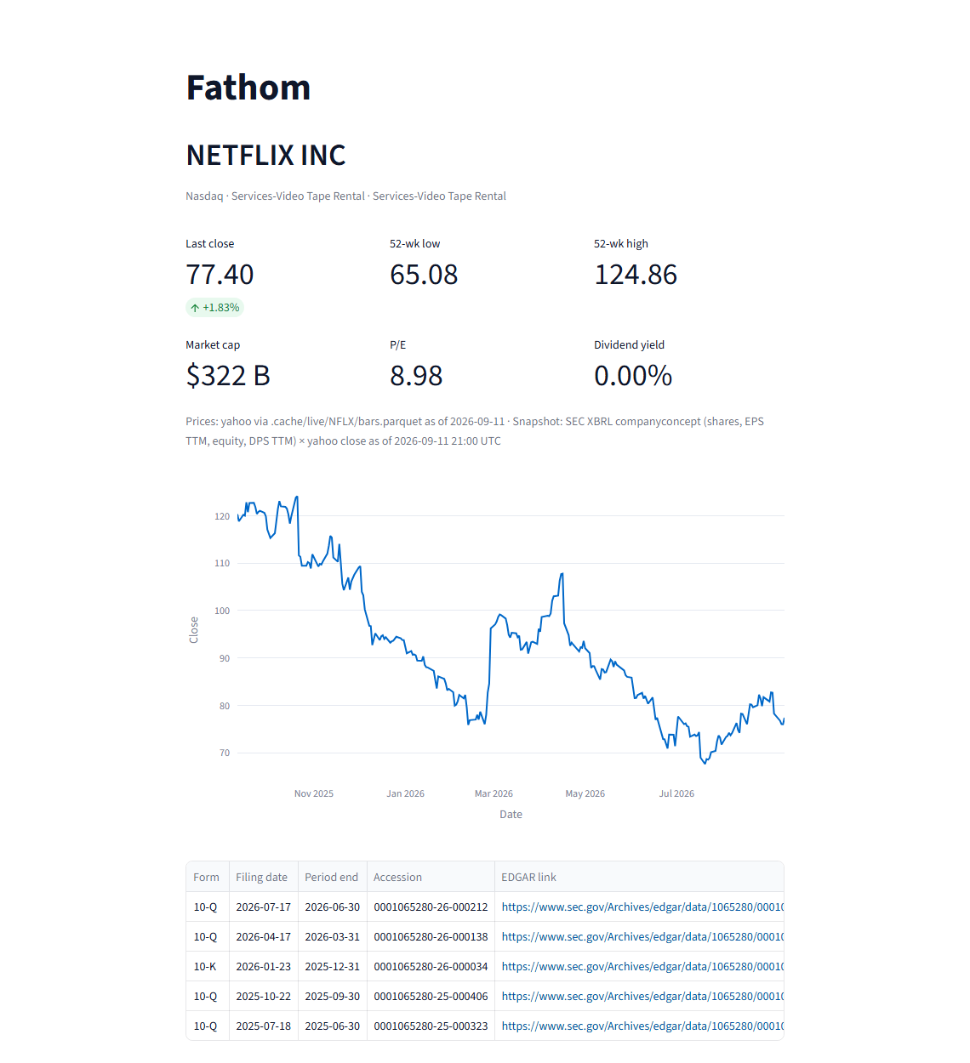
SCREENSHOTS · LIVE MODE (NETFLIX)
Live mode: a ticker outside the demo set
What happened
Sidebar switched to Live; ticker typed; Fetch. In about two seconds Fathom pulled five filings from SEC EDGAR, two years of Yahoo bars and four XBRL facts, and wrote the four tables plus a manifest.
Read the sources line
"Prices: yahoo via .cache/live/NFLX/bars.parquet as of 2026-09-11 · Snapshot: SEC XBRL companyconcept … × yahoo close" — provenance is on the page, not in a footnote.
Fathom · AI Systems Architecture Review · 16

Slide 17
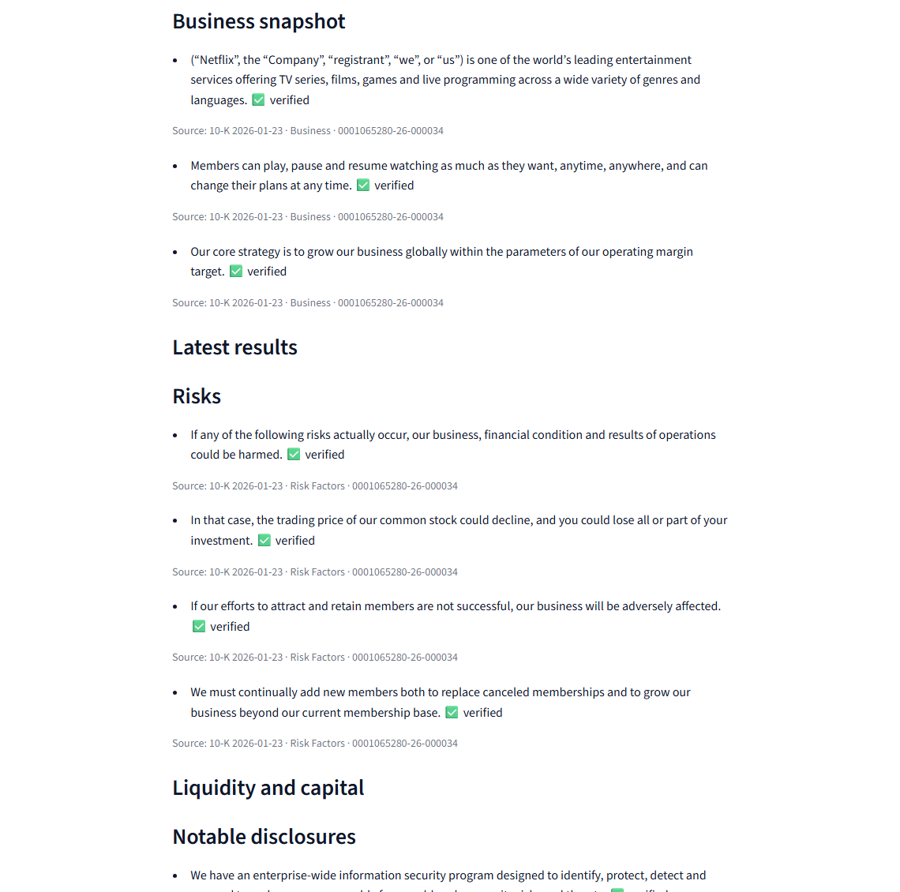
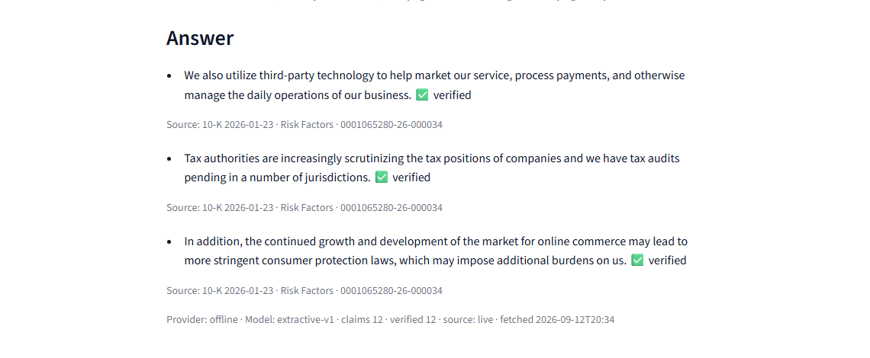
SCREENSHOTS · LIVE MODE (NETFLIX)
Live mode: briefing and answer on fresh filings
Honest reading
Offline extractive provider on live text: the Risk Factors and Business sections read well; "Latest results" and "Liquidity" came back empty because Netflix's MD&A opens with tables and boilerplate that the extractive heuristics skip. The live LLM path composes those sections; the extractive path is the no-key fallback.
Fathom · AI Systems Architecture Review · 17

Slide 18
ENTERPRISE READINESS · CONTROLS
Security and compliance controls
Boundary | Threat | Control in the code | Evidence
B1 user input | advice elicitation, prompt override, free-text ticker | input + output guard; ticker shape check before any path/URL; API enum for source; question length bound | guard tests, T-020 security
B2 AI gateway | key leakage; malformed or spoofed responses | keys only from env by name; secrets scan in the gate; JSON contract with one repair; every httpx error mapped to a Fathom error | T-004/T-015 security
B3 filing text | prompt injection embedded in filings | excerpts declared as data; injected instructions cannot become verified claims; FR-018 test in the bench | bench injection KPI
B4 audit file | bodies, questions or keys in logs | hashes and counts only by default; never-log test with a capturing handler | T-005 security
B6 live sources | tampered or malformed payloads; rate limits; contact exposure | stdlib parsing; typed accessors; whole-body guards; streamed size cap; throttle; contact never committed | T-018 … T-024 security
Residual risks are written down and owned: no authentication in the prototype (SSO in front for a pilot), local audit file not tamper-evident, unofficial price endpoints.
Fathom · AI Systems Architecture Review · 18

Slide 19
ENTERPRISE READINESS · PROCESS
How it was built: a gated, evidence-producing lifecycle
G0 brief
G1 reqs
G2 HLD + threat model
G3 LLD (frozen contracts)
G4 plan + packs
G5 foundation + CI
G6 build loop
G7 assurance
G8 release
25
25
14
43
task packs, each with acceptance criteria, scope, budget and risk class
independent verifications in a fresh context, in a git worktree pinned to the task's commit
security reviews; every HIGH closed by a fix pack and a fresh re-review
hash-chained evidence-ledger entries; chain verified at export
Separation of duties, by construction
One command validates everything
Frontier model for design, threat model, contracts and orchestration; Sonnet-class agents for every implementation, verification and security review. The implementer never verifies; the verifier never edits; no agent writes an approver's name.
ruff · mypy strict (host and Linux) · pytest with ≥ 80 % coverage · secrets scan · offline eval bench · drift checks. CI runs the same command on every push; the network is never touched.
Fathom · AI Systems Architecture Review · 19

Slide 20
ENTERPRISE READINESS · MEASUREMENT
Quality metrics from the gate
KPI | Value | Target
Tests / coverage | 458 passed (2 network tests skipped offline) / 95.8 % | ≥ 80 %
Guard escapes (30 adversarial phrases) | 0 | 0
Guard false positives (12 benign) | 0 | info only
Offline briefing latency, median | 33 ms | ≤ 5 s
Live cold fetch (NFLX, COST) | ≈ 2–3 s | ≤ 30 s
Prompt size per briefing | ≈ 27 k tokens | ≤ 40 k
Live briefing latency | measured from the audit log on the day | ≤ 90 s
Retrieval hit-rate is below its 0.9 aspiration and is shown as informational rather than edited to pass; title boosting raised it from 0.74 to 0.78 and the ranker is one function to replace.
Fathom · AI Systems Architecture Review · 20

Slide 21
HONESTY
Quirks and known limitations (stated, not hidden)
Offline mode proves plumbing, not prose
XBRL-derived ratios are approximations
Its 100 % verified share is by construction; on live text it can leave a section empty (Netflix MD&A opens with tables). The LLM path composes those sections.
EPS TTM sums quarterly XBRL frames and is not split-adjusted: Netflix shows P/E 8.98 after its stock split. Labelled as derived; a vendor feed would replace it in a pilot.
Unofficial price endpoints
Retrieval hit-rate 0.78
Yahoo's chart API and Stooq CSV are keyless but unofficial; Stooq intermittently serves a bot-challenge page. Fixture mode is the demo default for that reason.
Lexical ranking misses some golden queries; the KPI is informational and the ranker is swappable.
Cross-reference-sheet 10-Ks
No authentication, local audit file
McDonald's-style filings need a heading fallback; two sub-sections still over- or under-run slightly (backlog).
Single-user prototype: SSO in front of the API and a tamper-evident audit sink are pilot work, listed in the ORR.
Metrics card timestamp churn
Guard scans claim text, not quotes
Every gate run rewrites the rendered card's timestamp; harmless, noted for the next build.
Quotes are never rendered, so the exposure is nil today; noted as LOW.
Fathom · AI Systems Architecture Review · 21

Slide 22
ENTERPRISE READINESS · OPERATIONS
Cost, performance and operability
1 call
33 ms
2–3 s
0 keys
per briefing or question; prompt capped by section character limits (≈ 27 k tokens)
median offline briefing; live ≈ 60–90 s dominated by the model
cold live fetch per ticker (five documents, four facts, one chart); warm reads < 1 s
needed for the demo or for live data; the AI gateway key is injected at runtime only
Operability
Observability and audit
• Runbook with start/stop, modes, common failures and fallbacks
• Demo checklist with a fallback line for every failure mode
• Operational readiness review and change records for 0.1.0 and 0.2.0
• `fathom probe` checks the gateway; `fathom fetch` pre-warms live data
• Rollback is an environment variable (offline / fixture) or a git tag
• Structured INFO logs: provider, model, latency, claim counts — never bodies
• Audit JSONL per call with sha256 of prompt and response
• Alert candidates named for a pilot: verified share < 0.7/day, guard hits > 0, provider error rate
• Manifest per live ticker records URLs, accessions and fetched-at for provenance
Fathom · AI Systems Architecture Review · 22

Slide 23
NEXT STEPS
Roadmap to a pilot
Weeks 1–2
Weeks 3–4
Weeks 5–6
Week 7+
Harden data
Secure and host
Measure
Scale
Vendor or licensed quote feed behind the existing price interface
Split-adjusted fundamentals; XBRL only as fallback
Full EDGAR universe with nightly pre-warm
SSO in front of the API and page
Tamper-evident audit sink (hash chain or append-only store)
Secrets from the platform vault; SBOM in CI
Advisor eval set built with the compliance team
Live verified-share and guard dashboards
Embedding or hybrid ranker if the hit-rate target is confirmed
Model routing through the gateway (cost tiers)
Batch briefings for watchlists
Change record and ORR sign-off for production
Everything above is additive: the contracts, the verifier, the guard and the audit record do not change.
Fathom · AI Systems Architecture Review · 23

Slide 24
APPENDIX
Appendix A — Decision log (abridged)
ID | Decision | Consequence
D-002 | Demo data from four Hugging Face datasets, committed as fixtures with licences and anchors | Deterministic, offline demo; refresh is one script
D-003 | Grounding by verbatim citation, not by trust | JSON claim contract; verifier; badges; verified-share KPI
D-004 | BM25 over SEC items, no vector database | No infrastructure; explainable; one function to replace
D-005 | Providers speak one JSON contract; offline is a real provider | One code path; CI and demo never need a key
D-006 / D-009 | Parser heading fallback for cross-reference-sheet 10-Ks (tightened after a failed attempt) | McDonald's briefing restored; invariant for all other filings
D-007 / D-010 | Claim conversion never raises; transport errors are Fathom errors | HIGH security finding and a resilience gap closed
D-008 / D-011 | Title-boosted retrieval; API binds loopback; demo polish heuristics | Honest KPI; safer default; readable offline briefing
D-013 | Live mode materializes the fixture schema from SEC EDGAR + Yahoo/Stooq | Any US ticker; downstream untouched; new trust boundary B6
D-014 | Typed payload accessors and structural fuzz as acceptance criteria | Closed a class of parsing crashes found across four security rounds
Fathom · AI Systems Architecture Review · 24

Slide 25
APPENDIX
Appendix B — Build statistics and lessons
Item | v0.1.0 (fixtures) | v0.2.0 (live data)
Task packs | 18 (T-000 … T-017) | 7 (T-018 … T-024)
Implementer attempts | 22 | 17
Verifier runs (fresh context, pinned worktree) | 20 | 13
Security reviews | 8 | 9 (four rounds on payload parsing)
Real bugs caught by independent roles | 5 (deps extras, fallback bodies, null completion, stale figures, bind 0.0.0.0) | 6 (ticker routing, path build before validation, four parsing classes)
Ledger entries / gates | 32 / G0–G8 | 11 / G1–G4 re-entry, G6.4, G7, G8
Tests / coverage at ship | 287 / 96.0 % | 458 / 95.8 %
Lessons written into the decision log
• Specs that touch unstructured text need a content-level acceptance test before dispatch (the parser fallback took two attempts).
• Documentation packs run last, once, after all code tasks (figures moved three times).
• For third-party payloads, specify typed accessors, whole-body guards and structural fuzzing up front; enumerating failure modes leaks.
• Verifiers occasionally write into the worktree copy; the orchestrator names the live path and copies before removal.
Fathom · AI Systems Architecture Review · 25

Slide 26
APPENDIX
Appendix C — Repository map and how to run
fathom/ core: config, errors, data, quotes, filings, retrieval,
prompts, providers, contracts, guard, audit, briefing,
ask, bench, cli, api, mcp_server, live/*
app/ Streamlit page + rendering helpers
data/ fixtures (parquet) + SOURCES.md (licences, anchors)
tests/ 458 tests; recorded live fixtures
metrics/ headline.json, card.json/md, render.py (drift-checked)
docs/design/ brief, requirements, HLD, threat model, LLD,
plan, live-data amendment, decisions
docs/tasks/ 25 packs with verdict and security files
docs/evidence/ hash-chained ledger + exported evidence pack
docs/ops/ runbook, ORR, change records, demo checklist
docs/pitch/ one-slide pitch and this deck
Run it
uv sync --all-extras
uv run python scripts/check.py
uv run fathom app
# live data, no keys
export FATHOM_DATA_SOURCE=live
export FATHOM_SEC_CONTACT=you@firm.com
uv run fathom fetch NFLX
uv run fathom brief NFLX
# live model via the gateway
export FATHOM_LLM_PROVIDER=portkey
export PORTKEY_API_KEY=…
uv run fathom probe
Fathom · AI Systems Architecture Review · 26

Slide 27
Questions
Fathom · roshanrana/fathom · release 0.2.0 · design docs, evidence ledger and runbook in the repository

