Slide 1






COMPUTER VISION HACKATHON
AI Interview Companion
GraderX
Roshan Rateria

Slide 2


Facing the
Interview Gauntlet?
The Problem: The traditional job interview process can be stressful and unpredictable. Candidates often lack personalized guidance and struggle to accurately assess their interview performance.
Why it Matters: Effective interview skills are crucial for securing dream jobs. However, generic advice doesn't address the unique needs of each individual or specific job requirements.
Who is Affected: Millions of job seekers, from recent graduates to seasoned professionals, face these challenges, leading to missed opportunities and career setbacks.
@INSIGHT HACKATHON TEMPLATE

Slide 3
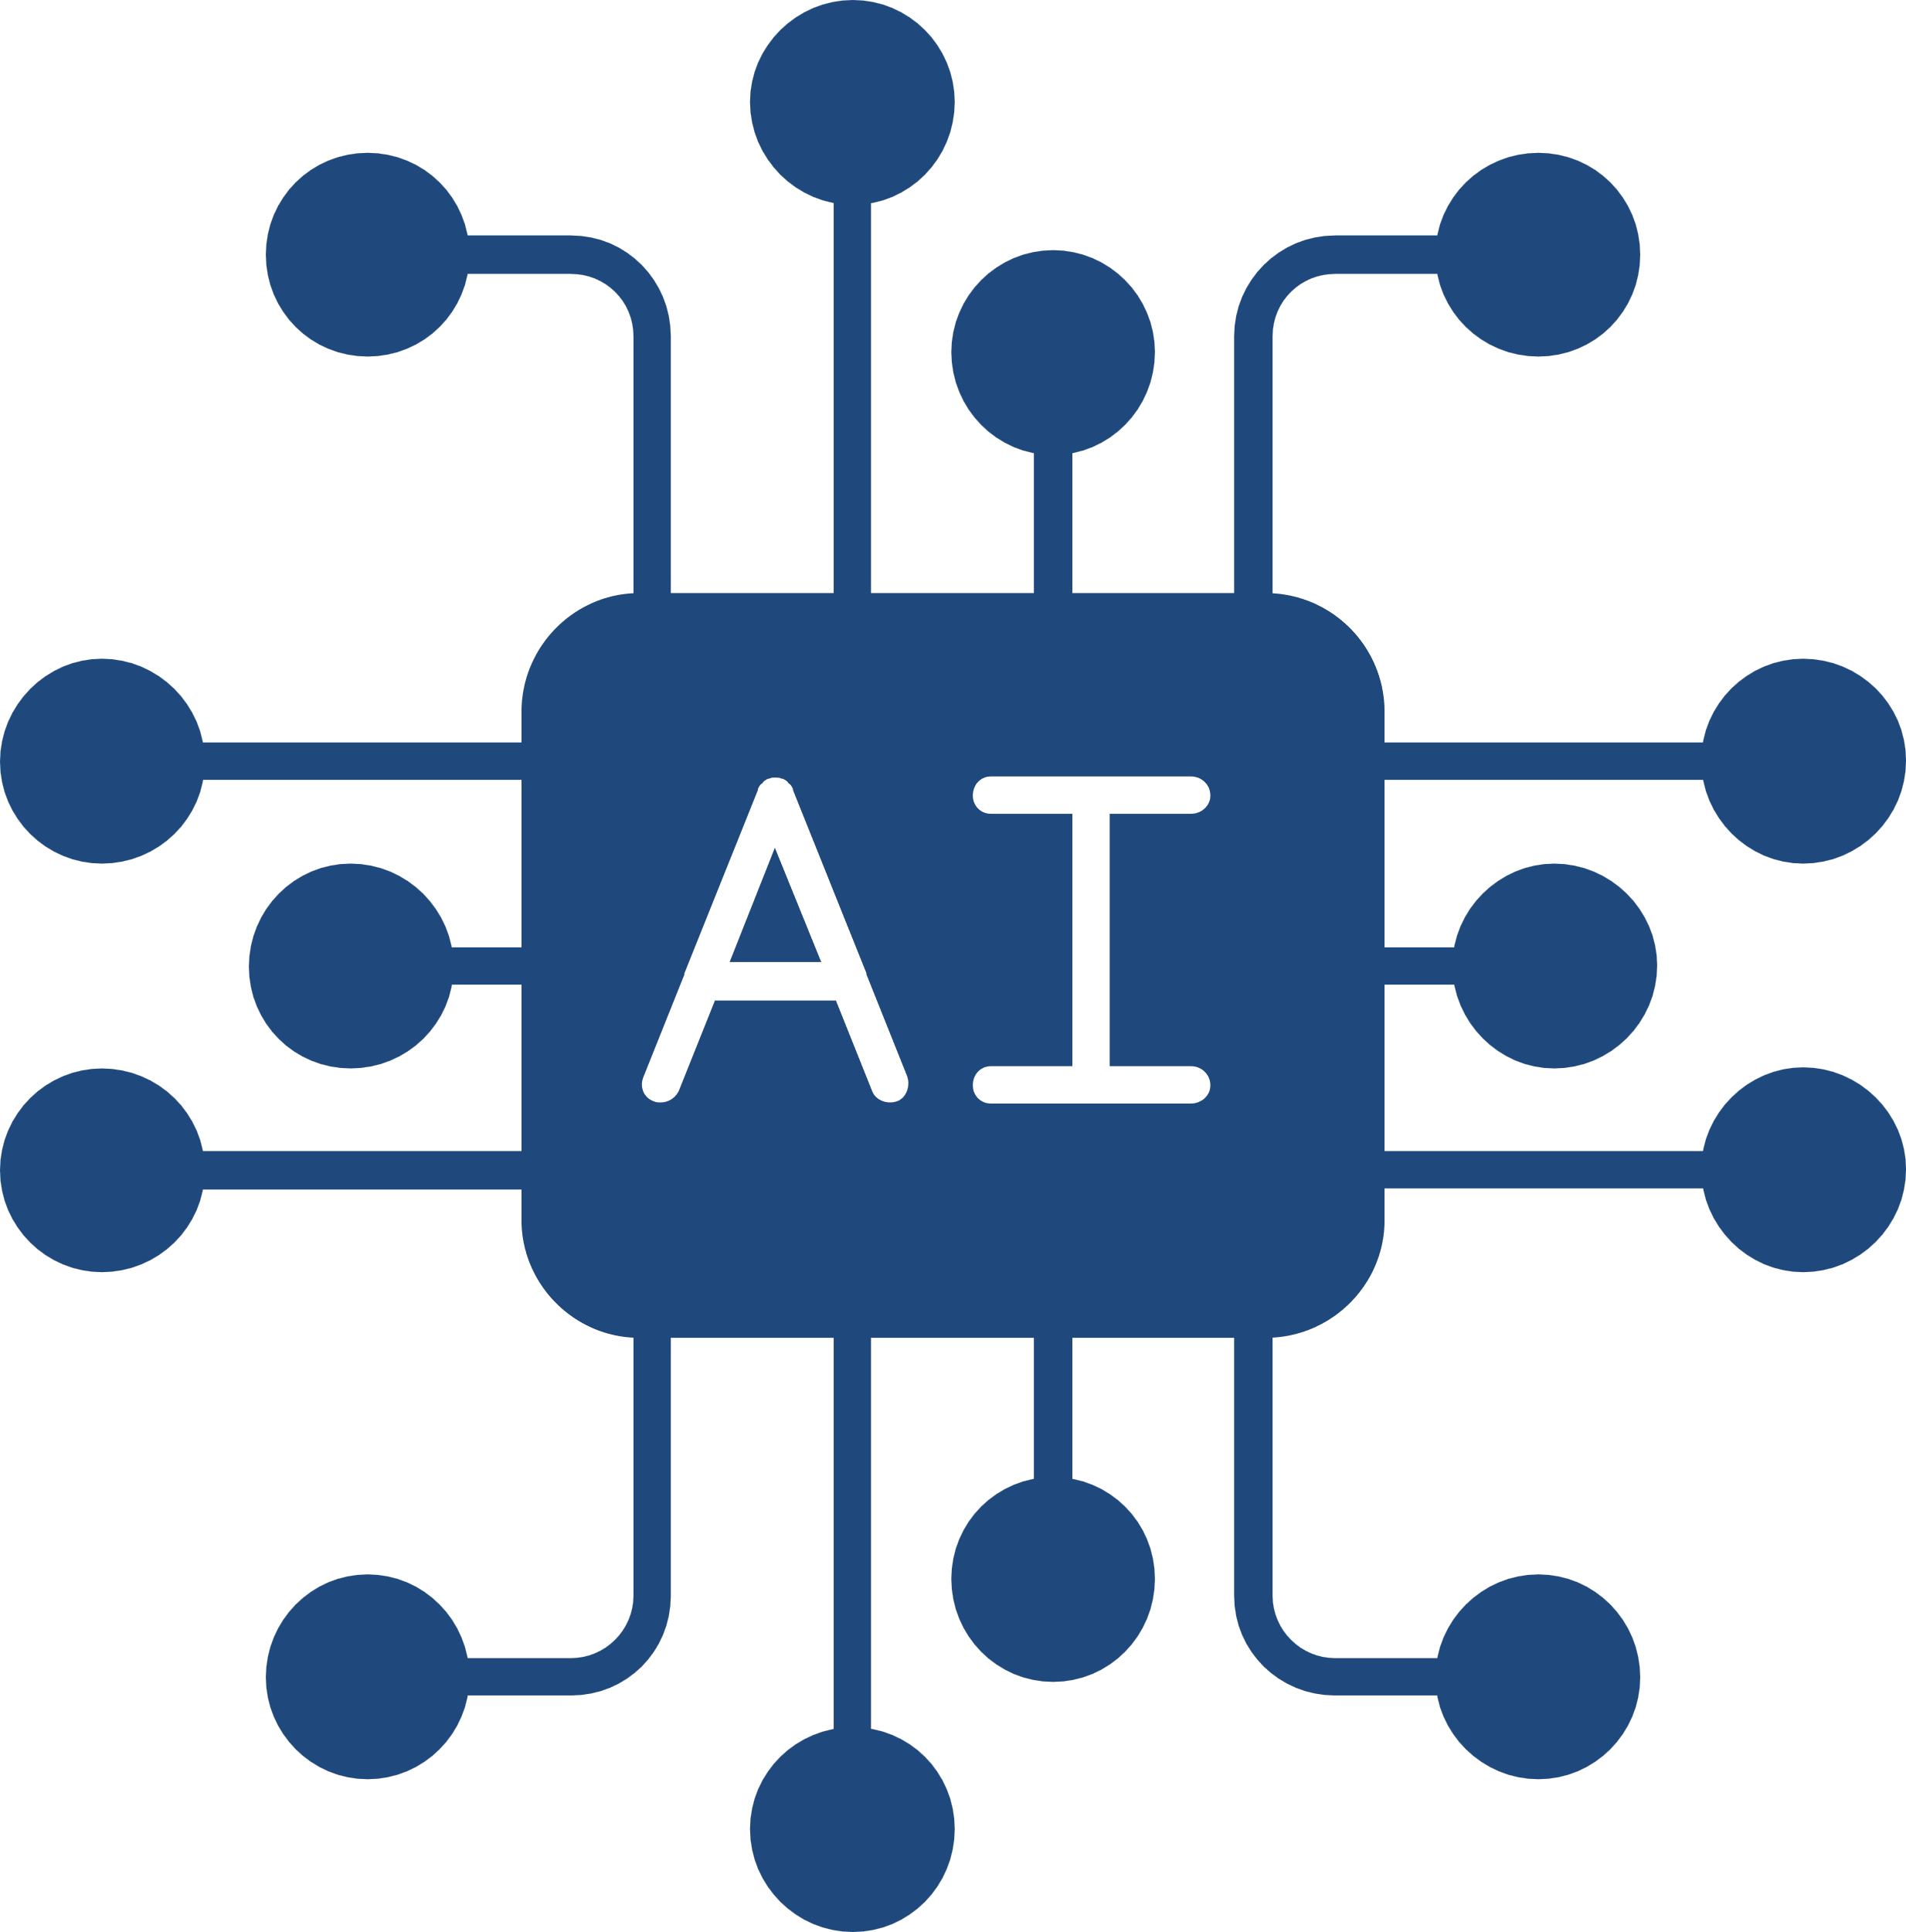

Introducing Powered Interview Prep
Our Solution: We've developed an AI-driven platform that uses a candidate's resume, target job description, and computer vision to provide a personalized interview experience.
How it Works:
Resume & Job Analysis: AI extracts key skills, experience, and potential interview questions from the provided documents.
Personalized Questions: The system generates tailored questions based on the specific role and the candidate's profile.
Computer Vision Analysis: Candidates practice answering questions while our system analyzes their video, providing feedback on:
Verbal Communication: Clarity, pacing, use of filler words
Non-Verbal Communication: Body language, eye contact, facial expressions
Expected Impact: Empowering individuals with the tools and insights to confidently approach interviews, increasing their chances of success and unlocking career potential.
@INSIGHT HACKATHON TEMPLATE

Slide 4

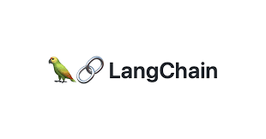
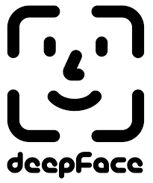
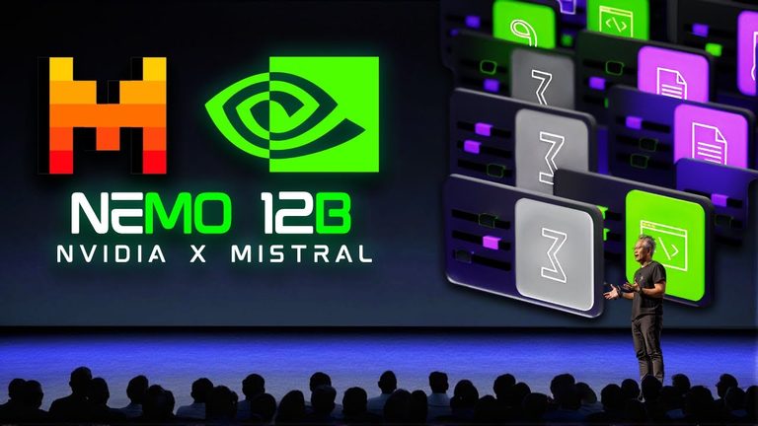
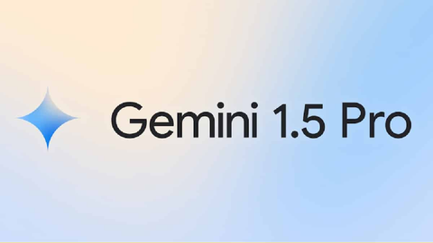


Major Tools & Tech Incorporated
@INSIGHT HACKATHON TEMPLATE

Slide 5

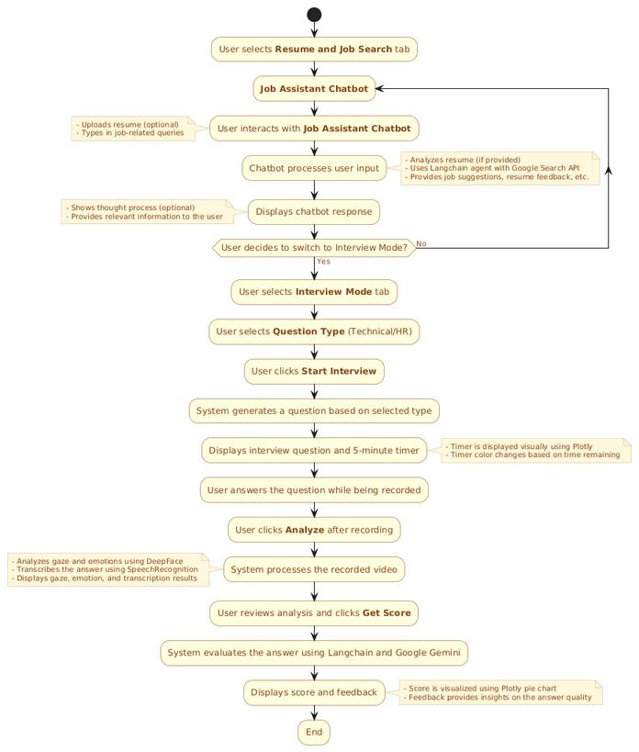
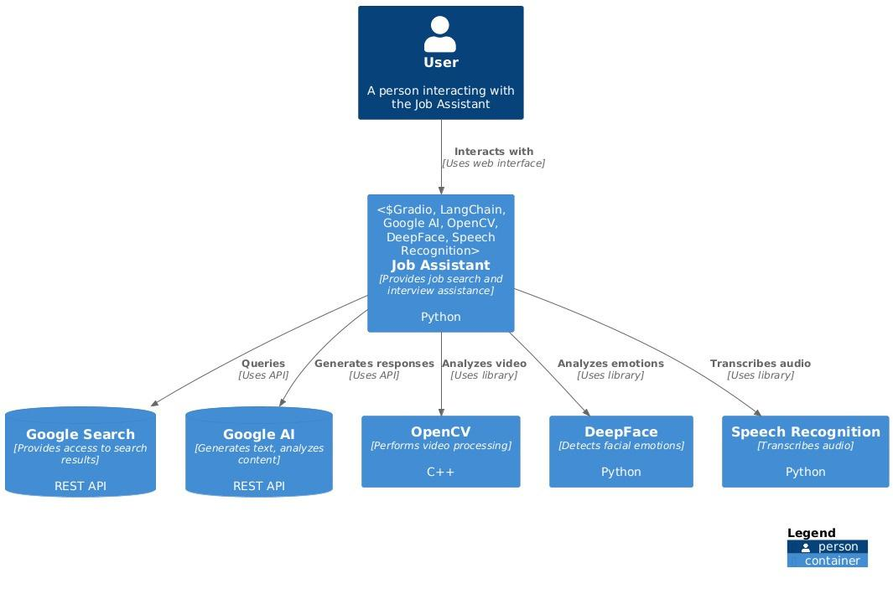
System Architecture
Workflow
@INSIGHT HACKATHON TEMPLATE

Slide 6



Building the Future of Interviewing
Challenges:
Combining Industry Leading Models for Best Results
Balancing Automation and Personalization: Creating a system that's both automated for efficiency and highly personalized to individual needs.
Key Learnings:
Iterative Development
Interdisciplinary Collaboration
@INSIGHT HACKATHON TEMPLATE

Slide 7



Unlocking Potential, One Interview at a Time
Potential Impact
Deployment Plans
Future Work
Democratizing Interview Success
Reducing Bias in Hiring
Bridging the Skills Gap
Multilingual Support
Real-Time Feedback
Industry-Specific Training
Launch as a Web Application
Partnerships with Universities & Job Boards
@INSIGHT HACKATHON TEMPLATE

Slide 8
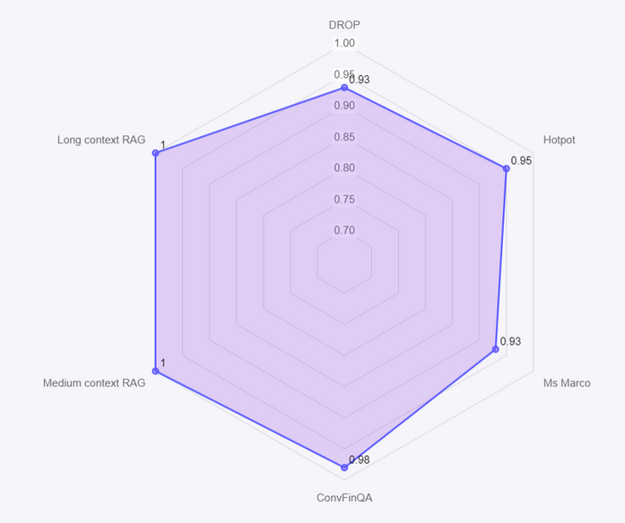
Measuring Success, Driving Improvement
Gemini 1.5 Pro is One of the Best Model for Long Context with 100% Context Adherence Score.
With a 128K context length, Mistral NeMo processes extensive and complex information more coherently and accurately, ensuring contextually relevant outputs.
Gemini 1.5-pro Performance
@INSIGHT HACKATHON TEMPLATE

Slide 9

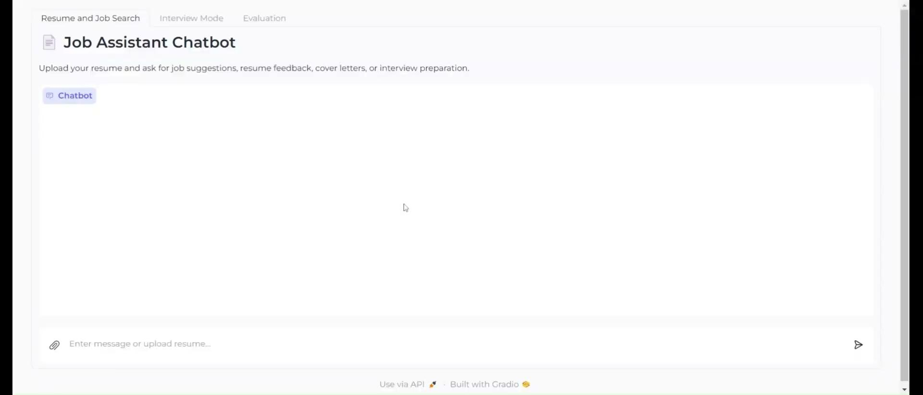

Video Demo
Github Link
https://github.com/roshanrateria/Interview/tree/main
@INSIGHT HACKATHON TEMPLATE

Slide 10
CONCLUSION
rungalileo.io
https://blogs.nvidia.com/blog/mistral-nvidia-ai-model/
https://github.com/antoinelame/GazeTracking
https://github.com/serengil/deepface
@INSIGHT HACKATHON TEMPLATE

