Slide 1
Student Management System

Slide 2
Introduction
In this application the student can see the operation of Student system can manage the services according to the needs.
And the management of services include the following scenarios:-
Insert student.
Update student.
Delete any student.

Slide 3
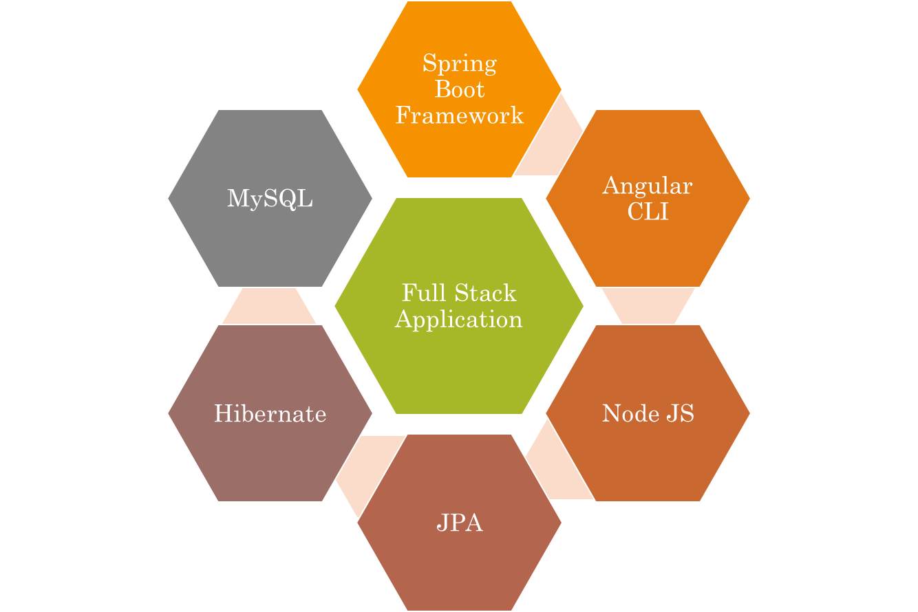
Technology Used

Slide 4
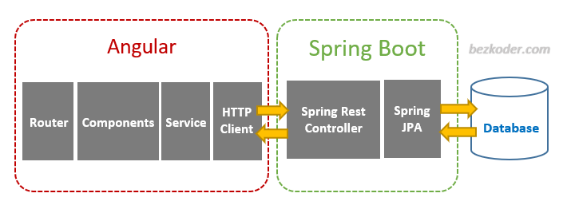
The Architecture of Angular, Spring & database(MySQL)

Slide 5
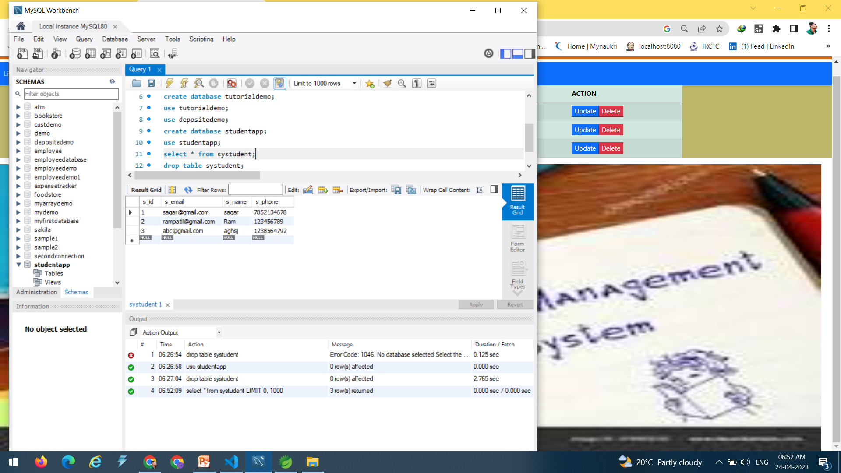

DataBase Used

Slide 6
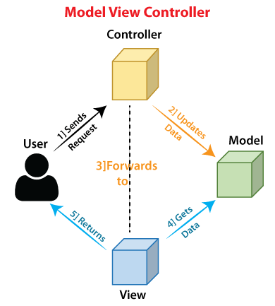
The Architecture of the Project

Slide 7
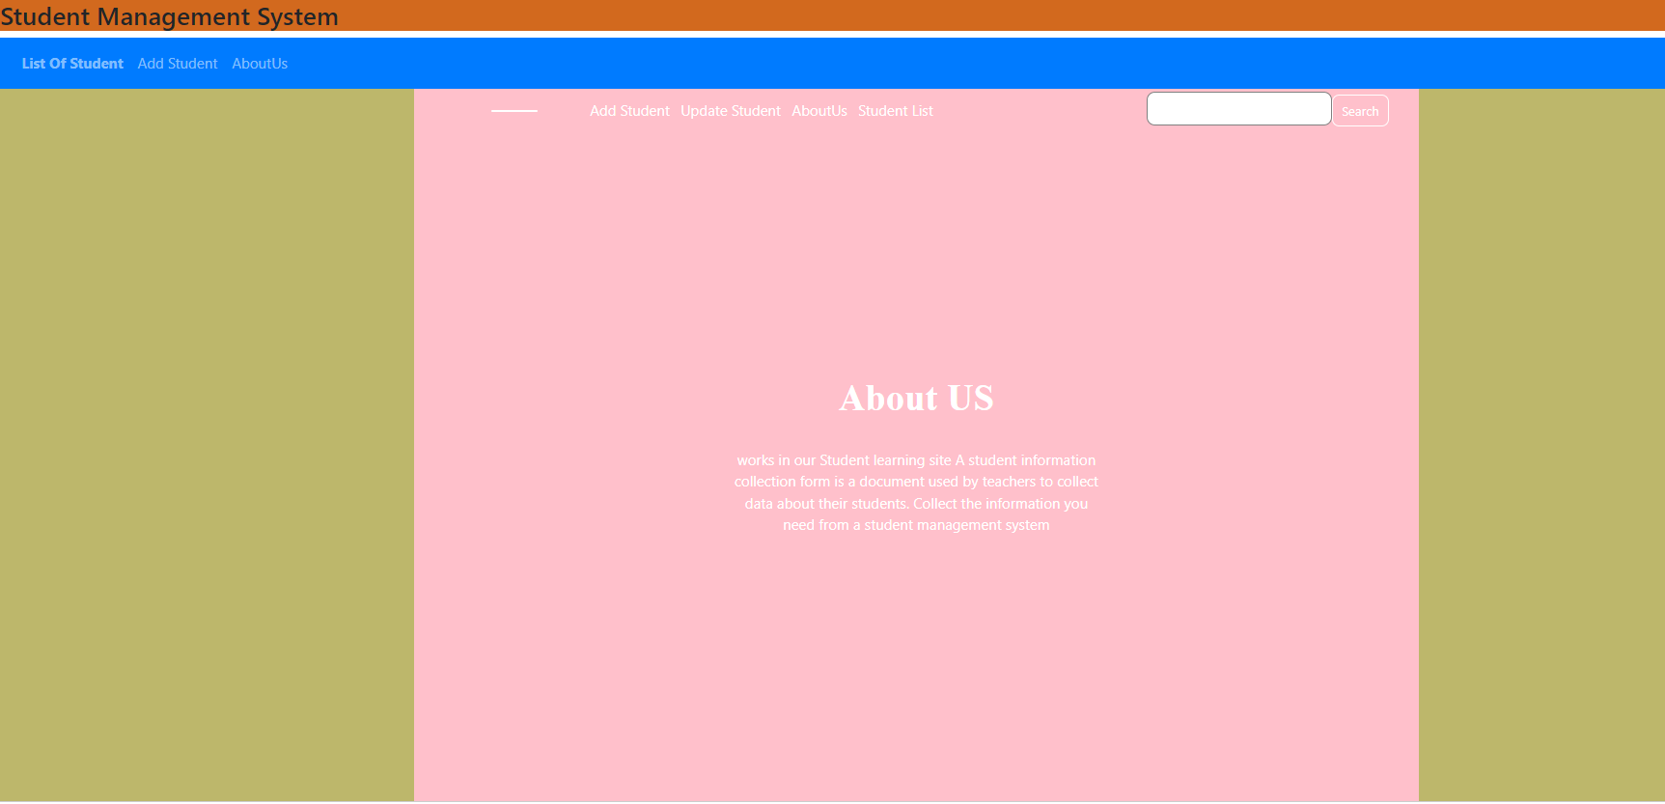
Front End Page

Slide 8
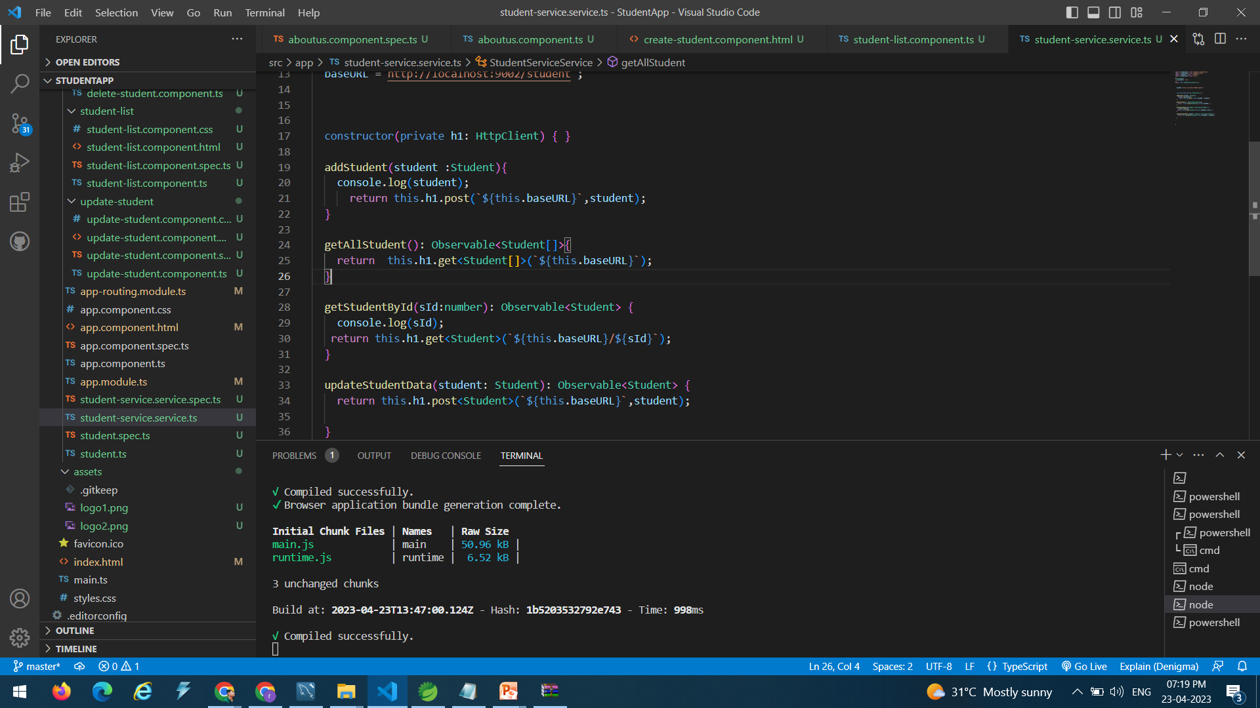
FrontEndCode

Slide 9
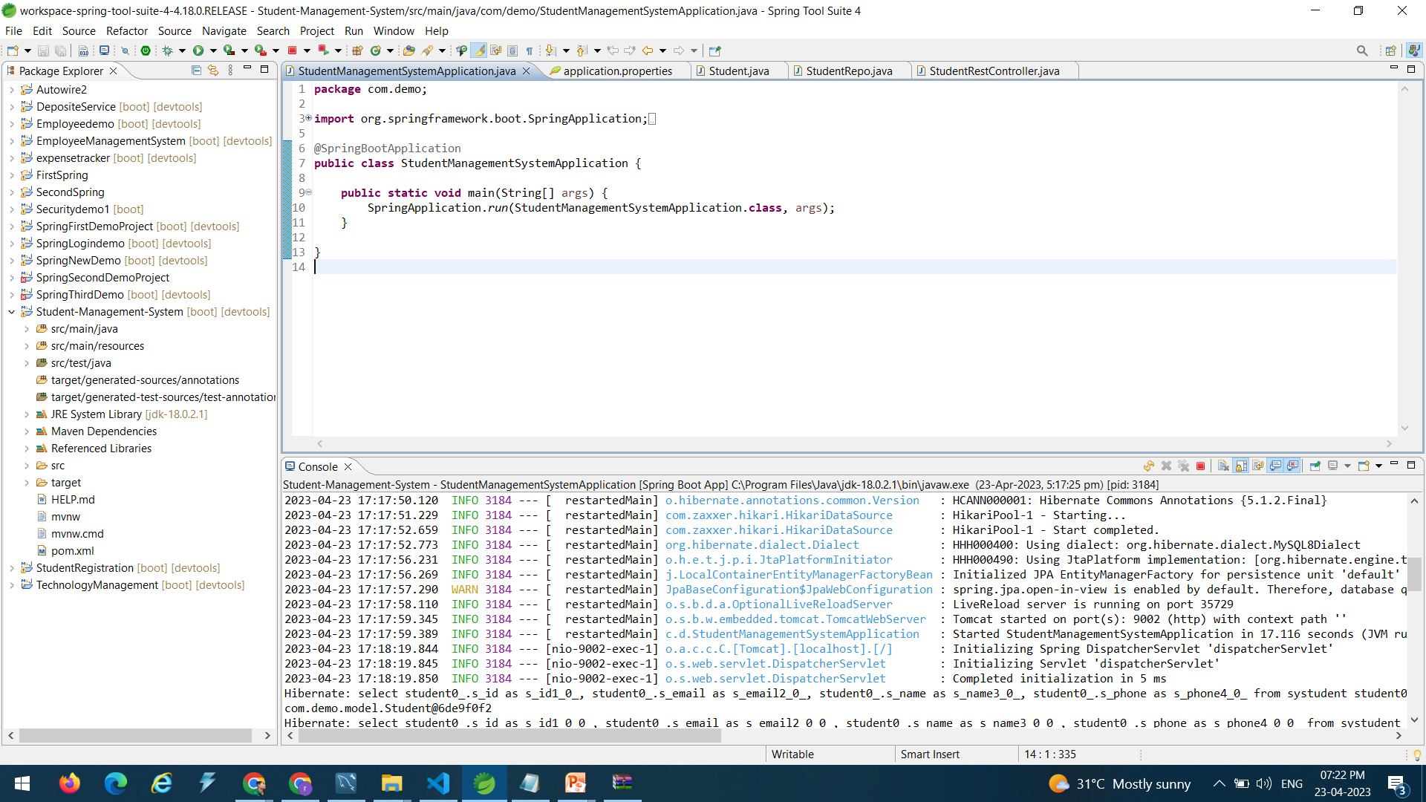
BackEndCode

Slide 10
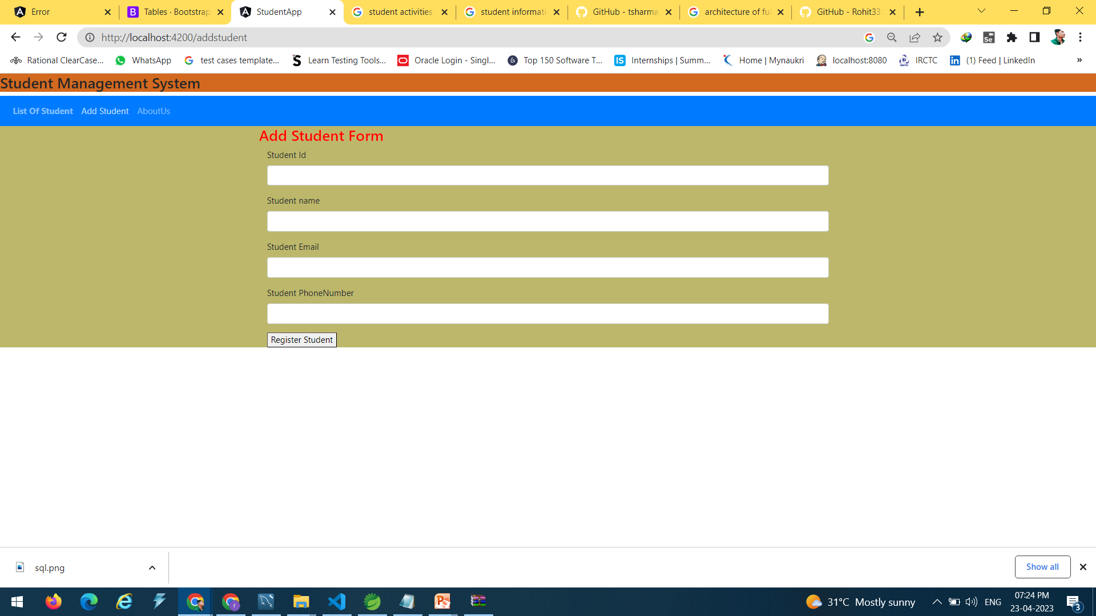
AddStudent Page

Slide 11

Update Student Page

Slide 12
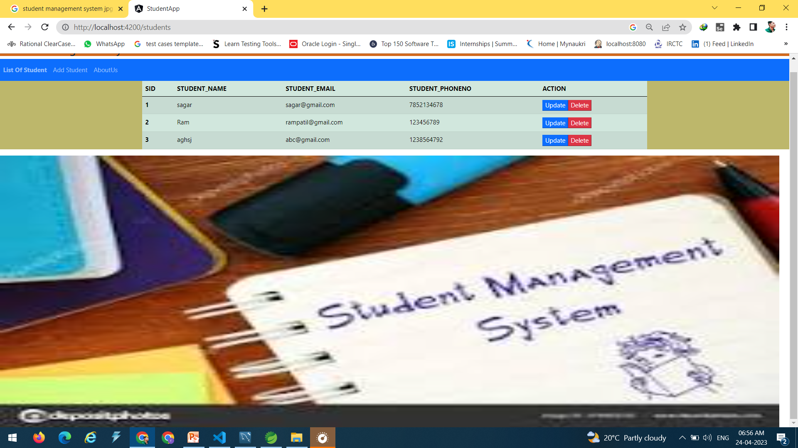
View Student Page

Slide 13

Future Scope
The scope of this project is as follows:
manage all the student's data like their grades, schedules, ages and which year are they in, course enrollment payment, and so on.
I will add login functionality,In future Student can also upload notes.
You can look at your dashboard and configure your reports on student grades, outcomes, performance, schedules, fees, and

Slide 14

Git HubLink
https://github.com/roshansadafale/Final_StudentManagementData.git

Slide 15


