Slide 1

Data Science Job Salaries Using SQL
Presented By:- Roshan Sahu

Slide 2
Objectives
Analyze salary trends over the years for data science roles.
Compare average salaries across different experience levels.
Identify the highest paying job titles in the data science field.
Understand the distribution of employment types in the industry.
Evaluate remote work trends and their impact over time.

Slide 3


1. Total Number of Jobs in Dataset
Query:-
Output:-

Slide 4

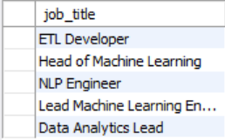
2. List All Unique Job Titles
Query:-
Output:-

Slide 5


3. Average Salary in USD
Query:-
Output:-

Slide 6

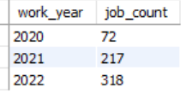
4. Job Count per Work Year
Query:-
Output:-

Slide 7

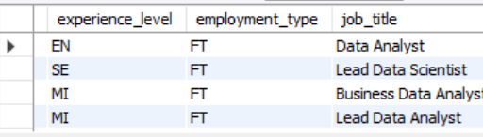
5. Jobs with Fully Remote Work (100%)
Query:-
Output:-

Slide 8
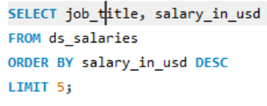
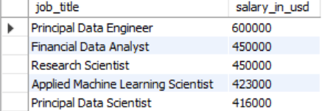
6. Top 5 Highest Salaries in USD
Query:-
Output:-

Slide 9

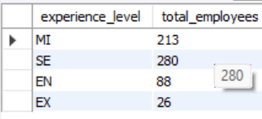
7. Count of Employees by Experience Level
Query:-
Output:-

Slide 10

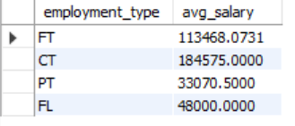
8. Average Salary by Employment Type
Query:-
Output:-

Slide 11

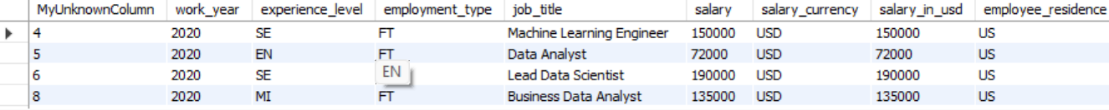
9. Jobs from United States (US) Only
Query:-
Output:-

Slide 12
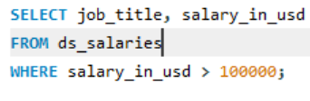
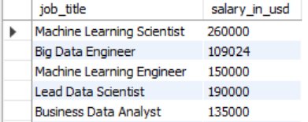
10. Job Titles with Salaries Above $100,000 USD
Query:-
Output:-

Slide 13


