Slide 1
Sequential Decoding of Lower Limb movements using a Non-invasive Brain Computer Interface
Nov 29, 2018
Dr. Elahe Abdi
Dr. Yan Tat Wong
Roshan Sivakumar

Slide 2
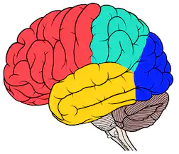
background
SMA :
Invasive brain acquisition
Non-human Primates
Ordering of upcoming movements in a sequence
Jun Tanj et al. , In: Nature, 1994
Pre - SMA :
Invasive brain acquisition
Non-human Primates
Information about next movements
Toshi Nakajima et al. , In: Journal of neurophysiology, 2009
LPFC :
Invasive brain acquisition
Non-human Primates
Activity related to upcoming movements represented simultaneously
Hajime Mushiake et al. , In: Neuron, 2006
DLPFC :
Neuro Imaging brain acquisition
Human subjects
Storage of forthcoming movements in working memory
Jean-Baptiste Pochon et al. , In: Cerebral Cortex, 2001.
Predict 2 forthcoming movements using invasive brain acquisition method in real time
Invasive
Non-Human Primate
Maryam M Shanechi et al. , In: Brain-Computer Interface Research A State-of-the-Art Summary, 2014

Slide 3

Motivation
first step in exploring alternative options to direct commanding of robotic platforms.
build up a better understanding of brain function and the limitations of EEG.
results will help us in identifying the best way forward in bio signal-based control of robots.
to decode brain signals and predict the upcoming movements in a sequence which will be the beginning of a wider range of studies on the potentials
Notes:
To predivt thr fortcvominhg m,obrmryd in a atask consiosting of sequential ebvemnts
in real time using a non-invasieve brain acquision deivce

Slide 4
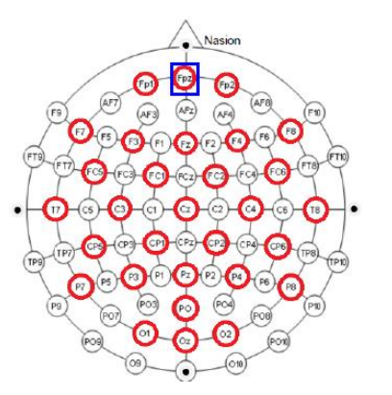
ABOUT THE RESEARCH
Parts of the brain involved:
DLPFC
LPFC
SMA
Pre-SMA
50 participants to be recruited
Ethics Approval
Measurements of Head taken for precise positioning of electrodes
Cap and water electrodes placed on head
Connectivity checked by looking at 50Hz level and blinking response
Laptop placed 20 cm in front of participant. Seated on armrest chair and strapped . Right foot on foot interface. Head and chin on holder. Earphones in ear.
Room Darkened, IR camera calibrated and move indication with auditory cues start.
200 trials. Breaks after every 6 trials for 2 min
Place phones in Metal Mesh Box
Participants Enter Room

Slide 5
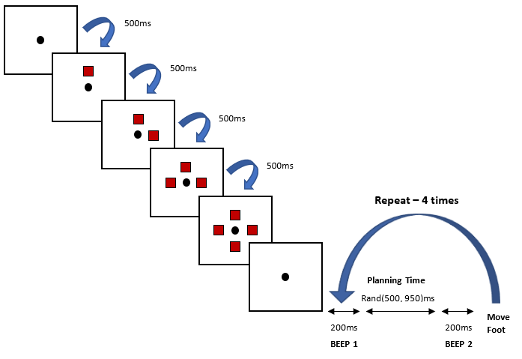
EXPERIMENT DESIGN
Fixation Dot
Move Indication
First Auditory Cue
Second Auditory Cue
Move Up
Move Left
Move Right
Move Down
Fixation Dot
Randomness to ensure no expectation

Slide 6
SETUP
FOOT INTERFACE
CHIN AND HEAD HOLDER
CAP
EYE TRACKING
AMPLIFIER
ELECTRODES
SHURE SE215

Slide 7
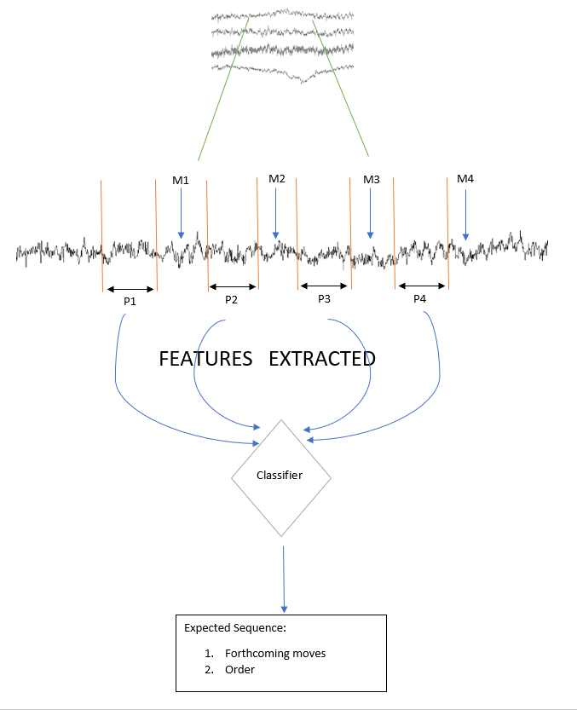
Filtering
Complete process

Slide 8
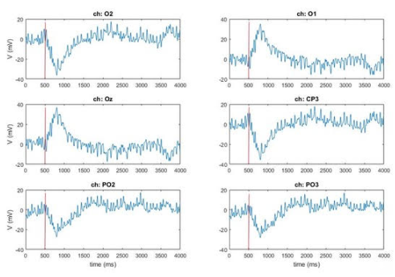
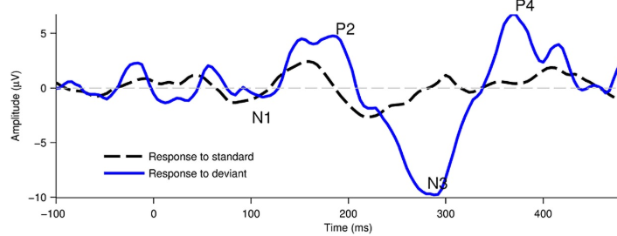

VALIDATE EXPECTED NEURAL SIGNAL
Response to Flicker stimulus
Response to oddball paradigm and observing the distinct N300 peak

Slide 9
CONCLUSION
Work Done Till Date:
Setup
Experiment design
Hypothesis
Correction of neural signals being recorded
Future Work :
Extract features like power changes and 2d topoplots
Design a lightweight classifier
Real time prediction on a new set of participants

Slide 10
Any Questions?

