Slide 1
JARVIS
Windows desktop agent: local Python backend, React/Electron UI,
optional cloud or local LLMs, tools, and persistent memory.
Navneet Nanda (CH.SC.U4CYS24039)
Roshan Srikanth (CH.SC.U4CYS24057)
Jyothir Adithya V B (CH.SC.U4CYS24022)

Slide 2
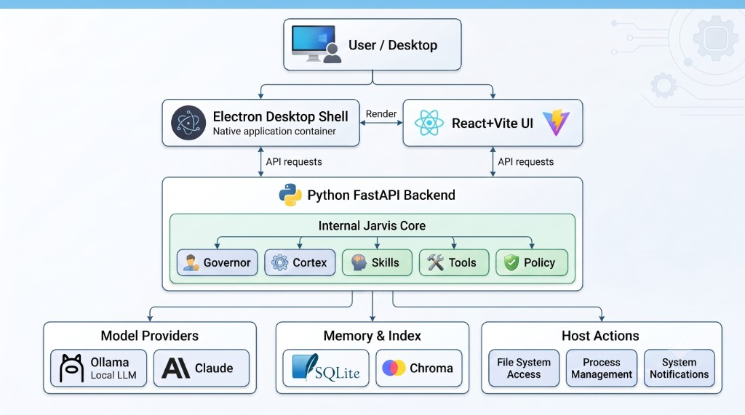
System Architecture — Electron / React above a single FastAPI process
Containment: jarvis/ lives inside the backend, not as a separate service
More modules inside jarvis/ (not shown above)
• DialogueStore — saves recent chat turns for short-term context
• Voice — microphone input and TTS output in the same loop
• Device — reads battery, heat, and RAM so Governor can save power
What connects to the backend
• LLMs: Ollama locally, Groq/Claude in cloud, Council for hard questions
• Tools reach the host: browser, desktop apps, terminal, ICT analysis
• SQLite stores Cortex memories; Chroma finds relevant past facts
2

Slide 3
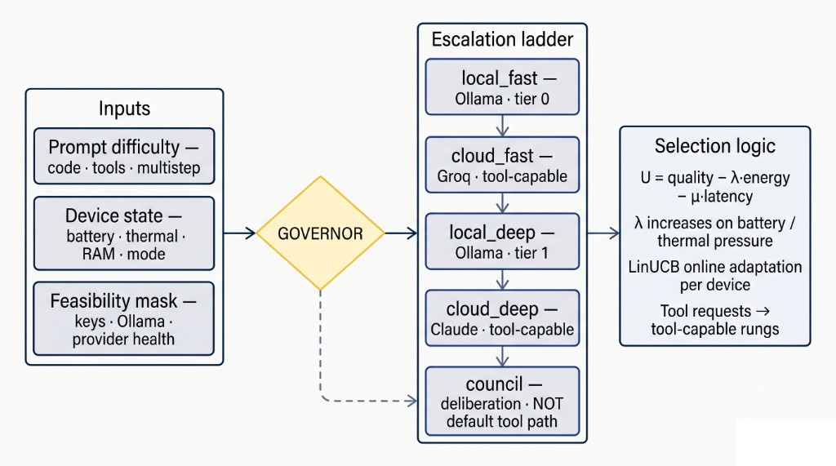
Governor — model rung selection from difficulty, device state, and feasibility
Utility = quality − λ·energy − μ·latency · LinUCB adapts per device
What the Governor looks at
• Prompt difficulty — is it code, tools, or multi-step?
• Device state — battery, temperature, RAM, eco/local/cloud mode
• Feasibility — which providers and keys are actually available
How it picks a model rung
• Scores rungs: answer quality vs energy cost vs latency
• Raises energy penalty when on battery or under thermal stress
• Sends tool requests only to models that can call tools
• Council is for deliberation — not the normal tool path
3

Slide 4
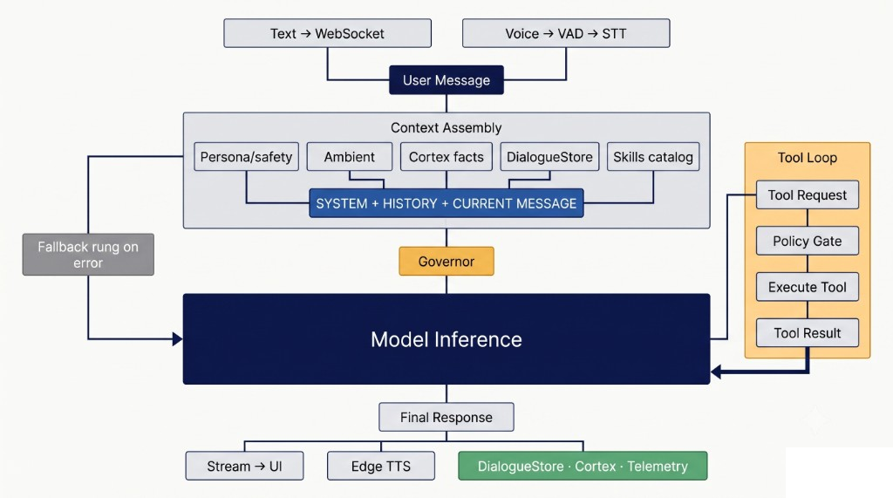
End-to-End User Turn — text and voice merge into one request loop
Voice is an I/O path into the same pipeline, not a parallel architecture
How a request enters the system
• Text chat and voice both become one user message
• Voice: VAD detects speech, Whisper transcribes (Groq if local fails)
• Context built from persona, memories, history, and skills catalog
What happens during the turn
• Governor picks model → model answers → may call tools in a loop
• Policy must approve before any risky host action runs
• Response streams to UI and Edge TTS; turn saved to memory
4

Slide 5
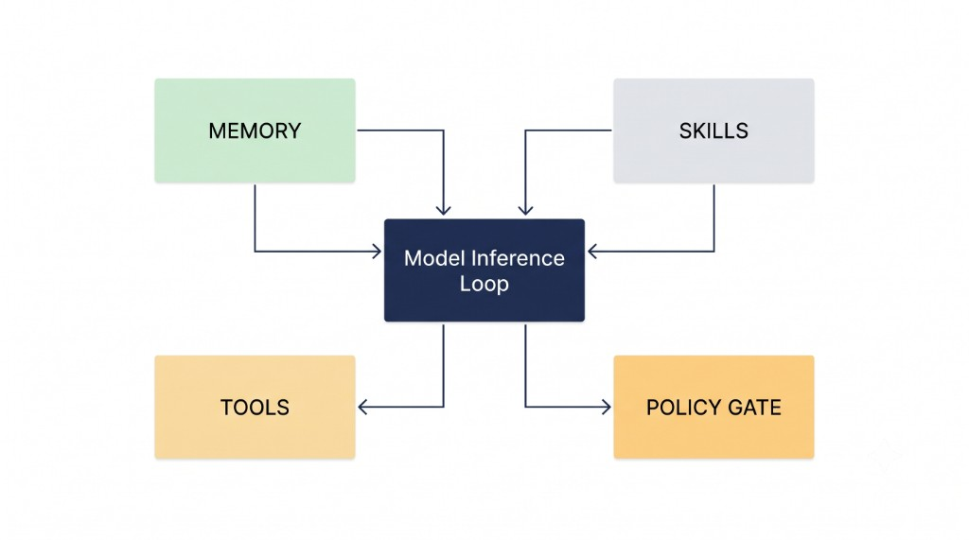
Memory, Skills, Tools & Policy — how subsystems support a turn
Policy gates every host action before execution
Memory — what the model remembers
• DialogueStore: recent conversation window (short-term)
• Cortex: long-term facts, episodes, and searchable memories
Skills, tools, and policy
• Skills: reusable procedures loaded from SKILL.md files
• Tools: let the model act on browser, desktop, and shell
• Policy gate: every tool call checked before execution
5

