Slide 1



APPLY DYNAMIC PROGRAMMING ALGORITHM FOR CONSTRUCTING AN OPTIMAL BINARY SEARCH TREE
MICRO PROJECT-DESIGN AND ANALYSIS OF ALGORITHM
NAME : ROSHAN THIRUMOORTHY
ROLL NO : 23ITR137
JAIHARI D (19ITR028)

Slide 2
Problem Description
Given n sorted keys and their search probabilities
Construct a Binary Search Tree (BST) with minimum expected search cost
The cost is calculated as the depth of the node × its probability
Goal: Minimize total cost using dynamic programming

Slide 3
Algorithm Design technique
Technique Used: Dynamic Programming
Optimal substructure: Best solution contains best subtrees
Overlapping subproblems: Same subtrees solved multiple times
Efficient compared to divide and conquer or greedy methods
3

Slide 4
Decide on Appropriate Data Structure
2D Arrays (Tables):
e[i][j]: Expected cost from ki to kj
w[i][j]: Sum of probabilities from pi to pj
root[i][j]: Root key index of subtree
Arrays store intermediate results to avoid recomputation

Slide 5
INPUT SIZE:
Number of keys: n
Key values (sorted): K = {k1, k2, ..., kn}
Search probabilities: P = {p1, p2, ..., pn}

Slide 6
Time Complexity: O(n³),Space Complexity: O(n²)
Best Case: When all keys have equal probability, and the tree is perfectly balanced.
Worst Case:When one key has very high probability, but is placed deep in the tree (not as root).
Efficiency Class:

Slide 7
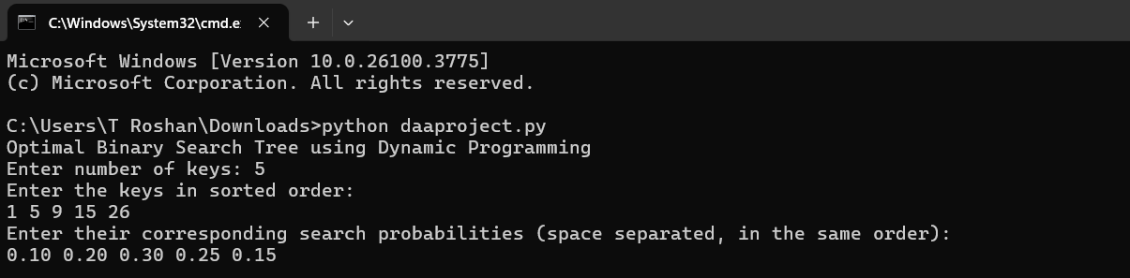
Sample Input

Slide 8
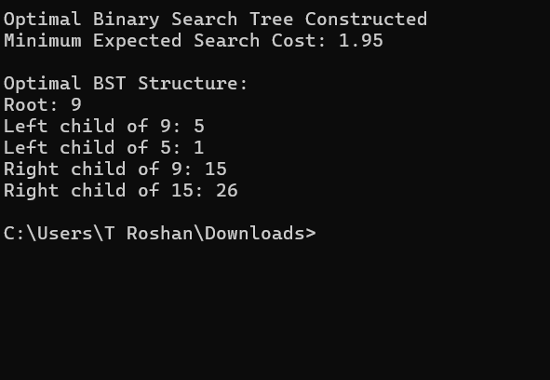
Sample Output

Slide 9
Sample Input / Output
Input:
Keys: 10, 20, 30
Probabilities: 0.3, 0.2, 0.5
Output:
Optimal BST Structure:
Root: 30
Left Child: 10
Right Child: 20
Minimum Cost: e[1][3] = 1.5

Slide 10
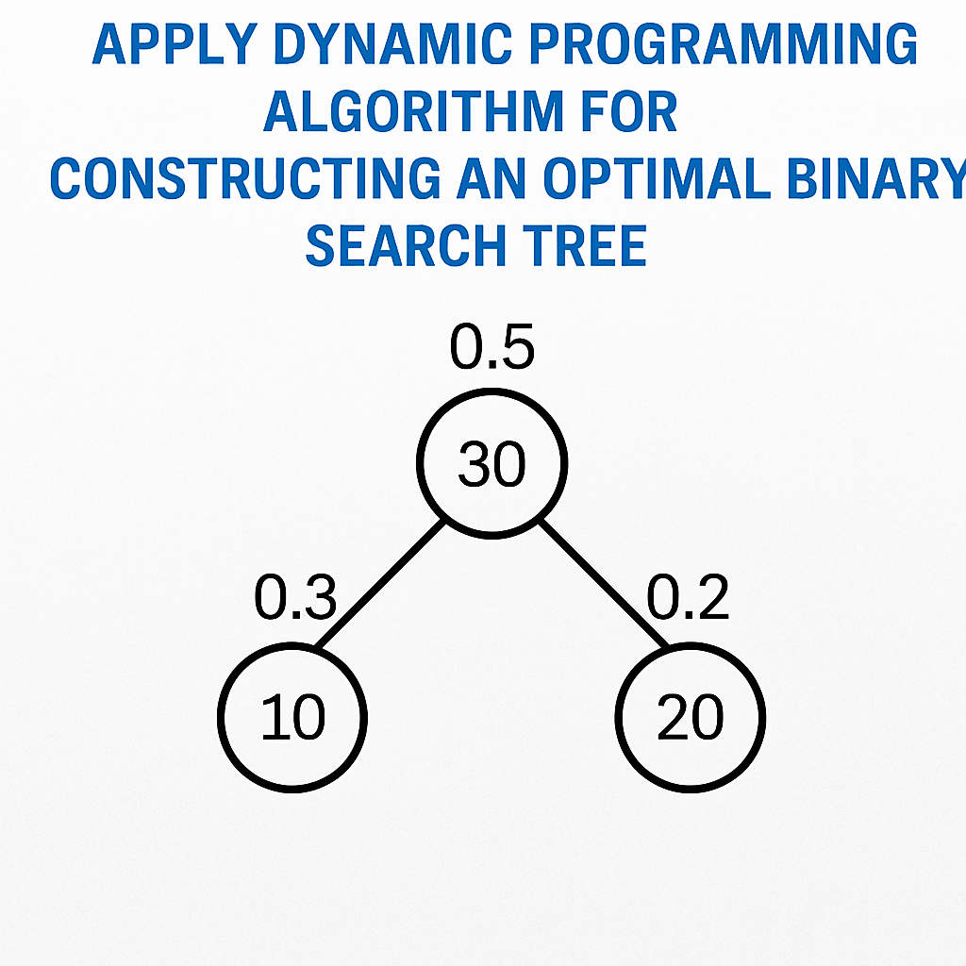
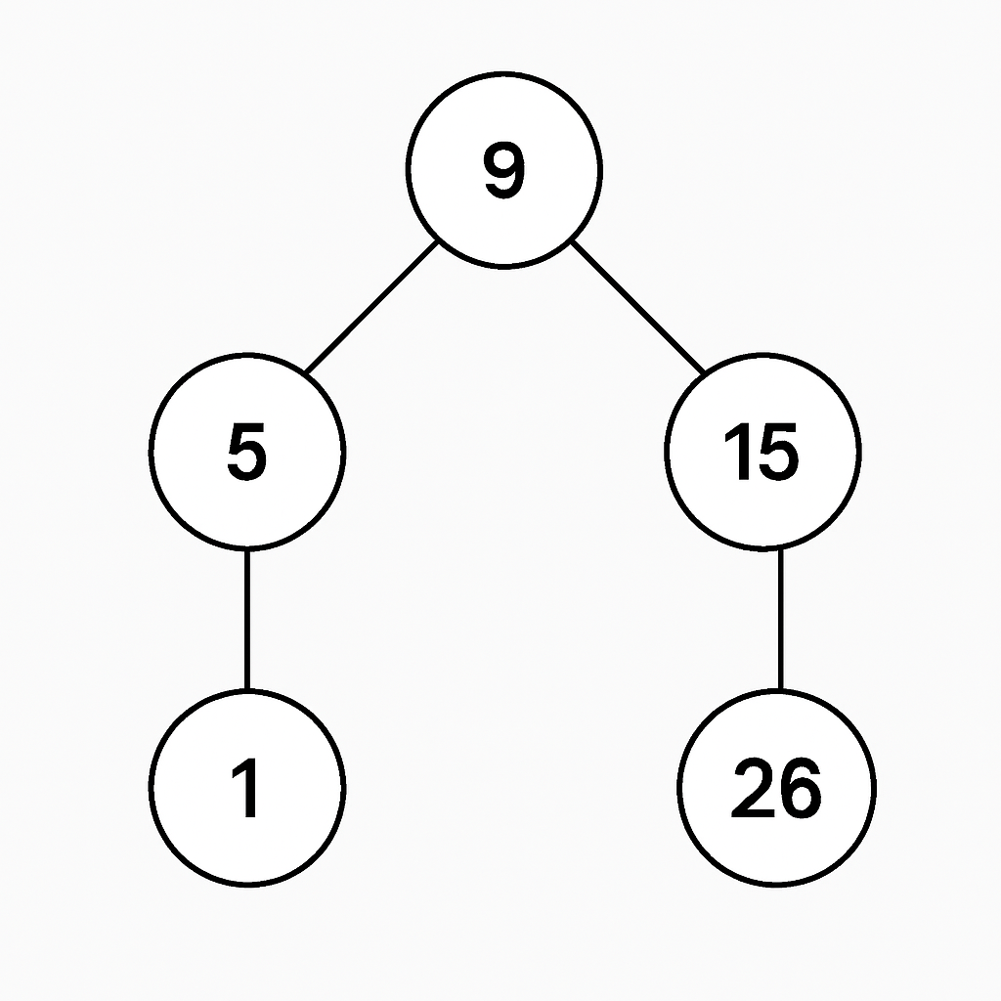

Slide 11
Thank You

