Slide 1

Data@ANZ – ANZ Virtual Internship
Exploratory Data Analysis
Roshan Wahane (Master of Data Science, Monash University)
Email: [Redacted]
Mobile: [Redacted]
LinkedIn: https://www.linkedin.com/in/roshan-wahane/
GitHub: https://github.com/roshanwahane
Tableau: https://public.tableau.com/profile/roshan.wahane#!/

Slide 2
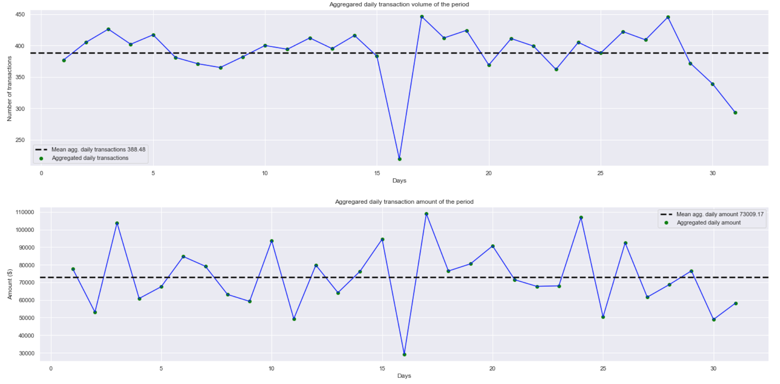
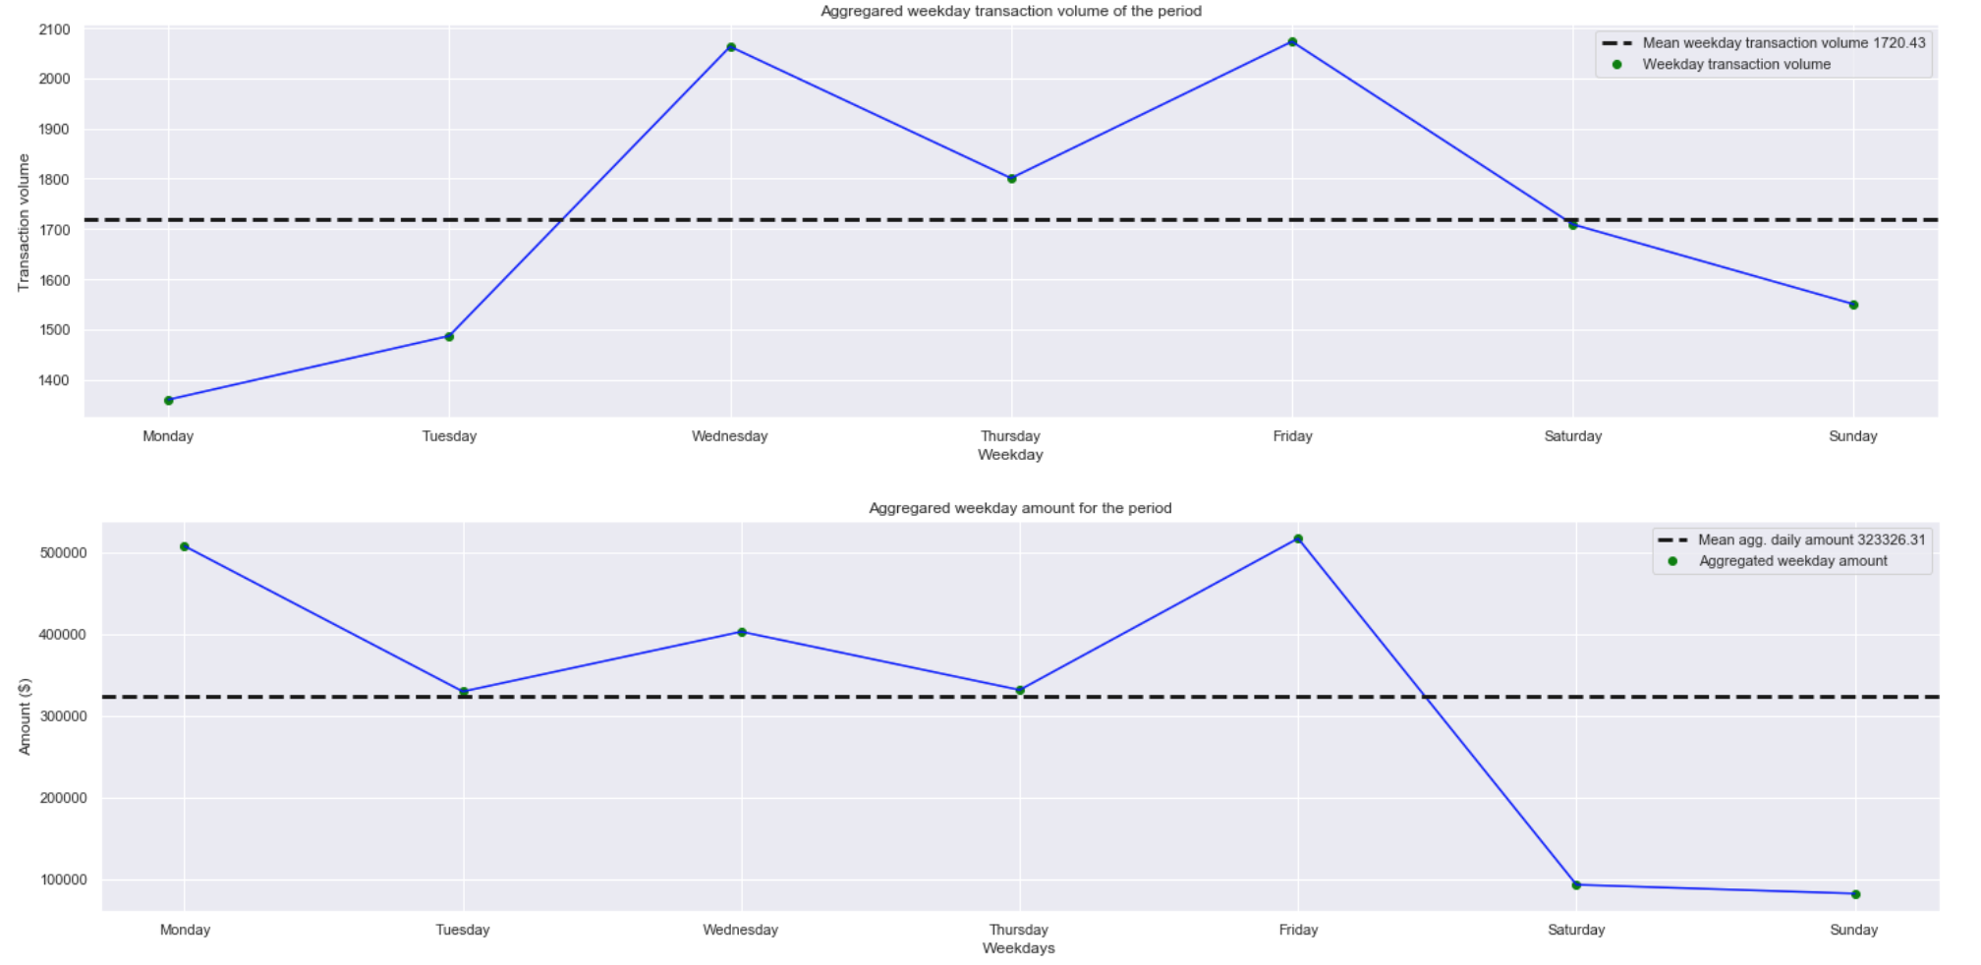
These charts show aggregated transaction volume (top) and amount (bottom) for each day for the period combined.
During the analysis, I found that the amount spending and transaction volume was very low compared on the 16th day in the data set.
After performing further analysis, I found that 16th August is missing completely from the data set hence the reason why we see the drop in the volume and amount in the charts.
These charts show aggregated transaction volume (top) and amount (bottom) for each weekday for the period combined.
It was surprising to see that the transaction volume and amount spent on weekends (Sat-Sun) was less than weekdays (Mon-Fri).
My previous assumption was that people on average spend more money during weekends as most people do not work on weekends giving them more opportunity to spend due to the time off.

Slide 3
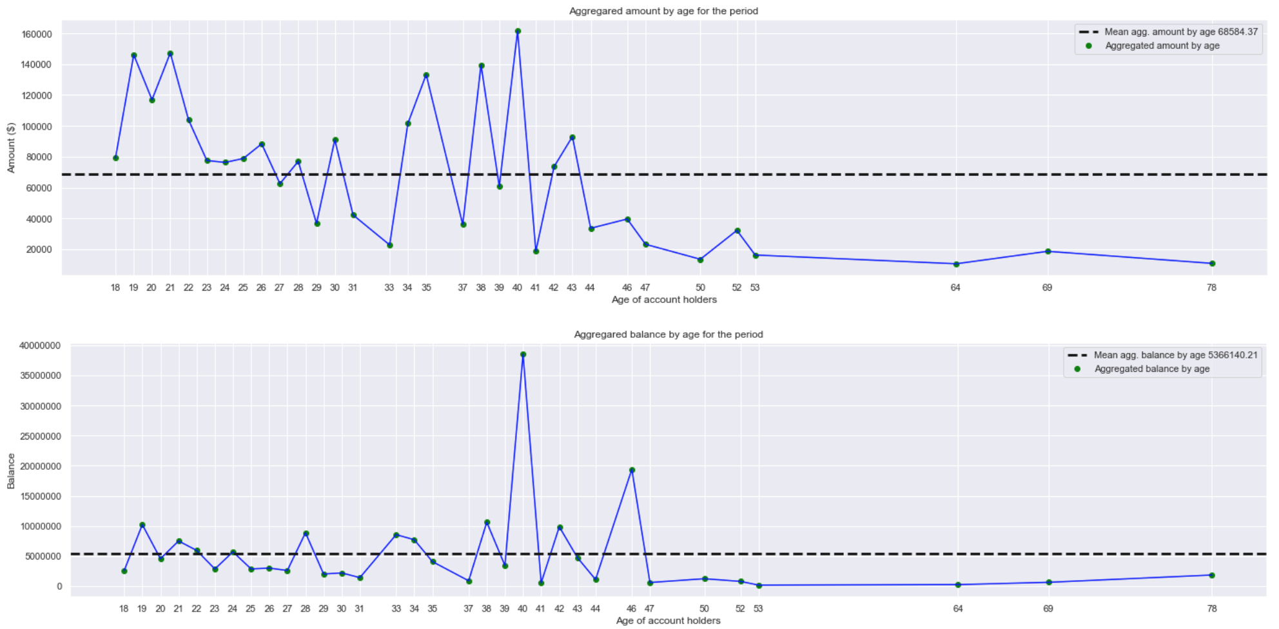
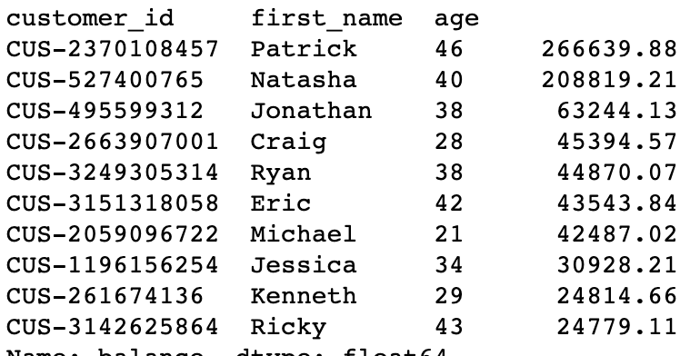
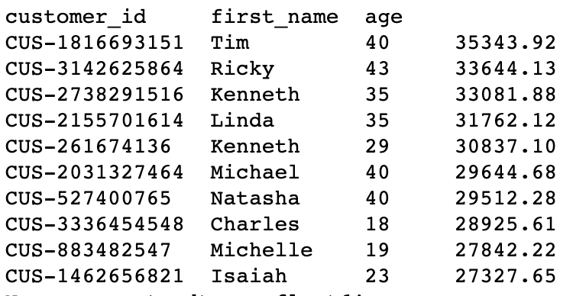
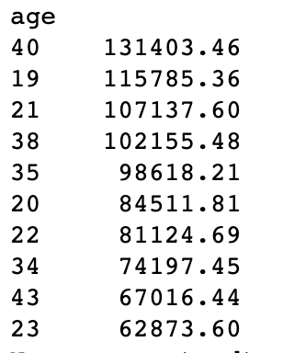
These charts show aggregated amount spent (top) and balance (bottom) of customers by age.
Customers with the age 40 spent most amount as well as have most balance compared to customers with other ages.
Below analysis shows top 10 customers with highest balance at the end of the period (31/10/2018); top 10 customers with highest pay/salaries and top 10 age group with most pay/salaries paid for the whole period.
We can see that the pay is directly related to the balance amount.
Top 10 customers with highest balance on 31/10/2018
Top 10 customers with highest pay/salaries
Top 10 ages with highest salaries

Slide 4
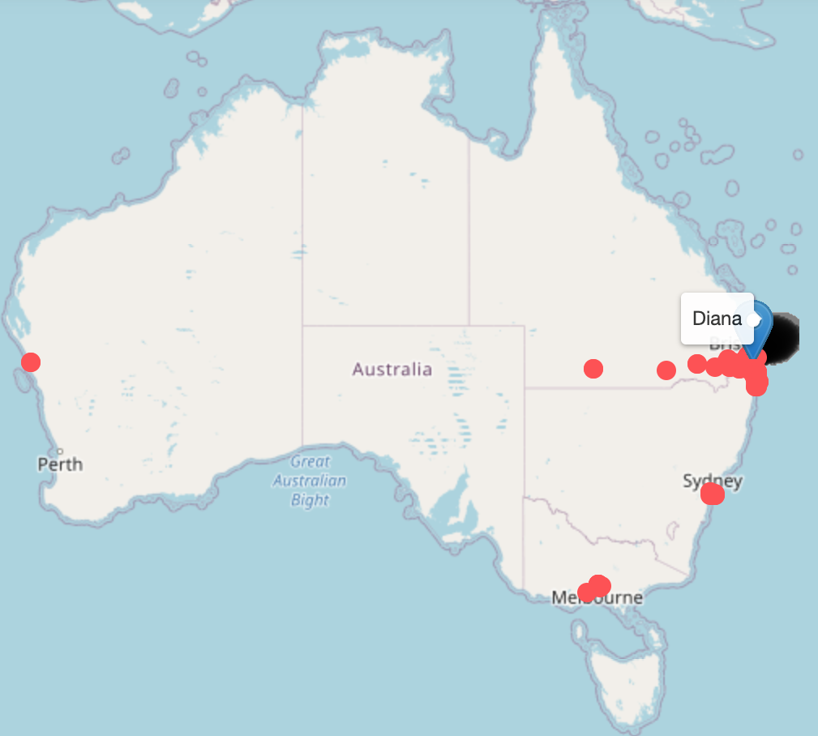
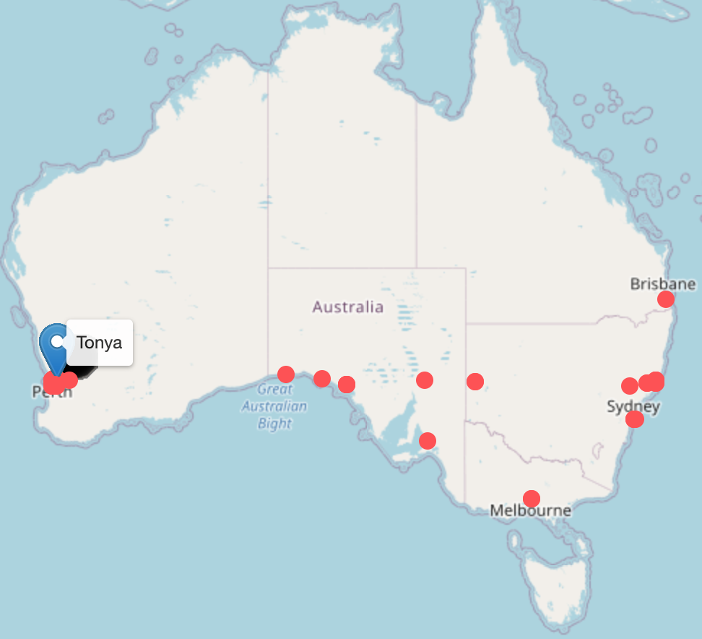
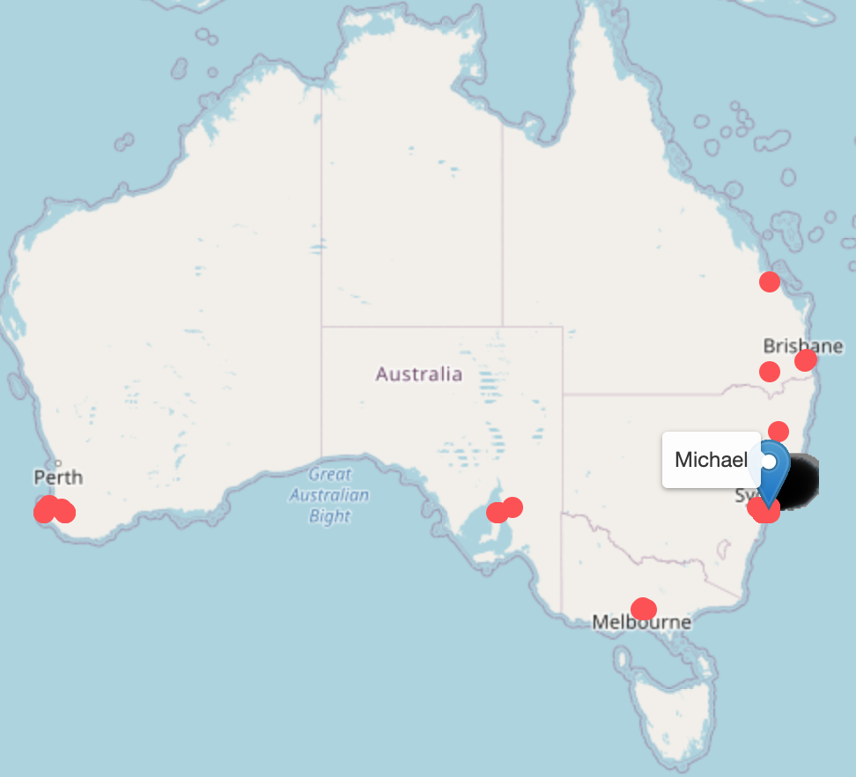
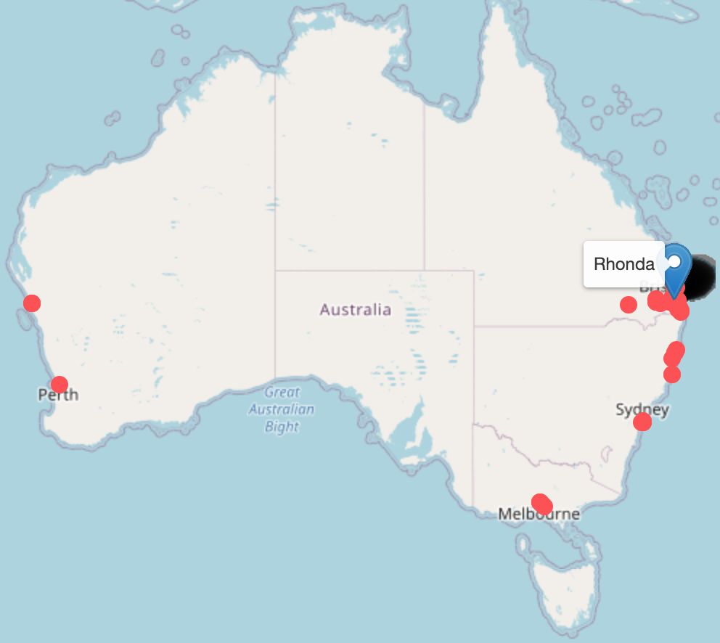
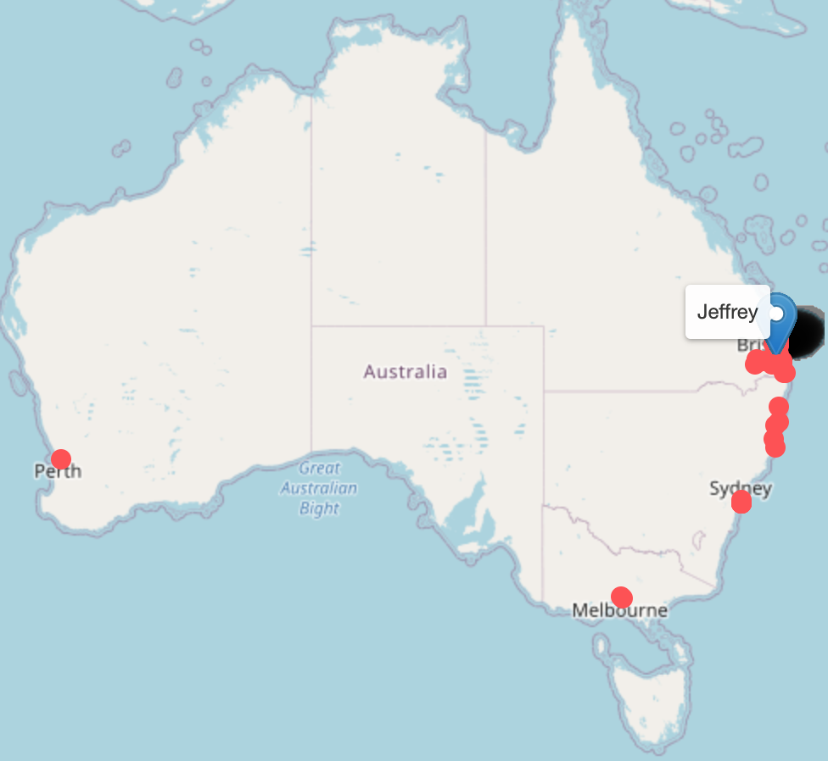
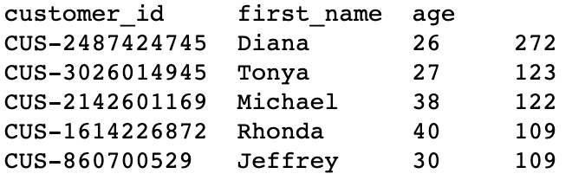
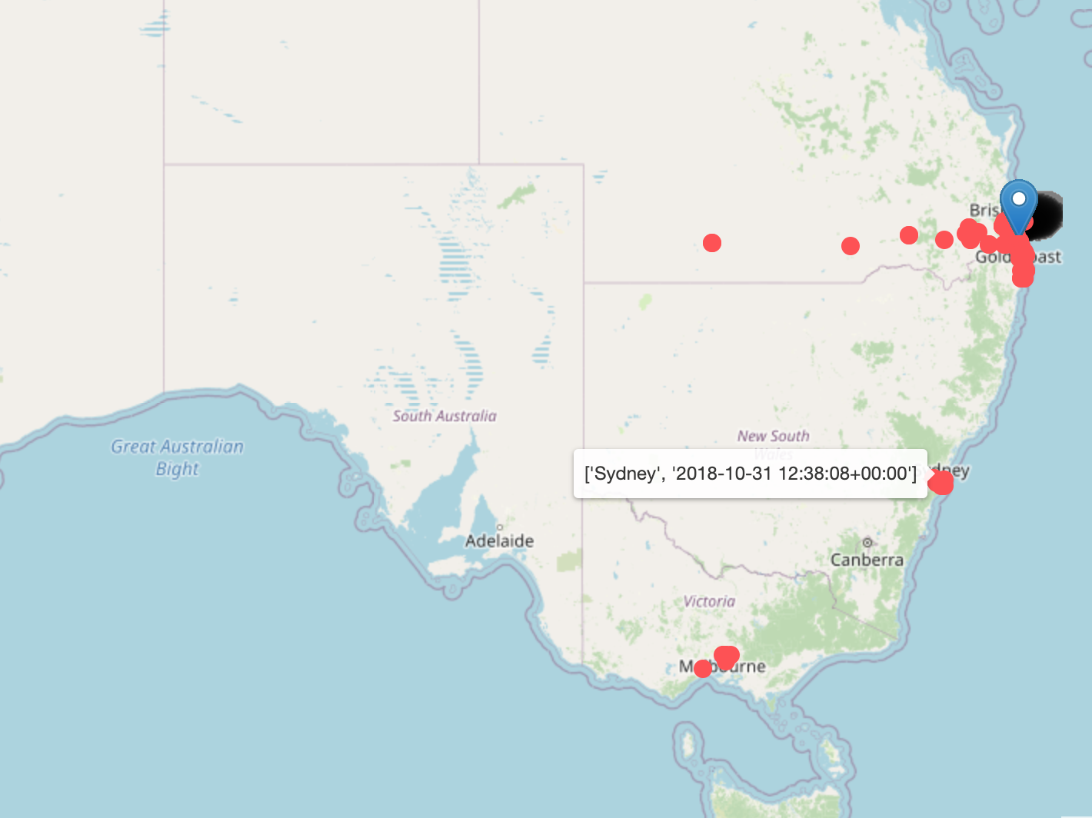


These maps show top 5 customers with most ‘POS/POS SALE’ transaction by volume (above).
We can see that the customers with most POS SALE transactions are travelling customers as we can see their footprint of transactions all over Australia.
The map on the right shows POS SALE transactions of Diana, as highlighted on the map we can see that Diana has a transaction stamp at Sydney at 12:38 PM and then at Geelong at 2:42 PM on the same day. From this we can conclude that Diana travelled from Sydney to Geelong.
This type of analysis can be useful to investigate fraud complaints.

