Slide 1
COMPARISON BETWEEN DIFFERENT FEATURE EXTRACTION TECHNIQUES FOR SPEAKER IDENTIFICATION SYSTEM
By : - AYUSHI VAISHNAVA(B120203014)
BORSE ROSHNI RAJENDRA(B120203031)
SARODE PALLAVI MAROTI(B120203189)
Internal Guide : - Prof. (Mrs) B.V.PATHAK
Sponsor : - SELF SPONSORED
Academic Year: - 2015-16
Department of Electronics & Telecommunication
M.K.S.S.S’s Cummins College of Engineering Karvenagar , Pune-411052

Slide 2
Contents
Introduction
Objective
Literature Survey
Feature Extraction Techniques
Block Diagrams
Matching Technique
Result Table
Applications
Conclusion
References / Bibliography
Work Plan

Slide 3
1)INTRODUCTION
Speaker Recognition
Identification of person from characteristics of voices.
i.e Voice Biometrics
Speaker verification
Its a one-to-one match process.
Eg : In passport presentation.
Speaker identification
Its a one-to-many process.
Eg: fingerprint recognition

Slide 4
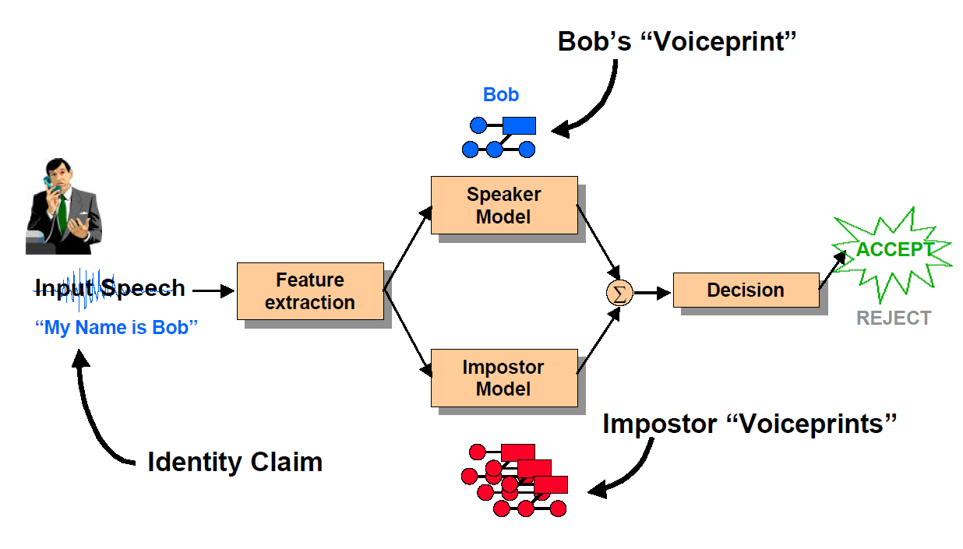
Components of a speaker Recognition system

Slide 5
TEXT-DEPENDENT vs TEXT-INDEPENDENT
1. Text-Dependent:
For enrollment & testing - text is same.
2. Text-Independent:
For enrollment & testing – text is different.

Slide 6
2) OBJECTIVE-
Our proposed work consists of truncating a recorded voice signal, framing it, passing it through a window function, calculating the Short Term FFT, extracting its features and matching it with a stored template.
Perceptual Linear Prediction (PLP), Linear Predictive Coding (LPC) and Mel frequency Cepstral Coefficients (MFCC) are applied for feature extraction purpose followed by codebook generation and Euclidean Distance is applied for matching purposes.

Slide 7
LITERATURE SURVEY-
[ 1] MFCC & LPC is feature extraction techniques ,VQ & Euclidean distance is used for matching.
[2] MFCC & LPC is feature extraction techniques.
[3] MFCC & DWT are feature extraction techniques , Euclidean distance used for matching.
[4] MFCC is feature extraction techniques ,VQ & Euclidean distance &DTW is used for matching.

Slide 8
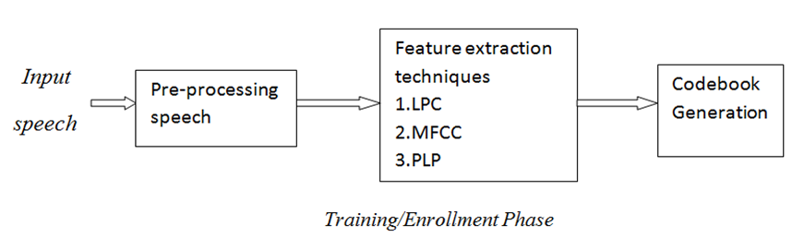
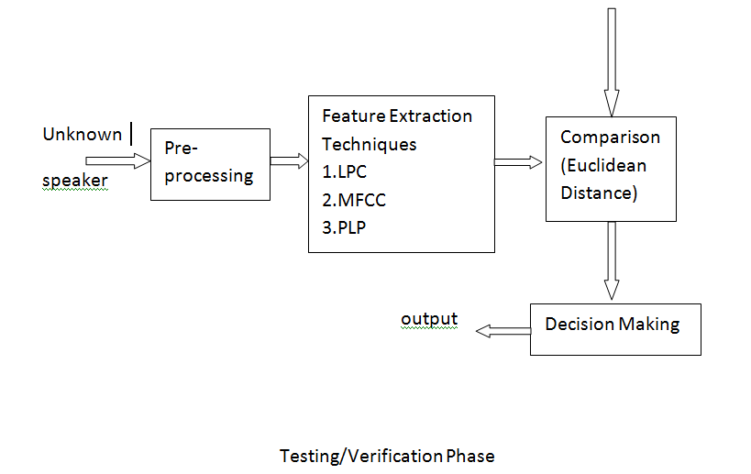

Slide 9
PRE-PROCESSING-
FRAMING-
-Split speech into frames to achieve stationarity.
WINDOWING-
-To avoid discontinuity.
-Hamming Window is used .

Slide 10
FEATURE EXTRACTION TECHNIQUES-
1-LINEAR PREDICTIVE CODING (LPC)
2-MEL-FREQUENCY CEPSTRAL COEFFICIENTS (MFCC)
3-PERPETUAL LINEAR PREDICTION(PLP)

Slide 11
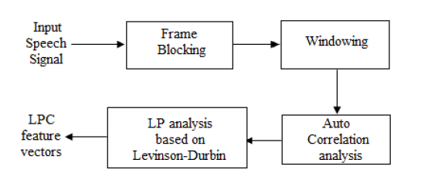
BLOCK DIAGRAMS – 1.LPC-

Slide 12
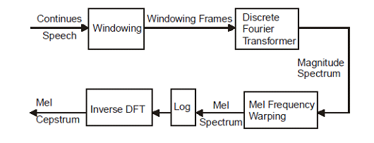
2.MFCC-

Slide 13
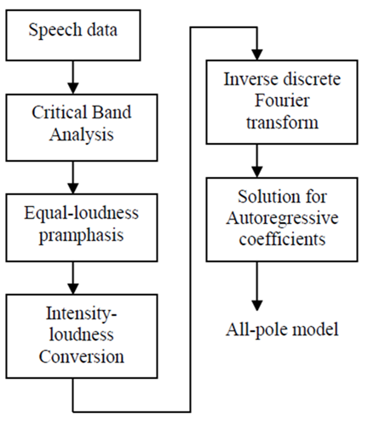
3.PLP-

Slide 14
Modelling Techniques
Vector Quantization (VQ)
Used in generation of codebook.

Slide 15

TECHNIQUES OF FEATURE MATCHING-
Distance Measure
The Euclidean distance between two points P = (p1, p2…pn) and Q = (q1, q2...qn),
The speaker with the lowest distortion distance is chosen to be identified as the unknown person.

Slide 16
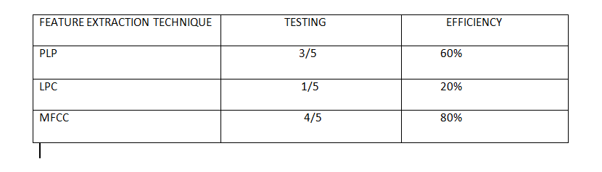
RESULT TABLE-

Slide 17
APPLICATIONS:
Voice dialling
Telephone shopping
Database access services
Information and reservation services
Security control for confidential information

Slide 18
CONCLUSION:
We have implemented all 3 feature extraction techniques namely MFCC,LPC and PLP and matching all using Euclidian distance .
We concluded that MFCC is the most efficient method as compared to other 2 techniques.

Slide 19
BIBILOGRAPHY-
[1]Dr. Shaila D. Apte-Speech and Audio Processing , Wiley India Second Edition
[2]Campbell, J.P., Jr. “Speaker recognition a tutorial” Proceedings of the IEEE, vol. 85, no. 9, Oct 1997.
[3] J. He, L. Liu and G. Palm, “A discriminative training algorithm for VQ-based speaker
[4]Vibha Tiwari “MFCC and its applications in speaker recognition ”.
[5]H. B. Chauhan, Prof. B. A. Tanawala -“Comparative Study of MFCC and LPC Algorithms for Gujrati Isolated Word Recognition”.
[6]Pravinkumar Premakanthan & Wasb. B. Mikhael-” SPEAKER VERIFICATION/RECOGNITION AND THE IMPORTANCE OF SELECTIVE FEATURE EXTRACTION: REVIEW”

Slide 20
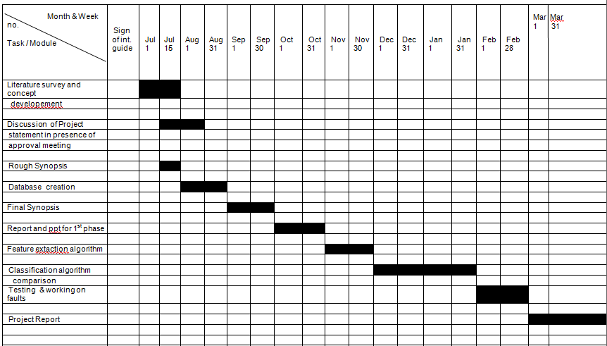

Slide 21
Thank You !

