Slide 1
Multi-Domain Intelligent Assistant with Supervisor Agent Architecture
Rosh Sreedharan
Dhruv Chaudhry
Natural Language Processing (Spring, 2026)

Slide 2
Why This Matters
NLP systems are evolving from simple question answering to multi-step, decision-making assistants
Most current systems rely on monolithic RAG architectures (one model, one knowledge base)
These systems struggle when handling multiple domains simultaneously
Result:
Irrelevant document retrieval
Weak domain understanding
No recovery when retrieval fails
As real-world use cases grow, there is a need for more structured, intelligent architectures

Slide 3
Context and Introduction
NLP systems are moving beyond simple Q&A into multi-step task execution
Real-world assistants need to plan, retrieve, reason, and self-correct
Standard RAG systems usually rely on one model and one shared knowledge base
This creates issues when handling very different domains in one system
Our project builds a multi-domain intelligent assistant for:
Industrial troubleshooting
Recipe assistance
Scientific paper summarization
Cross-domain synthesis
Web-search fallback
We use a supervisor agent to route each query to the right specialist agent
The goal is to test whether this architecture improves accuracy, retrieval quality, and reliability compared to a single general RAG system

Slide 4
Problem and Challenges
Standard RAG systems use one general pipeline for all queries
This causes problems when questions come from different domains
A query can be misunderstood or routed to the wrong type of information
Main challenges:
Cross-domain contamination: unrelated documents may be retrieved
Ambiguous queries: one question can fit multiple domains
Domain-specific terminology: fault codes, recipes, and research terms require different handling
Weak retrieval quality: irrelevant documents can lead to poor answers
Hallucination risk: the model may generate unsupported information
Latency: multiple retrieval and correction steps can slow the system
Core problem: Can a supervisor-based multi-agent RAG system outperform a single monolithic RAG system in accuracy, retrieval quality, hallucination reduction, and task completion?

Slide 5
Related solutions / State of Art
Three lines of related work motivate this design
Retrieval-Augmented Generation (Lewis et al., NeurIPS 2020)
Retrieves external documents before generation — but does not check retrieval quality
Corrective RAG / CRAG (Yan et al., 2024)
Adds a relevance-checking step; rewrites weak queries and retries — works as a plug-in pipeline
Self-RAG (Asai et al., ICLR 2024)
Model critiques its own output via reflection tokens — but requires fine-tuning
Supervisor-based multi-agent systems (AutoGen — Wu et al., 2023; HuggingGPT — Shen et al., 2023)
Central LLM routes tasks to specialists — but mainly scaled by tools, not by knowledge domains
Modular RAG (Gao et al., 2024) — reconfigurable retrieval, but no multi-domain routing
Our gap: few systems combine supervisor routing + domain-isolated retrieval + CRAG across heterogeneous domains (industrial · recipes · scientific papers)

Slide 6
Overview of Solution / Contributions
We propose a multi-domain intelligent assistant built around a supervisor-agent design
The supervisor identifies user intent and routes the query to the correct route
Three domain specialist agents:
Industrial Troubleshooting · Recipe Assistant · Scientific Paper Summarizer
Two safety routes (covered in detail on slide 9):
Synthesis Agent — fuses CRAG outputs across domains for cross-domain queries
Web-Search Fallback Agent — handles out-of-scope queries via Tavily / DDGS
Each specialist has its own ChromaDB collection (no cross-domain contamination)
All answer-producing routes share a Corrective RAG pipeline (grade · rewrite · retry · generate)
Main contribution: test whether routing + domain isolation + CRAG beats a single monolithic RAG on routing accuracy, retrieval precision, hallucination, and task completion

Slide 7
Data Collecting
The project uses data from three separate domains to test multi-domain performance
Industrial troubleshooting:
Rockwell Automation manuals and Logix troubleshooting articles
Recipe assistance:
Food.com recipe dataset
Scientific paper summarization:
ArXiv API for paper abstracts and metadata
Each domain has its own data source and knowledge base
Lets us compare domain-isolated retrieval against a single shared vector-store baseline

Slide 8
Data Preprocessing
Each domain requires its own preprocessing before retrieval
Industrial data: Extract fault codes, equipment model numbers, parameter IDs, and technical abbreviations
Recipe data: Clean ingredients, normalize recipe steps, and organize nutrition/rating fields
Scientific data: Parse paper titles, abstracts, authors, keywords, and metadata from ArXiv
Documents are then chunked, embedded, and stored in domain-specific ChromaDB collections
Goal: improve retrieval accuracy by making each knowledge base cleaner, more searchable, and domain-aware.

Slide 9
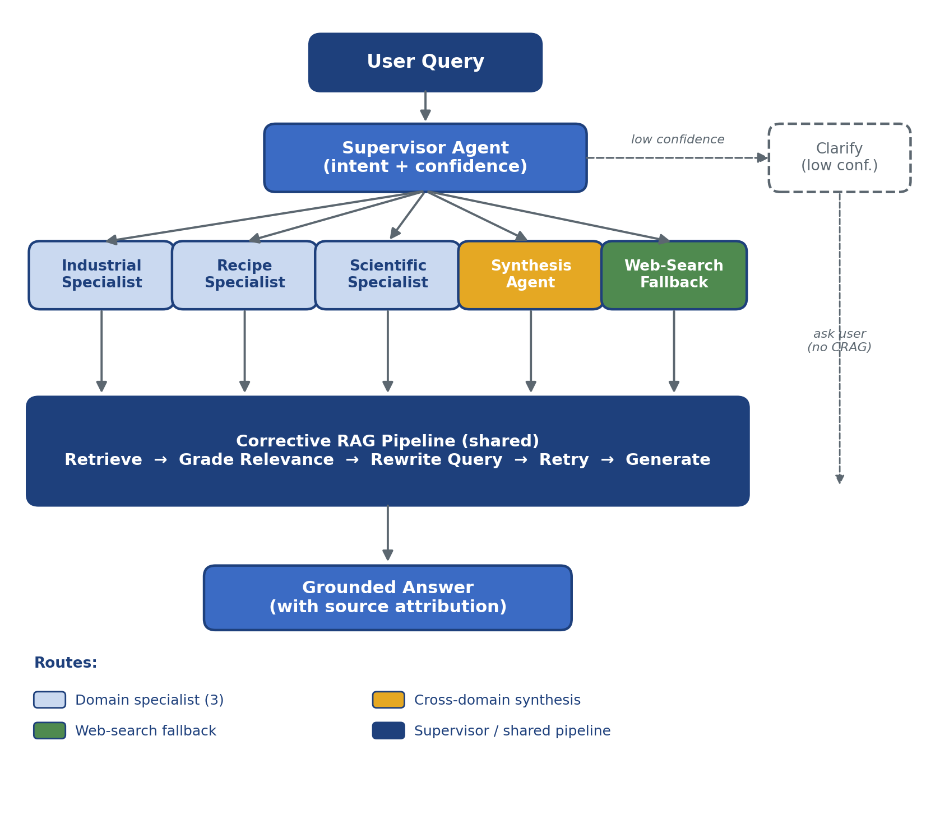
Methodology
User query first goes to the supervisor agent
Supervisor classifies into one of three domains:
Industrial · Recipe · Scientific
High confidence → route to specialist agent
Low confidence → ask a clarification question
Cross-domain query → Synthesis Agent fuses results from multiple domains
Out-of-scope query → Web-Search Fallback Agent (Tavily / DDGS)
Each specialist runs a Corrective RAG pipeline:
Retrieve → Grade → Rewrite → Retry → Generate

Slide 10
Models selection and parameters
LLM (primary): Gemini 2.5 Flash — supervisor routing, document grading, query rewriting, synthesis, fallback, response generation
LLM (local failover): Gemma 3 12B — keeps the system operational when the API is unreachable
Routing — two-tier text classification:
Tier 1: lightweight lexical / keyword text classifier (rule-based, no LLM call) — handles obvious queries cheaply
Tier 2: LLM-based zero-shot supervisor — handles ambiguous queries; emits domain + confidence + second-choice
Embedding model: GTE-Large (1024-dim vectors)
Vector database: ChromaDB with separate collections per domain
No model fine-tuning — reliability comes from retrieval grading, domain prompts, and source grounding
Data augmentation: CRAG query rewriting + domain-specific terminology expansion
Tuning parameters:
Routing confidence threshold · Lexical-router threshold · Top-k retrieval · Max 2 rewrite attempts · Per-agent prompt tuning

Slide 11
Setup, Validation, and Testing
This project does not train a large language model — focus is the architecture, not fine-tuning
Setup:
Build domain-specific vector stores
Write supervisor and specialist prompts
Assemble CRAG retrieval and query-rewrite pipeline
Validation:
Tune routing confidence threshold
Check retrieval quality from each domain database
Adjust top-k retrieval and rewrite-attempt cap
Testing:
150 evaluation queries total, 50 per domain (industrial · recipe · scientific)
Mix of routine, ambiguous, adversarial, cross-domain, and out-of-scope queries
Compare multi-agent system vs. single monolithic RAG baseline
Goal: measure routing accuracy, retrieval precision, hallucination rate, and task completion

Slide 12
Evaluation & Performance Comparison
Evaluated against a monolithic RAG baseline that holds everything constant except the architecture
Baseline system:
Same LLM (Gemini 2.5 Flash), same embedding model (GTE-Large), one shared ChromaDB store
No supervisor routing · no corrective retrieval · no synthesis · no fallback
Evaluation dataset:
150 total queries (50 per domain)
Routine, ambiguous, adversarial, cross-domain, and out-of-scope questions
Performance metrics:
Routing Accuracy: does the supervisor pick the right route (or correctly clarify)?
Precision@5: are the top retrieved documents actually relevant?
Hallucination Rate: does the answer stay supported by sources?
Task Completion Rate: did the user get a useful, grounded answer?
Main comparison: does supervisor routing + domain isolation + CRAG improve reliability over a single general RAG pipeline?

Slide 13
Expected Outcomes & Findings
Hypothesis: the multi-agent system outperforms the monolithic RAG baseline on all four metrics
Higher routing accuracy — supervisor sends queries to the correct domain agent (or correctly clarifies)
Better retrieval precision — each domain has its own isolated knowledge base
Lower hallucination rate — CRAG grades retrieved documents before generating answers
Higher task completion — weak retrievals get rewritten and retried; synthesis handles cross-domain queries; fallback handles out-of-scope queries safely
Main expected finding:
Domain specialization + corrective retrieval = more reliable NLP responses across heterogeneous query types — architecture matters as much as model choice
Forward-looking: the same architecture is designed to extend to a multi-turn task-completion agent — supervisor routing, tool use, retry, and fallback are the substrate; planning and stateful execution are the natural next layer (see Future Work)

Slide 14
Lessons learned and Perspectives
Multi-domain NLP systems need more than a strong language model
Architecture matters: routing, domain separation, and retrieval correction can improve reliability
Domain-specific preprocessing helps the system better understand technical terms, recipe details, and research metadata
CRAG adds value by reducing weak retrieval and unsupported responses
Main tradeoff: more correction steps can improve accuracy but may increase response time
The architecture is a reusable substrate for agentic systems — not just RAG
Future improvements:
Extend to a multi-turn task-completion agent — add a planning layer + stateful execution on top of the existing supervisor / specialists / CRAG / fallback substrate (e.g., diagnose-then-guide-fix for industrial; multi-meal recipe planning with constraint tracking)
Add more domains and grow the synthesis / fallback coverage
Optimize latency — cache grader / hallucination-checker calls; explore the optional fine-tuned grader / router as a faster Tier-2
Better-calibrated routing confidence thresholds
Broader real-world evaluation beyond the curated 150-query set

Slide 15
Bibliographical References
Lewis, P. et al. Retrieval-Augmented Generation for Knowledge-Intensive NLP Tasks. NeurIPS 2020.
Yan, S.-Q. et al. Corrective Retrieval Augmented Generation (CRAG). arXiv:2401.15884, 2024.
Asai, A. et al. Self-RAG: Learning to Retrieve, Generate, and Critique through Self-Reflection. ICLR 2024.
Wu, Q. et al. AutoGen: Enabling Next-Gen LLM Applications via Multi-Agent Conversation. arXiv:2308.08155, 2023.
Shen, Y. et al. HuggingGPT: Solving AI Tasks with ChatGPT and its Friends in Hugging Face. NeurIPS 2023.
Gao, Y. et al. Modular RAG: Transforming RAG into a LEGO-like Reconfigurable Framework. arXiv:2407.21059, 2024.
Li, Z. et al. Towards General Text Embeddings (GTE). arXiv:2308.03281, 2023.
Google DeepMind. Gemini 2.5 Flash Technical Report. 2025. · Gemma 3 Technical Report. 2025.
LangGraph Documentation — multi-agent orchestration. langchain-ai.github.io/langgraph
Chroma. ChromaDB — open-source embedding database. trychroma.com
Food.com Recipes & Interactions Dataset (Kaggle / Food.com) · ArXiv API — arxiv.org/help/api · Rockwell Logix 5000 troubleshooting docs

Slide 16
Demo !
Live demonstration of the deployed system
Planned queries (watch routing + source attribution):
Industrial — fault code or PLC question
Recipe — substitution or technique
Scientific — paper summarization
Ambiguous query → triggers clarify
Cross-domain query → triggers synthesis
Out-of-scope query → triggers web-search fallback
What to watch for: the supervisor's routing decision and the per-source attribution in the final answer — that's the architecture working in real time.

