Slide 1

DBIT / DEPARTMENT OF INFORMATION TECHNOLOGY / SEM V / 2026-2027
6
DocConnect : Healthcare Appointment System
with DevOps Automation
SDG 3 (Good Health & Well-being) • SDG 9 (Industry, Innovation & Infrastructure) • SDG 12 (Responsible Consumption)
Project Team Members (Group 6):
• Roll 13 — Simone D’sa | P4: Kubernetes Orchestration & Scaling
• Roll 18 — Shraddha Hebbar | P3: AWS Cloud & Terraform IaC
• Roll 34 — Roshell Miranda | P1: Full Stack Application & Git Repository Owner
• Roll 37 — Kalanidhi Namboothiri | P2: Docker Containerization & Jenkins CI/CD

Slide 2
DBIT/IT/V/25IT5CEP3/DevOps-MiniProject
6
Problem Statement
Operational Challenges in Small Healthcare Clinics
• Manual & Paper-Based Workflows: Small healthcare providers and community clinics frequently rely on spreadsheets or uncoordinated manual systems, resulting in double-booking and appointment record loss.
• Absence of In-House DevOps: Most local clinics and NGOs lack dedicated IT or DevOps personnel, leading to slow, error-prone manual recovery whenever systems fail.
• Traffic Surges & Inelasticity: Patient bookings experience severe spikes during seasonal epidemics (e.g., flu season) and morning reservation hours. Static manual infrastructure cannot dynamically scale up to meet demand nor scale down to cut costs.
• Compromised Continuity of Care: Server downtime directly impacts patient access to specialists, increasing wait times and emergency room congestion.
Deployment Inefficiencies & Infrastructure Gaps
• Environment Inconsistency ('Works on my Machine'): Deploying backend and database services manually onto virtual machines introduces dependency mismatches and unpredictable runtime bugs.
• Absence of Automated CI/CD: Bug fixes and feature updates require manual terminal intervention, risking configuration drifts, faulty releases, and service interruption.
• Single Points of Failure: Traditional monolithic deployments lack automated liveness monitoring, leading to undetected outages until patients complain.
• The DocConnect Solution: A containerized, automated healthcare appointment system orchestrated via Kubernetes and Jenkins CI/CD to provide self-healing, elasticity, and zero-downtime maintenance.
2

Slide 3
DBIT/IT/V/25IT5CEP3/DevOps-MiniProject
6
Objectives & Outcomes
01 | Full-Stack Healthcare Application
Objective: Develop a modular React 19, Express REST API, and PostgreSQL system for end-to-end appointment scheduling, specialist lookup, and status tracking.
Status & Outcome: [IMPLEMENTED] Full-stack application functional with live database, validation & health probes.
02 | Docker Containerization
Objective: Package frontend and backend services into isolated, reproducible multi-stage Docker images to guarantee deployment parity across development and production.
Status & Outcome: [IMPLEMENTED / PACKAGED] Dockerfile definitions configured for frontend and backend microservices.
03 | Automated Jenkins CI/CD Pipeline
Objective: Construct an automated pipeline triggered on code commit to execute test suites, build container images, and execute rolling cloud deployments without manual intervention.
Status & Outcome: [PIPELINE DESIGNED] Pipeline stages (Checkout -> Test -> Build -> Deploy) scripted in Jenkinsfile.
04 | Terraform Cloud Provisioning (IaC)
Objective: Define and provision reproducible AWS cloud networking, IAM security roles, and managed compute/Kubernetes infrastructure as version-controlled code.
Status & Outcome: [IaC ARCHITECTED] Terraform configuration blueprint structured for AWS cloud provisioning.
05 | Kubernetes Resilience & Autoscaling
Objective: Ensure high availability and fault tolerance through Horizontal Pod Autoscaler (HPA) during traffic spikes and self-healing pod recovery upon failure.
Status & Outcome: [CONFIGURED / PROBES READY] Express /health probe integrated; K8s manifests configured.
3

Slide 4
DBIT/IT/V/25IT5CEP3/DevOps-MiniProject
6
Literature Review — Cloud-Native Healthcare & Telehealth
Paper 01: Cloud Native Technologies for Healthcare Scalability
Citation: V. Salunkhe et al., 'The Impact of Cloud Native Technologies on Healthcare Application Scalability and Compliance,' IJPREMS, 2021. [1]
Overview: Investigates how cloud-native tooling (Docker, Kubernetes) addresses uptime, security compliance, and fluctuating patient demand in clinical applications.
Key Findings & Metrics:
• Containerization ensures deployment consistency across environments.
• Kubernetes orchestration achieves automated horizontal scaling and high availability.
• CI/CD pipeline integration significantly shortens release and patch cycles.
Research Gap & How DocConnect Addresses It:
Existing research primarily provides conceptual frameworks for compliance and scalability but lacks an end-to-end, functional reference implementation. DocConnect provides a practical full-stack appointment system integrated with an automated DevOps toolchain.
Paper 02: DevOps Adoption for Telehealth Services
Citation: N. Vemuri, 'DevOps for Telehealth Services: Accelerating Deployment and Scalability,' IJRITCC, 2024. [2]
Overview: Focuses on adopting automated CI/CD and Infrastructure-as-Code (IaC) to handle explosive user growth in modern telehealth platforms.
Key Findings & Metrics:
• Automated infrastructure provisioning reduces deployment bottlenecks.
• Continuous integration accelerates zero-downtime maintenance.
• Automated monitoring enables healthcare platforms to support expanded patient populations.
Research Gap & How DocConnect Addresses It:
Literature identifies a severe shortage of practical integrations combining real appointment booking workflows with declarative IaC (Terraform) and container CI/CD. DocConnect validates this integration with concrete REST APIs.
4

Slide 5
DBIT/IT/V/25IT5CEP3/DevOps-MiniProject
6
Literature Review — Deployment Efficiency & Microservices
Paper 03: Deployment Automation & Operational Reliability
Citation: J. Oluwaseyi, 'DevOps in the Context of Telehealth Services: Streamlining Deployment and Enabling Scalability,' SSRN Electronic Journal, 2023. [3]
Overview: Examines how automated testing, CI/CD pipelines, and health monitoring improve service reliability and reduce operational deployment friction.
Key Findings & Metrics:
• Automated pipelines drastically reduce human errors during production releases.
• Comprehensive test suites prevent regression bugs in appointment workflows.
• Proactive health monitoring lowers Mean Time to Recovery (MTTR).
Research Gap & How DocConnect Addresses It:
Most publications remain conceptual and omit live cloud orchestrator implementations. DocConnect incorporates health probes (/health) and automated Jest test suites into the deployment pipeline.
Paper 04: Cloud-Based Microservices for Healthcare
Citation: J. I. Akerele et al., 'Improving Healthcare Application Scalability Through Microservices Architecture in the Cloud,' IJSRU, 2024. [4]
Overview: Compares monolithic vs. microservice healthcare software architectures under heavy patient load conditions.
Key Findings & Metrics:
• Microservice decoupling enables granular scaling of bottlenecked services.
• Isolated service failures prevent complete clinical application outages.
• Decoupled databases provide superior transactional isolation.
Research Gap & How DocConnect Addresses It:
Prior literature concentrates on high-level architecture diagrams with minimal focus on automated provisioning. DocConnect decouples React frontend, Express API, and PostgreSQL with independent container lifecycle definitions.
5

Slide 6
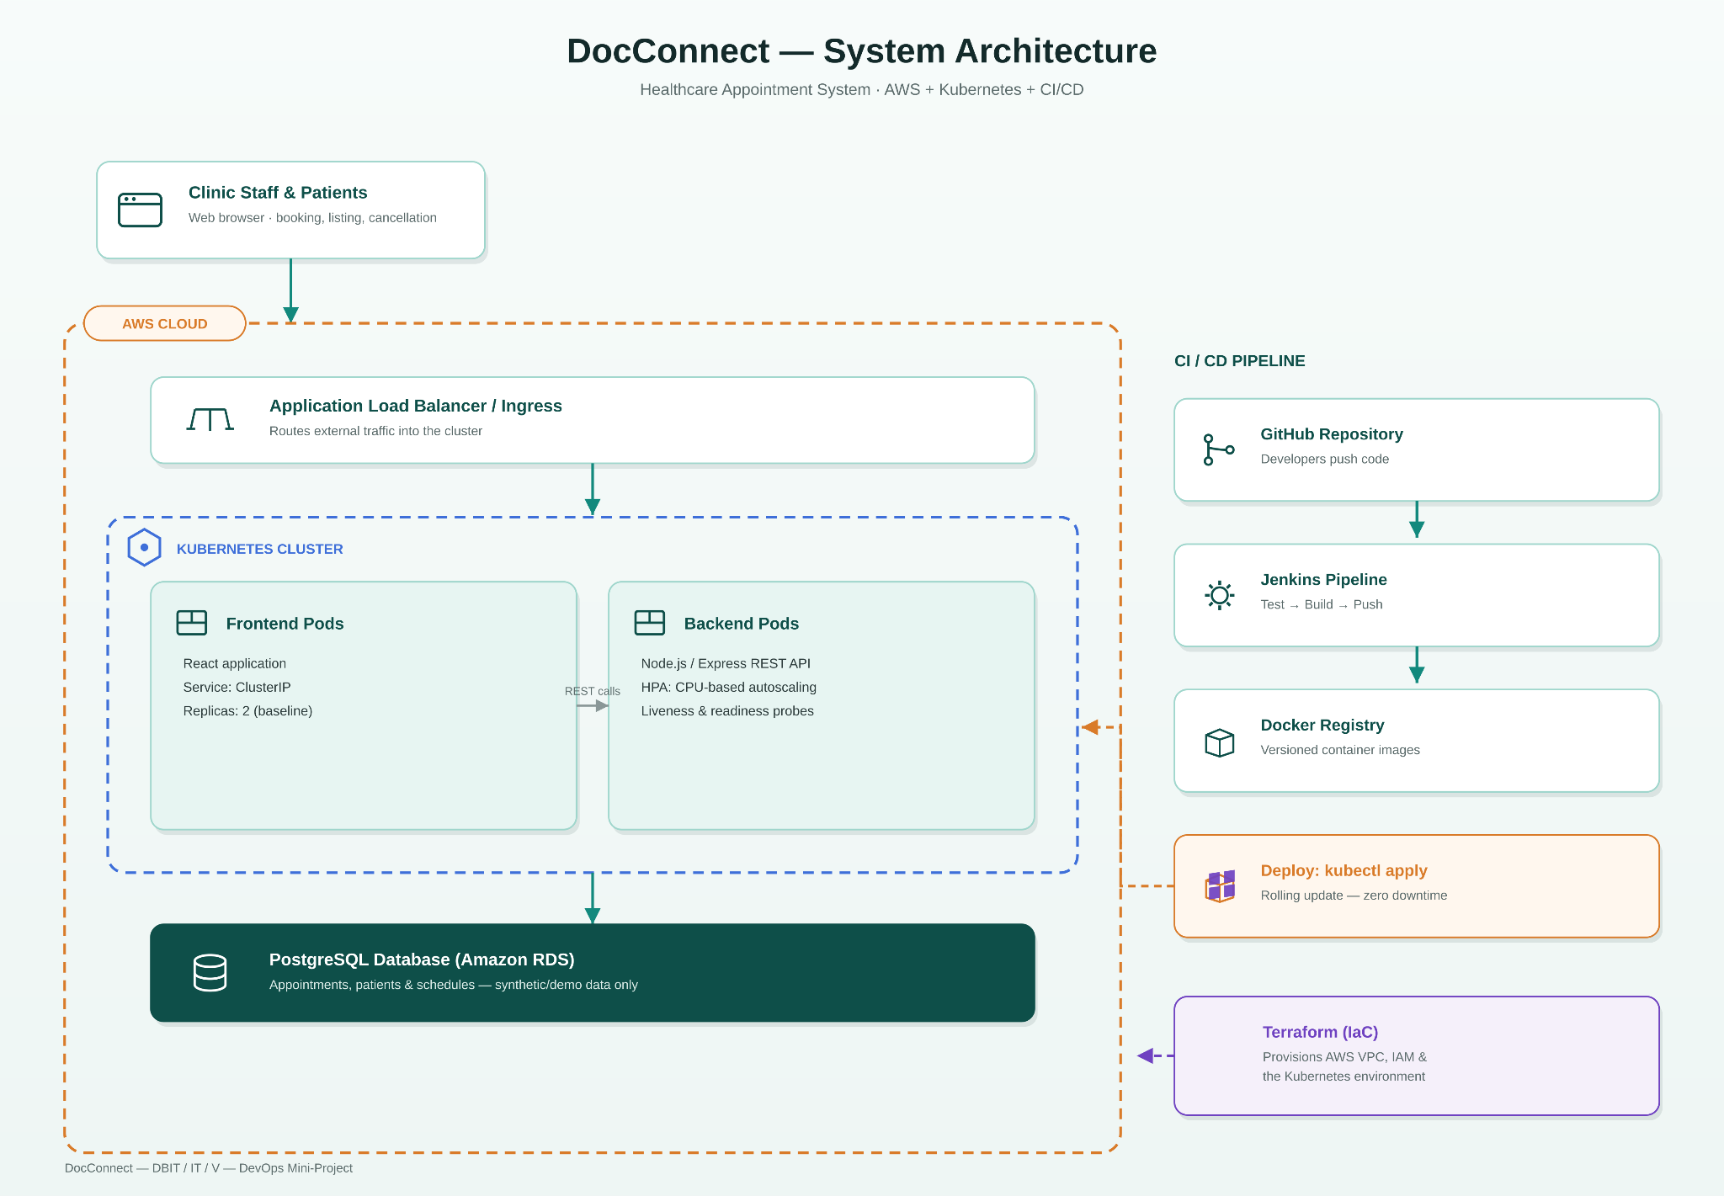
DBIT/IT/V/25IT5CEP3/DevOps-MiniProject
6
DocConnect — System Architecture & Cloud Topology
Architectural Highlights
1. User Presentation Layer (React 19 + Vite):
• Clean client portal for booking, cancellation, and viewing doctor credentials.
• Communicates over HTTP REST to Node.js backend.
2. Application Logic Layer (Express.js REST API):
• Stateless backend handling appointment slots, authentication, and validation.
• Exposes GET /health probe for Kubernetes liveness & readiness.
3. Data Persistence Layer (PostgreSQL Database):
• Relational tables for users and appointments with ACID transaction guarantees.
• Indexed queries preventing double-booking.
4. Automated DevOps & Deployment Plane:
• GitHub repository triggers Jenkins CI/CD pipeline.
• Terraform provisions AWS networking and EKS cluster.
• Kubernetes orchestrates pods, HPA autoscaling, and self-healing.
6

Slide 7
DBIT/IT/V/25IT5CEP3/DevOps-MiniProject
6
DocConnect — DevOps Toolchain & Lifecycle Workflow
Tool | DevOps Stage | Project Role & Technical Implementation | Status
Git | Version Control | Tracks code revisions, branching strategy, and atomic commits across modules. | IMPLEMENTED
GitHub | Code Repository | Central repository hosting frontend, backend, database schema, and DevOps configs. | IMPLEMENTED
Jenkins | CI/CD Automation | Automates code checkout, Jest test execution, Docker build, and deployment triggers. | CONFIGURED
Docker | Containerization | Multi-stage Dockerfiles packaging React SPA and Node.js backend into slim images. | IMPLEMENTED
PostgreSQL | Database Layer | Relational persistence with connection pooling, indexes, and schema migrations. | IMPLEMENTED
Terraform | Infrastructure as Code | Declaratively provisions AWS VPC, subnets, security groups, and EKS cluster. | CONFIGURED
AWS (EKS/RDS) | Cloud Infrastructure | Enterprise cloud platform providing managed Kubernetes and managed PostgreSQL. | CONFIGURED
Kubernetes | Container Orchestration | Manages pod replicas, /health probes, service routing, and self-healing. | CONFIGURED
7

Slide 8
DBIT/IT/V/25IT5CEP3/DevOps-MiniProject
6
Process 1: Automated Cloud CI/CD Pipeline Workflow
01
Source Control
Tool:
GitHub Repository
Workflow:
Developer pushes feature or bug fix commit to repository branch.
02
CI Trigger
Tool:
Jenkins Automation
Workflow:
Jenkins webhook detects push and initiates multi-stage Jenkinsfile pipeline.
03
Automated Testing
Tool:
Jest & Supertest
Workflow:
Runs backend test suites; halts pipeline if any test assertion or validation fails.
04
Containerization
Tool:
Docker Image Build
Workflow:
Builds optimized Docker container images for frontend and backend microservices.
05
Registry Staging
Tool:
Docker Registry
Workflow:
Tags images with commit SHA and pushes versioned artifacts to DockerHub.
06
Continuous Deploy
Tool:
Kubernetes Rollout
Workflow:
Executes kubectl apply rolling update to EKS cluster with zero downtime.
Key Benefit: Guarantees deployment reproducibility — eliminates manual server configuration and ensures every production release is test-validated.
8

Slide 9
DBIT/IT/V/25IT5CEP3/DevOps-MiniProject
6
Process 2: Local Development, Verification & Staging Flow
01
Full Stack Development
Component:
Node.js & React 19
Process:
Modular architecture with separated controllers, models, routes, and Vite frontend components.
02
Database Setup
Component:
PostgreSQL Migrations
Process:
Database schema execution via schema.sql; seeded with synthetic healthcare records via seed.sql.
03
Local Verification
Component:
Jest Test Execution
Process:
Automated API endpoint testing against mocked and live database connections (npm test).
04
Container Building
Component:
Local Docker Builds
Process:
Multi-stage Docker builds locally isolating dependencies, minimizing final image size.
05
Health Probing
Component:
/health Verification
Process:
Direct verification of PostgreSQL pool connectivity via GET /health endpoint returning JSON status.
06
Staging & Handover
Component:
Git Version Control
Process:
Clean code commits pushed to shared repository ready for Jenkins CI/CD pickup.
DevOps Principle: 'Shift-Left' quality assurance — bugs and database integration issues are caught locally before hitting cloud deployment.
9

Slide 10
DBIT/IT/V/25IT5CEP3/DevOps-MiniProject
6
Configuration Management & Deployment Architecture
Configuration Management Best Practices
1. Strict Environment Isolation (.env & ConfigMaps):
• Database credentials, JWT secrets, and CORS origins isolated from source code.
• Controlled via .env.example template for development and Kubernetes Secrets in production.
2. Parameterized Database Connection Pooling:
• pg.Pool dynamically configured for max client connections, timeout thresholds, and SSL flags.
• Seamless transition between local PostgreSQL and AWS RDS PostgreSQL.
3. Multi-Stage Container Packaging:
• Frontend build stage executes npm run build; production stage serves static assets.
• Backend Dockerfile locks node:20-alpine runtime to eliminate OS-level security risks.
4. Declarative Pipeline-as-Code:
• Jenkinsfile centrally versioned in repository ensuring identical build steps across all runners.
Deployment Architecture & Traffic Routing
1. External Ingress / Application Load Balancer:
• Terminates incoming HTTPS traffic and forwards requests to cluster ingress.
2. Frontend Microservice Tier (ClusterIP Service):
• Replicated React UI pods serving static assets and dynamic dashboard views.
3. Backend Microservice Tier (REST API Pods):
• Stateless Express.js pods mounted behind internal ClusterIP service.
• Horizontal Pod Autoscaler (HPA) monitors CPU/memory to scale from 2 to 5+ replicas.
4. Dedicated Health Monitoring & Probes:
• Kubernetes Liveness Probe checks if process is responsive.
• Readiness Probe queries GET /health ensuring DB pool is connected before routing traffic.
5. Managed Relational Storage (PostgreSQL RDS):
• Persistent storage with ACID transactions, automated backups, and encrypted storage.
Key Benefits: ✓ Zero Configuration Drift ✓ Instant Horizontal Elasticity ✓ Zero-Downtime Rolling Updates ✓ Self-Healing Resiliency
10

Slide 11
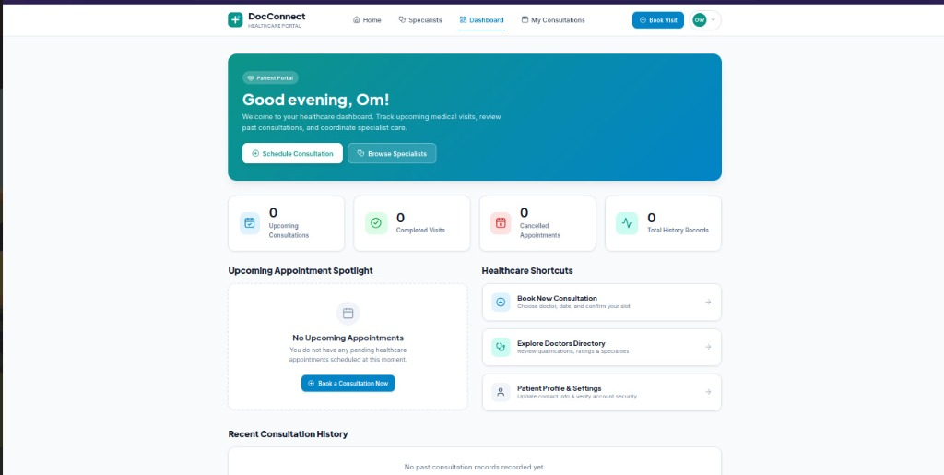
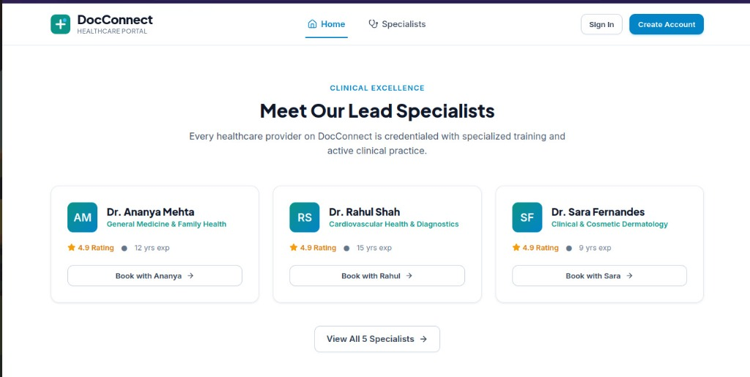
DBIT/IT/V/25IT5CEP3/DevOps-MiniProject
6
Application Implementation — Dashboard & Specialist Directory
Implemented Features (Application Layer)
Status: [IMPLEMENTED & FUNCTIONAL]
1. Interactive Patient Dashboard (Top Screenshot):
• Live metrics cards: Upcoming Consultations, Completed Visits, Cancelled Appointments, Total History Records.
• Personalized greeting banner with patient name ('Om') and account role badge.
• Upcoming appointment spotlight with direct scheduling shortcuts.
2. Lead Specialists Directory (Bottom Screenshot):
• Credentialed doctor profiles: Dr. Ananya Mehta (General Medicine, 12 yrs exp), Dr. Rahul Shah (Cardiovascular Health, 15 yrs exp), Dr. Sara Fernandes (Dermatology, 9 yrs exp).
• Star ratings, practice tags, and direct 'Book with Specialist' action button.
3. Modern React 19 Frontend:
• Responsive SaaS design with modular components, dynamic modal dialogs, and instant state updates via React hooks.
11

Slide 12
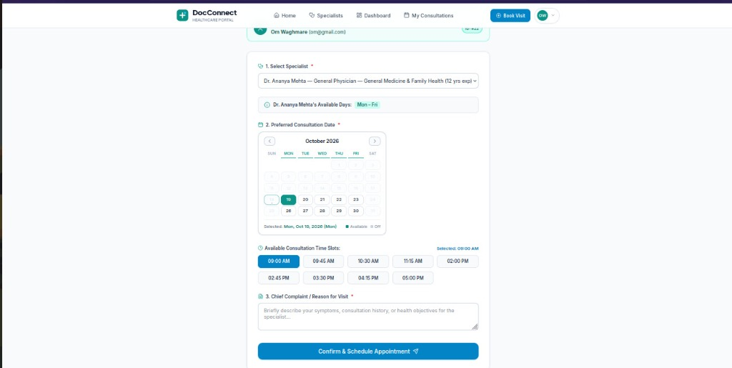
DBIT/IT/V/25IT5CEP3/DevOps-MiniProject
6
Application Implementation — Booking Modal & Data Integrity
Booking Workflow & Database Consistency
Status: [IMPLEMENTED & TESTED]
1. Multi-Step Guided Booking Workflow (Live UI):
• Step 1: Specialist Selection — dynamically renders practitioner's available clinic days (e.g. Mon - Fri).
• Step 2: Interactive Calendar & Slot Picker — interactive monthly calendar (October 2026) with morning and afternoon consultation slots (09:00 AM, 09:45 AM, 10:30 AM...).
• Step 3: Chief Complaint & Clinical Notes — input textarea capturing clinical symptoms prior to doctor review.
2. Double-Booking Prevention & ACID Transactions:
• Database Unique Constraints: PostgreSQL enforces uniqueness on (doctor_name, appointment_date, appointment_time).
• Concurrency Handling: Prevents race conditions when two patients simultaneously attempt to reserve the same time slot.
3. REST API & Validation Middleware:
• Express.js middleware validates required fields, dates, and email syntax before database queries.
• Returns clean HTTP 409 Conflict status if a slot collision occurs.
12

Slide 13
DBIT/IT/V/25IT5CEP3/DevOps-MiniProject
6
Automated Testing, Verification & Health Probes
Automated Test Suites (Jest & Supertest)
Status: [IMPLEMENTED IN BACKEND/TESTS]
1. API Endpoint Coverage (Supertest):
• GET /health: Verifies server returns 200 OK and database connectivity status.
• GET /appointments: Asserts array payload structure and filter parameters.
• POST /appointments: Tests successful booking creation with valid payload.
• Validation Failures: Verifies 400 Bad Request on missing patient email or invalid slot.
2. Test Execution Command:
• Configured script in package.json: jest --runInBand --detectOpenHandles --forceExit
• Isolated test environment preventing open handles on database connection pools.
3. Pipeline Integration:
• Serves as the mandatory quality gate in the CI/CD pipeline — any failing test aborts container image build and rollout.
DevOps Health Probe & Verification Notes
1. Dedicated /health Probe (server.js):
• Endpoint: GET /health
• Logic: Executes 'SELECT 1 as is_healthy' on PostgreSQL connection pool.
• Response: Returns { service: 'docconnect-backend', status: 'healthy', database: 'connected', version: '2.0.0' }.
• Kubernetes Role: Configured as Liveness Probe (restarts dead container) and Readiness Probe (routes traffic only when DB is up).
2. Verification & Demo Status Distinction:
• [VERIFIED & WORKING]: Full-stack React app, Express API, PostgreSQL relational database, and /health probe.
• [VERIFICATION PLACEHOLDER / LIVE DEMO]: Live Jenkins pipeline execution logs, AWS EKS cluster console output, and HPA load-test metrics to be demonstrated during presentation review.
13

Slide 14
DBIT/IT/V/25IT5CEP3/DevOps-MiniProject
6
Societal Impact & SDG Alignment Validation
Societal Impact on Healthcare Delivery
1. Democratizing Access for Small Clinics & NGOs:
• Small clinics, rural health centers, and NGO medical camps cannot afford dedicated DevOps teams. DocConnect provides an automated, self-healing system requiring zero server maintenance.
2. Eradicating Missed & Double-Booked Appointments:
• Automated database constraints and digital confirmations prevent booking errors, reducing patient wait times and clinic friction.
3. High Availability During Peak Health Crises:
• During seasonal flu outbreaks and morning booking windows, the system automatically scales out, guaranteeing uninterrupted appointment scheduling.
4. Extensible Open Community Framework:
• Architecture easily extends to vaccination drives, blood donation camps, and community specialist visits.
Validation Against UN Sustainable Development Goals
SDG 3: Good Health & Well-Being (Primary Focus)
• Focus: Healthcare access & operational reliability.
• Contribution: Eliminates appointment server outages and booking collisions; ensures continuous patient care and rapid specialist consultation access.
SDG 9: Industry, Innovation & Infrastructure
• Focus: Resilient digital infrastructure & automation.
• Contribution: Delivers modern CI/CD automation, containerization, and self-healing cloud infrastructure to healthcare providers lacking in-house technical staff.
SDG 12: Responsible Consumption & Production
• Focus: Efficient cloud resource utilization.
• Contribution: Kubernetes autoscaling (HPA) avoids expensive, permanently over-provisioned servers, dynamically scaling down compute resources during off-peak hours to conserve energy and costs.
14

Slide 15
DBIT/IT/V/25IT5CEP3/DevOps-MiniProject
6
Team Organization & Individual Contributions
01. Roshell Miranda
Roll 34 | P1
Full Stack Development & Repository Owner
• Developed React 19 + Vite frontend (dashboard, booking modal, doctor catalog).
• Built Node.js/Express REST API with input validation middleware.
• Designed PostgreSQL schema, connection pooling, and double-booking constraints.
• Implemented GET /health probe for Kubernetes liveness/readiness.
• Configured repository structure and Git version control.
02. Kalanidhi Namboothiri
Roll 37 | P2
Docker Containerization & Jenkins CI/CD
• Authored multi-stage Dockerfiles for frontend and backend microservices.
• Designed Jenkins CI/CD pipeline automation (Checkout -> Test -> Build -> Deploy).
• Configured container image versioning and DockerHub registry management.
• Automated build validation triggers on code commit.
03. Shraddha Hebbar
Roll 18 | P3
AWS Cloud Infrastructure & Terraform IaC
• Architected AWS cloud topology (VPC, public/private subnets, security groups).
• Authored Terraform declarative Infrastructure-as-Code manifests.
• Configured IAM roles and AWS managed Kubernetes (EKS) permissions.
• Documented cloud infrastructure specifications and cost model.
04. Simone D’sa
Roll 13 | P4
Kubernetes Orchestration & Scalability
• Authored Kubernetes Deployment, Service, and ConfigMap/Secret manifests.
• Configured Horizontal Pod Autoscaler (HPA) for CPU-triggered scaling.
• Integrated container liveness and readiness health probes.
• Orchestrated rolling zero-downtime updates and self-healing pod recovery.
15

Slide 16
DBIT/IT/V/25IT5CEP3/DevOps-MiniProject
6
References & Literature Citations
Academic & Industry Research Sources:
[1] V. Salunkhe et al., “The Impact of Cloud Native Technologies on Healthcare Application Scalability and Compliance,” International Journal of Progressive Research in Engineering Management and Science (IJPREMS), 2021.
[2] N. Vemuri, “DevOps for Telehealth Services: Accelerating Deployment and Scalability,” International Journal of Recent Trends in Engineering & Research (IJRITCC), 2024.
[3] J. Oluwaseyi, “DevOps in the Context of Telehealth Services: Streamlining Deployment and Enabling Scalability,” SSRN Electronic Journal, 2023.
[4] J. I. Akerele et al., “Improving Healthcare Application Scalability Through Microservices Architecture in the Cloud,” International Journal of Scientific Research Updates (IJSRU), 2024.
16

Slide 17
THANK YOU!
DocConnect : Healthcare Appointment System with DevOps Automation
Department of Information Technology | Don Bosco Institute of Technology, Mumbai
Open for Faculty Review, Evaluation & Questions (Q&A)

