Slide 1


Automatic Emergency Alert System

Slide 2
Contents:
Project Title
Objective
Problem Identification
Flow Diagram
Literature Surv.ey
Research Methodology
Modules(5 modules)
Conclusion

Slide 3
Objective
To detect emergency situations automatically.
To send an alert message without delay.
To identify the user's location using GPS.
To notify family members, friends, or emergency services.
To reduce the response time during emergencies.
To improve personal safety using technology.

Slide 4
Problem Identification
Emergencies can happen suddenly.
A person may be unable to call for help.
Manual alerts can cause delay.
Family members may not know the exact location.
So, an automatic alert system is needed.
The system detects the emergency and sends an alert with GPS location.

Slide 5
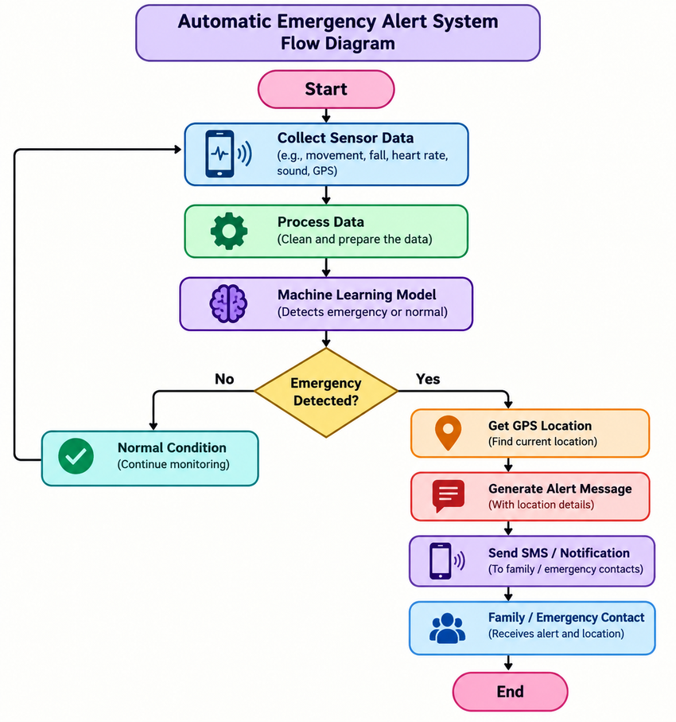
Flow Diagram

Slide 6
Literature Survey
2023: IoT-based systems were used for real-time emergency detection.
2023: Machine Learning was used for accident detection.
2024: AI methods improved emergency and abnormal activity detection.
2024: GPS and IoT were used to send quick location alerts.
2025: Deep Learning improved accident and emergency recognition.

Slide 7
2025: Mobile applications provided automatic emergency notifications.
2026: AI + IoT systems focused on faster emergency response.
Research Gap:
Existing systems mainly focus on detection or notification separately. Our system combines ML detection + GPS location + automatic alert in one system.

Slide 8
Research Methodology – Algorithm Explanation
Algorithm: Machine Learning Based Emergency Detection
Step 1: Collect data from sensors or mobile phone.
Step 2: The system checks parameters such as:
Sudden movement
Fall detection
Heart rate, if available
Sound or abnormal activity
GPS location
Step 3: Preprocess the collected data.

Slide 9
Step 4: Give the data to the machine learning model.
Step 5: The model classifies the situation as:
Normal
Emergency
Step 6: If it is normal, the system continues monitoring.
Step 7: If it is an emergency, the system gets the GPS location.
Step 8: An automatic alert is generated.
Step 9: The alert is sent to emergency contacts.

Slide 10
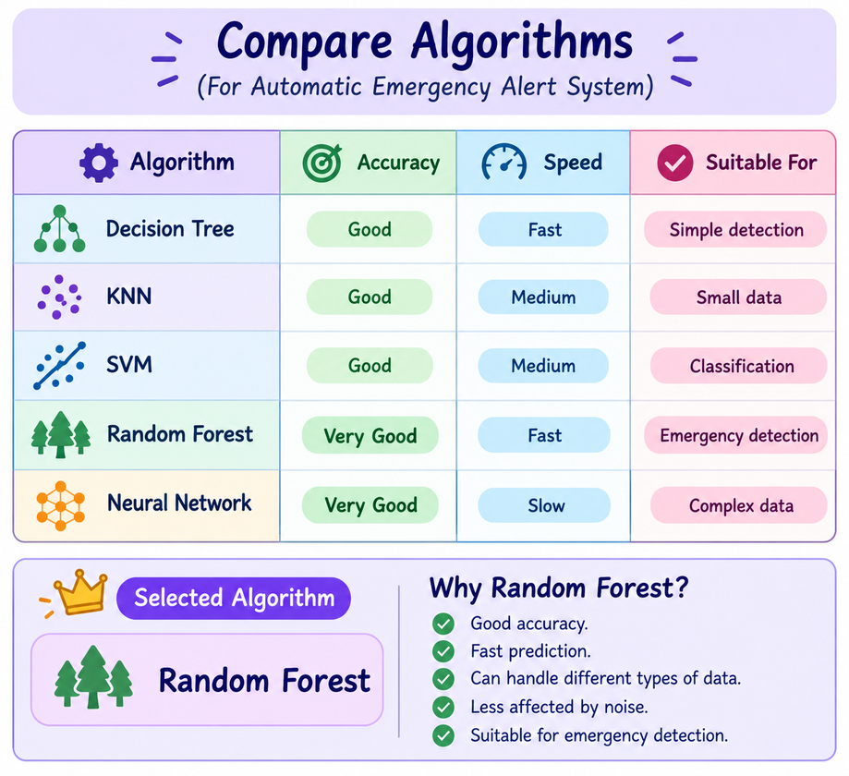
Compare Algorithms

Slide 11
Implementation Idea
The system can be implemented as a mobile or IoT-based application.
Basic Implementation
Collect sensor data.
Store the data in a database.
Train the machine learning model.
Detect normal/emergency conditions.
Get the GPS location.
Create an emergency message.
Send the message to registered contacts.
Display the emergency status in the application.

Slide 12
Modules
Module 1 – Data Collection Module
Collects sensor and user data.
Uses mobile sensors or IoT sensors.
Collects movement and activity information.
Module 2 – Emergency Detection Module
Checks the collected data.
Identifies unusual or dangerous situations.
Uses the machine learning model.
Module 3 – Location Tracking Module
Uses GPS.
Finds the user's current location.
Provides location information during an emergency.

Slide 13
Module 4 – Alert Generation Module
Creates an emergency alert.
Adds important information such as location.
Prepares the message automatically.
Module 5 – Notification Module
Sends the alert to emergency contacts.
Can use SMS, mobile notification, or app notification.
Helps family members respond quickly.

Slide 14
Conclusion
The Automatic Emergency Alert System helps detect emergency situations automatically. The system uses sensors, GPS, and machine learning to identify dangerous conditions. When an emergency is detected, it sends an alert and location to selected contacts. This reduces delay and helps provide quick assistance and improved personal safety.

