Slide 1

Scaling Smarter: Parameter-Efficient Fine-Tuning of Foundation Models
By :
Roshini Joga
(018221736)

Slide 2
Contents
1. Introduction to PEFT and Foundation Models
2. Categories of Foundation Models
3. Overview of PEFT Approaches
4. Selective PEFT: Strategies and Examples
5. Additive PEFT: Adapter Paradigm
6. Prompt and Reparameterization PEFT
7. Hybrid PEFT and Model Integration
8. Applications of PEFT Across Domains
9. Current Trends and Research Directions
10. Conclusion: The Value of PEFT for Foundation Models

Slide 3
Introduction to PEFT and Foundation Models
What is PEFT?
Parameter-Efficient Fine-Tuning (PEFT) is a set of techniques for efficiently fine-tuning large pre-trained foundation models (FMs) by minimizing the number of trainable parameters while maintaining high performance. This enables reduced computational cost and memory usage during adaptation to new tasks.
Foundation Models (FMs)
Foundation Models are pre-trained on large, diverse datasets and can be adapted to a wide variety of tasks, including language understanding, code generation, image and video analysis, and multimodal interactions. Notable FMs include ChatGPT, DALL-E, LLaVA, and more, each designed for specific domains.
Significance
PEFT addresses key challenges associated with large FMs, such as computational expense and the need to adapt to specific downstream tasks with minimal resources, making it highly relevant for practical real-world applications.

Slide 4
PEFT Overview & Taxonomy
Parameter-Efficient Fine-Tuning (PEFT) encompasses five categories:
• Selective Tuning: Freeze most parameters, update critical ones. • Adapters: Insert small bottleneck modules. • Prompt PEFT: Learn continuous prompts or prefixes. • Reparameterization: Inject low-rank matrices (LoRA). • Hybrid Methods: Combine multiple strategies under one framework.

Slide 5
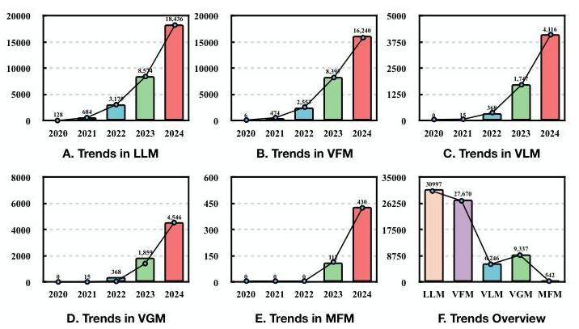
Categories of Foundation Models
Large Language Models (LLMs)
LLMs are trained on massive text corpora and excel at language-centric tasks, including translation, summarization, text generation, and question answering. Examples include BERT, LLaMA, GPT-4, and ChatGLM.
Visual Foundation Models (VFMs)
VFMs process images for tasks like classification, object detection, and segmentation. They are pre-trained on extensive image datasets and generalize well. Grounding DINO and SAM are key examples.
Vision-Language and Multi-Modal Models
Vision Language Models (VLMs) and Multi-Modal Foundation Models (MFMs) simultaneously process text, images, audio, and sometimes video for rich interaction. Models like CLIP, BLIP, LLaVA-1.5, and Gemini 1.5 Pro exemplify these types.

Slide 6
Overview of PEFT Approaches
1 | Selective PEFT Fine-tunes only a chosen subset of model parameters, keeping others frozen. Approaches include layer-wise freezing, masking, and automatically determining which parameters are most relevant for adaptation, thus saving resources.
2 | Additive PEFT Inserts small trainable modules (adapters) into the model without altering the main parameters. This enables efficient task adaptation and improved knowledge sharing across tasks. Examples include bottleneck adapters and multi-adapter frameworks.
3 | Prompt and Reparameterization PEFT Prompt PEFT introduces learnable prompts that guide models on new tasks, while Reparameterization PEFT (e.g., LoRA) rewrites model weights through low-rank decomposition, balancing performance with efficiency. Hybrid PEFT combines strategies for robust results.

Slide 7
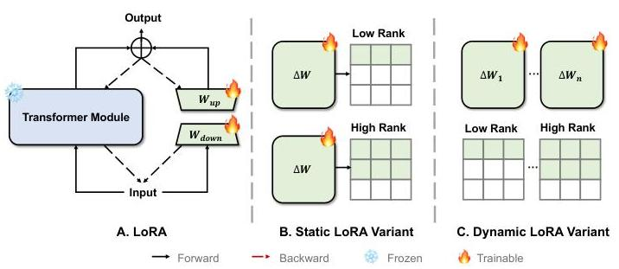
Selective PEFT: Strategies and Examples
Specific vs Automatic Selection
Specific selection methods, such as Freeze Layers and BitFit, predetermine certain parameters (e.g., layers, bias terms) to be updated. Automatic methods like Masking and CHILD-TUNING use algorithmic strategies (e.g., binary masks) for parameter selection.
Applications
Selective PEFT methods are applied not only to LLMs, but also to VFMs and multi-modal models, with techniques like LayerNorm Tuning and FC-CLIP for vision, and Tune-A-Video for video generation. Memory and efficiency benefits are key advantages, but care must be taken regarding potential increased training times and memory use in some approaches.

Slide 8
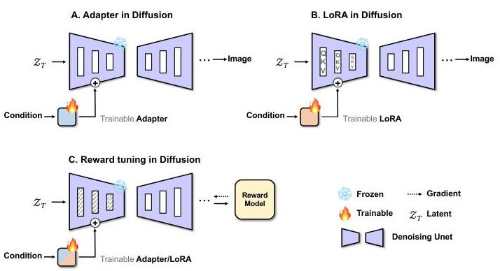
Additive PEFT: Adapter Paradigm
Bottleneck and Multi-Adapter Approaches
Adapters insert small, parameter-efficient layers between existing layers. Bottleneck adapters use dimension reduction and expansion, while multi-adapter infrastructures (e.g., Adapter Fusion, MAD-X) allow knowledge sharing across tasks and languages, boosting transferability.
Adapter Sparsity and Advances
Increasing adapter efficiency is achieved via combinations like AdapterDrop (randomly dropping adapters during training) and sparse/side-networks (LST, AdapterBias, Convpass). These approaches offer significant memory and compute savings, but may increase inference overhead.

Slide 9
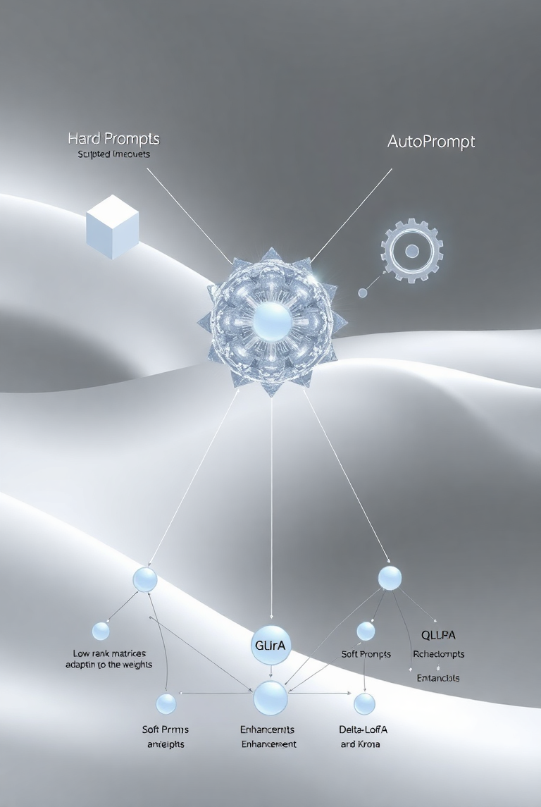
Prompt and Reparameterization PEFT
Prompt PEFT: Hard, Auto, and Soft Prompts
Prompt-based methods guide FMs by crafting or learning input prompts. Hard prompts use templates, AutoPrompt automates this process, and soft prompts utilize learnable embeddings or vectors. Techniques like Prefix Tuning and P-Tuning integrate prompts deeply within the model.
Reparameterization: LoRA and Variants
LoRA (Low-Rank Adaptation) and related methods adjust model weights by introducing low-rank matrices, greatly reducing the number of updated parameters. QLoRA, Delta-LoRA, and KronA further enhance performance or memory efficiency, often with minimal trade-off in accuracy.

Slide 10

Hybrid PEFT and Model Integration
Hybrid Approaches
Hybrid PEFT combines multiple strategies (e.g., adapters, LoRA, prompt tuning) to maximize adaptation efficiency and flexibility. Frameworks like UniPELT and COMPACTER coordinate various modules, leading to synergistic performance improvements, though sometimes at the cost of higher complexity.
Application Highlights
Hybrid approaches show promise in multi-task learning, continual learning, and achieving robust results with minimal compute, but require careful design to avoid unnecessary complexity and potential underperformance from method interaction.

Slide 11

Applications of PEFT Across Domains
Large Language Models (LLMs)
PEFT efficiently adapts both causal (e.g., GPT-3, LLaMA) and prefix (e.g., ChatGLM) language models, reducing the resource footprint for domain adaptation. Techniques such as QLoRA, LoRA-Sparse, and prefix/prompt tuning are widely adopted for language and instruction tasks.
Vision and Multimodal FMs
PEFT enhances performance and efficiency in vision models (ViTs), vision-language models (CLIP), and content generation (diffusion models). Adapter and prompt tuning are used for segmentation, recognition, and generative tasks. Multimodal models benefit from LoRA and adapters for cross-domain adaptation, as shown in models like LLaVA-1.5 and Gemini 1.5 Pro.

Slide 12
Current Trends and Research Directions
Trends in PEFT
The field is rapidly growing, with LLMs and VFMs seeing the most activity. Vision-language and generative models are emerging areas with significant potential. Current focus includes robustness, interpretability, and standardized benchmarking for PEFT techniques.
Future Opportunities
Promising directions include interdisciplinary applications (e.g., medical, scientific domains), integration with continual learning, tailoring PEFT to specific architectures, researching scaling laws, developing layered abstraction strategies, and drawing inspiration from brain-like efficient coding and adaptation mechanisms for next-generation PEFT.

Slide 13
Conclusion: The Value of PEFT for Foundation Models
Parameter-Efficient Fine-Tuning (PEFT) is transforming how foundation models are adapted for diverse and demanding real-world tasks. By reducing the required computation and memory, PEFT makes it practical to deploy and update large models without retraining from scratch or incurring prohibitive costs. The spectrum of PEFT methods—from selective masking and adapter modules to learnable prompts and low-rank reparameterization—enables practitioners to choose the most suitable strategy for their application. The integration of PEFT with various foundation model architectures, including language, vision, multimodal, and generative models, ensures broad applicability. As research focuses on unified benchmarks, interpretability, and bio-inspired approaches, PEFT is poised to play a critical role in scaling foundation models efficiently and responsibly into new domains and dynamic environments.

