Slide 1
RETAIL SALES ANALYTICS Retail Sales Analytics Dashboard using SQL, Python, and Power BI
Roshini Yelisetti
Tools: SQL | Python | Power BI

Slide 2
OUTLINE
Problem Statement
Project Objectives
Dataset Overview
Tools & Technologies
SQL Analysis
Executive Overview Dashboard
Product Performance Dashboard
Customer Insights Dashboard
Profitability Analysis Dashboard
Business Insights & Recommendations
Key Findings
Business Recommendations
Conclusion

Slide 3
Problem Statement
Retail organizations generate large amounts of sales data.
The challenge is to transform this raw data into actionable business insights.
This project aims to analyze sales performance, customer behavior, profitability, and product performance to support business decision-making.

Slide 4
Project Objectives
• Analyze overall sales performance
• Identify profitable categories and products
• Evaluate customer segment contribution
• Analyze regional sales performance
• Generate business recommendations

Slide 5
Tools and Technologies
• SQL (MySQL)
• Python
• Power BI
• Excel
Python Libraries:
• Pandas
• NumPy
• Matplotlib
• Seaborn

Slide 6
SQL Analysis
• Sales Analysis • Product Performance Analysis • Category Analysis • Regional Analysis • Profitability Analysis Outcome: Generated business insights through SQL queries.

Slide 7
Python Analysis
• Data Cleaning
• Data Transformation
• Exploratory Data Analysis
• Sales Trend Analysis
• Data Visualization
Outcome:
Prepared data for business intelligence reporting.

Slide 8
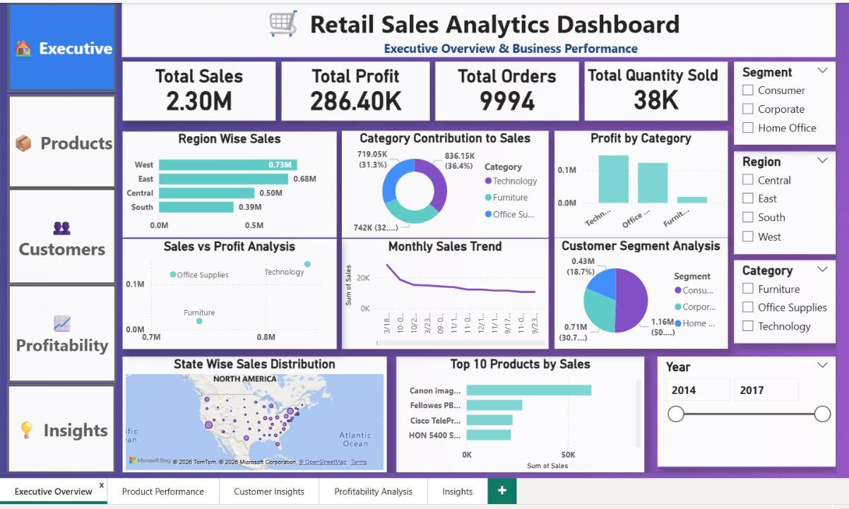
Executive Overview Dashboard
The Executive Overview Dashboard provides a high-level summary of the retail business performance.
Key KPIs such as Total Sales, Total Profit, Total Orders, and Total Quantity Sold are displayed to monitor overall business performance.
The dashboard includes Region-wise Sales Analysis, Category Contribution, Profit by Category, Monthly Sales Trends, Customer Segment Analysis, State-wise Sales Distribution, and Top Products Analysis.
Interactive slicers allow users to filter data by Region, Category, Segment, and Year for deeper analysis.

Slide 9
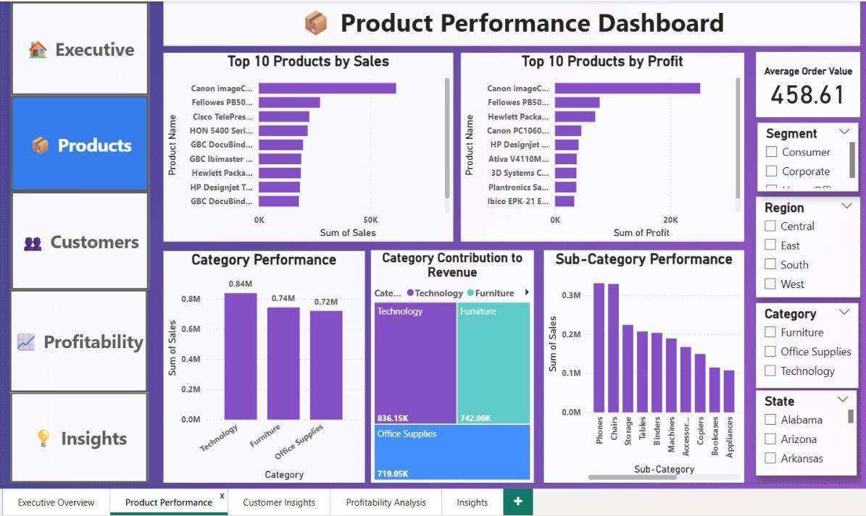
Product Performance Dashboard
The Product Performance Dashboard focuses on evaluating product-level performance.
It identifies Top 10 Products by Sales and Profit, helping stakeholders understand which products contribute most to revenue and profitability.
Category and Sub-Category analysis helps compare product groups and identify growth opportunities.
The dashboard supports inventory planning, product strategy, and performance monitoring.

Slide 10
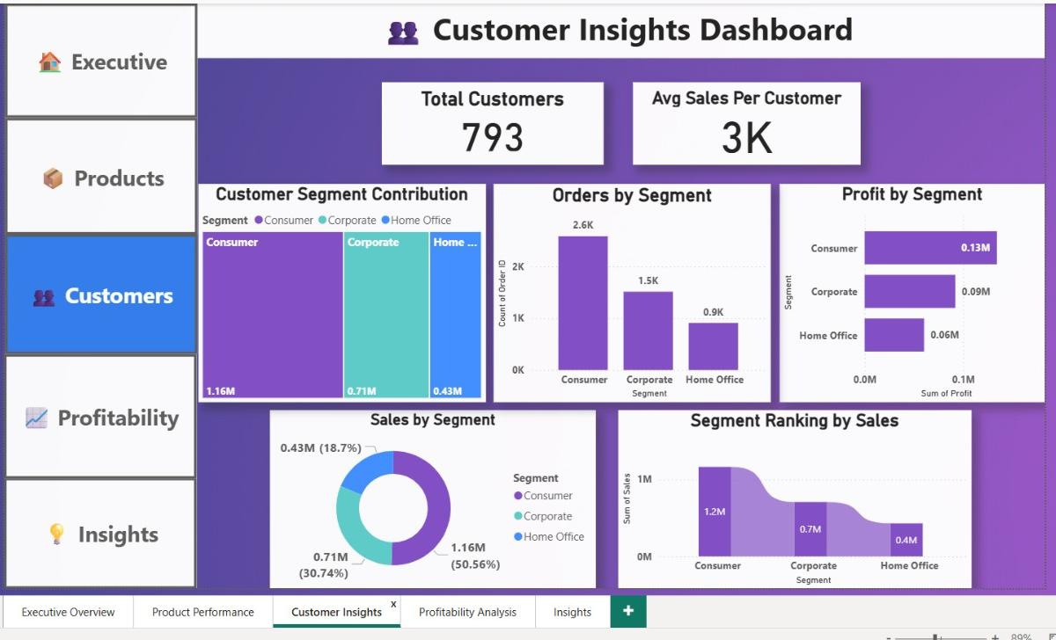
Customer Insights Dashboard
The Customer Insights Dashboard analyzes customer behavior and segment contribution.
The dashboard highlights Total Customers, Customer Segment Contribution, Sales by Segment, and Profit by Segment.
This analysis helps understand customer purchasing patterns and identify high-value customer groups.
The insights can support customer retention strategies and targeted marketing initiatives.

Slide 11
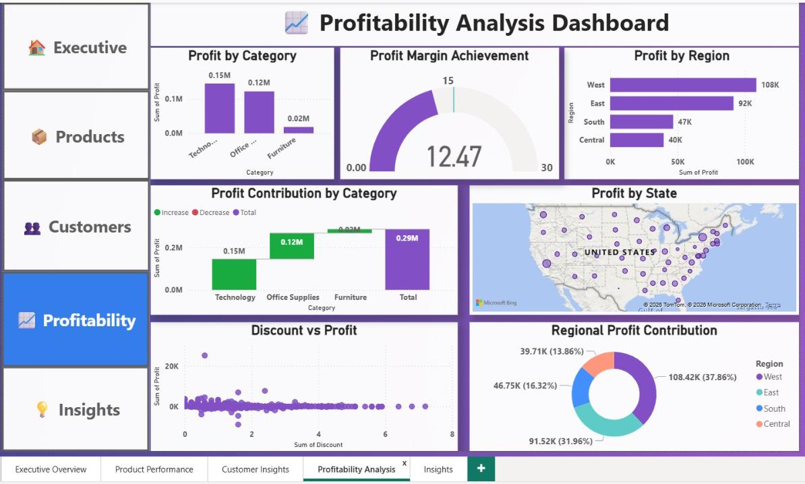
Profitability Analysis Dashboard
The Profitability Analysis Dashboard evaluates profit performance across different business dimensions.
The dashboard includes Profit by Region, Profit by Category, Profit by State, and Discount vs Profit Analysis.
The analysis helps identify profitable regions and categories while highlighting the impact of discounts on overall profitability.
These insights support pricing strategies and profit optimization efforts.

Slide 12
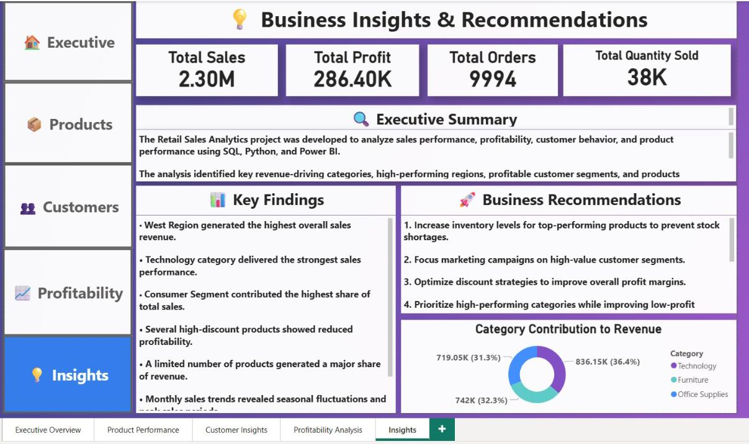
Business Insights & Recommendations
The Business Insights Dashboard summarizes key findings and strategic recommendations derived from the analysis.
The page presents executive-level insights regarding sales performance, customer behavior, product contribution, and profitability.
Business recommendations are provided to improve revenue growth, optimize inventory planning, increase customer retention, and enhance profit margins.
This page serves as a decision-support summary for business stakeholders.

Slide 13
Key Findings
• West Region generated the highest overall sales revenue.
• Technology category achieved the strongest sales performance.
• Consumer Segment contributed the highest share of total sales.
• Top-performing products generated a significant portion of revenue.
• High discount levels negatively affected profitability.
• Sales trends revealed seasonal fluctuations and peak sales periods.
• Regional performance varied across sales and profit metrics.

Slide 14
Business Recommendations
• Increase inventory availability for high-performing products.
• Optimize discount strategies to improve profitability.
• Focus marketing efforts on high-value customer segments.
• Improve performance of low-profit product categories.
• Expand successful products into underperforming regions.
• Use historical sales trends for forecasting and inventory planning.
• Monitor profitability regularly through dashboard-driven decision making.

Slide 15
Conclusion
This Retail Sales Analytics Project successfully transformed raw sales data into actionable business insights using SQL, Python, and Power BI.
The project enabled comprehensive analysis of sales performance, customer behavior, product performance, and profitability.
Interactive dashboards and business recommendations support data-driven decision-making and demonstrate practical business intelligence capabilities.

