Slide 1
Financial Sales Dashboard – Business Insights
Task 4: Dashboard Design using Power BI
Name: Roshini Yelisetti
MBA - HR & Marketing

Slide 2
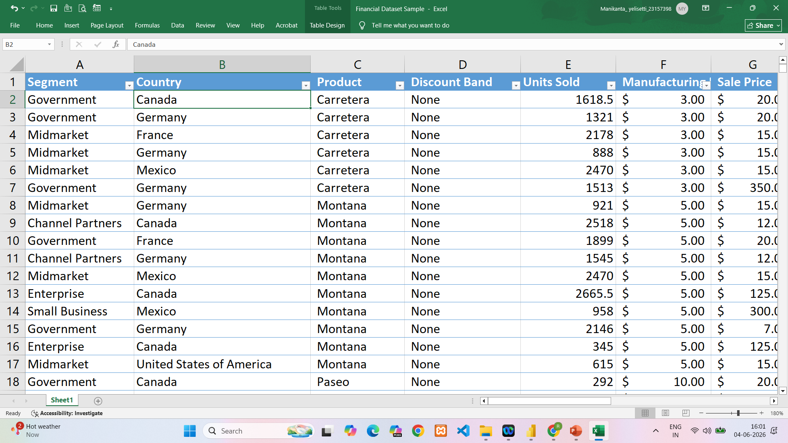
Dataset Overview
Dataset: Financial Dataset Sample
Source: Kaggle
Total Rows: 700
Total Columns: 16
Tool Used: Power BI

Slide 3
KPIs Overview
Key Performance Indicators:
Total Sales: 118.73M
Total Profit: 16.89M
Units Sold: 1.13M
Total Discounts: 9.21M
Growth %: 14.23

Slide 4
Sales Analysis
Insights:
United States has highest sales.
Canada and France follow.
Sales vary across countries.
Helps identify strong markets.

Slide 5
Profit Analysis
Insights:
Paseo generated highest profit.
VTT and Amarilla performed well.
Product-level analysis helps improve profitability.

Slide 6
Trend Analysis
Insights:
Sales increased over time.
Positive growth observed.
Trend analysis helps forecasting future sales.

Slide 7
Customer Segment Analysis
Insights:
Government segment contributes highest sales.
Midmarket and Channel Partners also contribute significantly.
Useful for customer targeting.

Slide 8
Dashboard Interactivity
Interactive Features:
Country Filter
Product Filter
Segment Filter
Year Slicer
Dynamic report updates

Slide 9
Business Recommendations
Recommendations:
Focus on high-profit products.
Increase sales in low-performing regions.
Monitor discount strategies.
Expand successful customer segments.

Slide 10
Conclusion
Successfully created an interactive Power BI dashboard.
Used KPIs, charts, slicers, and trend analysis.
Dashboard supports business decision-making.

Slide 11


