Slide 1

Safe Click: Anti-Phishing Measures for Enhanced Cybersecurity Protection
CS 5593: Data Mining
Semester: Spring 2024
Sowmya Gangireddy
Sruthi Pedakolimi
Roshini Talluru

Slide 2
Outline
Introduction
Related Work
Proposed Work
Application overview
Dataset and Preprocessing
Feature Selection and Importance
Machine Learning Models and Evaluation
4. System Architecture and UI
5. Demo-"Safe-click"
5.Conclusions and Future Work

Slide 3
Introduction
Problem Statement:
- Phishing attacks mimic legitimate websites to steal sensitive data.
Challenges in Existing Systems:
- Limited adaptability to evolving threats
- Poor interpretability reduces user trust
- Inefficient in computational resource usage
Goal:
"Safe Click": A machine learning-based phishing detection system
- High accuracy
- Real-time predictions
- Interpretability to build user trust

Slide 4
Related Work
Traditional Methods:
- Blacklists and heuristics: Limited adaptability to evolving phishing patterns.
Advancements in Machine Learning:
- Structural, content-based, and behavioral features improve phishing detection.
- Challenges: Scalability, transparency, and computational efficiency.
How "Safe Click" Improves:
- Uses Recursive Feature Elimination with Cross-Validation (RFECV).
- Focuses on interpretability and real-time detection.

Slide 5
Proposed Work

Slide 6
Application Overview
Frontend:
A simple UI built with HTML and CSS for users to input URLs and see if they’re safe or phishing.
Backend:
Preprocessing the data.
Modeling with machine learning to classify as safe or phishing.
Displaying results to the user in real-time.

Slide 7
Dataset and Preprocessing
Dataset Overview:
Total Samples: 9,581 rows (after preprocessing).
Features: 49 columns initially, , reduced to 37 after feature selection.
Balanced Dataset: Equal phishing (1) and legitimate (0) samples.
Feature Types:
Structural Features: E.g., NumDots, HostnameLength.
Content Features: E.g., PctExtHyperlinks, NumSensitiveWords.
Behavioral Features: E.g., IframeOrFrame, SubmitInfoToEmail.

Slide 8
Preprocessing steps
Duplicate Removal: Eliminated 419 duplicate rows.
Outlier Handling: Removed extreme values (e.g., NumDots > 20).
Irrelevant Feature Removal: Dropped id and HttpsInHostname (constant values).
Normalization: Scaled numeric features for uniformity.

Slide 9
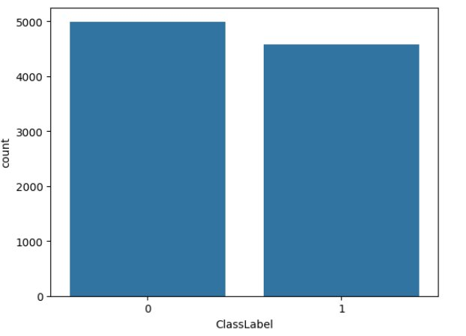
Class Labels
Balanced dataset with almost equal phishing and legitimate samples.

Slide 10
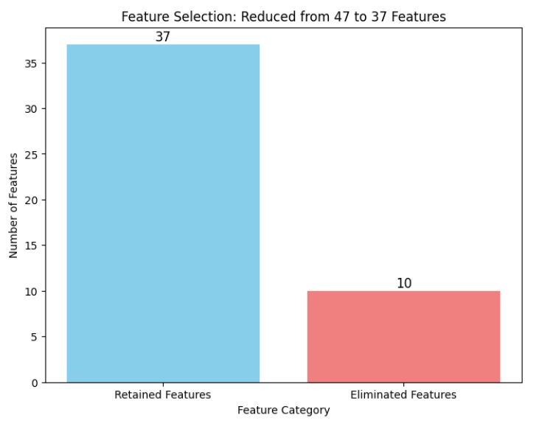
Feature Selection and Importance
Objective: Optimize features for better model performance.
Primary Method: Recursive Feature Elimination with Cross-Validation (RFECV).
Complementary Methods:
Correlation Matrix.
Chi-Square Test.
Outcome: Reduced features from 49 to 37, enhancing efficiency and accuracy.
Notes:
The features extracted using RFECV is complimented by the feature importance and chi-square test

Slide 11
Recursive Feature Elimination (RFECV)
Iteratively removes less important features based on model performance.
Evaluates subsets using cross-validation to avoid overfitting.
Eliminated Features: Examples include RightClickDisabled, FakeLinkInStatusBar.

Slide 12
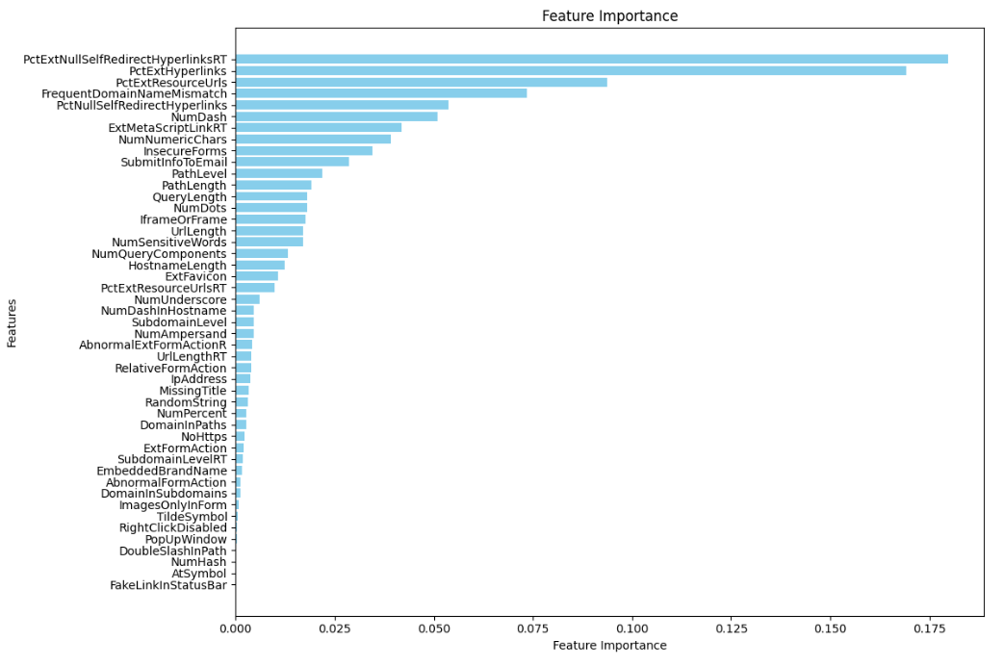
Feature Importance
Feature importance quantifies the contribution of each feature in improving the predictive accuracy of the model

Slide 13
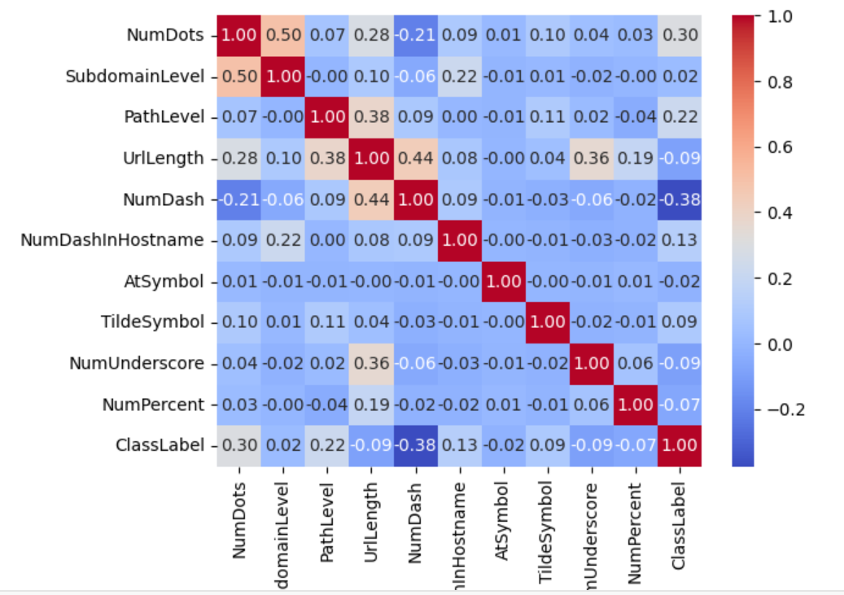
Correlation matrix
Example: FrequentDomainNameMismatch
(correlation = 0.477).

Slide 14
Overview of Machine Learning Models
Models Used:
Decision Tree
Random Forest
Gradient Boosting
Support Vector Machine (SVM)
K-Nearest Neighbors (KNN)
Hyperparameter Tuning:
Used GridSearchCV with 5-fold cross-validation.
Optimized parameters such as:
Number of trees in Random Forest.
Learning rate and estimators for Gradient Boosting

Slide 15
Best Hyperparameters
Model | Best Hyperparameters
Decision Tree | {'max_depth': 10}
Random Forest | {'n_estimators': 200, 'max_depth': 15}
SVM | {'C': 100, 'kernel': 'rbf'}
KNN | {'n_neighbors': 3, 'weights': 'distance', 'metric': 'manhattan'}
Gradient Boosting | {'n_estimators': 300, 'max_depth': 5, 'learning_rate': 0.2}

Slide 16
Performance Metrics and Accuracy Selection
Metrics Tested: Accuracy, F1-Score, ROC AUC.
Why Accuracy Was Chosen:
Dataset is balanced (equal phishing and legitimate samples).
Accuracy effectively measures the proportion of correct predictions.
F1-Score and ROC AUC are better suited for imbalanced datasets.

Slide 17
Statistical Validation and Model Selection
T-Test for Model Comparison
Performed on the average accuracy across 5 folds.
Compared Gradient Boosting, Random Forest, and other models
Results:
Top Models: Gradient Boosting and Random Forest.
These models were statistically significant compared to others.
Why Gradient Boosting for deployment?
High accuracy (98%).
Strong ability to capture complex patterns.
Robustness in generalizing across datasets.

Slide 18
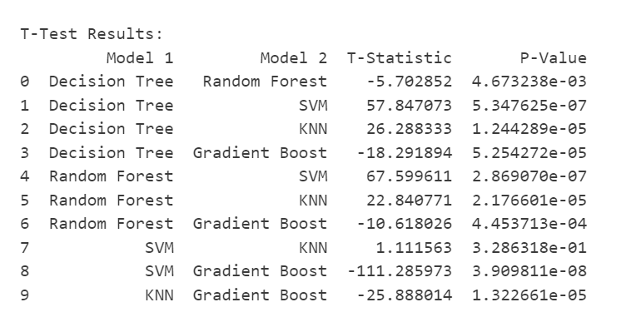
T-Test Results

Slide 19
System Architecture
System Architecture
Frontend
Backend
HTML
Python
Django
CSS

Slide 20
User Interface
User Workflow
Input URL
Feature Extraction
Classification models
Result Display
Safe
Unsafe

Slide 21
DEMO Screenshots

Slide 22

SAFE CLICK

Slide 23

SAFE URL

Slide 24

UNSAFE URL

Slide 25
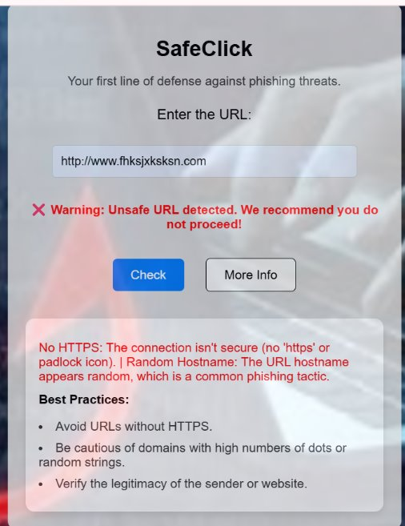
More Info

Slide 26
Conclusions and Future Work
Conclusions:
"Safe Click" achieves:
High accuracy (Gradient Boosting: 98.4%).
Real-time detection with interpretable results.
Feature selection using RFECV enhances efficiency.
Future Work:
Advanced hyperparameter tuning and ensemble methods.
Integration of domain reputation checks and IP analysis.
Real-time phishing alerts via browser extensions.
Support for deep learning models and multilingual URLs.

