Slide 1
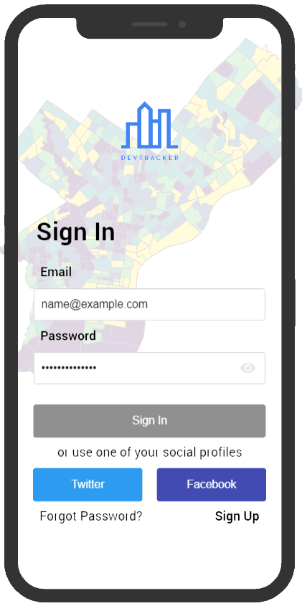
DevTracker:
Forecasting Development Changes in Philadelphia
Roshini Ganesh
Samriddhi Khare
MUSA 508

Slide 2
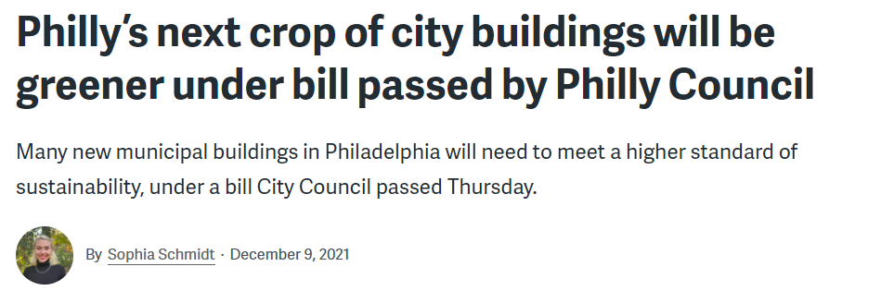
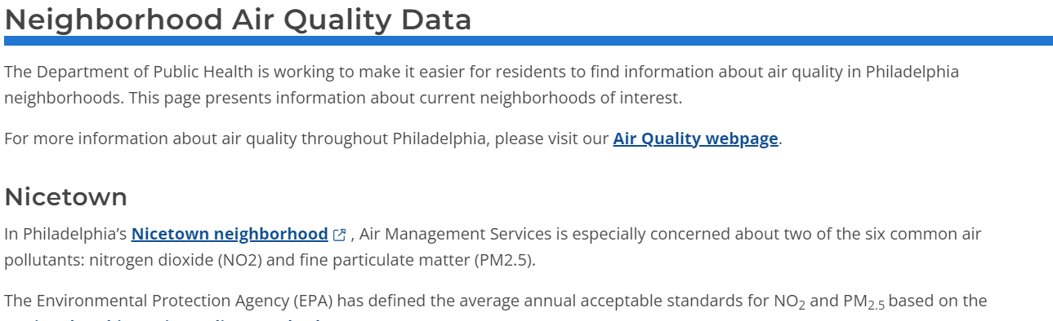
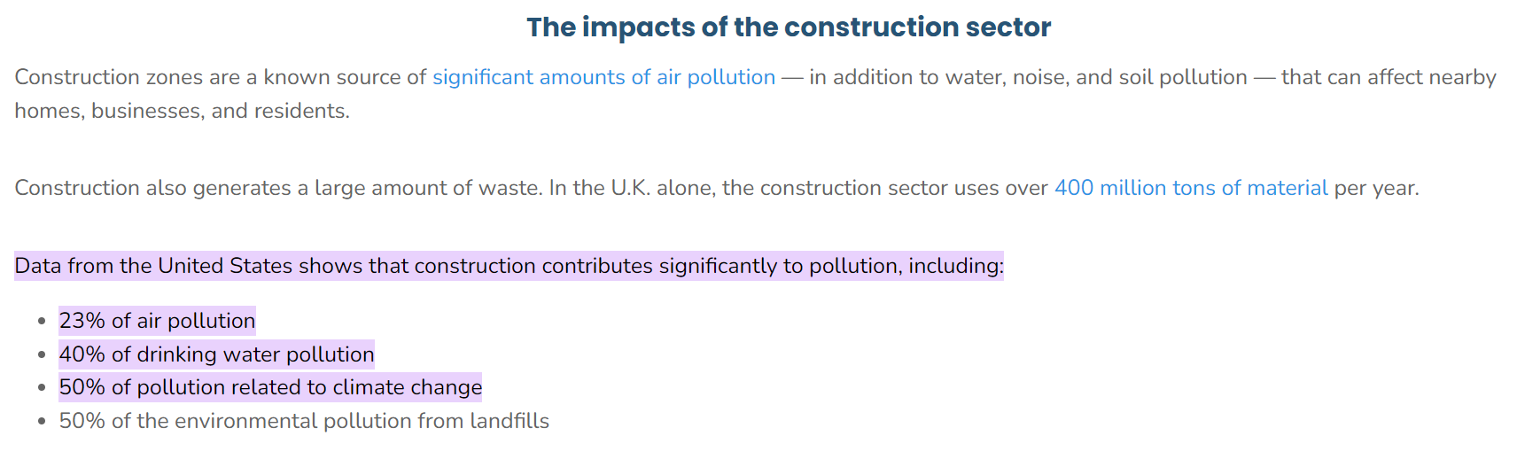
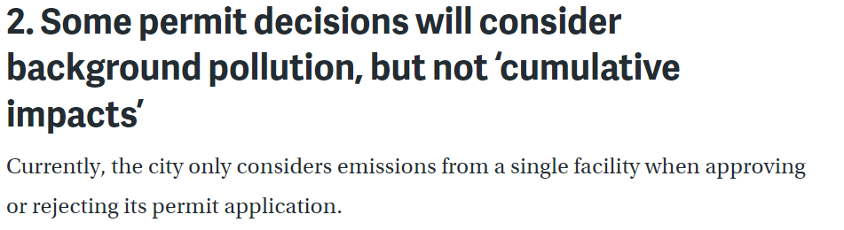
Construction is one of the most polluting industries in Philadelphia.
The Office of Sustainability has been approached by the Department of Licenses and Inspections to make recommendations for incorporating green building standards to the current building code.
Click to view Image Source
Notes:
Ground up: But advocates say there is more work to be done. Training programs and more granular context-based policy solutions

Slide 3
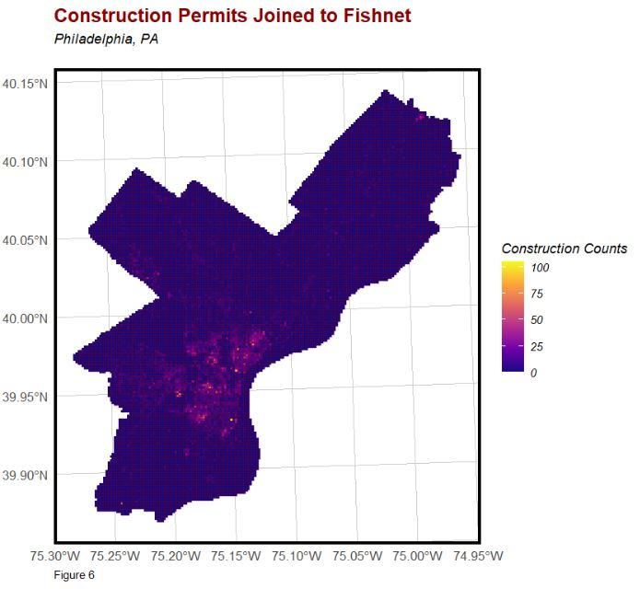
Development patterns are not uniform across the city.
The Office of Sustainability could benefit from understanding past, current, and future development trends to propose context-based Green Building recommendations for different neighborhoods.

Slide 4

Property Values
Economic Profiles
Demographic Profiles
To analyze and forecast development trends:
OOS has identified potential spatial, demographic, economic, and environmental parameters.
Contractor Details
Building Performance
L&I Permit Data
Parks and Green Spaces
Vacant Land & Buildings
Notes:
Uses this data to creat regression

Slide 5
5. CHECKING STATISTICAL ERRORS
Processing the results to see if there are spatial or statistical error clustering,.
1: CREATING NEW VARIABLES
Filtering the data, finding the best variables and creating predictive fixed effect and KNN.
4. CROSS VALIDATION
Checking the generalizability of the model using LOGO cross validation.
2. IDENTIFYING HOTSPOTS
Running further analysis to see development trends,
MODEL PROCESS
3. MODELLING THE REGRESSION
Running a Poisson regression to predict and visualize permit issuance.

Slide 6
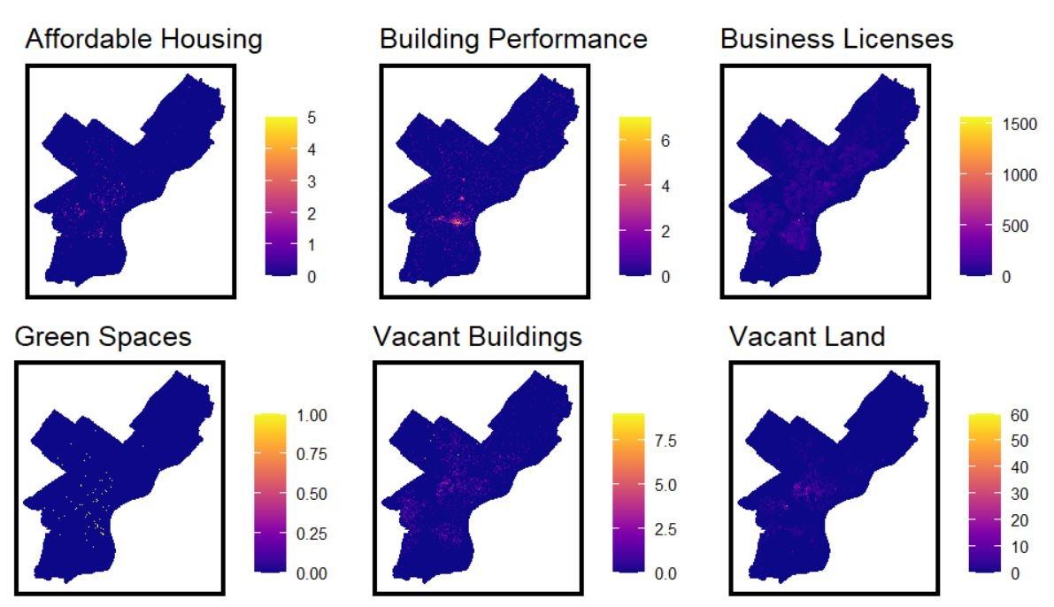
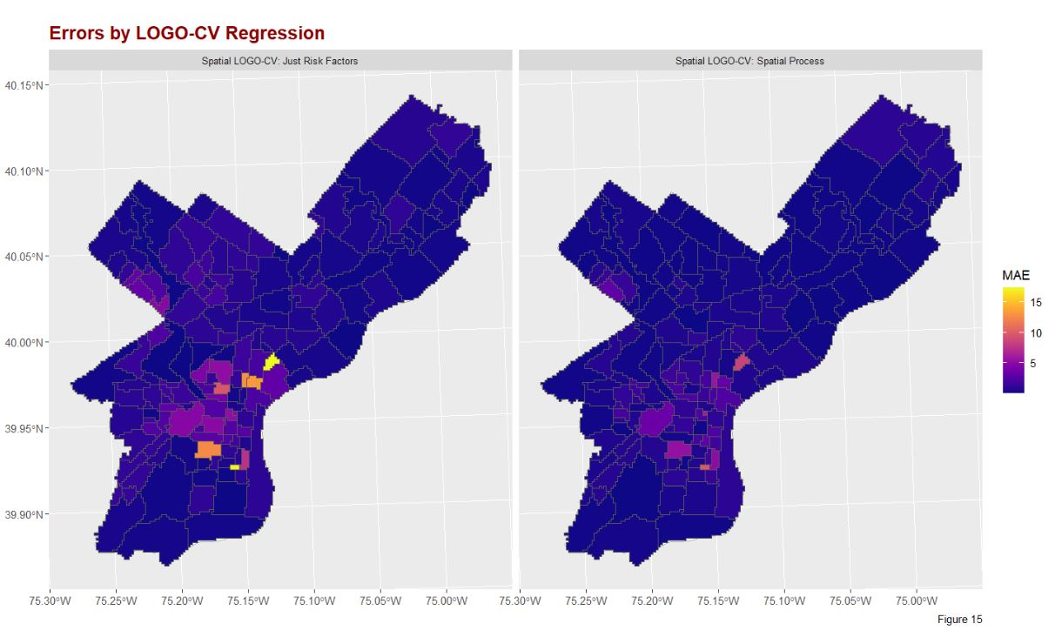
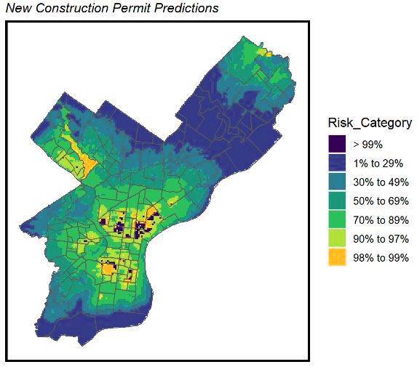
Factors influencing? Correlations?
Initial analyses indicate:
Correlations between predictions and spatial variables as well as home-ownership related demographic variables
Lower MAE values through LOGO CV Spatial Process
Data cleaning: same plot multiple permits - int vs exterior
Construction following demolition?
Make up lie about correlation and show any ⅔ variables ka distribution

Slide 7
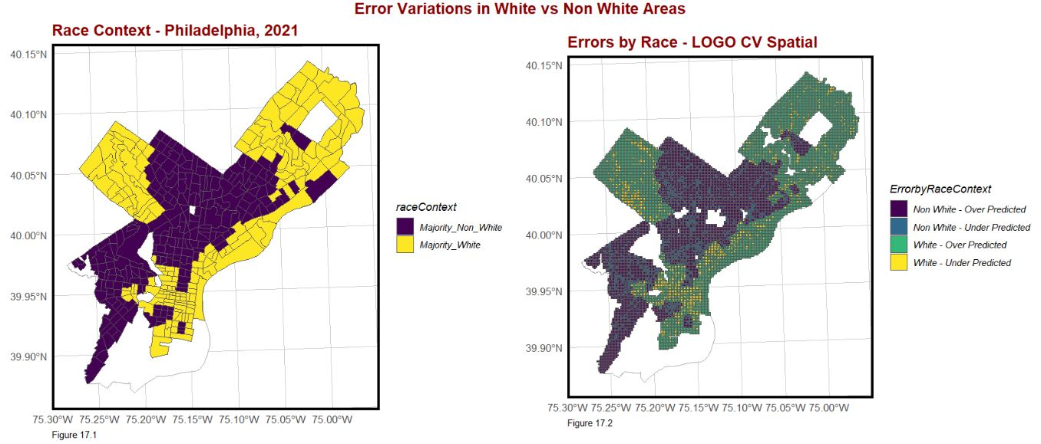
Factors influencing? Correlations?
Model results indicate:
Predictions for development are concentrated in areas near Northern Liberties Old Kensington, and Rittenhouse
Model under-predicts in Non-White neighborhoods and over-predicts in White neighborhoods.
Data cleaning: same plot multiple permits - int vs exterior
Construction following demolition?
Make up lie about correlation and show any ⅔ variables ka distribution

Slide 8
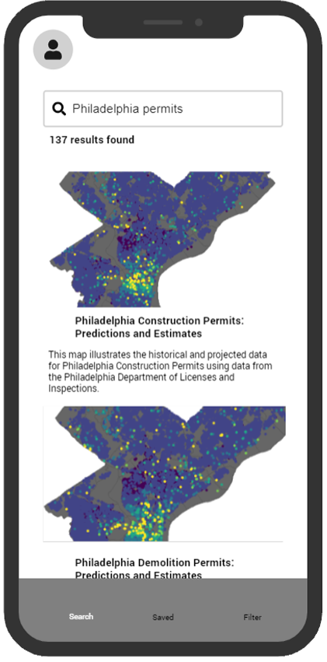
DevTracker: Forecasting Development Changes in Philadelphia
Our application can assist sustainability professionals by analyzing and predicting development trends across the city. DevTracker provides insight into socio-economic patterns and new construction.
SEARCH FORECASTS FOR PERMITS

Slide 9
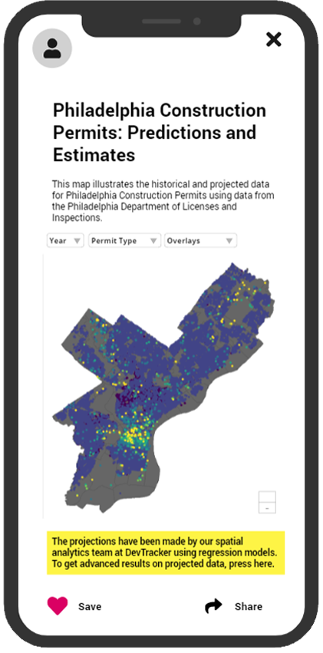
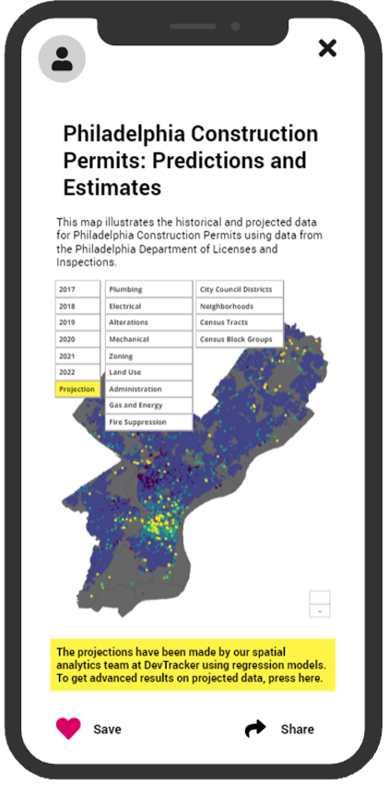
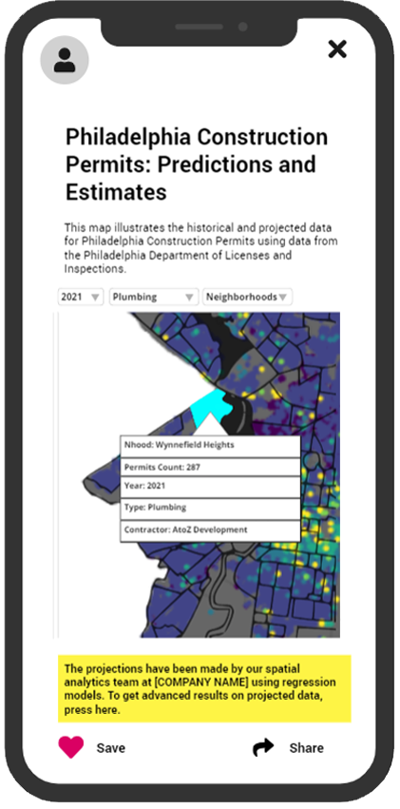
VIEW
FILTER
ZOOM IN
Notes:
With this context, the app visually presents: The trends in permits issued zooming in details

Slide 10


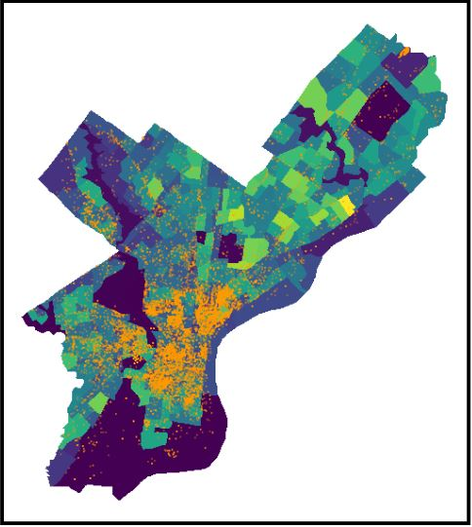
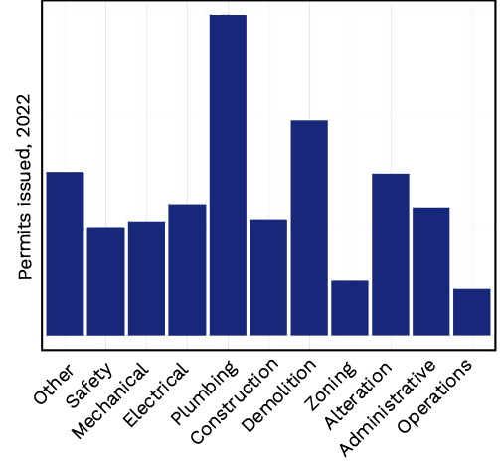
Conduct in-depth analyses of neighborhood patterns.
OVERLAY
ANALYZE
Notes:
With this context, the app visually presents: The trends in permits issued zooming in details

Slide 11
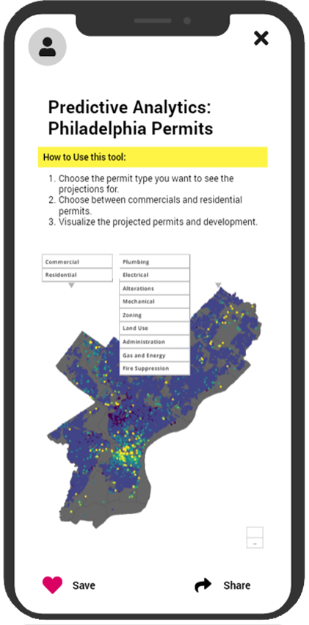
Make predictions specific to your needs
In this forecasting process, the app allows the decision maker to adjust forecasts based on the kind of permits ~ change the dependent variable ‘y’.
CUSTOMIZE
Notes:
With this context, the app visually presents: The trends in permits issued zooming in details

Slide 12

Use Case #1 - Examining large scale permits issued in the city
Construction
Demolition
Zoning
To propose neighborhood specific green building recommendations and industry specific strategies

Slide 13

Use Case #2 - Preparing Targeted Training Programs
Plumbing
Electrical
Mechanical
Alterations
To develop targeted Green Building Training Programs for contractors in Philadelphia that are working on these development projects

