Slide 1
ARRHYTHMIA-ON-ECG-CLASSIFICATION-USING-CNN
ROSHINI S
BE – COMPUTER SCIENCE AND ENGINEERING – III YR
MADRAS INSTITUTE OF TECHNOLOGY, ANNA UNIVERSITY

Slide 2
OUTLINE
Problem Statement
Proposed System/ Solution
System Development Approach
Algorithm & Deployment
Result
Conclusion
References

Slide 3
PROBLEM STATEMENT
The aim of this project is to develop a deep learning model using Convolutional Neural Networks (CNNs) to accurately classify different types of arrhythmias based on electrocardiogram (ECG) signals. Arrhythmias are abnormal heart rhythms that can lead to serious health complications if not detected and treated early. ECG signals provide crucial information about the electrical activity of the heart, making them a valuable tool for diagnosing arrhythmias.

Slide 4
PROPOSED SOLUTION
Data Collection:
Gather a diverse dataset of ECG signals containing various arrhythmia types.
Source datasets from hospitals, research databases, and open repositories.
Data Preprocessing:
Remove noise from ECG signals using filters or wavelet transforms.
Normalize signal amplitudes and segment ECGs into consistent time windows or heartbeats.
Augment the dataset using techniques like time-shifting, scaling, and rotation to increase training data diversity.

Slide 5
PROPOSED SOLUTION – CONT.
Model Development:
Design a CNN architecture tailored for ECG signal classification.
Utilize convolutional layers to capture local features and pooling layers for spatial down-sampling.
Implement fully connected layers for classification and integrate dropout for regularization.
Use softmax activation in the output layer to produce probability distributions over arrhythmia classes.
Training and Validation:
Split the dataset into training, validation, and test sets.
Train the CNN model using the training set, optimizing with categorical cross-entropy loss and Adam optimizer.
Validate the model's performance on the validation set, adjusting hyperparameters and architecture as needed.

Slide 6
PROPOSED SOLUTION – CONT.
Model Evaluation:
Assess the model's performance on the test set using metrics like accuracy, precision, recall, and F1-score.
Analyze the confusion matrix and ROC curves to understand classification strengths and weaknesses.
Clinical Validation:
Deploy the trained model in a clinical environment using an independent ECG dataset.
Collaborate with cardiologists to evaluate the model's diagnostic accuracy and its potential to aid in clinical decision-making.
Refine the model based on feedback and further validation to ensure its reliability and usefulness in real-world scenarios.

Slide 7
SYSTEM APPROACH
System Requirements:
Hardware Requirements:
CPU: Multi-core processor (Intel i5 or equivalent) or better for faster data preprocessing and model training.
GPU: NVIDIA GeForce GTX 1060 or higher with CUDA support for accelerated CNN training (optional but recommended).
RAM: Minimum of 16GB RAM for handling large datasets and model training.
Storage: SSD with at least 500GB for storing datasets, trained models, and software.

Slide 8
SYSTEM APPROACH- CONT.
Software Requirements:
Operating System: Windows 10/11, macOS, or Linux.
Python: Python 3.x for coding and development.
Deep Learning Frameworks: TensorFlow or PyTorch for building and training CNN models.
Data Preprocessing Libraries: NumPy, Pandas, and SciPy for data manipulation and preprocessing.
Visualization Libraries: Matplotlib and Seaborn for data visualization.
Additional Libraries: scikit-learn for model evaluation, OpenCV for image processing (if needed), and TensorFlow/Keras or PyTorch libraries for deep learning.

Slide 9
ALGORITHM & DEPLOYMENT
Data Preparation:
Load ECG datasets and preprocess them by removing noise, normalizing amplitudes, and segmenting into time windows.
Split the dataset into training, validation, and test sets.
CNN Model Architecture:
Input Layer: Accept segmented ECG signals as input.
Convolutional Layers: Extract features from the input data using convolution operations.
Pooling Layers: Down-sample spatial dimensions to reduce computation and retain important features.
Flatten Layer: Flatten the pooled feature maps into a 1D vector.
Fully Connected Layers: Dense layers to perform classification.
Output Layer: Softmax activation to produce probability distributions over arrhythmia classes.

Slide 10
ALGORITHM & DEPLOYMENT – CONT.
Training Process:
Initialize the CNN model with the chosen architecture.
Compile the model using categorical cross-entropy loss and Adam optimizer.
Train the model on the training dataset, adjusting weights through backpropagation.
Validate the model's performance on the validation dataset and tune hyperparameters if needed.
Model Evaluation:
Evaluate the trained model on the test dataset using metrics like accuracy, precision, recall, and F1-score.
Analyze the confusion matrix and ROC curves to assess classification performance.

Slide 11
ALGORITHM & DEPLOYMENT – CONT.
Deployment:
Model Serialization:
Save the trained CNN model using frameworks like TensorFlow's SavedModel or PyTorch's TorchScript for serialization.
Deployment Options:
Local Deployment:
Deploy the model locally using a Python web framework like Flask or FastAPI.
Create a RESTful API endpoint to accept ECG data as input, classify arrhythmias using the trained model, and return the prediction results.

Slide 12
ALGORITHM & DEPLOYMENT – CONT.
Cloud Deployment:
Utilize cloud platforms like AWS, Azure, or Google Cloud for scalable and accessible deployment.
Containerize the model using Docker for consistency and portability.
Deploy the containerized model on cloud services like AWS EC2, Azure Kubernetes Service, or Google Kubernetes Engine.
Edge Deployment:
Optimize the model for deployment on edge devices like Raspberry Pi, Jetson Nano, or mobile devices.
Use frameworks like TensorFlow Lite or ONNX for model optimization and deployment on edge platforms.

Slide 13
ALGORITHM & DEPLOYMENT – CONT.
API Development (For Local and Cloud Deployment):
Develop API endpoints to handle ECG data input, preprocess the data, and make predictions using the trained CNN model.
Implement error handling and input validation to ensure robustness and security.
Secure the API endpoints using authentication and authorization mechanisms to protect sensitive data.
Monitoring and Maintenance:
Monitor the deployed model's performance, response times, and error rates using logging and monitoring tools.
Implement automated testing and continuous integration/continuous deployment (CI/CD) pipelines for updates and maintenance.
Regularly update the model with new data and retrain if necessary to maintain accuracy and adapt to changing arrhythmia patterns.

Slide 14
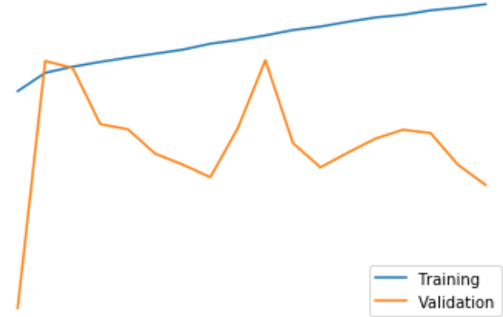
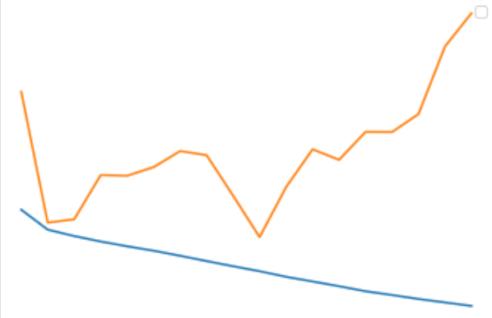
RESULT

Slide 15
CONCLUSION
Developing a CNN model for arrhythmia classification using ECG signals promises improved diagnosis of cardiac arrhythmias. By following the outlined approach—from data collection and preprocessing to model training and deployment—we aim to create a reliable system to assist healthcare professionals. With flexible deployment options and ongoing maintenance, this CNN-based solution has the potential to enhance patient care and cardiovascular health outcomes. Collaboration with experts and continuous refinement are key to realizing its full potential in clinical settings.

Slide 16
REFERENCES
Clifford GD, Azuaje F, McSharry PE. "Advanced Methods and Tools for ECG Data Analysis." Artech House, 2006.
Laguna P, et al. "A Database for Evaluation of Algorithms for Measurement of QT and Other Waveform Intervals in the ECG." Computers in Cardiology. 1997;24:673-676.
Rajpurkar P, et al. "Cardiologist-level arrhythmia detection and classification in ambulatory electrocardiograms using a deep neural network." Nat Med. 2017;25(1):65-69.
Acharya UR, et al. "Automated detection of arrhythmias using different intervals of tachycardia ECG segments with convolutional neural network." Inf Sci. 2017;405:81-90.
Goldberger AL, et al. "PhysioBank, PhysioToolkit, and PhysioNet: Components of a New Research Resource for Complex Physiologic Signals." Circulation. 2000;101(23):e215-e220.

Slide 17
THANK YOU

