Slide 1


SMART INDIA HACKATHON 2026
TITLE PAGE
Problem Statement ID –26161
ProblemStatement-Dam Inundation Model
Theme-Disaster Management
PS Category- Software/Hardware
Team ID-SIH26-A0H-T240
Team Name-TechNova

Slide 2

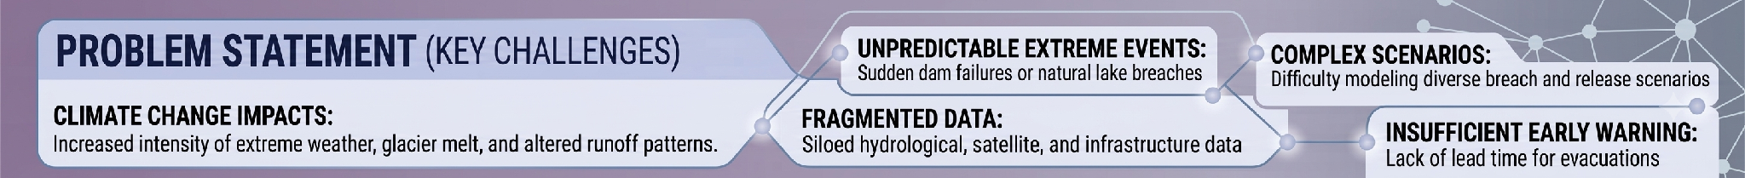
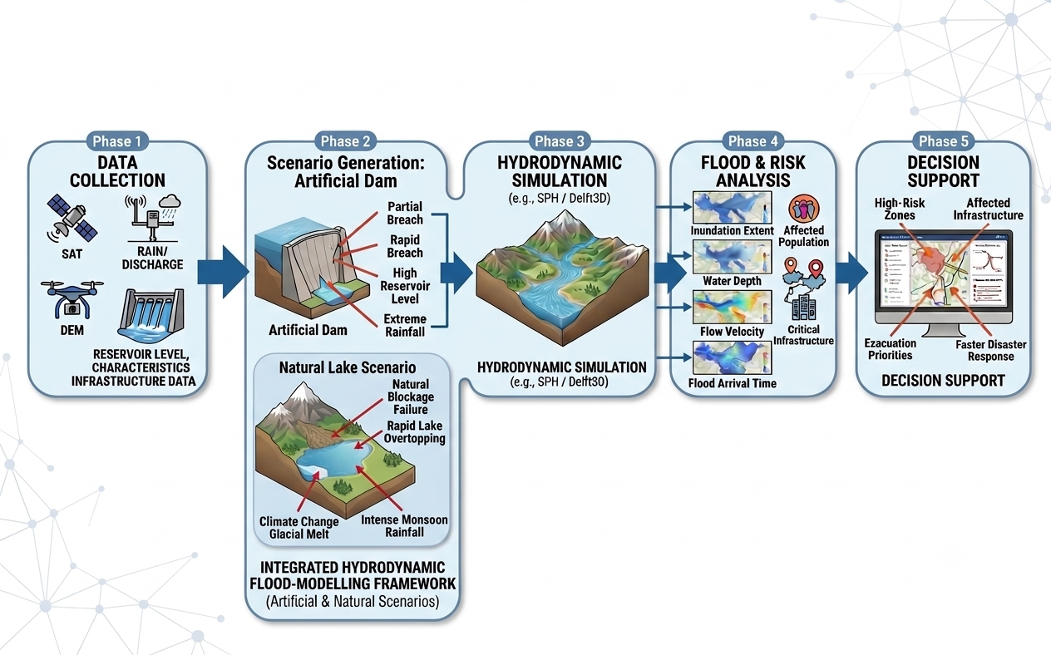
PROPOSED SOLUTION: INTEGRATED DAM BREAK FLOOD PREDICTION & DECISION SUPPORT SYSTEM
CORE INNOVATION:
“From predicting WHERE the water goes to predicting WHO and WHAT will be affected, WHEN it will happen, and WHERE evacuation should be prioritized.”

Slide 3
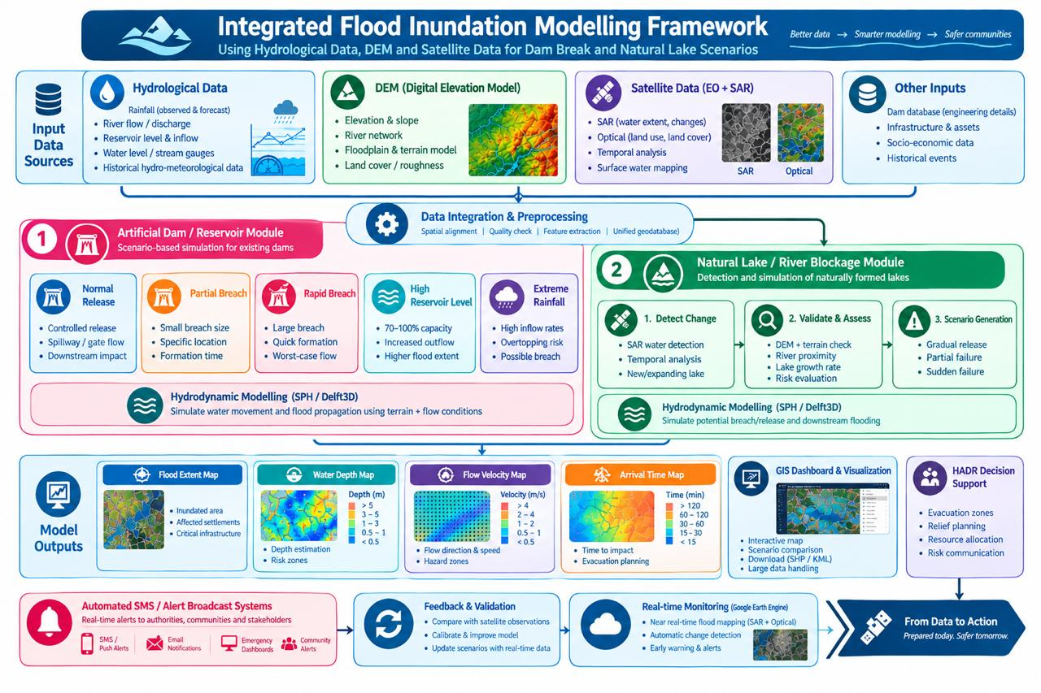
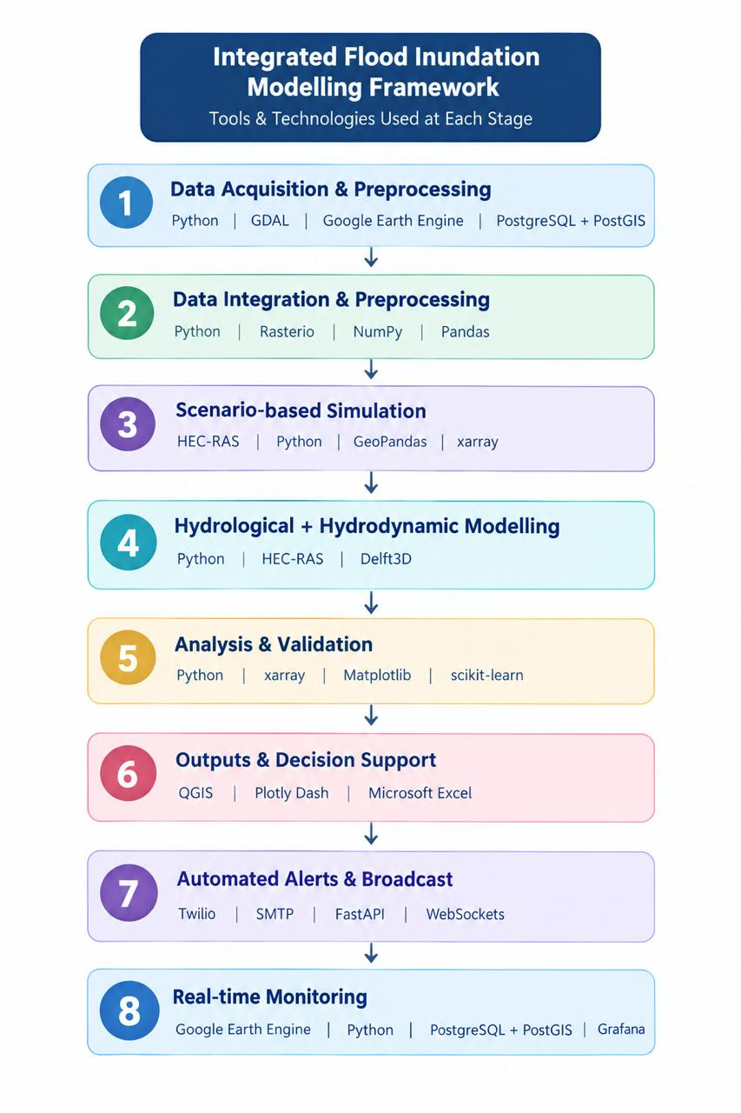
TECHNICAL APPROACH

Slide 4
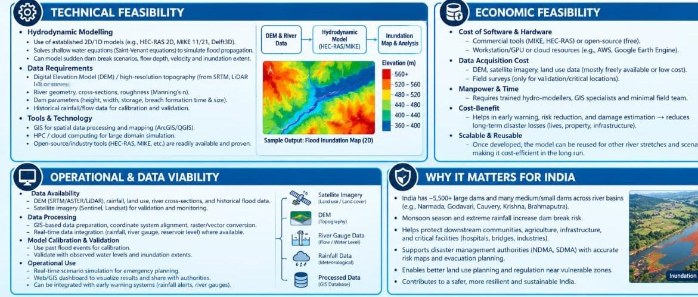
FEASIBILITY AND VIABILITY

Slide 5
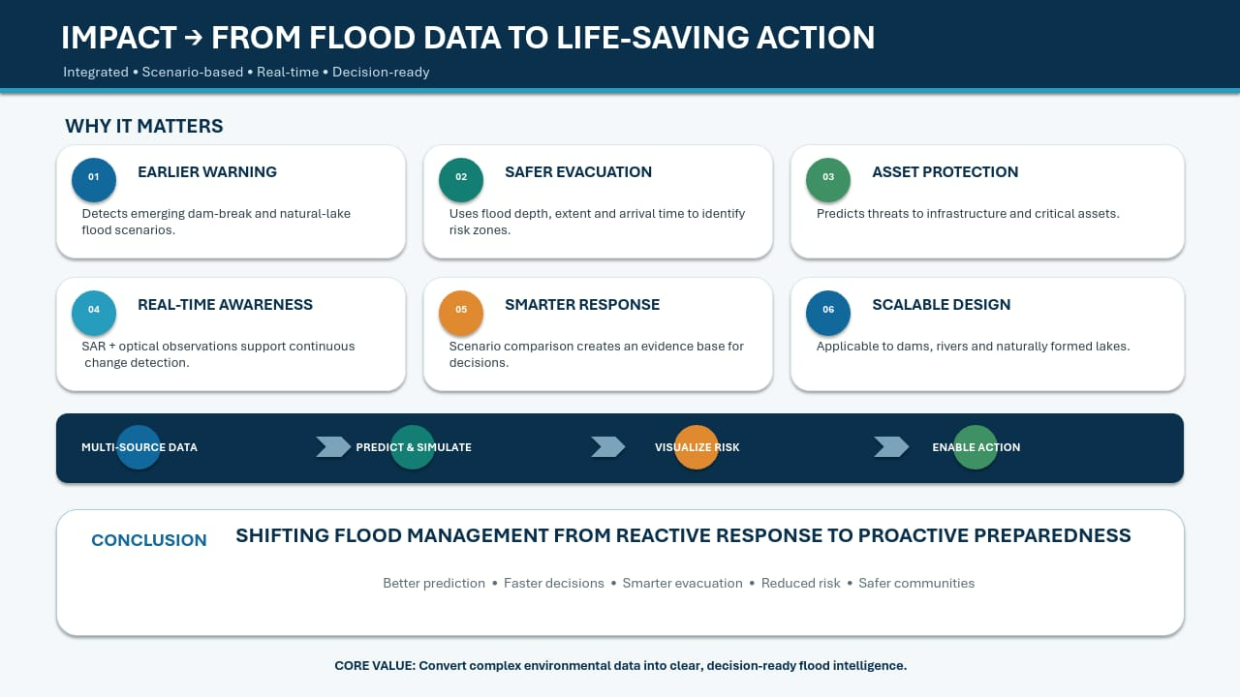
IMPACT AND BENEFITS

Slide 6
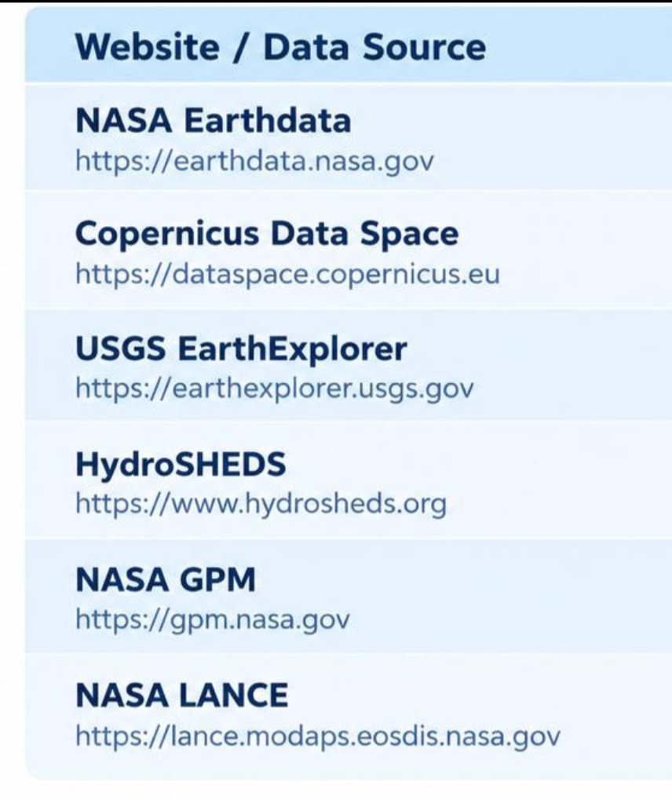
RESEARCH AND REFERENCES
REFERENCES
DATA BASE SOURCE
https://shaastramag.iitm.ac.in/interview/most-dam-failures-india-happen-small-dams
https://www.esa.int/Applications/Observing_the_Earth/Wetland_management_on_the_radar
https://www.hec.usace.army.mil/software/hec-ras/features.aspx
https://www.sciencedirect.com/science/article/abs/pii/S0022169412003605

