Slide 1

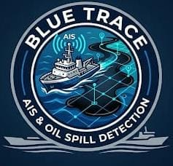

SMART INDIA HACKATHON 2026
BLUE TRACE
Problem Statement ID –SIH26143
Problem Statement Title- SATELLITE + AIS OIL SPILL
Theme-DISASTER MANAGEMENT
PS Category- Software
Team ID-SIH26-A0H-T241
Team Name - TechNova

Slide 2
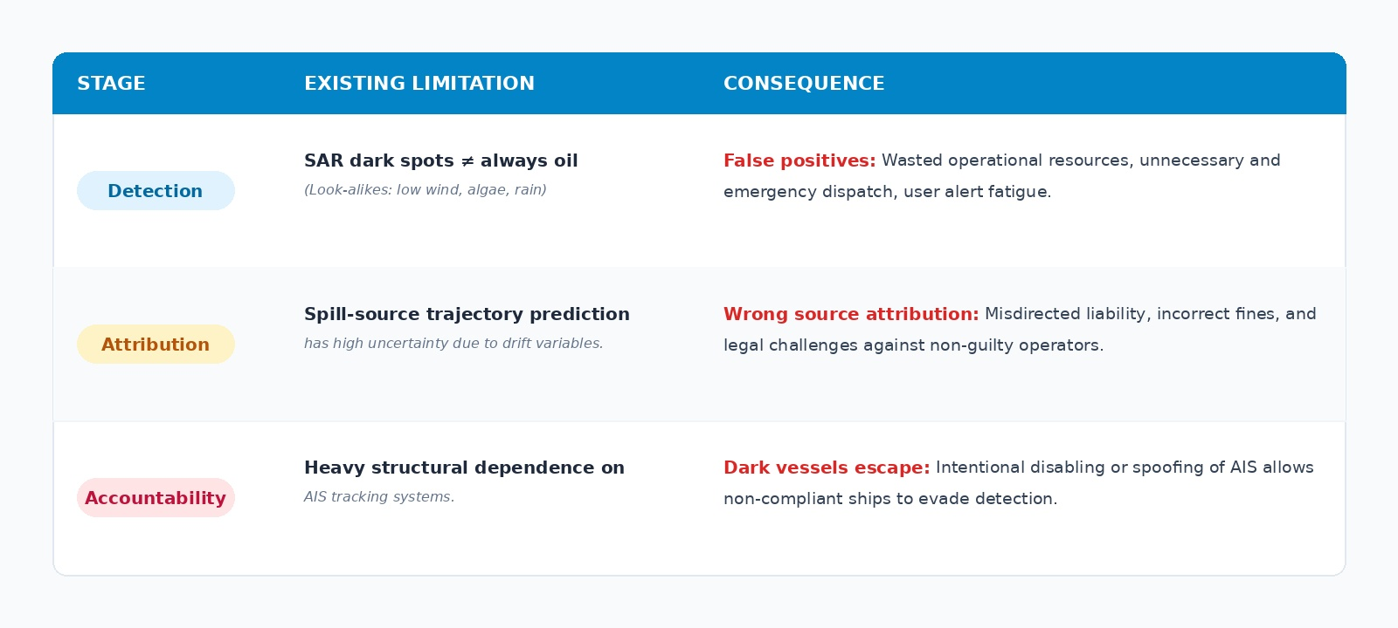
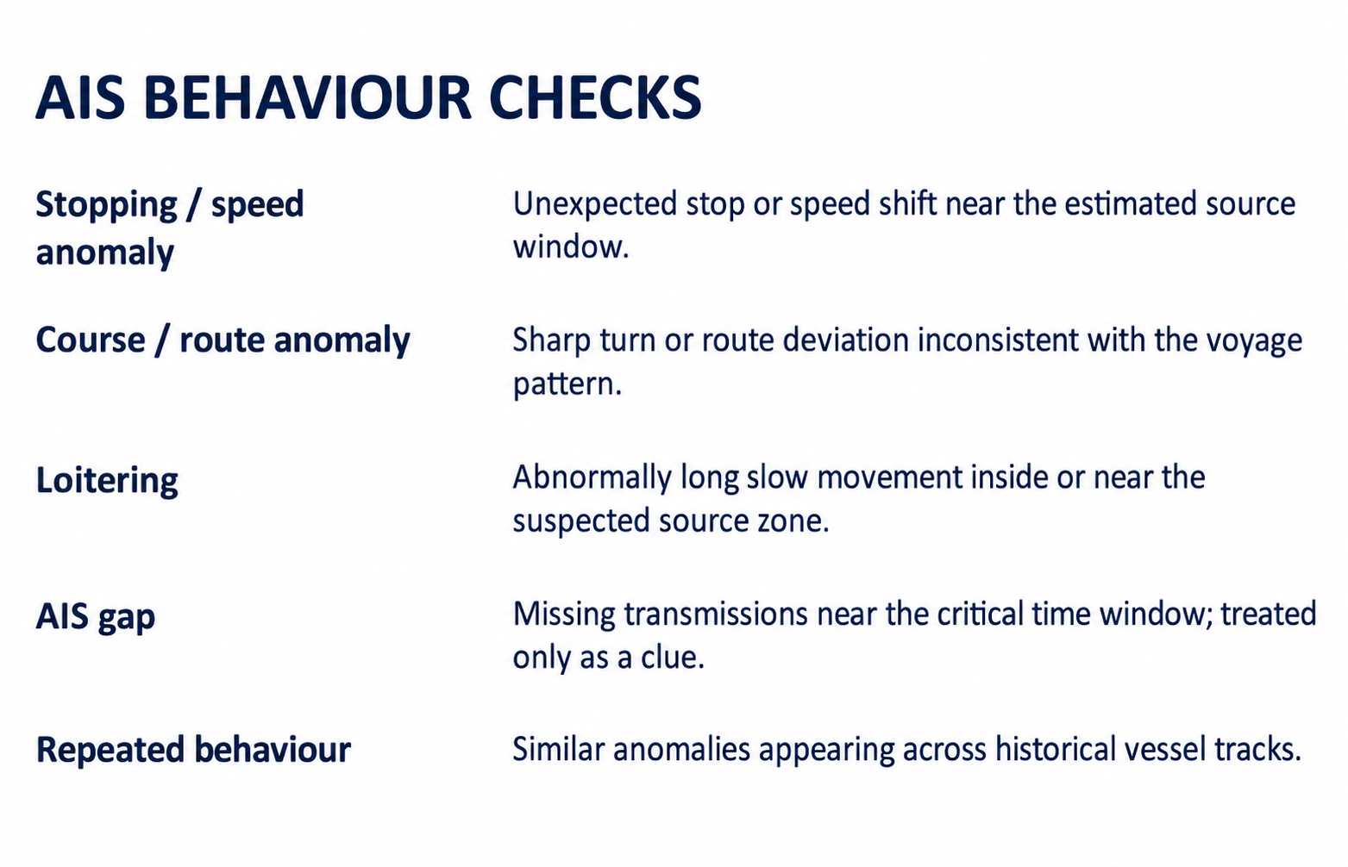
SATELLITE + AIS OIL SPILL
Optical/hyperspectral data along with SAR to identify oil slicks
SAR ship detection along with AIS tracks for increased accuracy
Historical vessel trajectory and gap detection using SAR for possible dark vessel detection
@SIH Idea submission- Template

Slide 3
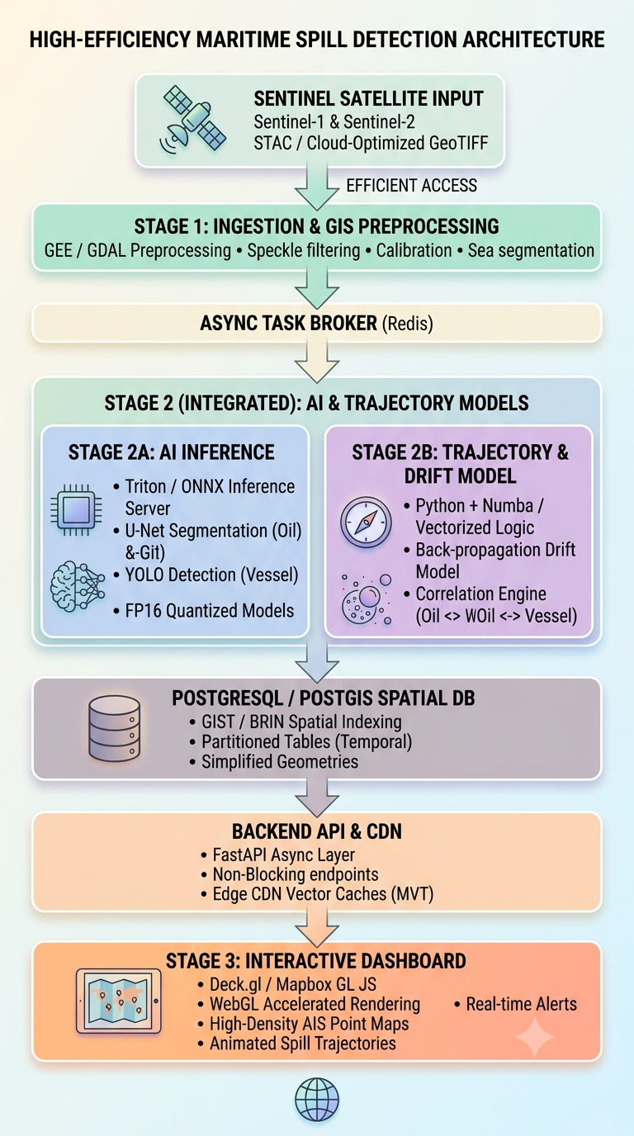
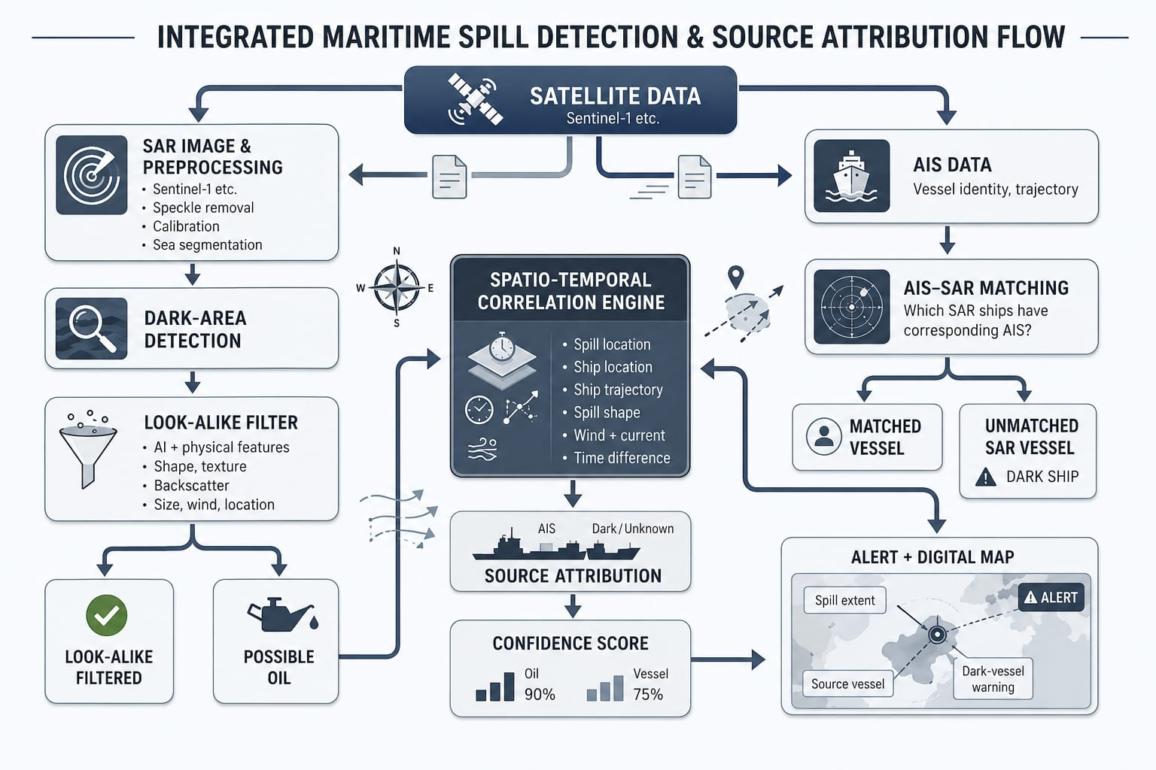
TECHNICAL APPROACH
@SIH Idea submission- Template

Slide 4
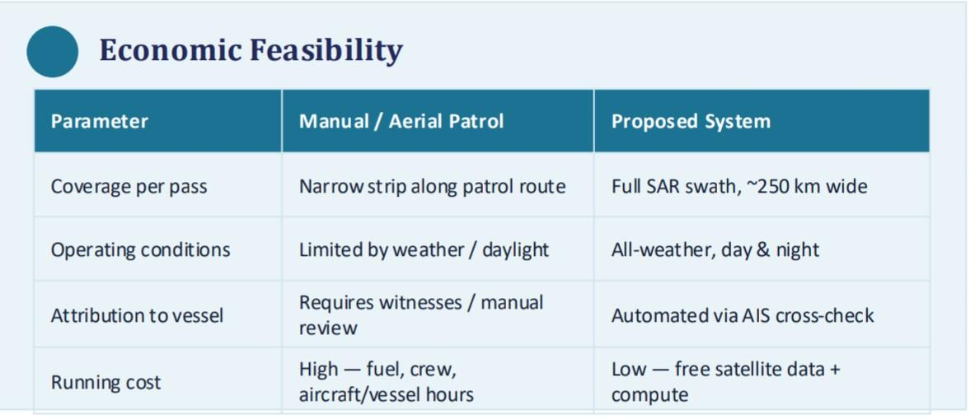
FEASIBILITY AND VIABILITY
Why This Can Realistically Be Built
Technical Feasibility
Sentinel-1 SAR data is free and openly available via Copernicus, with ~6–12 day revisit over Indian coastal waters.
Open SAR oil-spill datasets exist for training/benchmarking segmentation models.
Public AIS aggregators (AIS Hub, MarineTraffic API) supply vessel-track data for attribution.
Reference systems (e.g. EMSA CleanSeaNet) already push pollution alerts within ~30 minutes of image acquisition — a proven benchmark to aim for.
Sentinel-1
Operational & Data Viability
Small spills under ~7 tonnes are the hardest to catch manually, yet may account for up to 80% of global spill incidents — the automation gap is real.
SAR works day/night and through cloud cover, unlike optical satellite imagery or manual patrols.
Dashboard output (map + vessel ID + estimated area) is directly usable by Coast Guard / port control workflows.
Why It Matters for India
India has a coastline of roughly 7,500 km and an EEZ of about 2.15 million km² to monitor.
A large share of global seaborne oil trade transits Indian Ocean waters, raising spill risk near ports and shipping lanes.
Manual/aerial patrols cover only a fraction of this area — satellite-based monitoring scales where patrols cannot.
@SIH Idea submission- Template

Slide 5
IMPACT AND BENEFITS
Taking into account environmental features like wind speed/direction, ocean currents wave conditions temperature and rainfall can largely affect the capacity of SAR to predict oil slicks with accuracy.
Studies show that wind speed/direction incorporation gives false alarm reduction ranging from 14% to 34% compared to mono-modal models.
Target: 10–20% improvement in overall oil-spill identification reliability and a significant reduction in false positives through multi-source SAR + environmental-data fusion.
In the 2010s, there were 63 spills of 7 tonnes and over, resulting in 164,000 tonnes of oil lost.
In the 2020s to date, there have been 43 spills of 7 tonnes and over, resulting in 42,000 tonnes of oil lost.
Sentinel-1 can detect ships even when they aren't broadcasting AIS.
The European Space Agency specifically describes the capability of SAR and AIS integration for identifying so-called "dark" vessels.
TARGET: 15-35% improvement in probabilistic attribution of ships along with reduction in false attribution / missed-vessel cases through SAR–AIS cross-validation.
Oil spills devastate the biosphere by coating habitats in toxic petroleum, which suffocates aquatic life and poisons the food chain
@SIH Idea submission- Template

Slide 6
RESEARCH AND REFERENCES
KEY REFERENCES
DATA SOURCES
Topouzelis, K., "Oil Spill Detection by SAR Images: Dark Formation Detection, Feature Extraction and Classification Algorithms," Sensors, 2008.
Zhao, J. et al., "Tracing illegal oil discharges from vessels using SAR and AIS in the Bohai Sea, China," Marine Pollution Bulletin, 2021.
EMSA (European Maritime Safety Agency), "How does SAR detection work? Satellite-based Services," emsa.europa.eu.
ICEYE, "Oil Spills SAR Data Use Case," iceye.com.
Krestenitis, M. et al., "Full-Scale Aggregated MobileUNet for SAR Oil Spill Detection," 2024.
Sentinel Online / ESA, "Sentinel-1 Supports Detection of Illegal Oil Spills," sentinel.esa.int.
Case study: C-band Sentinel-1A SAR data for oil-spill detection off Chennai, East Coast of India, 2017 event, Marine Pollution Bulletin.
Copernicus Open Access Hub: Free Sentinel-1 SAR imagery
AISHub/ MarineTraffic API: Public AIS vessel-position feeds
Open SAR oil-spill Datasets: For training/benchmarking the segmentation model
@SIH Idea submission- Template

